Slide 1
Masterfoods Japan
MFJ Data Warehouse & ICS/LADS Overview

Slide 2
Introduction
2004 - MFJ business identified additional functional and data requirements. These were :
  Planning and management report modifications.
  Forecast accuracy report modifications.
  Data Warehouse Atlas data requirements.
  Flow to Retailer Atlas data requirements.
  Trade Promotions Atlas data requirements.

Slide 3
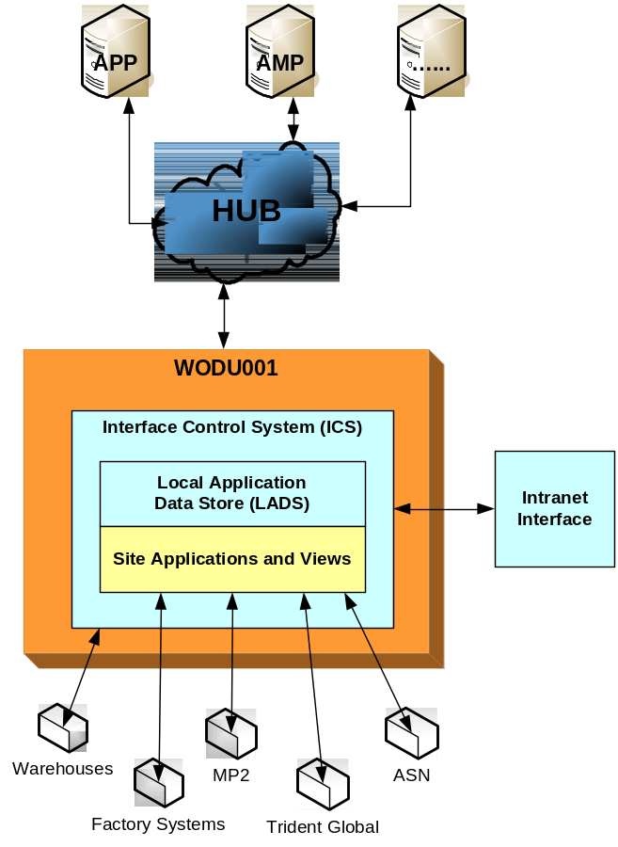
The Solution :
Interface Control System / Local Application Data Store (ICS/LADS)
Local central repository of ATLAS data for non-2005 systems
Provide centralised, once only development
Provide centralised notification/alerts
Minimise WAN Network & HUB Traffic (MTO <-> AP)
Address HUB Sequencing issues
Centralised application support
Service Legacy Servers without Maestro and Data Junction
4 Core Components
ICS
LADS
Intranet Interface (website)
Data Warehouse - Aggregations/Flattening/Reporting

Slide 4
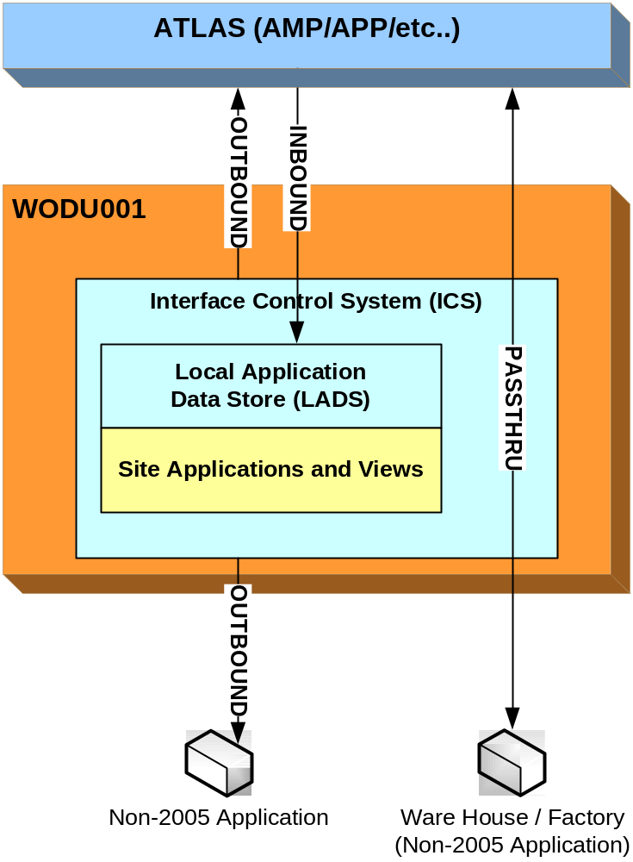
The Solution :
Interface Control System (ICS)
Primary features
Inbound Interfaces
  ATLAS to ICS
  Non-2005 to ICS
Outbound Interfaces
  ICS to ATLAS
  ICS to Non-2005
Passthrough Interfaces
  ATLAS to Non-2005
  Non-2005 to ATLAS
Event Logging / Notification
Job Scheduling
It also ….
Encapsulates the complexity of the data interface
functionality into a central point for support issues
Works in conjunction with : Data Junction, MQSeries,
MQFT, MQIF, Maestro, Tivoli, Oracle Views, etc.
Expandable as required (e.g. new interfaces/extracts) in a common and supportable fashion
Control all interface from central point (e.g. during outages)

Slide 5
The Solution :
Benefits – The new Japan Data Warehouse
Complete data sets from SAP – inclusive of IDOC number and significantly more business data
All published SAP data now available within DW (e.g. Sales Orders, Shipments, STO/PO’s, etc)
Centralized logging of interface events – easily viewable via website.
Centralized notification of interface exceptions & reference for interface support issues (web site).
Configurable
Provides a standard way of implementing new requirements – ensuring consistency and supportability
Processing can be manually triggered from website
Significant processing speed increases :
Event
Legacy CLIO
ICS/LADS CLIO
Aggregation 131 + 132
30 mins
12mins
Flattening
45mins
5mins
Invoice Load
2.5 – 3 hours
1 min
Reports Available
8.30am
5.00am

Slide 6
The Solution :
Local Application Data Store (LADS)
Provides singular local storage for ATLAS Master, Reference (GRD) and Transaction data
Data is loaded and available within seconds of arrival
Data is reloaded upon re-receiving an existing document
Data Purged based on configurable guidelines (currently 3 months)
DWT doesn’t support data, rather the process of loading (data owned by business & functional groups)
Data in LADS is NEVER updated, must be changed and resent from SAP
Non-2005 Applications access data via Oracle views
Currently 23 Interfaces from ATLAS
For example : Sales Orders, Delivery, Material Master, Invoices, Customers, Bill of Materials, etc.
– more planned for future rollouts

Slide 7
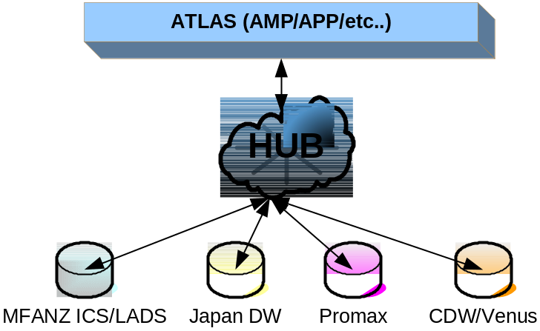
The Solution :
Performance to date
MFANZ implementation process 1000 – 5000 messages per day (will double with Petcare rollout)
0 Callouts in 1+ years in relation to ICS/LADS specific issue
Generic architecture allows for reuse – currently also used for Japan DW, Promax, CDW/Venus

Slide 8
Batch CLIO versus ICS/LADS CLIO - Comparison
HUB
IDOCS
IDOCS
BATCH LOADER
ICS
UNIX BATCHING
ICS LOADING
UNIX BATCH FILES
ICS TABLES
ORACLE LOADING
LADS
LADS LOADING
BATCH TABLES
LADS TABLES
ODS LOADING
LADS VIEWS
ODS
ODS TABLES
ODS VIEWS
ODS TABLES
ODS VIEWS
ODS VIEWS
Existing surrogate codes replaced with SAP codes
FLATTENING
AGGREGATION
FLATTENING
AGGREGATION
DDS
DIMENSION TABLES
FACT
TABLES
DIMENSION TABLES
FACT
TABLES
Existing surrogate codes replaced with SAP codes

Slide 9
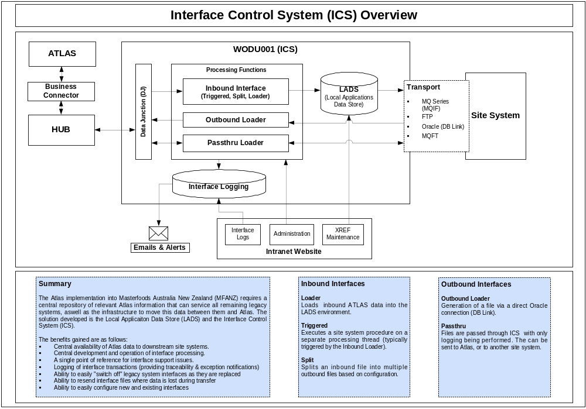
Technical Overview

Slide 10
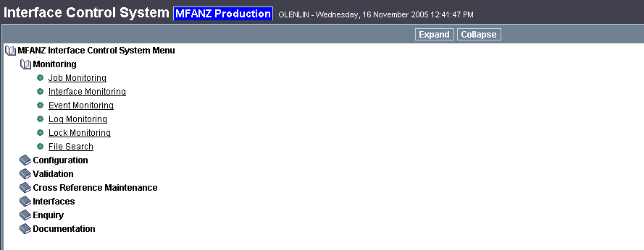
Support :
ICS Website
Website Link : http://webappdev11.ap.mars/ics_browser.asp
Core functions :
  Monitor and Review Interfaces Status
  Review Exceptions
  Review Interface Data
  Re-send Interfaces
  Interface Configuration
  Job Control

Slide 11
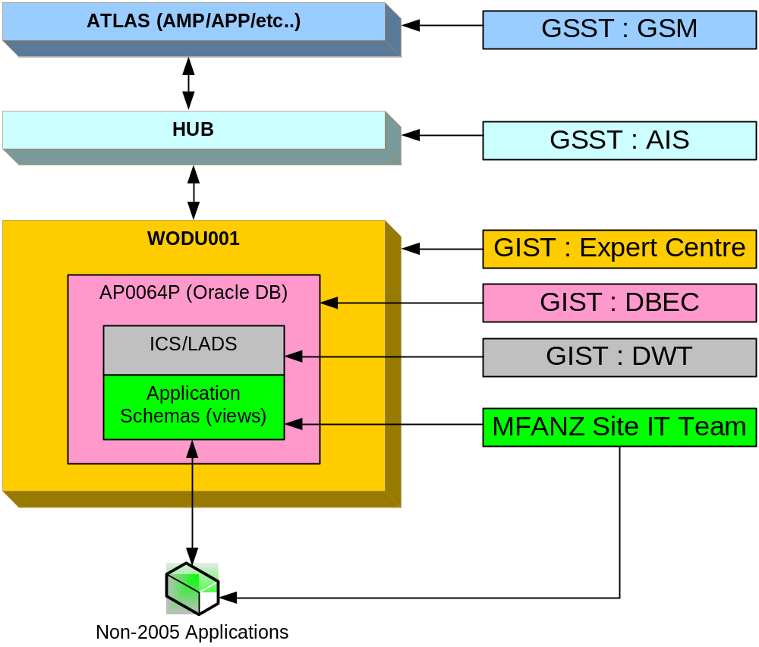
Support :
Support Structure

