Slide 1
Using Quantum Chemistry to Parameterize the Frenkel/Charge-Transfer Holstein Hamiltonian
Nicholas Hestand

Slide 2
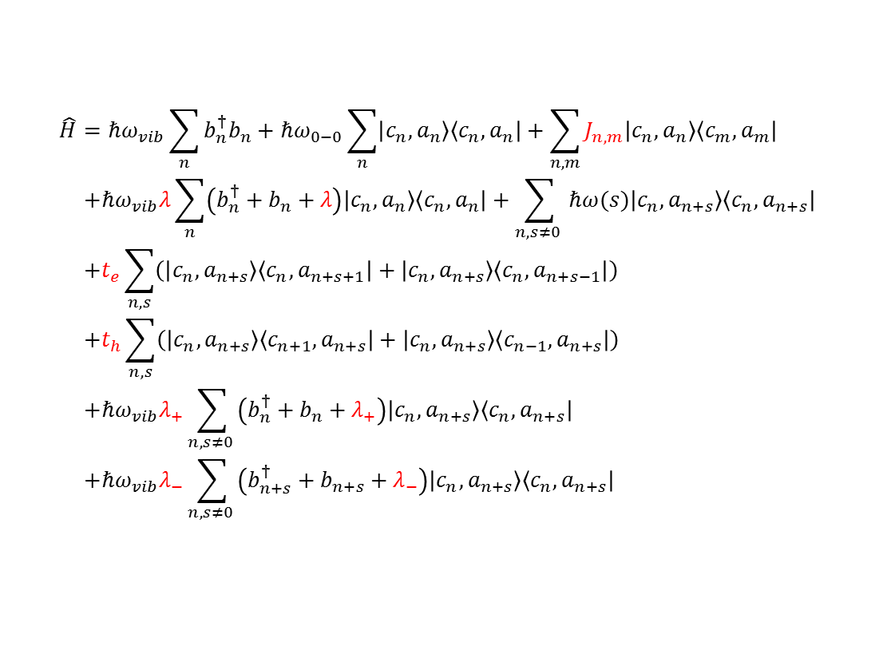


Overview
Frenkel/CT Holstein Hamiltonian:
$$\hat{H}=ℏω_{vib}\sum_{n}{b_{n}^{†}b_{n}}+ℏω_{0−0}\sum_{n}{\left|c_{n},a_{n}\right\rangle \left\langle c_{n},a_{n}\right|}+\sum_{n,m}{J_{n,m}\left|c_{n},a_{n}\right\rangle \left\langle c_{m},a_{m}\right|} \\ +ℏω_{vib}λ\sum_{n}{\left(b_{n}^{†}+b_{n}+λ\right)\left|c_{n},a_{n}\right\rangle \left\langle c_{n},a_{n}\right|}+\sum_{n,s≠0 }{ℏω(s)\left|c_{n},a_{n+s}\right\rangle \left\langle c_{n},a_{n+s}\right|} \\ +t_{e}\sum_{n,s}{\left(\left|c_{n},a_{n+s}\right\rangle \left\langle c_{n},a_{n+s+1}\right|+\left|c_{n},a_{n+s}\right\rangle \left\langle c_{n},a_{n+s−1}\right|\right)} \\ +t_{h}\sum_{n,s}{\left(\left|c_{n},a_{n+s}\right\rangle \left\langle c_{n+1},a_{n+s}\right|+\left|c_{n},a_{n+s}\right\rangle \left\langle c_{n−1},a_{n+s}\right|\right)} \\ +ℏω_{vib}λ_{+}\sum_{n,s≠0 }{\left(b_{n}^{†}+b_{n}+λ_{+}\right)\left|c_{n},a_{n+s}\right\rangle \left\langle c_{n},a_{n+s}\right|} \\ +ℏω_{vib}λ_{−}\sum_{n,s≠0 }{\left(b_{n+s}^{†}+b_{n+s}+λ_{−}\right)\left|c_{n},a_{n+s}\right\rangle \left\langle c_{n},a_{n+s}\right|}$$
Hole on molecule $n$, Electron on molecule$n+s$
…
…
… $n−2$ $n−1$ $n$ $n+1$ $n+2$ …
How can we parameterize this Hamiltonian?

Slide 3




Overview
Huang-Rhys Factors
$$λ^{2},λ_{−}^{2},λ_{+}^{2}$$
Ionic factors not easily accessible from experiment.
Coulombic Coupling
(Transition Charges)
Charge-Transfer Integrals
LUMO
$$t_{e}$$
LUMO
$$J_{C}$$
HOMO
HOMO
LUMO
$$t_{h}$$
Point Dipole Approximation breaks down at close intermolecular distances relevant for π-stacked systems.
HOMO
Energy splitting method requires symmetry.

Slide 4


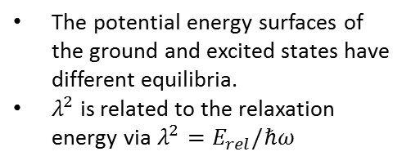

Huang Rhys Factors
Displaced Harmonic Oscillator:
Excited
To calculate the Huang Rhys factor, we need to know:
The geometries of the ground and excited states
The normal vibrational modes (of the ground state) and their frequencies
These can be calculated using Gaussian 09.
$$E_{rel}=\frac{1}{2}mω^{2}R_{0}^{2}$$
$$ℏω$$
Ground
$$R_{0}$$
The potential energy surfaces of the ground and excited states have different equilibria.
$λ^{2}$ is related to the relaxation energy via $λ^{2}=E_{rel}/ℏω$

Slide 5
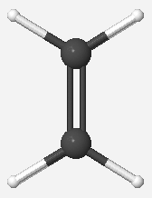
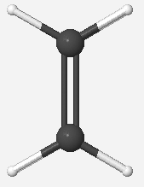
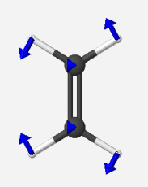
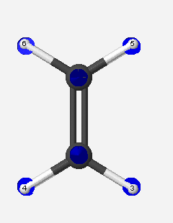
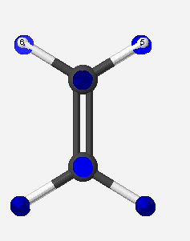
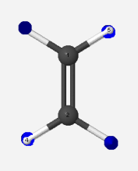
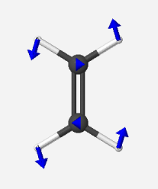
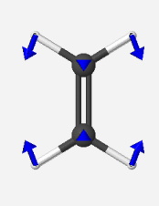
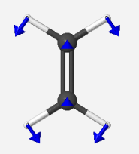
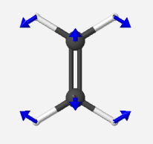
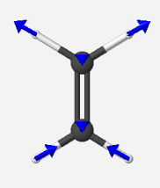
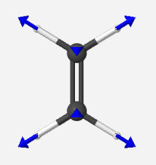
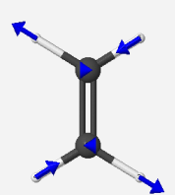
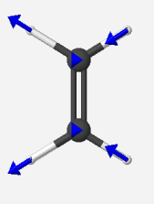
Example: Ethylene
We can project the displacement onto the normal modes to find the Huang-Rhys Factor for each mode.
Double Bond
Lengthens
Ground State
Excited State
12 Normal Modes (Excluding Translation/Rotation):
Frequency (cm⁻¹): 836 979 984 1067 1247 1382
1479 1692 3126 3139 3195 3223
Notes:
Anion & Cation too?

Slide 6



Huang Rhys Factors From Gaussian 09
Steps:
Calculate the optimized geometry of the ground and excited state
Calculate the normal vibrational modes by diagonalizing the mass weighted Hessian
Project the difference of the excited and ground state geometries onto the normal coordinates
Calculate the Huang-Rhys factor for each normal mode
Calculate an effective Huang-Rhys factor and Frequency
$$λ_{i}^{2}=\frac{m_{i}ω_{i}}{2ℏ}R_{i}^{2}$$
$$λ_{eff}^{2}=\sum_{i}{λ_{i}^{2}}$$
$$ω_{eff}=\frac{1}{λ_{eff}^{2}}\sum_{i}{λ_{i}^{2}ω_{i}}$$

Slide 7
Using the g09_lambda Utility Program
Running g09_lambda.exe will calculate the Huang-Rhys parameters for ground to excited (neutral, cation, anion) transformations.
Options:
-i in_file: specify the input file containing the necessary information
-o out_file: specify the file to write the results
-m: make the Gaussian 09 input files

Slide 8
Using the g09_lambda Utility Program
Example Input File:
Example XYZ File:
# ethylene.inp input file for making G09 input
# Lines starting with # are ignored
#
# Formatted checkpoint file names
ground_fch ‘test_g.fch’ # Ground
excited_fch ‘test_e.fch’ # Neutral Excited
cation_fch ‘test_c.fch’ # Cation
anion_fch ‘test_a.fch’ # Anion
#
# Info for effective parameter calculations
lower_bound 1000.d0
upper_bound 1800.d0
#
# Information for setting up Gaussian calculations
# QC method (ground/cation/anion)
method ‘B3LYP/cc-pVTZ’
# QC method (neutral excited)
emethod ‘TD=(nstates=1,root=1) B3LYP/cc-pVTZ’
# name of G09 input files generated
task ethylene
# xyz file containing coordinates to be optimized
xyz_file ethylene.xyz
C 0.00000000 0.00000000 0.00000000
C 1.30860442 0.03217880 0.00000000
H 1.87664502 -0.89810604 0.00000000
H 1.83023441 0.98925881 0.00000000
H -0.52162999 -0.95708001 0.00000000

Slide 9
Using the g09_lambda Utility Program
Example Usage:
./g09_lambda.exe –m –i ethylene.inp
(Run Gaussian 09 Calculations)
(Convert chk files to fch files using formchk)
./g09_lambda.exe –i ethylene.inp –o ethylene.out

Slide 10
Using the g09_lambda Utility Program
Results:
ethylene.out
UB3LYP
CC-pVTZ
************************************************************
Mode Frequency (cm-1) lambda
************************************************************
1 -5.2587794055 -0.0000000000
2 -0.0203707857 -0.0000000000
3 -0.0184218903 -0.0000000000
4 0.0483418898 0.0000000000
5 4.3071018492 -0.0000000000
6 5.0345663643 0.0000000000
7 836.0866449198 -0.0000000013
8 979.0992814061 -0.0000000000
9 983.6754136707 0.0000000000
10 1067.1879585596 -0.0000000000
11 1246.5645659156 0.0000000000
12 1382.1199683765 -0.1245280739
13 1478.8808287271 0.0000000000
14 1692.7685822881 -1.3967306397
15 3125.5667698884 0.0000000000
16 3139.3324582045 0.2790954152
17 3194.7104980596 0.0000000000
18 3223.1612822683 -0.0000000006
************************************************************
Effective HR range (cm-1): 1000.0 1800.0
Effective HR Factor: 1.97
Effective HR Frequency: 1690.32
Ground State
Excited State
1692 cm⁻¹

Slide 11
Using the g09_lambda Utility Program
Results (continuted):
************************************************************
Mode Frequency (cm-1) lambda-
************************************************************
1 -5.2587794055 -0.0000000000
2 -0.0203707857 -0.0000000000
3 -0.0184218903 -0.0000000000
4 0.0483418898 0.0000000000
5 4.3071018492 -0.0000000000
6 5.0345663643 0.0000000000
7 836.0866449198 -0.0000000021
8 979.0992814061 -0.0000000000
9 983.6754136707 0.0000000000
10 1067.1879585596 -0.0000000000
11 1246.5645659156 0.0000000000
12 1382.1199683765 0.9816962551
13 1478.8808287271 0.0000000000
14 1692.7685822881 -1.0280110470
15 3125.5667698884 -0.0000000000
16 3139.3324582045 -0.0567008341
17 3194.7104980596 -0.0000000000
18 3223.1612822683 -0.0000000004
************************************************************
Effective HR- range (cm-1): 1000.0 1800.0
Effective HR- Factor: 2.02
Effective HR- Frequency: 1544.60
************************************************************
Mode Frequency (cm-1) lambda+
************************************************************
1 -5.2587794055 -0.0000000000
2 -0.0203707857 -0.0000000000
3 -0.0184218903 -0.0000000000
4 0.0483418898 0.0000000000
5 4.3071018492 -0.0000000000
6 5.0345663643 0.0000000000
7 836.0866449198 -0.0000000016
8 979.0992814061 -0.0000000000
9 983.6754136707 0.0000000000
10 1067.1879585596 -0.0000000000
11 1246.5645659156 0.0000000000
12 1382.1199683765 0.6214830337
13 1478.8808287271 0.0000000000
14 1692.7685822881 -0.9267322291
15 3125.5667698884 -0.0000000000
16 3139.3324582045 -0.0465989385
17 3194.7104980596 -0.0000000000
18 3223.1612822683 -0.0000000004
************************************************************
Effective HR+ range (cm-1): 1000.0 1800.0
Effective HR+ Factor: 1.25
Effective HR+ Frequency: 1596.40

Slide 12
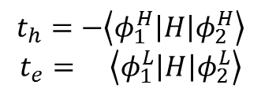
Charge Transfer Integrals
Charge Transfer Integrals
To calculate the charge transfer integrals, we need to know:
The Hamiltonian in the molecular orbital basis
The overlap matrix in the molecular orbital basis
These can be calculated with the help of Gaussian 09.
LUMO
$$t_{e}$$
HOMO
LUMO
$$t_{h}$$
HOMO
$$t_{h}=−\left\langle φ_{1}^{H}\left|H\right|φ_{2}^{H}\right\rangle$$
$$t_{e}= \left\langle φ_{1}^{L}\left|H\right|φ_{2}^{L}\right\rangle$$

Slide 13
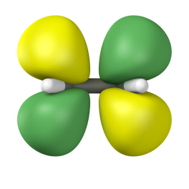





Example: Ethylene
$$t_{e}=\left\langle φ_{1}^{L}\left|H\right|φ_{2}^{L}\right\rangle$$
$$φ_{2}^{L}$$
$$φ_{2}^{L}$$
$$φ_{1}^{L}$$
$$φ_{1}^{L}$$
Cofacial
Face to End
The integrals correspond to the interaction energy between MOs
Cofacial – Energy splitting method should be fine since both molecules have the same energy
Face to End – Energy splitting method will not work well since the molecules have different energies (they are not symmetry related)
Notes:
Anion & Cation too?

Slide 14

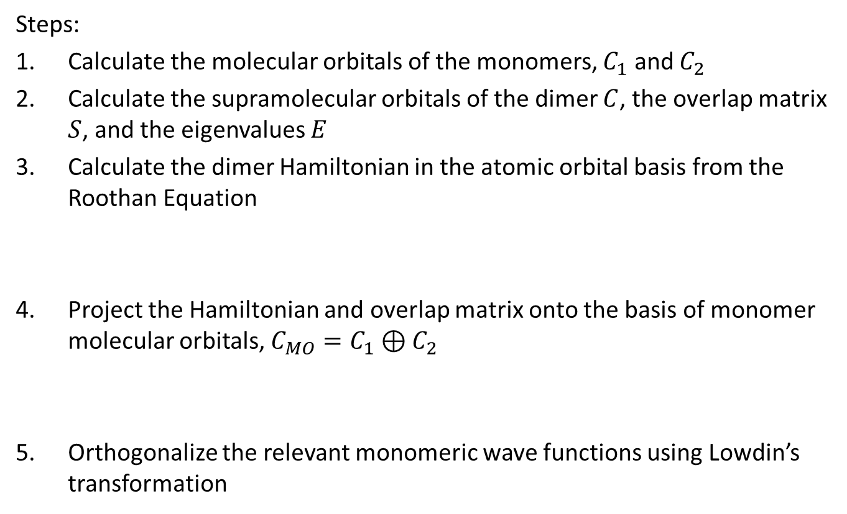



Charge Transfer Integrals From Gaussian 09
Steps:
Calculate the molecular orbitals of the monomers, $C_{1}$ and $C_{2}$
Calculate the supramolecular orbitals of the dimer $C$, the overlap matrix $S$, and the eigenvalues $E$
Calculate the dimer Hamiltonian in the atomic orbital basis from the Roothan Equation
Project the Hamiltonian and overlap matrix onto the basis of monomer molecular orbitals, $C_{MO}=C_{1}⊕C_{2}$
Orthogonalize the relevant monomeric wave functions using Lowdin’s transformation
$$H_{AO}=SCEC^{−1}$$
$$H_{MO}={C_{MO}^{T}H}_{AO}C_{MO}$$
$$S_{MO}=C_{MO}^{T}SC_{MO}$$
$$H_{MO}^{′}=S_{MO}^{−1/2}H_{MO}S_{MO}^{−1/2}$$

Slide 15
Using the g09_ctint Utility Program
Running g09_ctint.exe will calculate the Hamiltonian submatrix relevant for charge transfer.
Options:
-i in_file: specify the input file containing the necessary information
-o out_file: specify the file to write the results
-m: make the Gaussian 09 input files

Slide 16
Using the g09_ctint Utility Program
Example Input File:
Example XYZ Files:
# ct_ethylene.inp input file for making G09 input
# Lines starting with # are ignored
#
# log file and fch file names from G09 output
fch_m1 ethylene_cofacial_m1.fch #mol 1
log_m1 ethylene_cofacial_m1.out
fch_m2 ethylene_cofacial_m2.fch #mol 2
log_m2 ethylene_cofacial_m2.out
fch_d ethylene_cofacial_d.fch #dimer
log_d ethylene_cofacial_d.out
#
# Information for setting up Gaussian calculations
method 'B3LYP/6-31++G**‘
# Name of the Gaussian files to create
task ethylene_cofacial
# file with xyz of molecule 1
xyz_file_m1 ethylene_m1.xyz
# file with xyz of molecule 2
xyz_file_m2 ethylene_m2.xyz
C 0.672749 0.000000 0.000000
C -0.672749 0.000000 0.000000
H 1.242623 0.934806 0.000000
H 1.242623 -0.934806 0.000000
H -1.242623 0.934806 0.000000
H -1.242623 -0.934806 0.000000
C 0.672749 0.000000 4.000000
C -0.672749 0.000000 4.000000
H 1.242623 0.934806 4.000000
H 1.242623 -0.934806 4.000000
H -1.242623 0.934806 4.000000
H -1.242623 -0.934806 4.000000
ethylene_m1.xyz
ethylene_m2.xyz

Slide 17
Using the g09_ctint Utility Program
Example Usage:
./g09_ctint.exe –m –i ct_ethylene.inp
(Run Gaussian 09 Calculations)
(Convert chk files to fch files using formchk)
./g09_ctint.exe –i ct_ethylene.inp –o ct_ethylene.out

Slide 18
Using the g09_ctint Utility Program
Results (Cofacial ethylene):
Nonorthogonal Sub Hamiltonian (cm-1)
 | |HOMO1> | |HOMO2> | |LUMO1> | |LUMO2>
<HOMO1| | -59949.1 | 5062.521 | 0 | 0
<HOMO2| | 5062.521 | -59949.1 | 0 | 0
<LOMO1| | 0 | 0 | -2651.71 | 2830.339
<LOMO2| | 0 | 0 | 2830.339 | -2651.71
Orthogonalized Sub Hamiltonian (cm-1)
 | |HOMO1> | |HOMO2> | |LUMO1> | |LUMO2>
<HOMO1| | -59851.8 | 1765.845 | 0 | 0
<HOMO2| | 1765.845 | -59851.8 | 0 | 0
<LOMO1| | 0 | 0 | -2266.34 | 2477.862
<LOMO2| | 0 | 0 | 2477.862 | -2266.34
Overlap Sub Matrix
 | |HOMO1> | |HOMO2> | |LUMO1> | |LUMO2>
<HOMO1| | 1 | -0.0551 | 0 | 0
<HOMO2| | -0.0551 | 1 | 0 | 0
<LOMO1| | 0 | 0 | 1 | -0.1555
<LOMO2| | 0 | 0 | -0.1555 | 1
Failure to orthogonalize results in integrals that are too large and dependent on the reference energy.
Note that the integrals relevant for singlet fission are also available, although they are zero here for the perfectly eclipsed system.

Slide 19

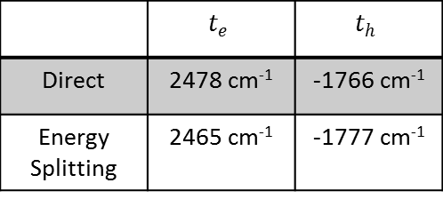








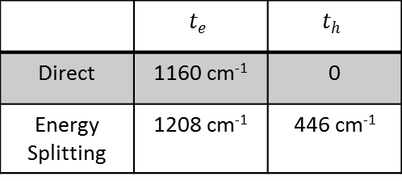
Example: Ethylene
$$φ_{2}^{L}$$
$$φ_{2}^{L}$$
Cofacial
 | $$t_{e}$$ | $$t_{h}$$
Direct | 2478 cm⁻¹ | -1766 cm⁻¹
Energy Splitting | 2465 cm⁻¹ | -1777 cm⁻¹
$$φ_{1}^{L}$$
$$φ_{1}^{L}$$
Cofacial
Face to End
Face to End
$$φ_{2}^{H}$$
$$φ_{2}^{H}$$
 | $$t_{e}$$ | $$t_{h}$$
Direct | 1160 cm⁻¹ | 0
Energy Splitting | 1208 cm⁻¹ | 446 cm⁻¹
$$φ_{1}^{H}$$
$$φ_{1}^{H}$$
Notes:
Anion & Cation too?

Slide 20
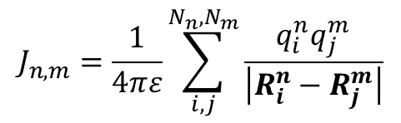

Coulomb Coupling (Transition Charges)
Coulombic Coupling
(Transition Charges)
To calculate the transition charges, we need to know:
Overlap Matrix
Configuration Interaction Matrix for the excited state
Molecular Orbital Matrix
These can be calculated with the help of Gaussian 09.
LUMO
$$J_{n,m}$$
HOMO
Point Dipole Approximation breaks down at close intermolecular distances relevant for π-stacked systems.
$$J_{n,m}=\frac{1}{4πε}\sum_{i,j}^{N_{n},N_{m}}{\frac{q_{i}^{n}q_{j}^{m}}{\left|R_{i}^{n}−R_{j}^{m}\right|}}$$

Slide 21


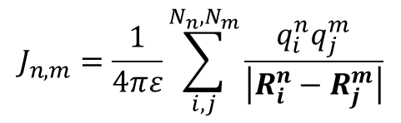

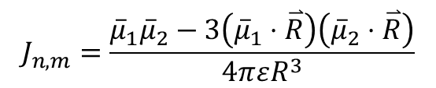

Example: Ethylene
Point Dipole
Transition Charges
$$J_{n,m}=\frac{{\overline{μ}}_{1}{\overline{μ}}_{2}−3\left({\overline{μ}}_{1}⋅\overset{⃑}{R}\right)\left({\overline{μ}}_{2}⋅\overset{⃑}{R}\right)}{4πεR^{3}}$$
$$J_{n,m}=\frac{1}{4πε}\sum_{i,j}^{N_{n},N_{m}}{\frac{q_{i}^{n}q_{j}^{m}}{\left|R_{i}^{n}−R_{j}^{m}\right|}}$$
-
-
-0.02
-0.02
-0.02
-0.02
$$\overset{⃑}{R}$$
-0.34
-0.34
0.34
0.34
0.02
0.02
0.02
0.02
+
+
$${\overline{μ}}_{1}$$
$${\overline{μ}}_{2}$$
Using transition charges gives spatial resolution to the transition moments which is necessary for accurate couplings when the molecules are close.
The difference may not be that significant for ethylene, but can be bigger molecules like perylene.
Notes:
Anion & Cation too?

Slide 22
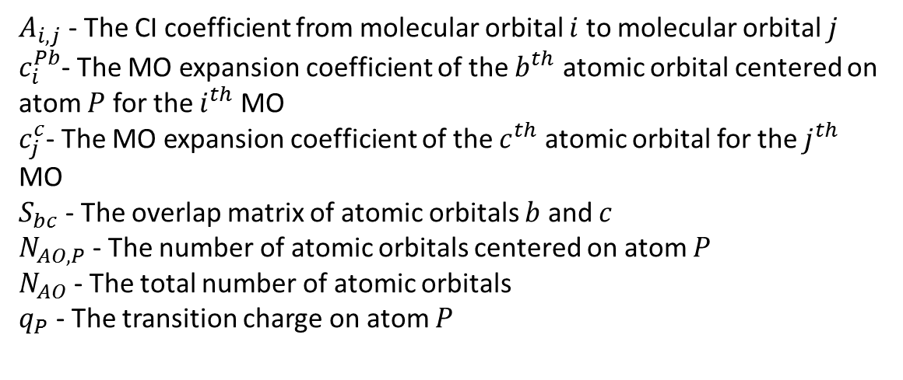
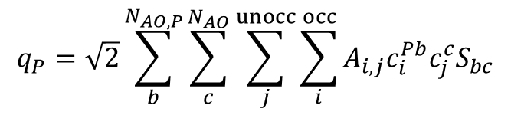
Transition Charges From Gaussian 09
$$q_{P}=\sqrt{2}\sum_{b}^{N_{AO,P}}{\sum_{c}^{N_{AO}}{\sum_{j}^{unocc}{\sum_{i}^{occ}{A_{i,j}c_{i}^{Pb}c_{j}^{c}S_{bc}}}}}$$
$A_{i,j}$ - The CI coefficient from molecular orbital $i$ to molecular orbital $j$
$c_{i}^{Pb}$- The MO expansion coefficient of the $b^{th}$ atomic orbital centered on atom $P$ for the $i^{th}$ MO
$c_{j}^{c}$- The MO expansion coefficient of the $c^{th}$ atomic orbital for the $j^{th}$ MO
$S_{bc}$ - The overlap matrix of atomic orbitals $b$ and $c$
$N_{AO,P}$ - The number of atomic orbitals centered on atom $P$
$N_{AO}$ - The total number of atomic orbitals
$q_{P}$ - The transition charge on atom $P$

Slide 23
Using the g09_tq Utility Program
Running g09_tq.exe will calculate the transition charges of a molecule
Options:
-i in_file: specify the input file containing the necessary information
-o out_file: specify the file to write the results
-m: make the Gaussian 09 input files
-c tq_file_m1, tq_file_m2 : calculate the coupling between two molecules after the transition charges have been calculated

Slide 24
Using the g09_tq Utility Program
Example Input File:
Example XYZ Files:
# ct_ethylene.inp input file for making G09 input
# Lines starting with # are ignored
#
# log file and fch file names from G09 output
fch tq_ethylene.fch
log tq_ethylene.out
#
# The excited state of interest
estate 1
# Information for setting up Gaussian calculations
emethod ‘CIS(nstates=1,root=1)/cc-pVTZ’
# Name of the Gaussian input files to create
task tq_ethylene
# file with xyz coordinates
xyz_file ethylene.xyz
C 0.672749 0.000000 0.000000
C -0.672749 0.000000 0.000000
H 1.242623 0.934806 0.000000
H 1.242623 -0.934806 0.000000
H -1.242623 0.934806 0.000000
H -1.242623 -0.934806 0.000000
ethylene.xyz

Slide 25
Using the g09_tq Utility Program
Example Usage:
./g09_tq.exe –m –i tq_ethylene.inp
(Run Gaussian 09 Calculations)
(Convert chk files to fch files using formchk)
./g09_tq.exe –i tq_ethylene.inp –o tq_ethylene_tqs.out
./g09_tq.exe –c tq_ethylene_tqs.out
tq_ethylene_shift_tqs.out

Slide 26
Using the g09_tq Utility Program
Results:
Atomic Number | X (bohr) | Y(bohr) | Z(bohr) | TQ (au)
6 | 0 | 0 | 0 | 0.341555
6 | 2.472904 | 0.060809 | 0 | -0.34156
1 | 3.546345 | -1.69717 | 0 | -0.02038
1 | 3.458642 | 1.869428 | 0 | -0.02038
1 | -0.98574 | -1.80862 | 0 | 0.020381
1 | -1.07344 | 1.757984 | 0 | 0.020381
tq sum | 1.04E-09
tq dipole (au) | -1.02937 | -0.02531 | 0
tq dipole (debye) | -2.61622 | -0.06433 | 0
The transition charges should sum to zero
The transition dipole moment calculated from the transition charges should be fairly close to the one calculated by Gaussian, although this is not always the case.
The transition charges can now be used to calculate the couplings (-c)

Slide 27
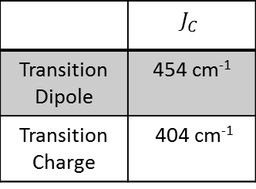


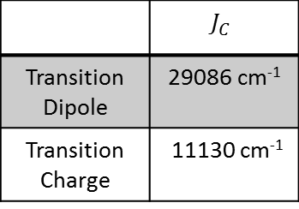
Example: Ethylene
-
-
Unscreened, π-stacked at 8 Bohr (Approx. 4.2 Å)
 | $$J_{C}$$
Transition Dipole | 454 cm⁻¹
Transition Charge | 404 cm⁻¹
+
+
$${\overline{μ}}_{1}$$
$${\overline{μ}}_{2}$$
Unscreened, π-stacked at 2 Bohr (Approx. 1 Å) where the spatial resolution becomes more important for ethylene
-0.02
-0.02
-0.02
-0.02
 | $$J_{C}$$
Transition Dipole | 29086 cm⁻¹
Transition Charge | 11130 cm⁻¹
-0.34
-0.34
0.34
0.34
0.02
0.02
0.02
0.02
Notes:
Anion & Cation too?

Slide 28
Some References
Huang Rhys Calculation
Gisslen, L.; Scholz, R. Phys. Rev. B 2009, 80, 115309. (Sec II B, C, and D.)
Charge-transfer Integrals
Valeev, E. F.; Coropceanu, V.; da Silva Filho, D. A.; Salman, S.; Bredas, J. L. J. Am. Chem. Soc. 2006, 128, 9882.
Senthilkumar, K.; Grozema, F. C.; Bickelhaupt, F. M.; Siebbeles, L. D. A. J. Chem. Phys. 2003, 119, 9809.
Transition Charges
Kistler, K. A.; Spano, F. C.; Matsika, S. J. Phys. Chem. B 2013, 117, 2032.

