Slide 1
BU Datathon 2018
Feb 24, 2018
Kris Pan

Slide 2
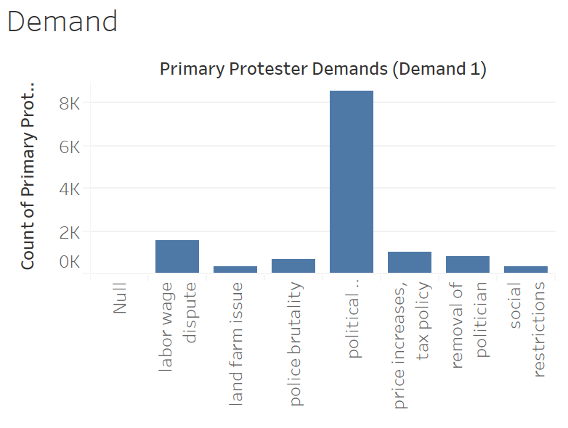

Slide 3
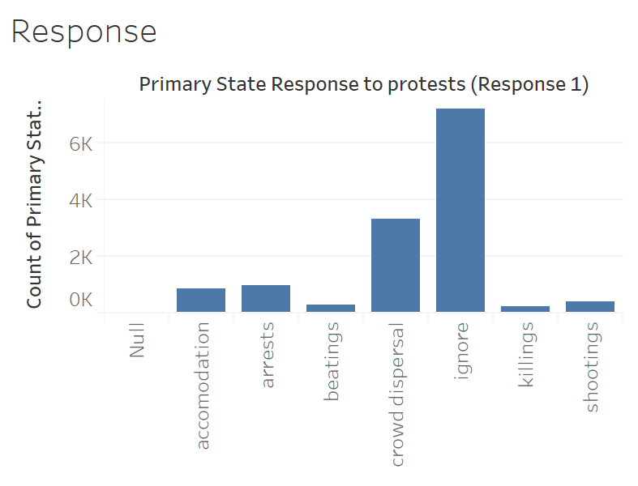

Slide 4
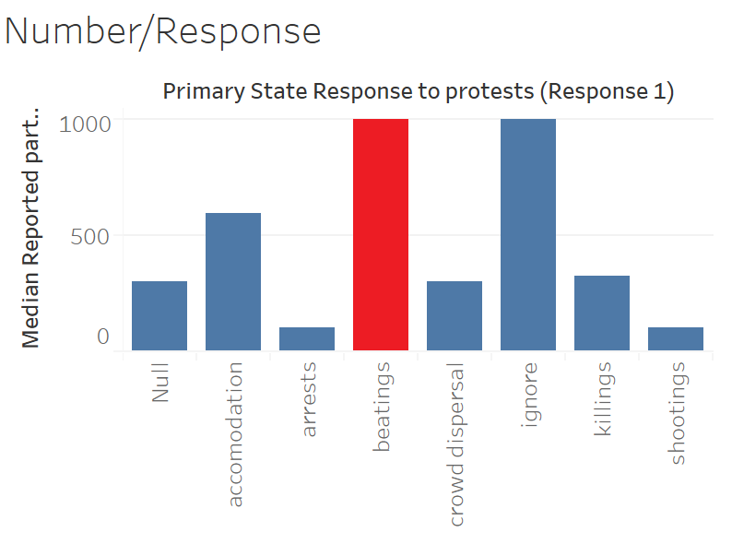

Slide 5
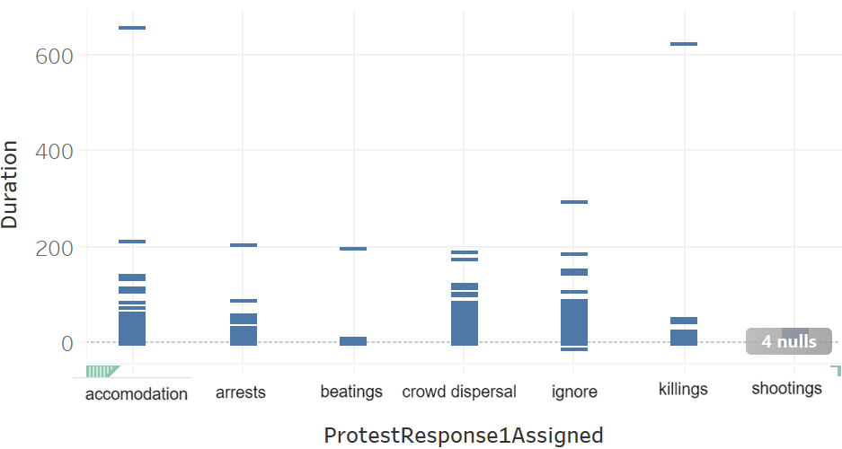

Slide 6


Slide 7
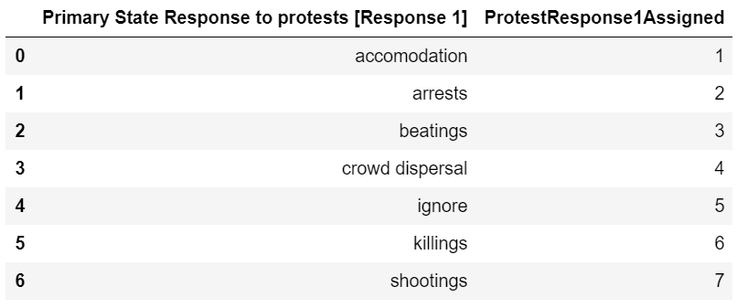
Numeric Translation

Slide 8
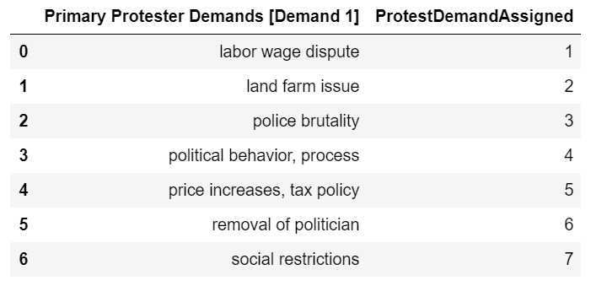
Numeric Translation

Slide 9
Questions?

