Slide 1
Stroke Data

Slide 2
Research Question
What kind of model will be able to more accurately predict if a patient will have a stroke.

Slide 3
Dataset
Data obtained from Kaggle
Stroke Prediction Dataset | Kaggle

Slide 4
Input Variables
Gender
Male or Female
Age
Hypertension
1 if patient has hypertension
Heart Disease
1 if patient has heart disease
Ever Married
Yes if patient was ever married
Work type
Children, gov’t, never worked, private, self-employed
Residence Type
Urban or Rural
Average Glucose Level
BMI
Smoking Status
Formerly smoked, never smoked, smokes, unknown

Slide 5
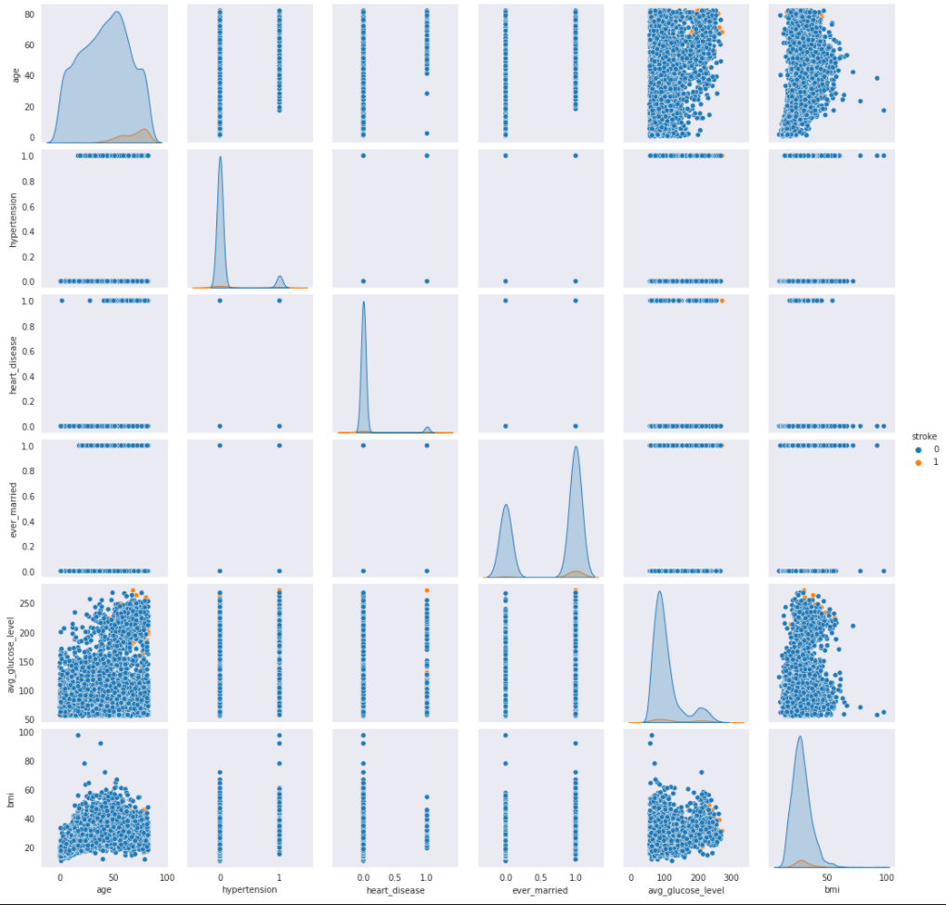
Data

Slide 6
Data Preprocessing 1
Removed Nan
201 Entries in BMI had Nan out of a total of 5110 rows
Binned Numeric values into 5 bins
Converted all variables into numeric encoding using OrdinalEncoder

Slide 7
Naïve Bayes
Test size 0.30
Using CategoricalNB
Training Score: 0.935
Testing Score: 0.928

Slide 8
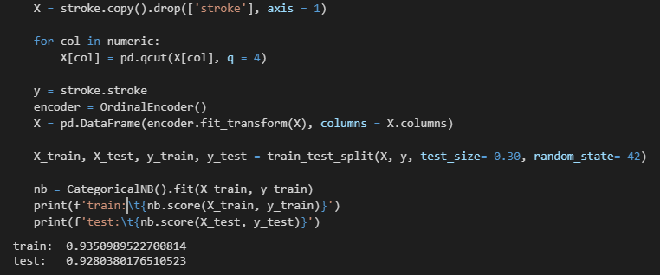
Naïve Bayes

Slide 9
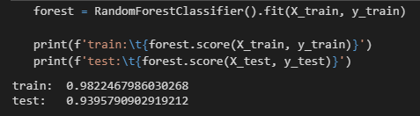
Random Forest
Using same training and testing data
Training Score: 0.982
Testing Score: 0.940

Slide 10
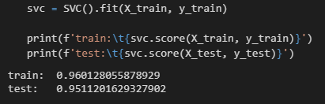
SVM Classifier
Using same training and testing data
Training Score: 0.960
Testing Score: 0.951

Slide 11
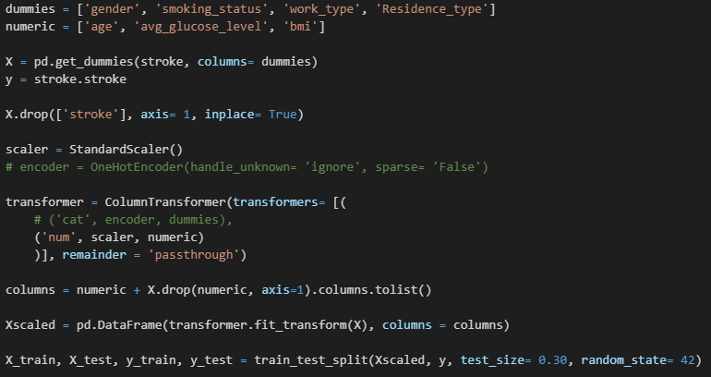
Data Preprocessing 2
Removed Nan
201 Entries in BMI had Nan out of a total of 5110 rows
One hot encoded categorical data
Normalized continuous data with StandardScaler

Slide 12
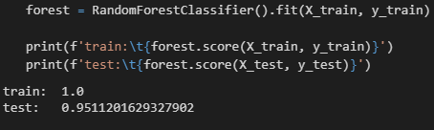
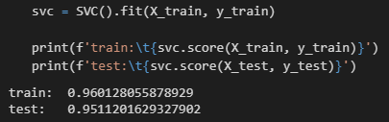
Random Forest SVM Classifier
Training Score: 1.0
Testing Score: 0.951
Training Score: 0.96
Testing Score: 0.951

Slide 13
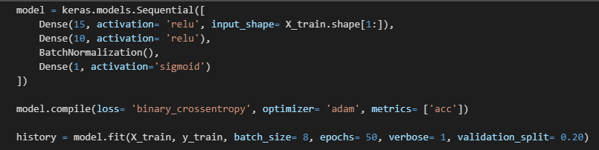
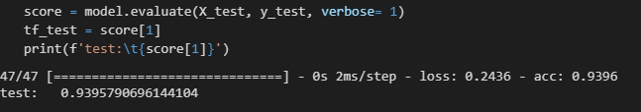
TensorFlow 2.0
Using Rescaled Data

Slide 14
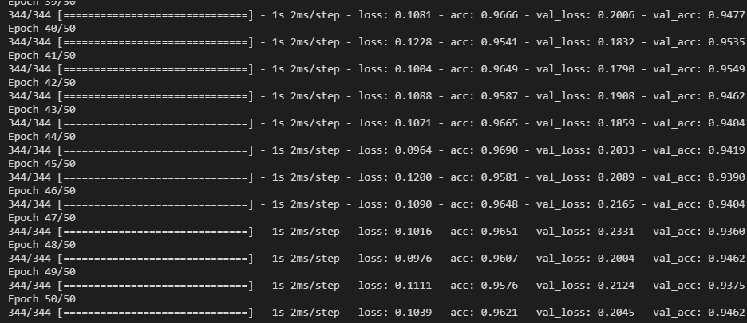
Training Output

Slide 15
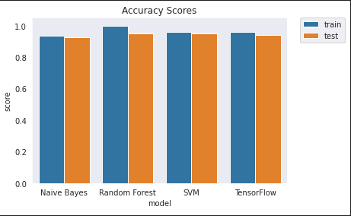
Accuracy Scores

Slide 16
Conclusion
TensorFlow did essentially the same as the rest.
Naïve Bayes Performed the worse.
After Rescaling data
May be overfitting Random Forest
Really any classification model for this stroke data is pretty accurate.

