Slide 1

SMART INDIA HACKATHON 2026
Problem Statement ID – 26060
Problem Statement Title- Digital Platform for Efficient Remote Management of Indian Antarctic Research Stations
PS Category- Software
Team Name: Glory code

Slide 2
DPT-A
Glory Code
What is a Digital Twin?, How is it used?
A digital twin with a Machine Learning model embedded into the system with the appropriate datasets and information. The Basic Idea is to understand historical data from the Station’s expeditions and act according to the number of personnel, the temperature, physical conditions, season. To finally, predict the number of adequate resources such as fuel, water, equipment required to be given.
Since the region is far away from the mainland, the resources required must be delivered well in advance, our digital twin is designed to predict the need for these resource well in advance to avoid mishaps.

Slide 3
MAITRI STATION
Glory Code
Where: Situated at Larsemann Hills along the coast of Prydz Bay in East Antarctica.
Distance: Located about 3,000 km east of India's second Antarctic station, Maitri.
Establishment: Officially commissioned on March 18, 2012, making it India's third research base in Antarctica (after Dakshin Gangotri and Maitri).
Purpose: Built to expand India's year-round scientific reach in Antarctica, focusing on ocean studies, atmospheric research, and continental history.
Construction Feat: Constructed in a record 127 days using 134 prefabricated shipping containers joined together to withstand extreme sub-zero weather and high winds.

Slide 4
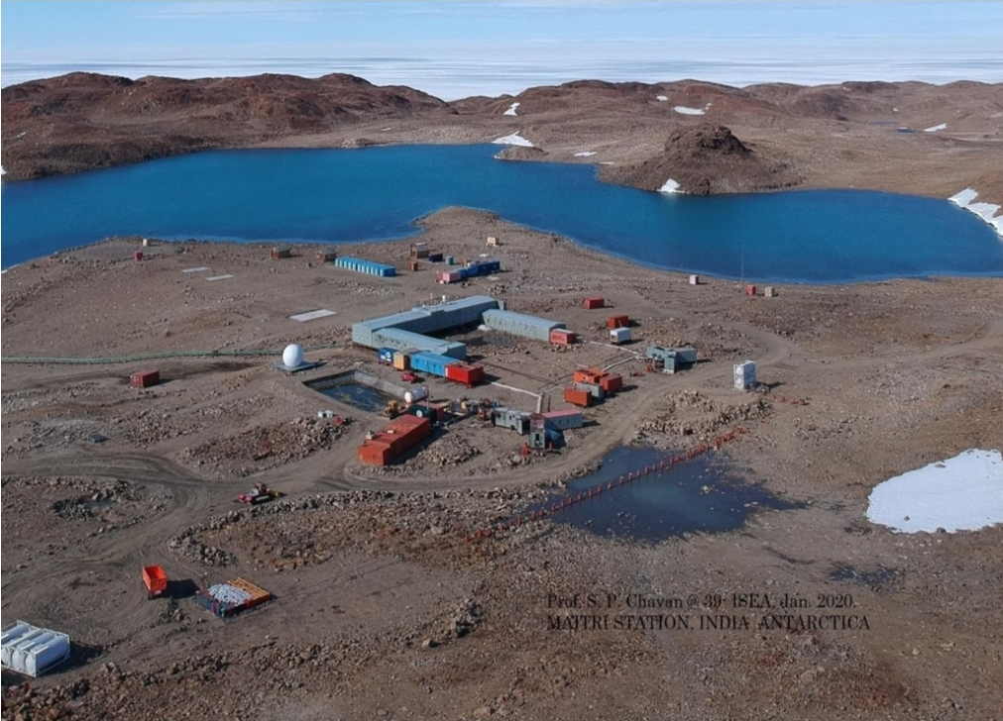
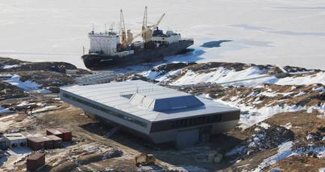
BHARATI STATION
Glory Code
Personnel & Capacity
Year-Round Capacity: 47 people (main facility)
Peak Summer Capacity: Up to 72 people (47 in the main station + 25 in emergency shelters)
Average Occupancy: ~45–50 in summer; ~20–25 in winter
Location
Where: Larsemann Hills along Prydz Bay in East Antarctica.
Setting: A rocky, snow-free peninsula elevated ~35 meters above sea level and ~50 meters from the coast.
Distance: ~3,000 km east of India's Maitri station.
History & Construction
Commissioned: March 18, 2012, as India's 3rd research station.
Build Time: Built in a record 127 days using 134 prefabricated shipping containers.
Primary Mission: Oceanography, continental drift studies, and Earth observation satellite data reception for ISRO.

Slide 5
About the ML Model
Glory Code
The ML model learns the relationship between expedition parameters and historical resource requirements. The model is evaluated using Leave-One-Out Cross-Validation (LOOCV) Principle.
LOOCV works by using all but one observation for training and the remaining observation for testing. This process is repeated until every observation has been used once as the test sample.
Example:
Round 1: Train → Rows 2 + 3 | Test → Row 1
Round 2: Train → Rows 1 + 3 | Test → Row 2
Round 3: Train → Rows 1 + 2 | Test → Row 3
The predictions from each round are compared with the actual values to calculate the model's prediction error.
Maximize use of limited data → Evaluate generalization → Estimate prediction reliability

Slide 6
ML Machinery
Glory Code
Input Features: Personnel count, expedition duration, and season are provided as inputs to the model.
Historical Data: Past expedition/station data is used to identify patterns between these inputs and resource consumption.
Data Preprocessing: Data is cleaned and converted into a format suitable for machine learning
Supervised Learning: The model learns from historical inputs along with their corresponding resource requirements.
Regression: The model predicts continuous quantities such as food, fuel, energy, and other supplies. It uses Ridge Regression ML Model.
Model Validation: Leave-One-Out Cross-Validation (LOOCV) is used to evaluate the model with the limited available dataset.
Prediction: Once validated, the trained model receives new expedition parameters and estimates the required resources.
Digital Twin Integration: These predictions are passed to the Digital Twin to simulate resource consumption and identify potential shortages.
User
Frontend: User Inputs
Backend: Basic Logic
Prediction Engine: Data Validation
ML Model: Linear Regression
Predicted Resources
Digital Twin

Slide 7
Logic of the Model
Glory Code
User Input
Baseline Prediction
Check ML Reliability
ML Reliable
YES
ML Reliable
NO
Baseline Prediction
Final Digital Twin Result

Slide 8
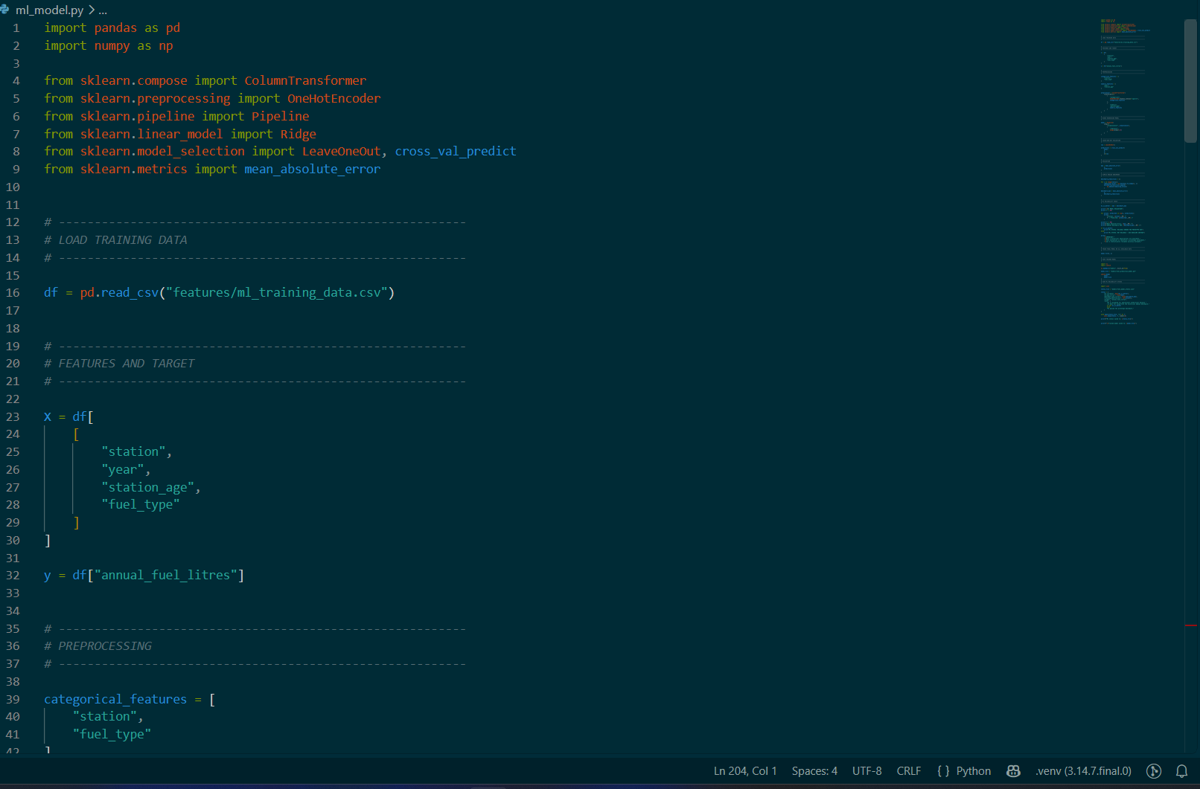
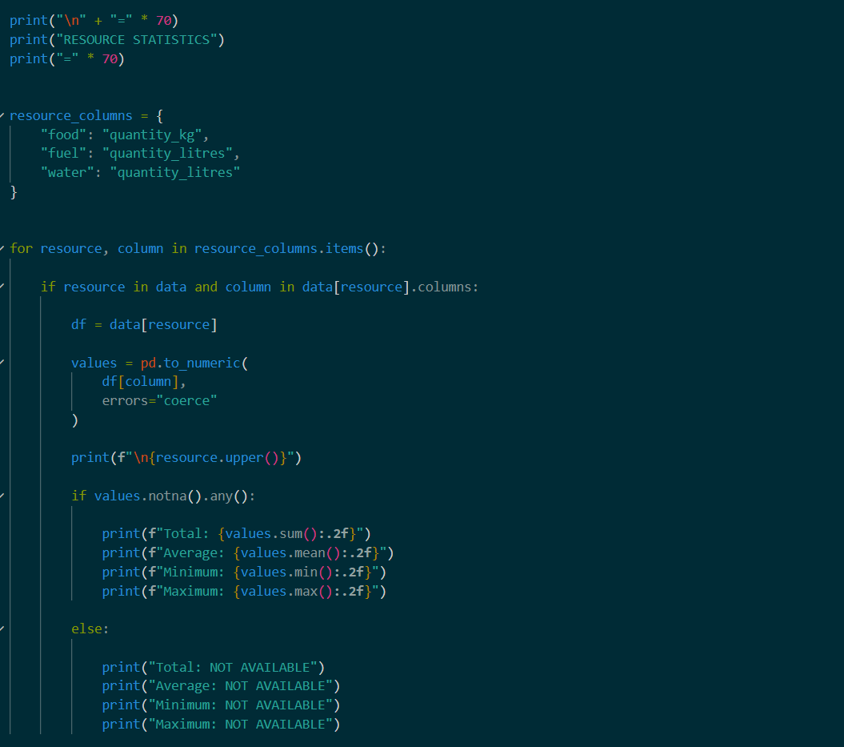
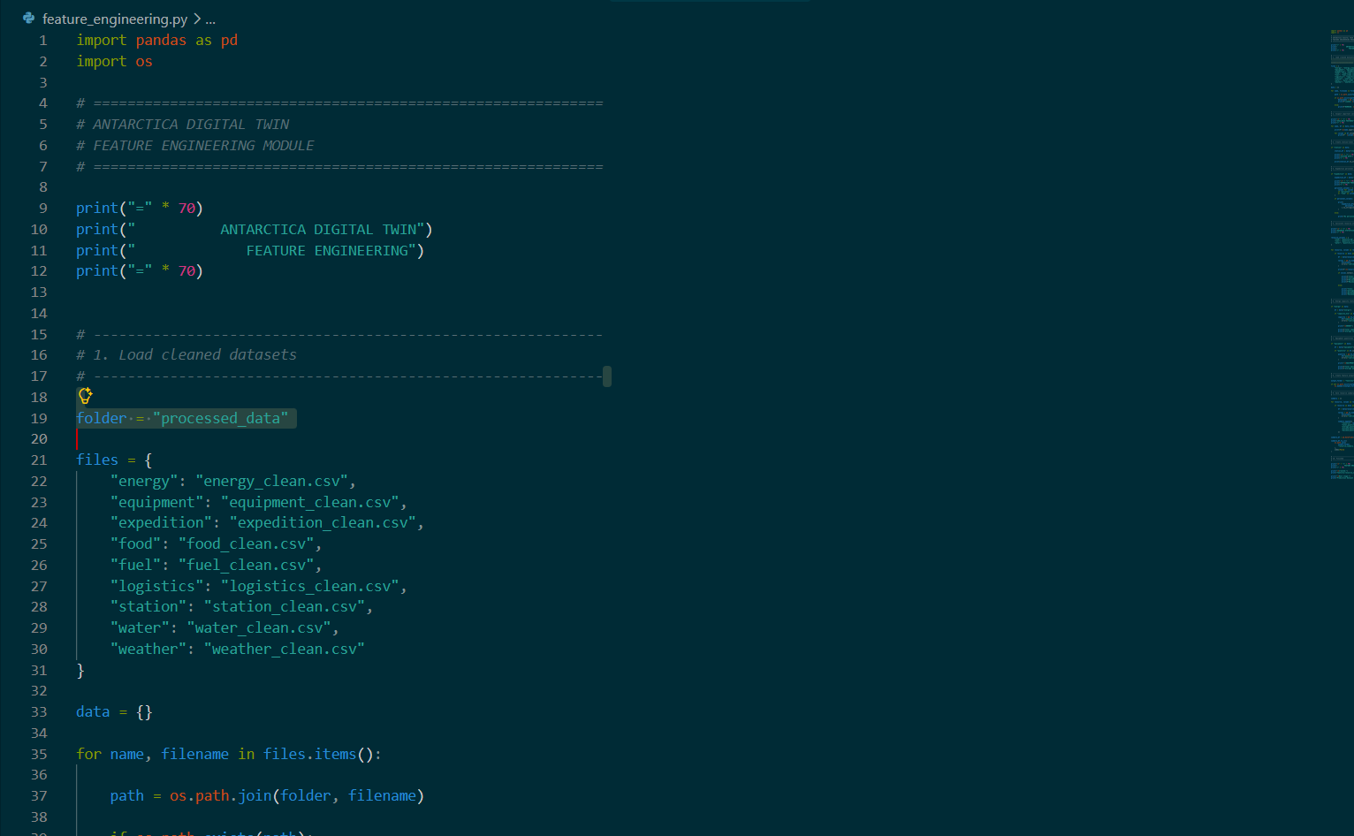
RESEARCH AND REFERENCES
Glory Code
Mayur Navaratna
Jedidah P Reddy
Shreyas Dhavali
Utkarsh Joshi
Anagha Bidare
Anjana Yadur
References: https://data.ncpor.res.in/PolarDirectory/

