Slide 1
Data Visualization in Python
Libraries, plot types and best practices
MTH1203 Probability and Statistics | Group Research Assignment, Advent 2026
Uganda Christian University – Faculty of Engineering, Design and Technology
Group members:
Wamala stuart | M26b13/040
Ssettuba imran | M26b13/058
Ndahayo dieu est la | M26b13/071
Kaineyesu melissa | M26b13/021
Notes:
Introduce the group and the topic. Say who will present each section.

Slide 2
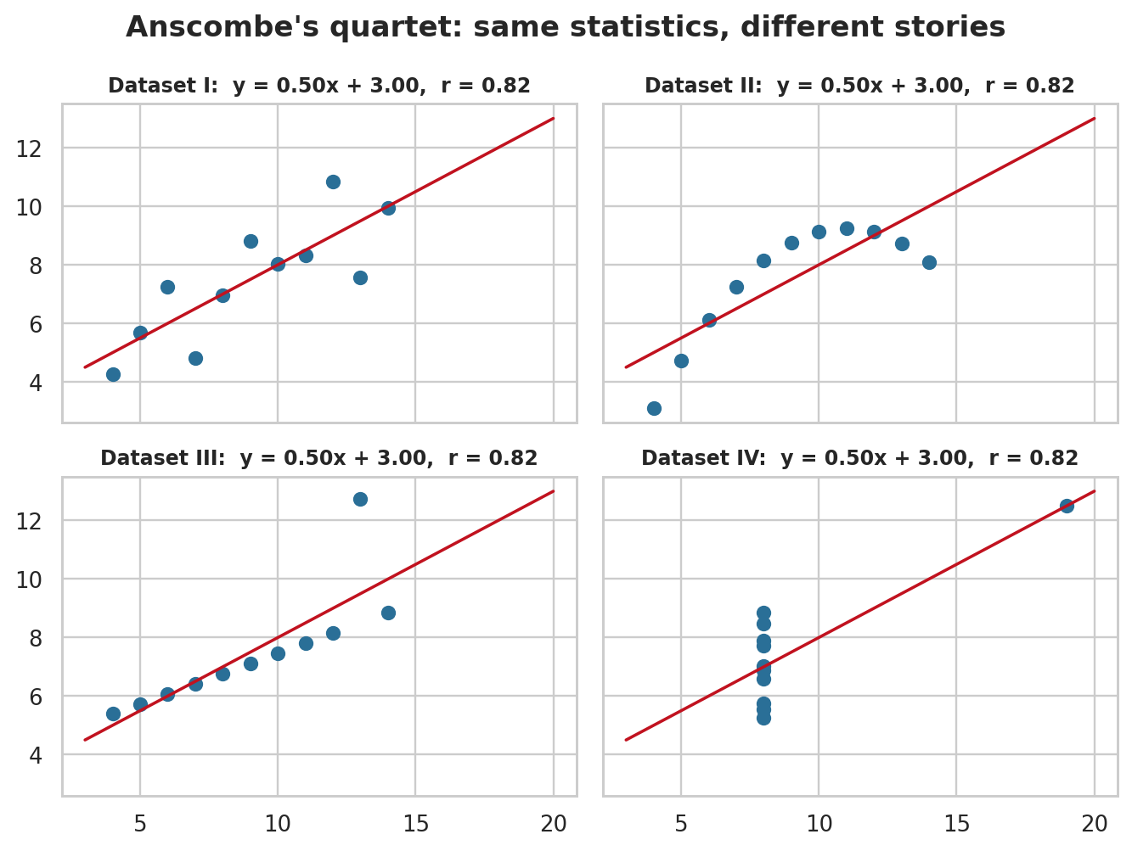
What is data visualization?
Showing data as graphics (charts, plots, maps) so patterns are easy to see
Exploring: shape, outliers, errors, choice of method
Communicating: results are clearer to everyone
Numbers can hide the truth: Anscombe's four datasets share the same mean, variance, r = 0.82 and line
Anscombe's quartet (from our notebook)
Notes:
Explain visualization for exploration and communication. Anscombe (1973): identical statistics, four different stories. Always plot before trusting numbers.

Slide 3

Main Python visualization libraries
Matplotlib
Seaborn
The foundation. Full control of every detail; static, publication-quality figures.
Built on Matplotlib. Statistical plots, attractive defaults, works with DataFrames.
Plotly
Pandas plotting
Interactive charts: hover, zoom, pan. Good for dashboards and web pages.
One-line .plot() charts straight from a DataFrame. Best for quick exploration.
Notes:
Matplotlib = base (Hunter 2007). Seaborn = statistical (Waskom 2021). Plotly = interactive. Pandas = quick. They are used together.

Slide 4
How the libraries compare
Feature | Matplotlib | Seaborn | Plotly | Pandas plot
Purpose | General, full control | Statistical graphics | Interactive charts | Quick exploration
Ease of use | Moderate | Easy | Easy (Express) | Very easy
Interactive? | No | No | Yes | No
Customisation | Very high | Medium | High | Low
Built on | NumPy | Matplotlib + Pandas | JavaScript engine | Matplotlib
In practice we combine them: Pandas to prepare data, Seaborn for fast statistical plots, Matplotlib to fine-tune, Plotly for interactivity.

Slide 5
Common plot types and when to use them
Chart | Shows | Use when
Bar | Value per category | Comparing categories
Line | Change over an ordered scale | Trends over time
Histogram | Distribution of one variable | Shape, centre, spread
Scatter | Two numerical variables | Correlation, outliers
Box plot | Median, quartiles, outliers | Comparing groups
Pie | Parts of a whole | Few categories (5 or fewer)
Heatmap | Values as colours | Correlation matrices
Notes:
Start with the question, then choose the chart. Each one is demonstrated next with code in the notebook.

Slide 6
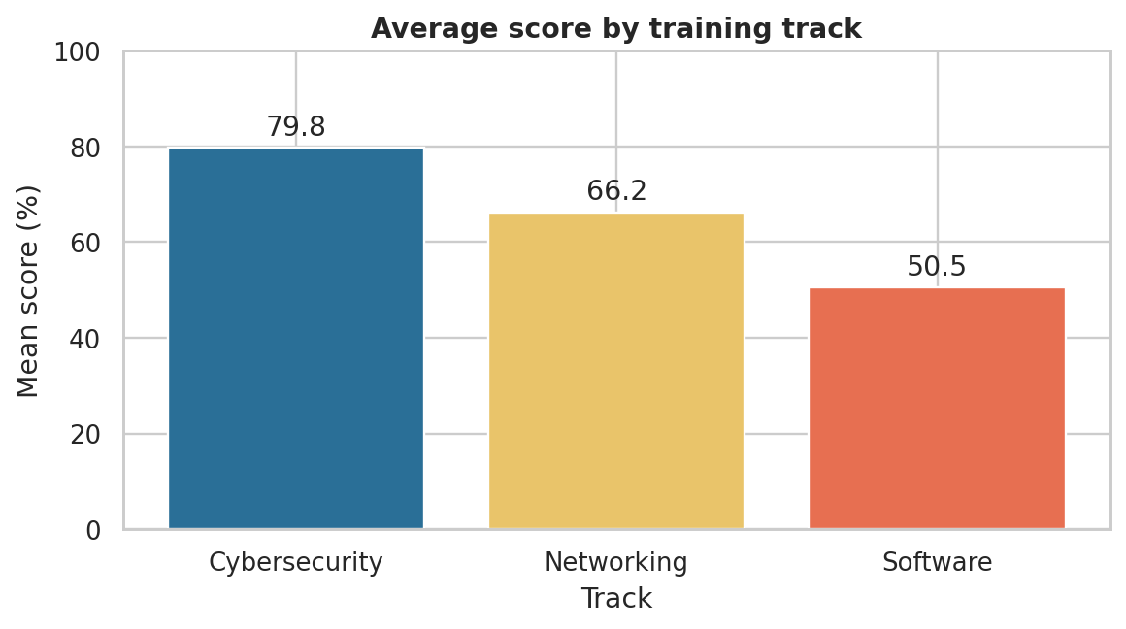
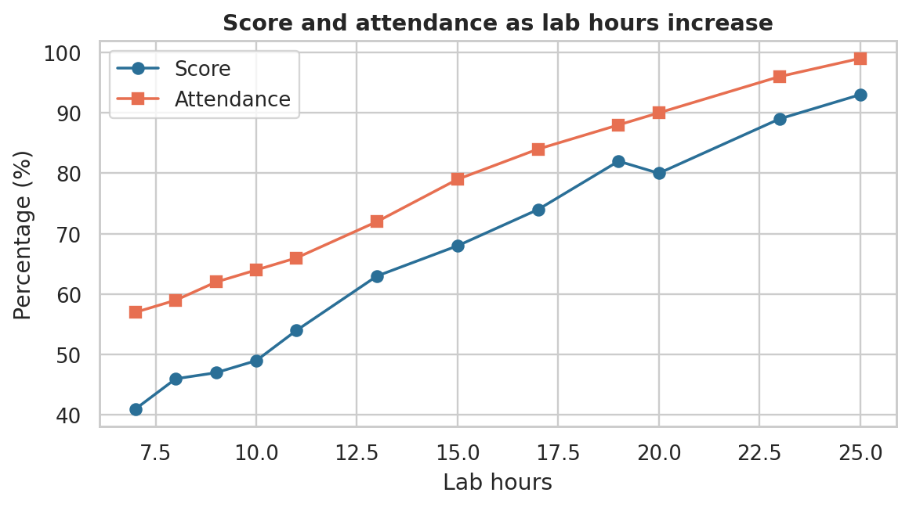
Bar chart and line chart
Bar: compare categories (start at zero)
Line: change along an ordered scale
ax.bar(avg.index, avg.values) ax.plot(df_sorted['LabHours'], df_sorted['Score'])

Slide 7
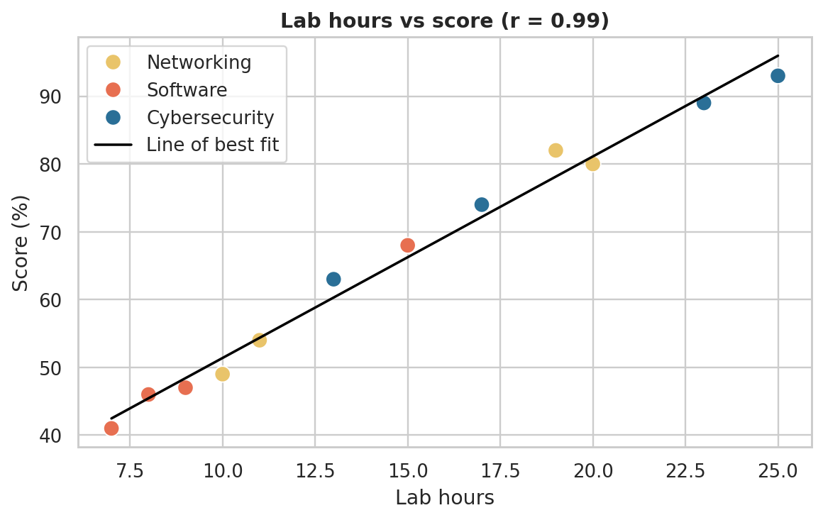
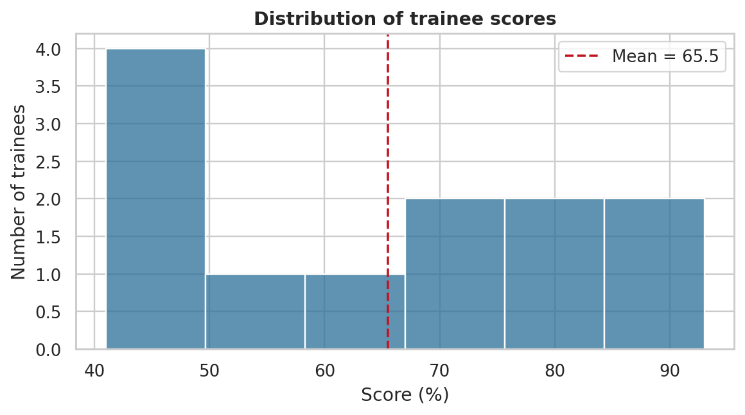
Histogram and scatter plot
Histogram: distribution (mean 65.5, sd 18.1)
Scatter: lab hours vs score, r = 0.99
sns.histplot(df['Score'], bins=6) sns.scatterplot(data=df, x='LabHours', y='Score')

Slide 8

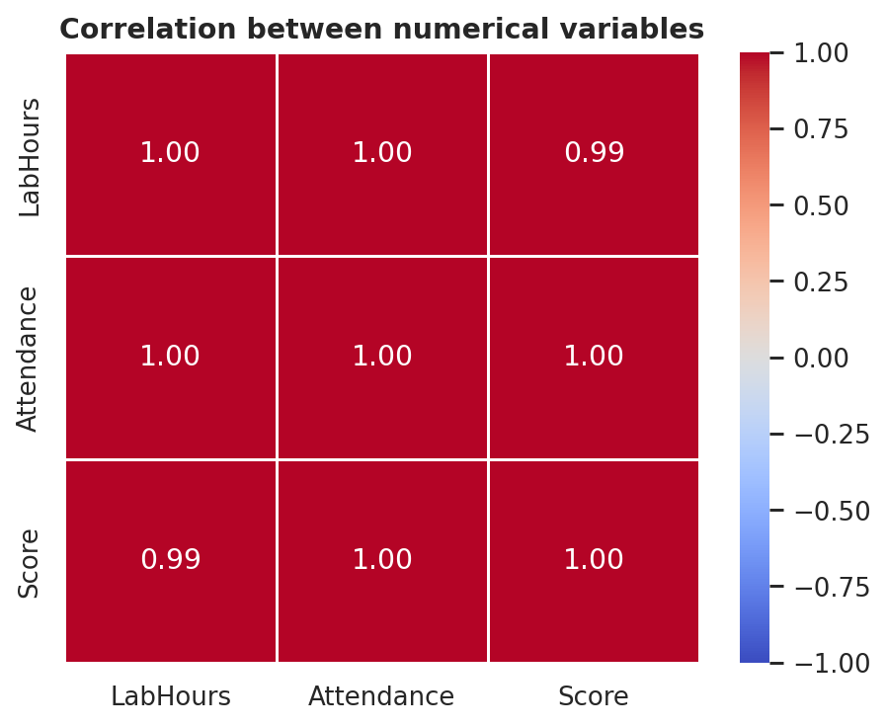
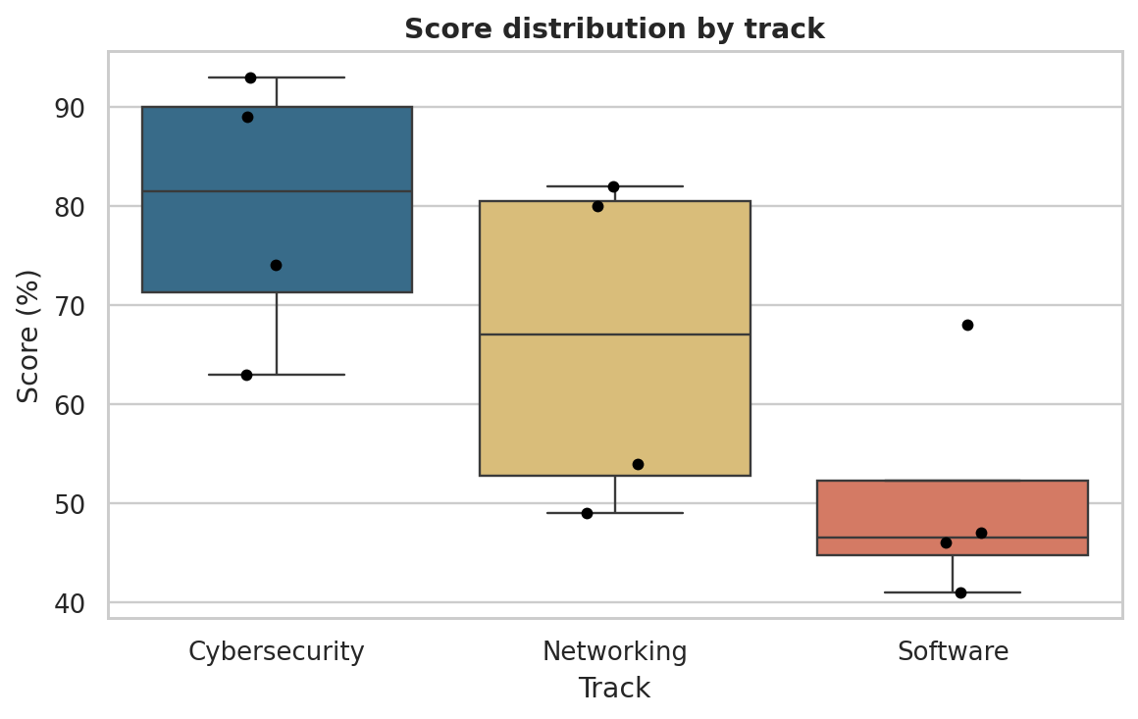
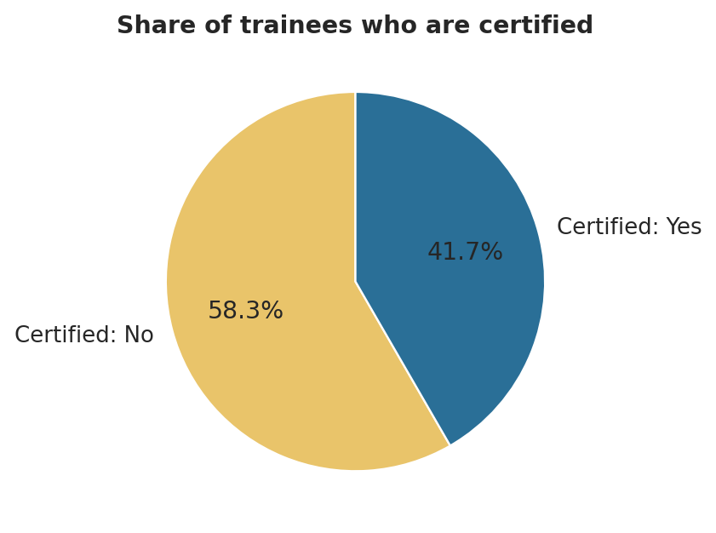
Box plot, pie chart and heatmap
Box plot: compare group spreads
Pie: share certified (5 of 12)
Heatmap: correlation matrix
sns.boxplot(...) plt.pie(..., autopct='%1.1f%%') sns.heatmap(corr, annot=True)

Slide 9

Best practices for good visualization
Choose the chart that fits the question and the data type
Clear title, labelled axes with units, legend only when needed
Use colour with purpose; limit the palette; be colour-blind friendly
Remove clutter: 3D, heavy grid, shadows; one message per chart
Be honest: bars start at zero, consistent scales, show the source
Correlation is not causation
Notes:
Based on Tufte (2001), Cleveland & McGill (1984) and Wilke (2019).

Slide 10

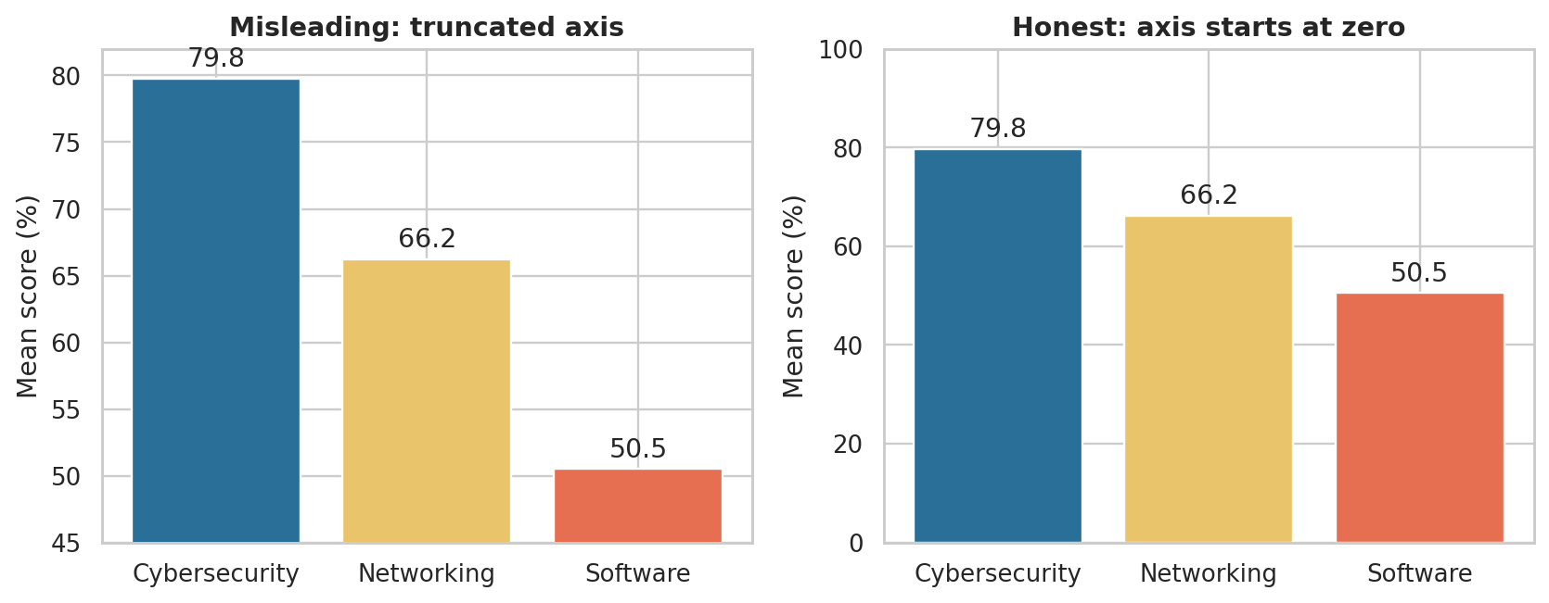
Honest vs misleading: the same data
Cutting the axis makes Software (50.5) look tiny next to Cybersecurity (79.8). The honest chart shows it is about 63% of it.

Slide 11

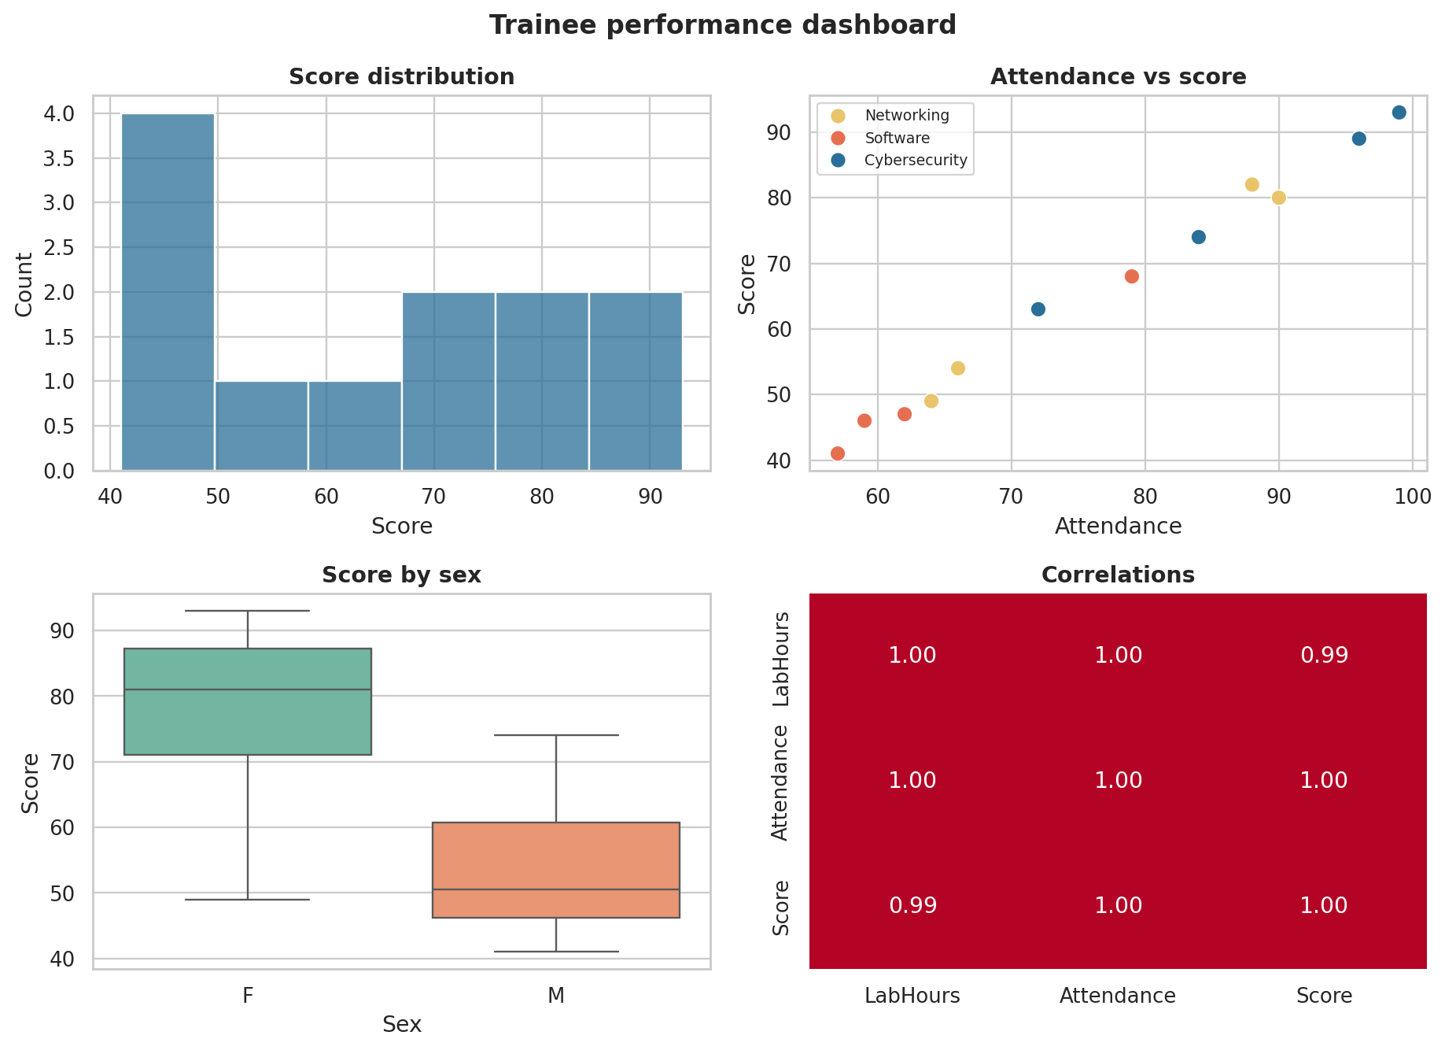
Our notebook and what the plots told us
Dataset: trainees.xlsx, 12 trainees, 3 tracks
Scores 41 to 93: mean 65.5, sd 18.1
Lab hours, attendance and score rise together (r = 0.99 to 1.00)
Track means: Cybersecurity 79.8, Networking 66.2, Software 50.5
5 of 12 certified; all scored 74 or above
Notes:
Be ready to run the notebook live and explain any cell. With only 12 trainees the findings are tentative and illustrate technique.

Slide 12
Conclusion
Visualization reveals what summary statistics can hide
Matplotlib, Seaborn, Pandas and Plotly complement each other
Each plot type answers a specific kind of question
Clear, honest design makes charts trustworthy
Thank you. Questions?

