Slide 1
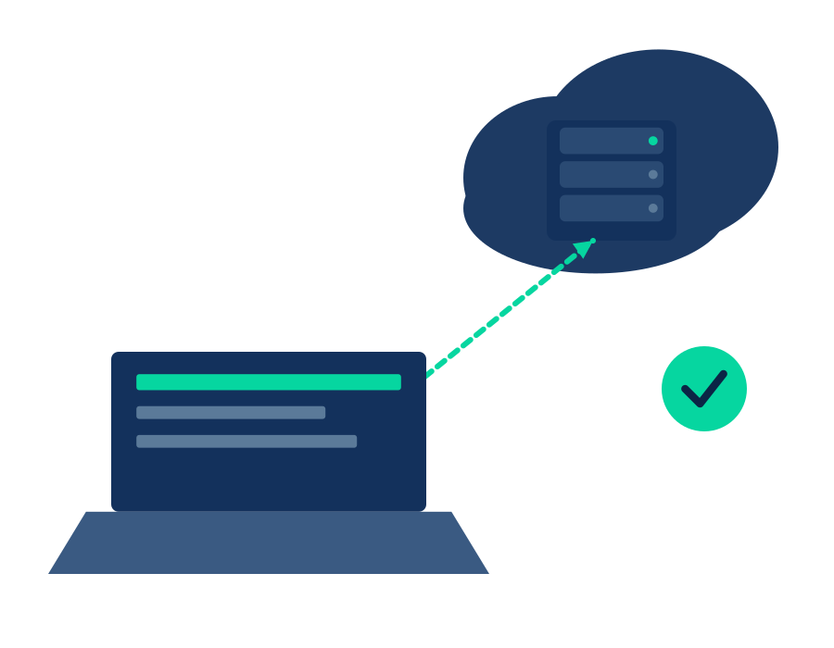
OSI MODEL · NETWORKING FUNDAMENTALS
The Application Layer
Layer 7 of the OSI Model — where networks meet the software people actually use.
Presented by
Presented by
1 Jonathans Stefane Irene
Nabukenya Sarah
Wamala Stuart
ssettuba imran
Ndahayo Dieu Est la
Takua Jenifer David
Akello Robinah patience
Apio Agatha
01

Slide 2
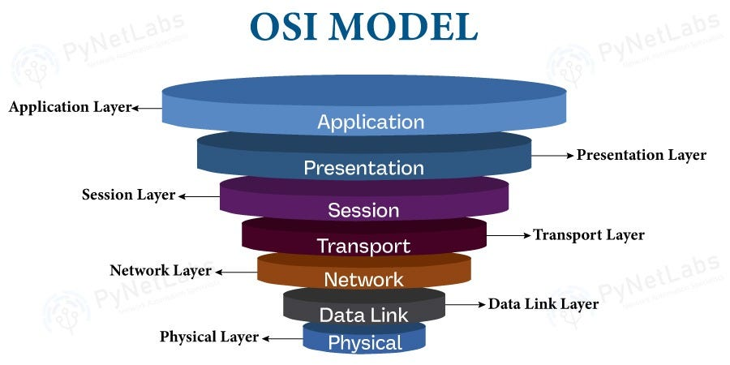
THE BIG PICTURE
Where Layer 7 Sits in the OSI Model
7
Application
HTTP, DNS, SMTP — user-facing services
6
Presentation
Encryption, compression, formatting
5
Session
Establishes & manages connections
4
Transport
TCP / UDP — reliable delivery
3
Network
IP addressing & routing
2
Data Link
MAC addressing, switches
1
Physical
Cables, signals, hardware
02

Slide 3

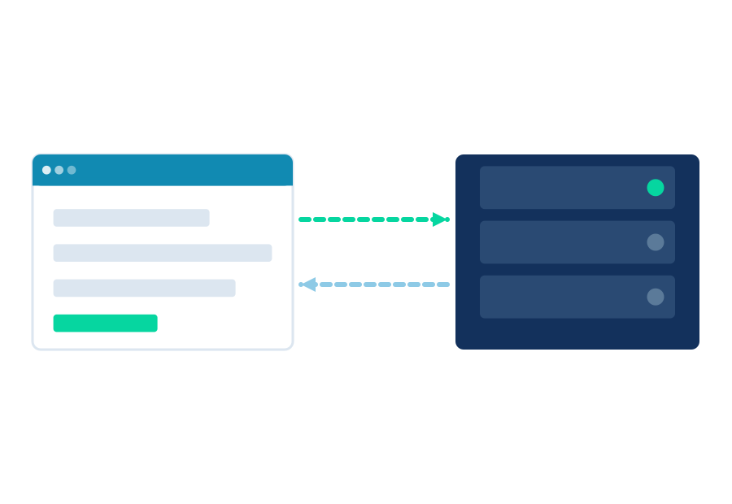
DEFINITION
What Is the Application Layer?
The Application Layer is the OSI layer closest to the end user. It doesn't move data across a wire — it defines the rules that let software (browsers, email clients, apps) request and exchange data in a way both ends understand.
It's an interface, not a program
It defines shared rules
It's protocol-driven, not hardware
Apps use Layer 7 protocols; they aren't part of the layer itself.
HTTP and SMTP set the format both sender and receiver must follow.
No cables here — just standards that let systems interoperate.
03

Slide 4

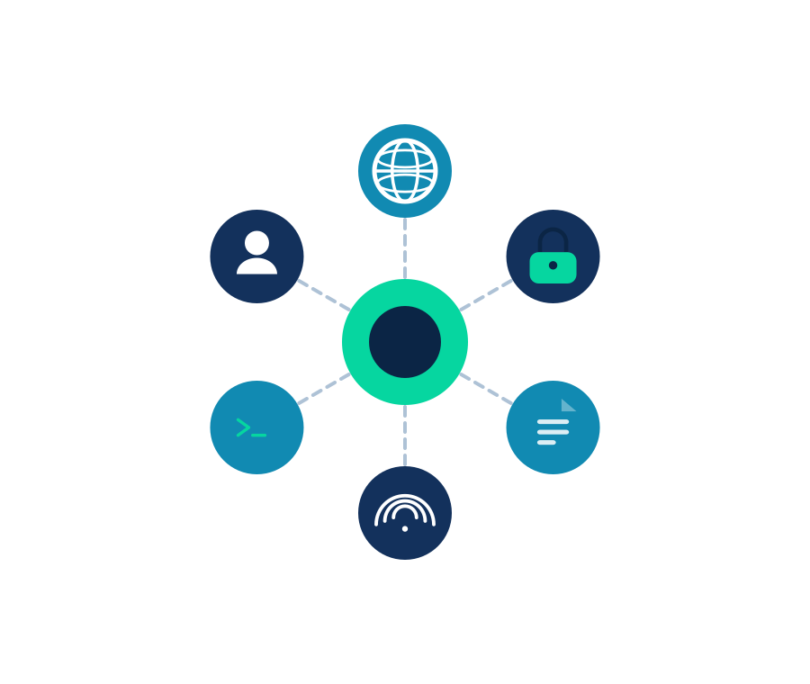
CORE FUNCTIONS
What the Application Layer Actually Does
Identifies communication partners
Confirms availability and identity of the party you're trying to reach.
Authenticates & authorizes
Verifies identity and permission to exchange the requested data.
Syncs data & formats requests
Structures data (JSON, XML, form fields) for the receiving app.
Manages the user-facing session
Coordinates login state, upload progress, and similar app-level flow.
Handles errors application-side
Surfaces meaningful errors (404, bounced email) instead of raw failures.
Bridges user & network
Translates a click or command into a network-ready protocol message.
04

Slide 5

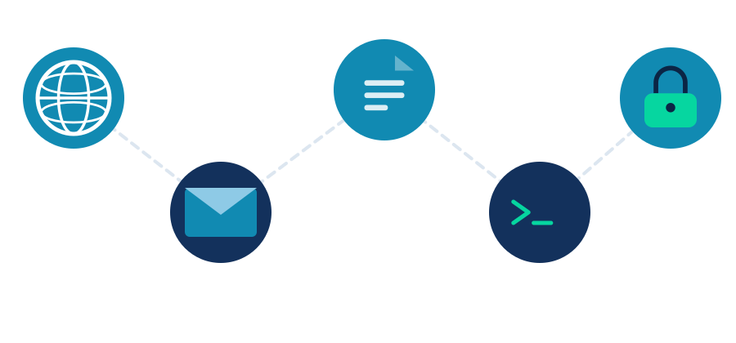
IN PRACTICE
Common Layer 7 Protocols
HTTP / HTTPS
Web browsing
443, 80
SMTP / IMAP / POP3
Sending & receiving email
25, 143, 110
FTP / SFTP
File transfer between systems
21, 22
DNS
Translates domain names to IP addresses
53
SSH
Secure remote login to a system
22
DHCP
Assigns IP addresses on a network
67, 68
05

Slide 6
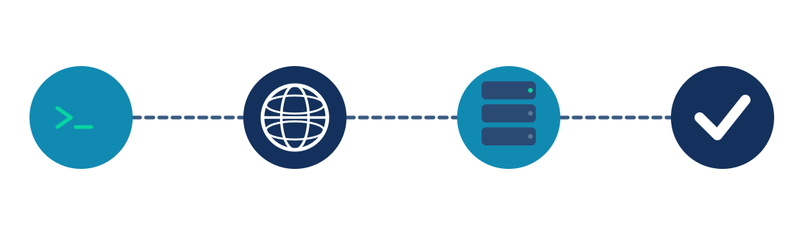
WALKTHROUGH
Layer 7 in a Single Page Load
What happens at the Application Layer when you type a URL and hit enter.
01
02
03
04
You type the URL
DNS resolves the name
HTTP request is sent
Server responds
Browser prepares to resolve the domain into a routable address.
A DNS query (Layer 7) translates the domain into an IP address.
The browser builds an HTTP GET — headers, method, resource.
An HTTP status and the page's HTML come back, ready to render.
06

Slide 7

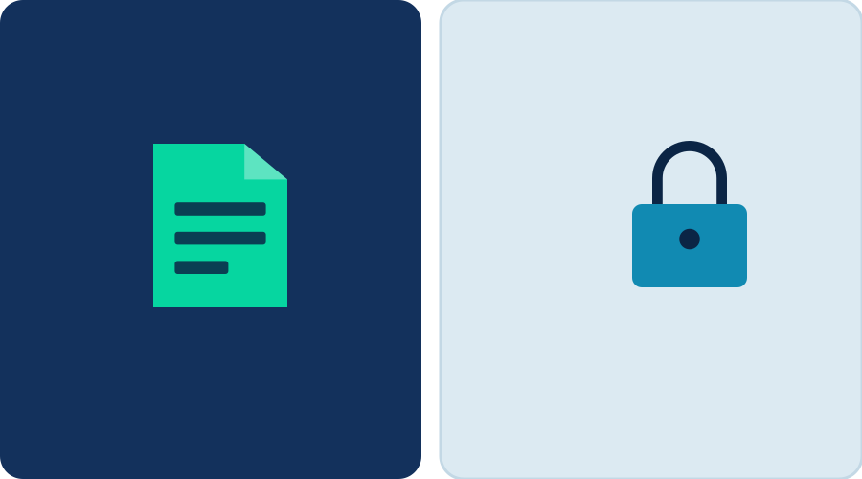
DON'T CONFUSE THESE
Layer 7 vs. Layer 6 — A Common Mix-Up
LAYER 7 — APPLICATION
LAYER 6 — PRESENTATION
• What the user's software is trying to do
• How the data is packaged for transport
• Defines HTTP, SMTP, DNS, FTP requests
• Handles encryption (TLS), compression
• Example: “Get me this webpage”
• Example: “Encrypt this before it's sent”
07

Slide 8

KEY TAKEAWAYS
Remember This About Layer 7
1
It's closest to the user
Every other layer exists to support what happens here.
2
It's about protocols, not programs
HTTP, DNS, SMTP — shared rules, not the apps themselves.
3
It defines the message, not the wire
Format and meaning live here; delivery is handled below.
Thank you — questions?
08

