Slide 1

Slicer: Auto-Sharding for Datacenter Applications
Atul Adya, Daniel Myers, Jon Howell, Jeremy Elson, Colin Meek, Vishesh Khemani, Stefan Fulger, Pan Gu, Lakshminath Bhuvanagiri, Jason Hunter, Roberto Peon, Larry Kai, Alexander Shraer, Arif Merchant, Kfir Lev-Ari (Technion – Israel)

Slide 2
Local Memory Considered Helpful
Server machines have a lot of memory
Applications should take advantage of it, e.g., caching
Datacenter applications often don’t cache data
Too hard to implement
Slicer makes it easy to build services that use local memory

Slide 3
Talk Outline
Why stateful servers are difficult
Slicer model and architecture
Evaluation

Slide 4


Building a DNS Service
End-user devices
DNS Service
Virtual Machines
Cloud Platform
DNS service needs to be scalable and fast!
4

Slide 5
Full State Replicated on Every Server
End-user devices
Any server can handle any request
Easy adaptation to failures, capacity changes, load skews
Hard to scale or handle mutations
Frontends
DNS Servers

Slide 6
Stateless: Interchangeable Servers + Database
End-user devices
Any server can handle a request
Cannot query DB for every DNS request
High latency
Network hop and marshaling costs
Frontends
DNS Servers
Database

Slide 7
Stateful: Static Sharding
Hash(key) mod 4
Hash(key) mod 4
Frontends
DNS servers
☺ Simple mapping from keys to servers via static function
☹ Failure adaptation: Black-hole traffic for crashed server
☹ Capacity adaptation: Could result in significant key churn

Slide 8

Stateful: Consistent Hashing
ConsistentHash(key)
ConsistentHash(key)
Frontends
DNS servers
Implement server presence detection
☺ Addresses capacity and failure adaptation, key churn
☹ Stochastic load balancing is inadequate
☹ Distributed decisions harm affinity

Slide 9
Stateful: Central Controller
Hash(key)
Hash(key)
Hash(key)
Frontends
Storage Master
Controller
Application
servers
Tablet
servers
Central server: presence detection, load monitoring, consistent view
☹ Fan-out assignments to large number of clients and servers
😐 Internals of a sharded distributed storage system! Should we use stateless servers? 😫

Slide 10
Slicer: Refactored System for Sharded Apps
Provides auto-sharding without tying to storage
Separate assignment generation “control plane” from request forwarding “data plane”
Via a small interface
In a scalable, consistent, fault-tolerant manner
Reshards for capacity and failure adaptation, load balancing
Evaluated Slicer in production deployment

Slide 11
Benefits of Sharding/Affinity
Any type of serving from memory / caching
E.g., Cloud DNS
Even stateless services use stateful components
E.g. External caches such as Memcache
Affinity helps aggregating writes to storage
E.g., Thialfi [SOSP ’11] batches notification messages to storage

Slide 12
Slicer Sharding Model
Application
servers
Hash keys into 63-bit space
Hash(K₁)
Hash(K₂)
Hash(K₃)
Assign ranges ("slices") of space to servers
Split/Merge/Migrate slices for load balancing
“Asymmetric replication”: more copies for hot slices
0
2⁶³ - 1
“Slices”

Slide 13
Slicer Architecture: Goals
High-quality sharding and consistency of a centralized system
Low latency and high availability of local decisions

Slide 14
Slicer Overview
Distributed data plane
Centralized control plane
Hash(key)
Hash(key)
Frontends
Clerk
Slicelet
Application
servers
Slicer Service

Slide 15
Slicer Architecture
Frontends
Clerk
Backup
Distributor
Slicelet
Application
servers
Assigner
Distributor
Existing Google
Infrastructure
Capacity Monitoring
Health Monitoring
Load Monitoring
Lease Manager

Slide 16
Tolerating Failures
Two types of failures:
Localized failures: machine failures or datacenter offline
Correlated failures: whole service such as Assigner or Distributor being down due to, e.g.,
Bad configuration push
Software bug
Bug in underlying dependencies

Slide 17
Tolerating Localized and Correlated Failures
Frontends
Distributor datacenters
Application
servers
Backup Distributor datacenters
Smaller/Simpler Components
More Complex Components
Assigner datacenters

Slide 18
Slicer Features and Evaluation
Load balancing algorithm
Assignments with strong consistency guarantees
Production Measurements
scale, load balancing, availability,
Comparison with consistent hashing
Experiments
Comparing load balancing strategies
Load reaction time
Assigner recovery time
Detailed
assignment latencies
Brief

Slide 19
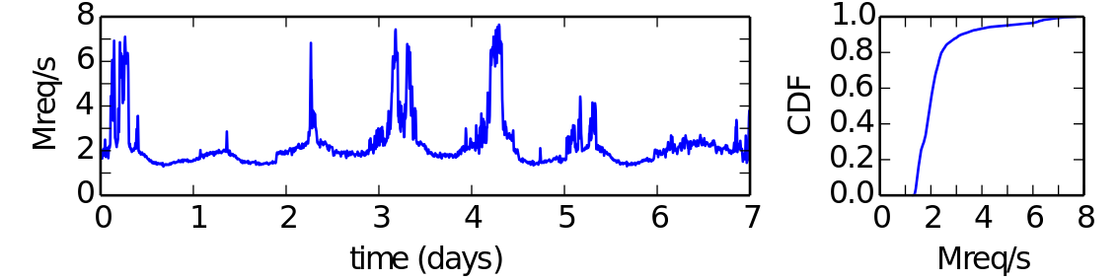
Evaluation: Slicer Usage
Slicer load balances a few million RPS for several Google services
99.98% of clients requests had a valid assignment
< 0.01% of these requests directed to the wrong server

Slide 20
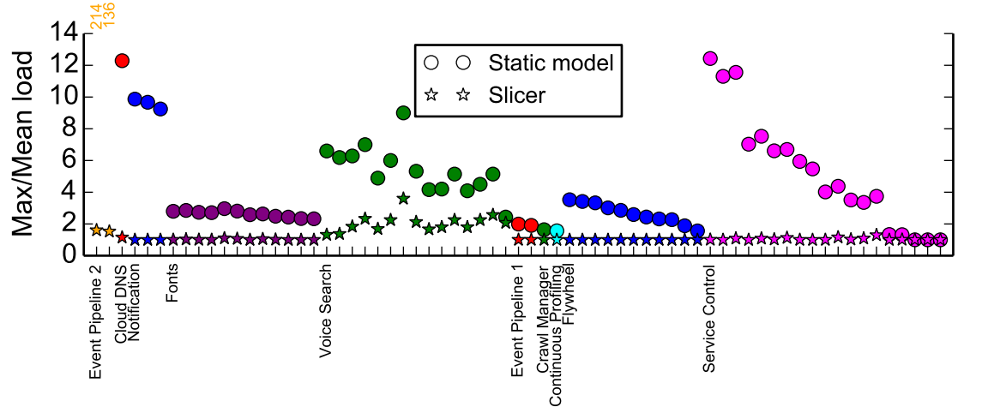
Evaluation: Load Balancing Effectiveness
Slicer allows tighter capacity allocation by reducing skew

Slide 21
Summary: Slicer makes Stateful Services Practical
Reshards in the presence of capacity changes, failures, load skews
Scalable and fault-tolerant architecture
Separates assignment generation “control plane” from request forwarding “data plane”
Evaluated Slicer in production deployment

