Slide 1
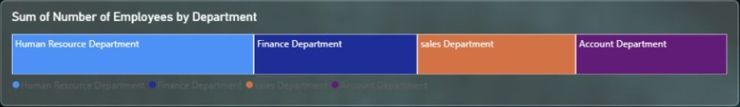
Department Mix — Employee Distribution
CHART 01 • DEPARTMENT COMPOSITION
DASHBOARD VISUAL
WHAT THIS VISUAL TELLS US
The visual compares employee totals across Human Resource, Finance, Sales and Account departments.
The width of each colored block represents its relative contribution to the displayed total.
Sales and Human Resource appear among the larger blocks, while Finance and Accounts remain substantial contributors.
Use this view to spot concentration and support high-level workforce planning.
Confirm exact headcounts in the underlying report before staffing decisions.
KEY TAKEAWAY • Department mix gives a fast snapshot of workforce distribution.
INSIGHTS / 01

Slide 2

Index Gauge — Overall Index Position
CHART 02 • GAUGE KPI
DASHBOARD VISUAL
WHAT THIS VISUAL TELLS US
The gauge displays an index value of approximately 501K on a 0M–1M scale.
The indicator sits around the midpoint of the displayed range.
A gauge is useful when stakeholders need an at-a-glance status against a defined scale.
The source image does not show a target or threshold, so the value cannot be labelled good or bad.
Add target bands or historical comparisons to make the KPI more actionable.
KEY TAKEAWAY • The index is near the middle of the gauge range; a benchmark adds context.
INSIGHTS / 02

Slide 3

KPI — Contract Value
KPI 01 • COMMERCIAL VALUE
DASHBOARD VISUAL
WHAT THIS VISUAL TELLS US
The card reports a summed contract value of 497K.
It provides a concise view of contract value represented in the current report context.
Compare it with revenue, customer count and time-period trends to understand commercial scale.
A sum can be influenced by currency, date range and repeated records.
Validate the currency and aggregation level before external reporting.
KEY TAKEAWAY • Contract value is displayed as 497K; confirm currency and reporting period.
INSIGHTS / 03

Slide 4

KPI — Annual Revenue
KPI 02 • REVENUE PERFORMANCE
DASHBOARD VISUAL
WHAT THIS VISUAL TELLS US
The dashboard shows summed annual revenue of 504K.
This card acts as a headline indicator for revenue represented in the dataset.
Review it alongside the city revenue chart to understand geographic distribution.
Use consistent fiscal-year definitions when comparing this KPI across periods.
A trend or year-over-year comparison adds context beyond the single total.
KEY TAKEAWAY • Annual revenue is shown as 504K; trend and period context are needed.
INSIGHTS / 04

Slide 5

KPI — Customer Since
KPI 03 • CUSTOMER TENURE FIELD
DASHBOARD VISUAL
WHAT THIS VISUAL TELLS US
The displayed aggregate is 2M for the field labelled Customer Since.
Customer Since is often a date or tenure-related field, so summing it may not be meaningful.
Check the source data type and aggregation setting in the BI report.
A customer count by start year, average tenure or new-customer trend may be more informative.
Treat this KPI cautiously until its definition is verified.
KEY TAKEAWAY • Verify the field definition: summing a customer-start date may not be meaningful.
INSIGHTS / 05

Slide 6

KPI — Number of Employees
KPI 04 • WORKFORCE SCALE
DASHBOARD VISUAL
WHAT THIS VISUAL TELLS US
The card reports a summed employee measure of 5M.
This is the value displayed by the source, not necessarily a unique employee headcount.
The large magnitude suggests checking whether counts repeat across customer or department records.
For workforce reporting, a distinct count or validated snapshot may be more suitable.
Compare with department charts only after confirming the same data grain.
KEY TAKEAWAY • Validate the data grain because a summed employee field can overstate headcount.
INSIGHTS / 06

Slide 7

KPI — Customer ID Count
KPI 05 • CUSTOMER COVERAGE
DASHBOARD VISUAL
WHAT THIS VISUAL TELLS US
The dashboard displays a count of Customer ID of 1K.
A count indicates nonblank ID records, which may differ from unique customers.
Use a distinct count if customer IDs can appear in multiple rows.
Compare customer count with country and city distributions to understand coverage.
Check missing IDs and duplicates as part of data-quality review.
KEY TAKEAWAY • The dashboard counts about 1K ID records; confirm whether this is distinct customers.
INSIGHTS / 07

Slide 8

KPI — Message Count
KPI 06 • ENGAGEMENT ACTIVITY
DASHBOARD VISUAL
WHAT THIS VISUAL TELLS US
The card displays a count of Messages of 1K.
This may represent message entries included in the current report context.
Compare message volume with customer count to estimate engagement per customer.
A time-based trend can reveal peaks, drops or changes in communication activity.
Clarify whether the measure counts messages, message-bearing rows or nonblank values.
KEY TAKEAWAY • Message count is about 1K; define the counting logic before comparison.
INSIGHTS / 08

Slide 9
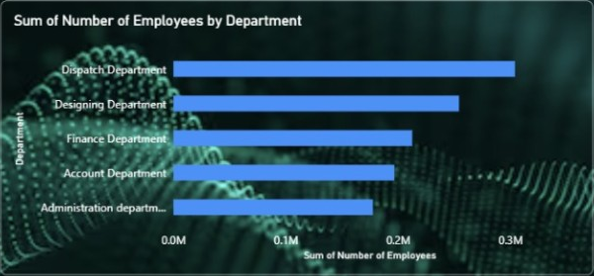
Department Ranking — Employee Totals
CHART 03 • HORIZONTAL BAR CHART
DASHBOARD VISUAL
WHAT THIS VISUAL TELLS US
Dispatch Department has the longest bar in the displayed ranking.
Designing and Finance follow, with Account and Administration below them in this view.
Horizontal bars make department comparisons and label reading straightforward.
The axis is shown in millions (M), so verify the employee measure and scaling.
Use the ranking to identify workforce concentration, not as a substitute for validated headcount.
KEY TAKEAWAY • Dispatch leads the displayed department ranking; verify units and aggregation.
INSIGHTS / 09

Slide 10
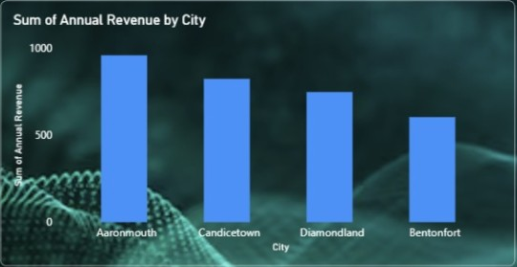
Annual Revenue by City — Bar Comparison
CHART 04 • CITY COMPARISON
DASHBOARD VISUAL
WHAT THIS VISUAL TELLS US
Aaronmouth has the tallest bar among the four displayed cities.
Candicetown follows, then Diamondland, with Bentonfort lowest in the shown comparison.
The chart makes relative city-level revenue differences easy to scan.
Only four city labels are visible, so this may be a selected subset.
Use a city filter and consistent time window to investigate revenue gaps.
KEY TAKEAWAY • Aaronmouth leads the four-city comparison in the supplied visual.
INSIGHTS / 10

Slide 11
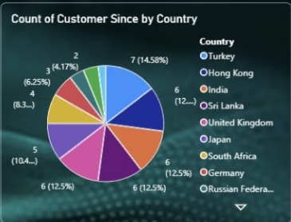
Customer Since by Country — Share of Records
CHART 05 • COUNTRY DISTRIBUTION
DASHBOARD VISUAL
WHAT THIS VISUAL TELLS US
The pie chart compares the displayed Customer Since measure across countries.
Turkey, Hong Kong and India are among the labelled country categories.
Several slices have similar sizes, suggesting the distribution spans multiple countries.
Check the title and measure: Customer Since may not be suitable to sum by country.
A distinct customer count by country would usually be easier to interpret.
KEY TAKEAWAY • Country shares are visible, but confirm the metric before interpreting them.
INSIGHTS / 11

Slide 12
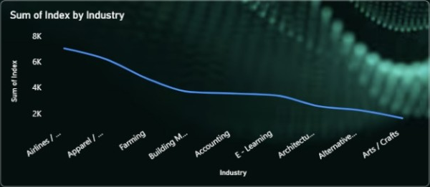
Index by Industry — Trend Across Categories
CHART 06 • INDUSTRY LINE CHART
DASHBOARD VISUAL
WHAT THIS VISUAL TELLS US
The line slopes downward overall across the industry categories shown.
The highest displayed index is at the left side, followed by a general decline.
Industry labels are truncated, limiting precise identification of every category.
A line chart implies continuity; a sorted bar chart may be clearer for independent categories.
Use full labels and a documented sort order for reliable comparisons.
KEY TAKEAWAY • The index decreases across the displayed sequence; a sorted bar chart may be clearer.
INSIGHTS / 12

Slide 13
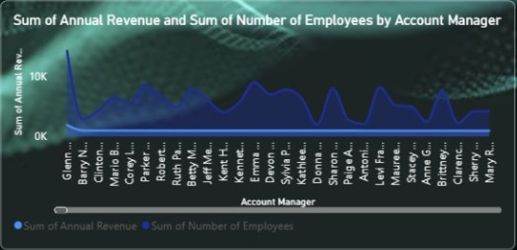
Account Manager — Revenue & Employee Measures
CHART 07 • DUAL-SERIES LINE CHART
DASHBOARD VISUAL
WHAT THIS VISUAL TELLS US
Two series show annual revenue and number of employees across account managers.
Values vary by manager, with visible peaks and dips across the sequence.
The chart is dense and manager labels are rotated or truncated.
Revenue and employee totals may use different scales; verify axis treatment.
Try a shorter manager list, ranked bar chart or drill-through for detailed comparisons.
KEY TAKEAWAY • Manager-level variation is visible, but readability and scale alignment need review.
INSIGHTS / 13

Slide 14
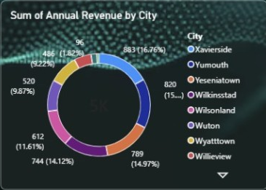
Annual Revenue by City — Donut Breakdown
CHART 08 • CITY CONTRIBUTION
DASHBOARD VISUAL
WHAT THIS VISUAL TELLS US
The donut presents city-level revenue contributions, with multiple cities represented.
The largest visible labelled segment is around 883 (16.76%), followed by 820 (about 15%).
The ring layout emphasizes share of the whole rather than precise comparisons.
Several city names appear in the legend, while smaller labels can be difficult to read.
Use a sorted bar chart when stakeholders need exact city-to-city ranking.
KEY TAKEAWAY • City contributions span several locations; a ranked bar chart improves precision.
INSIGHTS / 14

