Slide 1
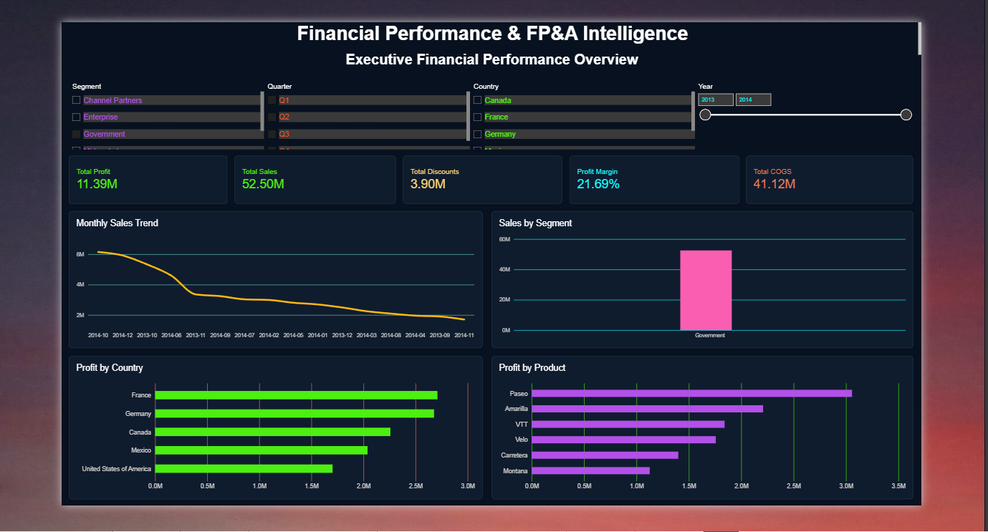
FINANCIAL PERFORMANCE
& BUSINESS INTELLIGENCE
A Power BI case study on revenue, profitability, risk and management decisions
THE CORE QUESTION
Where is the business
making money — and
where is profit under pressure?
SALES
PROFIT
MARGIN
LOSS RECORDS
118.73M
16.89M
14.23%
8.29%
Financial Performance & Business Intelligence

Slide 2
01
Why I built this
The idea was not to make another sales dashboard.
WHY?
WHAT?
WHICH / WHERE?
Sales alone don't tell the full story.
A 6-page financial intelligence dashboard
Which areas deserve attention?
• A business can have strong sales and still lose margin.
• Discounts can increase sales while putting pressure on profit.
• Management needs to know where to look next, not just what happened.
• Executive performance overview
• Revenue & profitability trends
• Segment, country & product analysis
• Profitability risk and discount exposure
• Management decision signals
• Global financial footprint
• Which segments drive profit?
• Which countries perform better?
• Which products create losses?
• Where is discount exposure highest?
• Where should management investigate?
Financial Performance & Business Intelligence

Slide 3
02
How I built it
From raw financial data to a decision-focused dashboard
01
Clean
02
Validate
03
Model
Parsed dates, cleaned fields and classified missing discount values.
Checked Sales = Gross Sales − Discounts and Profit = Sales − COGS.
Built Date, Product, Country and Segment dimensions around the fact table.
04
Measure
05
Analyze
06
Design
Created DAX KPIs for sales, profit, margin, discounts, loss rate and time intelligence.
Compared trends, segments, countries, products and discount risk.
Turned the analysis into six pages with one clear business story.
Tools: Power BI • DAX • Power Query • Excel • Python
Financial Performance & Business Intelligence

Slide 4
03
Executive Overview
The first screen gives the full financial picture in one place.
WHAT THIS PAGE ANSWERS
The first screen gives the full financial picture in one place.
Key views
• Sales, profit and margin at a glance
• Monthly sales trend
• Segment, country and product view
• Starting point for management review
Financial Performance & Business Intelligence

Slide 5
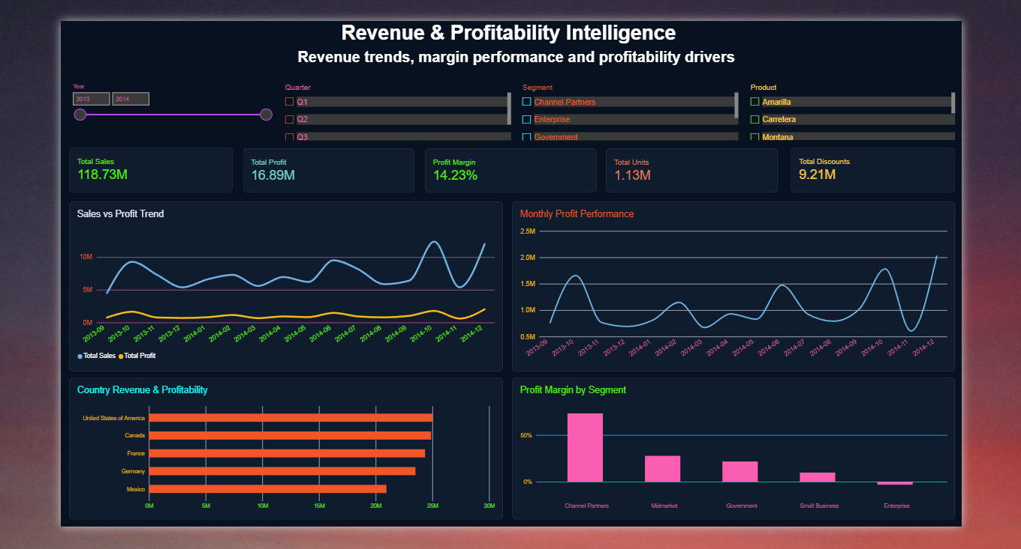
04
Revenue & Profitability
This page moves from headline numbers to trends and drivers.
WHAT THIS PAGE ANSWERS
This page moves from headline numbers to trends and drivers.
Key views
• Sales vs profit over time
• Monthly profit performance
• Country revenue & profitability
• Profit margin by segment
Financial Performance & Business Intelligence

Slide 6
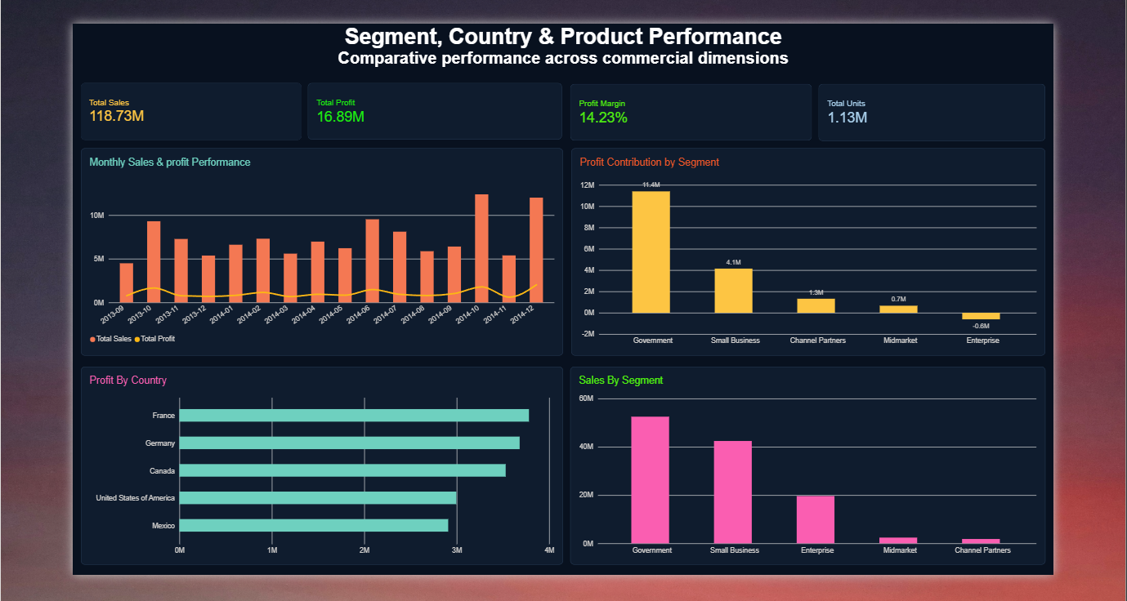
05
Business Performance
A deeper look at the commercial dimensions behind the numbers.
WHAT THIS PAGE ANSWERS
A deeper look at the commercial dimensions behind the numbers.
Key views
• Monthly sales & profit
• Profit contribution by segment
• Country-level profit
• Sales mix across segments
Financial Performance & Business Intelligence

Slide 7
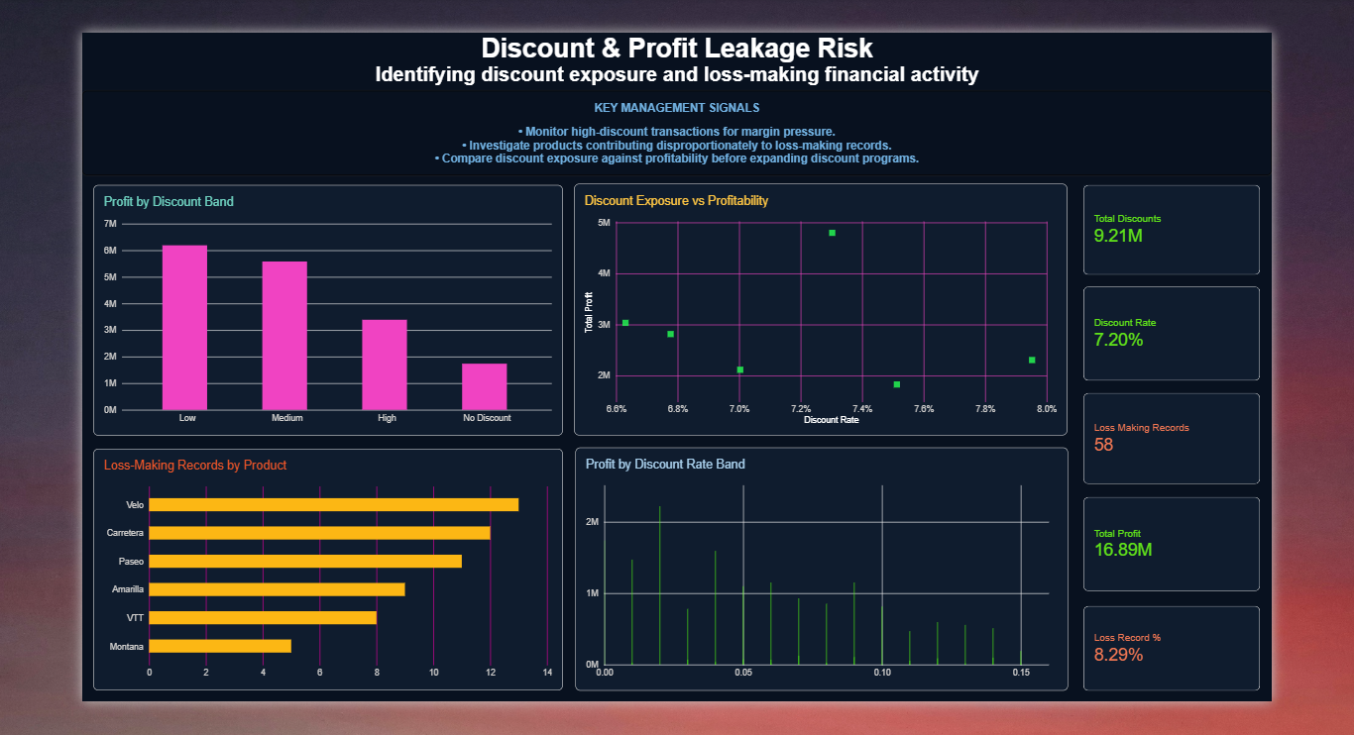
06
Profitability Risk
The focus shifts from growth to where profit may be under pressure.
WHAT THIS PAGE ANSWERS
The focus shifts from growth to where profit may be under pressure.
Key views
• Profit by discount band
• Discount exposure
• Loss-making records by product
• Profit by discount-rate band
Financial Performance & Business Intelligence

Slide 8
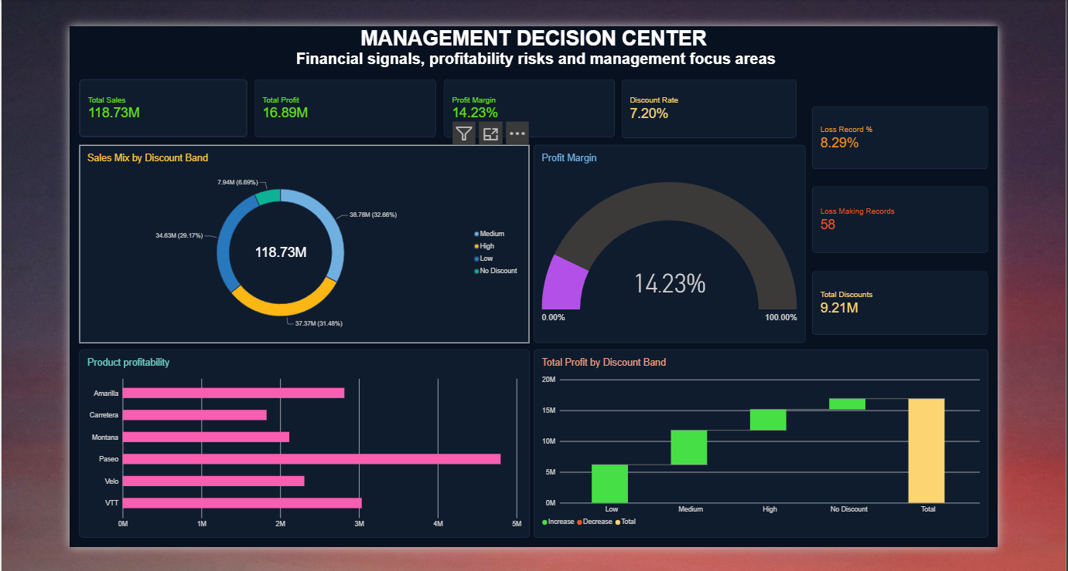
07
Management Decision Center
A compact page built around signals that need management attention.
WHAT THIS PAGE ANSWERS
A compact page built around signals that need management attention.
Key views
• Sales mix by discount band
• Current profit margin
• Loss and discount indicators
• Product profitability and profit contribution
Financial Performance & Business Intelligence

Slide 9
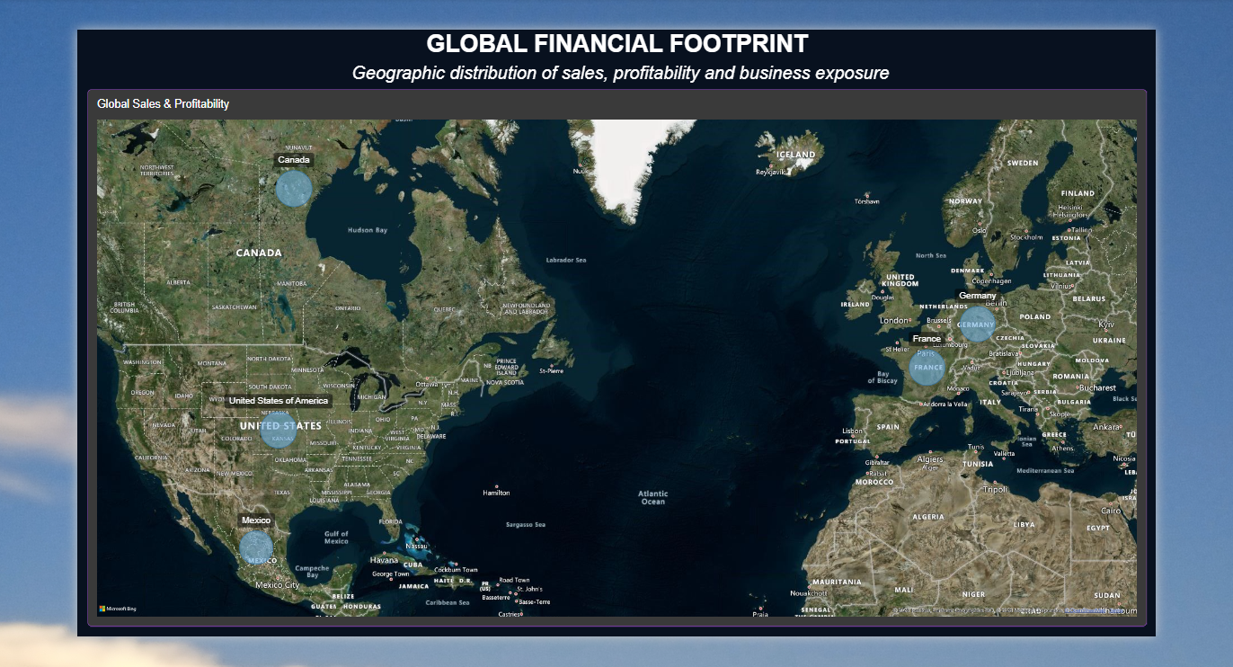
08
Global Financial Footprint
A geographic view of where the financial activity is happening.
WHAT THIS PAGE ANSWERS
A geographic view of where the financial activity is happening.
Key views
• Country-level sales markers
• Global distribution
• Financial exposure by geography
• Designed for a quick global read
Financial Performance & Busines Intelligence

Slide 10
09
What I got from the analysis
The point was not just to show numbers — it was to find where to ask better questions.
TOTAL SALES
TOTAL PROFIT
PROFIT MARGIN
DISCOUNTS
LOSS RECORD RATE
118.73M
16.89M
14.23%
9.21M
8.29%
BUSINESS SIGNALS
WHAT THIS PROJECT SHOWS
• Government was the strongest profit-contributing segment in the analysis.
• Paseo was the highest-profit product.
• France had the highest country-level profit.
• Discount bands showed clear differences in profitability.
• 58 records were loss-making, giving management a clear area to investigate.
• I can clean and validate data before building visuals.
• I can build a usable Power BI model and DAX KPI layer.
• I can move from reporting into profitability and risk analysis.
• I can present findings in a way that a business user can follow.
GitHub + interactive Power BI report →
Financial Performance & Business Intelligence

