Slide 1
Flight Booking lab Requirements
Provide shortest route from a source to destination
User friendly as user will be direct consumer
Should have access from geographically distributed locations
Scalable
Should be able to add/delete/update airports
Should be able to add/delete/update runways
Should be able to add/delete/update cities
Should be able to add/delete/update countries
Should be able to add/delete/update air line companies
Should be able to add/delete/update flights
Should cater for peak loads
Highly Available
Minimum down time
User Interface
Web portal
Mobiles
Tabs
Laptops
Desktops

Slide 2
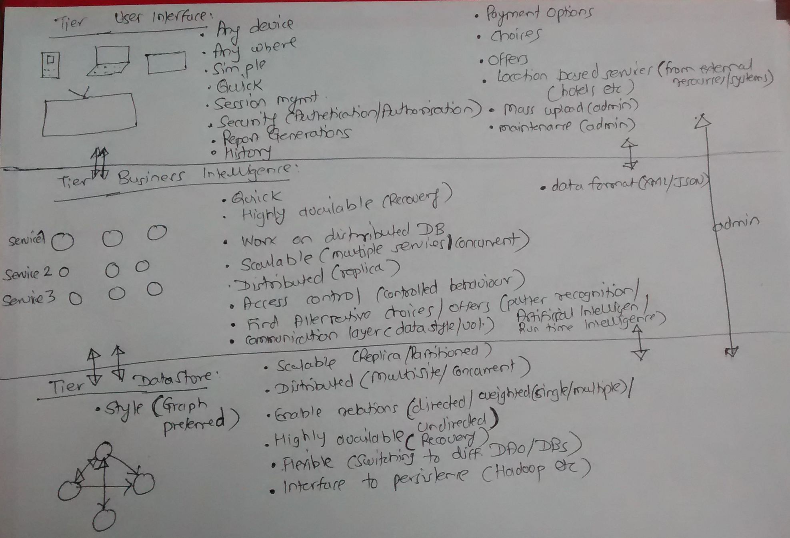
Solution :

Slide 3
Solution Details
Proposed solution is multi tiered
Different tiers would be :
Data Layer
Intelligence engine
User access layer

Slide 4
Data Layer
Proposed style is Graph styled Data Base as it enables directed / undirected / weighted relations
Should be scalable (Replica / Partitioned)
Distributed(Multisite / Concurrent transactions)
Should be able to have weighted (Single / multiple) relations (Directed / Undirected)
Should be highly available: minimum down time and recovery time
Flexible (Switching to different DAOs/ DBs/ low cost hard wares)
Interface to persistence (Hadoop etc.)

Slide 5
Business intelligence Layer
Response time should be in seconds (or less than a second or in mili seconds)
Highly available (minimum down time and recovery time)
Work on the top of distributed DBs
Scalable and load balancing (replica / concurrent processing)
Access control (controlled behavior)
Should provide alternatives / choices / offers (Pattern recognition, Run time intelligence)
Process high volume of requests
Data format (XML/JSON)
Session management
Location based additional services
Mass uploading of data
Maintenance

Slide 6
UI Layer
From Any device
From Any where
Simple, Quick response
Session management
Security (Authentication / Authorization) (UserName-Password/ MD5Hashes / certificates/ tokens)
Report Generation
History presentation
Payment options
Location based additional services (from external resources / systems)(hotels, cabs etc.)
Separate admin interface
Mass upload interface

Slide 7
Data Modelling : Entity relation diagram

Slide 8
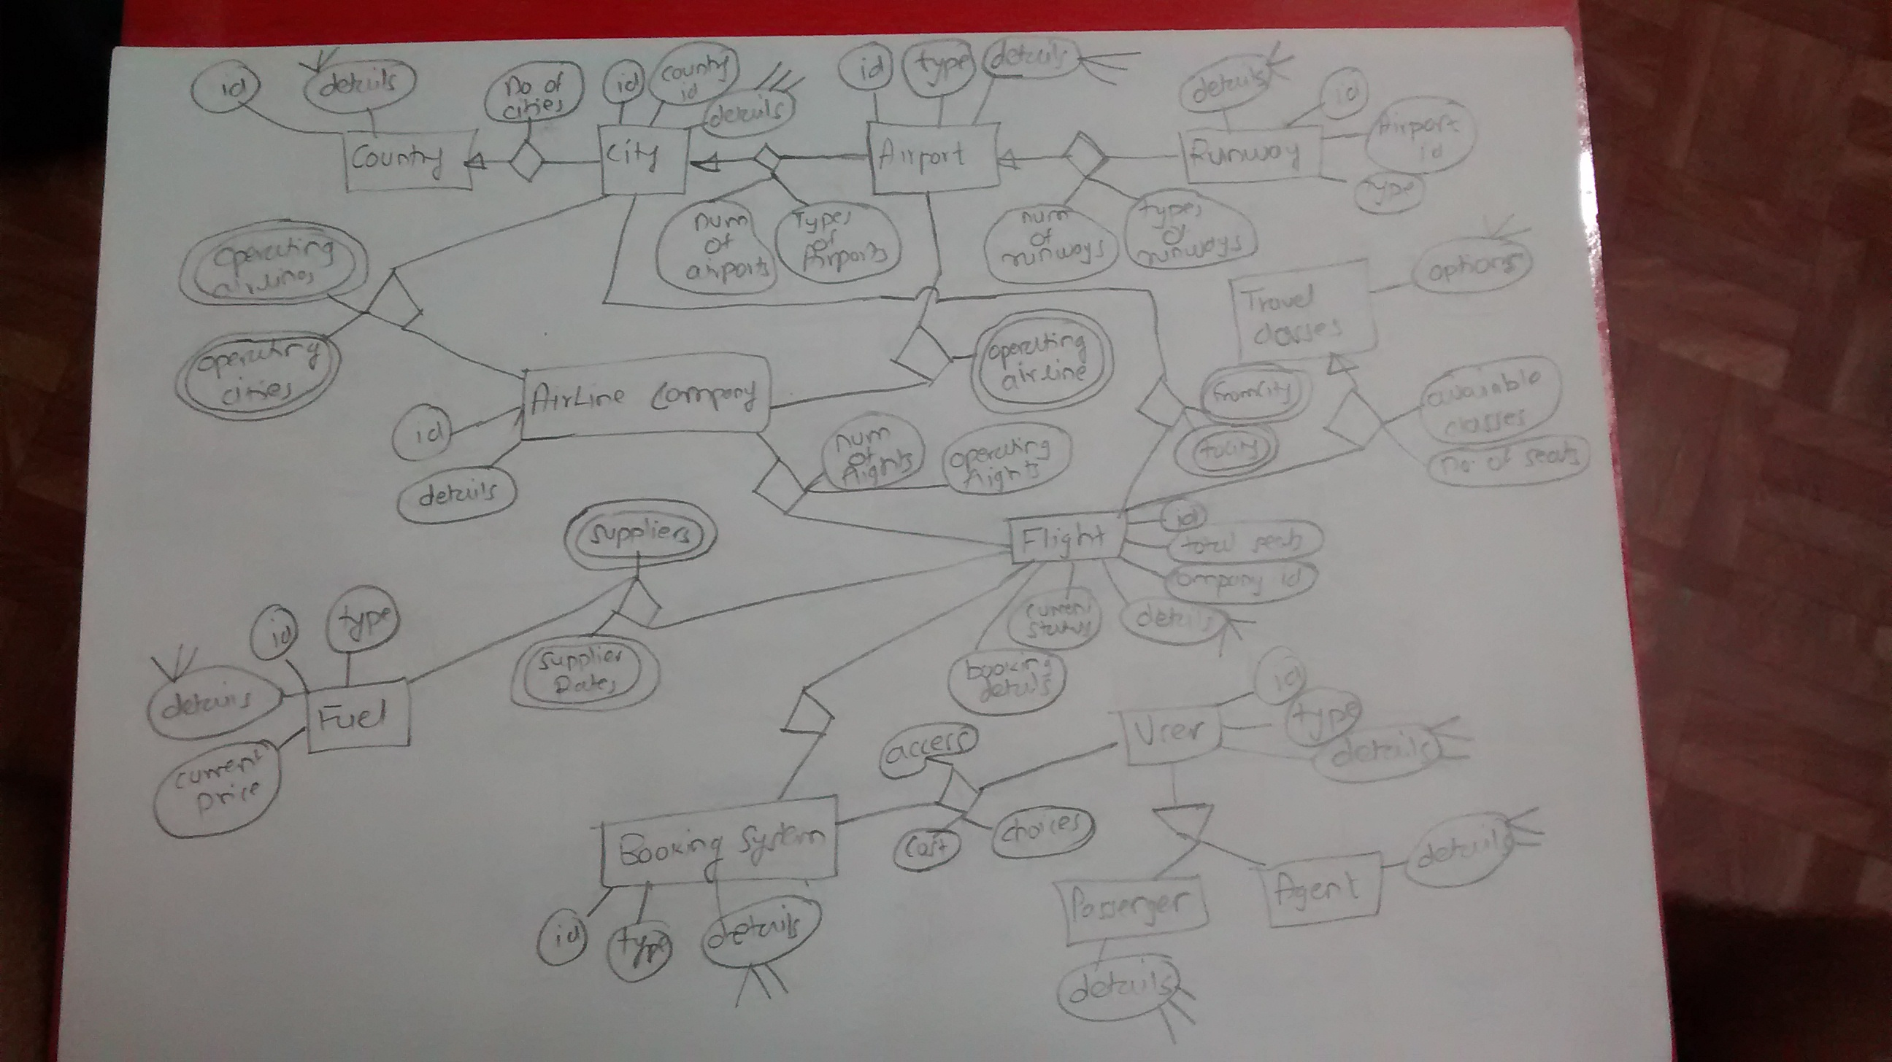

Slide 9
Solution Implementation

Slide 10
Assumptions
User should be able to load some data (JSON)
Should be able to specify weight for relations
Should be able to define air ports and their relations with weight
Should be built on standard / customized tools
Good to have persistence of model, but not must.
100 % modelling is not needed, just a prototype would do.
Weight defines: number of flights, cost and any other aspects that decides weightage to relation
Airports = nodes
Edges = route from first airport to second air port
Number of flights + fuel cost + …(criteria) = weight
Minimum weight path should be selected
Common data loading and queries specification format should be implemented (user preference and choices
In the sample Model provided in problem statement its seems to edges from ‘c’ to ‘e’ are invalid, as both of them indicate number of flights then it should be one edge from ‘c’ to ‘e’ with 5 + 4 = 9 as its weight. I have assumed this a correction.
Assuming highest weight where no flights exists

Slide 11
Common implementation
User should specify in user-inputs.txt
Data Nodes path
Queries
Sample
//Data Nodes PathDataFile=E:\FlightSystems\FlightSystem\files\nodes.json
//Queries:from and to destinations
FromNode---ToNode= 1 --- 4
FromNode---ToNode= 2 --- 4

Slide 12
Common implementation
Data mode should be specified in JSON format ( “to” represents destination to and weight pair)
Sample
[
[
{
"id":"1",
"to":[["2","2"],["3","3"],["4","100"]]
}
],
[
{
"id":"2",
"to":[["3","6"],["4","8"]]
}
],
[
{
"id":"3",
"to":[["4","1"]]
}
],
[
{
"id":"4",
"to":[["1","89"]]
}
]
]

Slide 13
Solution 1: Using Neo4j DB Instance with REST
Using Neo4J DB and using REST API
Model nodes (Airports)
Create relations
Add weights to relations
Specify and Process queries
Separates DB and Processing
Persists data after processing
MainNeoGraphRest.java has necessary starting point
Install Neo4j and start DB instance at 7474.

Slide 14
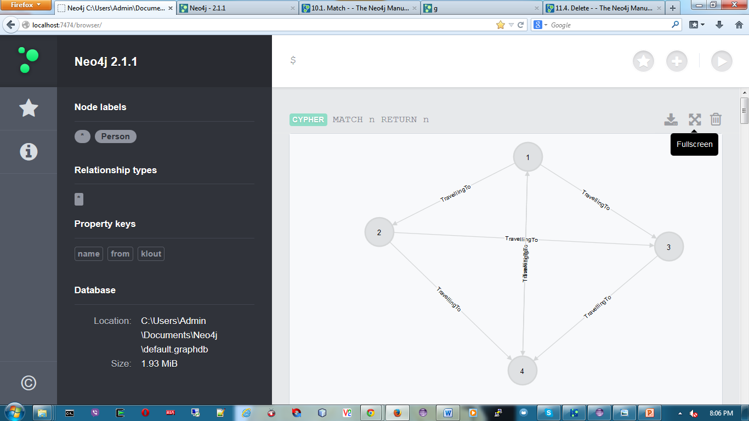
Solution 1 : Data model from Neo4j DB

Slide 15
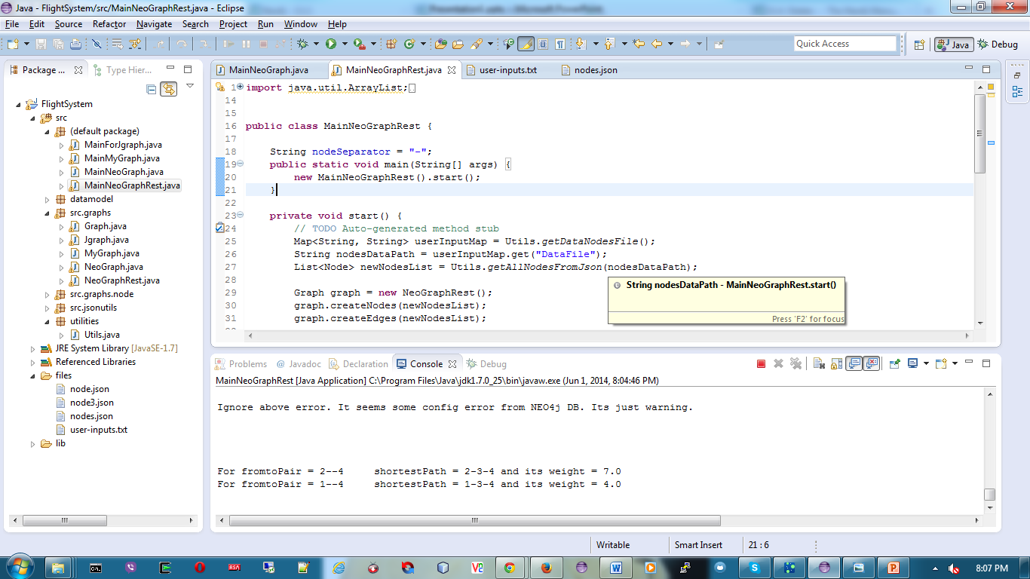
Solution 1 : Output from Eclipse

Slide 16
Solution 2 With Embedded Neo4j DB
In memory Graph modelling
Convenient where persistence is not needed but only processing
Graphing capacity available

Slide 17
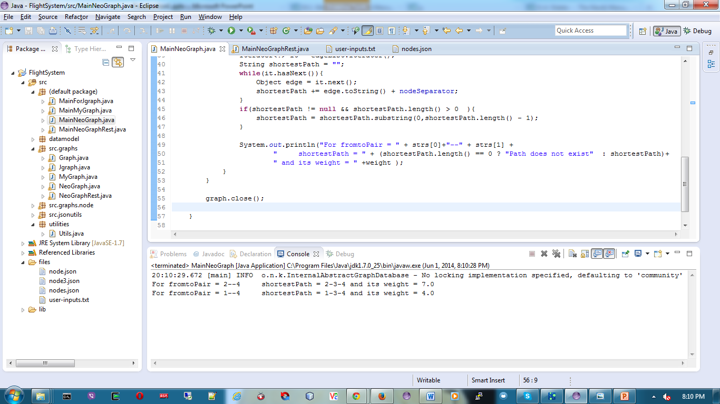
Solution 2 Output from eclipse

Slide 18
Solution 3 With JGraphT as library
In memory Graph modelling
No DB included
Convenient where persistence is not needed but only processing
Graphing capacity available
No UI representation

Slide 19
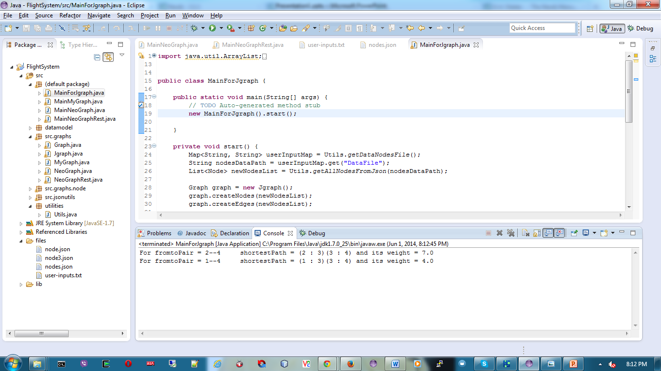
Solution 3: Eclipse output

Slide 20
Solution 4: My own Graph Implementation
Developed limited functionality
Fully customized
Persistence can be added
Useful where restriction are not to use third party tools.
In house maintenance

Slide 21
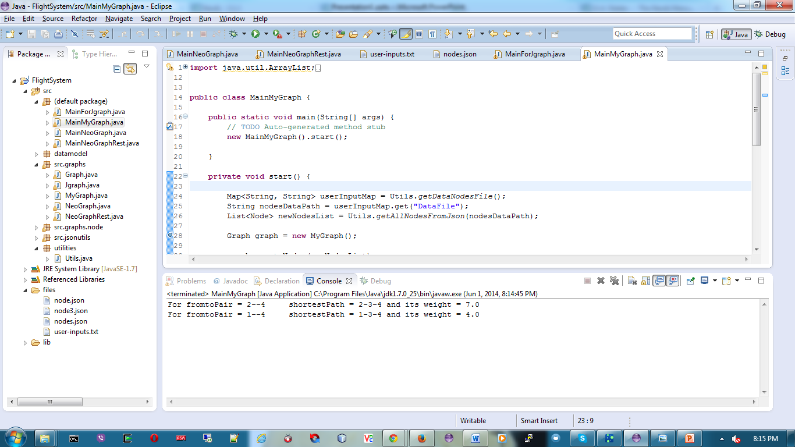
Solution 4: Eclipse output

Slide 22
Thank You and see snap shots for model stated in FlightBookingLab.doc ahead

Slide 23
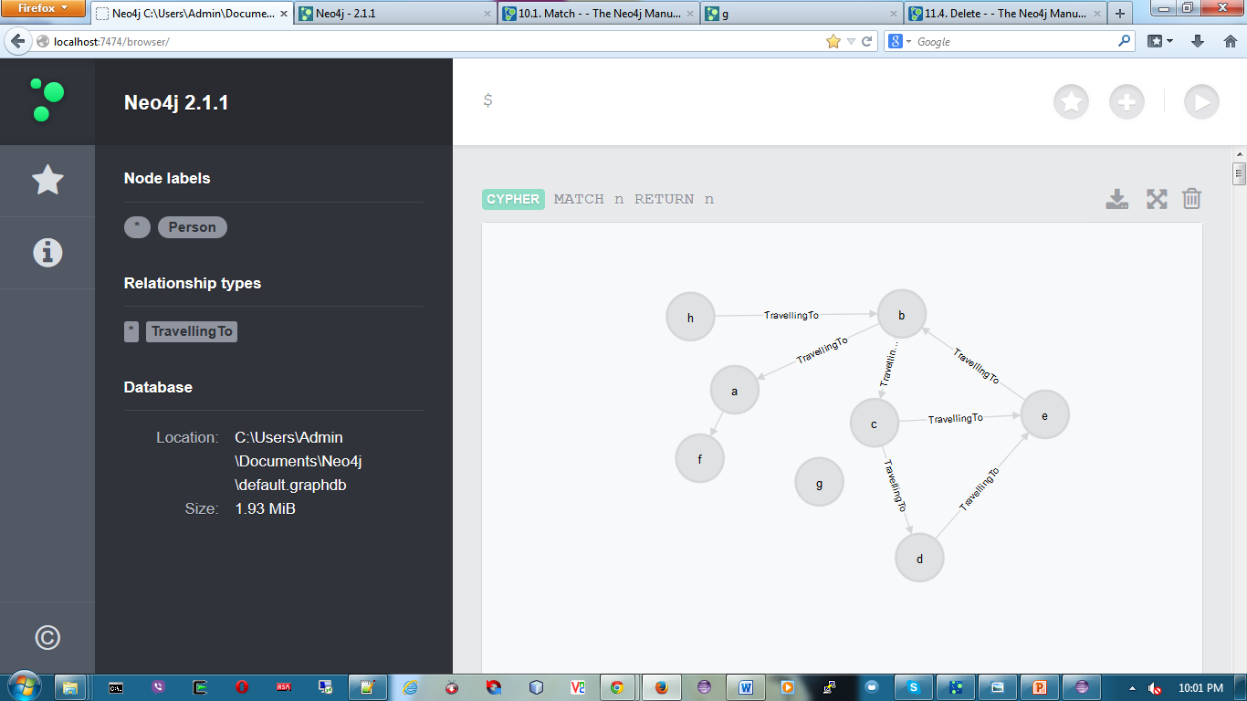

Slide 24
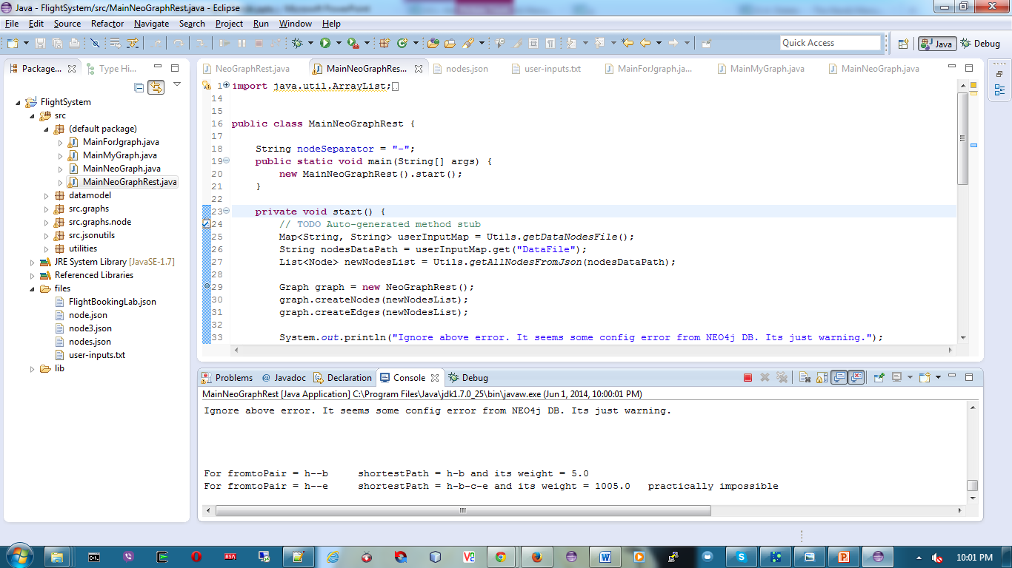

Slide 25


Slide 26
