Slide 1

APARTMENT LEASING SYSTEM
ATHARVA PANDE - 001556270
KSHITIJA SURYAVANSHI - 001539935
SANNIDHI SANNIDHI - 002109583
SHABANA MYDEEN ABDUL KADIR - 002109589

Slide 2
PROBLEM STATEMENT
Competitive renting market
Difficulty in maintaining and managing all tenant details
Tedious leasing process
Fradulent transactions due to lack of transparency

Slide 3
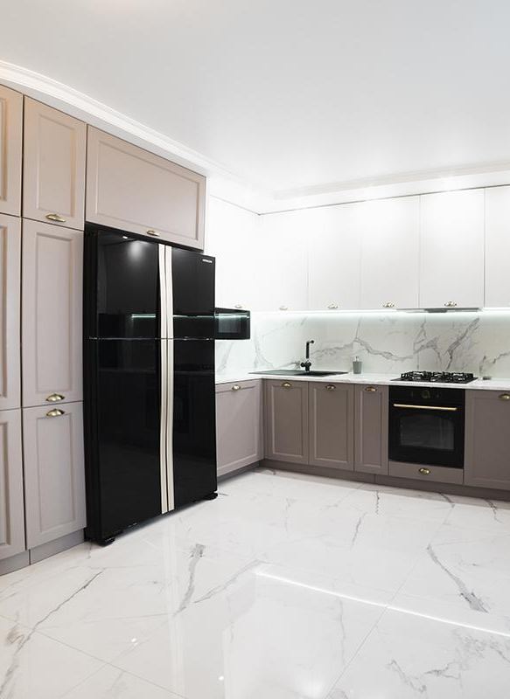
PROPOSED SOLUTION
Fully automated database to retrieve relevant data
Different user roles for optimized access control
Hassle free leasing experience
Reduce manual errors

Slide 4
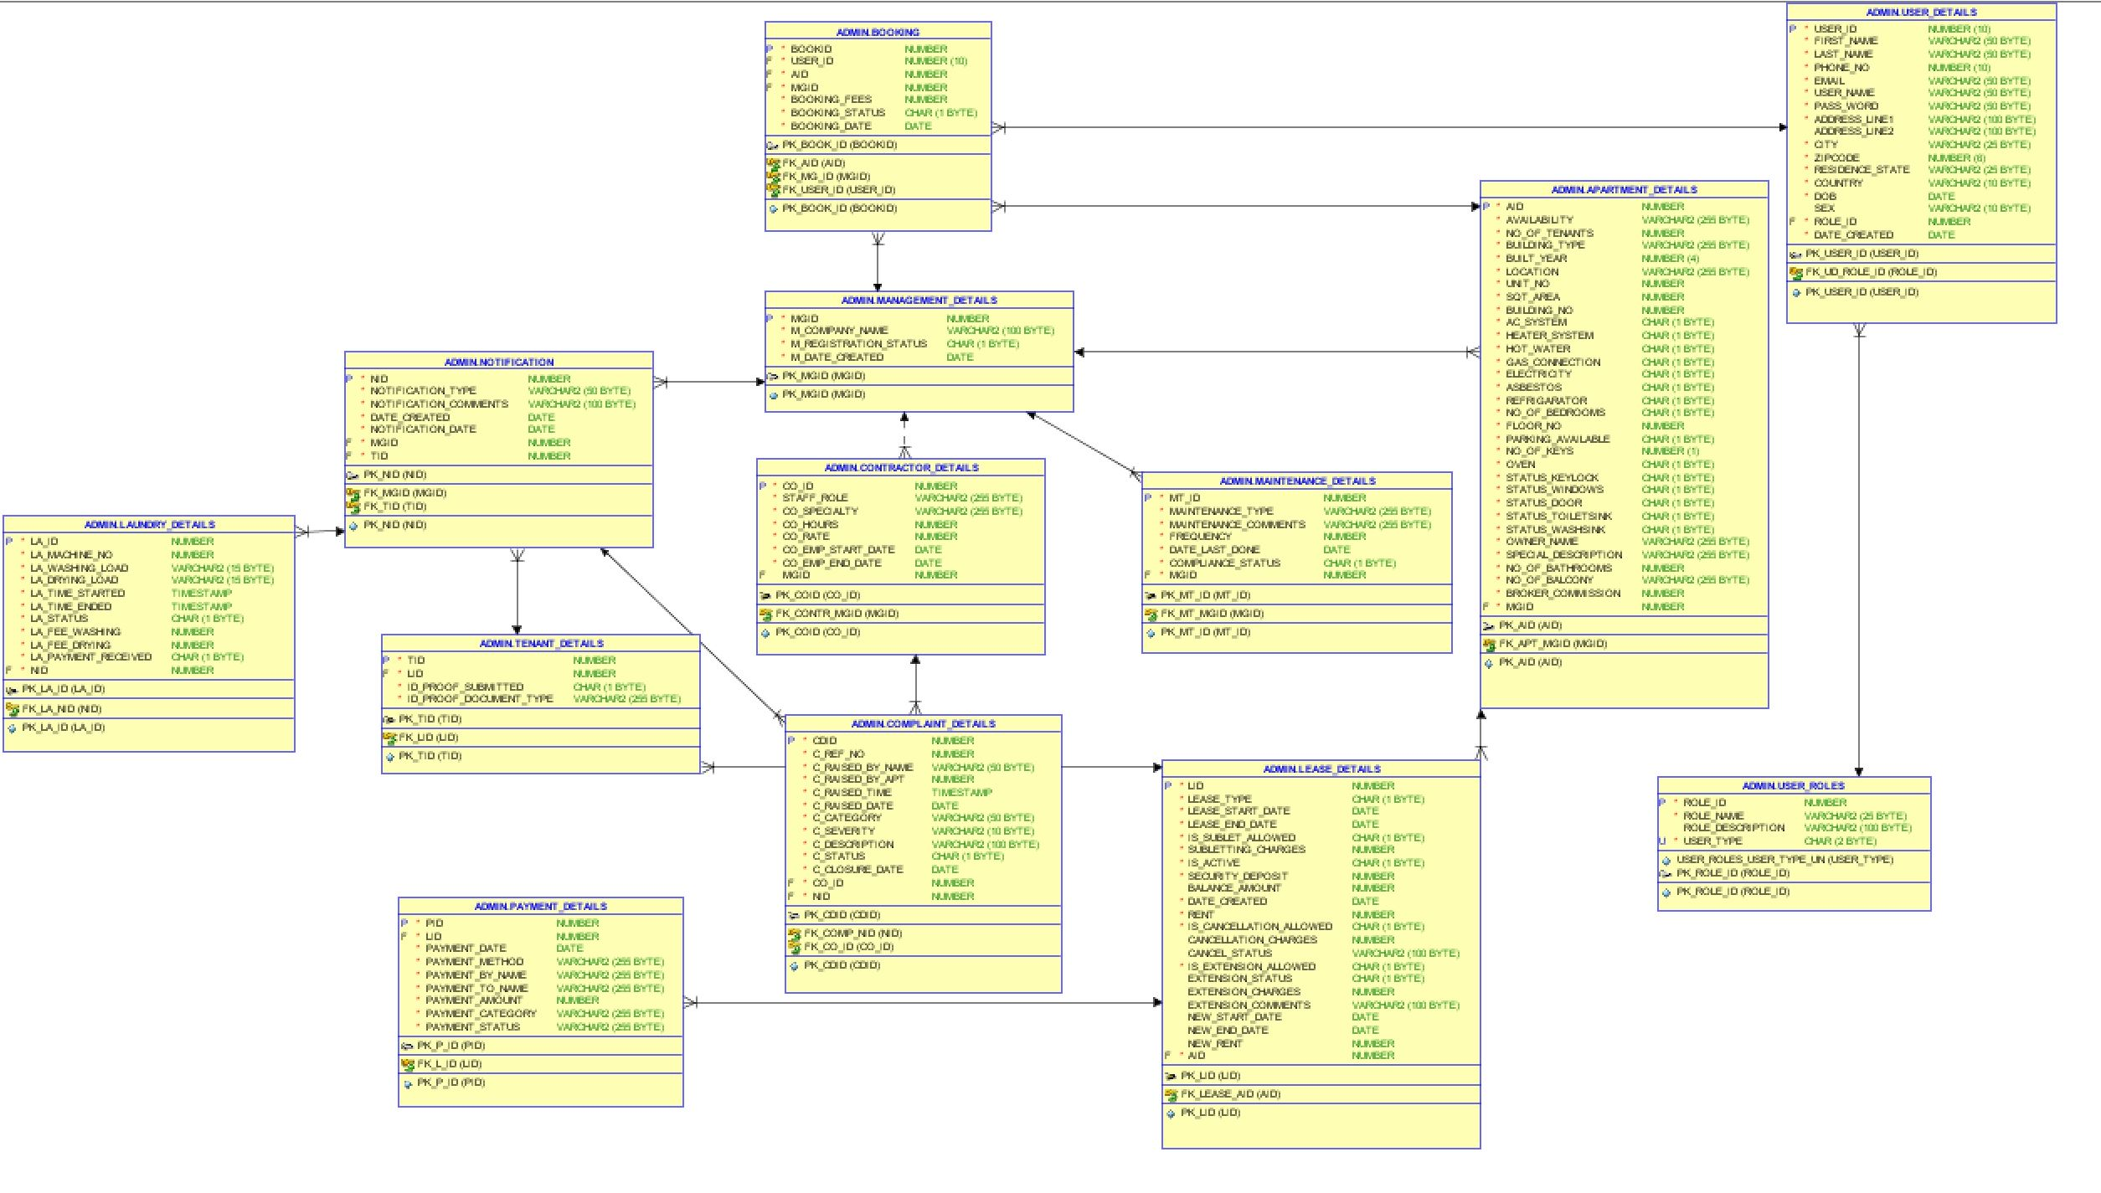
ERD

Slide 5
FEATURES
Procedures
Packages
Indexes
Triggers
Functions
Cursors
User roles
Views
Reports
Tables

Slide 6
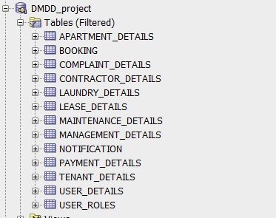
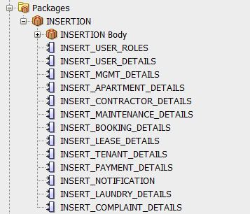
DB OBJECTS

Slide 7
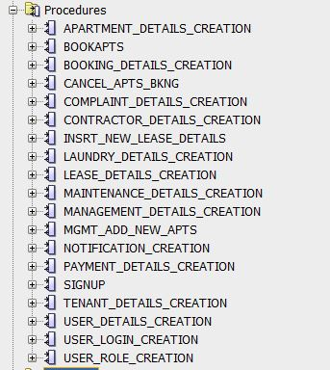
DB OBJECTS

Slide 8
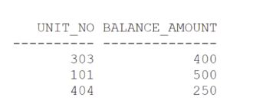
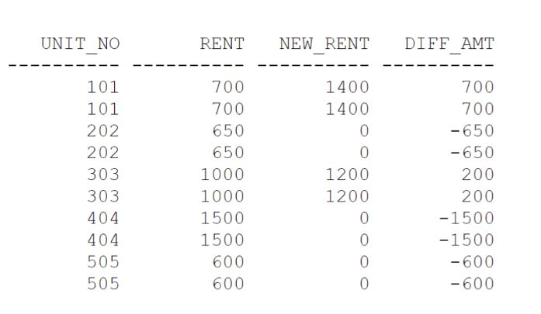
CHECKING OUTSTANDING BALANCE FOR APARTMENTS
REPORTS
DIFF BETWEEN CURRENT & NEW RENT

Slide 9
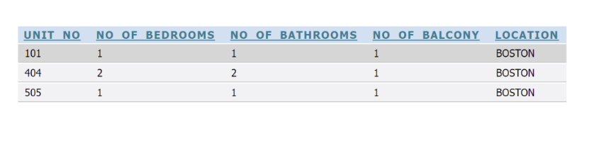
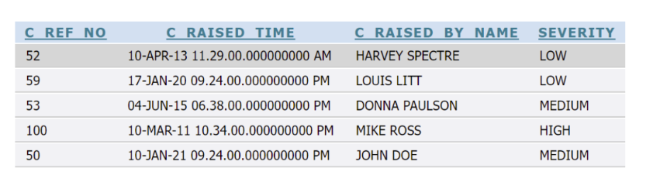
CHECK AVALIABLE APARTMENTS FOR BOOKING
CHECK COMPLAINT SEVERITY BY PERSON

Slide 10
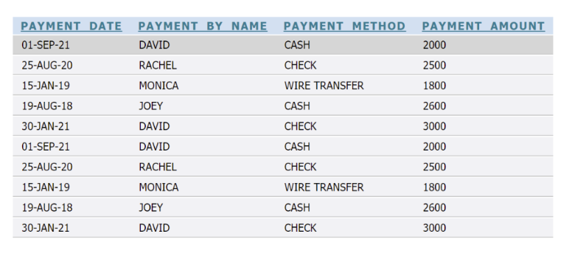
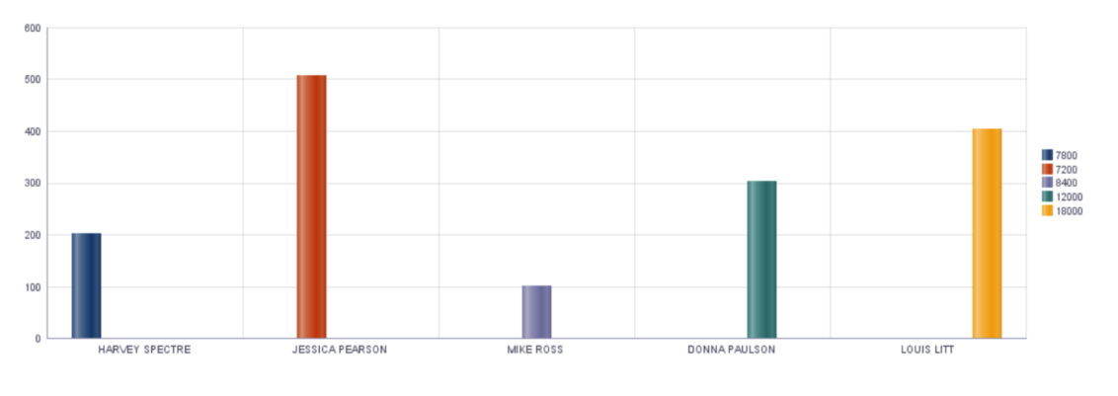
PAYMENT DONE BY EACH APARTMENT
YEARLY INCOME OF OWNERS APARTMENT WISE

Slide 11
CONTRIBUTIONS
ATHARVA PANDE
Table initialization, insertion packages, insert proc, business logic inserts, trigger, reports
KSHITIJA SURYAVANSHI
Table initialization, insertion packages, cancel proc, business logic inserts, access control, function, reports
SANNIDHI SANNIDHI
Role creation and User creation, insertion packages, update proc, business logic inserts, index
SHABANA MYDEEN ABDUL KADIR
Role creation and User creation, insertion packages, delete proc, business logic inserts, views

Slide 12
Thank you

