Slide 1
SQL

Slide 2
What Is SQL?
SQL-a structured query language,
It helps you to communicate with the database by commands
Features of SQL Database are as follows:
It allows users to extract data from relational database
It allows to create database and tables
It allows updating, inserting, deleting and altering database and tables
It provide security and allow to set a permission

Slide 3
Types of SQL Commands
SQL commands are traditionally divided into four categories:
Data Query Language (DQL)
Data Definition Language (DDL)
Data Manipulation Language (DML)
Data Control Language (DCL)

Slide 4
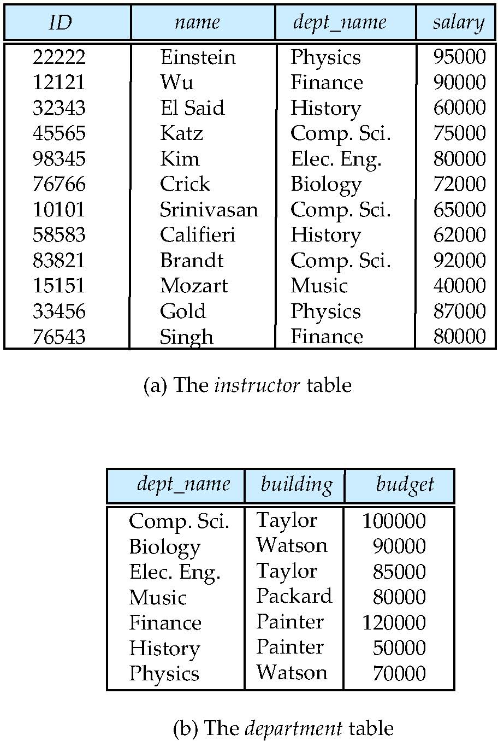
Relational Model
All the data is stored in various tables.
Example of tabular data in the relational model
Columns
Rows
Notes:
4

Slide 5
Table in SQL
Field:
It is a column in a table that is designed to maintain specific information about every record in the table
Record or Row:
A row of data is each individual entry that exists in a table
Column:
A vertical entity in a table that contains all information associated with a specific field in a table

Slide 6

Create, Use and Drop a Database
CREATE DATABASE databasename;
Create
Use
USE databasename;
Drop
DROP DATABASE databasename;

Slide 7
Create Table
Creating a table which involves naming the table
Defining its columns which are part of the table
Assigning a data type to each column
CREATE TABLE table_name(
column1 datatype,
column2 datatype,
column3 datatype,
……..
columnN datatype,
PRIMARY KEY (one or more columns));

Slide 8
Insert into Table
INSERT INTO TABLE_NAME VALUES (value1, value2, …..valueN);

Slide 9
Drop Table
DROP TABLE table_name;

Slide 10
Delete from Table
DELETE
FROM table_name;
All values
DELETE
FROM table_name
WHERE condition;
Selective values with condition

Slide 11
Select from Table
SELECT *
FROM table_name;
All values
Selective values
SELECT column1, column2 …columnN
FROM table_name;
SELECT column1, column2 …columnN
FROM table_name
WHERE condition;
Selective values with condition

Slide 12
SELECT DISTINCT
SELECT DISTINCT column1,column2….
FROM table_name
WHERE [condition];

Slide 13
Data Types in SQL
Data type defines what kind of data a column can hold
It handles:
Numeric Data
Date and Time Data
Character and String Data
Binary Data
Miscellaneous Data Types

Slide 14
Numeric Data Types
Datatype | From | To
bit | 0 | 1
tinyint | 0 | 255
smallint | -32,768 | 32,767
int | -2,147,483,648 | 2,147,483,647
bigint | -9,223,372,036, 854,775,808 | 9,223,372,036, 854,775,807
decimal | -10^38 +1 | 10^38 -1
numeric | -10^38 +1 | 10^38 -1
float | -1.79E + 308 | 1.79E + 308
real | -3.40E + 38 | 3.40E + 38

Slide 15
Date and Time Data Types
Datatype | Description
DATE | Stores date in the format YYYY-MM-DD
TIME | Stores time in the format HH:MI:SS
DATETIME | Stores date and time information in the format YYYY-MM-DD HH:MI:SS
TIMESTAMP | Stores number of seconds passed since the Unix epoch (‘1970-01-01 00:00:00’ UTC)
YEAR | Stores year in 2 digit or 4 digit format. Range 1901 to 2155 in 4-digit format. Range 70 to 69, representing 1970 to 2069.

Slide 16
Character and String Data Types
Datatype | Description
CHAR | Fixed length with maximum length of 8,000 characters
VARCHAR | Variable length storage with maximum length of 8,000 characters
VARCHAR(max) | Variable length storage with provided max characters, not supported in MySQL
TEXT | Variable length storage with maximum size of 2GB data

Slide 17
Binary Data Types
Datatype | Description
BINARY | Fixed length with maximum length of 8,000 bytes
VARBINARY | Variable length storage with maximum length of 8,000 bytes
VARBINARY(max) | Variable length storage with provided max bytes
IMAGE | Variable length storage with maximum size of 2GB binary data

Slide 18
Miscellaneous Data Types
Datatype | Description
CLOB | Character large objets that can hold up to 2GB
BLOB | For binary large objects
XML | for storing xml data
JSON | for storing JSON data

