Slide 1
Customer retention & churn insights
MavenFlix
Subscription Analysis
Rakshit Pandey

Slide 2
Executive summary
3069
1065
2004
77 days
15.9%
78.6%
Total Subscriptions
Active Customers
Churned Customers
Avg Duration
Month-Over-Month Retention
5+ Months
Github Repository: https://www.github.com/pandey-rakshit/mavenflix-analytics/
Key takeaway
High churn rate (65.3%) with most customer leaving within first 2 months. Only 15.9% stay beyond 5 months, indicating early-stage retention problem

Slide 3
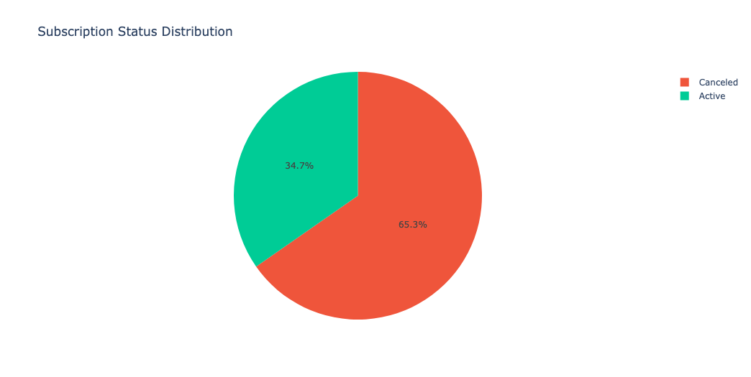
Subscription status Overview
2877
192
Unique customers
Repeat subscriptions((6’26%)
65% of all subscriptions have been canceled
Only 34.7% customers remain active
For every 3 customers acquired, 2 have left
Indicates a significant retention problem
The high cancellation rate signals an urgent need to understand and address the root cause driving customers away.

Slide 4
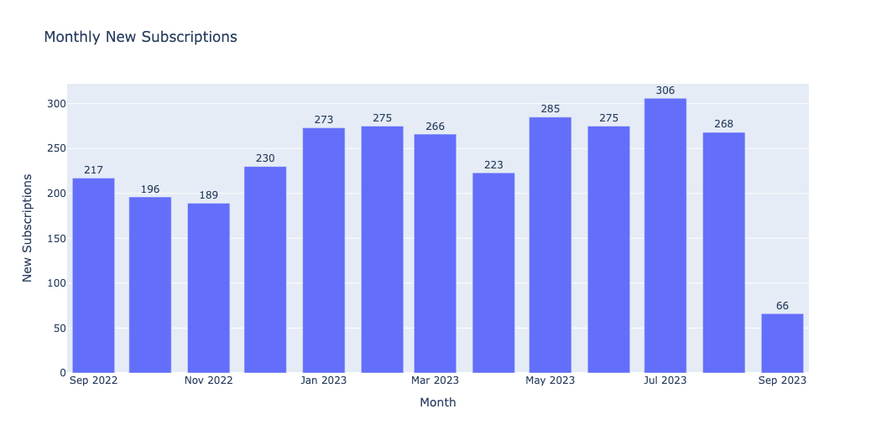
Monthly New Subscriptions
Acquisition ranged from 189 (Nov 2022) to 306 (Jul 2023)
Upward trend in 2023 compared to late 2022
July 2023 was the peak month
Sep 2023 is incomplete (66)

Slide 5
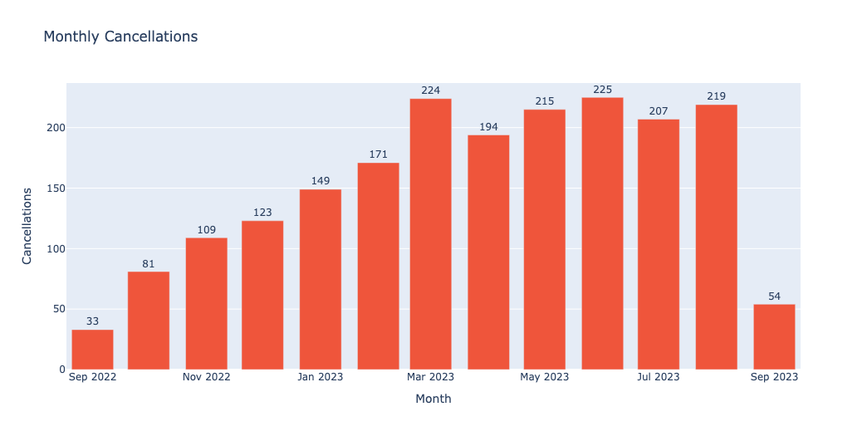
Monthly Cancellations
7x increase over the year
Cancellations grew from 33 (sep 2022) to 225 (Jul 2023)
Peak Month: Mar 2023 (224), July 2023 (225)
Churn got worse as customer base grew.

Slide 6
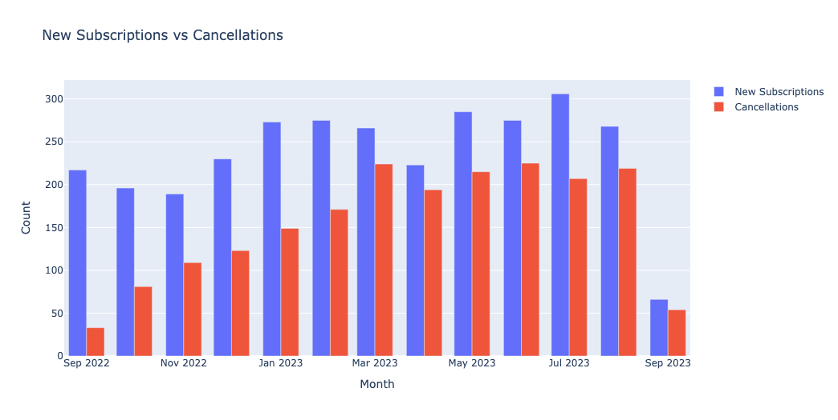
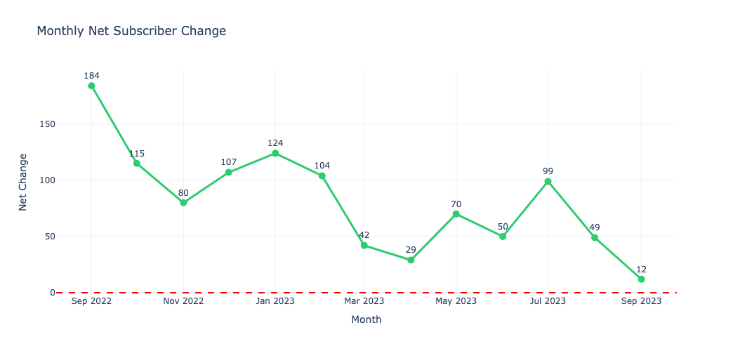
Acquisition vs. Cancellation patterns
Growth Despite challenges
Warning Signs
New subscription peaked at 306 in July 2023, while cancellations reached their high of 225 in June 2023
Cumulative net subscriber growth shows an upward trend, reaching 1065 active subscribers by September 2023 – a positive signal despite persistent churn
Net Change dropped from 184 (sep 2022) to 12 (Sep2023)
Growth is positive but declining
Lowest point: Apr 2023 (+19)

Slide 7
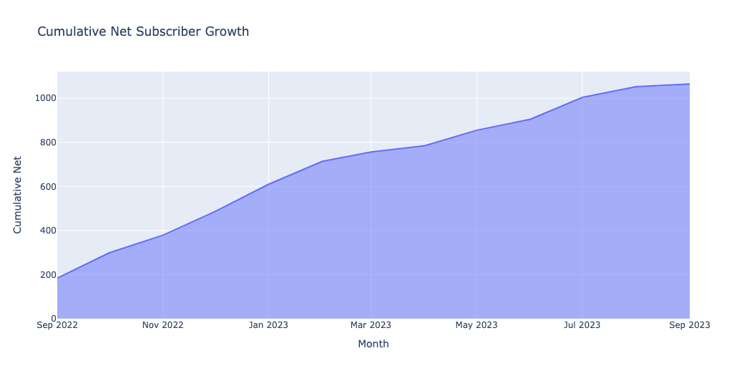
Cumulative Net Subscriber Growth
Subscriber base grewfrom ~200 to ~1065 over the year
5x growth in 12 months
Curve is flattering toward the end
Growth is decelerating

Slide 8
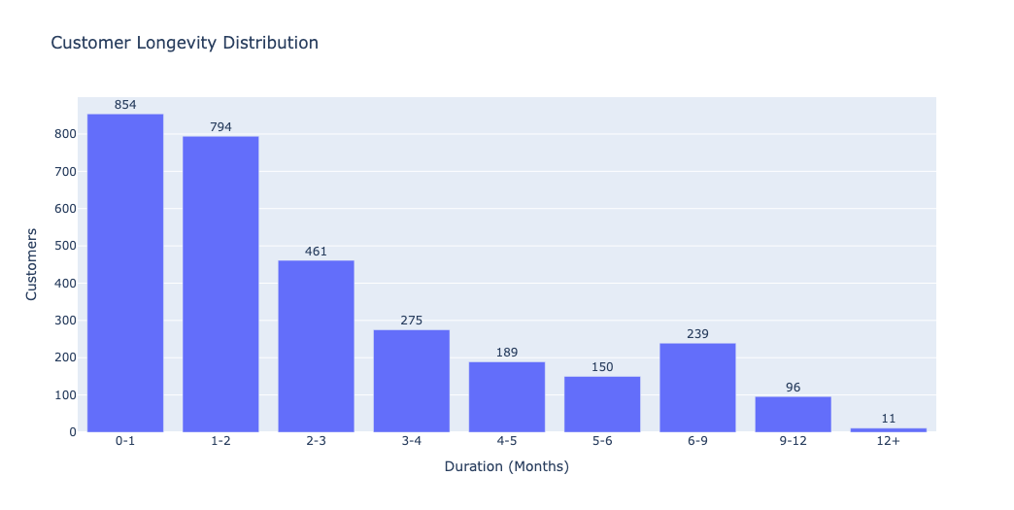
Customer longevity distribution
854 Customers
Churned within first month – the largest segment
77.2 Days
Average subscription duration (median: 52 days)
16.16%
Only 496 customers maintain subscriptions for 5+ months

Slide 9
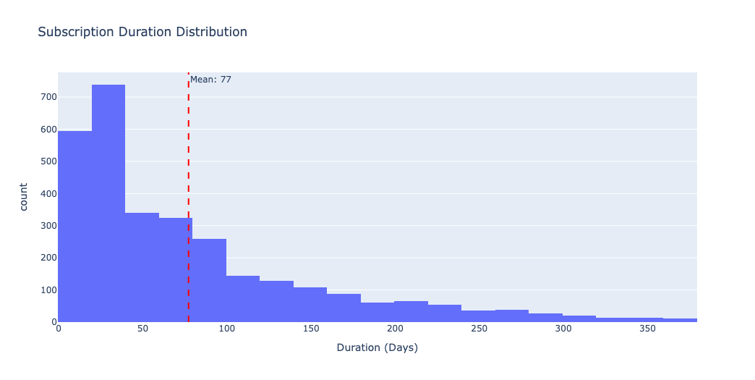
Subscription Duration Distribution
Mean duration: 77 days (~2.5 Months)
Distribution is heavily right skewed
Most subscriptions last 0-100 days
Very few last beyond 200 days

Slide 10
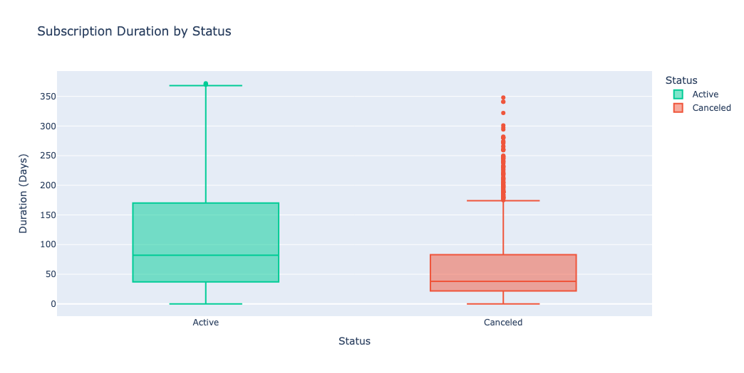
Subscription duration by status
Active median: ~90 days
Canceled Median: ~40 days
Canceled customers left within first 1-2 months
Active customers have been around longer

Slide 11
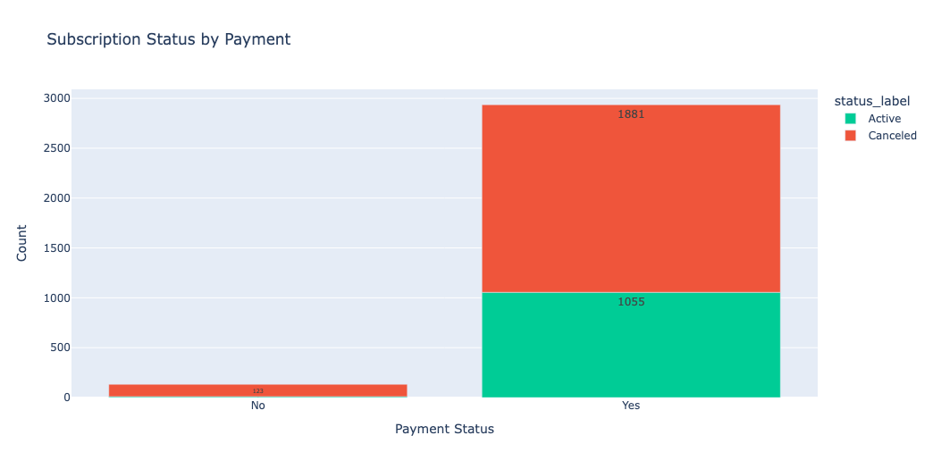
The Payment Problem
Paid subscriptions: 2,936 (1,055 active, 1,881 canceled)
Unpaid subscriptions: 133 (10 active, 123 canceled)
Unpaid churn rate: 92%
Paid churn rate: 64%

Slide 12
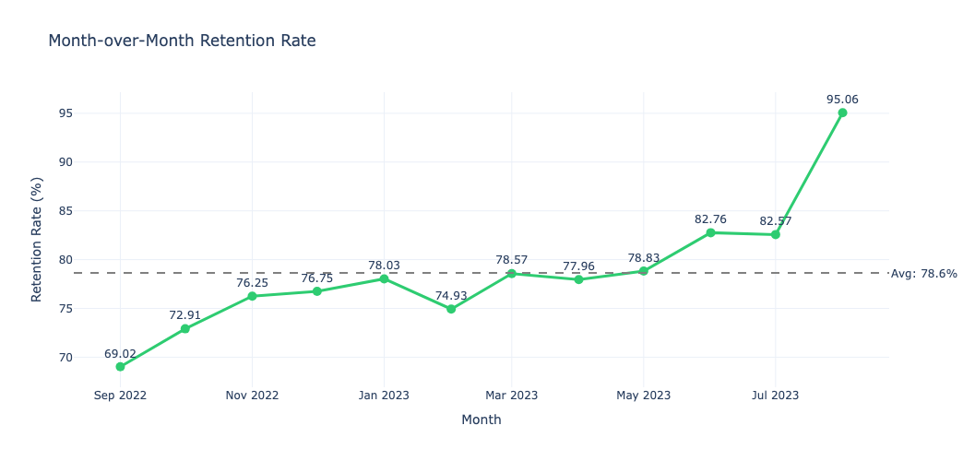
Month over Month Retention Rate
MoM retention improved from 69% (Sep 2022) to 95% (Aug 2023)
Average: 78.6%
Dip in Feb 2023 (74.93%)
Retention is improving over time

Slide 13
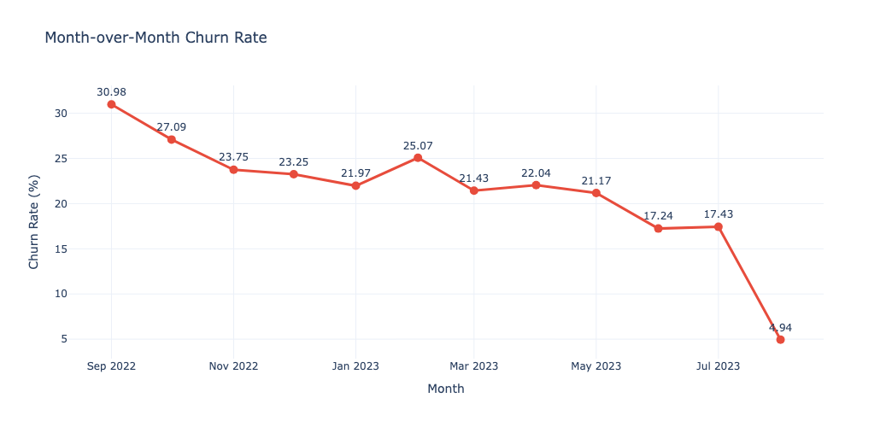
Month over Month churn RAte
MoM churn dropped from 31% (Sep 2022) to 5% (Aug 2023)
Peak churn: Feb 2023 (25%)
Clear downward trend
Whatever changed in mid-2023 is working

Slide 14
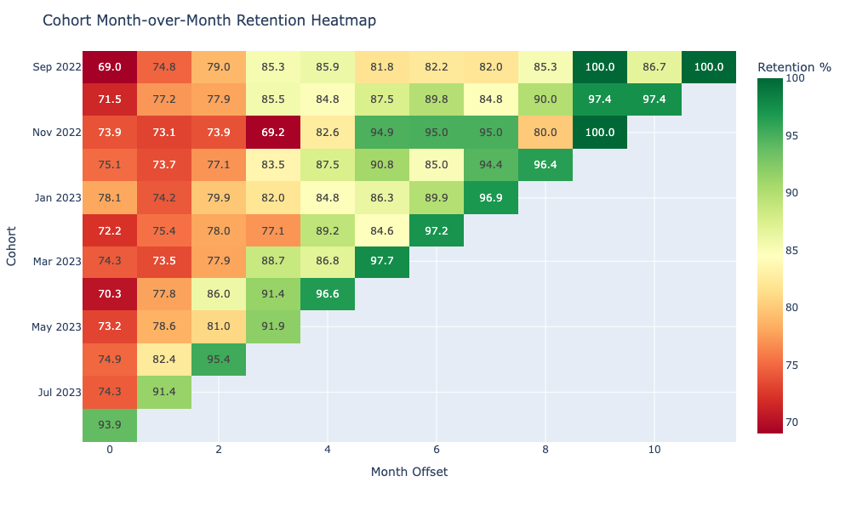
Cohort Month-over-Month Retention Heatmap
Older vs. Newer Cohorts
September 2022 cohort shows only 9.22% long-term retention, while recent cohorts demonstrate higher initial retention due to recency.
The September 2023 cohort shows 96.97% retention, but this is expected as they've had minimal time to churn.
Best retention: September 2023 (96.97%)
Worst retention: September 2022 (9.22%)
Clear pattern: retention degrades significantly over time

Slide 15
Month over Month stability
Average Churn: 78.64%
Persistent monthly churn rate
Average Retention: 21.36%
Month-over-month retention rate
The platform shows relatively stable month-over-month metrics. Best retention month was August 2023 (95.06%), while worst was September 2022 (69.02%). This consistency suggests systemic issues rather than seasonal fluctuations.

Slide 16
Key Findings
Finding | Evidence
High overall churn (65.3%) | Status distribution Chart
Early churn is critical | 54% leave within 2 months
First month retention is weakest | Heatmap shows 69-94% at offset 0
Retention is improving | MoM retention: 69% → 95%
Growth is slowing | Net change: +184 → +12
Payment is not the main issue | 64% of paid customers still churned

Slide 17
Top Recommendations
Focus on First 60 Days
Payment Recovery
Replicate Mid-2023
Problems
54% churn within 2 months
Action:
Improve Onboarding
Engagement emails
Personalized content
Why ?
Early churn is the biggest leak in the funnel
Problem:
92% unpaid subscriptions churm
Action:
Retry failed payments
Multiple payment methods
Dunning emails
Why?
Payment failures are preventable churn
Problem:
Need to understand success
Action:
Identify Jun-Aug changes
Document what worked
Scale successful tactics
Why ?
MoM retention jumped 78% - 95%

Slide 18
Additional Recommendations
Proactive Outreach to At-Risk Customers
Exit Surveys for Churned Customers
Loyalty Rewards for Long-Term Customers
Use duration and engagement data to predict churn
Intervene before month 2 with special offers or support
Why: Customers who survive first 2 months are 3x more likely to stay
Understand why customers leave
Identify product gaps or competitors
Why: Data shows WHAT is happening, surveys tell WHY
Only 15.9% stay 5+ months
Reward loyalty with exclusive content or discounts
Why: Retaining existing customers is cheaper than acquiring new ones

Slide 19
Assumptions
Data period: September 2022 to September 2023 (12 months)
September 2023 data is incomplete (partial month)
If canceled_date is null, customer is considered active as of September 8, 2023
Subscription duration calculated as: canceled_date - created_date (for churned) or reference_date - created_date (for active)
Reference date for active customers: September 8, 2023 (last date in data)
Duration in months approximated as: duration_days / 30
Cohort defined by subscription start month (created_date)
All subscriptions are monthly billing (subscription_interval = "month")
All subscriptions have same price ($39)

Slide 20
Thank you
Rakshit Pandey
inbox.rakshitpandey@gmail.com
Linkedin : https://www.linkedin.com/in/pandey-rakshit/
Github: https://www.github.com/pandey-rakshit/

