Slide 1
CONSTITUTION OF INDIA

Slide 2
OUTLINES
Module 1
Introduction and Basic Information about Indian Constitution
Meaning of the constitution law and constitutionalism, Historical Background of the Constituent Assembly, Government of India Act of 1935 and Indian Independence Act of 1947,Enforcement of the Constitution, Indian Constitution and its Salient Features, The Preamble of the Constitution, Fundamental Rights, Fundamental Duties, Directive Principles of State Policy, Parliamentary System, Federal System, Centre-State Relations, Amendment of the Constitutional Powers and Procedure, The historical perspectives of the constitutional amendments in India, Emergency Provisions: National Emergency, President Rule, Financial Emergency, and Local Self Government – Constitutional Scheme in India.

Slide 3
Preamble
Sovereign
Socialist
Secular
Democratic
Republic
Justice, Liberty, Equality, Fraternity

Slide 4
Parts of the Constitution (25)
Union & Its Territory
Citizenship
Fundamental Rights
Directive Principles of State Policy
Fundamental Duties
Union (Executive, Parliament, CAG)
States (Governor, Legislature, High Court)
Union Territories
Panchayats & Municipalities
Scheduled & Tribal Areas
Union–State Relations
Finance, Trade & Commerce
Services & Tribunals
Elections
Special Provisions for Certain Classes
Official Language
Emergency Provisions
Amendments, Transitional, Miscellaneous

Slide 5
Schedules (12)
States & Union Territories
Provisions for President, Governors, Judges
Oaths & Affirmations
Rajya Sabha Seats
Scheduled Areas & Tribes
Tribal Areas (NE States)
Union/State/Concurrent Lists
22 Official Languages
Validation of Certain Acts (9th Schedule)
Anti-defection Law
Panchayats
Municipalities

Slide 6
Key Features
Longest written Constitution
Federal with unitary bias
Parliamentary govt.
Independent Judiciary & Judicial Review
Fundamental Rights, Duties, DPSPs
Single Citizenship
Universal Adult Franchise
Emergency Provisions

Slide 7
Important Amendments
1st (1951): Ninth Schedule, land reforms
7th (1956): State Reorganisation
42nd (1976): Mini Constitution, Preamble changes
44th (1978): Safeguards after Emergency; property removed from FRs
61st (1989): Voting age 18
73rd & 74th (1992): Panchayati Raj & Municipalities
86th (2002): Right to Education
101st (2016): GST

Slide 8
Major issues
The Constitution was adopted by the Constituent Assembly on 26 Nov 1949 and came fully into force on 26 Jan 1950.
India is a Union of 28 States and 8 Union Territories.
Each state is administered by a Governor appointed by the President while each Union Territory is administered by the President through an Administrator or Lieutenant Governor (Art. 239).

Slide 9
Major Issues
The provisions relating to Citizenship, elections, provisional Parliament, temporary and transitional positions were given immediate effect on The 26th Nov.1949.
While the rest of the Constitution came into force on the 26th Jan. 1950. And this date is referred to in the Constitution as The Date of its Commencement.

Slide 10
Major Issues
The bicameral parliament is composed of the Council of States / Rajya Sabha, and the House of the People / Lok Sabha.
The Council of States i.e. Rajya Sabha or the permanent house has a maximum of 250 members (245 at present), of whom the President nominates 12 persons having special knowledge or practical experience in respect of literature, art, science and social service.
The remaining 238 seats are for representatives of the States (elected by MLAs) and of the Union Territories; one-third retire every second year.
The House of the People has a maximum of 550 members (Art. 81): up to 530 from the States and up to 20 from the UTs. Present strength: 543.

Slide 11
Major Issues
Six States have bicameral legislatures: Andhra Pradesh, Bihar, Karnataka, Maharashtra, Telangana and Uttar Pradesh. The others are unicameral.
In Legislative Councils, one-third of the members retire every two years. Legislative Assemblies are chosen by direct election.

Slide 12
Constitution – Making
The Constituent Assembly which had been elected for undivided India and held its first sitting on 9th Dec.1946, re-assembled on the 14th August 1947, as The Sovereign Constituent Assembly for the dominion of India.
In regard to its composition the members were elected by indirect election by the members of The Provisional Legislative Assemblies (lower house only).

Slide 13
Constitution – Making
Each Province and each Indian State or group of States were allotted the total no. of seats proportional to their respective population roughly in the ratio of 1:1000000.
As a result The Provinces were to elect 292 members while the Indian States were allotted a minimum of 93 seats.
The seats in each Province were distributed among the three main communities, Muslims, Sikh and general, in proportion to their respective populations.
Members of each community in the Provisional Legislative Assembly elected their own representatives by the method of proportional representations with single transferable vote.

Slide 14
Constitution – Making
Unfortunately as a result of a partition under the plan of June3, 1947.The territories, which fell under Pakistan and those members who were part of The Constituent Assembly, ceased to be members of the Constituent Assembly, which re-assembled on the 31st Oct.1947.
The Assembly's strength fell to 299. The Constitution was adopted on 26 Nov 1949, and 284 members signed it on 24 Jan 1950.

Slide 15
Historical Milestones
British Acts
  The Regulating Act 1773
  The Charter Act 1793
  The Charter Act 1813
  The charter Act 1833
  The charter Act 1853.
Regulating Act 1773: 1. Centralized administration in India (appointing a Gov. Gen. of Bengal with authority over other presidencies. 2. Limited the East India Company's dividend and restricted the terms of the Court of Directors. 3. Prohibited company officials from engaging in private trade or accepting bribes.
Charter Act 1793: 1. Extended the East India Company's charter by 20 years. 2. Increased the power of the Governor-General, allowing them to overrule the Council's decisions in certain cases.
Charter Act 1813: 1. Ended the Company's trade monopoly in India (except tea and the China trade); missionaries allowed. 2. Set aside Rs 1 lakh a year for education, literature and science.
Charter Act 1833: 1. Ended the Company's commercial functions; it became a purely administrative body. 2. Made the Governor-General of Bengal the Governor-General of India with central law-making power; no Indian to be barred from office by religion, birth or descent.
Charter Act 1853: 1. Introduced open competitive examination for the civil service. 2. Added a separate legislative wing with six legislative members to the Governor-General's Council.

Slide 16
Historical Milestones
British Paramountcy & End of company rule:
  End of company rule
  The First war of independence 1857
  The Govt. of India Act 1858
  The Indian Councils Act 1861
  Formation of Indian National Congress in 1885.
  The Indian Councils Act 1892.
  The split of Congress and demand for SWARAJ ( Self - Rule)
The Government of India Act, 1858, transferred the administration of India from the East India Company to the British Crown.
The Indian Councils Act, 1861, introduced legislative councils at the provincial level and allowed limited Indian participation in governance.
The Indian Councils Act, 1892, expanded the legislative councils and introduced indirect elections for non-official members.

Slide 17
Historical Milestones
  Surat Split of 1907 ; Indian National Congress divided into Moderates and Radicals.
  Division: The Indian National Congress split into two factions: the Moderates (Early Nationalists) and the Radicals (Extremists).
  Ideological Differences: Moderates: Favoured gradual reforms and constitutional methods to achieve self-government within the British Empire. Radicals: Advocated for more direct action and assertive methods to achieve self-rule, which was a more radical interpretation of Swaraj.
  Swaraj and its Significance
  Definition: Swaraj translates to self-governance or self-rule and was a core demand for Indian independence from foreign rule.
  Gandhi's Vision: Mahatma Gandhi later expanded on the concept of Swaraj, emphasizing the discarding of British institutions and the focus on individual and community self-governance.
  Impact of the Split: The 1907 split highlights the different approaches to achieving Swaraj within the Congress. The Radicals' push for more immediate and complete self-rule contributed to the evolving demand for Swaraj, eventually leading to the call for Purna Swaraj (complete independence).

Slide 18
Historical Milestones
Congress in Extremist phase:
  The Govt. of India Act 1909.
  The Govt. of India Act 1919.
  Jallian wallah Bagh tragedy 1919.
Advent of Gandhiji:
  Non Co-operation Movement 1920
  Simon Commission 1927
  Nehru Report 1928
  Civil disobedience 1930.
GoI Act 1909 (Morley-Minto Reforms):
Legislative councils at both central and provincial levels.
Separate electorates for Muslims. (introduced a communal divide)
Indians in Viceroy's Executive Council. (Satyendra Prasanna Sinha, first Indian member)
GoI Act 1919 (Montagu-Chelmsford Reforms):
Dyarchy (dual governance) in the provinces
  ”Transferred" (Indian ministers - Legislature)
  ”Reserved" (British Governor and Executive Council)
Bicameral legislature at the center.
Separate electorates to Sikhs, Anglo-Indians, Christians, and Europeans.
Jallianwala Bagh Tragedy (1919):
April 13, 1919, British troops under General Dyer
Hundreds killed and injured, Brutal Display of colonial repression.
Turning point, Indian resistance : Loss of faith in British intentions.

Slide 19
Historical Milestones
Congress in Extremist phase:
  The Govt. of India Act 1909.
  The Govt. of India Act 1919.
  Jallian wallah Bagh tragedy 1919.
Advent of Gandhiji:
  Non Co-operation Movement 1920
  Simon Commission 1927
  Nehru Report 1928
  Civil disobedience 1930.
Mahatma Gandhi and the Non-Cooperation Movement (1920):
Gandhi (1915) emerged; prominent leader, advocate of non-violent resistance.
The Jallianwala Bagh massacre & Khilafat issue resulted in launch of the Non-Cooperation Movement.
Boycotting British goods, institutions, and titles, mobilizing mass participation, including women and peasants.
Withdrawn by Gandhi after the Chauri Chaura incident (1922); it had broadened the base of the movement.
Simon Commission (1927):
Review the GoI Act 1919 and recommend reforms.
Entirely of British members, "Simon Go Back" slogan.
United various Indian political parties, leading to demands for self-governance.

Slide 20
Historical Milestones
Congress in Extremist phase:
  The Govt. of India Act 1909.
  The Govt. of India Act 1919.
  Jallian wallah Bagh tragedy 1919.
Advent of Gandhiji:
  Non Co-operation Movement 1920
  Simon Commission 1927
  Nehru Report 1928
  Civil disobedience 1930.
Nehru Report (1928):
Indian reply to Lord Birkenhead's challenge to frame their own constitution.
Dominion Status for India and proposed a federal system, responsible government, and fundamental rights.
Rejected Separate electorates, instead proposed joint electorates with reserved seats for minorities, which led to objections from the Muslim League.
Civil Disobedience Movement (1930):
Launched by Gandhi ; Salt March (Dandi March)
Mass protests, boycotts, non-payment of taxes and protest
International attention; highlighting British exploitation and mobilizing a vast section of Indian society.
Increasing calls for Purna Swaraj (complete independence), Official goal of the Indian National Congress in 1929.

Slide 21
Historical Milestones
Govt. of India Act 1935
  Backbone of our present Constitution
  Federation and provincial autonomy
  Diarchy at the centre
  A bicameral Central legislature created
  Distribution of powers between centre and provinces
Government of India Act of 1935
Comprehensive & Significant ; British Parliament for India
Simon Commission Report & Round Table Conferences + 1933 White Paper.
  Federal structure and division of powers
  All India Federation: Uniting British Indian Provinces and Princely states. Optional for the states ; Never fully implemented.
Legislative powers Federal, Provincial, and Concurrent lists
Viceroy's residuary powers: The Governor-General held residual powers to address matters not on the lists.
Changes in provincial and central governance
Provincial autonomy: Dyarchy was removed, Governors retained special powers.
Dyarchy at the Center: Dyarchy was proposed at the federal level (never implemented), dividing subjects into Reserved and Transferred categories, with the Governor-General managing Reserved subjects independently of the legislature.

Slide 22
Historical Milestones
Govt. of India Act 1935
  Backbone of our present Constitution
  Federation and provincial autonomy
  Diarchy at the centre
  A bicameral Central legislature created
  Distribution of powers between centre and provinces
Legislative and electoral changes
Bicameral legislature: The Act established bicameral legislatures at the federal level and in several provinces.
Expanded franchise
Extended communal electorates
  Federal Court: A Federal Court was created to resolve disputes, though the Privy Council in London remained the final authority.
  Reserve Bank of India (RBI): The RBI was established to manage currency and credit.
  Public Service Commissions: The Act provided for the establishment of various Public Service Commissions.
Separation of Burma: Burma was separated from India in 1937.
Reorganization of provinces: The Act led to the reorganization of certain provinces.

Slide 23
Historical Milestones
Demand for a constituent assembly :
  Demand for a constituent assembly
  The Act of 1935 failed to satisfy the Indian aspirations
  The idea came from M.N. Roy (1934); the Congress demanded it in 1935 and Nehru restated it in 1938.
A Constituent Assembly is a body of elected representatives whose primary purpose is to draft or revise a country's constitution.
The demand for a constituent assembly in India was a pivotal part of the Indian independence movement, symbolizing the aspiration for self-determination and the desire to frame a constitution created by and for the Indian people, free from foreign interference.
  Self-rule and the inadequacy of British-imposed constitutional frameworks in colonial India
  GoI Acts (1919 & 1935) Retained significant control.

Slide 24
Salient Features
Fundamental Rights
"A state is known by the rights it maintains“.
They are
Right to equality,
Right to freedom,
Right against exploitation,
Right to freedom of Religion,
Cultural and Educational rights and
Right to constitutional remedies.
Right to property (Article-31) originally a fundamental right was omitted by the 44th Amendment Act, 1978. It is now a legal right under Art. 300A.

Slide 25
Salient Features
Directive principles
It embodies important principles like
  Adequate means to livelihood,
  Equal pay for both men and women,
  Distribution of wealth so as to subserve the common good,
  Early childhood care and education up to age six (Art. 45),
  Right to work,
  Public assistance in case of old age,
  Unemployment,
  Sickness and disablement,
  The organisation of village Panchayats,
  Special care to the economically back ward sections of the people etc.

Slide 26
Salient Features
Fundamental Duties
These duties are:
  To abide by the Constitution and respect its ideals and institutions, the National Flag and the National Anthem;
  To cherish and follow the noble ideals, which inspired our national struggle for freedom;
  To uphold and protect the sovereignty, unity and integrity of India;
  To defend the country and render national service when called upon to do so;
  to promote harmony and the spirit of common brotherhood amongst all the people of India transcending religious, linguistic, regional or sectional diversities, to renounce practices derogatory to the dignity of woman.

Slide 27
Salient Features
Fundamental Duties
These duties are:
  To value and preserve the rich heritage of our composite culture;
  To protect and improve the natural environments including forests, lakes, rivers and wild life and to have compassion for living creatures;
  To develop scientific temper, humanism and the spirit of inquiry and reform;
  To safeguard public property and to abjure violence;
  To strive towards excellence in all spheres of individual and collective activity so that the nation constantly rises to higher levels of Endeavour and achievement.

Slide 28
Salient Features
Secular State
A secular state is neither religious nor irreligious, or anti - religious. Rather it is quite neutral in matters of religion. India being a land of many religions, the founding fathers of the Constitution thought it proper to make it a secular state. India is a secular state, because it makes no discrimination between individuals on the basis of religion. Neither it encourages nor discourages any religion.

Slide 29
An Independent Judiciary
The judiciary occupies an important place in our Constitution and it is also made independent of the legislature and the executive. The Supreme Court of India stands at the apex of single integrated judicial system. It acts as protector of fundamental rights of Indian citizens and guardian of the Constitution. If any law passed by the legislature or action taken by the executive contravenes the provisions of the Constitution, they can be declared as null and void by the Supreme Court. Thus, it has the power of judicial review.

Slide 30
Salient Features
Single Citizenship
The Constitution of India recognises only single citizenship. In the USA, a person is a citizen of both the Union and a State.

Slide 31
Preamble
PREAMBLE
WE, THE PEOPLE OF INDIA, having solemnly resolved to constitute India into a SOVEREIGN SOCIALIST SECULAR DEMOCRATIC REPUBLIC and to secure to all its citizens:
      JUSTICE, social, economic and political;
      LIBERTY of thought, expression, belief, faith and worship;
      EQUALITY of status and of opportunity; and to promote among them all
      FRATERNITY assuring the dignity of the individual and the unity and integrity of the Nation;
IN OUR CONSTITUENT ASSEMBLY this twenty-sixth day of November, 1949, do HEREBY ADOPT, ENACT AND GIVE TO OURSELVES THIS CONSTITUTION.

Slide 32
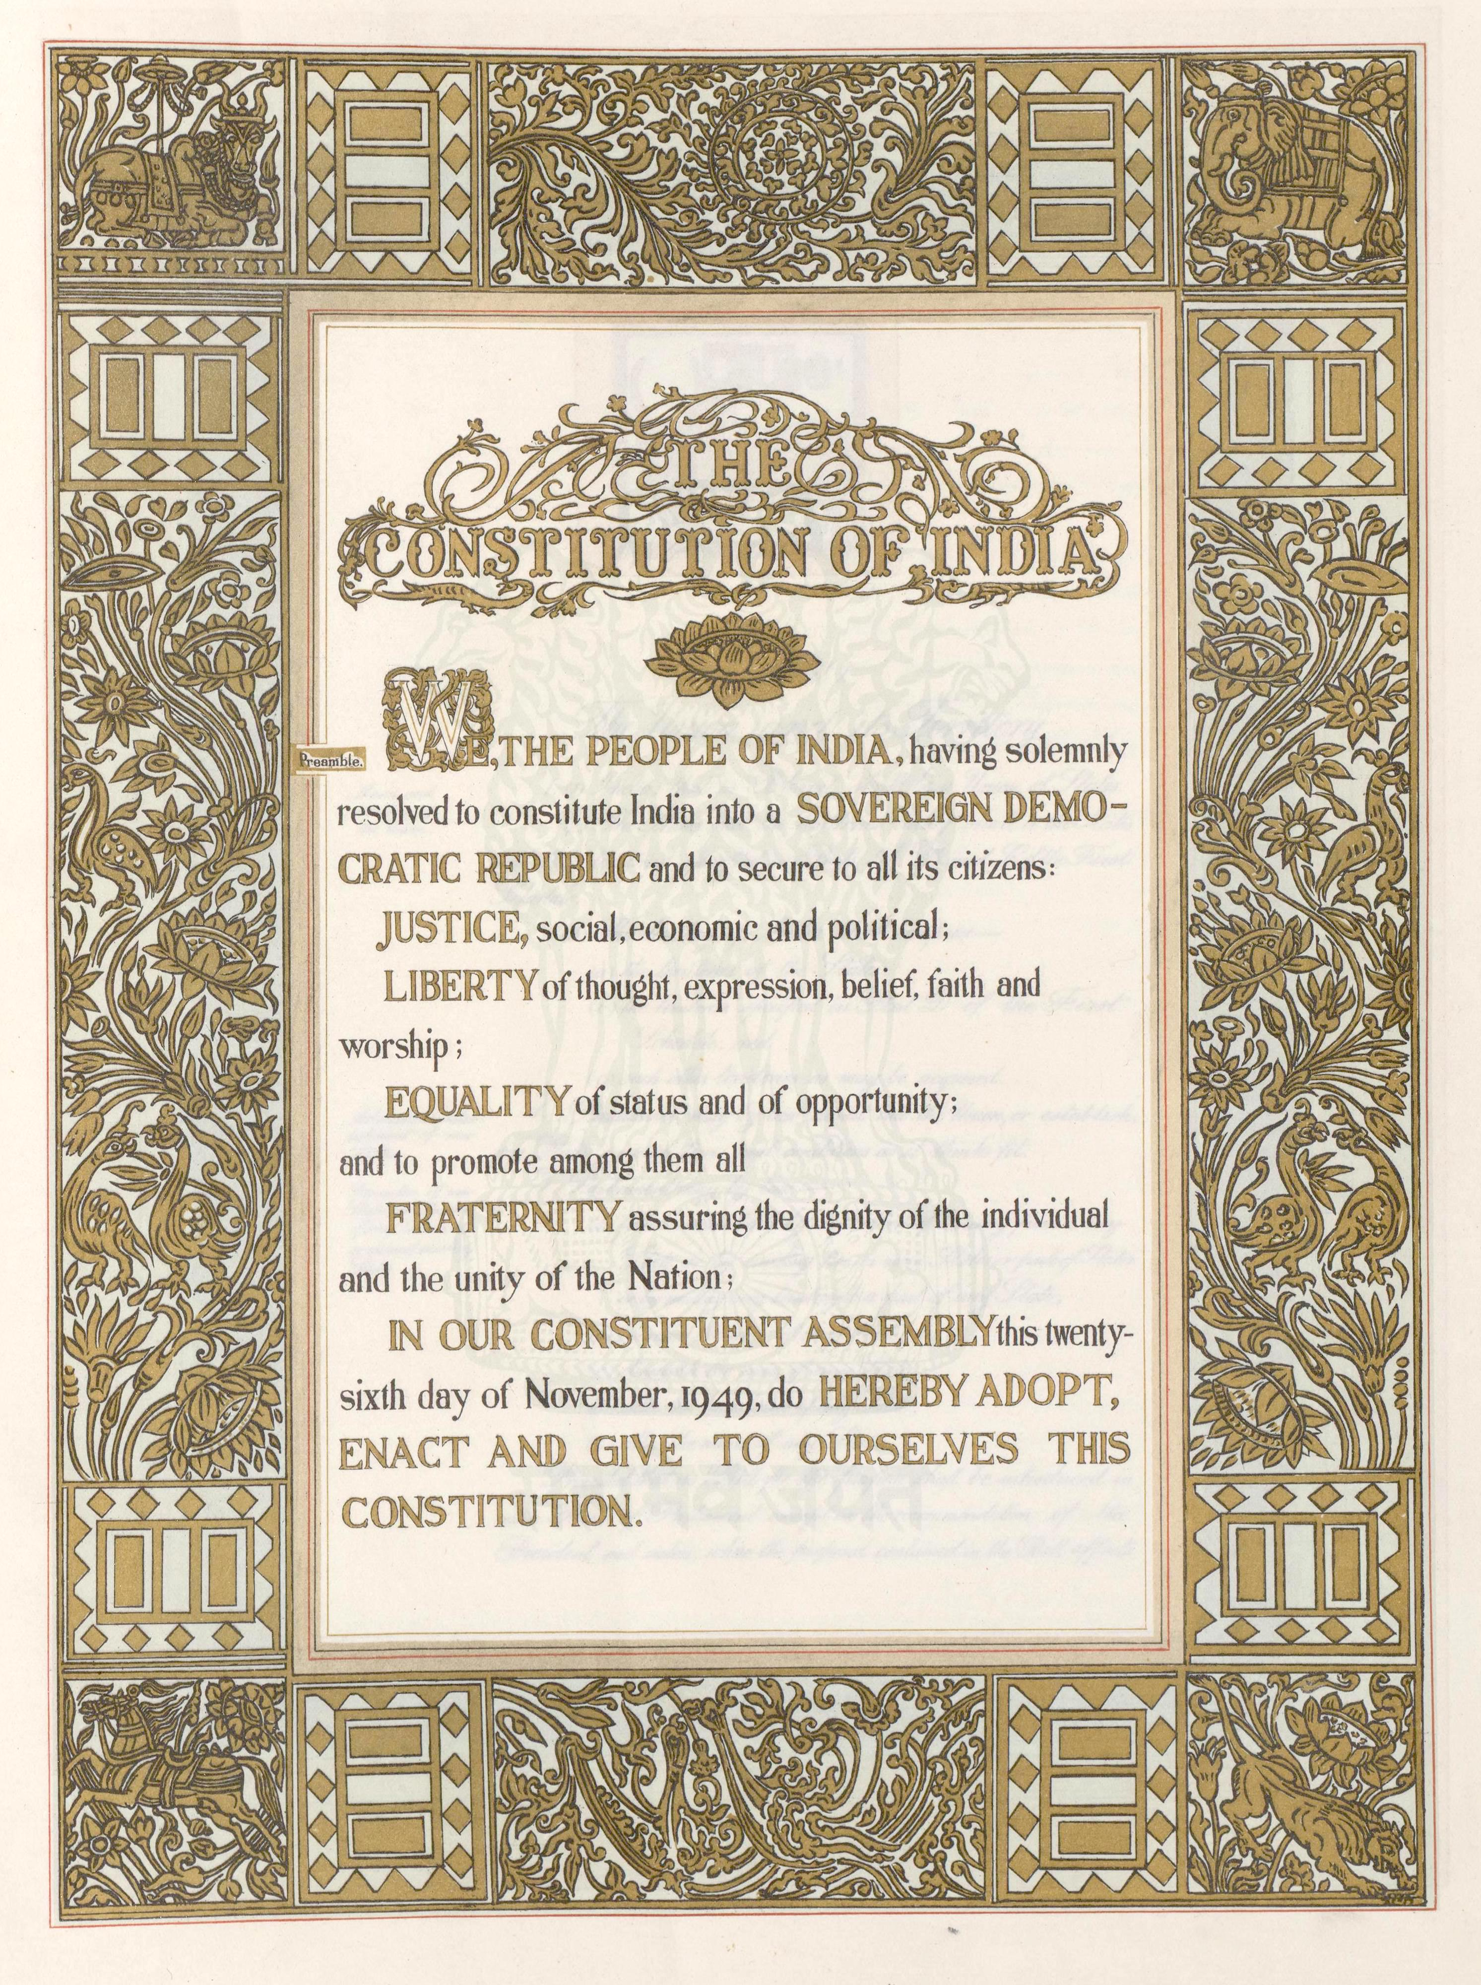
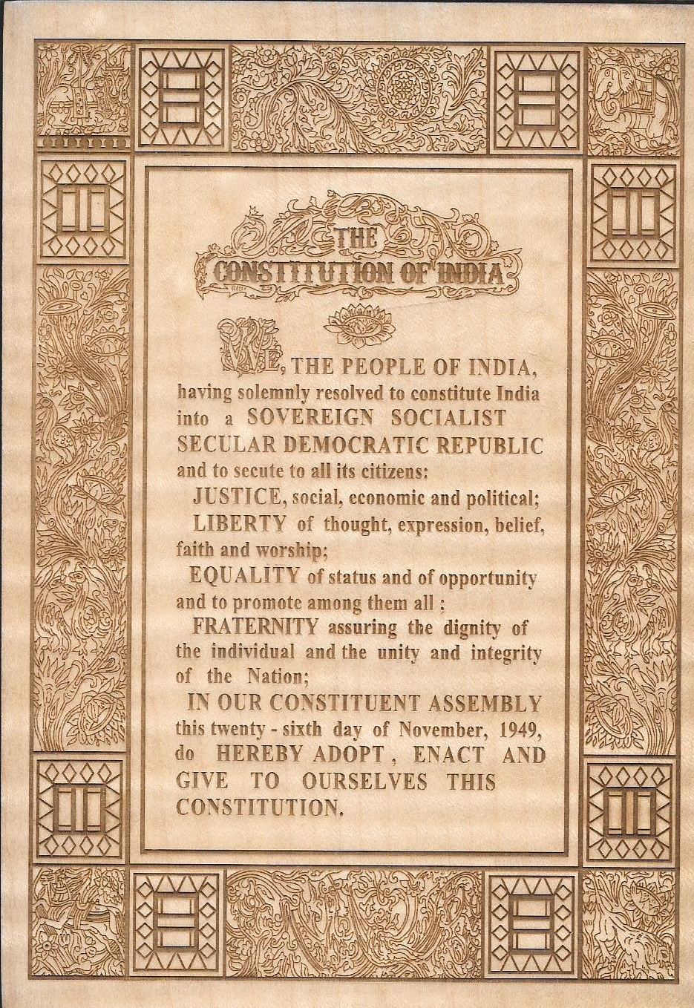

Slide 33
CENTRE-STATE RELATIONS
Legislative relations (Arts. 245-255): the Seventh Schedule divides subjects into the Union, State and Concurrent Lists. Parliament can legislate on State List subjects in special cases (Arts. 249-253, 356).
Administrative relations (Arts. 256-263): States must use their executive power in line with Union laws, and the Union can give directions. The Inter-State Council (Art. 263) helps coordination.
Financial relations (Arts. 268-293): taxes are divided between the Union and the States, and the Finance Commission (Art. 280), appointed every five years, recommends how revenue is shared.
Since 2017 the GST Council (Art. 279A) decides GST matters for the Union and the States.
India is described as a federal system with a unitary bias, because the Union is stronger, especially in emergencies.

Slide 34
LOCAL SELF-GOVERNMENT: PANCHAYATS AND MUNICIPALITIES
The 73rd Amendment (1992) added Part IX (Arts. 243-243O) and the Eleventh Schedule for Panchayats. The 74th Amendment added Part IXA (Arts. 243P-243ZG) and the Twelfth Schedule for Municipalities.
Panchayats have three tiers: village, intermediate and district. A State with a population under 20 lakh may skip the intermediate tier.
Members are directly elected for five years, and fresh elections are held within six months if a body is dissolved.
Seats are reserved for Scheduled Castes and Tribes in proportion to population, and at least one-third of seats go to women.
The State Election Commission conducts the elections, and a State Finance Commission reviews finances every five years.
Municipalities are of three types: Nagar Panchayat, Municipal Council and Municipal Corporation.

Slide 35
Parts of Constitution
Originally 395 Articles in 22 Parts and 8 Schedules; now about 448 Articles in 25 Parts and 12 Schedules. The Parts are:
Part I - The Union and its Territory
Part II - Citizenship
Part III - Fundamental Rights
Part IV - Directive Principles of State Policy
Part IVA - Fundamental Duties
Part V - The Union
Part VI - The States
Part VII - (Repealed in 1956)
Part VIII - The Union Territories
Part IX - Panchayats
Part IXA, IXB - Municipalities, Co-operatives
Part X - The Scheduled and Tribal Areas
Part XI - Relations Between The Union and The States
Part XII - Finance, Property, Contracts and Suits
Part XIII - Trade, Commerce and Intercourse within The Territory of India
Part XIV - Services Under The Union and The States
Part XIVA - Tribunals
Part XV- Elections
Part XVI - Special Provisions Relating to Certain Classes
Part XVII - Official Language
Part XVIII - Emergency Provisions
Part XIX - Miscellaneous
Part XX - Amendment of the Constitution
Part XXI - Temporary, Transitional and Special Provisions
Part XXII - Short Title, Commencement, Authoritative Text in Hindi and Repeal

Slide 36
Schedules
Schedules to the Constitution of India can be added through the amendments to it. There are twelve schedules to Constitution of India, which are effective at present, are given below:
  First Schedule: This schedule is about the States and Union Territories of India.
  Second Schedule: In this Schedule, provisions made to the President and the Governors of States, Speaker and the Deputy Speaker of the House of the People, the Chairman and the Deputy Chairman of the Council of States, the Speaker and the Deputy Speaker of the Legislative Assembly, the Chairman and the Deputy Chairman of the Legislative Council of a State, the Judges of the Supreme Court and of the High Courts and the Comptroller and Auditor-General of India

Slide 37
Schedules
  Third Schedule: Forms of Oaths or Affirmations are mentioned in this Schedule.
  Fourth Schedule: This Schedule specifies the allocation of seats in the Council of States.
  Fifth Schedule: Provisions as to the Administration and Control of Scheduled Areas and Scheduled Tribes are mentioned in this Schedule. The amendment of the schedule is also included in the Part D of the Schedule.
  Sixth Schedule: This Schedule deals with the provisions as to the Administration of Tribal Areas in the States of Assam, Meghalaya, Tripura and Mizoram.

Slide 38
Schedules
  Seventh Schedule: The List I or the Union List, List II or the State List and List III or the Concurrent List are included in this Schedule.
  Eighth Schedule: The 22 languages selected as the official languages of India are mentioned in this Schedule.
  Ninth Schedule: Validation of certain Acts and Regulations is dealt with in this Schedule

Slide 39
Schedules
  Tenth Schedule: Provisions as to disqualification on ground of defection for the Members of Parliament and Members of the State Legislatures are mentioned in this Schedule.
  Eleventh Schedule: This Schedule talks about the powers, authority and responsibilities of Panchayats
  Twelfth Schedule: Powers, authority and responsibilities of Municipalities are defined in this Schedule.

Slide 40
FUNDAMENTAL RIGHTS
The Fundamental Rights are defined as the basic human rights of all citizens. These rights, defined in Part III of the Constitution, apply irrespective of race, place of birth, religion, caste, creed or gender. They are enforceable by the courts
    Right to Equality
    Right to Freedom
    Right against Exploitation
    Right to freedom of religion
    Cultural and educational rights
    Right to Constitutional remedies

Slide 41
RIGHT TO EQUALITY
Equality before law[14]—The State shall not deny to any person equality before the law or the equal protection of the laws within the territory of India.
Prohibition of discrimination on grounds of religion, race, caste, sex or place of birth.— [15]
  The State shall not discriminate against any citizen on grounds only of religion, race, caste, sex, place of birth or any of them.
  No citizen shall, on those grounds, face any disability or restriction on access to shops, hotels, restaurants and places of public entertainment, or on use of wells, tanks, roads and public places funded by the State or open to the public.
  Nothing in this article shall prevent the State from making any special provision for women and children.
  Nothing in this article or in clause (2) of article 29 shall prevent the State from making any special provision for the advancement of any socially and educationally backward classes of citizens or for the Scheduled Castes and the Scheduled Tribes.

Slide 42
RIGHT TO EQUALITY
Equality of opportunity in matters of public employment.— [16]
  There shall be equality of opportunity for all citizens in matters relating to employment or appointment to any office under the State.
  No citizen shall, on grounds only of religion, race, caste, sex, descent, place of birth, residence or any of them, be ineligible for, or discriminated against in respect of, any employment or office under the State.
  Nothing in this article shall prevent Parliament from making any law prescribing, in regard to a class or classes of employment or appointment to an office under the Government of, or any local or other authority within, a State or Union territory, any requirement as to residence within that State or Union territory prior to such employment or appointment.

Slide 43
RIGHT TO EQUALITY
Abolition of Untouchability [17]
  “Untouchability” is abolished and its practice in any form is forbidden. The enforcement of any disability arising out of“Untouchability” shall be an offence punishable in accordance with law.
Abolition of titles [18]
  No title, not being a military or academic distinction, shall be conferred by the State.
  No citizen of India shall accept any title from any foreign State.
  No person who is not a citizen of India shall, while he holds any office of profit or trust under the State, accept without the consent of the President any title from any foreign State.
  No person holding any office of profit or trust under the State shall, without the consent of the President, accept any present, emolument, or office of any kind from or under any foreign State.

Slide 44
RIGHT TO FREEDOM
Protection of certain rights regarding freedom of speech, etc.— [19]
  All citizens shall have the right—
    to freedom of speech and expression;
    to assemble peaceably and without arms;
    to form associations or unions;
    to move freely throughout the territory of India;
    to reside and settle in any part of the territory of India; and
    to practice any profession, or to carry on any occupation, trade or business.

Slide 45
RIGHT TO FREEDOM
Freedoms in Art. 19 are not absolute. The State may impose reasonable restrictions by law. For speech and expression [Art. 19(2)] the grounds are:
  interests of the sovereignty and integrity of India.
  the security of the State.
  friendly relations with foreign States.
  public order.
  decency or morality.
  in relation to contempt of court.
  defamation or incitement to an offence.

Slide 46
RIGHT TO FREEDOM
Further protections [Art. 20, 21, 22]
  No person shall be prosecuted and punished for the same offence more than once.
  No person accused of any offence shall be compelled to be a witness against himself.
  No person shall be deprived of his life or personal liberty except according to procedure established by law.
  Art. 21A: Free and compulsory education for children aged 6 to 14 years (86th Amendment, 2002).
  Maneka Gandhi v. Union of India (1978): the procedure under Art. 21 must be just, fair and reasonable.
  No person who is arrested shall be detained in custody without being informed, as soon as may be, of the grounds for such arrest nor shall he be denied the right to consult, and to be defended by, a legal practitioner of his choice. [22]
  Every person who is arrested and detained in custody shall be produced before the nearest magistrate within a period of twenty-four hours of such arrest excluding the time necessary for the journey from the place of arrest to the court of the magistrate and no such person shall be detained in custody beyond the said period without the authority of a magistrate. [22]

Slide 47
RIGHT AGAINST EXPLOITATION
Prohibition of traffic in human beings and forced labour.[23]
  Traffic in human beings and begar and other similar forms of forced labour are prohibited and any contravention of this provision shall be an offence punishable in accordance with law.
  Nothing in this article shall prevent the State from imposing compulsory service for public purposes, and in imposing such service the State shall not make any discrimination on grounds only of religion, race, caste or class or any of them.
Prohibition of employment of children in factories, etc. [24]
  No child below the age of fourteen years shall be employed to work in any factory or mine or engaged in any other hazardous employment.

Slide 48
RIGHT TO FREEDOM OF RELIGION
Freedom of conscience and free profession, practice and propagation of religion.[25]
  Subject to public order, morality and health and to the other provisions of this Part, all persons are equally entitled to freedom of conscience and the right freely to profess, practise and propagate religion.
  Nothing in this article shall affect the operation of any existing law or prevent the State from making any law—
    regulating or restricting any economic, financial, political or other secular activity which may be associated with religious practice;
    providing for social welfare and reform or the throwing open of Hindu religious institutions of a public character to all classes and sections of Hindus.

Slide 49
RIGHT TO FREEDOM OF RELIGION
Freedom to manage religious affairs.—[26]
Subject to public order, morality and health, every religious denomination or any section there of shall have the right
  to establish and maintain institutions for religious and charitable purposes;
  to manage its own affairs in matters of religion;
  to own and acquire movable and immovable property; and
  to administer such property in accordance with law.

Slide 50
RIGHT TO FREEDOM OF RELIGION
Freedom as to payment of taxes for promotion of any particular religion.—[27]
  No person shall be compelled to pay any taxes, the proceeds of which are specifically appropriated in payment of expenses for the promotion or maintenance of any particular religion or religious denomination.

Slide 51
RIGHT TO FREEDOM OF RELIGION
Freedom as to attendance at religious instruction or religious worship in certain educational institutions.— [28]
  No religious instruction shall be provided in any educational institution wholly maintained out of State funds.
  Nothing in clause above shall apply to an educational institution which is administered by the State but has been established under any endowment or trust which requires that religious instruction shall be imparted in such institution.
  No person attending any educational institution recognised by the State or receiving aid out of State funds shall be required to take part in any religious instruction that may be imparted in such institution or to attend any religious worship that may be conducted in such institution or in any premises attached thereto unless such person or, if such person is a minor, his guardian has given his consent thereto.

Slide 52
CULTURAL & EDUCATIONAL RIGHTS
Protection of interests of minorities.— [29]
  Any section of the citizens residing in the territory of India or any part thereof having a distinct language, script or culture of its own shall have the right to conserve the same.
  No citizen shall be denied admission into any educational institution maintained by the State or receiving aid out of State funds on grounds only of religion, race, caste, language or any of them.

Slide 53
CULTURAL & EDUCATIONAL RIGHTS
Right of minorities to establish and administer educational institutions. — [30]
  All minorities, whether based on religion or language, shall have the right to establish and administer educational institutions of their choice.
  The State shall not, in granting aid to educational institutions, discriminate against any educational institution on the ground that it is under the management of a minority, whether based on religion or language.

Slide 54
RIGHT TO CONSTITUTIONAL REMEDIES[32]
(1) The right to move the Supreme Court by appropriate proceedings for the enforcement of the rights conferred by this Part is guaranteed
(2) The Supreme Court shall have power to issue directions or orders or writs, including writs in the nature of habeas corpus, mandamus, prohibition, quo warranto and certiorari, whichever may be appropriate, for the enforcement of any of the rights conferred by this Part.
(3) Without prejudice to the powers conferred on the Supreme Court by clauses (1) and (2), Parliament may by law empower any other court to exercise within the local limits of its jurisdiction all or any of the powers exercisable by the Supreme Court under clause (2).
(4) The right guaranteed by this article shall not be suspended except as otherwise provided for by this Constitution.

Slide 55
RIGHT TO CONSTITUTIONAL REMEDIES[33]
Power of Parliament to modify the rights conferred by this Part in their application to Forces, etc.—Parliament may, by law, determine to what extent any of the rights conferred by this Part shall, in their application to,—
  (a) the members of the Armed Forces; or
  (b) the members of the Forces charged with the maintenance of public order; or
  (c) persons employed in any bureau or other organisation established by the State for purposes of intelligence or counter intelligence; or
  (d) persons employed in, or in connection with, the telecommunication systems set up for the purposes of any Force, bureau or organisation referred to in clauses (a) to (c),
  (e) be restricted or abrogated so as to ensure the proper discharge of their duties and the maintenance of discipline among them

Slide 56
RIGHT TO CONSTITUTIONAL REMEDIES[34]
Restriction on rights conferred by this Part while martial law is in force in any area.—
  Notwithstanding anything in the foregoing provisions of this Part, Parliament may by law indemnify any person in the service of the Union or of a State or any other person in respect of any act done by him in connection with the maintenance or restoration of order in any area within the territory of India where martial law was in force or validate any sentence passed, punishment inflicted, forfeiture ordered or other act done under martial law in such area.

Slide 57
RIGHT TO CONSTITUTIONAL REMEDIES[35]
Legislation to give effect to the provisions of this Part.—notwithstanding anything in this Constitution,—Parliament shall have, and the Legislature of a State shall not have, power to make laws on matters under Articles 16(3), 32(3), 33 and 34, and to prescribe punishment for offences under this Part.

Slide 58
DIRECTIVE PRINCIPLES
TYPES OF DIRECTIVE PRINCIPLES OF STATE POLICY
  Socialistic Principles
  Gandhian Principles
  Liberal Principles
  General / Miscellaneous Principles

Slide 59
DIRECTIVE PRINCIPLES
38. State to secure a social order for the promotion of welfare of the people
  The State shall strive to promote the welfare of the people by securing and protecting as effectively as it may a social order in which justice, social, economic and political, shall inform all the institutions of the national life.

Slide 60
DIRECTIVE PRINCIPLES
39. Certain principles of policy to be followed by the State.—
The State shall, in particular, direct its policy towards securing—
  (a) that the citizens, men and women equally, have the right to an adequate means of livelihood;
  (b) that the ownership and control of the material resources of the community are so distributed as best to serve the common good;
  (c) that the operation of the economic system does not result in the concentration of wealth and means of production to the common detriment;
  (d) that there is equal pay for equal work for both men and women;
  (e) that the health and strength of workers, men and women, and the tender age of children are not abused and that citizens are not forced by economic necessity to enter avocations unsuited to their age or strength;
  (f) that children are given opportunities and facilities to develop in a healthy manner and in conditions of freedom and dignity and that childhood and youth are protected against exploitation and against moral and material abandonment.

Slide 61
DIRECTIVE PRINCIPLES
39A. Equal justice and free legal aid.—
The State shall secure that the operation of the legal system promotes justice, on a basis of equal opportunity, and shall, in particular, provide free legal aid, by suitable legislation or schemes or in any other way, to ensure that opportunities for securing justice are not denied to any citizen by reason of economic or other disabilities.

Slide 62
DIRECTIVE PRINCIPLES
40. Organization of village panchayats.—
  The State shall take steps to organize village panchayats and endow them with such powers and authority as may be necessary to enable them to function as units of self -government.
41. Right to work, to education and to public assistance in certain cases.—
  The State shall, within the limits of its economic capacity and development, make effective provision for securing the right to work, to education and to public assistance in cases of unemployment, old age, sickness and disablement, and in other cases of undeserved want.

Slide 63
DIRECTIVE PRINCIPLES
42. Provision for just and humane conditions of work and maternity relief.—
  The State shall make provision for securing just and humane conditions of work and for maternity relief.
43. Living wage, etc., for workers.—
  The State shall endeavour to secure, by suitable legislation or economic organisation or in any other way, to all workers, agricultural, industrial or otherwise, work, a living wage, conditions of work ensuring a decent standard of life and full enjoyment of leisure and social and cultural opportunities and, in particular, the State shall endeavour to promote cottage industries on an individual or co-operative basis in rural areas.

Slide 64
DIRECTIVE PRINCIPLES
43A. Participation of workers in management of industries.—
  The State shall take steps, by suitable legislation or in any other way, to secure the participation of workers in the management of undertakings, establishments or other organisations engaged in any industry.
44. Uniform civil code for the citizens.—
  The State shall endeavour to secure for the citizens a uniform civil code throughout the territory of India.
45. Provision for early childhood care and education to children below six years.—
  The State shall endeavour to provide early childhood care and education for all children until they complete the age of six years.

Slide 65
DIRECTIVE PRINCIPLES
46. Promotion of educational and economic interests of Scheduled Castes, Scheduled Tribes and other weaker sections.—
  The State shall promote with special care the educational and economic interests of the weaker sections of the people, and, in particular, of the Scheduled Castes and the Scheduled Tribes, and shall protect them from social injustice and all forms of exploitation.
47. Duty of the State to raise the level of nutrition and the standard of living and to improve public health.—
  The State shall regard the raising of the level of nutrition and the standard of living of its people and the improvement of public health as among its primary duties and, in particular, the State shall endeavour to bring about prohibition of the consumption except for medicinal purposes of intoxicating drinks and of drugs which are injurious to health.

Slide 66
DIRECTIVE PRINCIPLES
48. Organization of agriculture and animal husbandry.—
  The State shall endeavour to organize agriculture and animal husbandry on modern and scientific lines and shall, in particular, take steps for preserving and improving the breeds, and prohibiting the slaughter, of cows and calves and other milch and draught cattle.
48A. Protection and improvement of environment and safeguarding of forests and wild life.—
  The State shall endeavour to protect and improve the environment and to safeguard the forests and wild life of the country.

Slide 67
DIRECTIVE PRINCIPLES
49. Protection of monuments and places and objects of national importance.—
  It shall be the obligation of the State to protect every monument or place or object of artistic or historic interest, declared by or under law made by Parliament to be of national importance, from spoliation, disfigurement, destruction, removal, disposal or export, as the case may be.
50. Separation of judiciary from executive.—
  The State shall take steps to separate the judiciary from the executive in the public services of the State.

Slide 68
DIRECTIVE PRINCIPLES
51. Promotion of international peace and security.
The State shall endeavour to—
  (a) promote international peace and security;
  (b) maintain just and honourable relations between nations;
  (c) foster respect for international law and treaty obligations in the dealings of organized peoples with one another; and
  (d) encourage settlement of international disputes by arbitration.

Slide 69
FUNDAMENTAL DUTIES [51A]
Fundamental duties.—It shall be the duty of every citizen of India—
  (a) to abide by the Constitution and respect its ideals and institutions, the National Flag and the National Anthem;
  (b) to cherish and follow the noble ideals which inspired our national struggle for freedom;
  (c) to uphold and protect the sovereignty, unity and integrity of India;
  (d) to defend the country and render national service when called upon to do so;
  (e) to promote harmony and the spirit of common brotherhood amongst all the people of India transcending religious, linguistic and regional or sectional diversities; to renounce practices derogatory to the dignity of women;

Slide 70
FUNDAMENTAL DUTIES [51A]
Fundamental duties.—It shall be the duty of every citizen of India—
  (f) to value and preserve the rich heritage of our composite culture;
  (g) to protect and improve the natural environment including forests, lakes, rivers and wild life, and to have compassion for living creatures;
  (h) to develop the scientific temper, humanism and the spirit of inquiry and reform;
  (i) to safeguard public property and to abjure violence;
  (j) to strive towards excellence in all spheres of individual and collective activity so that the nation constantly rises to higher levels of endeavor and achievement.

Slide 71
FUNDAMENTAL DUTIES [51A]
The 11th Fundamental Duty, which states that every citizen "who is a parent or guardian, to provide opportunities for education to his child or, as the case may be, ward between the age of six and fourteen years" was added by the 86th constitutional amendment in 2002.

Slide 72
THANK YOU!!!

Slide 73
SOURCES
Brij Kishore Sharma: Introduction to the Indian Constitution, PHI, New Delhi, latest edition.
Granville Austin: The Indian Constitution: Cornerstone of a Nation. 1966, Oxford Clarendon Press.
Subhash C. Kashyap: Our Constitution: An Introduction to India’s Constitution and constitutional Law, NBT, 2018.
PM Bakshi: The Constitution of India, Latest Edition, Universal Law Publishing.
V.K. Ahuja: Law Relating to Intellectual Property Rights (2007)
Suresh T. Viswanathan: The Indian Cyber Laws, Bharat Law House, New Delhi‐88
P. Narayan: Intellectual Property Law, Eastern Law House, New Delhi
Prabudh Ganguli: Gearing up for Patents: The Indian Scenario, Orient Longman.
BL Wadehra: Patents, Trademarks, Designs and Geological Indications. Universal Law Publishing - LexisNexis.
Intellectual Property Rights: Law and Practice, Module III by ICSI (only relevant sections)
Executive programme study material Company Law, Module II, by ICSI (The Institute of Companies Secretaries of India) (Only relevant sections i.e., Study 1, 4 and 36).https://www.icsi.edu/media/webmodules/publications/Company%20Law.pdf
Handbook on e-Governance Project Lifecycle, Department of Electronics & Information Technology, Government of India, https://www.meity.gov.in/writereaddata/files/e- Governance_Project_Lifecycle_Participant_Handbook-5Day_CourseV1_20412.pdf
Companies Act, 2013 Key highlights and analysis by PWC. https://www.pwc.in/assets/pdfs/publications/2013/companies-act-2013-key-highlights-andanalysis..pdf

