Slide 1
CONSTITUTION OF INDIA

Slide 2
OUTLINES
Module 3
Introduction and Basic Information about Legal System
The Legal System:
Sources of Law and the Court Structure: Enacted law -Acts of Parliament are of primary legislation, Common Law or Case law, Principles taken from decisions of judges constitute binding legal rules.
The Court System in India and Foreign Courts (District Court, District Consumer Forum, Tribunals, High Courts, Supreme Court).
Arbitration: As an alternative to resolving disputes in the normal courts, parties who are in dispute can agree that this will instead be referred to arbitration. Contract law, Tort, Law at workplace.

Slide 3
THE LAW & THE LEGAL SYSTEM
The law and the legal system are very important in any civilization. In modern times, no one can imagine a society without law and a legal system.
Law can be described as
“a system of rules and regulations which a country or society recognizes as binding on its citizens, which the authorities may enforce, and violation of which attracts punitive action”.
These laws are generally contained in the constitutions, legislations, judicial decisions etc.

Slide 4
THE LAW & THE LEGAL SYSTEM : DEFINITION
“As an embodiment of reasons whether in individual or the community”
Aristotle
“A collection of signs declarative of a volition conceived or adopted by the sovereign”
Jeremy Bentham
“A body of rules determined and enforced by a sovereign political authority”
John Austin
“A system of rules, a union of primary and secondary rules. The Primary rules impose duties on people to behave in certain ways. Secondary rules, by contrast, pertain to the primary rules”
H. L. A. Hart

Slide 5
THE LAW & THE LEGAL SYSTEM : DEFINITION
“Law is a product of the general consciousness of the people”
Friedrich Carl von Savigny
“An organised and critically controlled body of knowledge both of legal institutions and legal precepts and of the legal order, that is, of the legal ordering of the society”
Roscoe Pound
“The prophecies of what Courts will do in fact, and nothing more pretentious, are what I mean by the law”
Oliver Wendell Holmes
“Judges create a rationally integrated and coherent network of legal principles which is law”
Ronald Dworkin
“Law consists of authoritative positivist considerations enforceable by the courts”
Joseph Raz

Slide 6
THE LAW & THE LEGAL SYSTEM : DEFINITION
The Principle of Natural Justice
The principle of natural justice encompasses the following two rules
1. Nemo judex in causa sua - No one should be a judge in his own cause or, the rule against bias.
2. Audi alteram partem - Hear the other party or, the rule of fair hearing or, the rule that no one should be condemned unheard.

Slide 7
THE LAW & THE LEGAL SYSTEM : DEFINITION
Functions and purpose of law have been changing with time and place. They
depend on the nature of the state. However, at present in a welfare and democratic
state, there are several important functions of law.
To deliver justice
To provide equality and uniformity. To maintain impartiality.
To maintain law and order.
To maintain social control. To resolve conflicts.
To bring orderly change through law and social reform.

Slide 8
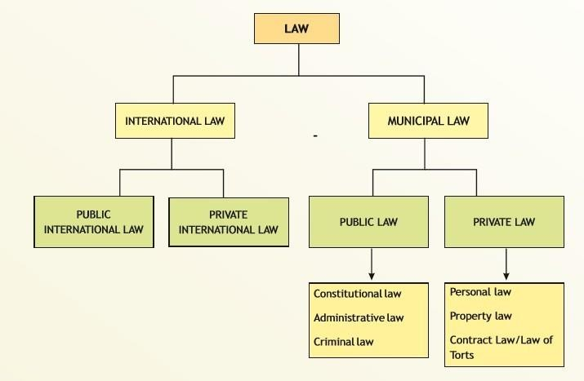
THE LAW & THE LEGAL SYSTEM : DEFINITION

Slide 9
THE LAW & THE LEGAL SYSTEM
International Law
International law is an important branch of law. It deals with those rules and regulations of nation which are recognized and are binding upon each other through reciprocity.
Public International Law : This branch of law relates to the body of rules and regulations which governs the relationship between nations. Countries mutually recognise these sets of rules which are binding on them in their transactions on a reciprocal basis.
Private International Law : Private international law is that part of law of the State, which deals with cases having a foreign element. Private international law relates to the rights of private citizens of different countries. Marriages and adoption of individuals belonging to different nations fall within its domain

Slide 10
THE LAW & THE LEGAL SYSTEM
Municipal Law
Municipal laws are basically domestic or national laws. They regulate the relationship between the State and its citizen and determines the relationship among citizens.
Public Law :Public law chiefly regulates the relationship between the State and its subjects. It also provides the structure and functioning of the organs of States.
Public Law [Constitutional Law] :Constitutional law is considered to be the basic as well as the supreme law of the country. The nature of any State is basically determined by its Constitution. It also provides the structure of the government. All the organs of states derive their powers from the Constitution. Eg. Fundamental Rights & Duties.

Slide 11
THE LAW & THE LEGAL SYSTEM
Municipal Law
Public Law [Administrative Law]: It mainly deals with the powers and functions of administrative authorities - government departments, authorities, bodies etc. It deals with the extent of powers held by the administrative bodies and the mechanism whereby their actions can be controlled. It also provides for legal remedies in case of any violation of the rights of the people.
Public Law [Criminal Law]: It deals with acts which are prohibited by law and defines the prohibited act as an offence. It also prescribes punishments for criminal offences. Criminal law is very important for maintaining order in the society, and for maintaining peace. It is considered a part of public law, as crime is not only against the individual but against the whole society. The Bharatiya Nyaya Sanhita, 2023 (BNS), in force since 1 July 2024, replaced the IPC, 1860. Procedure: BNSS, 2023 (formerly CrPC). Evidence: BSA, 2023 (formerly Evidence Act).

Slide 12
THE LAW & THE LEGAL SYSTEM
Municipal Law
Private Law : This branch of law defines, regulates, governs and enforces relationships between individuals and associations and corporations. In other words, this branch of law deals with the definition, regulation and enforcement of mutual rights and duties of individuals. The state intervenes through its judicial organs (e.g. courts) to settle the dispute between the parties. Private or Civil law confers civil rights which are administered and adjudicated by civil courts. Much of the life of a society is regulated by this set of private laws or civil rights.
Private Law [Personal Law]: It is a branch of law related to marriage, divorce and succession (inheritance). These laws are based on religion, ritual and customs of marriage, divorce, and inheritance. In such matters, people are mostly governed by the Personal laws laid down by their religions. For example, the marriage of Hindus is governed by Personal laws like the Hindu Marriage Act, 1955 while Muslim marriages are governed by the Muslim personal law based on a Muslim customary law.

Slide 13
THE LAW & THE LEGAL SYSTEM
Municipal Law
Private Law [Property Law]: This branch of law deals with the ownership of immovable and movable properties. For example, the Transfer of Property Act, 1882, deals with transfer of immovable property, whereas the Sale of Goods Act, 1930, deals with movable property.
Private Law [Law of Obligations]: This branch of the law pertains to an area where a person is required to do something because of his promise, contract or law. It puts an obligation on the person to perform certain actions which generally arise as a consequence of an enforceable promise or agreement. If someone violates his promise, that promise may be enforced in a court of law. According to the Indian Contract Act, 1872, a contract is an agreement which is enforceable by law.

Slide 14
THE LAW & THE LEGAL SYSTEM
Municipal Law
Private Law [Law of Obligations or Contract Law]
Main elements of a Contract :
An offer
An acceptance of that offer which results in a meeting of the minds
A promise to perform
A valuable and legal consideration (which can be a promise or payment in some form) A time or event when performance must be made (meet commitments)
Terms and conditions for performance, including fulfilling promises

Slide 15
THE LAW & THE LEGAL SYSTEM
Municipal Law
Private Law [Law of Torts or Civil wrong]
This branch of law creates and provides remedies for civil wrongs that do not arise out of contractual duties. A tort deals with negligence cases as well as intentional wrongs which cause harm. An aggrieved person may use Law of Tort to claim damages from someone who has caused the wrong or legal injury to him/ her. Torts cover intentional acts and accidents.
For instance, if 'A' throws a stone and it hits another person namely 'B' on the head, 'B' may sue 'A" for the injury caused by the accident.

Slide 16
THE LAW & THE LEGAL SYSTEM
Sources of Law
Formal Sources of Law:
These are the sources from which law derives its force and validity. A law enacted by the State or Sovereign falls into this category.
Material Sources of Law:
It refers to the material of law. In simple words, it is all about the matter from where the laws are derived. Customs fall in this category of law.
•

Slide 17
THE LAW & THE LEGAL SYSTEM
Sources of Law
Three major sources of law can be identified in any modern society:
Custom
Judicial precedent
Legislation
A custom, to be valid, must be observed continuously for a very long time without any interruption. Further, a practice must be supported not only for a very long time, but it must also be supported by the opinion of the general public and morality. However, every custom need not become law. For example, the Hindu Marriage Act, 1955 prohibits marriages which are within the prohibited degrees of relationship.
However, the Act still permits marriages within the prohibited degree of relationship if there is a proven custom within a certain community.

Slide 18
THE LAW & THE LEGAL SYSTEM
Sources of Law
Three major sources of law can be identified in any modern society:
Custom
Judicial precedent
Legislation
Custom can simply be explained as those long established practices or unwritten rules which have acquired binding or obligatory character.
In ancient societies, custom was considered as one of the most important sources of law; In fact it was considered as the real source of law. With the passage of time and the advent of modern civilization, the importance of custom as a source of law diminished and other sources such as judicial precedents and legislation gained importance.

Slide 19
THE LAW & THE LEGAL SYSTEM
Sources of Law
Three major sources of law can be identified in any modern society:
Custom
Judicial precedent
Legislation
Customs can be broadly divided into two classes:
Customs without sanction: These kinds of customs are non-obligatory in nature and are followed because of public opinion.
Customs with sanction: These customs are binding in nature and are enforced by the State. These customs may further be divided into the following categories:

Slide 20
THE LAW & THE LEGAL SYSTEM
Sources of Law
Three major sources of law can be identified in any modern society:
Custom
Judicial precedent
Legislation
(a) Legal Custom: Legal custom is a custom whose authority is absolute; it possesses the force of law. It is recognized and enforced by the courts. Legal custom may be further classified into the following two types:
  General Customs: These types of customs prevail throughout the territory of the State.
  Local Customs: Local customs are applicable to a part of the State, or a particular region of the country.

Slide 21
THE LAW & THE LEGAL SYSTEM
Sources of Law
Three major sources of law can be identified in any modern society:
Custom
Judicial precedent
Legislation
(b) Conventional Customs: Conventional customs are binding on the parties to an agreement. When two or more persons enter into an agreement related to a trade, it is presumed in law that they make the contract in accordance with established convention or usage of that trade. For instance an agreement between landlord and tenant regarding the payment of the rent will be governed by convention prevailing in this regard.

Slide 22
THE LAW & THE LEGAL SYSTEM
Sources of Law
Three major sources of law can be identified in any modern society:
Custom
Judicial precedent
Legislation
All customs cannot be accepted as sources of law, nor can all customs be recognized and enforced by the courts. The jurists and courts have laid down some essential tests for customs to be recognized as valid sources of law :
Antiquity: In order to be legally valid customs should have been in existence for a long time, even beyond human memory. However, in India there is no such time limit for deciding the antiquity of the customs. The only condition is that those should have been in practice since time immemorial.
Continuous: A custom to be valid should have been in continuous practice. It must have been enjoyed without any kind of interruption. Long intervals and disrupted practice of a custom raise doubts about the validity of the same.

Slide 23
THE LAW & THE LEGAL SYSTEM
Sources of Law
Three major sources of law can be identified in any modern society:
Custom
Judicial precedent
Legislation
Exercised as a matter of right: Custom must be enjoyed openly and with the knowledge of the community. It should not have been practised secretly. A custom must be proved to be a matter of right. A mere doubtful exercise of a right is not sufficient to a claim as a valid custom.
Reasonableness: A custom must conform to the norms of justice and public utility. A custom, to be valid, should be based on rationality and reason. If a custom is likely to cause more inconvenience and mischief than convenience, such a custom will not be valid.
Morality: A custom which is immoral or opposed to public policy cannot be a valid custom. Courts have declared many customs as invalid as they were practised for immoral purpose.

Slide 24
THE LAW & THE LEGAL SYSTEM
Sources of Law
Three major sources of law can be identified in any modern society:
Custom
Judicial precedent
Legislation
In simple words, judicial precedent refers to previously decided judgments of the superior courts, such as the High Courts and the Supreme Court, which judges are bound to follow. Judicial precedent is an important source of law, but it is neither as modern as legislation nor is it as old as custom. It is an important feature of the English legal system as well as of other common law countries which follow the English legal system.

Slide 25
THE LAW & THE LEGAL SYSTEM
Sources of Law
Three major sources of law can be identified in any modern society:
Custom
Judicial precedent
Legislation
Judicial decisions can be divided into following two parts:
Ratio decidendi (Reason of Decision):
'Ratio decidendi' refers to the binding part of a judgment. 'Ratio decidendi' literally means reasons for the decision. It is considered as the general principle which is deduced by the courts from the facts of a particular case. It becomes generally binding on the lower courts in future cases involving similar questions of law.
Obiter dicta (Said by the way): An 'obiter dictum' refers to parts of judicial decisions which are general observations of the judge and do not have any binding authority.
However, obiter of a higher judiciary is given due consideration by lower courts and has persuasive value.

Slide 26
THE LAW & THE LEGAL SYSTEM
Sources of Law
Three major sources of law can be identified in any modern society:
Custom
Judicial precedent
Legislation
In modern times, legislation is considered as the most important source of law. The term 'legislation' is derived from the Latin word legis which means 'law' and latum which means "to make" or "set". Therefore, the word 'legislation' means the 'making of law’.
The importance of legislation as a source of law can be measured from the fact that it is backed by the authority of the sovereign, and it is directly enacted and recognised by the State. The expression 'legislation' has been used in various senses. It includes every method of law-making. In the strict sense it means laws enacted by the sovereign or any other person or institution authorised by him.

Slide 27
THE LAW & THE LEGAL SYSTEM
Sources of Law
Three major sources of law can be identified in any modern society:
Custom
Judicial precedent
Legislation
Supreme Legislation:
When the laws are directly enacted by the sovereign, it is considered as supreme legislation. One of the features of Supreme legislation is that, no other authority except the sovereign itself can control or check it. The law enacted by the Indian Parliament falls in this category.
However in India, powers of the Parliament are regulated and controlled by the Constitution, through the laws enacted by it are not under the control of any other legislative body.

Slide 28
THE LAW & THE LEGAL SYSTEM
Sources of Law
Three major sources of law can be identified in any modern society:
Custom
Judicial precedent
Legislation
Subordinate Legislation:
Subordinate legislation is a legislation which is made by any authority which is subordinate to the supreme or sovereign authority. It is enacted under the delegated authority of the sovereign.
The origin, validity, existence and continuance of such legislation totally depends on the will of the sovereign authority. Subordinate legislation further can be classified into the following types:
Autonomous Law
Judicial Rules
Local laws
Colonial Law
Executive Legislation

Slide 29
THE LAW & THE LEGAL SYSTEM
Sources of Law
Three major sources of law can be identified in any modern society:
Custom
Judicial precedent
Legislation
Autonomous Law:
When a group of individuals recognized or incorporated under the law as an autonomous body, is conferred with the power to make rules and regulation, the laws made by such body fall under autonomous law. For instance, laws made by the bodies like Universities, incorporated companies etc. fall in this category of legislation
Judicial Rules:
In some countries, judiciary is conferred with the power to make rules for their administrative procedures. For instance, under the Constitution of India, the Supreme Court and High Courts have been conferred with such kinds of power to regulate procedure and administration.

Slide 30
THE LAW & THE LEGAL SYSTEM
Sources of Law
Three major sources of law can be identified in any modern society:
Custom
Judicial precedent
Legislation
Local laws:
In some countries, local bodies are recognized and conferred with the law-making powers. They are entitled to make bye-laws in their respective jurisdictions. In India, local bodies like Panchayats and Municipal Corporations have been recognized by the Constitution through the 73rd and 74th Constitutional amendments. The rules and bye-laws enacted by them are examples of local laws.
Colonial Law:
Laws made by colonial countries for their colonies or the countries controlled by them are known as colonial laws. For a long time, India was governed by the laws passed by the British Parliament. However, as most countries of the world have gained independence from the colonial powers, this legislation is losing its importance and may not be recognized as a kind of legislation.

Slide 31
THE LAW & THE LEGAL SYSTEM
Sources of Law
Three major sources of law can be identified in any modern society:
Custom
Judicial precedent
Legislation
Laws made by the Executive:
Laws are supposed to be enacted by the sovereign and the sovereignty may be vested in one authority or it may be distributed among the various organs of the State. In most of the modern States, sovereignty is generally divided among the three organs of the State. The three organs of the State namely legislature, executive and judiciary are vested with three different functions. The prime responsibility of law-making vests with the legislature, while the executive is vested with the responsibility to implement the laws enacted by the legislature.
However, the legislature delegates some of its law-making powers to executive organs which are also termed delegated legislation. Delegated legislation is also a class of subordinate legislation. In welfare and modern states, the amount of legislation has increased manifold and it is not possible for legislative bodies to go through all the details of law. Therefore, it deals with only a fundamental part of the legislation and wide discretion has been given to the executive to fill the gaps.

Slide 32
THE LAW & THE LEGAL SYSTEM
Sources of Law
Three major sources of law
can be identified in any
modern society:
Custom
Judicial precedent
Legislation

Slide 33
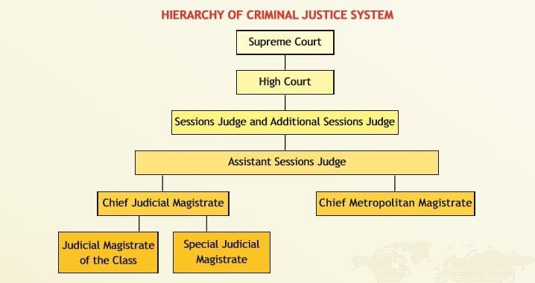
THE LAW & THE LEGAL SYSTEM
• Hierarchy of criminal courts
• Supreme Court
• High Court
• Court of Session (Sessions Judge and Additional Sessions Judges)
• Chief Judicial Magistrate
• Judicial Magistrates (First Class and Second Class)

Slide 34
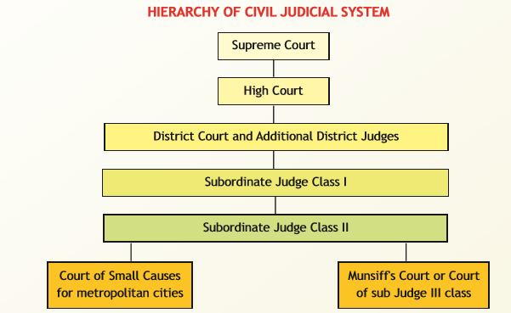
THE LAW & THE LEGAL SYSTEM
• Hierarchy of civil courts
• Supreme Court
• High Court
• District Court (District Judge and Additional District Judges)
• Civil Judge (Senior Division)
• Civil Judge (Junior Division)
• Small Cause Courts hear small money claims in some areas

Slide 35
THE TRIBUNAL
The term ‘Tribunal’ is derived from the word ‘Tribunes’, which means ‘Magistrates of the Classical Roman Republic’.
Tribunal is referred to as the office of the ‘Tribunes’ i.e., a Roman official under the monarchy and the republic with the function of protecting the plebeian citizen from arbitrary action by the patrician magistrates.
A Tribunal, generally, is any person or institution having an authority to judge, adjudicate on, or to determine claims or disputes – whether or not it is
called a tribunal

Slide 36
THE TRIBUNAL
Tribunals and commissions
i. Central Government Industrial Tribunal: Handles industrial disputes.
ii. Income Tax Appellate Tribunal: Hears appeals related to income tax matters.
iii. Customs, Excise and Service Tax Appellate Tribunal: Hears appeals on customs, excise, and service tax issues.
iv. Appellate Tribunal under the Smugglers and Foreign Exchange Manipulators (Forfeiture of Property) Act, 1976: Hears appeals against orders of the Adjudicating Authority under the act.
v. Central Administrative Tribunal: Deals with disputes and complaints related to the recruitment and conditions of service of public servants.
vi. Railway Claims Tribunal: Hears claims related to railway accidents and incidents.
vii. Securities Appellate Tribunal: Hears appeals against orders of the Securities and Exchange Board of India (SEBI).

Slide 37
THE TRIBUNAL
viii. Debts Recovery Tribunal: Adjudicates on the recovery of debts owed to banks and financial institutions.
ix. Debts Recovery Appellate Tribunal: Hears appeals against the orders of the Debts Recovery Tribunals.
x. Telecom Disputes Settlement and Appellate Tribunal: Hears disputes related to telecom services.
xi. National Company Law Tribunal: Hears and adjudicates on cases relating to companies.
xii. National Company Law Appellate Tribunal: Hears appeals against the orders of the National Company Law Tribunal.
xiii. National Consumer Disputes Redressal Commission: Hears appeals against orders of the State Consumer Disputes Redressal Commissions.
xiv. Appellate Tribunal for Electricity: Hears appeals against the orders of the Central and State Electricity Regulatory Commissions.
xv. Armed Forces Tribunal: Hears appeals against judgments, orders, and sentences of courts-martial.
xvi. National Green Tribunal: Hears cases related to environmental protection and conservation of forests and other natural resources.

Slide 38
THE TRIBUNAL
The term ‘Tribunal’ is derived from the word ‘Tribunes’, which means ‘Magistrates of the Classical Roman Republic’.
‘Tribunal’ is an administrative body established for the purpose of discharging quasi-judicial duties. An Administrative Tribunal is neither a Court nor an executive body. It stands somewhere midway between a Court and an administrative body.

Slide 39
THE ADMINISTRATIVE TRIBUNAL
The Administrative Tribunals Act, 1985 brings into existence the ‘Tribunals’ contemplated under Article 323 - A(2), to deal with various matters. The Act specifically provides that it will not be applicable to:
any member of the naval, military or air force or of any other armed forces of the union;
any officer or servant of the Supreme Court or of any High Court, and
any person appointed to the secretarial staff of either House of Parliament or to the secretarial staff of any State Legislature or a House thereof or, in the case of a Union Territory having a legislature, of that legislature. Later on in the year of 1987, even the officers and servants of the subordinate courts were also excluded from the purview of the Act.

Slide 40
THE ADMINISTRATIVE TRIBUNAL
The Act provides for the establishment of three kinds of administrative Tribunals:
The Central Administrative Tribunal,
The State Administrative Tribunals and
The Joint Administrative Tribunals.

Slide 41
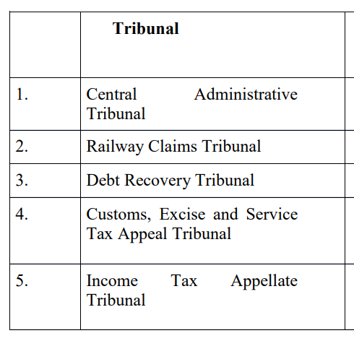
The Tribunals in India
• Central Administrative Tribunal
• Railway Claims Tribunal
• Debts Recovery Tribunal
• Customs, Excise and Service Tax Appellate Tribunal (CESTAT)
• Income Tax Appellate Tribunal (ITAT)

Slide 42
THE NATIONAL GREEN TRIBUNAL
The NGT has been set up to decide environmental disputes (NGT Act, 2010), with benches at Delhi, Bhopal, Pune, Kolkata and Chennai aka ‘environment court’.
A bench has at least one judicial and one expert member.
It has civil jurisdiction over environmental matters (not criminal).
There is a provision to appeal to the supreme court.

Slide 43
THE INCOME TAX APPEALLATE TRIBUNAL [ITAT]
ITAT is a quasi judicial institution set up in January, 1941 and specializes in dealing with appeals under the Direct Taxes Acts. The orders passed by the ITAT are final, an appeal lies to the High Court only if a substantial question of law arises for determination.
Starting in 1941 with six Members constituting three Benches - one each at Delhi, Kolkata (Calcutta) and Mumbai (Bombay), the numbers of Benches have progressively increased and presently ITAT has 63 Benches at 27 different stations covering almost all the cities having a seat of the High Court.

Slide 44
THE INCOME TAX APPEALLATE TRIBUNAL [ITAT]
ITAT draws inspiration from its motto ‘Nishpaksh Sulabh Satvar Nyay’, which means impartial, easy and speedy justice. ITAT stands out for its uniqueness of imparting justice to the litigants, by an inexpensive, easily accessible forum free from technicalities, regarded for its expert knowledge on the subject of Direct Taxes, besides rendering expeditious justice. More often than not, ITAT is referred to as 'Mother Tribunal' being the first & the oldest Tribunal in the country. More importantly, it is the success of the ITAT, which has prompted the Government of India to constitute similar Appellate Tribunals for indirect taxes i.e. Customs, Excise, Service Tax Appellate Tribunal (CESTAT), Central Administrative Tribunal (CAT),
Railway Claims Tribunal, Foreign Exchange Appellate Board, etc.

Slide 45
THE ADMINISTRATIVE TRIBUNAL
The characteristics of administrative tribunals are mentioned below:
They are of statutory origin, and so must be created by a statute by Parliament/Legislatures.
They are quasi-judicial in nature, which means, they have some, not all the features of a court.
They function on the principles of natural justice and are not bound by the Civil Procedure Code.
They have the power to summon witnesses, administer oaths and compel the submission of documents, etc. like other courts.
The writs of prohibition and certiorari are available against decisions of such tribunals.
They are independent bodies with no external interference.

Slide 46
THE ADMINISTRATIVE TRIBUNAL : ADVANTAGES
Administrative Tribunals Advantages
Tribunals offer flexibility when compared to ordinary courts that have to adhere to strict procedures.
They are cheaper and offer speedy justice.
The procedure followed by the tribunals is simple and easy to understand even for the layman.
They also offer relief to the ordinary courts that are already over-burdened with suits.

Slide 47
THE ADMINISTRATIVE TRIBUNAL :DISADVANTAGES
Administrative Tribunals Disadvantages
They go against the spirit of “Rule of Law”. Rule of Law ensures that arbitrary power is not exercised by institutions or individuals.
It is the principle that everybody is subject to and accountable to the law (which is fair). Ordinary courts have a uniform code of procedure for civil and criminal cases. But, administrative tribunals have no uniform code of procedure.
Such tribunals are sometimes handled by subject matter experts who have no experience in dealing with judicial proceedings.
Hence, they end up adopting summary procedures as well.

Slide 48
OTHER TRIBUNALS
Armed Forces Tribunal
This is a military tribunal established under the Armed Forces Tribunal Act, 2007.
It settles disputes with respect to the commission, emoluments, appointments and service conditions of personnel in the armed forces.
Its Principal Bench is in New Delhi. It also has Regional Benches across the country.
Water Disputes Tribunal
These are constituted for the purpose of settling disputes between Indian states on the question of water-sharing between rivers that flow through multiple states.

Slide 49
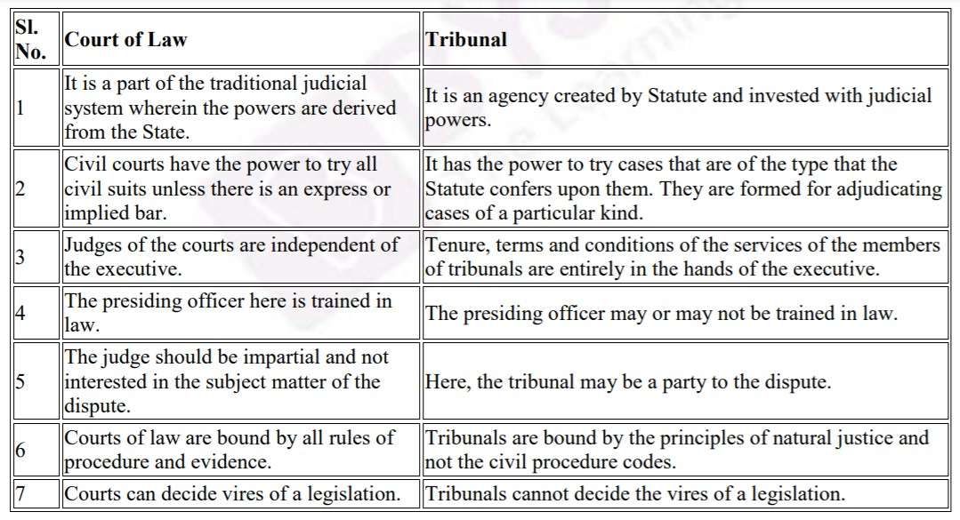
TRIBUNAL VS. COURT
Point | Court of law | Tribunal
Origin | Part of the traditional judicial system; powers come from the State | Created by a statute and given judicial powers
Jurisdiction | Tries all civil suits unless expressly or impliedly barred | Tries only the cases its statute gives it
Service conditions | Judges are independent of the executive | Set by the parent statute and rules; independence has been a recurring concern
Training | Presiding officer is trained in law | May or may not be trained in law; often has technical members
Procedure | Bound by all rules of procedure and evidence | Bound by natural justice, not strict rules of procedure and evidence
Validity of laws | Can decide the vires (validity) of legislation | Can test statutory provisions except its own parent statute (L. Chandra Kumar, 1997)

Slide 50
MERGING OF TRIBUNALS (FINANCE ACT, 2017)
The Employees Provident Fund Appellate Tribunal with The Industrial Tribunal.
The Copyright Board with The Intellectual Property Appellate Board.
The Railways Rates Tribunal with The Railways Claims Tribunal.
The Appellate Tribunal for Foreign Exchange with The Appellate Tribunal (Smugglers and Foreign Exchange Manipulators (Forfeiture of Property) Act, 1976.
The National Highways Tribunal with The Airport Appellate Tribunal.
The Cyber Appellate Tribunal and The Airports Economic Regulatory Authority Appellate Tribunal with The Settlement and Appellate Tribunal (TDSAT).
The Competition Appellate Tribunal with the National Company Law Appellate Tribunal.
The Tribunals Reforms Act, 2021 later abolished several appellate bodies (for example the Intellectual Property Appellate Board) and moved their work to High Courts and other forums.

Slide 51

CONSUMER RIGHTS

Slide 52
CONSUMER MOVEMENT
The consumer movement arose out of dissatisfaction of the consumers as many unfair practices were being indulged in by the sellers.
There was no legal system available to consumers to protect them from exploitation in the marketplace.
For a long time, when a consumer was not happy with a particular brand product or shop, he or she generally avoided buying that brand product, or would stop purchasing from that shop.
It was presumed that it was the responsibility of consumers to be careful while buying a commodity or service.

Slide 53
CONSUMER MOVEMENT
In India, the consumer movement as a ‘social force’ originated with the necessity of protecting and promoting the interests of consumers against unethical and unfair trade practices.
Because of all these efforts, the movement succeeded in bringing pressure on business firms as well as government to correct business conduct which may be unfair and against the interests of consumers at large. A major step in 1986 was the Consumer Protection Act 1986 (COPRA). It was replaced by the Consumer Protection Act, 2019, in force since 20 July 2020.

Slide 54
CONSUMER RIGHTS
Right to be informed about the particulars of goods and services that they purchase.
Right to choose whether to continue to receive the service or buy the goods.
Right to seek redressal against unfair trade practices and exploitation.
Right to be heard, and to have consumer interests considered at the proper forums.
Right to safety against goods and services hazardous to life and property.
Right to consumer awareness (consumer education).

Slide 55

CONSUMER RIGHTS : WHERE TO GO ?
• District Commission: claims up to Rs 50 lakh
• State Commission: above Rs 50 lakh and up to Rs 2 crore
• National Commission (NCDRC): above Rs 2 crore
• Complaints can be filed online through e-Daakhil
• National Consumer Helpline: 1915

Slide 56
CONSUMER PROTECTION ACT, 2019
The Act provides a three-tier quasi-judicial machinery: District, State and National Commissions for redressal of consumer disputes.
The District Commission hears claims up to Rs 50 lakh (value of goods or services paid for).
The State Commission: above Rs 50 lakh and up to Rs 2 crore; and
The National Commission (NCDRC): above Rs 2 crore.
If a case is dismissed in district level court, the consumer can also appeal in state and then in National level courts.
The Act also set up the Central Consumer Protection Authority (CCPA) and allows e-filing and mediation.

Slide 57
ARBITRATION: MEANING AND NEED
Arbitration is a private way of settling disputes: the parties refer the dispute to neutral arbitrators instead of a court.
Governed by the Arbitration and Conciliation Act, 1996, based on the UNCITRAL Model Law and amended in 2015, 2019 and 2021.
It needs a written arbitration agreement (Sec. 7), usually a clause in a contract such as a construction or supply contract.
Advantages: faster, flexible procedure, confidentiality, and parties choose the arbitrators.
Limits: cost can be high, and grounds of challenge to an award are narrow.

Slide 58
ARBITRATION: PROCESS AND AWARD
The parties choose the arbitrators. If they fail to agree, the court appoints them (Sec. 11).
If a valid agreement exists, a court must refer the parties to arbitration (Sec. 8).
The tribunal follows natural justice and should give its award within 12 months of the pleadings, extendable by 6 months (Sec. 29A).
The award is final and binding (Sec. 35) and enforceable like a court decree (Sec. 36).
A court can set an award aside only on limited grounds (Sec. 34).
Conciliation (Part III of the Act) and mediation (Mediation Act, 2023) are other ADR methods.

Slide 59
LAW AT THE WORKPLACE: THE FOUR LABOUR CODES
Since 21 November 2025, four Labour Codes have replaced 29 central labour laws.
Code on Wages, 2019: wages, minimum wages, bonus and equal remuneration.
Industrial Relations Code, 2020: trade unions, standing orders and industrial disputes (replaces the Industrial Disputes Act, 1947).
Code on Social Security, 2020: provident fund, gratuity, ESI and maternity benefit, with cover for gig and platform workers.
Occupational Safety, Health and Working Conditions Code, 2020: safety, health and working conditions (replaces the Factories Act, 1948).
Also relevant: the Sexual Harassment of Women at Workplace Act, 2013, which requires an Internal Committee.

Slide 60
Important Questions
What factors gave birth to the consumer movement in India? Trace its evolution.
Explain the need for consumer consciousness by giving two examples. Mention a few factors which cause exploitation of consumers.
Critically examine the progress of consumer movement in India.
What are tribunals? How they differ from courts.
Describe major tribunals in India.
Trace the major sources of international law. Explain private & public international law.
Trace the major sources of municipal law. Discuss the types of municipal law.
What is principle of natural justice? Explain the functions of legal system.
•

Slide 61
SOURCES
Brij Kishore Sharma: Introduction to the Indian Constitution, PHI, New Delhi, latest edition.
Granville Austin: The Indian Constitution: Cornerstone of a Nation. 1966, Oxford Clarendon Press.
Subhash C. Kashyap: Our Constitution: An Introduction to India’s Constitution and constitutional Law, NBT, 2018.
PM Bakshi: The Constitution of India, Latest Edition, Universal Law Publishing.
V.K. Ahuja: Law Relating to Intellectual Property Rights (2007)
Suresh T. Viswanathan: The Indian Cyber Laws, Bharat Law House, New Delhi‐88
P. Narayan: Intellectual Property Law, Eastern Law House, New Delhi
Prabudh Ganguli: Gearing up for Patents: The Indian Scenario, Orient Longman.
BL Wadehra: Patents, Trademarks, Designs and Geological Indications. Universal Law Publishing - LexisNexis.
Intellectual Property Rights: Law and Practice, Module III by ICSI (only relevant sections)
Executive programme study material Company Law, Module II, by ICSI (The Institute of Companies Secretaries of India) (Only relevant sections i.e., Study 1, 4 and 36).https://www.icsi.edu/media/webmodules/publications/Company%20Law.pdf
Handbook on e-Governance Project Lifecycle, Department of Electronics & Information Technology, Government of India, https:// www.meity.gov.in/writereaddata/files/e- Governance_Project_Lifecycle_Participant_Handbook-5Day_CourseV1_20412.pdf
Companies Act, 2013 Key highlights and analysis by PWC. https://www.pwc.in/assets/pdfs/publications/2013/companies-act-2013-key-
highlights-andanalysis..pdf

