Slide 1
CONSTITUTION OF INDIA

Slide 2
OUTLINES
Module 5
Business Organizations and E-Governance
Sole Traders, Partnerships: Companies: The Company’s Act: Introduction, Formation of a Company, Memorandum of Association, Articles of Association, Prospectus, Shares, Directors, General Meetings and Proceedings, Auditor, Winding up.
E-Governance and role of engineers in E-Governance, Need for reformed engineering serving at the Union and State level, Role of I.T. professionals in Judiciary, Problem of Alienation and Secessionism in few states creating hurdles in Industrial development.

Slide 3
SOLE PROPRIETORSHIP AND PARTNERSHIP
  Sole proprietorship: a business owned and run by one person. It is easy to start, but it is not a separate legal entity and the owner has unlimited liability.
  Partnership: the Indian Partnership Act, 1932 (Sec. 4) defines it as the relation between persons who agree to share the profits of a business carried on by all or any of them acting for all.
  A partnership firm can have 2 to 50 partners. Partners are jointly and severally liable without limit. Registration is not compulsory, but an unregistered firm has limited rights to sue.
  Limited Liability Partnership (LLP Act, 2008): a separate legal entity where each partner's liability is limited to the agreed contribution.

Slide 4
THE COMPANY ACT, 2013 [ERSTWHILE 1956]
This act extends to the whole of India.
The provisions of this Act shall apply to :
Companies incorporated under this Act or under any previous company law.
Insurance companies, except in so far as the said provisions are inconsistent with the provisions of the Insurance Act, 1938 (4 of 1938) or the Insurance Regulatory and Development Authority Act, 1999 (41 of 1999).
Banking companies, except in so far as the said provisions are inconsistent with the provisions of the Banking Regulation Act, 1949 (10 of 1949).
Companies engaged in the generation or supply of electricity, except in so far as the said provisions are inconsistent with the provisions of the Electricity Act, 2003 (36 of 2003).
Any other company governed by any special Act for the time being in force, except in so far as the said provisions are inconsistent with the provisions of such special Act.
Such body corporate, incorporated by any Act for the time being in force, as the Central Government may, by notification, specify in this regard.

Slide 5
THE COMPANY ACT, 2013 [ERSTWHILE 1956]
‘Body Corporate’ or ‘Corporation’ includes a company incorporated outside India, but does not include :
  A co-operative society registered under any law relating to co-operative societies.
  Any other body corporate (not being a company as defined in this Act), which the Central Government may, by notification, specify in this behalf.
  Company : Definition
  The word company means an association formed by a number of persons for some common object. When such an association of persons is registered under the companies act, it becomes an artificial person with perpetual succession. (A common seal has been optional since 2015.)

Slide 6
THE COMPANY ACT, 2013 [ERSTWHILE 1956]
  Company : Definition
  The word company means an association formed by a number of persons for some common object. When such an association of persons is registered under the companies act, it becomes an artificial person with perpetual succession. (A common seal has been optional since 2015.)
  A company is defined as, ‘a company formed and registered under this act or an existing company.’ An existing company means ‘a company formed and registered under any of the previous company laws.’ The definition given by the companies’ act does not define the company clearly as to its features.

Slide 7
THE COMPANY ACT, 2013 [ERSTWHILE 1956]
  Company : Definition
  Chief Justice Marshall of U.S.A. has defined the term company, as ‘a company is a person, artificial, invisible, intangible and existing only in the contemplation of the law. Being a mere creature of law, it posses only those properties which the charter of its creation confers upon it either expressly or as incidental to its very existence.’

Slide 8
THE COMPANY ACT, 2013 [ERSTWHILE 1956]
  Company : Formation of company
  A company may be formed for any lawful purpose by :
      (a) seven or more persons, where the company to be formed is to be a public company;
      (b) two or more persons, where the company to be formed is to be a private company; or
      (c)one person, where the company to be formed is to be One Person Company that is to say, a private company,

Slide 9
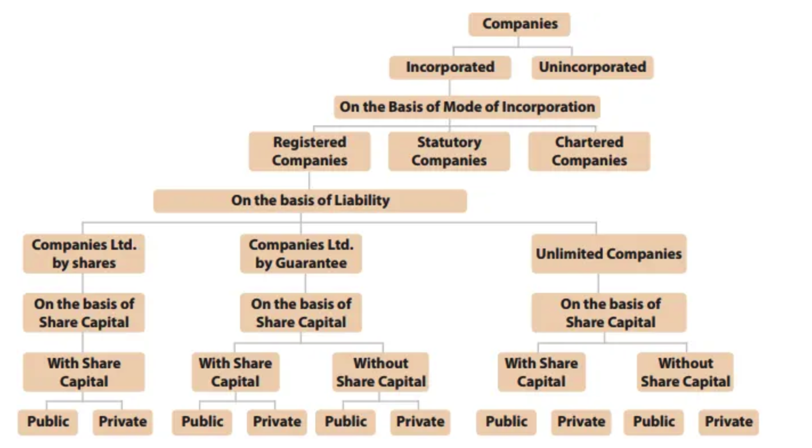
THE COMPANY ACT, 2013 [ERSTWHILE 1956]
•
•
•
•

Slide 10
THE COMPANY ACT, 2013 [ERSTWHILE 1956]
Generally there are two common types of companies which are registered under this Act, they are :
Private company 2. Public company
However, there are other types of companies which are shown as under:-
  Chartered Companies: The companies which are incorporated by a charter granted by the “Crown” in exercise of royal prerogative Eg. East India Company.
  Statutory Companies: The companies incorporated by means of Statute of special Act of the parliament or any State Legislative Eg. RBI, LIC etc.
  Registered Companies: The companies registered under the Companies Act, 2013 or earlier Companies Acts.
•
•
•
•

Slide 11
THE COMPANY ACT, 2013 [ERSTWHILE 1956]
Memorandum of Association
“Memorandum” means “Memorandum of Association of a company as originally framed and altered from time to time in pursuance of any provisions of company laws or of this Act”
The Memorandum of Association is a document of great importance in relation to the proposed company. It contains the objects for which the company is formed and therefore identifies the possible scope of its operations beyond which its action cannot go. It defines as well as confines the power of company. If anything is done beyond these power that will be ultra vires the Company and so void. Thus, it is evident that the memorandum is the charter and defines the limitation of the power of a company.
•
•
•
•

Slide 12
THE COMPANY ACT, 2013 [ERSTWHILE 1956]
Memorandum of Association
Memorandum of Association [Content Clauses]
  Name clause
  Registered office clause
  Object clause
  Liability clause
  Capital clause
  Association or Subscription clause

Slide 13
THE COMPANY ACT, 2013 [ERSTWHILE 1956]
Memorandum of Association
Memorandum of Association [Requirements to be stated]
There must be at least 7 persons in case of the public company and at least 2 persons in case of the private company. Memorandum of a limited company to contain the following clauses:
The name of the company with limited as the last word in case of a public limited company and with Private Limited as the last word in the case of a Private Limited Company.

Slide 14
THE COMPANY ACT, 2013 [ERSTWHILE 1956]
Memorandum of Association
The state in which the registered office of the company is to be situated.
The objects of the company must be separated on two basis :
(i) The main objects of the company to be pursued by the company on its incorporation and objects incidental to be fulfilment of the main object
(ii) Matters necessary for furthering the main objects.
The amount of authorized share capital divided into shares of fixed amounts.
The liability of members is limited if the company is limited by shares or by Guarantee.

Slide 15
THE COMPANY ACT, 2013 [ERSTWHILE 1956]
Memorandum of Association
Memorandum of Association [Requirements to be stated]
Clause 4 and 5 will not be included in the Memorandum of Association of an unlimited company.
In case of a company limited by Guarantee, its Memorandum of Association should state that each members undertakes to contribute to the asset of the company in the events of its being wound up while he is a member or within one year after he ceases to be a member for –
  Payment of debts of the company
  Payments of liabilities of the company, the costs, charges and expenses of winding up and
  Adjustment of right of contributories among themselves, such amount as may be required not exceeding a specified amount

Slide 16
THE COMPANY ACT, 2013 [ERSTWHILE 1956]
Memorandum of Association
Memorandum of Association [Alteration in the name clause]
The name of a company may be changed at any time by passing a special Resolution at a general meeting of the company and with the written approval of the Central Government.
However, no approval of the Central Government is necessary if the change of name involves only the addition or deletion of the word “private” (i.e. when public company is converted into a private company or vice versa).
If through inadvertence or otherwise, a company on its first registration or on its registration by a new name has been registered with a name which in the opinion of the Central Government, is identical with or too closely resembles the name of the existing company, the company may change its name by passing an ordinary resolution and by obtaining the approval of the Central Government in writing

Slide 17
THE COMPANY ACT, 2013 [ERSTWHILE 1956]
Memorandum of Association
Memorandum of Association [Alteration in the name clause]
Name availability is checked on the MCA portal (RUN service or SPICe+ Part A). The application for change of name is filed with the Registrar of Companies in Form INC-24 with the prescribed fee.
An approved name is reserved only for a limited period (20 days for a new company, 60 days for a change of name).
The special resolution must be filed with the Registrar in Form MGT-14 within 30 days of passing it.
On approval the Registrar issues a fresh certificate of incorporation, and the change takes effect from its date (Sec. 13).

Slide 18
THE COMPANY ACT, 2013 [ERSTWHILE 1956]
Memorandum of Association
Memorandum of Association [Alteration in the registered office clause]
The change of the Registered office may include:
Change of registered office from one place to another place in the same city, town
Change of registered office from one town to another town in the same state
Change of registered office from one state to another state is possible by alteration in the Memorandum of Association.

Slide 19
THE COMPANY ACT, 2013 [ERSTWHILE 1956]
Memorandum of Association
Memorandum of Association [Alteration in the registered office clause]
A special resolution is needed to shift the registered office from one State to another (Sec. 13(4)).
Notice of the proposed change is given to all shareholders, and the company advertises it in newspapers.
The change takes effect only after the Central Government (power delegated to the Regional Director) approves it on the company's application.
Before approving, the Regional Director must be satisfied that notice has been given to every person whose interest is affected.
The Registrar of Companies is also heard before the decision is made.

Slide 20
THE COMPANY ACT, 2013 [ERSTWHILE 1956]
Memorandum of Association [Alteration in the registered office clause]
The Regional Director may confirm the alteration on such terms as it thinks fit.
It must have regard to the rights and interests of the members and creditors of the company.
A certified copy of the order is filed with the Registrar within 30 days.
The Registrar's certificate is conclusive evidence that all requirements of the Act have been met.
The records of the company are then transferred to the Registrar of the State in which the registered office now lies.

Slide 21
THE COMPANY ACT, 2013 [ERSTWHILE 1956]
Memorandum of Association [Alteration in the object clause]
Under Sec. 13(1), a company may alter its object clause by a special resolution. Typical reasons are:
  To carry on its business more economically or more efficiently.
  To attain its main purpose by new of improved means.
  To enlarge or change the local area of its operation.
  To carry on some business which under existing circumstances may be conveniently or advantageously combined with the business of the company.
  To restrict or abandon any of the objects specified in the memorandum.
  To sell or dispose of the whole or any part of the undertaking to the company.
  To amalgamate with any other company or body of persons.

Slide 22
THE COMPANY ACT, 2013 [ERSTWHILE 1956]
Memorandum of Association [Alteration in the object clause]
  To alter the object of the company, a special resolution is to be passed at a general meeting.
  A printed or a typewritten copy of the special resolution is required to be filled with the Registrar of Companies within 30 days of the passing thereof.
  The Registrar of Companies will register the documents and issue within one month, a certificate which will be conclusive evidence that everything required has been done.
  The alteration takes effect only from the date it is registered by the Registrar.

Slide 23
THE COMPANY ACT, 2013 [ERSTWHILE 1956]
Memorandum of Association [Alteration in the liability clause]
In normal way a liability clause cannot be altered to make the liability unlimited, but still the alteration are done in the liability clause:
  Conversion of unlimited liability into a limited liability: the procedure is to get it re-registered.
  Limited liability into unlimited liability: All the members have to give consent and the consent should be written.

Slide 24
THE COMPANY ACT, 2013 [ERSTWHILE 1956]
Memorandum of Association [Alteration in the capital clause]
A company limited by share capital may, by an ordinary resolution passed in general meeting, alter the conditions of its memorandum in regard to capital so as
To increase its authorized share capital by such amount as it thinks expedient by issuing fresh shares.
To consolidate and divide all or any of its share capital into shares of larger amount than its existing shares e.g. 10 shares of Rs. 10 each may be consolidated into one share of Rs. 100 each.
To convert all or any of its fully paid up shares into stock, and reconvert that stock into fully paid up shares of any denomination.
To sub-divide its shares, or any of them, into shares of smaller amount than fixed by the memorandum, but the proportion of paid and unpaid on each share must remain the same.
To cancel shares which, at the date of passing of the resolution in that behalf, have not been taken by any person and thus diminish the amount of its share capital by the amount of the shares so cancelled.

Slide 25
THE COMPANY ACT, 2013 [ERSTWHILE 1956]
Memorandum of Association [Doctrine of ultra vires]
Ultra vires is the combination of two words and they are ‘ultra’ means beyond and ‘vires’ means power. An act will be said to be Ultra vires, when it is performed which though legal in itself, is not permitted by the objects clause in the Memorandum of Association or the statute. These are of three types:
Acts ultra vires the director: These acts are out of the scope of the direction of the company. They are not totally void or inoperative. They can be ratified by the shareholders in a general Meeting.
Acts ultra vires the Articles of association of the company: The acts will be ultra vires if they are beyond the powers of the company given to its by its Articles of association. They are also not void and inoperative. They can also be ratified by the company by altering the articles through a special resolution.
Acts ultra vires the memorandum of association of the company: These acts are beyond the powers of the company, so called. “Ultra vires the company”. They are wholly void, inoperative and cannot be ratified by whole body of the shareholders.

Slide 26
THE COMPANY ACT, 2013 [ERSTWHILE 1956]
Memorandum of Association [Doctrine of ultra vires : Implications]
  Injunction [restriction by the court’s order ; any member of the company can do that].
  Personal liability of the directors.
  Void ab initio [company cannot be sued for natural acts].
  Ultra vires acquired property.[can be claimed for the damages].
  Ultra vires borrowing. [no claim for such amount lent].

Slide 27
THE COMPANY ACT, 2013 [ERSTWHILE 1956]
  Articles of Association
  The Articles of association of a company are subordinate to and are controlled by the memorandum of association. The articles are framed mainly for carrying out the aims and objects of the Memorandum of Association. They accept the Memorandum of Association as the charter of incorporation and so accepting if the articles proceed to define the duties, rights and powers of the governing body. Under Sec. 5 of the 2013 Act every company must register its Articles with the Registrar, including:
  Company limited by guarantee
  Unlimited company
  Private Company limited by shares
  Public company limited by shares (it may adopt the model Articles, Table F)

Slide 28
THE COMPANY ACT, 2013 [ERSTWHILE 1956]
  Articles of Association (Content)
    Exclusion wholly or in part of Table F (model Articles in Schedule I).
    Adoption of preliminary contracts.
    Number and the value of shares
    Allotment of shares
    Call on shares
    Lien on shares
    Transfer and transmission of shares
    Forfeiture of shares
    Alteration of capital

Slide 29
THE COMPANY ACT, 2013 [ERSTWHILE 1956]
  Articles of Association (Alteration)
  According to the provisions of the act and to the conditions contained in its Memorandum of Association, a company may by passing a special resolution alter or add to its Articles of association.
  The company must file with the Registrar of Companies a copy of special resolution within 30 days from the date of its passing
  The altered Articles of association will bind the member in the same form as the original articles.

Slide 30
THE COMPANY ACT, 2013 [ERSTWHILE 1956]
  Articles of Association (Alteration)
    Articles of Association [Contents]
    Share certificates
    Conversion of shares into stock
    Voting right and proxies
    Meeting
    Directors and their appointment
    Borrowing powers
    Dividend and reserves
    Accounts and audit
    Winding up

Slide 31
THE COMPANY ACT, 2013 [ERSTWHILE 1956]
    Articles of Association [Valid Alteration]
    The alteration made in the articles are valid only if they satisfy all of the following conditions:
    The alteration must not authorize anything expressly or impliedly forbidden by the companies Act.
    The alteration must not extend or modify the Memorandum of Association.
    The alteration must not contain anything illegal.
    The alteration must not be inconsistent with any alteration made by the Tribunal (NCLT).
    The alteration must be bonafide for the benefit of the company as a whole.
    The alteration must not make the Articles unalterable, as that is bad in law.

Slide 32
THE COMPANY ACT, 2013 [ERSTWHILE 1956]
    Articles of Association [Valid Alteration]
  Retrospective operation of Articles of association.
  The alteration must not constitute fraud on the minority by a majority.
  An alteration of Articles of association to effect a conversion of a public company into a private company cannot be made without the approval of Central Government.
  There cannot be alteration of the Articles of association so as to compel an existing member to take or subscribe for more shares or in any way extend liability to contribute to shares capital, unless he gives his consent in writing.
  A company cannot justify breach of contract with third parties or avoid a contractual obligation by altering Articles of association.

Slide 33
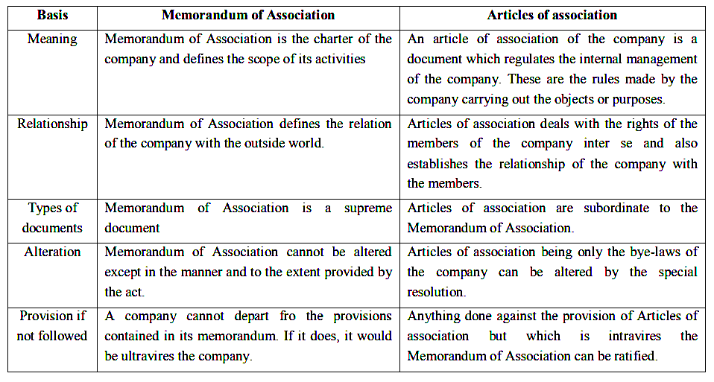
THE COMPANY ACT, 2013 [ERSTWHILE 1956]
•
•
•
•

Slide 34
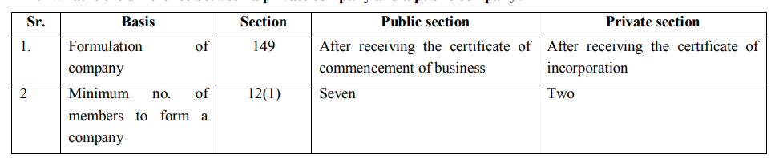
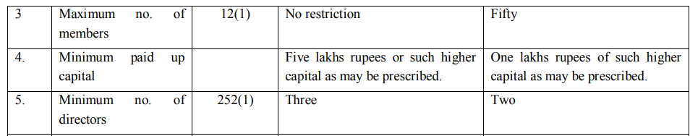
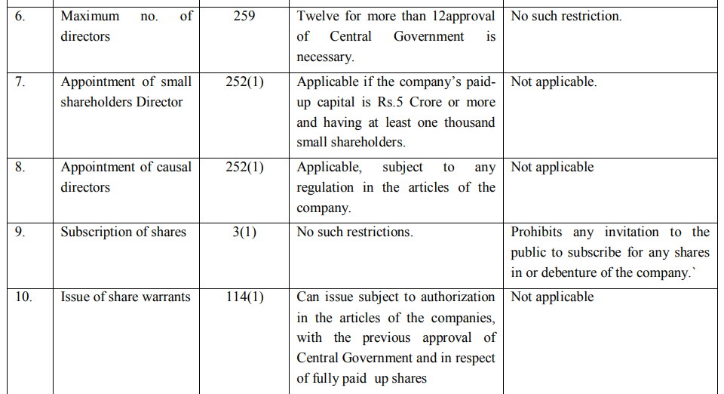
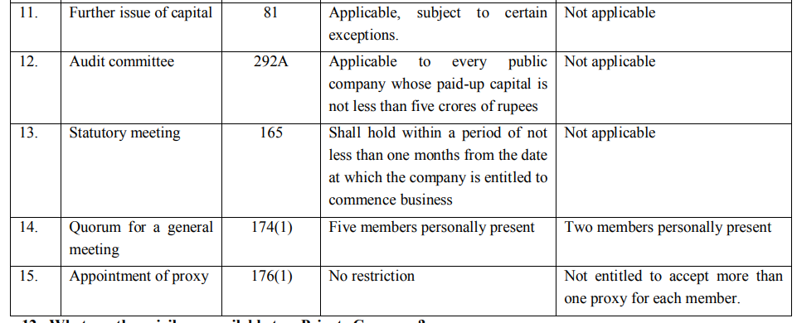
THE COMPANY ACT, 2013 [ERSTWHILE 1956]
Public Company Vs. Private Company
•
Basis | Public company | Private company
Minimum members | 7 | 2
Maximum members | No limit | 200
Minimum directors | 3 | 2
Maximum directors | 15 (more by special resolution) | 15 (more by special resolution)
Minimum paid-up capital | None (Rs 5 lakh rule removed in 2015) | None (Rs 1 lakh rule removed in 2015)
Name ends with | Limited | Private Limited
Invitation to the public for shares | Allowed, through a prospectus | Prohibited
Transfer of shares | Free (for listed companies) | Restricted by the Articles
Independent directors | Required for listed and prescribed public companies | Not required
Quorum of general meeting | 5 members (up to 1000 members); more for larger companies | 2 members
•
•
•

Slide 35
THE COMPANY ACT, 2013 [ ERSTWHILE 1956]
Conversion : Public company to Private Company
The conversion can take place in following ways:
  A Public company can be converted into a private company by altering the articles, incorporating the three restrictions, mentioned in section.
  Approval of the central government is necessary for converting a Public company into a private company.
  Special resolution is to be passed within 30 days, after obtaining the approval of the Central Government for conversion.
  The word private Ltd. is used.
  The conversion of a public company into a private company does not affect the identity of the company.
•
•
•
•

Slide 36
THE COMPANY ACT, 2013 [ ERSTWHILE 1956]
Conversion : Private company to Public Company
Under Sec. 14, a private company becomes a public company by altering its Articles.
A special resolution of the members is passed to delete the three restrictions: on transfer of shares, on the number of members, and on inviting the public.
A copy of the resolution and the altered Articles are filed with the Registrar within 30 days.
The word 'Private' is dropped from the name, and the Registrar issues a fresh certificate of incorporation.
The company must then meet the rules for a public company, such as at least 7 members and 3 directors.
•
•
•
•

Slide 37
THE COMPANY ACT, 2013 [ ERSTWHILE 1956]
Prospectus :
Where a company allots or agrees to allot any securities of the company with a view to all or any of those securities being offered for sale to the public, any document by which the offer for sale to the public is made shall, for all purposes, be deemed to be a prospectus issued by the company. It shall be dated and signed.
A prospectus is a document that invites the public to subscribe to or buy the securities of a company (Sec. 2(70)).
•
•
•
•

Slide 38
THE COMPANY ACT, 2013 [ ERSTWHILE 1956]
Prospectus should contain :
(a )state the following information, namely:
  names and addresses of the registered office of the company, company secretary, Chief Financial Officer, auditors, legal advisers, bankers, trustees, if any, underwriters and such other persons as may be prescribed;
  dates of the opening and closing of the issue, and declaration about the issue of allotment letters and refunds within the prescribed time;
  a statement by the Board of Directors about the separate bank account where all monies received out of the issue are to be transferred and disclosure of details of all monies including utilised and unutilised monies out of the previous issue in the prescribed manner;
  details about underwriting of the issue;
  consent of the directors, auditors, bankers to the issue, expert‘s opinion, if any, and of such other persons, as may be prescribed;
  the authority for the issue and the details of the resolution passed therefor;
  procedure and time schedule for allotment and issue of securities;
•
•
•
•

Slide 39
THE COMPANY ACT, 2013 [ ERSTWHILE 1956]
Prospectus should contain :
(a)state the following information, namely:
  capital structure of the company in the prescribed manner;
  main objects of public offer, terms of the present issue and such other particulars as may be prescribed;
  main objects and present business of the company and its location, schedule of implementation of the project;
  particulars relating to : management perception of risk factors specific to the project; gestation period of the project; extent of progress made in the project; deadlines for completion of the project; and any litigation or legal action pending or taken by a Government Department or a statutory body during the last five years immediately preceding the year of the issue of prospectus against the promoter of the company;
  minimum subscription, amount payable by way of premium, issue of shares otherwise than on cash;
  details of directors including their appointments and remuneration, and such particulars of the nature and extent of their interests in the company as may be prescribed; and
  disclosures in such manner as may be prescribed about sources of promoter‘s contribution;
•
•
•
•

Slide 40
THE COMPANY ACT, 2013 [ ERSTWHILE 1956]
Prospectus should contain :
(b)state the following reports , namely:
  Auditor’s report on profit / loss & assets / liabilities.
  Company’s report on profit / loss & assets / liabilities for last 5 financial years immediately preceding the current financial year. Such reports of subsidiary companies may be given too.
  Auditor’s report on profit / loss & assets / liabilities for last 5 financial years immediately preceding the current financial year in which issue is to be made.
  Reports on projected application of funds collected as a result of such issue.
•
•
•
•

Slide 41
THE COMPANY ACT, 2013 [ ERSTWHILE 1956]
Prospectus should contain :
  A valid declaration to abide by the provisions of this act.
  Other reports as desired.
•
•
•
•

Slide 42
THE COMPANY ACT, 2013 [ ERSTWHILE 1956]
Shares
  The share capital of a company limited by shares shall be of two kinds, namely:
  (a) equity share capital
      with voting rights; or
      with differential rights as to dividend, voting or otherwise in accordance with such rules as may be prescribed; and
  (b) preference share capital Provided that nothing contained in this Act shall affect the rights of the preference shareholders who are entitled to participate in the proceeds of winding up.
•
•
•
•

Slide 43
THE COMPANY ACT, 2013 [ ERSTWHILE 1956]
Shares [Types]
    Equity shares are representative of stakes in ownership of a company. If, for instance, Ms. Priya holds Rs. 10 lacs worth of equity shares in Company M with issued and paid up share capital of Rs 1 crore then the stake holding is 10 %.
    Preference shares Preference shares also commonly known as preferred stock, is a special type of share where dividends are paid to shareholders prior to the issuance of common stock dividends. Consequently, if a company lands into bankruptcy, preference shareholders are repaid before equity shareholders and have the first right to the company's assets. For preference shareholders, the dividend is fixed however, they don’t hold voting rights as opposed to common shareholders.
•
•
•
•

Slide 44
THE COMPANY ACT, 2013 [ ERSTWHILE 1956]
Equity Share [Types]
    Bonus share [preferably issued in place of paying the dividend]
    Right share [offered on a pro rata basis to the existing share holders at a specific price in a specified period]
    Sweat equity share [offered to present employees]
    Voting & non Voting share
    Authorised share capital
    Issued share capital
    Subscribed share capital
    Dividend stock
    Growth stock
•
•
•
•

Slide 45
THE COMPANY ACT, 2013 [ ERSTWHILE 1956]
Preference Share [Types]
  Cumulative preference share [unpaid dividend accumulates and is paid later]
  Non Cumulative preference share [year’s dividends to be paid out from that year’s profit]
  Redeemable preference share [buy back on a fixed date or giving a prior notice]
  Irredeemable preference share [no longer allowed: Sec. 55 requires redemption within 20 years]
  Participating preference share [normal(fixed) dividend + preferred(premium) dividend]
  Non participating preference share [normal or fixed dividend only]
  Convertible preference share [can be converted into equity shares]
  Non convertible preference share [cannot be converted into equity shares]
•
•
•
•

Slide 46
THE COMPANY ACT, 2013 [ ERSTWHILE 1956]
Salient features of share & shareholders
    Sweat equity shares can be issued not before one year of the commencement of the business, through the special resolution passed concerning numbers, price of the shares & to whom it should be issued. In case of listed company SEBI guidelines to be followed strictly.
    Bonus shares can be issued only out of free reserves, securities premium account or capital redemption reserve account.
•
•
•
•

Slide 47
THE COMPANY ACT, 2013 [ ERSTWHILE 1956]
Directors
    Numbers of directors are minimum 3 in case of public company, 2 in case of a private company & 1 in case of one person company. Maximum limit is 15.
    Every company should have at least one director who has stayed in India for at least 182 days in the previous financial year.
    In case of listed company at least one third of the directors should be independent. Public companies above prescribed limits must have at least two independent directors.
    Provided that a company may appoint more than fifteen directors after passing a special resolution:
    Provided further that such class or classes of companies as may be prescribed, shall have at least one woman director.
•
•
•
•

Slide 48
THE COMPANY ACT, 2013 [ ERSTWHILE 1956]
Directors
    Every listed public company must have at least one-third of its directors as independent directors (Sec. 149(4)).
    Public companies above prescribed limits of paid-up capital, turnover or borrowings must have at least two independent directors.
    An independent director can serve up to two terms of five consecutive years (Sec. 149(10)-(11)).
•
•
•
•

Slide 49
THE COMPANY ACT, 2013 [ ERSTWHILE 1956]
Independent Director
  An independent director in relation to a company, means a director other than a managing director or a whole-time director or a nominee director,
  who, in the opinion of the Board, is a person of integrity and possesses relevant expertise and experience.
  who is or was not a promoter of the company or its holding, subsidiary or associate company.
  who is not related to promoters or directors in the company, its holding, subsidiary or associate company.
  who has or had no pecuniary relationship with the company, its holding, subsidiary or associate company, or their promoters, or directors, during the two immediately preceding financial years or during the current financial year.
  none of whose relatives has or had pecuniary relationship or transaction with the company, its holding, subsidiary or associate company, or their promoters, or directors, amounting to two per cent. or more of its gross turnover or total income or fifty lakh rupees or such higher amount as may be prescribed, whichever is lower, during the two immediately preceding financial years or during the current financial year.
•
•
•
•

Slide 50
THE COMPANY ACT, 2013 [ ERSTWHILE 1956]
Independent Director
  who, neither himself nor any of his relatives—
    holds or has held the position of a key managerial personnel or is or has been employee of the company or its holding, subsidiary or associate company in any of the three financial years immediately preceding the financial year in which he is proposed to be appointed;
    is or has been an employee or proprietor or a partner, in any of the three financial years immediately preceding the financial year in which he is proposed to be appointed, of
      a firm of auditors or company secretaries in practice or cost auditors of the company or its holding, subsidiary or associate company; or
      any legal or a consulting firm that has or had any transaction with the company, its holding, subsidiary or associate company amounting to ten per cent. or more of the gross turnover of such firm;
    holds together with his relatives two per cent. or more of the total voting power of the company.
    is a Chief Executive or director, by whatever name called, of any non profit organisation that receives twenty-five per cent. or more of its receipts from the company, any of its promoters, directors or its holding, subsidiary or associate company or that holds two per cent. or more of the total voting power of the company.
•
•
•
•

Slide 51
THE COMPANY ACT, 2013 [ ERSTWHILE 1956]
Duties of the Director
  Subject to the provisions of this Act, a director of a company shall act in accordance with the articles of the company.
  A director of a company shall act in good faith in order to promote the objects of the company for the benefit of its members as a whole, and in the best interests of the company, its employees, the shareholders, the community and for the protection of environment.
  A director of a company shall exercise his duties with due and reasonable care, skill and diligence and shall exercise independent judgment.
  A director of a company shall not involve in a situation in which he may have a direct or indirect interest that conflicts, or possibly may conflict, with the interest of the company.
  A director of a company shall not achieve or attempt to achieve any undue gain or advantage either to himself or to his relatives, partners, or associates and if such director is found guilty of making any undue gain, he shall be liable to pay an amount equal to that gain to the company.
  A director of a company shall not assign his office and any assignment so made shall be void.
  If a director of the company contravenes the provisions of this section such director shall be punishable with fine which shall not be less than one lakh rupees but which may extend to five lakh rupees.
•
•
•
•

Slide 52
THE COMPANY ACT, 2013 [ ERSTWHILE 1956]
Meetings
  Every company shall hold the first meeting of the Board of Directors within thirty days of the date of its incorporation and thereafter hold a minimum number of four meetings of its Board of Directors every year in such a manner that not more than one hundred and twenty days shall intervene between two consecutive meetings of the Board.
  A meeting of the Board shall be called by giving not less than seven days‘ notice in writing to every director at his address registered with the company and such notice shall be sent by hand delivery or by post or by electronic means.
•
•
•
•

Slide 53
THE COMPANY ACT, 2013 [ ERSTWHILE 1956]
Meetings
  Provided that a meeting of the Board may be called at shorter notice to transact urgent business subject to the condition that at least one independent director, if any, shall be present at the meeting.
  Provided further that in case of absence of independent directors from such a meeting of the Board, decisions taken at such a meeting shall be circulated to all the directors and shall be final only on ratification thereof by at least one independent director, if any.
  The participation of directors in a meeting of the Board may be either in person or through video conferencing or other audio visual means, as may be prescribed, which are capable of recording and recognising the participation of the directors and of recording and storing the proceedings of such meetings along with date and time.
•
•
•
•

Slide 54
THE COMPANY ACT, 2013 [ ERSTWHILE 1956]
Meetings
  Every officer of the company whose duty is to give notice under this section and who fails to do so shall be liable to a penalty of twenty-five thousand rupees.
  A One Person Company, small company and dormant company shall be deemed to have complied with the provisions of this section if at least one meeting of the Board of Directors has been conducted in each half of a calendar year and the gap between the two meetings is not less than ninety days.
•
•
•
•

Slide 55
THE COMPANY ACT, 2013 [ ERSTWHILE 1956]
Meeting Quorum
  The quorum for a meeting of the Board of Directors of a company hall be one-third of its total strength or two directors, whichever is higher, and the participation of the directors by video conferencing or by other audio visual means shall also be counted for the purposes of quorum
•
•
•
•

Slide 56
THE COMPANY ACT, 2013 [ ERSTWHILE 1956]
Power of the board
  The Board of Directors of a company shall exercise the following powers on behalf of the company by means of resolutions passed at meetings of the Board, namely
    to make calls on shareholders in respect of money unpaid on their shares.
    to authorise buy-back of securities.
    to issue securities, including debentures, whether in or outside India.
    to borrow money.
    to invest the funds of the company.
    to grant loans or give guarantee or provide security in respect of loans.
    to approve financial statement and the Board‘s report.
    to diversify the business of the company.
    to approve amalgamation, merger or reconstruction.
    to take over a company or acquire a controlling or substantial stake in another company.
    any other matter which may be prescribed.
•
•
•
•

Slide 57
THE COMPANY ACT, 2013 [ ERSTWHILE 1956]
Appointment of the Director / MD / Manager
  No company shall appoint or employ at the same time a managing director and a manager.
  No company shall appoint or re-appoint any person as its managing director, whole-time director or manager for a term exceeding five years at a time: Provided that no re-appointment shall be made earlier than one year before the expiry of his term.
  No company shall appoint or continue the employment of any person as managing director, whole-time director or manager who :
    is below the age of twenty-one years or has attained the age of seventy years. Provided that appointment of a person who has attained the age of seventy years may be made by passing a special resolution in which case the explanatory statement annexed to the notice for such motion shall indicate the justification for appointing such person.
    is an undischarged insolvent or has at any time been adjudged as an insolvent.
    has at any time suspended payment to his creditors or makes, or has at any time made, a composition with them.
    has at any time been convicted by a court of an offence and sentenced for a period of more than six months.
•
•
•
•

Slide 58
GENERAL MEETINGS (COMPANIES ACT, 2013)
  Annual General Meeting (Sec. 96): every company except a One Person Company holds one each year. The gap between two AGMs must not exceed 15 months.
  The first AGM is held within 9 months of the end of the first financial year. Later AGMs are held within 6 months of the end of each financial year.
  Extraordinary General Meeting (Sec. 100): called by the Board, or on a requisition by members holding at least 10% of the voting power.
  Notice (Sec. 101): at least 21 clear days, unless members agree to shorter notice as the Act allows.
  Minutes of every meeting are recorded and signed by the Chairman (Sec. 118).

Slide 59
GENERAL MEETINGS: QUORUM, RESOLUTIONS AND PROXY
  Quorum (Sec. 103): public company, 5 members present if it has up to 1000 members (15 for 1000 to 5000 members, and 30 above 5000). Private company, 2 members.
  Ordinary resolution: passed by a simple majority of the votes cast.
  Special resolution: passed by at least three-fourths of the votes cast (Sec. 114).
  Proxy (Sec. 105): a member may appoint a proxy to attend and vote. A proxy need not be a member and may vote only on a poll.
  A proxy form must reach the company at least 48 hours before the meeting.

Slide 60
THE COMPANY ACT, 2013 [ ERSTWHILE 1956]
Auditors
  Every company shall, at the first annual general meeting, appoint an individual or a firm as an auditor who shall hold office from the conclusion of that meeting till the conclusion of its sixth annual general meeting and thereafter till the conclusion of every sixth meeting and the manner and procedure of selection of auditors by the members of the company at such meeting shall be such as may be prescribed.
•
•
•
•

Slide 61
THE COMPANY ACT, 2013 [ ERSTWHILE 1956]
Auditors
  Provided further that before such appointment is made, the written consent of the auditor to such appointment, and a certificate from him or it that the appointment, if made, shall be in accordance with the conditions as may be prescribed, shall be obtained from the auditor.
  Provided also that the certificate shall also indicate whether the auditor satisfies the criteria.
  Provided also that the company shall inform the auditor concerned of his or its appointment, and also file a notice of such appointment with the Registrar within fifteen days of the meeting in which the auditor is appointed.
•
•
•
•

Slide 62
THE COMPANY ACT, 2013 [ ERSTWHILE 1956]
Auditors
  No listed company or a company belonging to such class or classes of companies as may be prescribed, shall appoint or re-appoint :
  an individual as auditor for more than one term of five consecutive years.
  an audit firm as auditor for more than two terms of five consecutive years.

Slide 63
THE COMPANY ACT, 2013 [ ERSTWHILE 1956]
Auditors [Appointment]
  A person shall be eligible for appointment as an auditor of a company only if he is a chartered accountant.
  Provided that a firm whereof majority of partners practising in India are qualified for appointment as aforesaid may be appointed by its firm name to be auditor of a company.
  Where a firm including a limited liability partnership is appointed as an auditor of a company, only the partners who are chartered accountants shall be authorised to act and sign on behalf of the firm.

Slide 64
THE COMPANY ACT, 2013 [ ERSTWHILE 1956]
Auditors [Appointment Eligibility]
  The following persons shall not be eligible for appointment as an auditor of a company, namely:
    a body corporate other than a limited liability partnership registered under the Limited Liability Partnership Act, 2008 (6 of 2009).
    an officer or employee of the company.
    a person who is a partner, or who is in the employment, of an officer or employee of the company.
    a person who, or his relative or partner:
      is holding any security of or interest in the company or its subsidiary, or of its holding or associate company or a subsidiary of such holding company. Provided that the relative may hold security or interest in the company of face value not exceeding one thousand rupees or such sum as may be prescribed.
      is indebted to the company, or its subsidiary, or its holding or associate company or a subsidiary of such holding company, in excess of such amount as may be prescribed.
      has given a guarantee or provided any security in connection with the indebtedness of any third person to the company, or its subsidiary, or its holding or associate company or a subsidiary of such holding company, for such amount as may be prescribed.

Slide 65
THE COMPANY ACT, 2013 [ ERSTWHILE 1956]
Auditors [Appointment Eligibility]
  a person or a firm who, whether directly or indirectly, has business relationship with the company, or its subsidiary, or its holding or associate company or subsidiary of such holding company or associate company of such nature as may be prescribed.
  a person whose relative is a director or is in the employment of the company as a director or key managerial personnel.
  a person who is in full time employment elsewhere or a person or a partner of a firm holding appointment as its auditor, if such persons or partner is at the date of such appointment or reappointment holding appointment as auditor of more than twenty companies.
  a person who has been convicted by a court of an offence involving fraud and a period of ten years has not elapsed from the date of such conviction.
  any person whose subsidiary or associate company or any other form of entity, is engaged as on the date of appointment in consulting and specialised services.

Slide 66
THE COMPANY ACT, 2013 [ ERSTWHILE 1956]
Auditors [Powers & Duties]
  Every auditor of a company shall have a right of access at all times to the books of account and vouchers of the company, whether kept at the registered office of the company or at any other place and shall be entitled to require from the officers of the company such information and explanation as he may consider necessary for the performance of his duties as auditor and amongst other matters inquire into the following matters, namely :
    whether loans and advances made by the company on the basis of security have been properly secured.
    where the company not being an investment company or a banking company, whether so much of the assets of the company as consist of shares, debentures and other securities have been sold at a price less than that at which they were purchased by the company.
    whether loans and advances made by the company have been shown as deposits.
    whether personal expenses have been charged to revenue account.
    where it is stated in the books and documents of the company that any shares have been allotted for cash, whether cash has actually been received in respect of such allotment, and if no cash has actually been so received.

Slide 67
THE COMPANY ACT, 2013 [ ERSTWHILE 1956]
Auditors [are not supposed to do]
  accounting and book keeping services.
  internal audit.
  design and implementation of any financial information system.
  actuarial services.
  investment advisory services.
  investment banking services.
  rendering of outsourced financial services.
  management services.
  any other kind of services as may be prescribed.

Slide 68
THE COMPANY ACT, 2013 [ ERSTWHILE 1956]
Auditors [are supposed to do]
  The person appointed as an auditor of the company shall sign the auditor‘s report or sign or certify any other document of the company in accordance with the provisions.
  The qualifications, observations or comments on financial transactions or matters, which have any adverse effect on the functioning of the company mentioned in the auditor‘s report shall be read before the company in general meeting and shall be open to inspection by any member of the company.

Slide 69
THE COMPANY ACT, 2013 [ ERSTWHILE 1956]
Auditors [General Meeting]
  All notices of, and other communications relating to, any general meeting shall be forwarded to the auditor of the company, and the auditor shall, unless otherwise exempted by the company, attend either by himself or through his authorised representative, who shall also be qualified to be an auditor, any general meeting and shall have right to be heard at such meeting on any part of the business which concerns him as the auditor.

Slide 70
THE COMPANY ACT, 2013 [ ERSTWHILE 1956]
Winding Up
Winding up may happen
  Through tribunal or,
  Voluntary
  Insolvent companies (default of Rs 1 crore or more) are liquidated by the NCLT under the Insolvency and Bankruptcy Code, 2016

Slide 71
THE COMPANY ACT, 2013 [ ERSTWHILE 1956]
Winding Up [Through tribunal]
A company may, on a petition under section 272, be wound up by the Tribunal,
(a) if the company is unable to pay its debts;
(b) if the company has, by special resolution, resolved that the company be wound up by the Tribunal;
(c) if the company has acted against the interests of the sovereignty and integrity of India, the security of the State, friendly relations with foreign States, public order, decency or morality;
(d) if the company is ordered to be wound up as a sick company (Chapter XIX, now largely replaced by the Insolvency and Bankruptcy Code, 2016);
(e) if on an application made by the Registrar or any other person authorised by the Central Government by notification under this Act, the Tribunal is of the opinion that the affairs of the company have been conducted in a fraudulent manner or the company was formed for fraudulent and unlawful purpose;
(f) if the company has made a default in filing with the Registrar its financial statements or annual returns for immediately preceding five consecutive financial years; or (g) if the Tribunal is of the opinion that it is just and equitable that the company should be wound up.

Slide 72
THE COMPANY ACT, 2013 [ ERSTWHILE 1956]
Winding Up [Who can file the petition : Sec. 272]
  the company;
  any creditor or creditors, including any contingent or prospective creditor or creditors;
  any contributory or contributories;
  all or any of the persons specified in clauses (a), (b) and (c) together;
  the Registrar;
  any person authorised by the Central Government in that behalf; or
  in a case falling under clause (c) of sub-section (1) of section 271, by the Central Government or a State Government.
•
•
•
•

Slide 73
THE COMPANY ACT, 2013 [ ERSTWHILE 1956]
Winding Up [Voluntary]
  A company may be wound up voluntarily,
    if the company in general meeting passes a resolution requiring the company to be wound up voluntarily as a result of the expiry of the period for its duration, if any, fixed by its articles or on the occurrence of any event in respect of which the articles provide that the company should be dissolved; or
    if the company passes a special resolution that the company be wound up voluntarily
    Voluntary winding up of a solvent company is now done under Sec. 59 of the Insolvency and Bankruptcy Code, 2016 (special resolution and a declaration of solvency).

Slide 74
E-GOVERNANCE: MEANING AND INITIATIVES
  E-governance means using information and communication technology to deliver government services and information to citizens, businesses and government bodies.
  Types: G2C (government to citizen), G2B (business), G2G (government) and G2E (employees).
  Milestones: National e-Governance Plan (2006) and the Digital India programme (2015).
  Examples: MCA21 (company filings), DigiLocker, UMANG, GeM (government e-marketplace), e-Office, and Aadhaar-based services.

Slide 75
IMPORTANCE OF e-GOVERNANCE
  Information delivery is greatly simplified for citizens and businesses.
  It gives varied departments’ information to the public and helps in decision making.
  It ensures citizen participation at all levels of governance.
  It leads to automated services so that all works of public welfare is available to all citizens.
  It revolutionizes the functions of the government and ensures transparency.
  Each department and its actions is closely monitored.
  Public can get their work smartly done and save their time.
  It provides better services to citizens and brings government close to public. Public can be in touch with the government agency.
  It cuts middlemen and bribery if any from the picture.

Slide 76
CHALLENGES FACED BY e Governance
  Technical
  Infrastructural
  Privacy & Security
  Lack of training & awareness
  Lack of qualified persons
  Availability of the digital technology

Slide 77
ROLE OF ENGINEERS IN E-GOVERNANCE
  Engineers design, build and secure the systems: software, networks, data centres, cloud services and cybersecurity.
  They use GIS, IoT and data analytics for planning, monitoring and delivering public works and services.
  Need for reformed engineering services at the Union and State level: modern digital tools (e-tendering, online project monitoring, GIS mapping), regular training, transparent and accountable processes, and technical audits.
  Engineers also ensure accessibility, data privacy and reliable service for all citizens.

Slide 78
ALIENATION & SECESSIONISM
  Alienation is defined as the feeling that you have no connection with the people around you or that you are not part of a group.
  Secessionism is the ideology of becoming independent and no longer part of a country, area, organization, etc.

Slide 79
ALIENATION & SECESSIONISM
  Most secessionist movements those in India draw their sustenance from ethnic, religious and cultural factors
  The common grievance that the concerned communities share is the nature of their incorporation into the Indian state.
  The basis of their claims tends to rest on the argument that in the confusion following the end of the British Raj, India simply appropriated the autonomy of several distinct regions and communities.
  In other words, the ‘national territorial formation’ technique of New Delhi directly clashed with the aspirations of many ‘autonomy seeking’ communities and regions.

Slide 80
ALIENATION & SECESSIONISM
  Reasons for secessionism
    Geopolitics
    Decolonization conflict
    Kin state intervention
    Self perception of victimhood
    Lacking autonomy granting intentions / plans

Slide 81
ALIENATION AND SECESSIONISM: RESPONSES
  Constitutional accommodation: linguistic reorganisation of States (1956), the Sixth Schedule (autonomous councils) and special provisions such as Art. 371A for Nagaland.
  Political settlements: the Assam Accord (1985), the Mizoram Accord (1986) and the Bodo Accord (2020).
  Development and local participation through Panchayati Raj and special area programmes.
  Impact on industry: insecurity, poor connectivity and political uncertainty discourage investment, so peace, infrastructure and local participation support industrial development.

Slide 82
IT INITIATIVES IN THE JUDICIARY
  List of Business Information System (LOBIS):
    This system is about scheduling of cases to be heard by the courts on the following day.
    This process has enabled the court administration to eliminate the manual process of Cause List generation.
    These databases contain details of fresh cases, disposed and pending cases.
    This has proved to be a backbone application of every Court in these days.
    Due to this system Cause Lists are generated automatically by the computer without any manual interference resulting in generation of Cause List in time without any delay.
    Cases are listed strictly in chronological order of date of filing; eliminated irregularities

Slide 83
IT INITIATIVES IN THE JUDICIARY
  List of Business Information System (LOBIS):
    All the cases having the same law point(s) to be decided by the courts can be grouped and posted before one bench.
    This has helped the courts in faster disposal of cases.
    It has become easier to recall dismissed cases when review petitions are filed.
    The system has been effective in generating instantaneous statistical reports.
    It has helped Registry of Supreme Court in streamlining its day to day activities to achieve one of the main objectives of COURTIS Project
•
•

Slide 84
IT INITIATIVES IN THE JUDICIARY
  COURTNIC:
    This is about providing Supreme Courts' pending case status information to litigants/advocates on any node of NICNET.
    COURTNIC answers about two hundred queries of litigants/advocates per day all over the country on the status of their pending cases. It is available on nominal charges.
    Primarily COURTNIC information is available in all NIC-High Court Computer Cells and in some District Court. This system is in use since 1993.
    The response to the COURTNIC from the public is very positive because the litigants need not visit the court to come all over to Delhi from their place to get the information of their case.
    COURTNIC has largely been replaced by the eCourts services and the National Judicial Data Grid (NJDG).

Slide 85
IT INITIATIVES IN THE JUDICIARY
  JUDIS:
    NIC has brought out Judgment Information System (JUDIS) consisting of complete text of all reported judgment of Supreme Court of India from 1950 to till Date.
    Supreme Court's pending Cases on IVR: Interested litigants and advocates can find out the status of their cases pending in Supreme Court on telephone by making use of Interactive Voice Response System (IVR) free of charge.

Slide 86
IT INITIATIVES IN THE JUDICIARY
  CONFONET’ Scheme:
    A project for Computerization and Computer Networking of Consumer Fora in the Country (CONFONET).
    Consumer Fora are now Consumer Commissions, and complaints can be filed online through e-Daakhil.

Slide 87
e-COURTS PROJECT
  The e-Courts Mission Mode Project (from 2007) computerises district and subordinate courts. Phase III was approved in 2023.
  Case Information Software (CIS) records filing, listing and judgments, and the eCourts services app gives case status.
  National Judicial Data Grid (NJDG): online data on pending and decided cases across courts.
  E-filing, virtual courts and video conferencing reduce travel and delay.
  Role of IT professionals: building secure, accessible systems, protecting data, and training court staff.

Slide 88
INFORMATION TECHNOLOGY ACT 2000
Offences
[67A] Punishment for publishing or transmitting of material containing sexually explicit act, etc., in electronic form [ imprisonment up to 5 yrs or fine up to 10 lac INR or both if first timer ; imprisonment up to 7 yrs or fine up to 10 lac INR or both if repeated.]
[67B] Punishment for publishing or transmitting of material depicting children in sexually explicit act, etc., in electronic
[ imprisonment up to 5 yrs or fine up to 10 lac INR or both if first timer ; imprisonment up to 7 yrs or fine up to 10 lac INR or both if repeated.]
[71] Penalty for misrepresentation [imprisonment up to 2 yrs or fine up to 1 lac INR or both ]
•
•

Slide 89
ASSIGNMENT 5
  Define company. How a company is formed? Explain in short various types of companies.
  Compare & contrast a public limited company & a private limited company.
  What do you mean by Memorandum of Association & Articles of Association. Explain them.
  Why a prospectus required to be presented along with the issuance of securities(shares etc.)? What are the basic contents of the prospectus?
  What is a share? Explain various types of shares & share capitals.
  Who are independent directors? How are they appointed?
  Describe the general body meeting procedure. What do you mean by the quora of the meeting?
  Discuss the roles, duties, functions & responsibilities of auditors.
  Explain the process of winding up a company. Who is a liquidator?
  How secessionists differs from separatists? Discuss the major reasons of secessionist movement gathering rhythm.
  Discuss the various IT initiatives in the judiciary. List the importance of IT professionals in the judiciary.
  Describe the role of engineers in e governance.
•

Slide 90
SOURCES
Brij Kishore Sharma: Introduction to the Indian Constitution, PHI, New Delhi, latest edition.
Granville Austin: The Indian Constitution: Cornerstone of a Nation. 1966, Oxford Clarendon Press.
Subhash C. Kashyap: Our Constitution: An Introduction to India’s Constitution and constitutional Law, NBT, 2018.
PM Bakshi: The Constitution of India, Latest Edition, Universal Law Publishing.
V.K. Ahuja: Law Relating to Intellectual Property Rights (2007)
6.
Suresh T. Viswanathan: The Indian Cyber Laws, Bharat Law House, New Delhi‐88
P. Narayan: Intellectual Property Law, Eastern Law House, New Delhi
7.
8.
Prabudh Ganguli: Gearing up for Patents: The Indian Scenario, Orient Longman.
9.
BL Wadehra: Patents, Trademarks, Designs and Geological Indications. Universal Law Publishing - LexisNexis.
Intellectual Property Rights: Law and Practice, Module III by ICSI (only relevant sections)
Executive programme study material Company Law, Module II, by ICSI (The Institute of Companies Secretaries of India) (Only relevant sections i.e., Study 1, 4 and 36).https://www.icsi.edu/media/webmodules/publications/Company%20Law.pdf
Handbook on e-Governance Project Lifecycle, Department of Electronics & Information Technology, Government of India, https:// www.meity.gov.in/writereaddata/files/e- Governance_Project_Lifecycle_Participant_Handbook-5Day_CourseV1_20412.pdf
Companies Act, 2013 Key highlights and analysis by PWC. https://www.pwc.in/assets/pdfs/publications/2013/companies-act-2013-key- highlights-andanalysis..pdf

