Slide 1
6.3 Partial Fractions

Slide 2
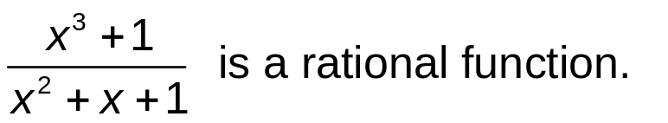
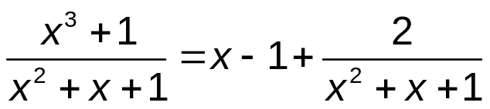
Rational Functions
Definition
A function of the type P/Q, where both P and Q are polynomials, is a rational function.
Example
The degree of the denominator of the above rational function is less than the degree of the numerator. First we need to rewrite the above rational function in a simpler form by performing polynomial division.
Rewriting
For integration, it is always necessary to perform polynomial division first, if possible. To integrate the polynomial part is easy, and one can reduce the problem of integrating a general rational function to a problem of integrating a rational function whose denominator has degree greater than that of the numerator (is called proper rational function). Thus, polynomial division is the first step when integrating rational functions.

Slide 3
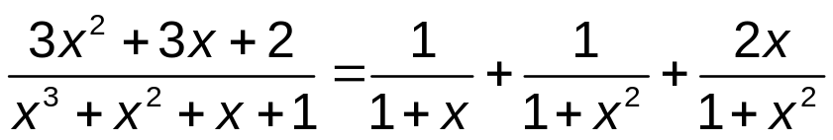
Partial Fraction Decomposition
The second step is to factor the denominator Q(x) as far as possible. It can be shown that any polynomial Q can be factored as a product of linear factors (of the form ax+b) and irreducible quadratic factors (of the form ax²+bx+c, where b²-4ac<0). For instance, if Q(x)=x⁴-16 then Q(x) = (x²-4)(x²+4)=(x-2)(x+2)(x²+4)
The third step is to express the proper rational function as a sum of partial fractions of the form
A / (ax+b)^{i} or (Ax+b) / (ax²+bx+c)^{j}
Example:
The fourth step is to integrate the partial fractions.

Slide 4
Integration Algorithm
Integration of a rational function f = P/Q, where P and Q are polynomials can be performed as follows.
If deg(Q) ≤ deg(P), perform polynomial division and write
P/Q = S + R/Q, where S and R are polynomials with deg(R) < deg(Q).
Integrate the polynomial S.
Factorize the polynomial Q.
Perform Partial Fraction Decomposition of R/Q.
Integrate the Partial Fraction Decomposition.

Slide 5
Different cases of Partial Fraction Decomposition
The partial fraction decomposition of a rational function R=P/Q,
with deg(P) < deg(Q), depends on the factors of the denominator Q. It may have following types of factors:
Simple, non-repeated linear factors ax + b.
Repeated linear factors of the form (ax + b)^{k}, k > 1.
Simple, non-repeated quadratic factors of the type ax² + bx + c. Since we assume that these factors cannot anymore be factorized, we have b² – 4 ac < 0.
Repeated quadratic factors (ax² + bx + c)^{k}, k>1. Also in this case we have b² – 4 ac < 0.
We will consider each of these four cases separately.

Slide 6
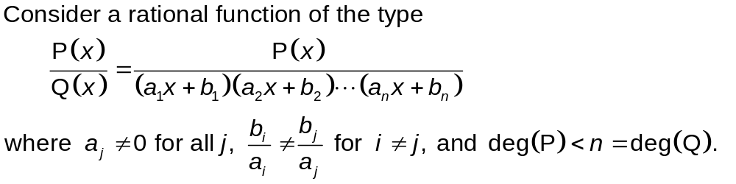
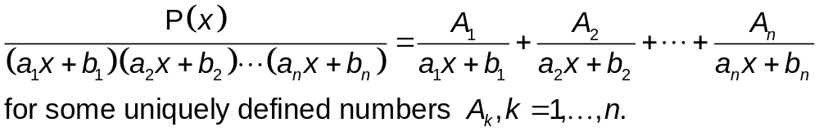
Simple Linear Factors
Case I
Partial Fraction Decomposition: Case I

Slide 7
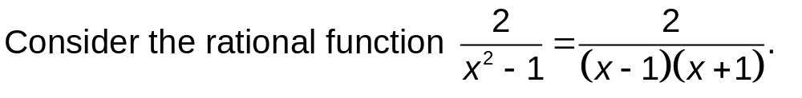

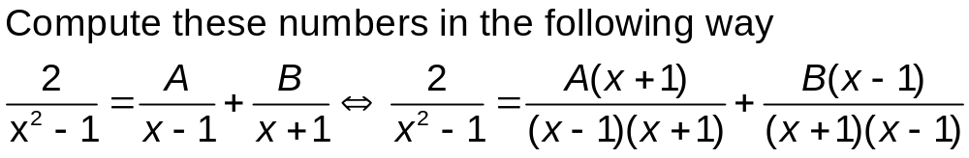
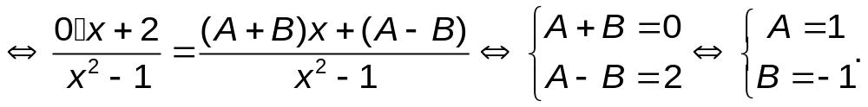
Simple Linear Factors
Example
To get the equations for A and B we use the fact that two polynomials are the same if and only if their coefficients are the same.

Slide 8
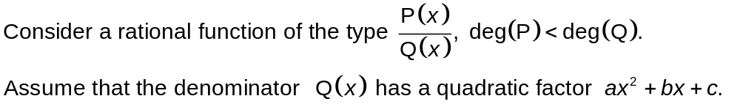

Simple Quadratic Factors
Case II
Partial Fraction Decomposition: Case II

Slide 9
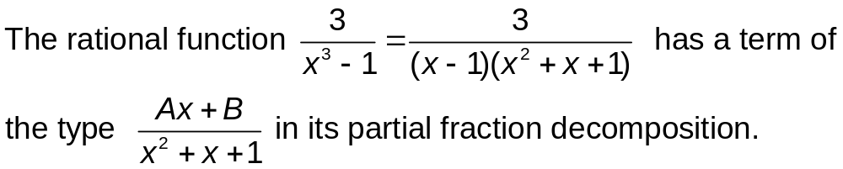
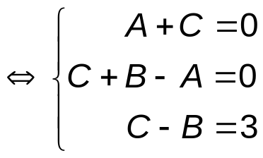
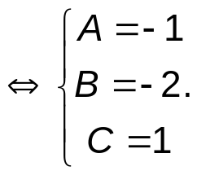
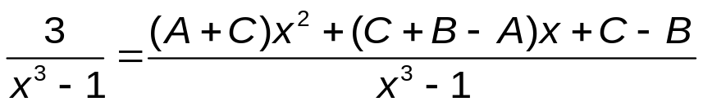
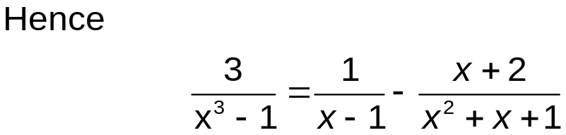
Simple Quadratic Factors
Example
To get these equations use the fact that the coefficients of the two numerators must be the same.

Slide 10
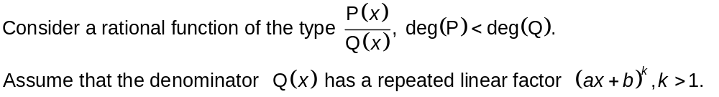
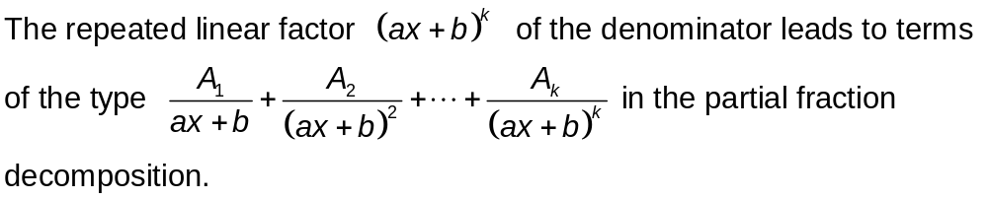
Repeated Linear Factors
Case III
Partial Fraction Decomposition: Case III

Slide 11
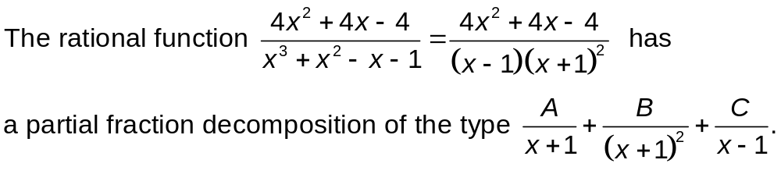
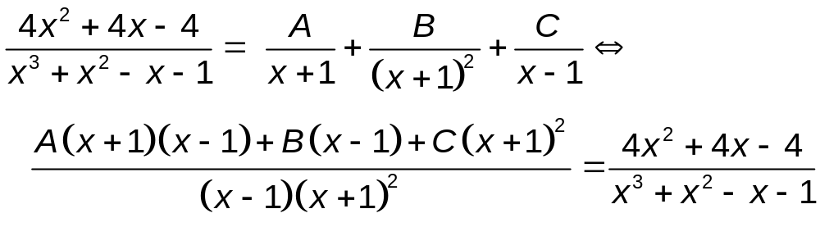
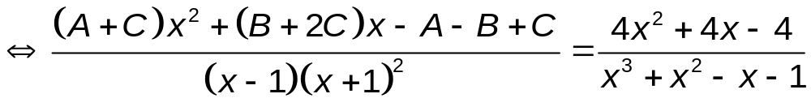
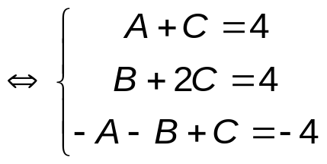
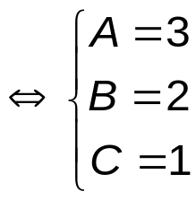
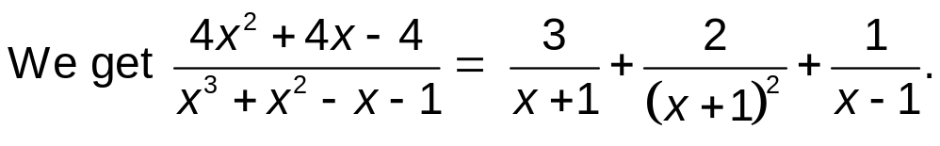
Repeated Linear Factors
Example
Equate the coefficients of the numerators.

Slide 12
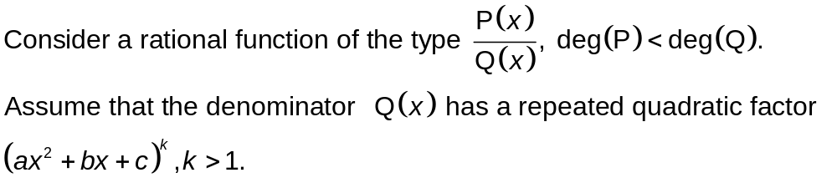
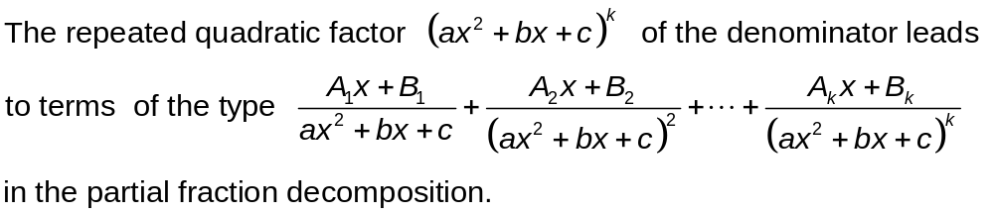
Repeated Quadratic Factors
Case IV
Partial Fraction Decomposition: Case IV

Slide 13
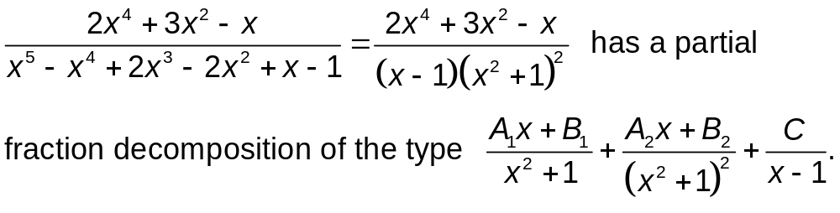
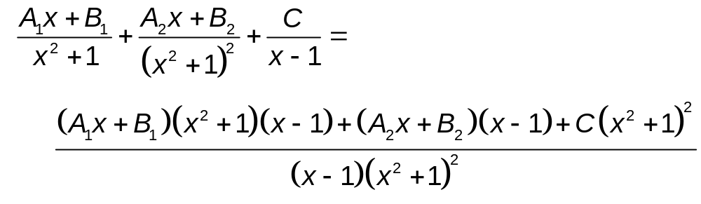
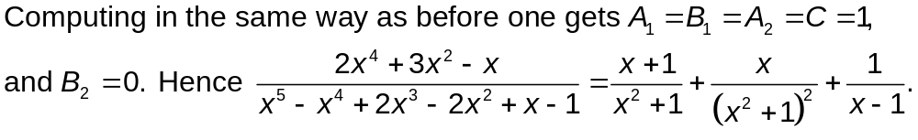
Repeated Quadratic Factors
Example

Slide 14
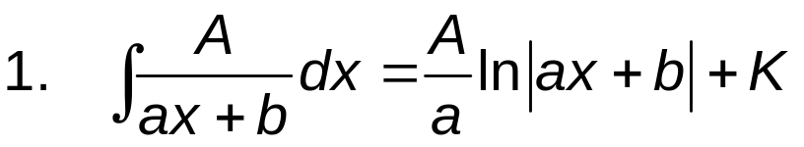
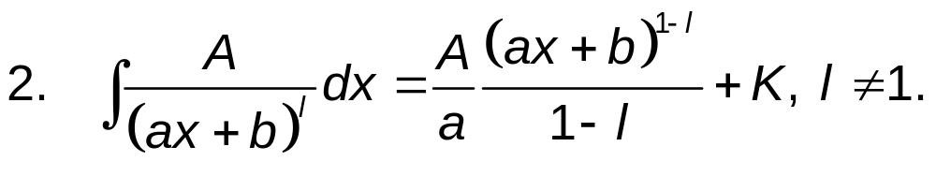
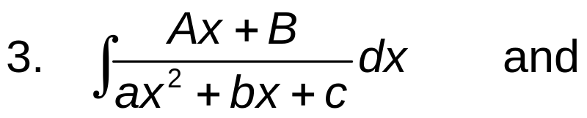
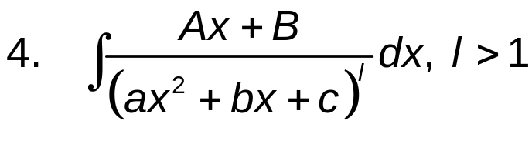
Integrating Partial Fraction Decompositions
After a general partial fraction decomposition one has to deal with integrals of the following types. There are four cases. Two first cases are easy.
Here K is the constant of integration.
In the remaining cases we have to compute integrals of the type:
We will discuss the integration of these cases based on examples. Normally, after some transformations they result in integrals which are either logarithms or tan⁻¹.

Slide 15
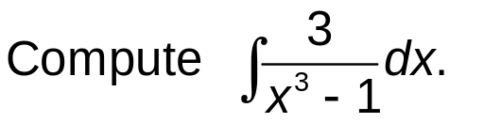
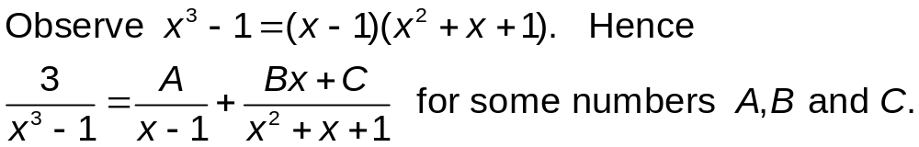
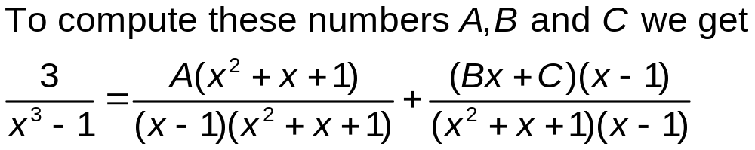
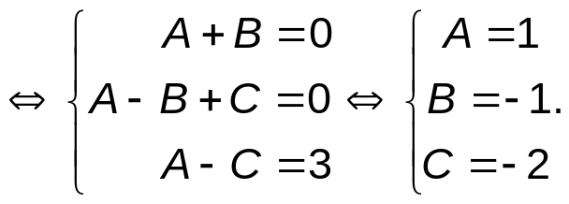
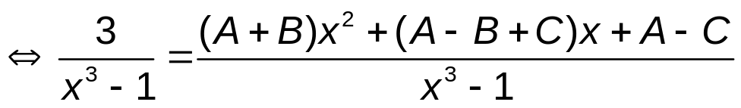

Examples
Example 1

Slide 16
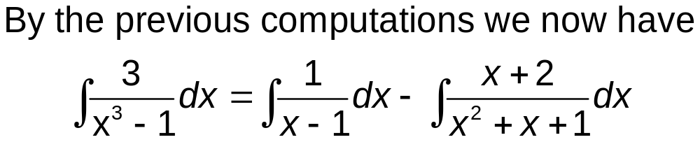
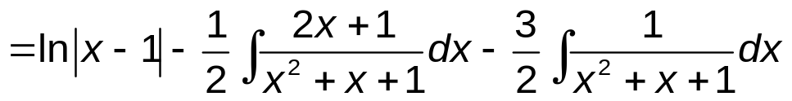
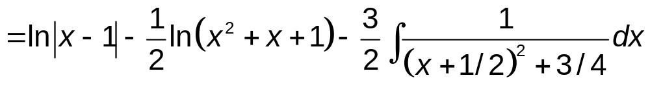
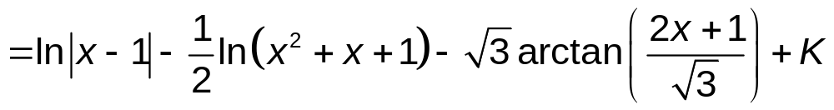
Examples
Example 1 (cont’d)
Substitute u=x²+x+1 in the first remaining integral and rewrite the last integral.
This expression is the required substitution to finish the computation.

Slide 17
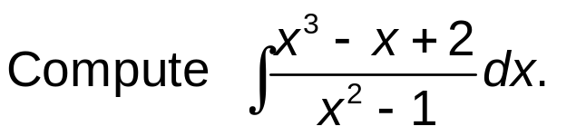
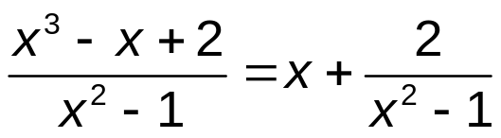
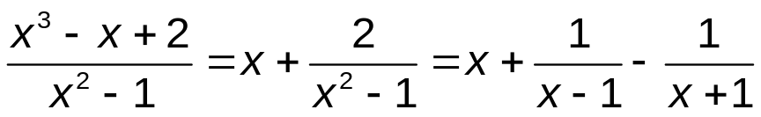
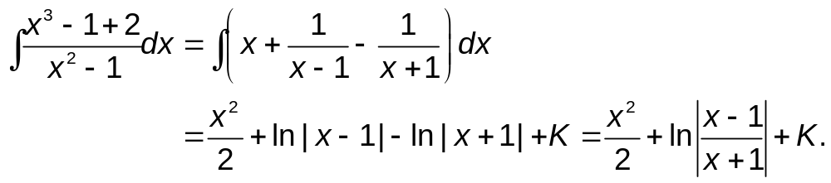
Examples
Example 2
We can simplify the function to be integrated by performing polynomial division first. This needs to be done whenever possible. We get:
Partial fraction decomposition for the remaining rational expression leads to
Now we can integrate

