Slide 1

SAMSUNG PRISM
Generative AI
Hackathon
3rd Edition 2026 – 27
Theme ID - 05, Interruptible Real-Time Agents
Project Title - An assistant you can interrupt mid-task
Team Name - [add team name]
College Name - [add college name]
Member Name & Email 1- [add]
Member Name & Email 2- [add]
Member Name & Email 3- [add]
Member Name & Email 4- [add]
Submission Github link - github.com/pandeykartik658-del/samsung-hackathon
Notes:
Title slide. Fill in team name, college and members before submitting. File name must follow CollegeName_TeamName (deck p12).

Slide 2
Theme
THE PROBLEM, IN OUR WORDS
FIVE THINGS A TURN-BASED BOT NEVER MEETS
Assistants take turns: listen, think, speak. People don't. They cut in, correct themselves mid-sentence and change the goal while a search or a booking is still running.
The agent has to keep talking, cancel the work nobody wants any more, re-plan on the new facts, and never repeat a side effect such as a booking.
A correction lands while the search it invalidates is still running.
1
2
A result comes back for a call the agent already cancelled.
3
A booking must never run twice, across retries, repeats and repairs.
HOW IT IS SCORED (THEME 05 GUIDE §5)
40
35
15
10
A tool it has never seen arrives in the scenario manifest.
4
Task completion
Interruption recovery
Latency
Safety
5
Audio and camera frames are slow next to the conversation.
× quality multiplier 0.8–1.2. Audio and visual scenarios weigh 1.5×, and they are about half of the ~60 hidden scenarios.
Notes:
Problem statement from deck p8 and the Theme 05 guide §1-§5. Scoring weights from guide §5.

Slide 3
Existing Solutions & Gaps
Half-duplex assistants
Restart on interrupt
An LLM call on every step
HOW IT WORKS
HOW IT WORKS
HOW IT WORKS
Listen, then think, then speak.
Throw the plan away and start over.
Every decision waits on a model.
THE GAP
THE GAP
THE GAP
Go silent while they reason. An interruption only lands after the turn ends, so stale work keeps running.
Repeat finished work, lose session context, and can send the same booking twice.
Seconds on the critical path, and no hard guarantee against duplicate writes.
What we do instead
A rule-based fast path answers on the same event tick. A coordination layer cancels only the calls a correction invalidates. An idempotency ledger makes a second identical booking impossible.
Notes:
The first two gaps paraphrase the Theme 05 problem statement (deck p8): systems 'either go silent while they reason, or throw everything away and start over'. The guide §1 calls the first 'half-duplex'.

Slide 4
Our Solutions & Architecture Diagram
EVALUATION KIT
FAST PATH · sync, no LLM
Coordinator
call registry, cancel tokens, generations, idempotency ledger
protocol.py
parse_event: names, units, nesting
Engine
one event loop, ordered dispatch, a single emit(), one task per tool call
Inbox
timestamped events
nlu
repairs, intents, slots
state
localised corrections
Slow path
Whisper ASR, OCR, optional LLM: cancellable tasks
Tool executor
mock tools, faults
protocol.py
to_wire: validate + State Snapshot
planner
manifest-driven, chaining
Outbox
actions
Watchdog
honest final + snapshot at 110 s, before the 120 s cap
nlg
grounded replies
Cancel before speaking
A correction cancels superseded calls in the same handler, stamped on the same clock tick, before any speech.
Generations drop stale results
Each re-plan bumps a generation. Late, stale or duplicate results are logged and never reach the planner.
Idempotency ledger
Writes are keyed on tool + canonical args. A committed key is never sent again; unmarked tools count as writes.
Notes:
Source: docs/ARCHITECTURE.md and the README diagram. Only protocol.py knows the kit's field names, so the official kit is a one-file change. Walk one interruption: interrupt at 1.9 s, cancel on the same tick, new search, late Delhi result dropped as late_after_cancel.

Slide 5
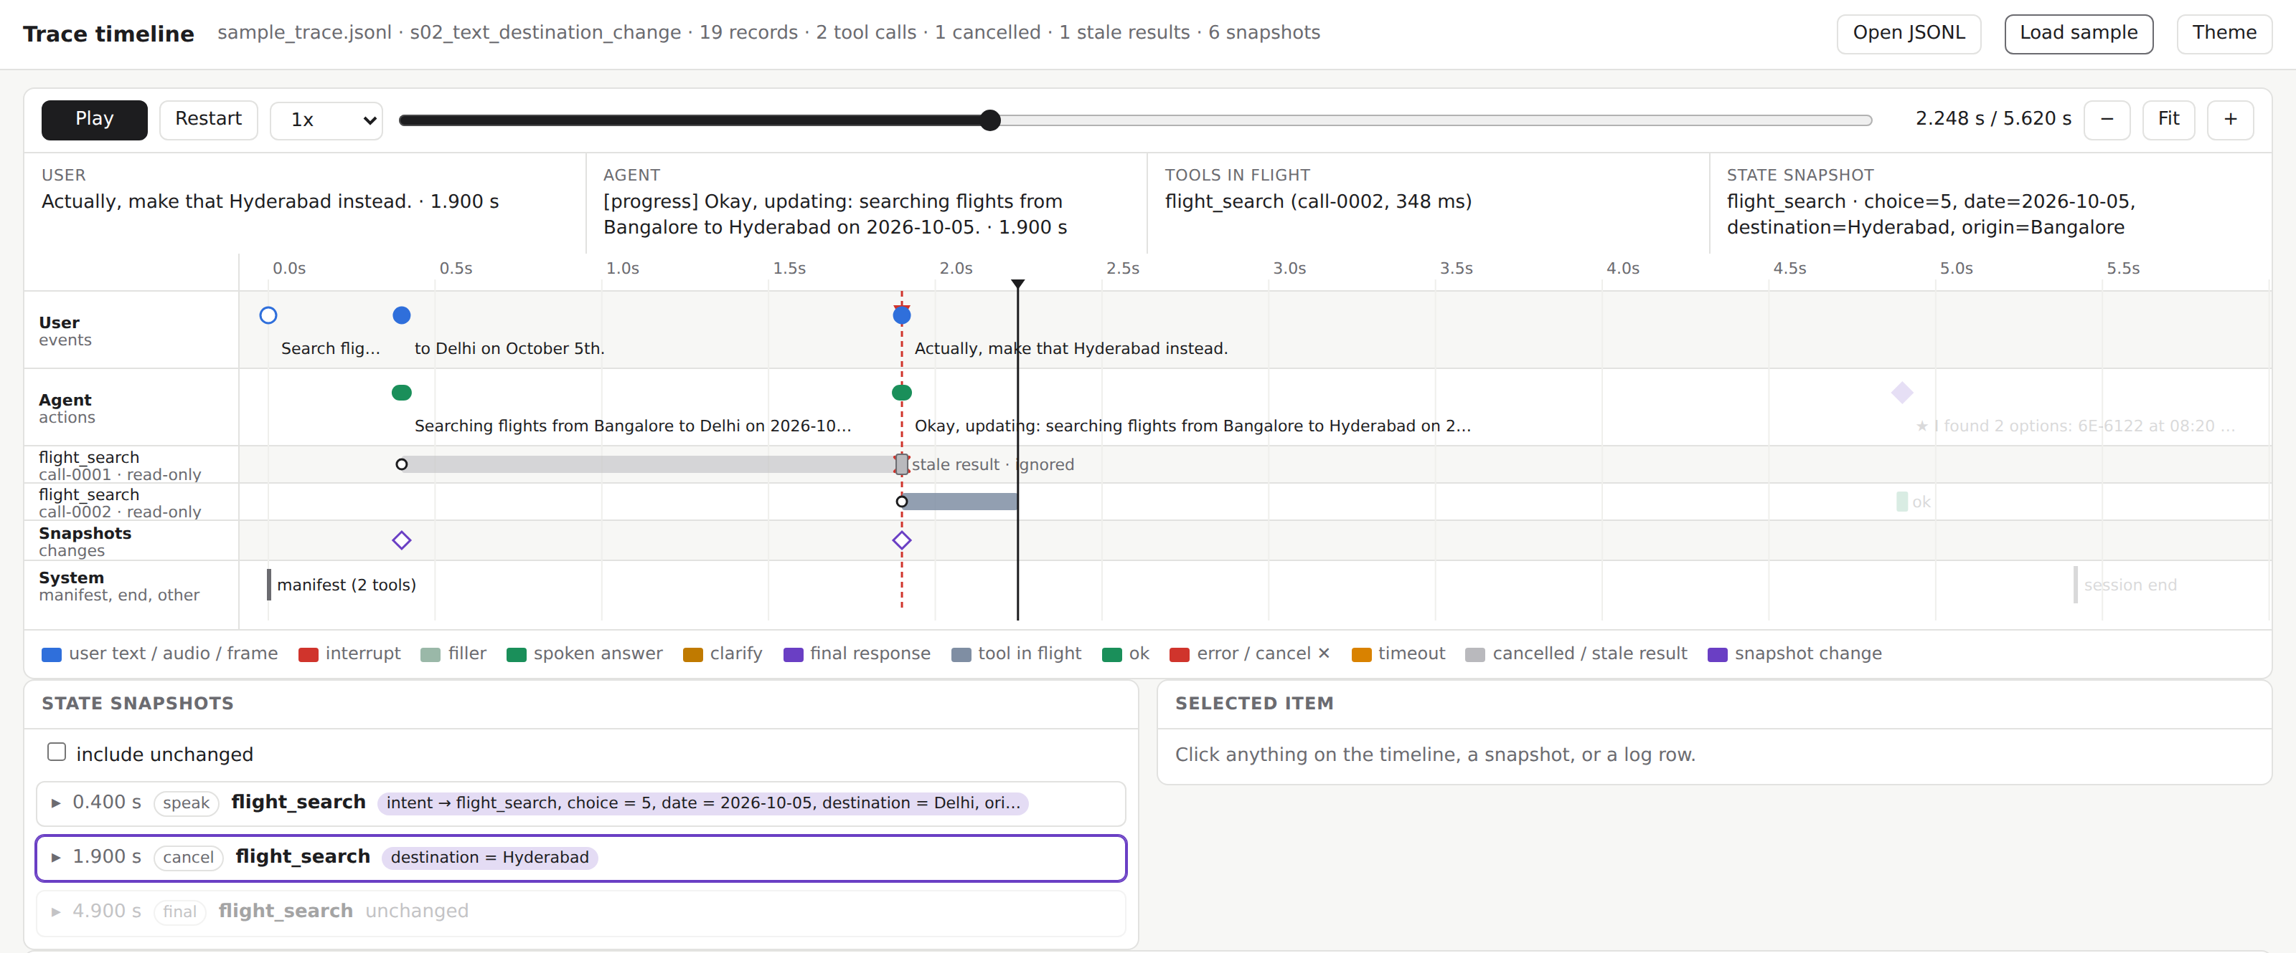
Demo & Product Walkthrough
SCENARIO S02, SECOND BY SECOND
0.4 s
“…to Delhi on October 5th.”
Speaks a progress line, starts flight_search to Delhi.
1.9 s
“Actually, make that Hyderabad.”
Cancels the Delhi call on the same tick, then searches Hyderabad.
Trace viewer replaying scenario s02 on the virtual clock, paused just after the interruption.
WHAT THE DEMO VIDEO SHOWS
4.9 s
Hyderabad result arrives
Final answer with 2 flights and a snapshot: destination = Hyderabad.
Destination change
cancel + re-plan
Duplicate-booking trap
one booking, not three
Ambiguous camera frame
asks, then answers
Video (max 5 min): [add YouTube or Drive link]
Notes:
Screenshot: viewer/trace_viewer.html with the s02 trace embedded (bash run_demo.sh). Timings are from runs/demo/scenarios/traces/s02_text_destination_change.jsonl.

Slide 6
Tools and tech stack used
RUNTIME
Python 3.10–3.12, asyncio
Stdlib-only core. One Agent per session, no module state.
SPEECH
faster-whisper base.en, int8
Best CPU accuracy per second; CTranslate2, no PyTorch.
VISION
RapidOCR (ONNX)
Reads display codes and model labels. Weights ship in the wheel.
LANGUAGE MODEL
Optional plug-in
2 s budget with a rule fallback. Never on the fast path.
TESTING
pytest, 458 tests
Plus protocol fuzzing: 60,000 malformed events, zero crashes.
EVALUATION
Own harness + scorer
Virtual-clock sim and a rubric replica with 50 documented assumptions.
DELIVERY
Docker, 1.01 GB
Whisper weights baked in, runs offline. python -m theme5 serve for JSONL.
CI AND DEMO
GitHub Actions + trace viewer
Build, real-weights Whisper test, all tests, demo. Single-file HTML viewer.
Notes:
Versions and sizes: docs/MULTIMODAL.md, README. CI run: https://github.com/pandeykartik658-del/samsung-hackathon/actions/runs/36743838976 (Docker build with Whisper base.en, real-weights test, 458 tests, demo; image 1.01 GB).

Slide 7
Impact & Use case
In-car, hands-free
The destination changes while the route search runs.
The stale call is cancelled on the same tick; its late result is dropped.
Customer support
The customer changes details mid-booking.
The ledger blocks a second write; changes go through a modify tool or are refused.
Field troubleshooting
“How do I fix the error on this?” with the camera on.
Frames are grounded into device and error code; an unclear frame gets one question.
Accessibility
“Delhi, uh, no, Hyderabad.” Hesitations and self-repairs.
Repair parsing changes only the corrected slot and keeps the rest.
Why it matters for Samsung devices: phones, cars and appliances need barge-in recovery without a network round trip. Our fast path answers in 0.69 ms (median) and runs offline.
Notes:
The four use cases are the guide's §2 list. Latency: bench/runs/profile_after (first spoken action p50 0.69 ms, p95 1.27 ms, 60 scenarios x 3 runs), docs/HARDENING.md.

Slide 8
Innovation highlights, results and limitations
100.0
60-scenario adversarial bench
and 100.0 on a held-out seed
9 / 9
public-style scenarios pass
mirroring the 9 in the guide
0.69 ms
median time to first spoken action
p95 1.27 ms
0
crashes in 60,000 fuzzed events
malformed, missing, out of order
All scores come from our own simulator and rubric replica. The official evaluation kit is not released yet.
INNOVATION HIGHLIGHTS
LIMITATIONS
Diff, don't flush: calls a correction leaves valid are kept, only the rest are cancelled.
Speculative read-only calls on partial turns, adopted or cancelled at end of turn.
Every kit guess sits in one adapter file, tagged ASSUMPTION with its unknown number.
26 wire-format details are guesses until the kit ships.
Self-graded, on scenarios we generated: a regression guard, not a forecast.
Default perception trusts kit transcripts and labels. With those removed and no models loaded, the suite drops to 78.2 (audio 54.7). Whisper and OCR are built and tested but not on by default.
Test audio and frames are synthetic. English only.
Notes:
Numbers re-run 2026-09-30: bench/scenarios60 suite 100.0 (TC 40, IR 34.9, LAT 15, SP 10, QM 1.10 mean); held-out seed 20261015 suite 100.0; sim 9/9; --strip-oracle suite 78.24 (text 100, audio 54.68, visual 77.3); 457 passed + 11 skipped locally, 458 in CI with Whisper weights. Latency from docs/HARDENING.md.

Slide 9
What’s next
Worklet: a kit-conformant, learning-assisted interruptible agent for on-device assistants.
•
1
2
3
NOW
MONTH 1
MONTH 2
MONTH 3
When the kit ships
Conformance
On-device understanding
Vision and evaluation
Fill protocol.py from the real schema
Full Safety & Protocol on the 9 public scenarios
Turn Whisper and OCR on by default
Kit-verified per-scenario scores
Profiling budgets and fuzzing as CI gates
Distilled intent/slot model under 50 MB behind the plug-in
Streaming ASR feeding speculative reads
Appliance and part detection for manual lookups
Evaluation on kit + our bench, write-up
The rule stays: every new model is a plug-in with a timeout and a rule fallback, and the first action stays synchronous.
Notes:
From the README 'Future work (worklet)' section: about 3 months.

Slide 10
Brownie points slide( differentiation)
1
2
3
Replay any session
Never times out silently
Adversarial bench
A single-file trace viewer plays a run on the virtual clock: calls, cancels, stale results, snapshots.
A watchdog at 110 s cancels open work and gives one honest answer with a valid snapshot.
60 scenarios in 13 families (30 text, 18 audio, 12 visual), scored in about a second.
4
5
6
Ask, don't guess
Unseen tools
Fault tolerant
Low ASR confidence, dark or ambiguous frames and missing parameters get one targeted question.
The planner reads any manifest and binds arguments by name, type and enum; unmarked tools are treated as writes.
Retries only on retryable errors, and the ledger still blocks duplicate writes. Fuzzed with 60,000 malformed events.
Notes:
Sources: viewer/trace_viewer.html, theme5/watchdog.py, bench/gen_scenarios.py, docs/MULTIMODAL.md, theme5/tools.py, docs/HARDENING.md.

Slide 11
Checklist- Updated on Public GitHub
Working prototype code — public or shared GitHub repo (Y/N): Y, github.com/pandeykartik658-del/samsung-hackathon
README with reproducible setup instructions (Y/N): Y, plus Dockerfile and CI
Demo video, max 5 minutes (YouTube or Drive link): [add link]
Presentation file (PPT or PDF) (Y/N): Y
Release tag PRISM_GENAI_HACKATHON_Y2026 on the final commit: [to do]
Notes:
Tag the final commit PRISM_GENAI_HACKATHON_Y2026 and add the video link before submitting (deck p13).

Slide 12
Thank you
Organised by the Language AI Team and the PRISM Team, Samsung R&D Institute India
Notes:
Closing slide. Add the Google Form URL and a contact email before sharing. Edition 2 organising team for reference: Language AI - Sourabh Tiwari, Gaurav, Sanjeeth Pothireddy, Gorang Maniar; PRISM - Binny Lakra, Prakhar Chandrakar, Vishu Kumar; Kick-off and mentors - Giridhar Jakki, Deepraj Prabhakar Patkar (Language AI), Srimanu Prasad Nagaraju, Ashish Kumar (Tech Strategy).

