Slide 1
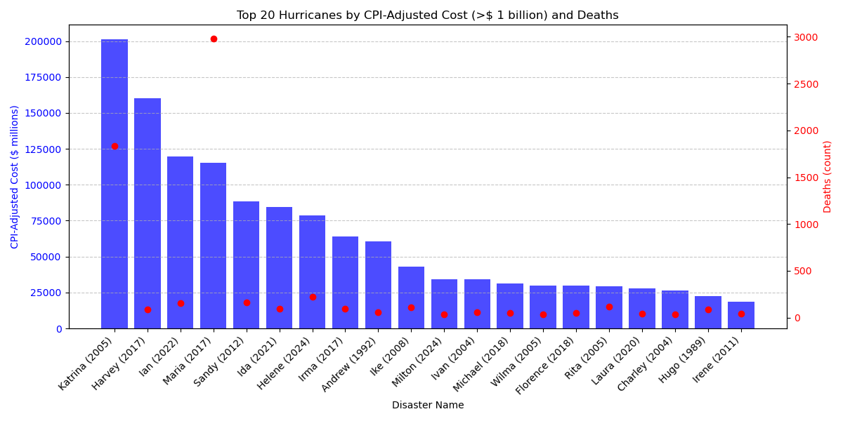
Top 20 hurricanes with CPI adjusted cost > $ 1 billion (1980-2024)
Even though Katrina (2005) has been the most expensive hurricane event so far, the most fatalities happened during hurricane Maria (2017) in Puerto Rico.
It highlights that damages and fatalities are dependent on multiple factors, not just the hurricane severity.

Slide 2
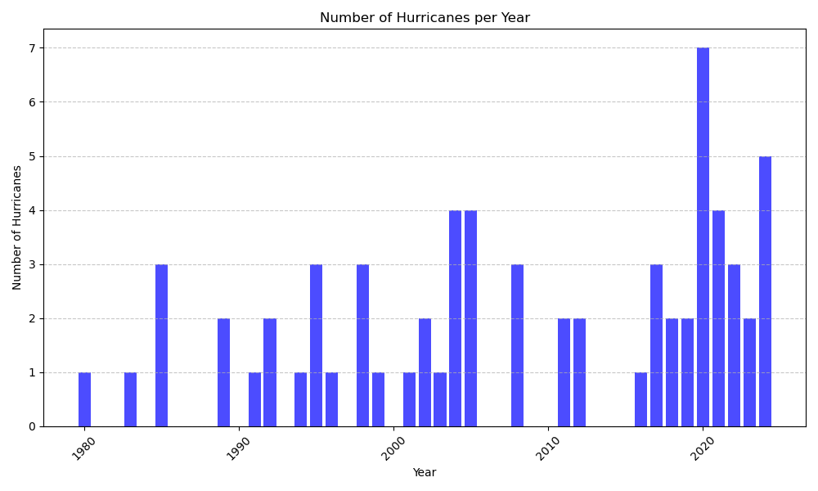
Frequency of hurricanes with CPI adjusted cost > $ 1 billion (1980-2024)
Visually, it appears frequency of hurricanes causing > $1 billion damages are increasing, however the statistical significance could not be determined.

