Slide 1
SMQTT
IoT Applications are immense in number and utilized to provide solutions for multitude of diversified problems.
Though IoT has lot of potentials in the digital world, during its deployment, it encounter several issues with respect to (w.r.t) heterogeneity of devices,device identity, device management, secure device to device communication (D2D), etc

Slide 2
SMQTT (Secure Message Queue Telemetry Transport) is an extension of MQTT protocol which uses encryption based on lightweight attribute encryption. The main advantage of this encryption is that it has a broadcast encryption feature. In this features, one message is encrypted and delivered to multiple other nodes. The process of message transfer and receiving consists of four major stages:
Setup: In this phase, the publishers and subscribers register themselves to the broker and get a secret master key.
Encryption: When the data is published to broker, it is encrypted by broker.
Publish: The broker publishes the encrypted message to the subscribers.
Decryption: Finally the received message is decrypted by subscribers with the same master key.
SMQTT is proposed only to enhance MQTT security feature.

Slide 3
Secure MQTT(SMQTT) which augments security feature for the existing MQTT protocol and its variants based on lightweight Attribute Based Encryption (ABE)
The advantage of using ABE is because of its inherent design which supports broadcast encryption (with one encryption, message is delivered to multiple intended users) and thus suitable for IoT applications.
ABE are of two types: (i). Ciphertext Policybased ABE (CP-ABE) and (ii). Key Policy based ABE (KP-ABE).

Slide 4
ABE is applied to ensure privacy for IoT based on generic Publish-Subscribe (Pub-Sub) architecture.
Here pay-load is encrypted using symmetric Advance Encryption System(AES) cryptography and
AES key is encrypted using ABE scheme which ensures that cipher text size and payload size is same.
As SMQTT protocol augments security feature to the existing MQTT.
To enable this, we propose a new MQTT Publish message Spublish with reserved message type ’0000.
Here Publisher uses Spublish command to publish an encrypted message using ABE. Hence, Subscribers who satisfy the access policy are capable of decrypting the message.

Slide 6
In ABE technique, sender device encrypts data based on set of conditions in terms of access policy and subsequently receiver device is able to decrypt the cipher text, if it satisfies access policy.
This access policy is expressed in terms of conditions containing the user attributes (can be feature, property, role, etc). Typically, access policy is expressed as a predicate with set of attributes and boolean constructs (OR, AND, NOT).
During setup phase, Broker (trusted third party) renders the function of a Public Key Generator (PKG) generates the master secret key and access policy

Slide 7
Proposed SMQTT Protocol

Slide 8
There are three entities:
(i) Publisher device publishes the data under the given topic.
(ii) Subscriber device receives the data under the same topic through a Broker.
(iii) PKG or broker is the trusted third party.
There are four phases in the protocol.
In setup phase, registration and key management are done.
Encrypt phase, data is encrypted and
In publish phase, Publisher publishes encrypted data under the given topic name and sends it to the broker.
In decrypt phase, data is decrypted by subscribed devices.

Slide 9
Setup Phase
Publisher and Subscriber devices register with the PKG by providing unique identity such as Universal Resource Identifier (URI) along with its attributes.
PKG generates Master Secret key set and public parameters according to the CP/KP-ABE scheme i.e ciphertext policy /key policy attribute based encryption.
All devices, which own the attributes receive the key set from PKG.

Slide 10
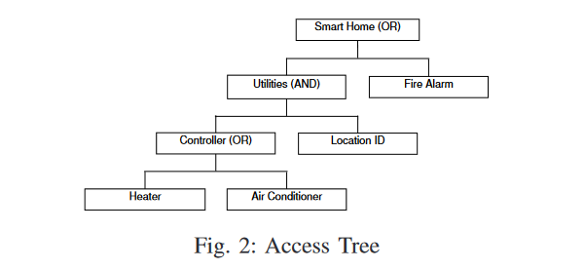
Encrypt Phase
Publisher device designs an access policy based on the access tree
Here interior nodes are threshold gates and leaf nodes are associated with attributes .
(Reference: File Access Control Through Access Tree And Attribute Based Encryption In Cloud Computing: A Survey”)

Slide 11
In CP-ABE, publisher encrypts the payload and provides the additional information to facilitate decryption along with the policy.
Publish Phase
Publisher embeds encrypted data as payload in SPublish command.
It sets topic name accordingly in variable header.
Then SPublish packet is sent to Broker.
•Broker responds with PUBACK packet.
•Publisher sends PUBREL packet to Broker.
•Broker forwards message to all Subscribers of topic including receiver.
•Broker deletes data and sends PUBCOMP packet to Sender.

Slide 12
Decrypt Phase
•Subscriber device decrypts the cipher text using its private attribute keys, if it satisfies access policy.

