Slide 1
By-Pramendra Pandey
FINANCE & RISK ANALYTICS

Slide 2
Problem Statement
Consider yourself working for an associate at an investment firm that manages accounts for private clients.
Your role requires you to analyze a portfolio of stocks to provide consultation on investment management based on client’s requirement.
Your task is to provide consultation to two different investors, Mr Patrick Jyenger and Mr Peter Jyenger based on their requirements and financial objectives.
As per their requirement , your job is to suggest the stock that would meet his goal .

Slide 3
Steps Involved in Data Insight
Import all the important libraries and data files of all 25 stocks provided .
Remove un-necessary columns -Keep the ‘Date’ and ‘Close’ columns only for given 25 stocks .
Merge all the 25 stocks in one Dataframe -Stock_data
Check for null value/Percentage in Dataframe and save data in csv file -Final_stock_data .
In this project we need previous 5 year data to predict next 5 year ,Slice only needed data for further analysis .
Calculate the key Metrics such as Sharpe ratio, risk and daily Returns for stocks provided .

Slide 4
Portfolio –Patrick Jyenger
Mid 50 and want decent living Standard .
Conservative investor during his life .
Available capital $1 million ; wants to invest $500k in a magazine for minority stake and remaining in 500k in equities .
Expect doubling his capital with less risk in 5 years time to buy minority portion in Naturo .

Slide 5
Portfolio –Peter Jyenger
Risk Taker , Prefers high return on investment .
Believes in himself and ability to bounce back .
Wanted to invest in equity in high margin stock .
Expect high returns within 5 year & wants to invest whole 1 million Dollar into equity .

Slide 6
Steps Involved in Data Insight
Based on Investors behavior and requirement , suggest and build the
Portfolio as per their need .

Slide 7
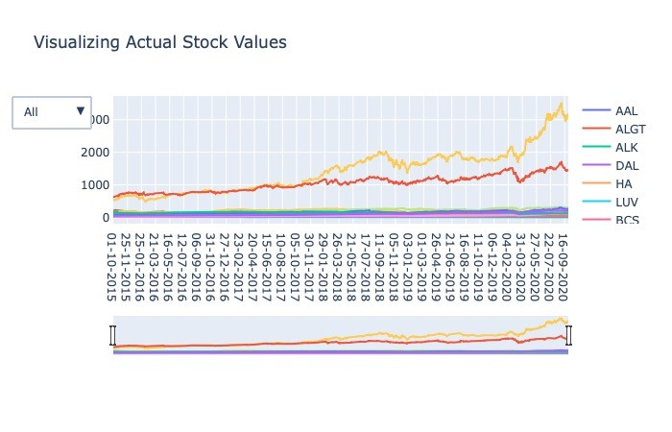
Historical Stocks Values

Slide 8
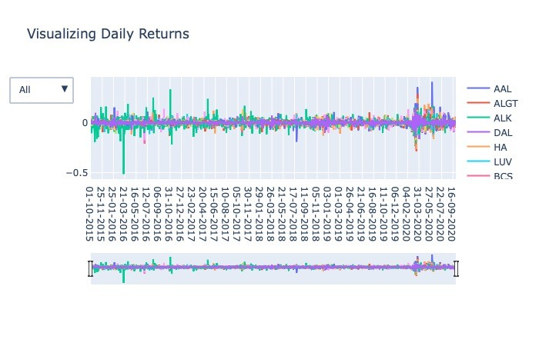
Daily Stocks Returns

Slide 9
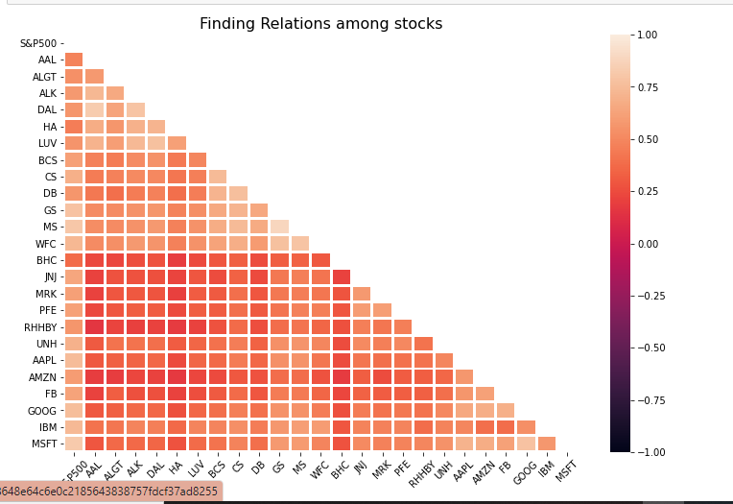
Heatmap for Stocks

Slide 10
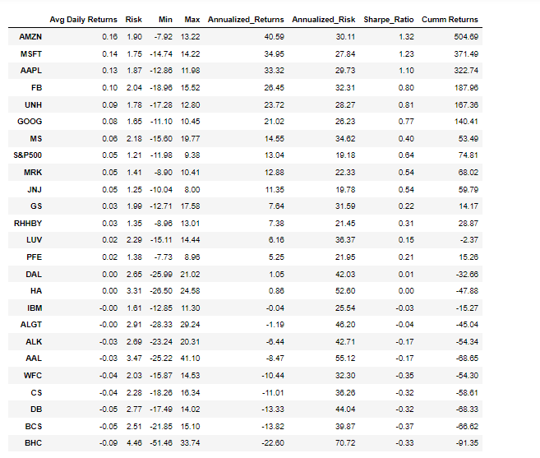
Key Values for Stocks

Slide 11
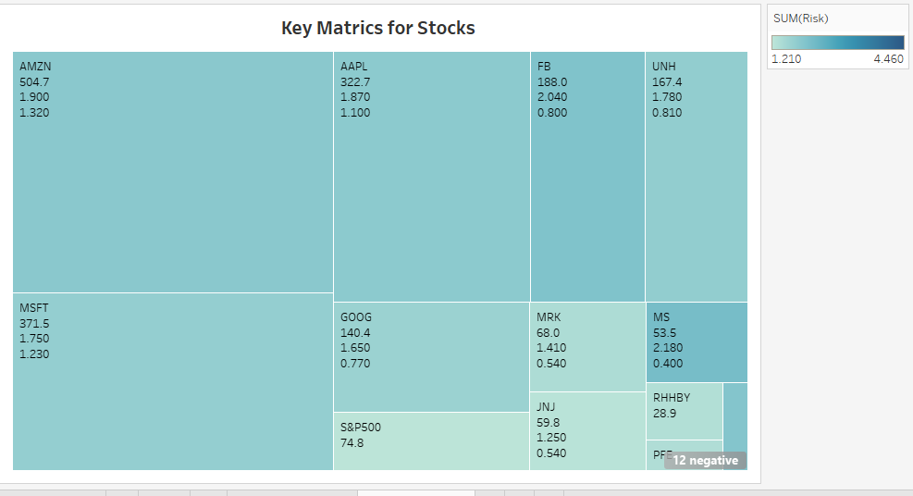
Stocks by Cum. Returns/Risk/Sharpe Ratio

Slide 12
Portfolio –Patrick Jyenger
Mid 50 and want decent living Standard .
Conservative investor during his life .
Available capital $1 million ; wants to invest $500k in a magazine for minority stake and remaining in 500k in equities .
Expect doubling his capital with less risk in 5 years time to buy minority portion in Naturo .

Slide 13
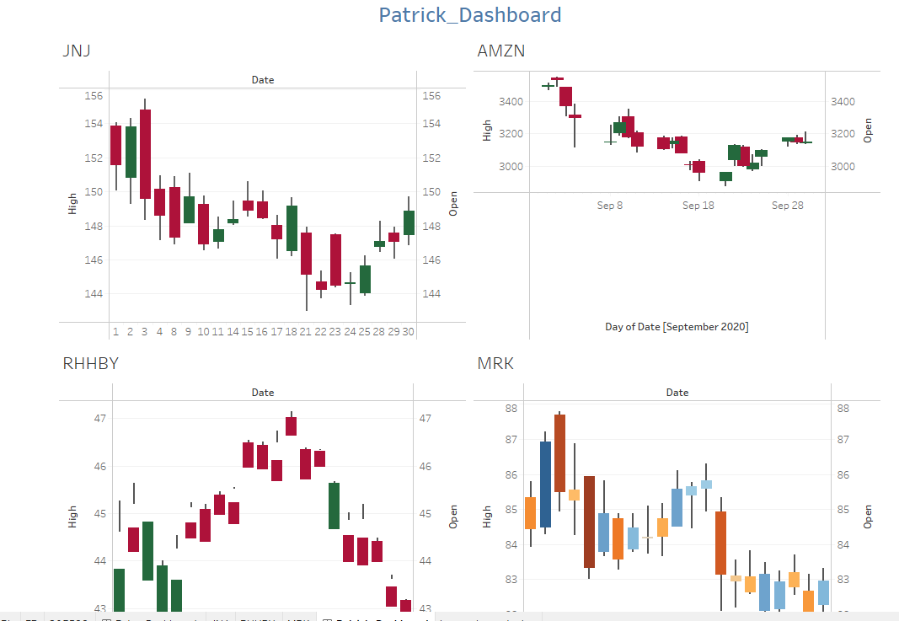
Mr. Patrick Jyenger’s Portfolio

Slide 14
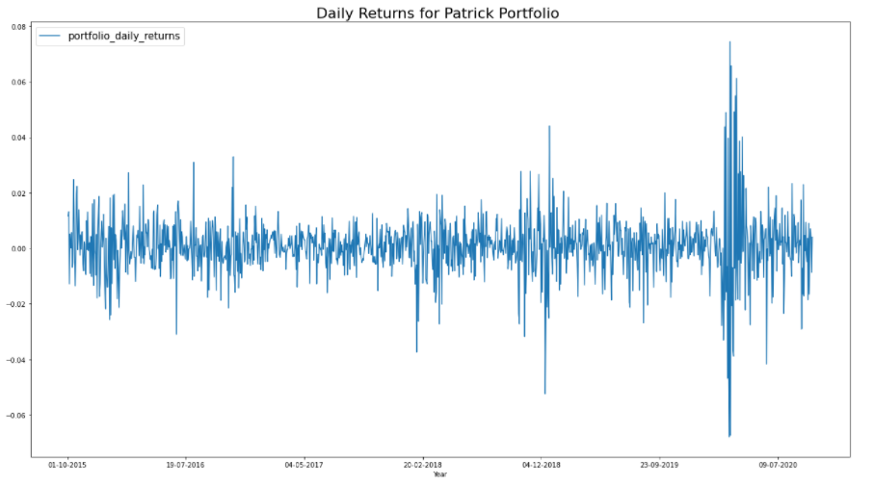
Returns for Patrick
Financial were doubled in next 5 year for Patrick with risk of 16 percent .
Stock chosen for him are 'AMZN', 'JNJ', 'RHHBY' ,'MRK' having portfolio weight .20,.30,.25 & .25 .
Expected gain for Patrick was 565314 after investing initial amount 500000.

Slide 15
Portfolio –Peter Jyenger
Risk Taker , Prefers high return on investment .
Believes in himself and ability to bounce back .
Wanted to invest in equity in high margin stock .
Expect high returns within 5 year & wants to invest whole 1 million Dollar into equity .

Slide 16
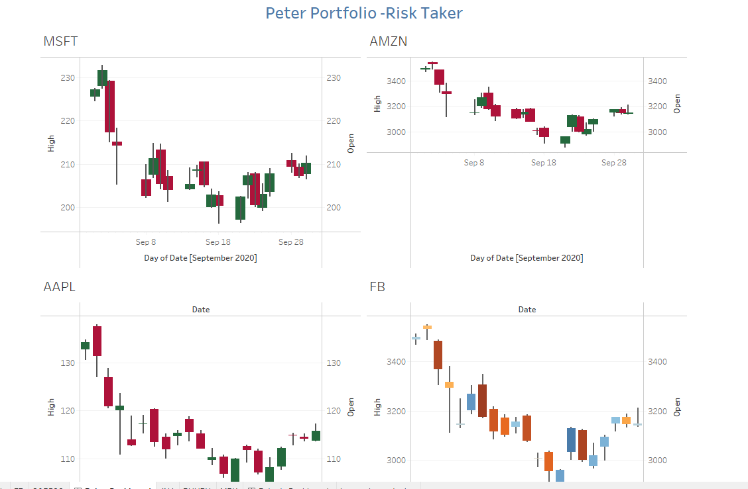
Mr. Peter Jyenger’s Portfolio

Slide 17
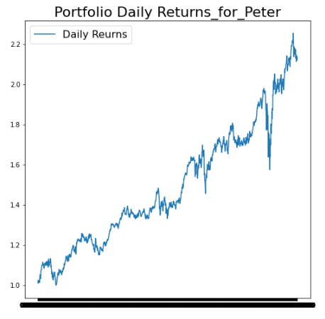
Mr. Peter Jyenger’s Returns
Financial were grown by almost 400 percent i.e. for 1 Million Dollar invested in equities ; Returns that he would fetch after 5 years is more than 5 Million Dollars with 4+ Million dollars of gain with Portfolio risk around 50 Percent .
Stock chosen for Peter are 'AMZN','MSFT','AAPL','FB’ having initial weight .40, .40 , .10 and .10 .

Slide 18
By-Pramendra Pandey
THANKS FOR WATCHING!

