Slide 1
EDUBRIDGE final Project
By,
Rahul Pandey
Topic : ATM Management System
Trainer: Ruby Mehra Bindra
Java Full Stack Developer Batch 2021-7127

Slide 2
Hardware & Software Requirement:
Hardware Interfaces
Minimum Hardware requirement
Processor: P4 3.0 GHz
RAM:1 GB or Higher
Monitor
Mouse
Hard disk: 80 GB

Slide 3
Software Interfaces
Minimum Software requirement
Servlet & JSP
Logger
Java (JSP and Servlet)
Apache Tomcat Server

Slide 4
Technology used
jdk-18.0.1.1
Spring-tool-suite-4-4.14.0
Apache Tomcat Server
I am using Java as the core technology to maintain the front view part I am using JSP, HTML, CSS, and JS.
To handle the server request I am using servlet and to store data or maintain the back-end records using the MYSQL database.

Slide 5
INTRODUCTION..
ATMs are Automated Teller Machines that are used to carry day-to-day financial transactions. ATMs can be used to withdraw money or to deposit money or even to know the information of an account like the balance amount, etc. They are convenient and easy to use, it allows consumers to perform quick self-service transactions.

Slide 6
INTRODUCTION..
ATM Management System is an electronic telecommunication device that enables the customers of financial institutions like banks, to carry out financial transactions, such as cash withdrawal, and Balance Inquiry without any requirement of a human cashier, cashier, or bank clerk. ATM provides service 24*7. The customer can withdraw or deposit cash up to a certain limit at any time.
So, I have developed an ATM Management System web application where we have all roles including Admin and User. Here, Admin’s responsibility is to view all the registered user on the application and accept or reject their registration request. Admin can also view all the transaction that are done by Users like deposit and withdrawal. Another User is the Customer for whom the application is built. They can view balance, can withdraw as well as deposit money. Along with that they can view their respective mini statement.

Slide 7
objective of this Project
The main objective is to build a secured, robust ATM Management System. It removes the manual process of going to ATM by an autonomous system. It maintains the record of the transaction efficiently so that it would be easy to access at any time 24*7.
There are two roles in this application. Admin who is the main user of this application has a responsibility of managing the overall application. Another role we have is User for whom the application is built. They will be just one click away from making balance enquires, mini statement, deposit/withdrawal..

Slide 8
Methodologies
There are two main users of this application one is the Admin and another one is the User (Customer). Now, let us see the responsibility.
1) Admin
Can Log in/Log out of the system.
Admin can View/Confirm/Cancel registrations.
Can manage users and their details.
Can maintain transactions history & databases.
Can change pin.

Slide 9
2) User
Can log in/log out of the system.
Can Manage “My profile”.
Users can manage their accounts.
Can withdraw/deposit money from bank accounts.
Can make balance inquiry.
Can view mini bank statements.
Can change pin.

Slide 10
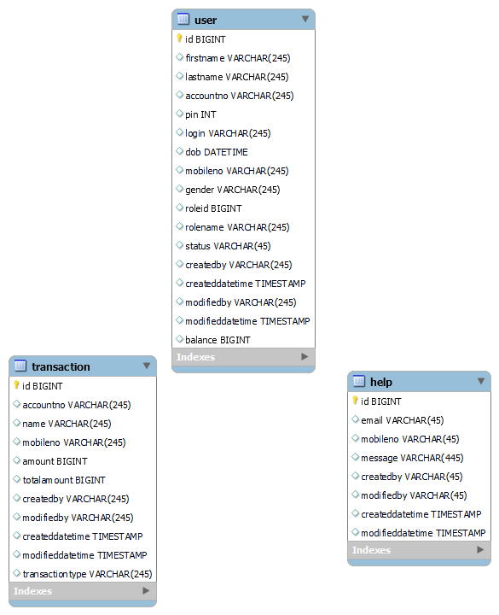
System Analysis
1 E R DIAGRAM

Slide 11
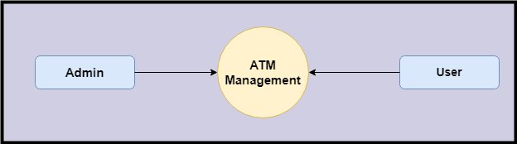
Data Flow Diagram (DFD)
Level 0:

Slide 12
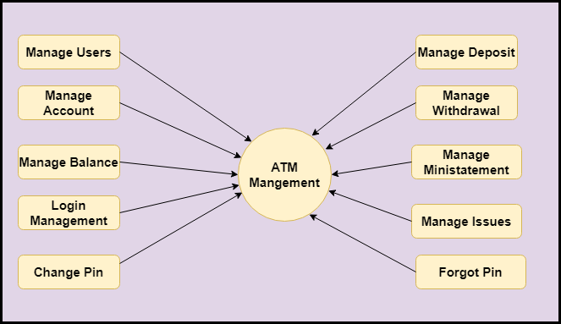
Level 1

Slide 13
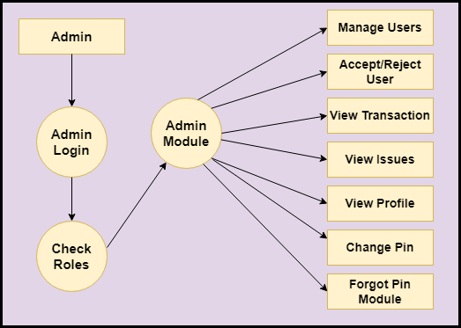
Level 2-DFD Admin

Slide 14
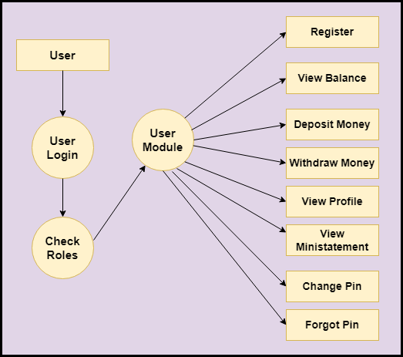
Level 2 DFD – User

Slide 15
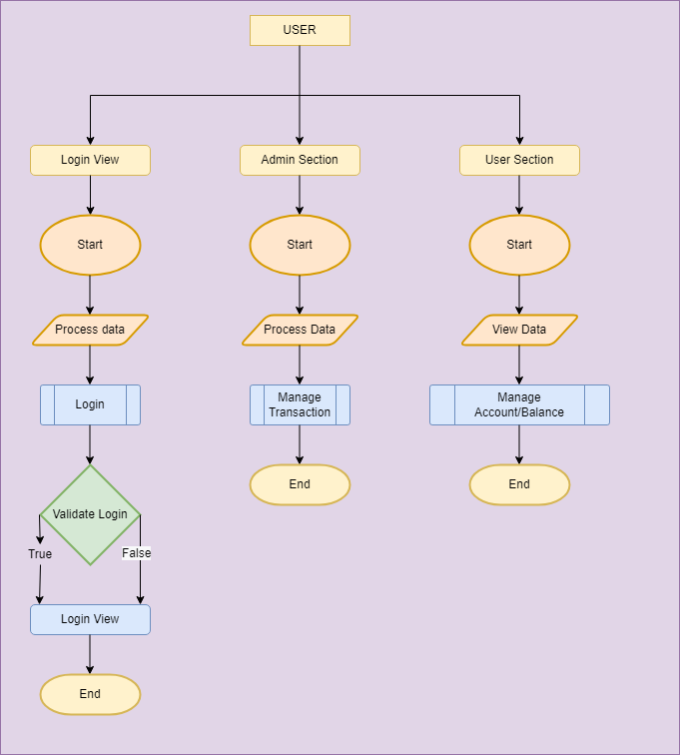
Design System Flow Chart

Slide 16
Limitations and Future Application of the Project
Futures Enhancement:
In future we can expand this project on the cloud.
In future, we can send messages/notifications to User on phone for their transaction.
Limitation :
In this, we don’t check the User’s bank name.

Slide 17
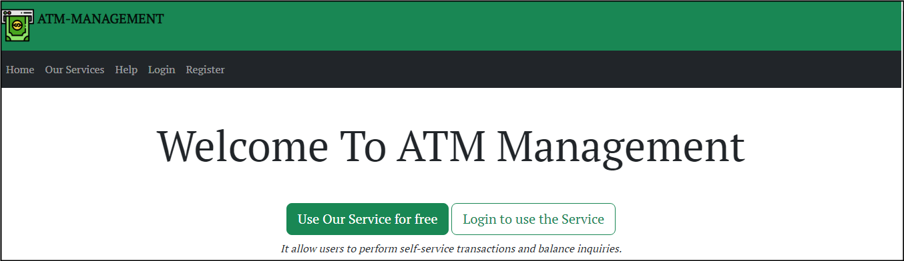
Screen Snapshot
Home Page

Slide 18
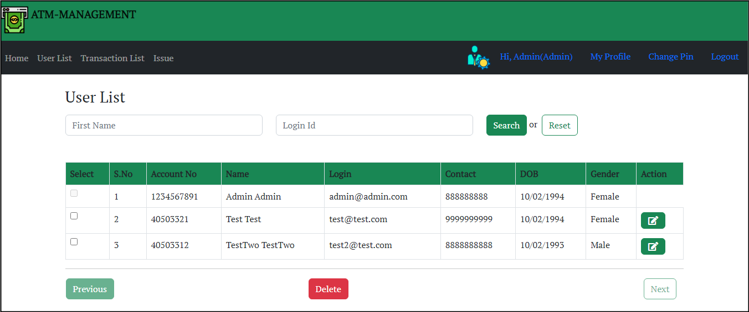
User List

Slide 19
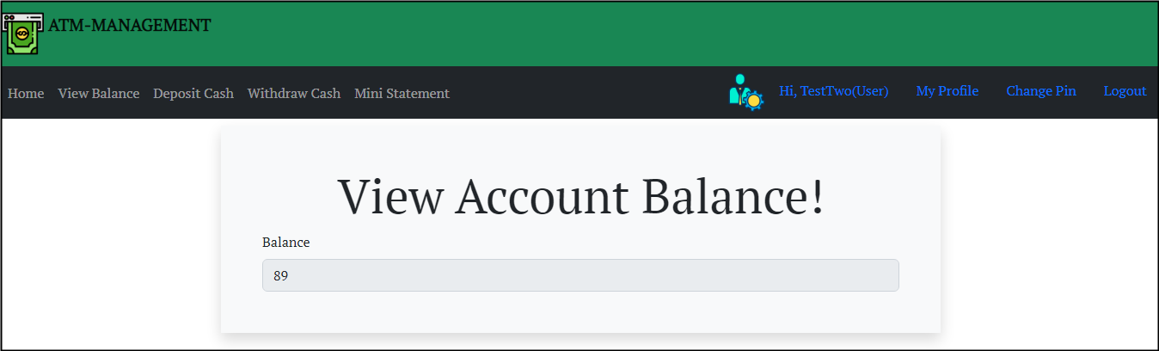
view account

Slide 20
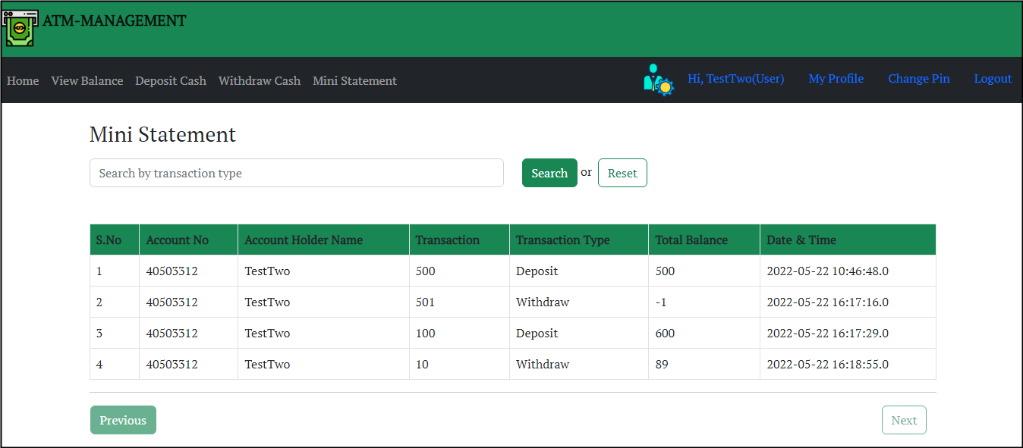
Mini statement

Slide 21
Conclusion
The ATM Management System provides a single gateway to the User and Admin to allow them to manage their banking related activity efficiently. Everything will be handled at one place.
Users can register on the portal, and withdraw or deposit money from bank accounts. Users can use ATMs for making online transactions with just one tap. There is no need for a user to enter multiple details while making the payment. Users will have the option of balance inquiry, changing password/pin, can view mini bank statements, etc.
This application is designed in such a way that any future modification can be done most easily.

Slide 22


