Slide 1

Diabetes Prediction Analysis
By Ramesh Pandey
Using SQL, Excel
Notes:
<a href='https://www.freepik.com/vectors/business'>Business vector created by stories - www.freepik.com</a>

Slide 2
Table of Contents
Introduction
Project Questions & Solutions
Summary
Notes:
<a href='https://www.freepik.com/vectors/work'>Work vector created by stories - www.freepik.com</a>

Slide 3
Introduction
Welcome to the Diabetes Prediction Analysis project – an innovative initiative at the intersection of healthcare and data analytics. Diabetes, a prevalent chronic condition, demands proactive measures for early detection and prevention. In this project, we leverage advanced data analytics to predict the likelihood of an individual developing diabetes based on various health-related features.
The Diabetes Prediction Analysis project is a data-driven initiative designed to contribute to the early detection and prevention of diabetes. By harnessing the power of data analytics, the project seeks to identify patterns, trends, and risk factors associated with the development of diabetes. The primary objective is to build a predictive model that can analyze health-related data and provide insights into an individual's susceptibility to diabetes.
Our goal is to harness the power of data to build a predictive model that identifies individuals at risk before clinical symptoms emerge. By analyzing key health indicators and employing machine learning algorithms, we aim to provide valuable insights for healthcare professionals and individuals alike.
Notes:
<a href='https://www.freepik.com/vectors/infographic'>Infographic vector created by stories - www.freepik.com</a>

Slide 4
Project Questions & Solutions

Slide 5
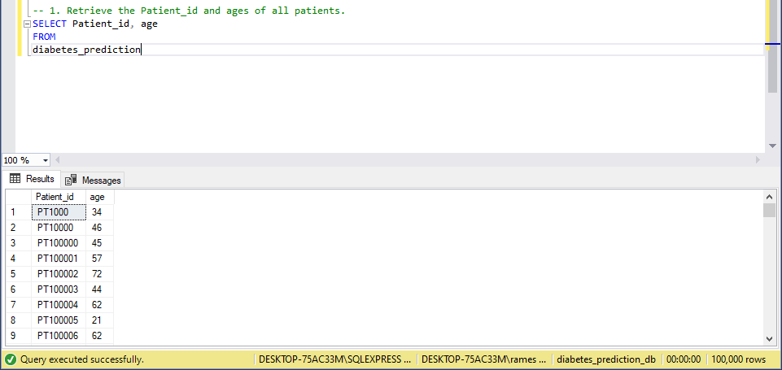
Q1: - Retrieve the Patient_id and ages of all patients.

Slide 6
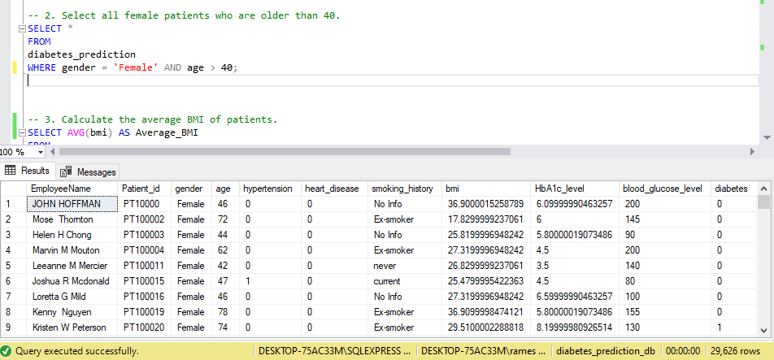
Q2: - Select all female patients who are older than 40.

Slide 7
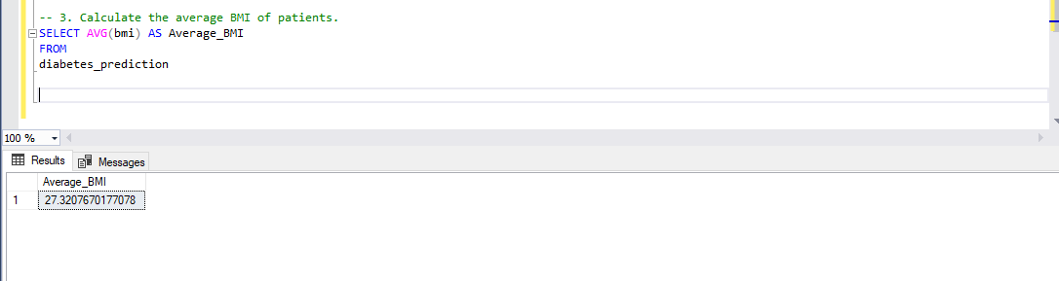
Q3: - Calculate the average BMI of patients.

Slide 8
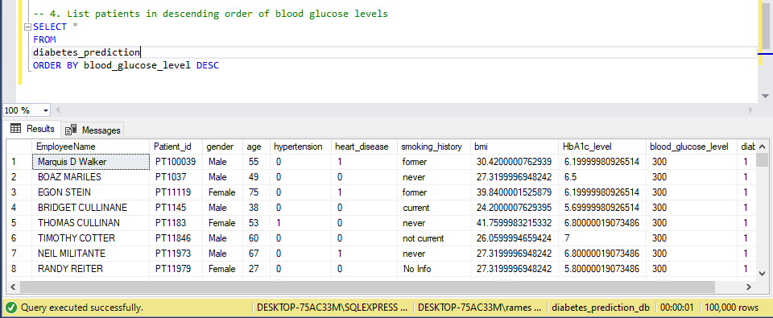
Q4: - List patients in descending order of blood glucose levels.

Slide 9
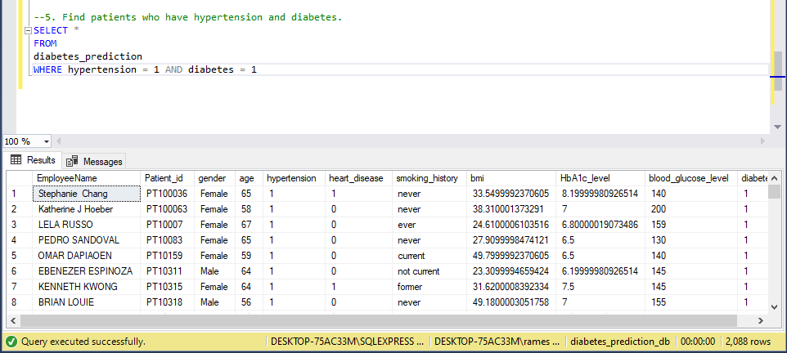
Q5: - Find patients who have hypertension and diabetes.

Slide 10
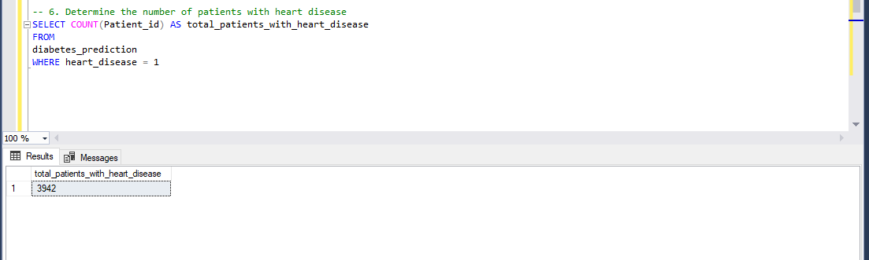
Q6: - Determine the number of patients with heart disease.

Slide 11
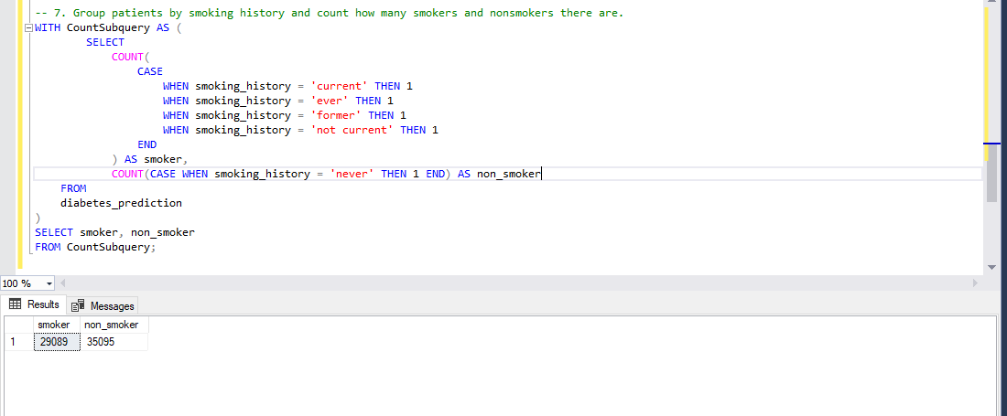
Q7: - Group patients by smoking history and count how many smokers and nonsmokers there are.

Slide 12
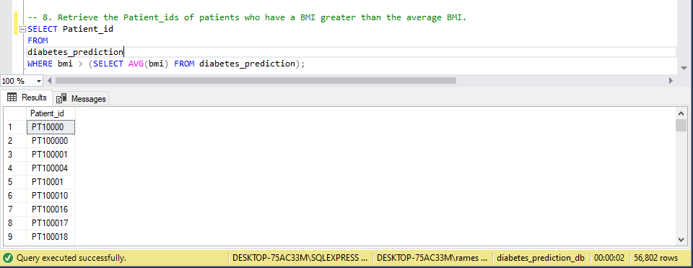
Q8: - Retrieve the Patient_ids of patients who have a BMI greater than the average BMI.

Slide 13
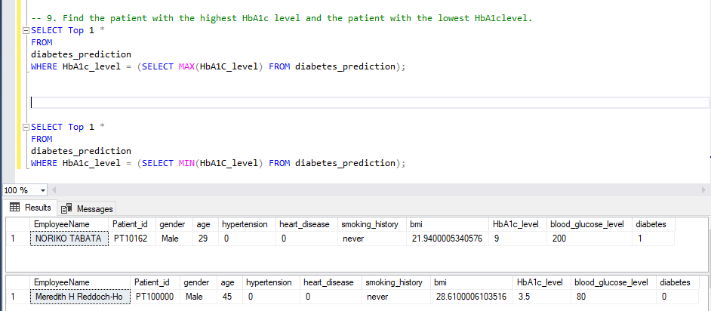
Q9: - Find the patient with the highest HbA1c level and the patient with the lowest HbA1clevel.

Slide 14
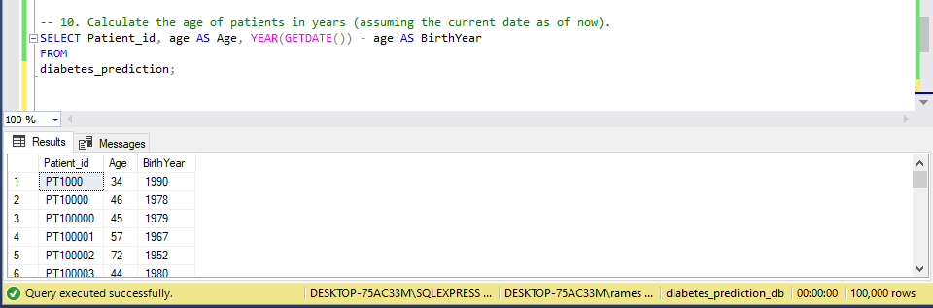
Q10: - Calculate the age of patients in years (assuming the current date as of now).

Slide 15
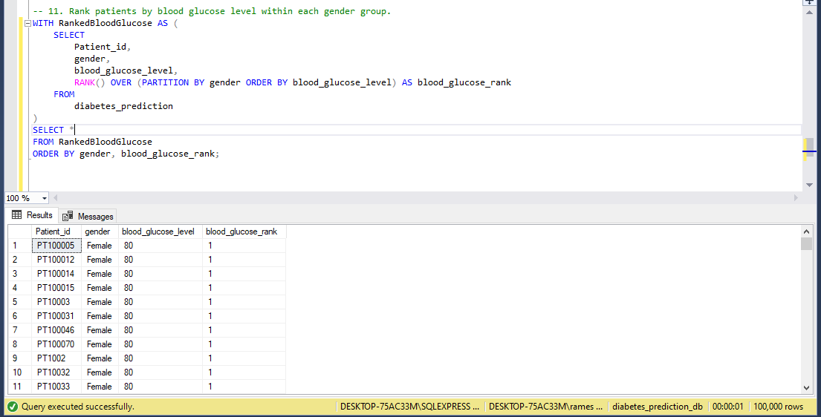
Q11: - Rank patients by blood glucose level within each gender group

Slide 16
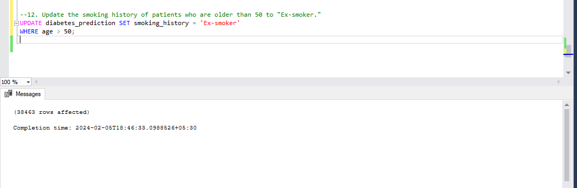
Q12: - Update the smoking history of patients who are older than 50 to "Ex-smoker."

Slide 17
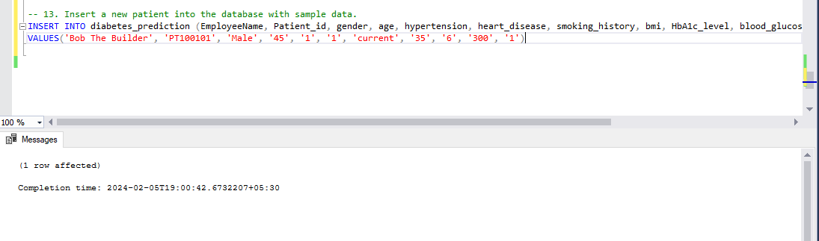
Q13: - Insert a new patient into the database with sample data.

Slide 18

Q14: - Delete all patients with heart disease from the database.

Slide 19
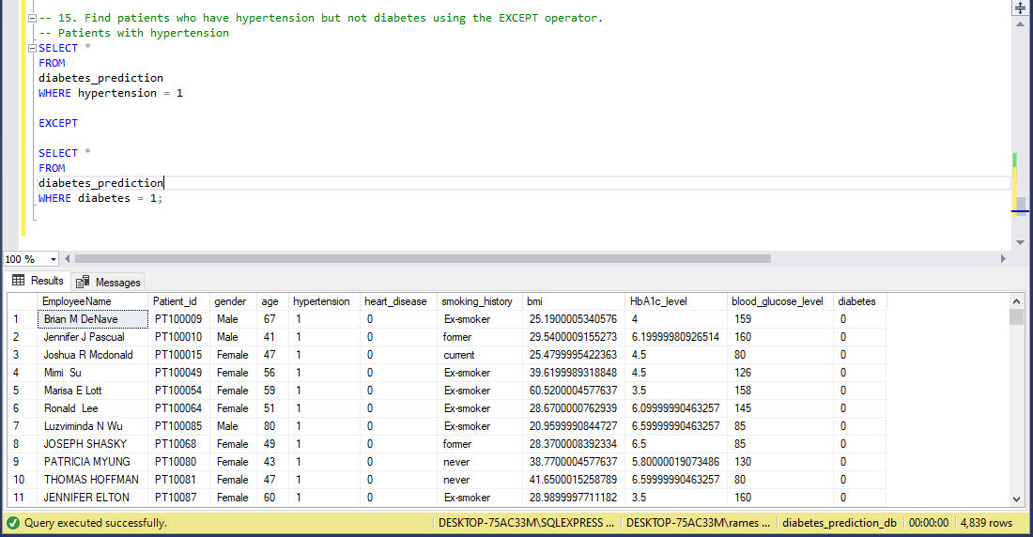
Q15: - Find patients who have hypertension but not diabetes using the EXCEPT operator.

Slide 20
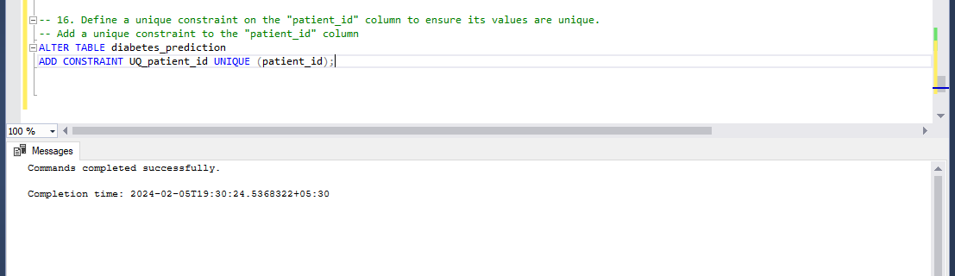
Q16: - Define a unique constraint on the "patient_id" column to ensure its values are unique.

Slide 21
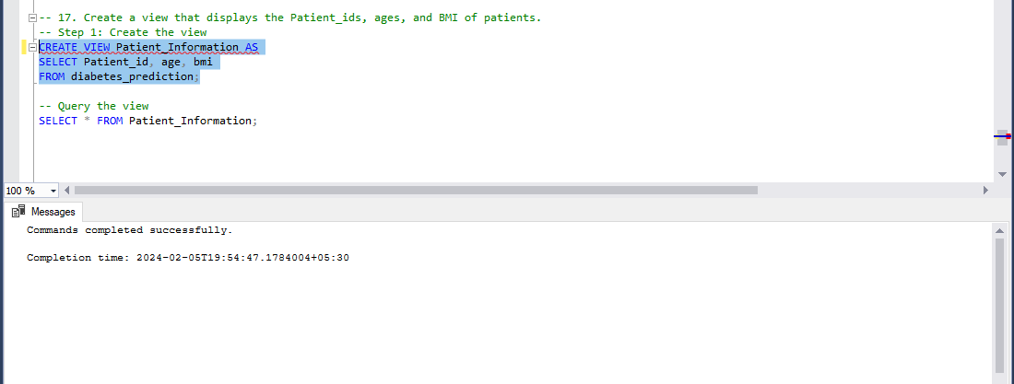
Q17: - Create a view that displays the Patient_ids, ages, and BMI of patients.

Slide 22
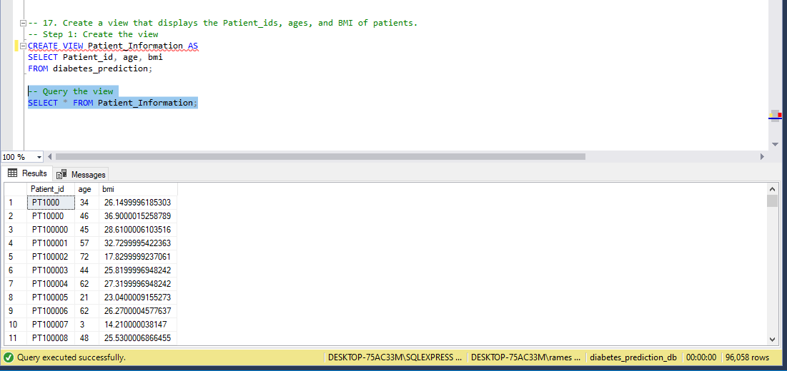
Q17: - Create a view that displays the Patient_ids, ages, and BMI of patients.

Slide 23
Q18: - Suggest improvements in the database schema to reduce data redundancy and improve data integrity.
To suggest improvements in a database schema for reducing data redundancy and improving data integrity, I would need more information about the existing schema and the requirements of the system. However, I can provide some general recommendations that are commonly used to enhance database design:
Normalization:
Ensure that the database schema is normalized to at least the third normal form (3NF). This helps minimize redundancy and ensures that data is stored efficiently without unnecessary duplication.
Primary Keys:
Verify that each table has a primary key, and it uniquely identifies each record in the table. This helps maintain data integrity and allows for efficient indexing.
Foreign Keys:
Use foreign keys to establish relationships between tables. This ensures referential integrity and helps prevent orphans (records with no corresponding parent record) in related tables.
Data Types:
Choose appropriate data types for each column to optimize storage space and improve data integrity. For example, use integer types for primary keys, date types for date values, etc.

Slide 24
Constraints:
Implement constraints such as UNIQUE constraints, NOT NULL constraints, and CHECK constraints to enforce data integrity rules at the database level.
Avoid Redundant Columns:
Eliminate redundant columns that can be derived from other columns in the same table. Redundant information can lead to inconsistencies.
Composite Keys:
Consider using composite keys (keys composed of multiple columns) when necessary to uniquely identify records.
Separate Concerns:
Organize the database schema in a way that separates different concerns. For example, use separate tables for user information, orders, and products.
Avoid Storing Calculated Values:
Avoid storing calculated values in the database. Instead, calculate them on-the-fly when needed. This reduces redundancy and ensures accuracy.
Audit Trails:
Consider adding audit trail columns (e.g., created_at, updated_at) to track when records are created or modified. This enhances data accountability.

Slide 25
Indexes:
Use indexes judiciously to improve query performance, but avoid unnecessary indexes as they can impact write performance.
Partitioning:
Depending on the database system, consider using partitioning to manage large tables more efficiently.
Remember that the specifics of these recommendations depend on the nature of your data and the requirements of your application. Always conduct a thorough analysis of your use cases before making schema changes.

Slide 26
Q19: - Explain how you can optimize the performance of SQL queries on this dataset.
Optimizing the performance of SQL queries on a dataset involves various strategies to ensure that queries are executed efficiently, minimizing response times, and utilizing system resources effectively. Here are several ways to optimize SQL queries:
Indexing:
Identify columns frequently used in WHERE clauses, JOIN conditions, or ORDER BY clauses and create appropriate indexes. Indexes can significantly speed up query performance.
Use Proper Joins:
Choose the appropriate type of JOIN (INNER JOIN, LEFT JOIN, etc.) based on the relationships between tables. Ensure that JOIN conditions are well-defined and use indexes when necessary.
Limit the Number of Columns Returned:
Only retrieve the columns that are necessary for the query. This reduces the amount of data that needs to be processed and transmitted.
*Avoid SELECT :
Instead of selecting all columns using SELECT *, explicitly specify the columns you need. This minimizes data transfer and improves query performance.

Slide 27
Optimize WHERE Clauses:
Use indexed columns in WHERE clauses for efficient data retrieval. Avoid complex or unnecessary conditions. Be cautious with functions in WHERE clauses, as they may prevent index usage.
Optimize ORDER BY and GROUP BY:
When using ORDER BY or GROUP BY, ensure that the columns involved are indexed. Avoid sorting or grouping large result sets whenever possible.
Avoid Nested Queries:
Rewrite queries to minimize the use of nested subqueries. Use JOINs and WHERE clauses effectively to achieve the same results with better performance.
Use EXISTS Instead of IN:
When checking for the existence of records, use EXISTS instead of IN, especially for large datasets. EXISTS can be more efficient.
Update Statistics:
Regularly update statistics on tables to help the query optimizer generate efficient execution plans.
Consider Materialized Views:
For complex queries that involve aggregations or calculations, consider using materialized views. These are precomputed views stored as tables, reducing the need for recalculations during query execution.

Slide 28
Partition Large Tables:
If dealing with large tables, consider partitioning based on certain criteria (e.g., date ranges). This can significantly improve query performance by limiting the amount of data that needs to be scanned.
Database Server Tuning:
Adjust database server settings, such as memory allocation, disk configuration, and parallelism, to optimize overall performance.
Cache Query Results:
If applicable, consider caching query results for frequently used queries to avoid redundant computations.
Regular Maintenance:
Schedule regular maintenance tasks, such as index rebuilding and database statistics updates, to keep the database in optimal condition.
Use Stored Procedures:
Consider using stored procedures to encapsulate and optimize frequently executed queries.
Always analyze the specific characteristics of your dataset, understand the workload, and use profiling tools to identify performance bottlenecks before implementing optimizations.

Slide 29
Summary
The Diabetes Prediction Analysis project utilizes SQL queries and Excel analytics for early diabetes detection. Focused on risk assessment through diverse health indicators, the project aims to optimize healthcare interventions, improve patient outcomes, and contribute to proactive healthcare strategies. The synergy of SQL and Excel provides a powerful toolset for data exploration and user-friendly reporting, making a meaningful impact on public health. In addition to its emphasis on risk assessment, the project delves into the intricate realm of healthcare data, utilizing SQL's robust querying capabilities to efficiently manage and analyze vast datasets. The strategic integration of Excel analytics adds a layer of dynamic visualization, allowing healthcare professionals to glean valuable insights from the data. This dynamic duo of SQL and Excel not only streamlines the identification of potential diabetes risks but also facilitates swift decision-making for healthcare practitioners. The cost-efficient nature of this approach ensures that advanced analytical tools are accessible without significant financial investment.

Slide 30
ThankYou
Notes:
<a href='https://www.freepik.com/vectors/infographic'>Infographic vector created by stories - www.freepik.com</a>

