Slide 1


TECHYUVA-11.0
Buddha Degree College
Gida,Gorakhpur
Project Presentation
On
CAMPUS 2 CAREER
COURSE-BCA
5th semester
Presented by :
Nitkarsh singh
Ritesh
Ritesh pandey
Under the Guidance of :
Mr.Prashant Sharama
HOD
BDC, Department

Slide 2
LIST OF CONTENT
Introduction
Review
Work Flow
Result and discussion
Conclusion
Scope for future work
References

Slide 3

INTRODUCTION
Purpose: This website is designed to help students prepare for campus placements by providing guided learning paths, coding practice, quizzes, and performance tracking.
Target Audience: BCA, MCA, or any college students preparing for technical and aptitude tests.
Problem Statement: Students often struggle to find a structured roadmap for placement preparation, lack coding practice environments, and do not have a system to track their progress.
Solution: A single platform that integrates:
  Stream selection (Web Dev, App Dev, Data Science, AI/ML)
  Guided roadmap
  Online compiler for coding practice
  Quiz and aptitude tests
  Performance tracking dashboard

Slide 4
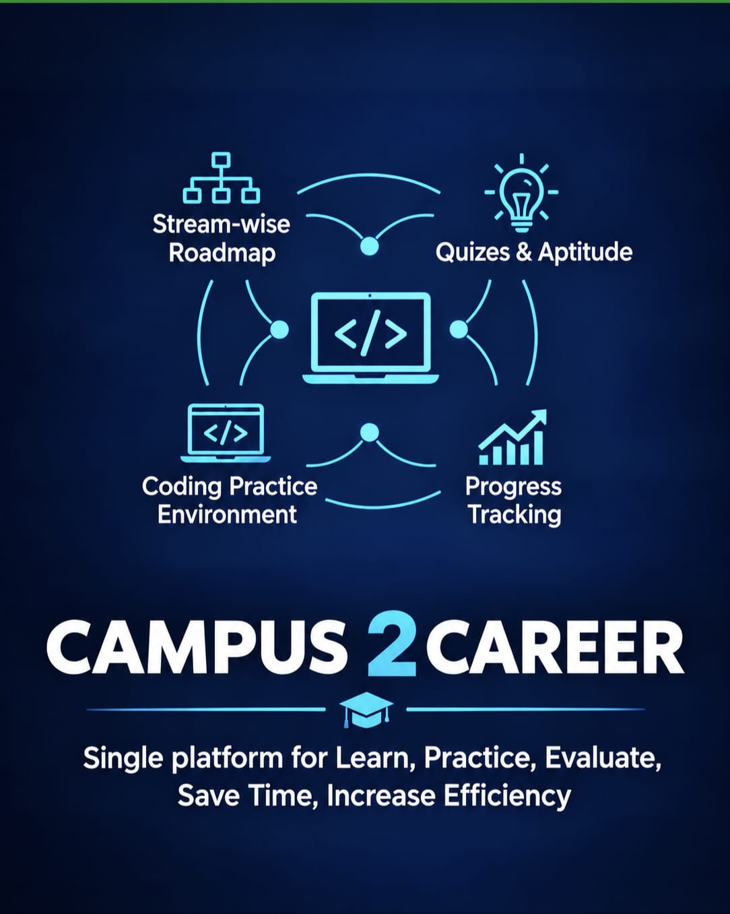
REVIEW
Existing platforms provide either:
  Coding practice only (LeetCode, HackerRank)
  Learning resources only (GeeksforGeeks, Coursera)
  Placement guides and aptitude tests separately
There is a need for an integrated system combining:
  Stream-wise roadmap
  Coding practice environment
  Quizzes for aptitude and technical skills
  Progress tracking
Detailed Explanation:
While many websites provide placement resources, most are fragmented. Students must switch between multiple platforms to learn, practice, and evaluate themselves. This project integrates all key features into a single interactive platform, saving time and increasing preparation efficiency.

Slide 5
WORK FLOW
Stream Selection
  Students select their preferred career stream (Web Dev, App Dev, Data Science, AI/ML)
  Each stream shows the stepwise roadmap
Guided Roadmap Module
  Interactive roadmap for topics
  Students can mark topics as completed
  Provides recommended resources and projects
Online Compiler Integration
  Supports multiple programming languages (C, C++, Java, Python, JavaScript)
  Uses Judge0 API or JDoodle API for code execution
  Students can write, compile, run, and debug code online
Quiz and Aptitude Module
  Covers technical, coding, and aptitude topics
  Multiple-choice questions (MCQs) with instant feedback and explanations
  Stores quiz results for performance tracking
Performance Tracker / Dashboard
  Tracks:
    Roadmap completion
    Quiz performance
    Coding practice statistics
  Displays graphs and charts for visualization
Technical Stack:
Frontend: React.js, HTML, CSS, JavaScript
Backend: Node.js + Express.js
Database: MongoDB
Compiler API: Judge0
Visualization: Chart.js / Recharts
Workflow:
Students register/login → select a stream → follow roadmap → practice coding → attempt quizzes → track performance → improve skills

Slide 6
RESULT AND DISCUSSION
Progress Tracking: Students can track their quiz scores and learning progress.
Easy Learning: Students can prepare step by step with the help of a stream-wise learning roadmap
Skill Improvement: Coding practice and aptitude quizzes help students improve their technical skills and problem-solving abilities
Overall Result: The system provides a convenient and well-organized platform for placement preparation, reducing the need to switch between multiple websites.

Slide 7
CONCLUSION
The platform provides a complete ecosystem for placement preparation.
Combines: learning roadmap, coding practice, quizzes, and performance tracking.
Improves student readiness for placements by structuring learning and providing continuous evaluation.
Reduces dependency on multiple platforms and resources.
Explanation:
This platform is student-centric, scalable, and can adapt to different streams and technologies. It ensures efficient preparation and better placement outcomes

Slide 8
SCOPE FOR FUTURE WORK
Add Interview Preparation Module (common questions, mock interviews).
Add Resume Builder for students.
Add AI-powered recommendation system to suggest topics based on performance gaps.
Add Community Forum / Discussion Board for collaborative learning.
Mobile App version for on-the-go learning.
Add gamification features (badges, points, leaderboards) to motivate students.

Slide 9
REFERENCES
JDoodle API: https://www.jdoodle.com/compiler-api
Judge0 API: https://judge0.com/
GeeksforGeeks: https://www.geeksforgeeks.org/
HackerRank: https://www.hackerrank.com/
LeetCode: https://leetcode.com/
Coursera: https://www.coursera.org/
React.js Documentation: https://reactjs.org/docs/getting-started.html

Slide 10
THANK
YOU…..

