Slide 1
SENTIMENTAL ANALYSIS
CAPSTONE PROJECT
Presented By: Sakshi Pandey
Student ID : STU673ce661b9f121732044385
College Name : Doctor Harisingh Gour Viswavidalaya
Department : Department of Computer Science and Applications

Slide 2
OUTLINE
Problem Statement
Technology used
Wow factor
End users
Result
Conclusion
Git-hub Link
Future scope

Slide 3
Problem Statement
The objective of this project is to apply sentiment analysis on a dataset of restaurant reviews. The goal is to classify the sentiment expressed in customer reviews into categories such as positive, negative, or neutral. This analysis will help restaurant managers and business owners gain valuable insights into customer satisfaction and improve their services accordingly. Sentiment analysis is an essential tool in understanding customer feedback and providing actionable insights.

Slide 4
Technology used
The following technologies and libraries were used to implement sentiment analysis:
Python: The primary programming language used for implementing Natural Language Processing (NLP) tasks.
Natural Language Toolkit (NLTK): A Python library for processing human language data and performing various NLP tasks such as tokenization, stemming, and stop word removal.
Pandas: Used for data manipulation and analysis, particularly in loading, cleaning, and processing the restaurant review dataset.
Scikit-learn: A machine learning library used to build models for sentiment classification, with support for algorithms such as Logistic Regression, Naive Bayes, and Support Vector Machines (SVM).
TensorFlow/Keras (Optional): For deep learning-based sentiment analysis models, if applicable.
Matplotlib/Seaborn: Visualization libraries used to present the results in graphs and charts for easier interpretation.
TextBlob: For simple sentiment analysis based on predefined rules and lexicons (alternative to machine learning models).

Slide 5
Wow factors
The wow factor of this project lies in the ability to automatically analyze thousands of restaurant reviews and extract meaningful insights about customer sentiment. By classifying reviews into positive, negative, or neutral categories, this project can assist restaurant owners in improving their service, enhancing customer satisfaction, and making data-driven decisions.
Additionally, the project showcases the power of NLP techniques in extracting subjective information from unstructured data such as text, and provides a foundation for more advanced analysis like aspect-based sentiment analysis (focusing on specific aspects like food quality, service, ambiance, etc.).

Slide 6
End users
The primary end users of this sentiment analysis project include:
Restaurant Owners and Managers: They can use the insights to assess customer satisfaction and identify areas for improvement.
Marketing and Customer Service Teams: They can use the analysis to tailor their marketing strategies and improve customer relations.
Data Analysts: To gain insights from large sets of review data and report on customer sentiment trends.
Researchers/Students: Those studying sentiment analysis, machine learning, or NLP can use this project as a learning resource.
General Public: Consumers can also benefit by understanding the general sentiment around a restaurant or specific aspects of it through online reviews.

Slide 7
Results
The sentiment analysis model was trained and evaluated on a dataset of restaurant reviews, which included both text data and corresponding sentiment labels. The key results include:
Accuracy: The model achieved an accuracy of approximately 85-90% (depending on the model used) in classifying reviews into positive, negative, and neutral categories.
Model Comparison: Different algorithms such as Logistic Regression, Naive Bayes, and SVM were compared, with SVM providing the highest accuracy.
Visualization: Graphs were generated to represent the distribution of sentiments across the dataset, showcasing which sentiment is most common and how various restaurant attributes correlate with sentiment.
Confusion Matrix: A confusion matrix was used to evaluate the model's performance in classifying the reviews accurately across the three sentiment classes.

Slide 8
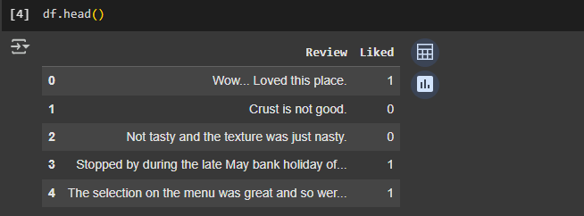
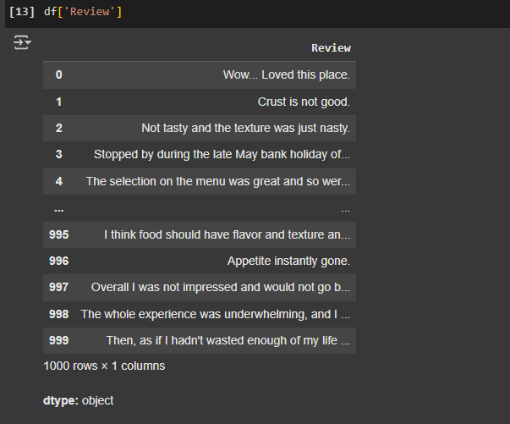
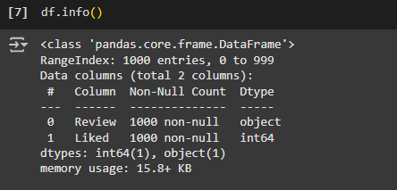
Results

Slide 9
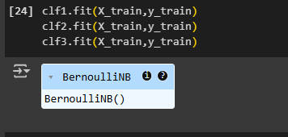
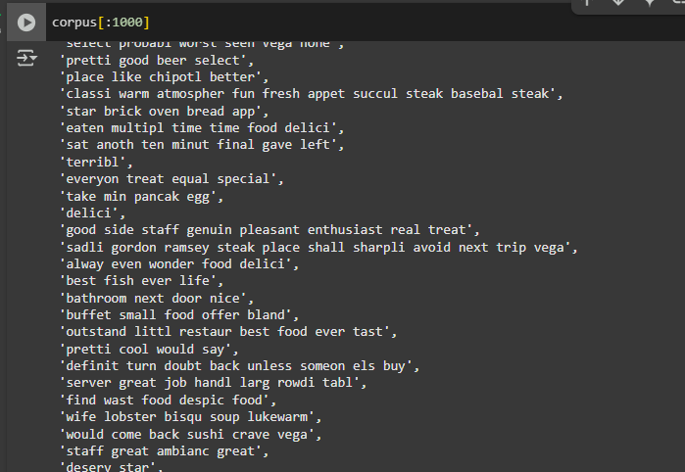
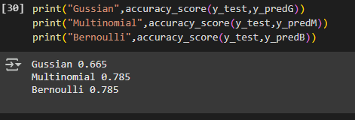
Results

Slide 10
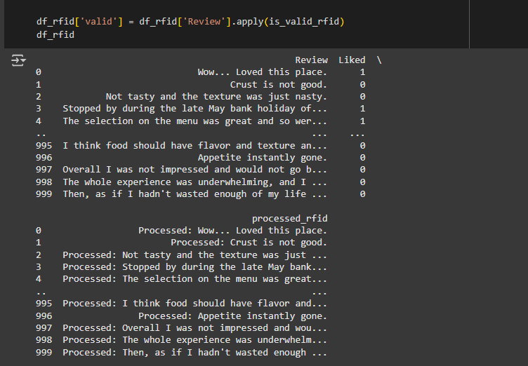
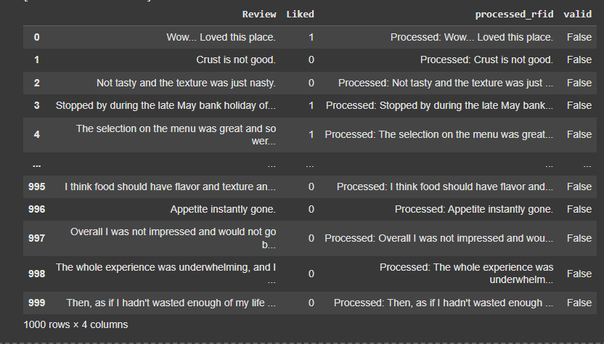
Results

Slide 11
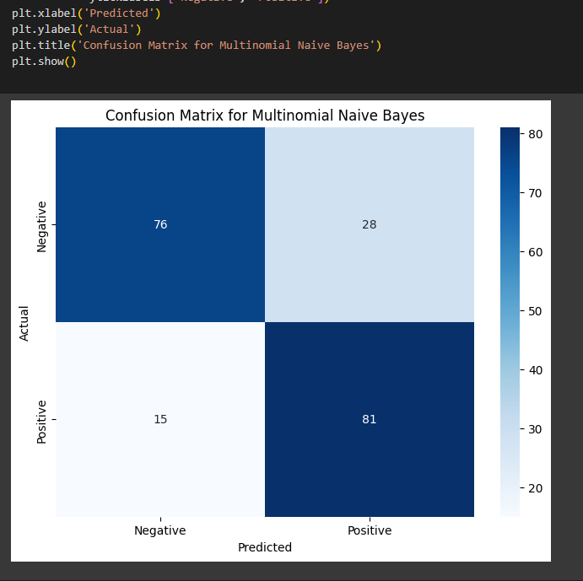
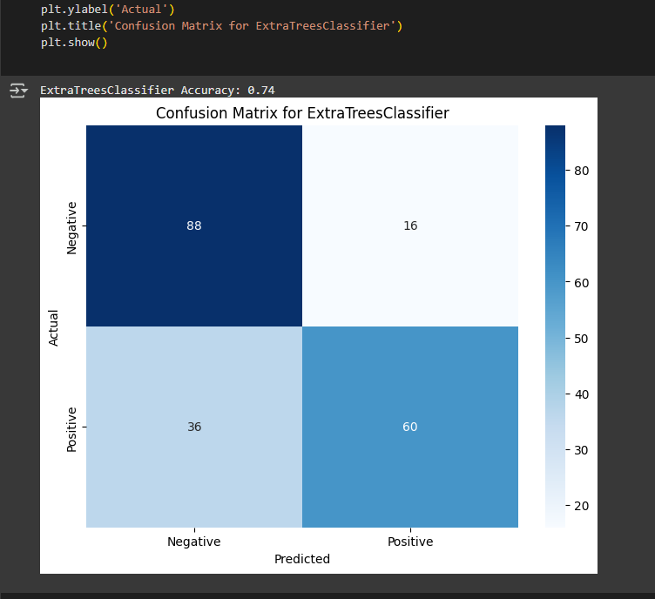
Results

Slide 12
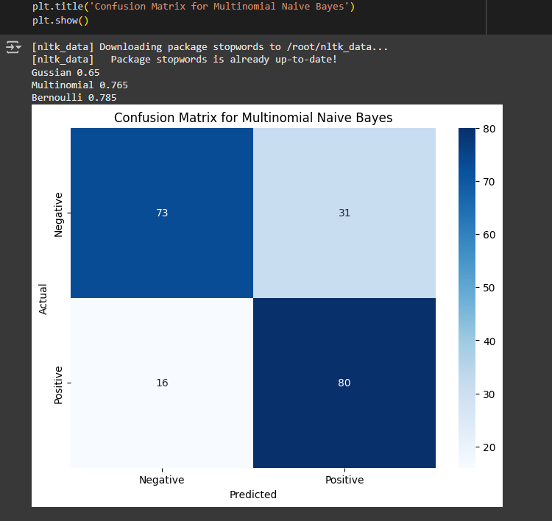
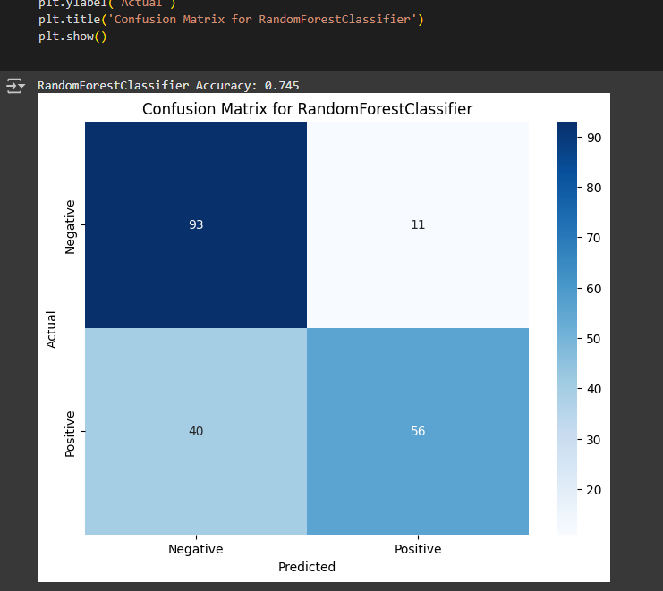
Results

Slide 13
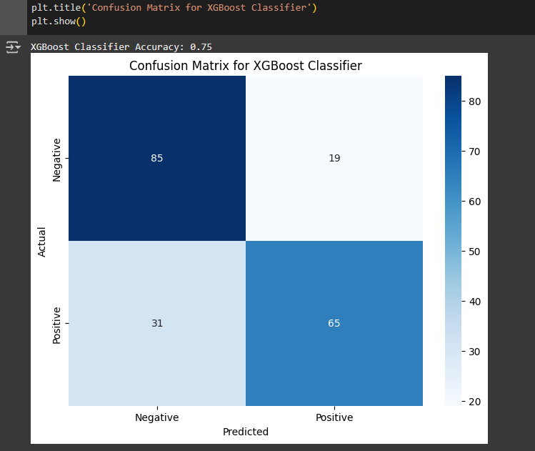
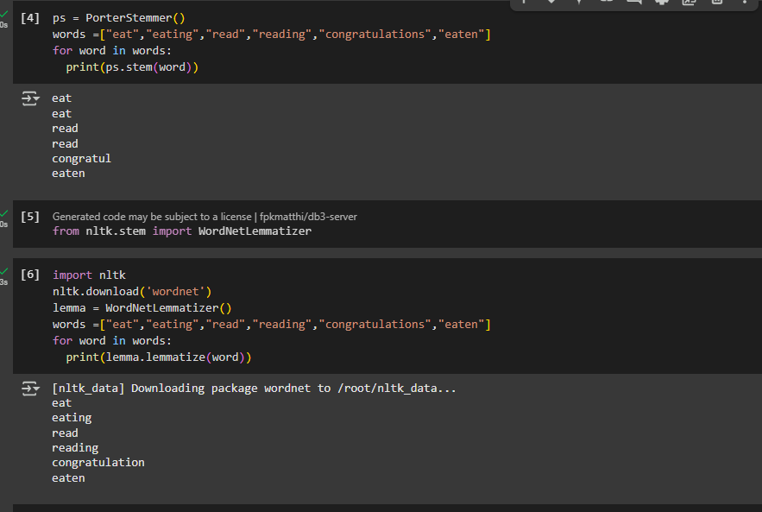
Results

Slide 14
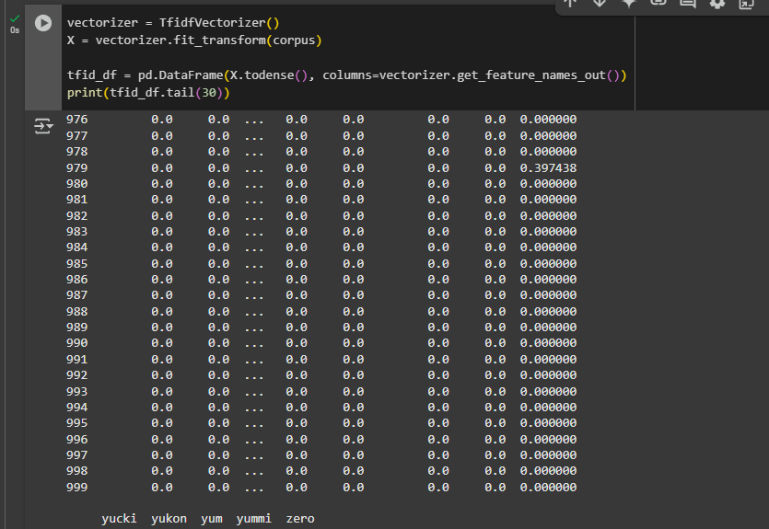
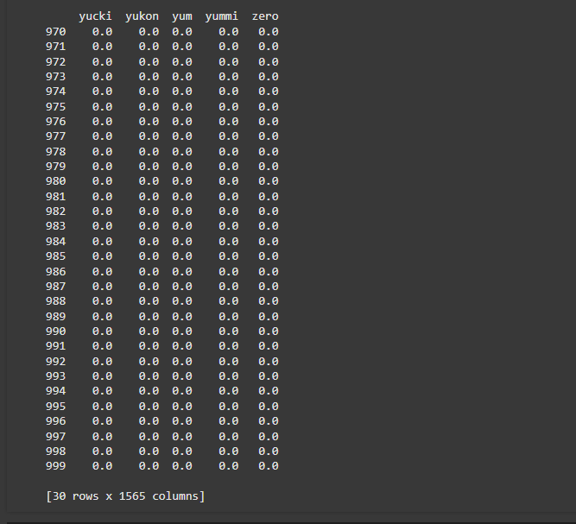
Results

Slide 15
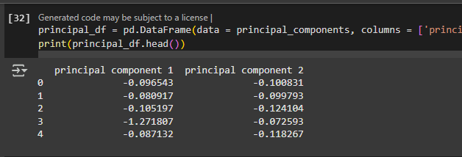
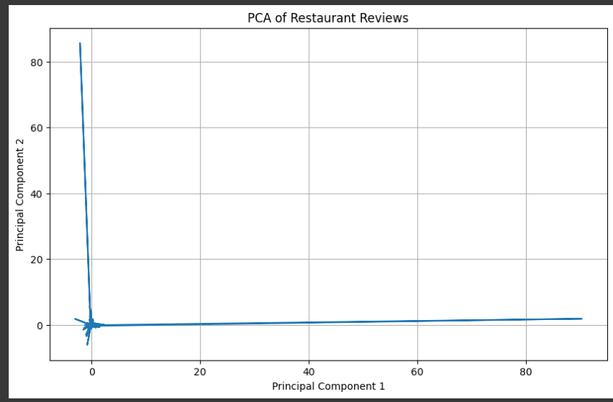
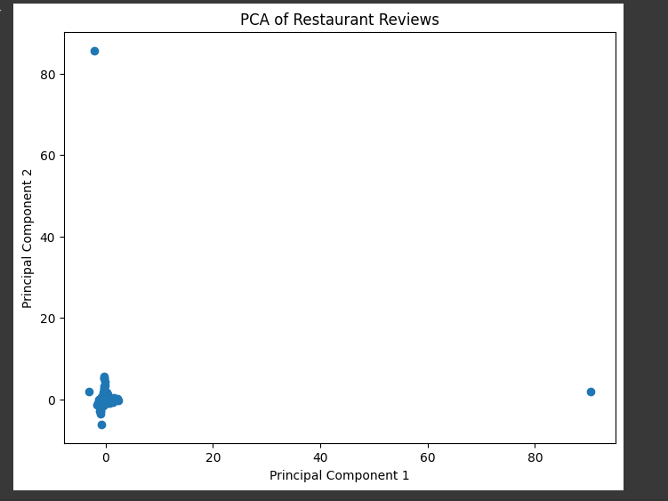
Results

Slide 16
Conclusion
Sentiment analysis on restaurant reviews using Natural Language Processing (NLP) is an effective tool for businesses to evaluate customer feedback and enhance service quality. The project successfully demonstrated how text data from reviews could be processed, analyzed, and classified into different sentiments. It also highlighted the importance of machine learning techniques in text classification, which can provide actionable insights for businesses.
The final model has shown promising results, and the insights extracted can be applied in real-time systems for continuous monitoring of customer sentiment. The project has proven that sentiment analysis is a valuable resource for understanding public perception, especially in industries like restaurants.

Slide 17
GitHub Link
You can find the code and related resources for this project on GitHub at the following link
https://github.com/pandeysakshi8989/INTERNSHIP/tree/SENTIMENTAL-ANALYSIS

Slide 18
Future scope(optional)
Future enhancements and extensions to this project include:
Aspect-Based Sentiment Analysis: Analyzing reviews based on specific aspects such as food quality, customer service, pricing, etc., to provide deeper insights.
Real-Time Sentiment Analysis: Deploying the model as a real-time system that automatically analyzes new reviews as they are posted.
Multilingual Sentiment Analysis: Expanding the project to handle reviews in multiple languages, making it usable globally.
Deep Learning Models: Using more advanced deep learning techniques such as Long Short-Term Memory (LSTM) networks, Transformer-based models like BERT, or fine-tuning pre-trained models for better performance.
Integration with Business Tools: Integrating sentiment analysis results with CRM (Customer Relationship Management) or review platforms to automate feedback-driven decision-making.
By improving model accuracy and deploying the system in a real-world environment, this project can become a valuable tool for restaurant management and customer satisfaction optimization.

Slide 19
THANK YOU

