Slide 1


NEXT GEN EMPLOYABILITY PROGRAM
CREATING A FUTURE-READY WORKFORCE
Student Name :
SAKSHI PANDEY
College Name :
Student ID :
DOCTOR HARISINGH GOUR VISHWAVIDALAYA
STU673ce661b9f121732044385

Slide 2
CAPSTONE PROJECT SHOWCASE
Project Title
REAL TIME COLLABORATION TOOL
Abstract | Problem Statement | Project Overview | Proposed Solution | Technology Used | Modelling & Results | Conclusion | Q&A

Slide 3
Abstract
1
Technology Stack: Utilize MongoDB for data storage, Express.js for server-side routing, React for the front-end UI, and Node.js for handling back-end logic and WebSocket communication to support live collaborative features.
2
Real-Time Collaboration: Implement Web Sockets to ensure seamless real-time synchronization of changes across all users editing the document, with live updates on content modifications and user actions.
3
User Interface: Create an intuitive, responsive UI using React to allow users to easily edit text, track changes, and manage multiple collaborators, with features like user roles, comments, and version control.
4
Security and Scalability: Implement user authentication and authorization with secure login systems, and design the architecture to be scalable, ensuring the tool can handle increasing numbers of concurrent users while maintaining performance.

Slide 4


Problem Statement
Modern collaborative work demands real-time tools that allow multiple users to edit and share documents seamlessly. Many tools struggle with synchronization , leading to version conflicts and delayed updates. The challenge is to build a system that ensures smooth , instant collaboration while managing authentication, document storage, and real time communication effectively.

Slide 5

Project Overview
The Real collaboration Tool is a web based application designed to facilitate synchronous document editing and management .
Efficient Document Management
Secure User Access
Real Time collaboration
User Friendly Interface
Robust Backend

Slide 6
Proposed Solution
Develop a real time collaboration tool using the MERN stack with Socket.IO integration
Frontend (React.js): Enable user engagement and live document editing
Backend ( Node.js + Express.js): Manages authentication , API endpoints, and communication.
Database(MongoDB): Stores user data and documents
Socket.IO: Provides instant updates and synchronization across users.

Slide 7
Technology used
Frontend : react.js for building dynamic user interfaces, Bootstrap for styling and Socket.io for real time updates.
Backend: Node.js and express.js for server – side logic . MongoDB for database management and Socket.io for real time communication.
Authentication: JSON Web Token for secure user authentication and authorization
Development Tools: Axios for HTTP requests, and tools for version, coding , testing and deployment

Slide 8
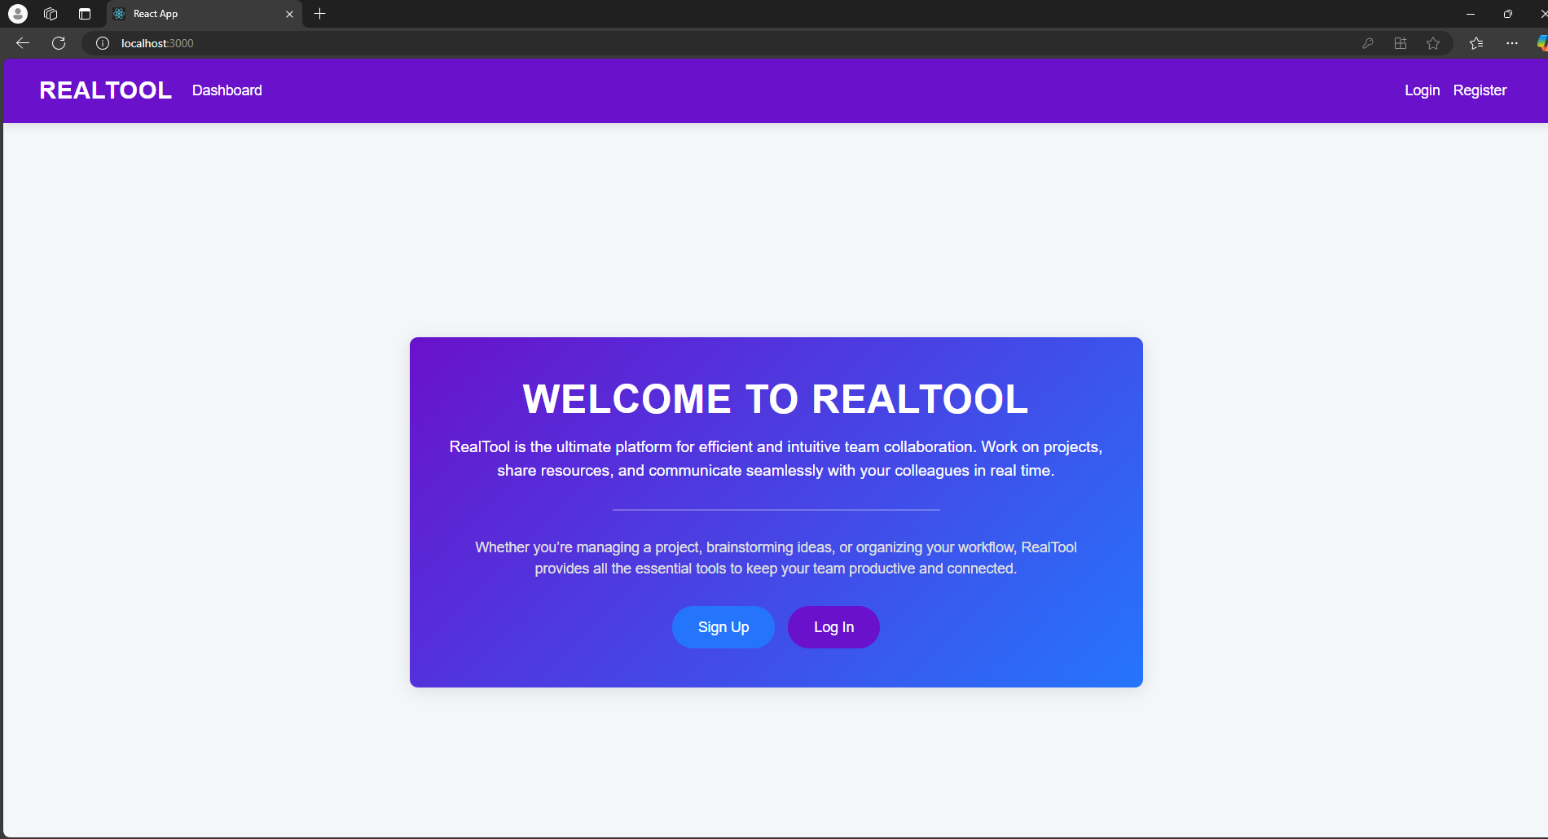
Modelling & Result

Slide 9
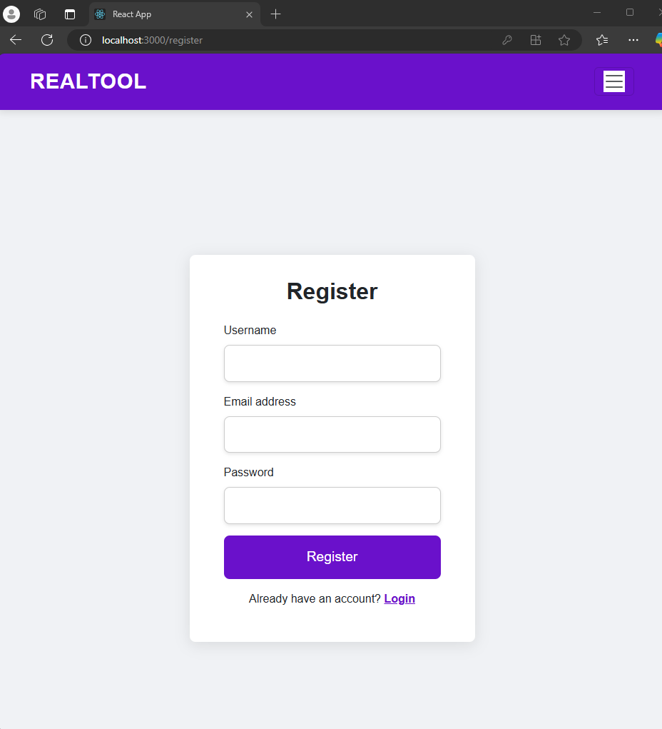
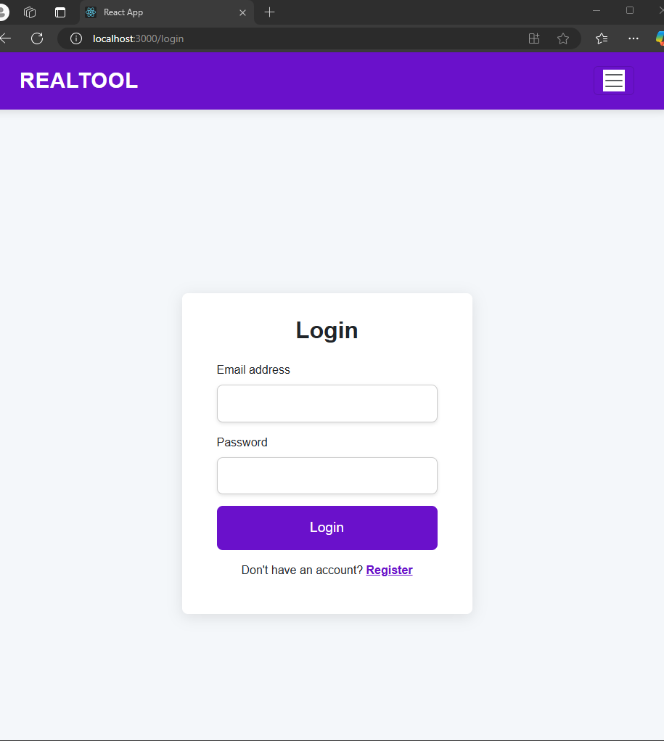
Modelling & Result

Slide 10
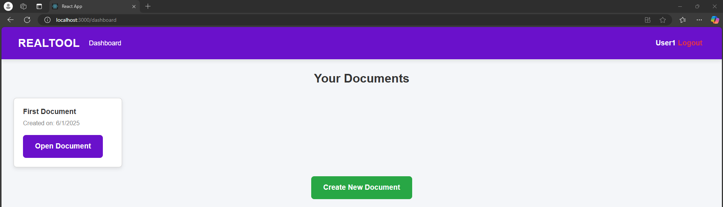
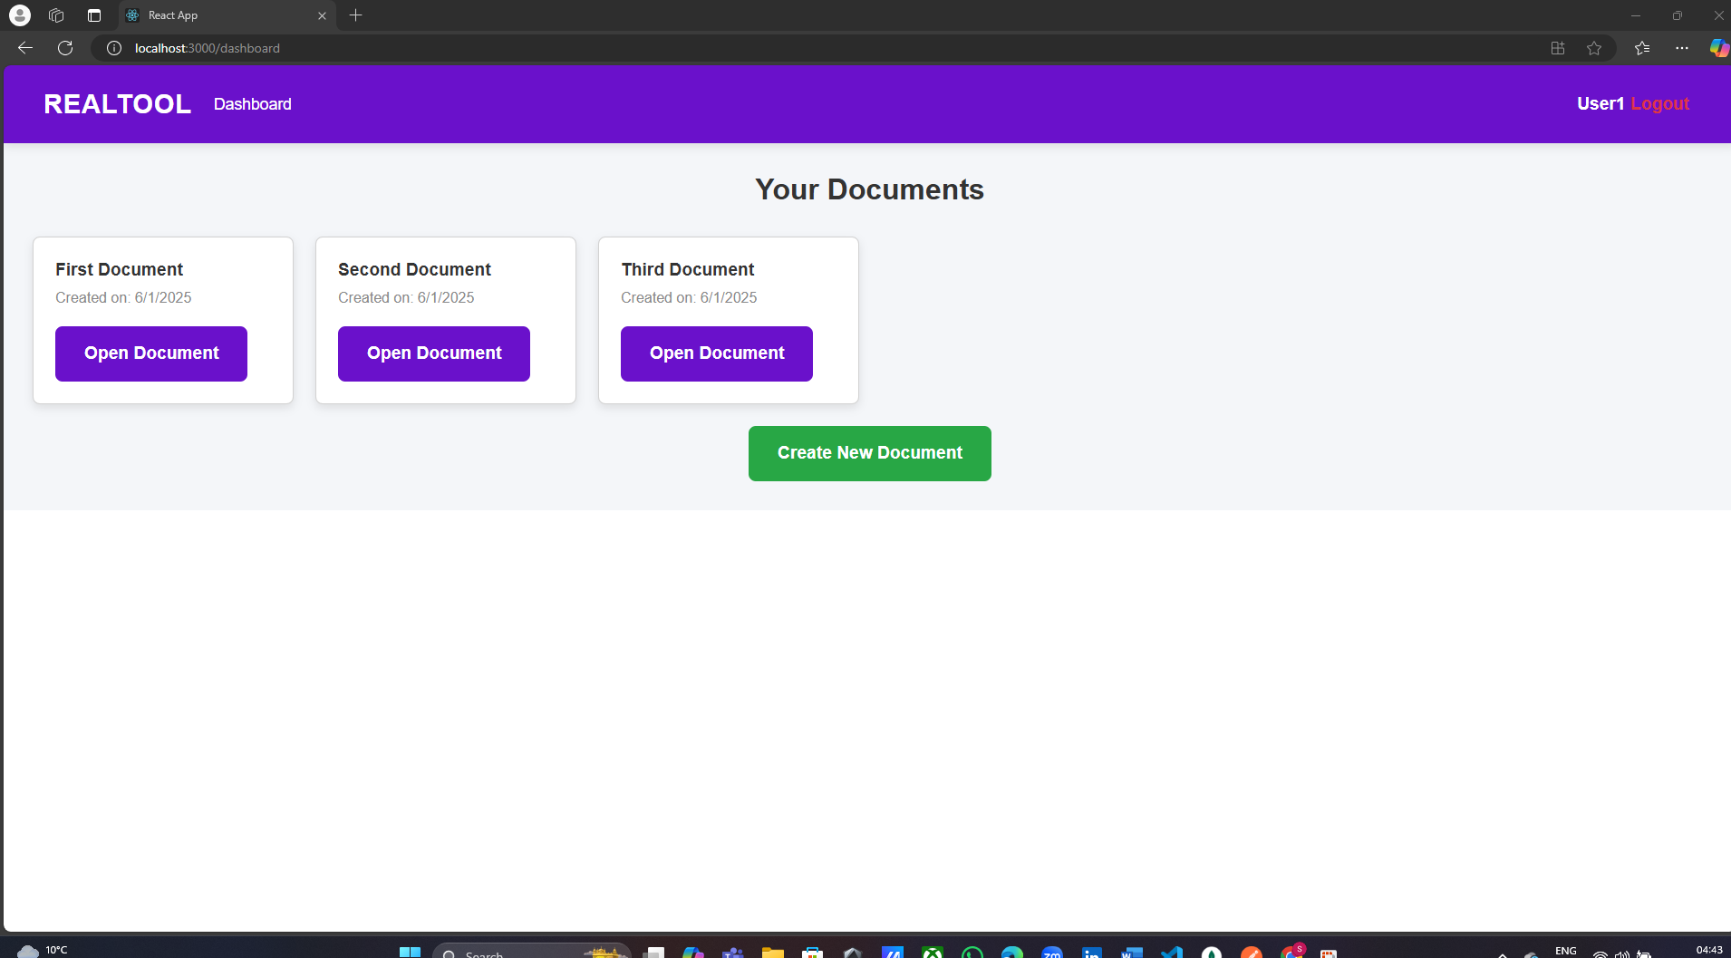
Modelling & Result

Slide 11
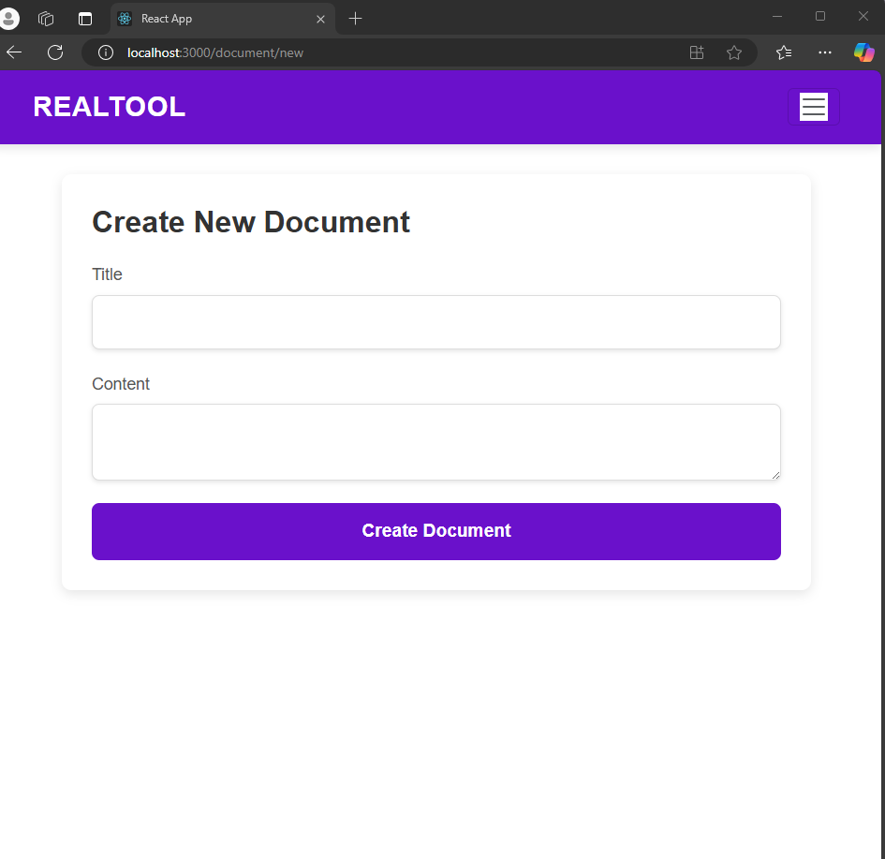
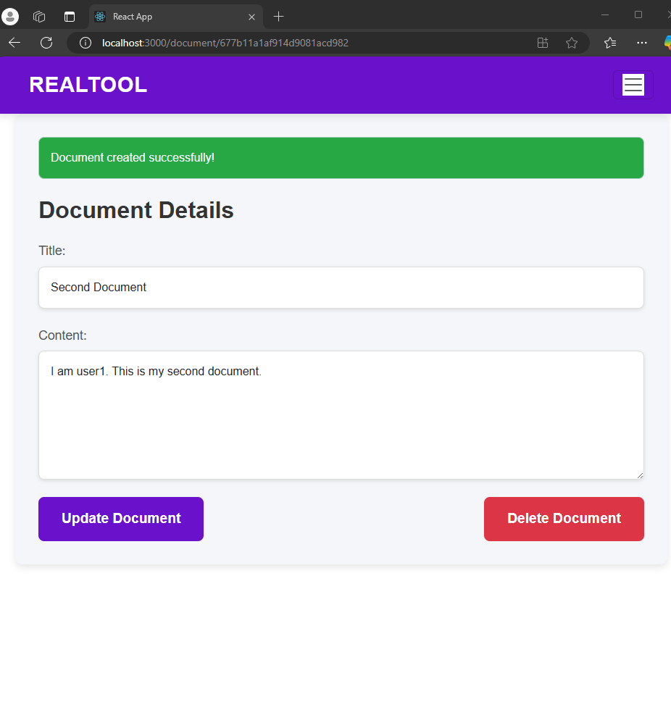
Modelling & Result

Slide 12
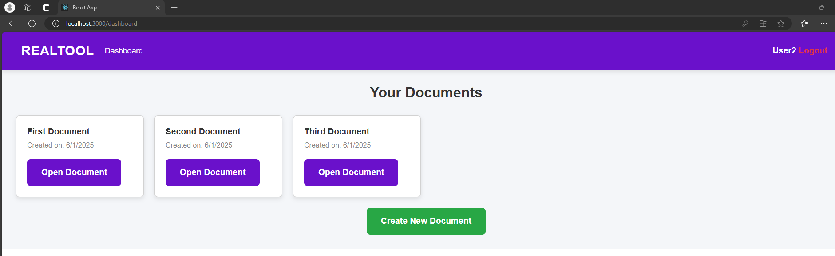
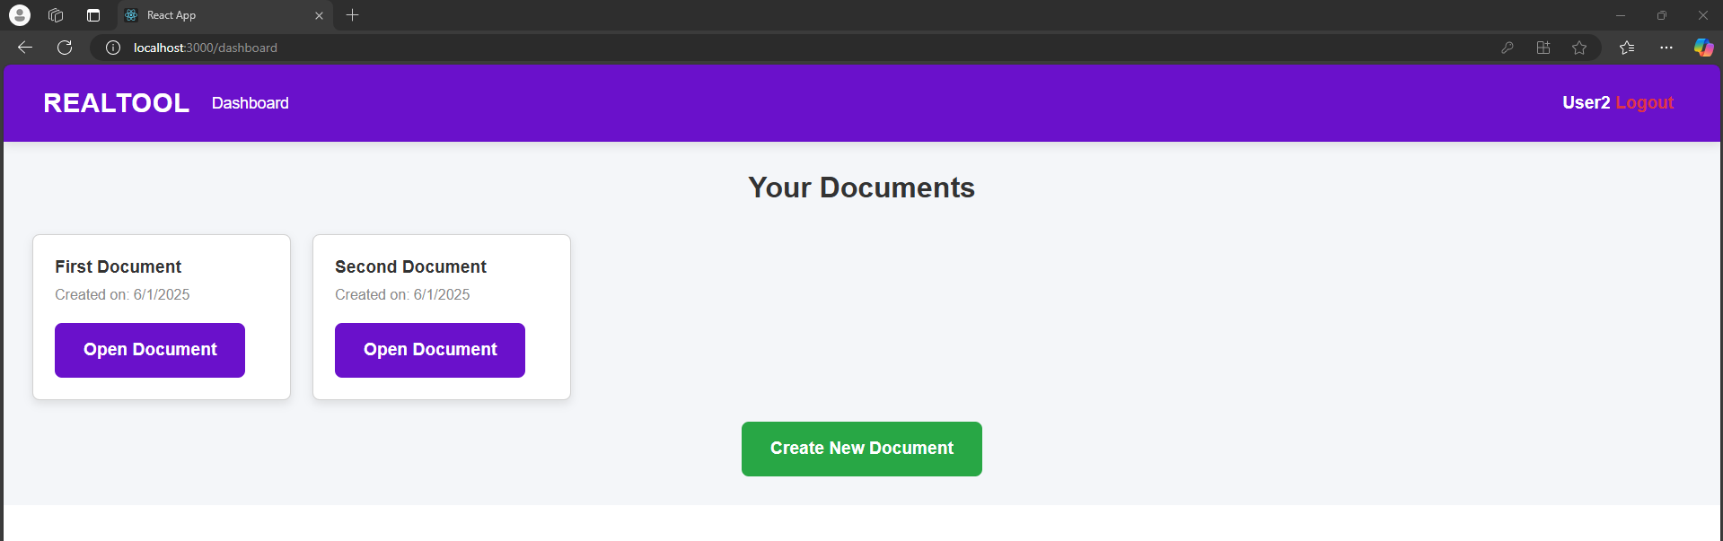
Modelling & Result

Slide 13
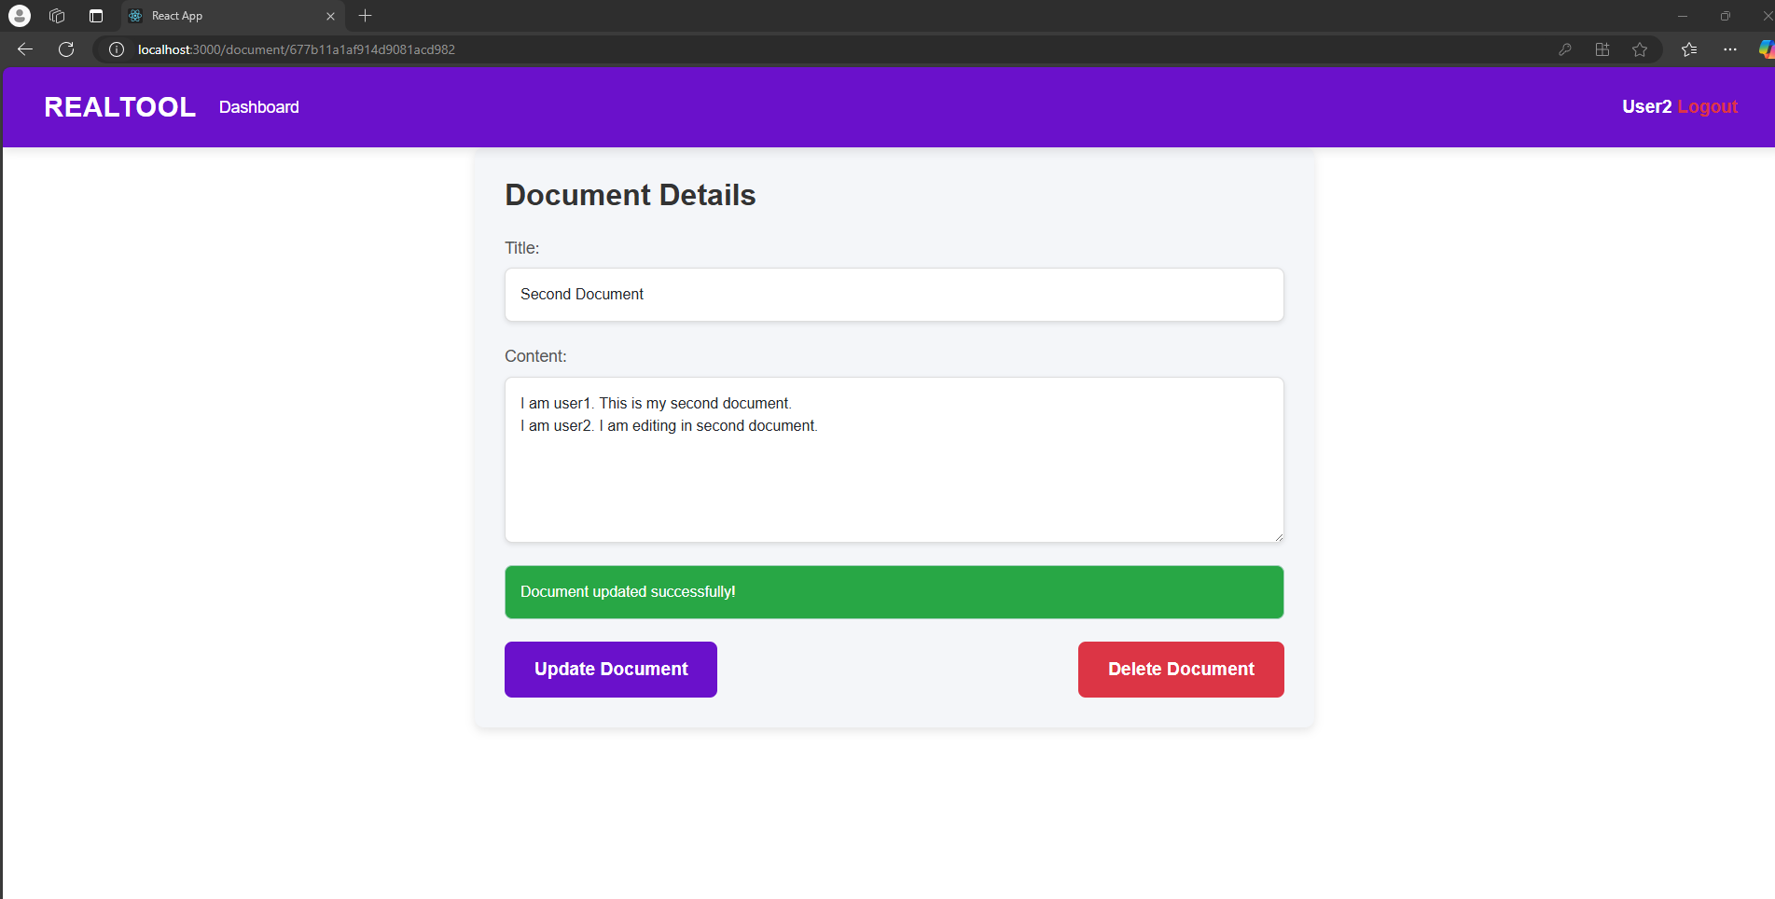
Modelling & Result

Slide 14

Conclusion
This project provides a highly functional, collaborative, and secure document management platform. By integrating real-time document editing and authentication, it allows users to seamlessly work together on shared documents, improving workflow efficiency and collaboration.
Project enhancements and additional features , such as chat functionality or advanced document collaboration features.
Explore future improvements for scalability, performance and user experience.

Slide 15
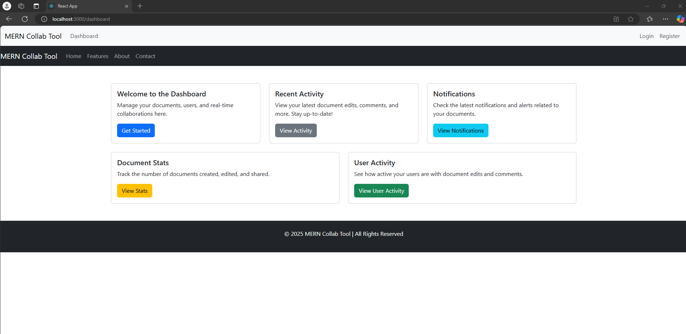
Future Scope
Real-Time Collaboration Enhancements: Adding features like document versioning, conflict resolution, and comment threads for better collaboration.
Rich Text Editor: Integrating a WYSIWYG editor for enhanced content creation (e.g., tables, images, etc.).
User Roles: Implementing role-based access control (e.g., admin, editor, viewer) to manage different levels of document access.
Cloud Storage Integration: Adding support for storing documents on cloud platforms like AWS S3 for better scalability and reliability.
Offline Mode: Enabling offline access to documents and syncing changes when the user is back online.
Multi-Language Support: Adding localization and internationalization features for global user base support.

Slide 16
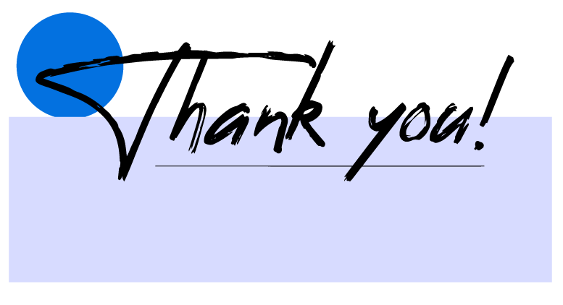

Notes:
Thank You !!

