Slide 1



A Guide to Building Dynamic Forms for Web Applications
DOCTOR HARISINGH GOUR VISWAVIDALAYA
DEPARTMENT OF COMPUTER SCIENCE AND APPLICATIONS
CSA-CC-3204 WEB APPLICATION DESIGN USING PHP
SESSION: 2024-2025
MID II ASSIGNMENT
Creating HTML Forms with PHP
SUBMITTED BY
SAKSHI PANDEY
Y23271024
MCA III SEMESTER
SUBMITTED TO
ER. KAMAL KANT SIR

Slide 2

TABLE OF CONTENTS
INTRODUCTION
BASIC STRUCTURE OF AN HTML FORM
GET METHOD VS POST METHOD
PROCESSING FORM DATA WITH PHP
VALIDATING FORM DATA WITH PHP
HANDLING MULTIPLE FORM INPUTS
STORING FORM DATA IN A DATABASE
SECURITY CONSIDERATIONS
CONCLUSION
QUIZ
REFRENCES

Slide 3


Introduction
What are HTML Forms?
Used to collect user input.
Essential for user interaction on websites (e.g., sign-ups, surveys).
Why Use PHP with HTML Forms?
PHP processes form data on the server.
Enables dynamic content generation and data handling.

Slide 4

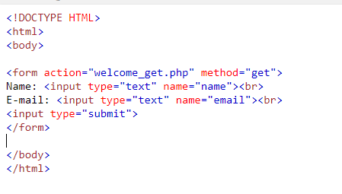
Basic Structure of an HTML Form
Input Types:
text, email, password, checkbox, radio
Key Attributes:
action: The PHP script to process the form data.
method: HTTP method (GET or POST) to send data.

Slide 5

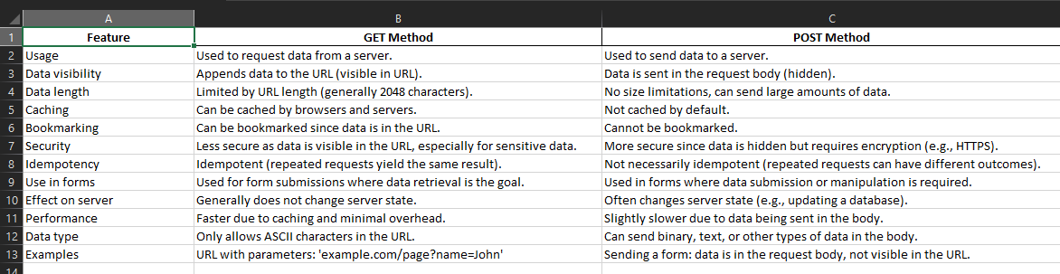
GET METHOD VS POST METHOD

Slide 6

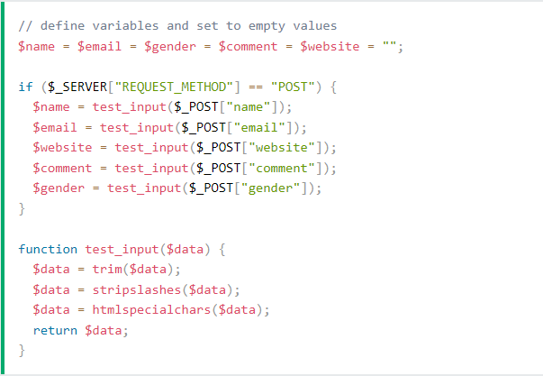
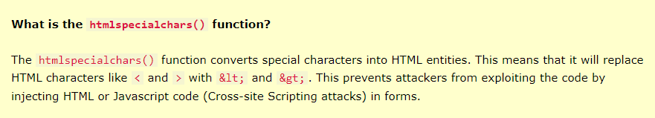
Processing Form Data with PHP
Accessing Form Data:
php
<?php if ($_SERVER["REQUEST_METHOD"] == "POST") { $name = htmlspecialchars($_POST['name']); echo "Hello, " . $name; } ?>
Key Points:
Use $_POST to retrieve data when using the POST method.
Use htmlspecialchars() to prevent XSS attacks.

Slide 7

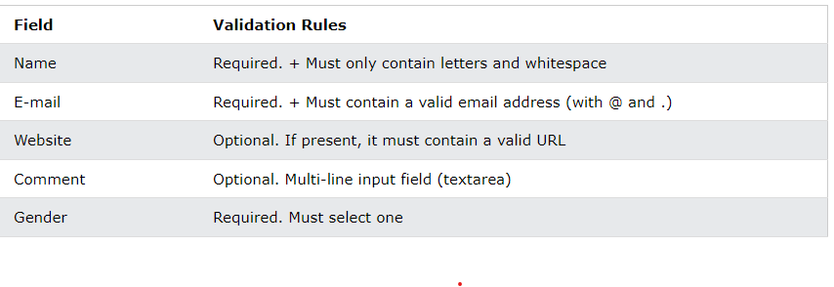
Validating Form Data
$name = test_input($_POST["name"]); if (!preg_match("/^[a-zA-Z-' ]*$/",$name)) { $nameErr = "Only letters and white space allowed"; }
$email = test_input($_POST["email"]); if (!filter_var($email, FILTER_VALIDATE_EMAIL)) { $emailErr = "Invalid email format"; }
$website = test_input($_POST["website"]); if (!preg_match("/\b(?:(?:https?|ftp):\/\/|www\.)[-a-z0-9+&@#\/%?=~_|!:,.;]*[-a-z0-9+&@#\/%=~_|]/i",$website)) { $websiteErr = "Invalid URL"; }
Client-Side Validation:
Use HTML5 attributes (e.g., required, pattern).
Server-Side Validation:
php
if (empty($name)) { echo "Name is required."; } elseif (!filter_var($email, FILTER_VALIDATE_EMAIL)) { echo "Invalid email format."; }

Slide 8

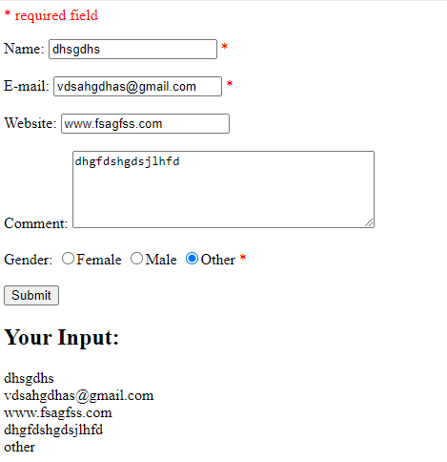
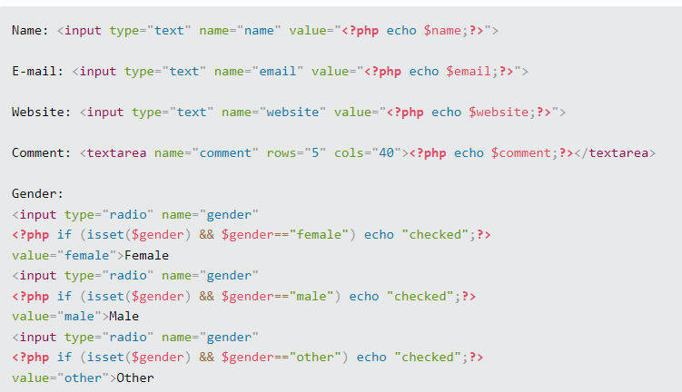
Handling Multiple Form Inputs

Slide 9

Storing Form Data in a Database
Connecting to a Database:
php
$conn = new mysqli($servername, $username, $password, $dbname);
Inserting Data:
php
$sql = "INSERT INTO users (name, email) VALUES ('$name', '$email')"; if ($conn->query($sql) === TRUE) { echo "New record created successfully"; }

Slide 10

Security Considerations
Conclusion
Sanitize User Input:
Use prepared statements to prevent SQL injection.
Use HTTPS:
Protect data in transit.
Session Management:
Implement proper session handling to maintain user authentication.
Summary:
HTML forms are crucial for user interaction.
PHP is a powerful tool for processing and validating form data.
Proper security measures are essential for protecting user information.

Slide 11

Q&A 1. b 2. c 3.c 4.b 5.d
Which two predefined variables are used to retrieve information from forms? a) $GET & $SET b) $_GET & $_SET c) $__GET & $__SET d) GET & SET
The attack which involves the insertion of malicious code into a page frequented by other users is known as _______________ a) basic SQL injection b) advanced SQL injection c) cross-site scripting d) scripting
When you use the $_GET variable to collect data, the data is visible to ___________ a) none b) only you c) everyone d) selected few
When you use the $_POST variable to collect data, the data is visible to ___________ a) none b) only you c) everyone d) selected few
Which variable is used to collect form data sent with both the GET and POST methods? a) $BOTH b) $_BOTH c) $REQUEST d) $_REQUEST

Slide 12

References
Further Reading:
PHP Documentation: php.net
W3Schools: w3schools.com
MDN Web Docs: developer.mozilla.org
https://www.sanfoundry.com/1000-php-questions-answers/
PHP Black Book by Peter Maudling

