Slide 1
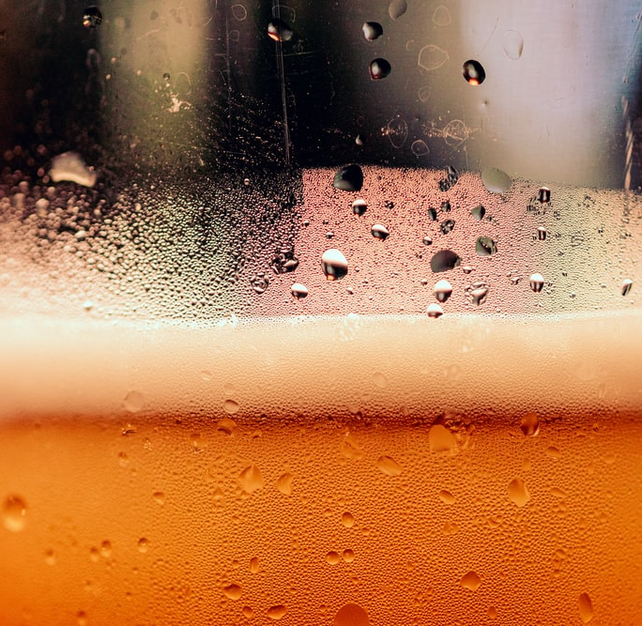
Case Study: Beers and Breweries
Presented by Shikha Pandey and Hien Lam

Slide 2
Objective and Approach
Approach:
Utilize R to study US craft Beers and Breweries dataset
Objective:
Analyze to generate visual and statistical evidence to help Budweiser plan strategic opportunities that may provided a competitive advantage in the United States operations.

Slide 3
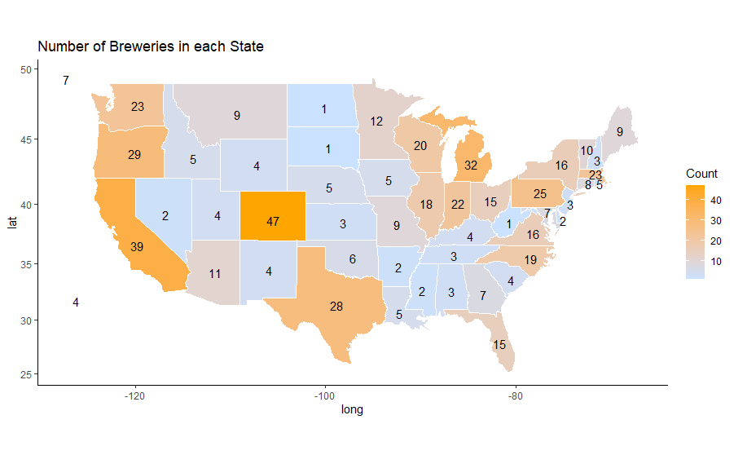
Breweries Per State

Slide 4
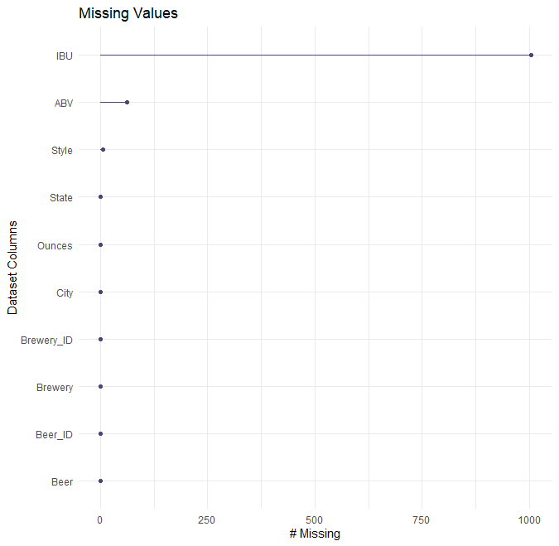
Addressing the Missing Data
Missing values are found for IBU (1005), ABV (62) and Style (5).
It is a significant number for IBU (41.7%), notable for ABV (2.57%) but insignificant for Style (0.2%), so, I decided to exclude the missing 'Style' data from dataset.

Slide 5
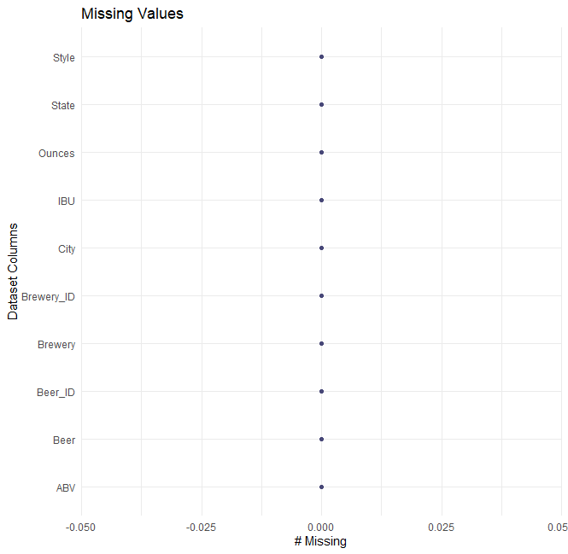
Addressing the Missing Data
After excluding missing data for 'Style' and replacing values for other missing data, clean and complete 2405 rows remain.
Set to perform further analysis with no missing values.

Slide 6
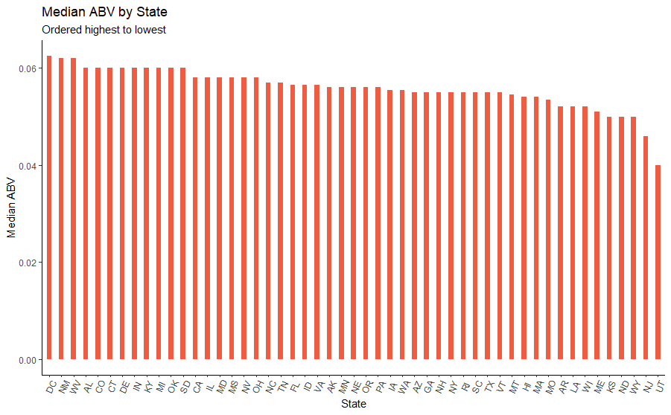
Median Alcohol by Volume (ABV) by State

Slide 7
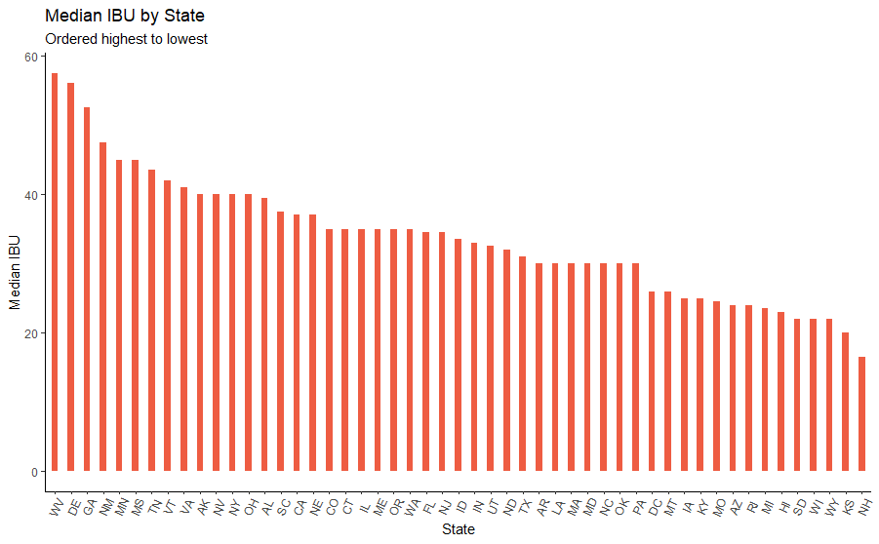
Median International Bitterness Unit (IBU) by State

Slide 8
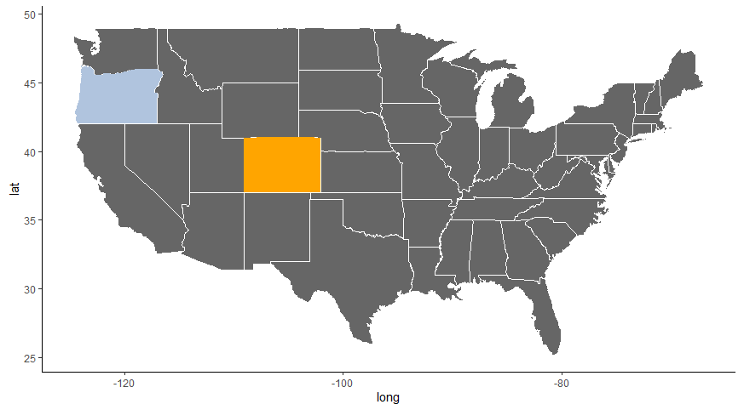
State with Maximum Alcoholic (ABV) and Most Bitter Beer
Most Bitter Beer:
Astoria, OR
138 IBUs
Max Alcoholic Beer:
Boulder, CO
12.8% ABV
Category
IBU
ABV
NA

Slide 9
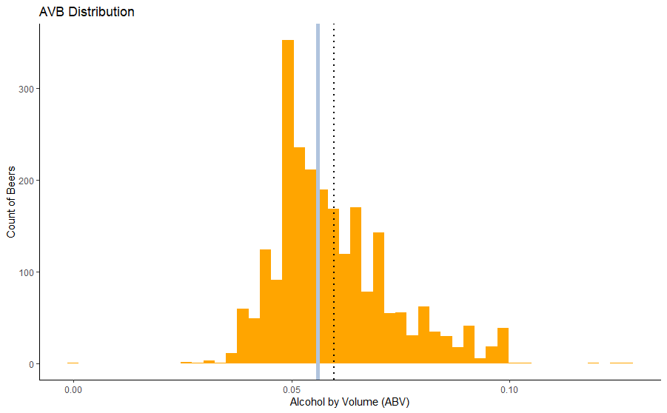
Summary Statistics and Distribution for ABV
Summary Statistics:
Median ABV = 5.6%
Mean ABV = 5.97%
Range (0.1% - 12.8%)
IQR = 1.7%
Right Skewed
Statistics
Median
Mean

Slide 10
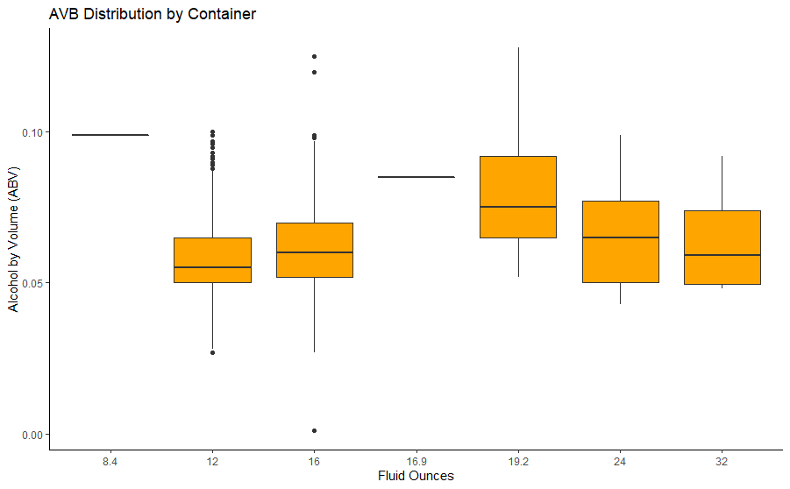
Distribution for ABV by Container

Slide 11
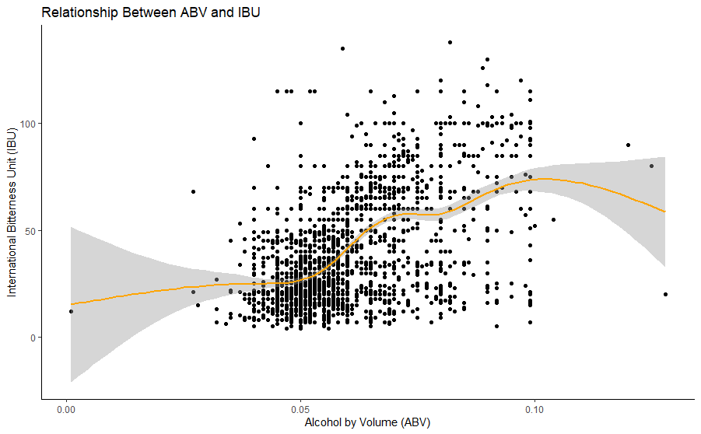
Relationship Between ABV and IBU

Slide 12
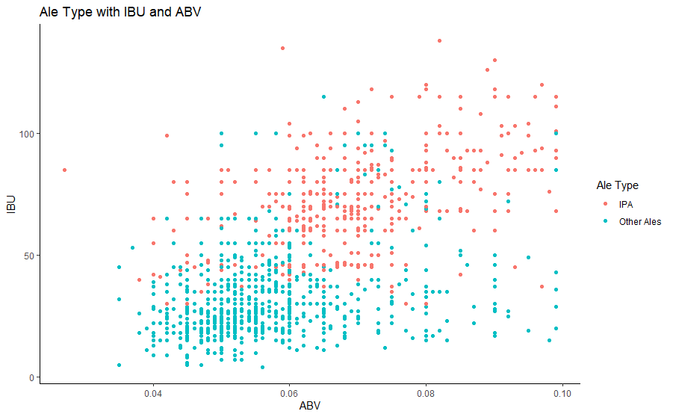
Classification of Beer Types Using ABV and IBU

Slide 13
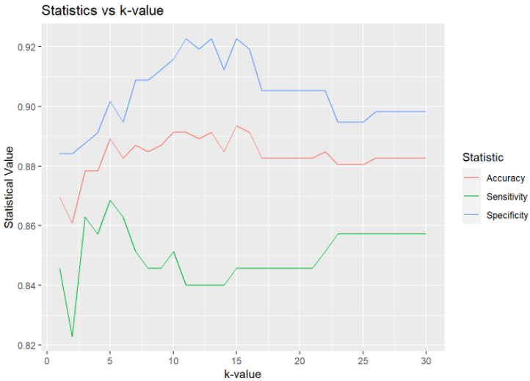
Classification of Beer Types Using ABV and IBU
Confusion Matrix and Statistics
Truth
classifications IPA Other Ales
IPA 149 26
Other Ales 26 259
Accuracy : 0.887
95% CI : (0.8544, 0.9144)
'Positive' Class : IPA
Mean Accuracy: 0.88
Mean Sensitivity: 0.85
Mean Specificity: 0.90

Slide 14
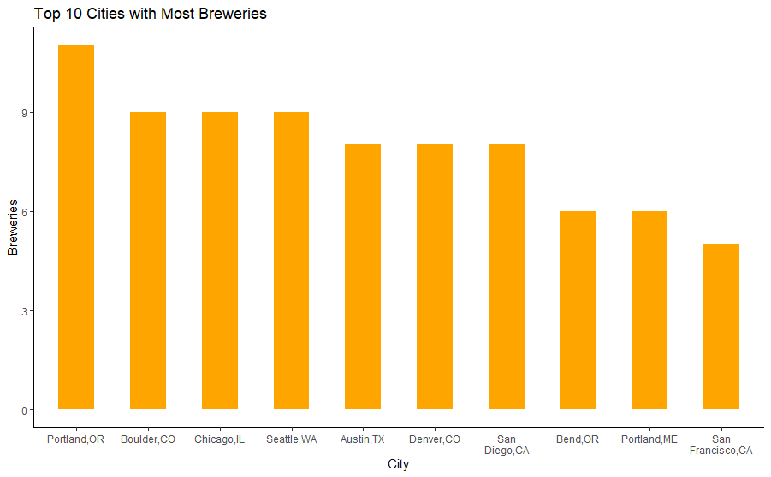
Brewery Hubs

Slide 15
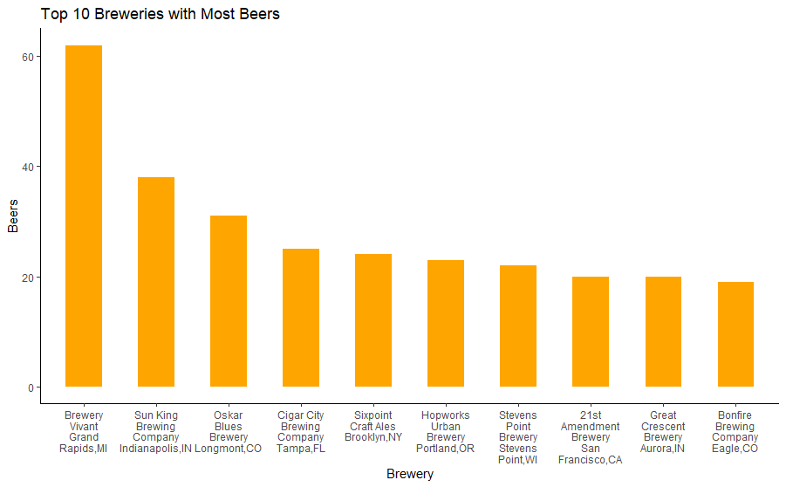
Brewery with Most Beers

Slide 16
Summary
Colorado has high rating for number of breweries and types of beers
Washington DC has highest ABV while Wyoming has the highest IBU
Relation between bitterness of beer and ABV
Machine learning to assist with missing data and building models to classify a beer type
Beer hubs and productive breweries

Slide 17
Contact Information
Name: Shikha Pandey
Email: pandeys@smu.edu

