Slide 1
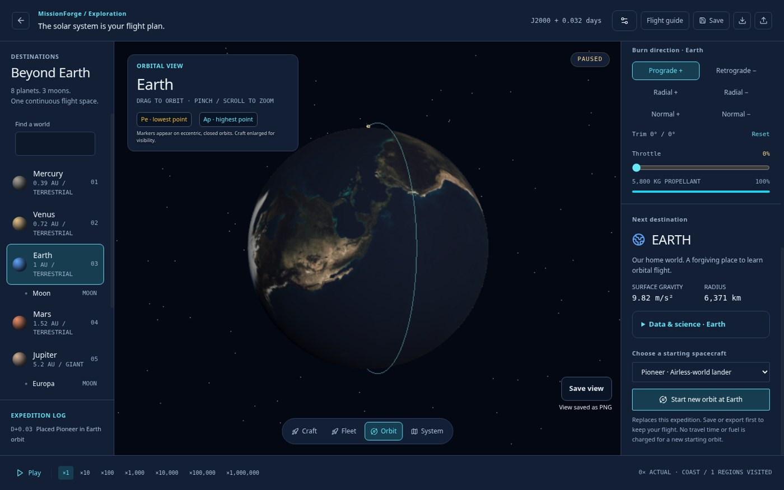
MISSIONFORGE / THE PROBLEM
Space is not orbit. Make the difference visible.
A space engineering platform
built for learning.
For students and space enthusiasts:
connect rocket design, sideways speed
and the orbit that actually results.
The learning goal
Explain the outcome using evidence.
Actual local browser capture • exploration view
Shashank Pandey • Astroverse • 7 November 2026
1/7
Notes:
0:00–0:20. I built MissionForge as an individual project. The problem is that reaching space can look like success even when a spacecraft lacks enough sideways velocity to stay in orbit. My intended audience is students and space enthusiasts. The project lets them make a prediction, fly and explain the result. Educational effectiveness is a hypothesis to test, not an outcome I have already measured.

Slide 2
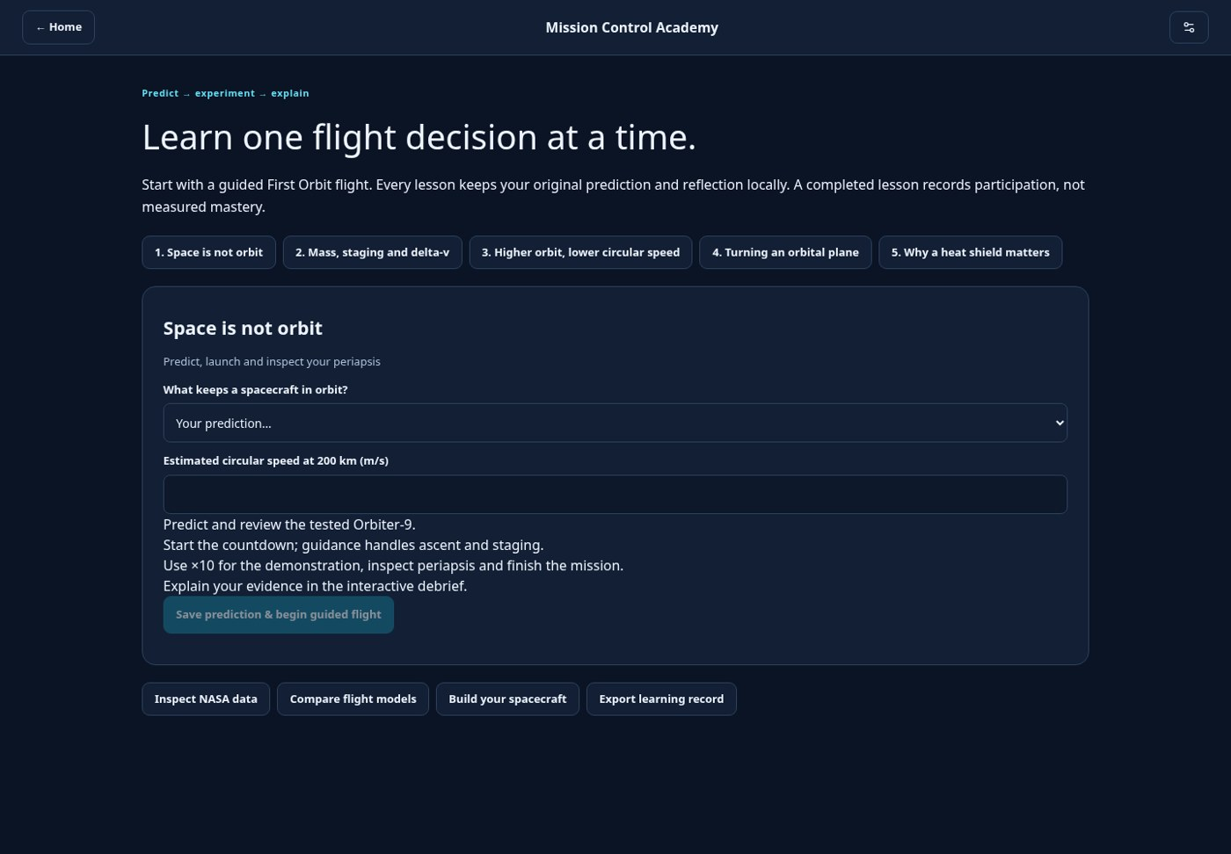
MISSIONFORGE / THE LEARNING WORKFLOW
From prediction to explanation.
01 PREDICT
02 BUILD
03 FLY
04 COMPARE
05 REFLECT
Choose an explanation
Inspect mass and staging
Launch and observe
Read the flight evidence
Choose the next change
Mission Control Academy
Five lessons connect orbit, staging, altitude, plane changes and heat shielding.
Predictions and reflections stay in a local learning record.
Shashank Pandey • Astroverse • 7 November 2026
2/7
Notes:
0:20–0:40. The central workflow is predict, build, fly, compare and reflect. The Academy has five lessons. It retains the original prediction, including an incorrect one, rather than silently replacing it. The debrief helps learners interpret evidence and select one change for their next attempt. Completing a lesson records participation; it does not prove mastery. Source: docs/connected-learning.md.

Slide 3
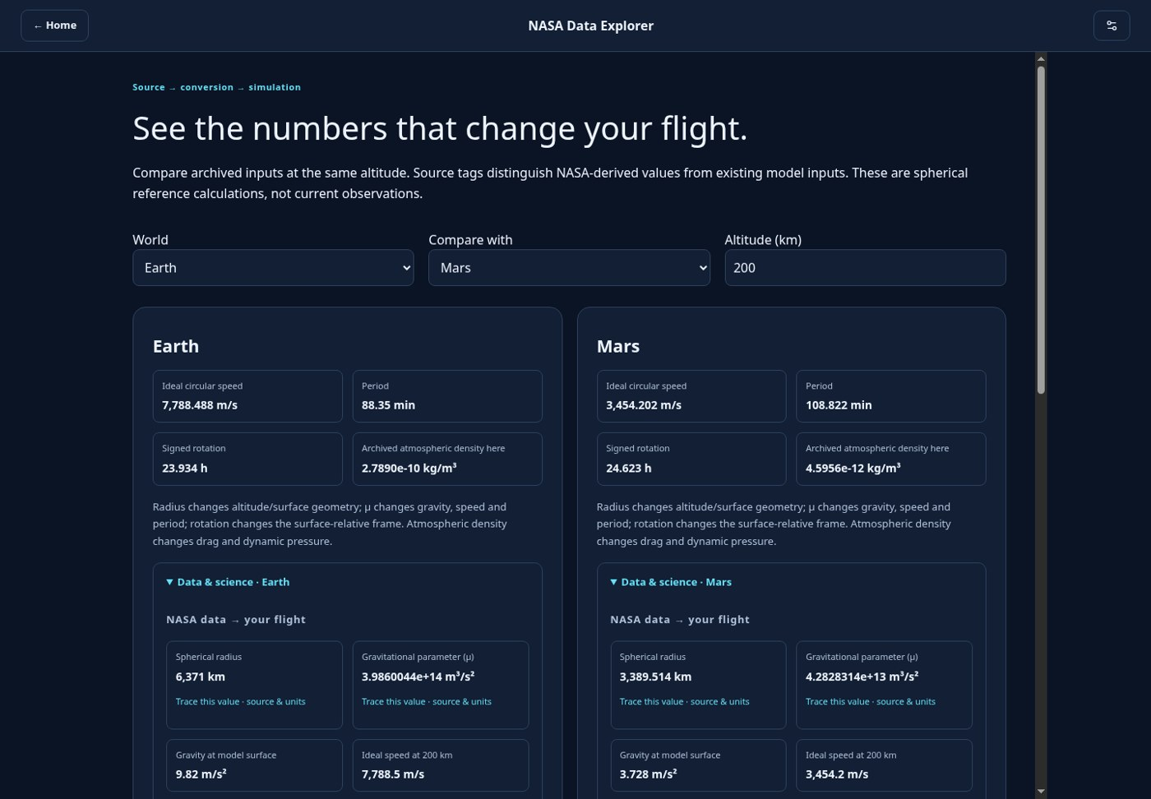
MISSIONFORGE / DATA → MODEL → LEARNING
NASA data changes the answer.
SOURCE
CONVERT
CALCULATE
EXPLAIN
NASA GMAT + NAIF
Units + pinned hashes
Gravity, speed and drag
Earth–Mars comparison
EARTH · 200 km
Circular reference speed: 7.788 km/s
MARS · 200 km
Circular reference speed: 3.454 km/s
Pinned NASA-repository inputs • 178 Earth/Mars density bands • archived models, not live observations
Shashank Pandey • Astroverse • 7 November 2026
3/7
Notes:
0:40–1:05. Open NASA Data Explorer and compare Earth and Mars at the same altitude. NASA GMAT defaults provide gravitational parameters. The NAIF planetary kernel provides radii and linear rotation fields. Earth and Mars tables provide 28 and 150 density bands. Source snapshots, conversions and hashes are retained. At 200 km, the ideal circular speeds are approximately 7.788 km/s for Earth and 3.454 km/s for Mars. These are model calculations, not measurements or live NASA observations. Sources: scripts/import_nasa_data.py; frontend/src/science/data/planetary.json; benchmarks.json; data/nasa/README.md.

Slide 4
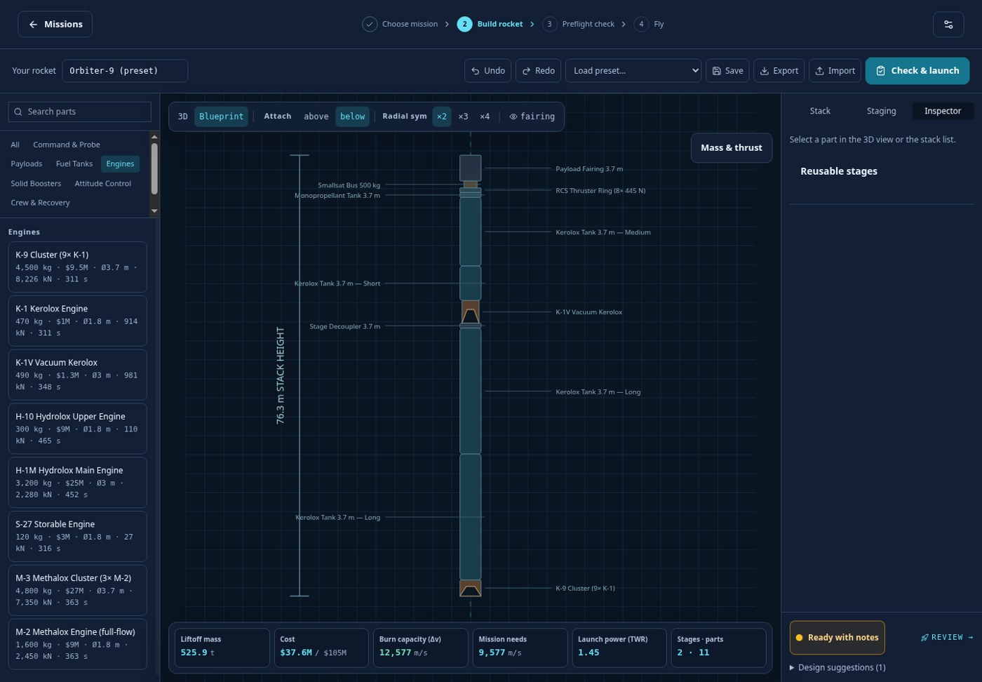
MISSIONFORGE / THE LIVE DEMONSTRATION
One flight. One clear lesson.
1 Inspect the rocket
Check mass, fuel, staging and readiness.
2 Launch with guidance
Watch altitude, speed and the orbit map.
3 Explain the result
Does periapsis clear the atmosphere?
First Orbit
Earth Observer
Lunar Orbiter
Crewed Flyby & Return
Shashank Pandey • Astroverse • 7 November 2026
4/7
Notes:
1:05–2:05. Use the prepared First Orbit route on Amateur with Orbiter-9. Show readiness checks, then use the prepared demonstration to inspect launch, staging and the achieved orbit. Point to periapsis and explain why high altitude alone is insufficient. Use a prepared checkpoint or the recorded showcase when time is limited, and explicitly identify the jump. Do not present checkpoint placement as an uninterrupted flight. The full campaign has First Orbit, Earth Observer, Lunar Orbiter, and Crewed Lunar Flyby and Return. The 1080p English and Hindi walkthroughs are in docs/videos.

Slide 5
MISSIONFORGE / SCIENCE & VALIDATION
Test the equations. Bound the claims.
321
621,913
12
330
regression tests
generated checks
expected campaign outcomes
emulated device/world/craft cases
v = √(μ / (R + h))
Evidence, with scope
Independent 60-digit Decimal references
Earth, Moon and Mars two-body cases
Coasting checks: orbit closure and energy drift
Recorded 30-group audit: 6 Nov 2026
Targeted mobile follow-up: 7 Nov 2026
Finite tests; no universal accuracy claim
Emulation is not physical-device certification. Learner outcomes have not yet been measured.
Shashank Pandey • Astroverse • 7 November 2026
5/7
Notes:
2:05–2:25. These figures come from recorded repository evidence, not a fresh full audit run while preparing these slides. The comprehensive audit is dated 6 November 2026 and the targeted mobile follow-up is dated 7 November. Generated checks and regression tests are different scopes; do not add them into a single pass count. Twelve campaign outcomes cover four missions and three difficulties, including an expected budget-limited partial result. Independent Decimal fixtures and selected external references test defined model conditions, not every trajectory or physical accuracy. Sources: docs/submission/final-validation.json; release-audit/manifest.json; mobile-layout-validation.json; validation-results.json.

Slide 6
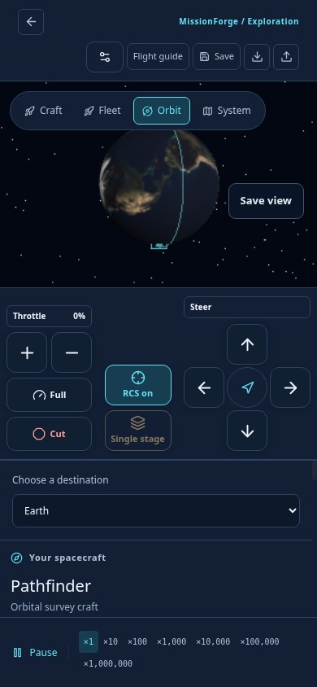
MISSIONFORGE / IMPLEMENTATION & ACCESS
Runs locally. Fits the device.
React + Three.js / WebGL
DESKTOP
Responsive interface and 3D spacecraft views.
WASD steering
Remappable keys
Keyboard + mouse
Local simulation + workers
Numerical physics, bundled data and optional laboratories.
TOUCH
Steering, throttle, stage and RCS
Separate camera and control areas
IndexedDB + offline preparation
Local saves, exports and cached play after setup.
Shashank Pandey • Astroverse • 7 November 2026
6/7
Notes:
2:25–2:45. The application runs in the browser without a hosted gameplay backend, account or runtime API key. Static hosting still delivers the files initially. Keyboard controls can be remapped; touch controls expose steering, throttle, staging and RCS. Offline use must be prepared while connected. The advanced laboratories remain optional. The Wasm engine lab uses a QuickJS interpreter worker; it is not a native C or Rust port and is not claimed faster in every case. The mobile image is a local browser capture, not physical-device certification. Sources: README.md; docs/controls.md; docs/next-milestones.md.

Slide 7
MISSIONFORGE / IMPACT & NEXT STEPS
Turn a launch into an explanation.
A learner should be able to explain why the spacecraft
stayed in orbit — and what to change next time.
DEMONSTRATE NOW
MEASURE NEXT
EXTEND WITH EVIDENCE
One reproducible mission, visible source data and an evidence-based debrief.
A consent-based learner trial and checks on real devices and the hosted origin.
Refine lessons and validate more models against clearly defined references.
Play: https://mission-forge.pandeyshashankai.workers.dev/
Source: https://github.com/pandeyshashankai/Mission-Forge
Shashank Pandey • Astroverse • 7 November 2026
7/7
Notes:
2:45–3:00. Close with the learning outcome: a user can connect a prediction, a design decision and a recorded result. This combines NASA-derived inputs with an accessible experiment, rather than adding data as decoration. The next evidence is a small consent-based learner study, physical-device checks and verification of the exact deployed build. No learner-improvement statistic or judging outcome is claimed. Invite the panel to try First Orbit and inspect Data Explorer. Live website and repository links are clickable on this slide.

