Slide 1
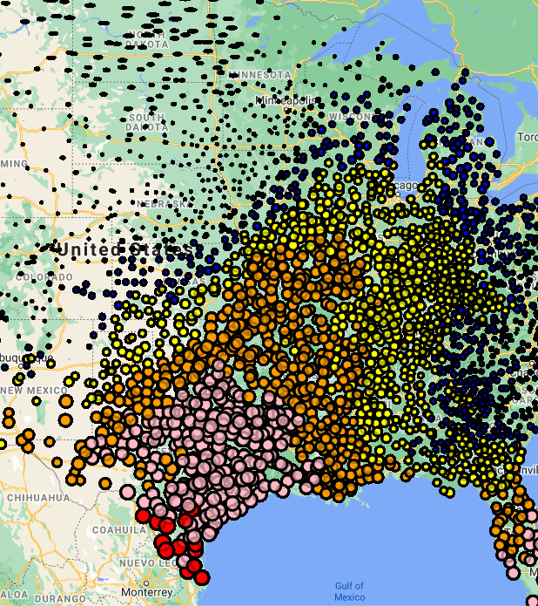

U.S Agriculture in 2017
Maria Di Pasquale
Sudip Pandey
Aurelian Foussé

Slide 2

Vision
Create a platform to visualize the U.S Agricultural productivity in the year 2017.
Using visualizers such as: maps, charts, and images.
Providing data but also related info such as news and images for each agricultural products.

Slide 3

Sources
USDA: https://quickstats.nass.usda.gov/
Agricultural News: https://www.agriculture.com/news/crops
Open Weather: https://openweathermap.org/api
Images: https://world-crops.com

Slide 4





Building our website
Data Mining
Data Storage
Connections
Website

Slide 5
Billions
In 2017, you can see that the U.S produced billions of dollars worth of agricultural product, for domestic and export purposes.
1
California Baby! When looking at plots, California is the largest producer of fruits, with 33 billion dollars worth of fruit sales.
2
Iowa and Illinois have the largest production of field crops, with respectively 27 and 26 Billion $ worth of sales in that ~field~.
3

