Slide 1
Quiz-Master: quiz Application
CAPSTONE PROJECT
Presented By:
Ritesh Dubey, ABES Engineering College, CSE-Data Science
AICTE id- STU687bae460f8d51752936006

Slide 2
OUTLINE
Problem Statement
System Development Approach
Algorithm & Deployment
Result
Conclusion
Future Scope
References

Slide 3
Problem Statement
Online Quiz Application
Students and educators lack lightweight, interactive quiz tools for practice and testing.
This project features a quiz app with multiple-choice questions, timers, and instant scoring.
It supports learning through immediate feedback.

Slide 4
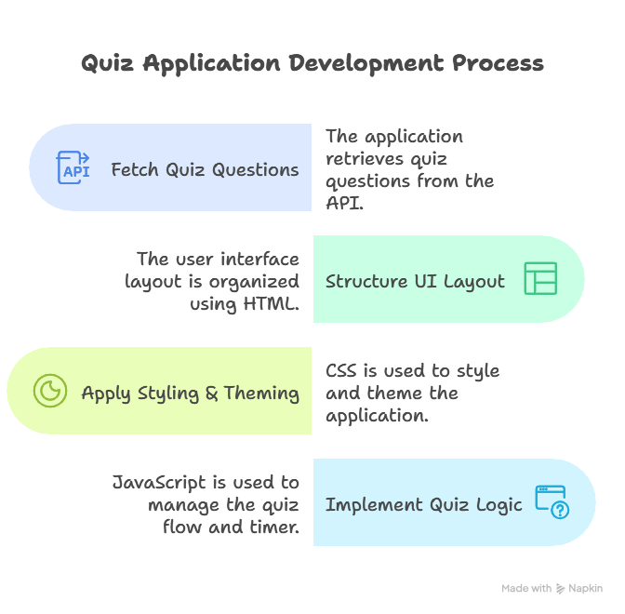
System Approach
Frontend Technologies:
HTML5: Created structure of the webpage.
CSS3: Used in styling and responsive layouts.
JavaScript: Given dynamic interactivity
API integration: For dynamic questions,
Open Trivia Database is used.

Slide 5
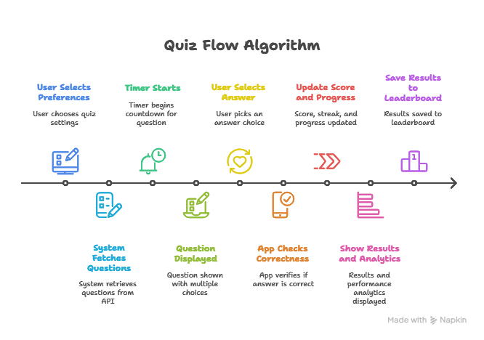
Algorithm & Deployment
Algorithm (Quiz Flow)
User selects quiz preferences
(category, difficulty, number of questions).
System fetches questions from API.
Timer starts then question displayed with multiple choices.
User selects answer then app checks correctness.
Score, streak, and progress updated.
After all questions it shows results & performance analytics.
Saves result to the leaderboard.
Deployment
Used GitHub Pages for hosting.

Slide 6
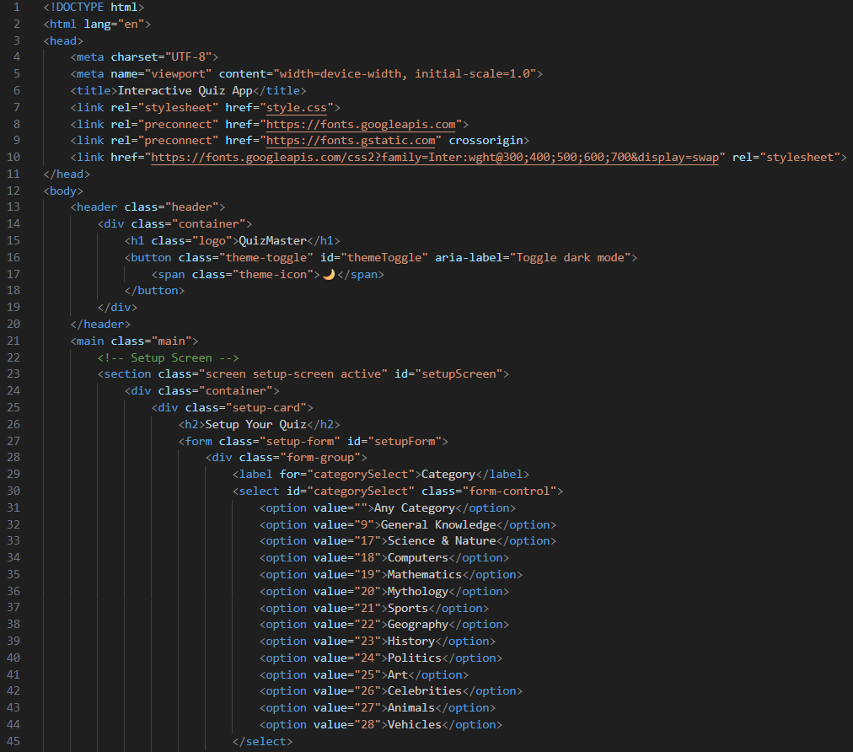
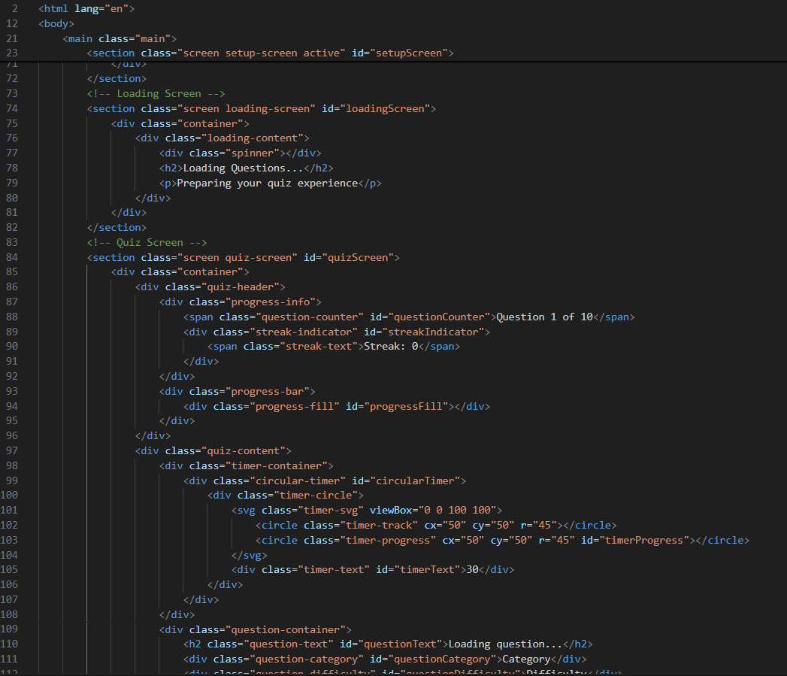
Result
Snaps of Code-

Slide 7
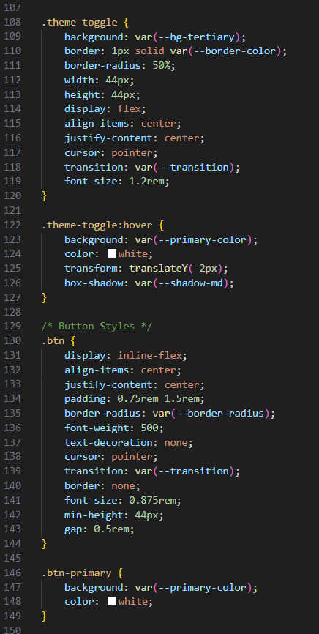
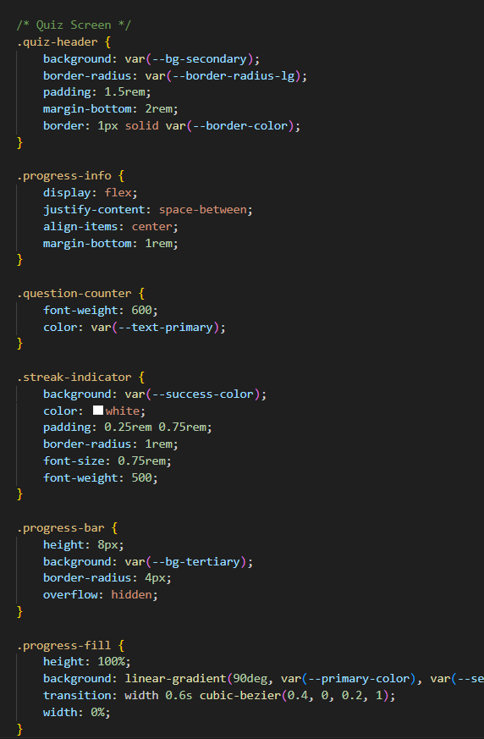
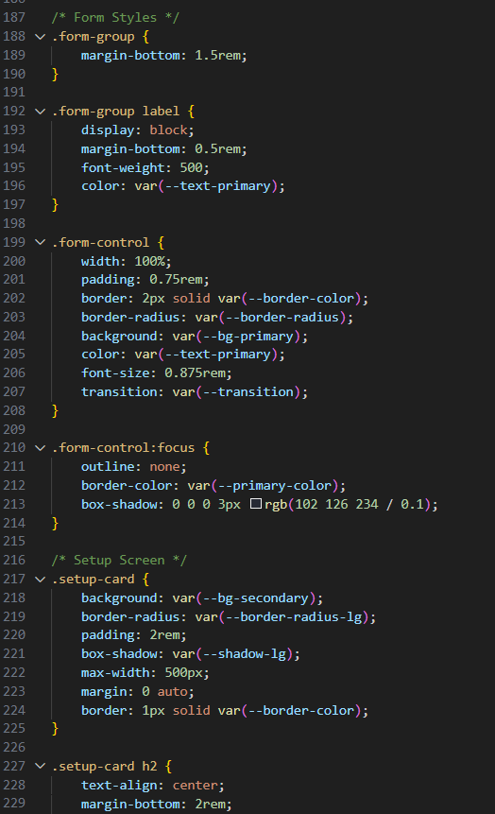
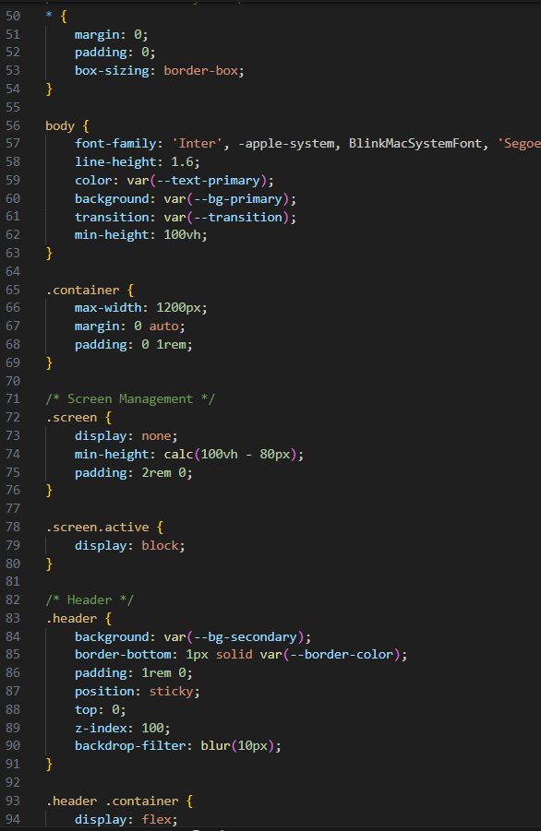

Slide 8
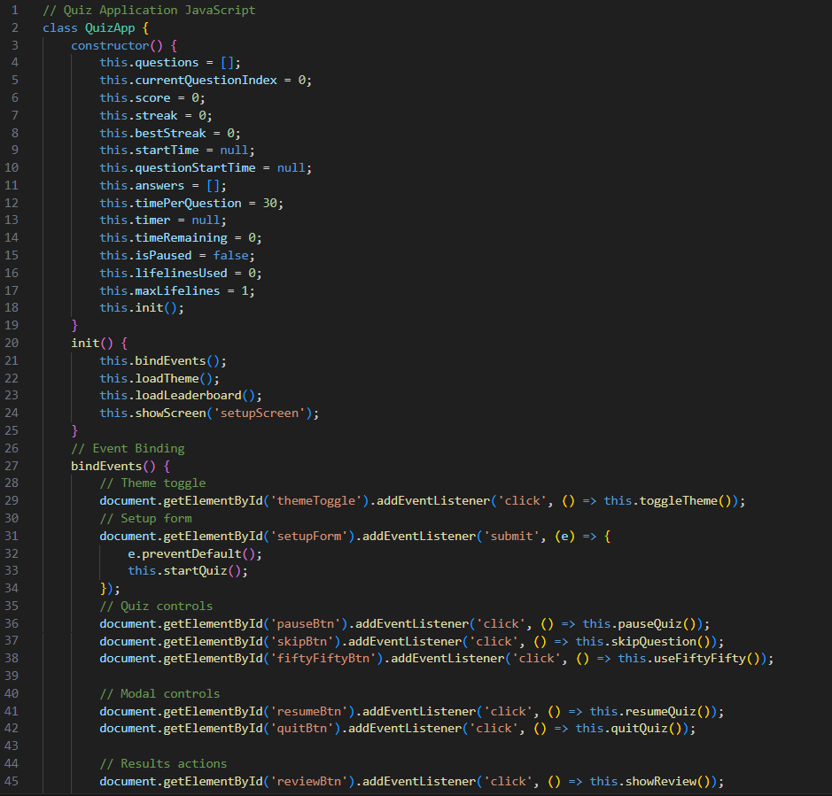
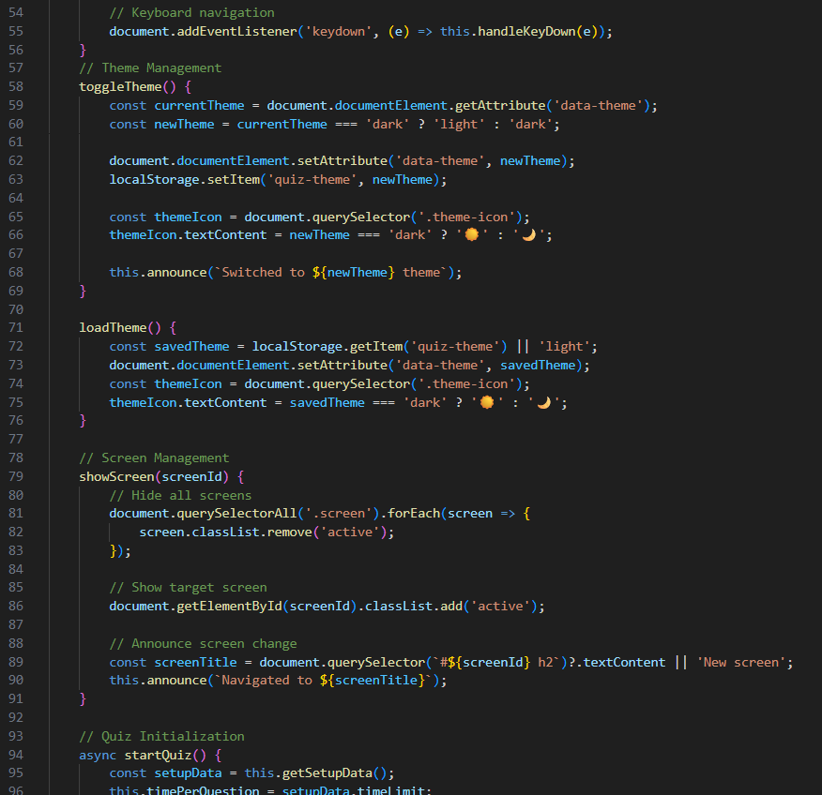

Slide 9
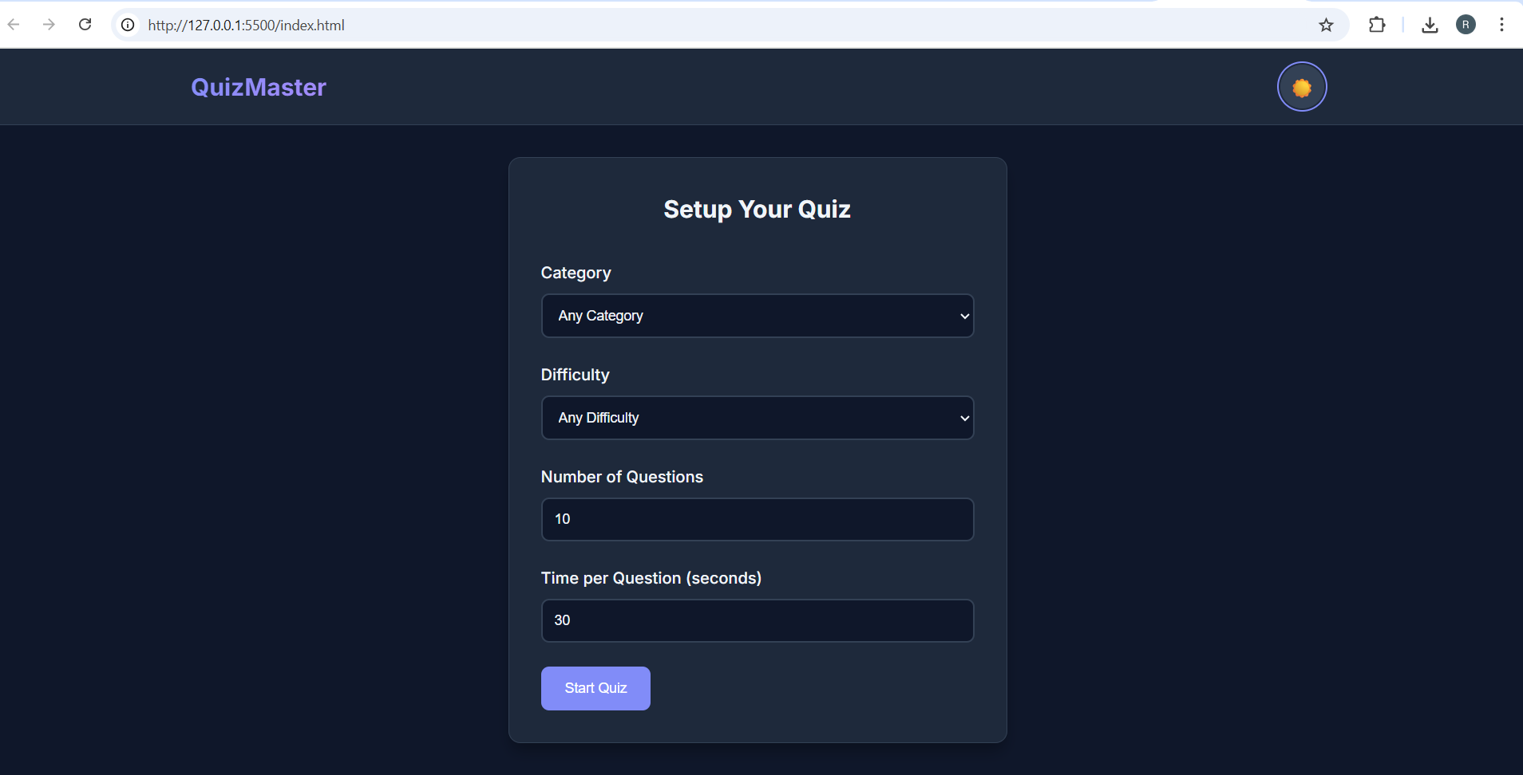
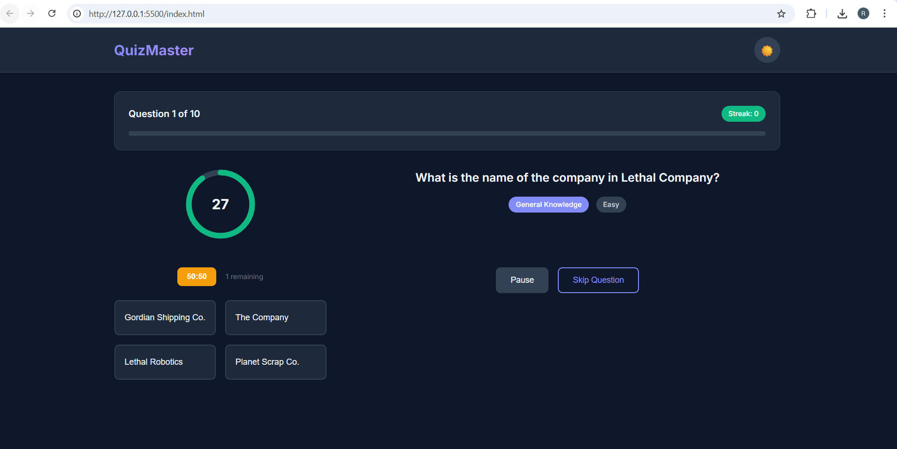
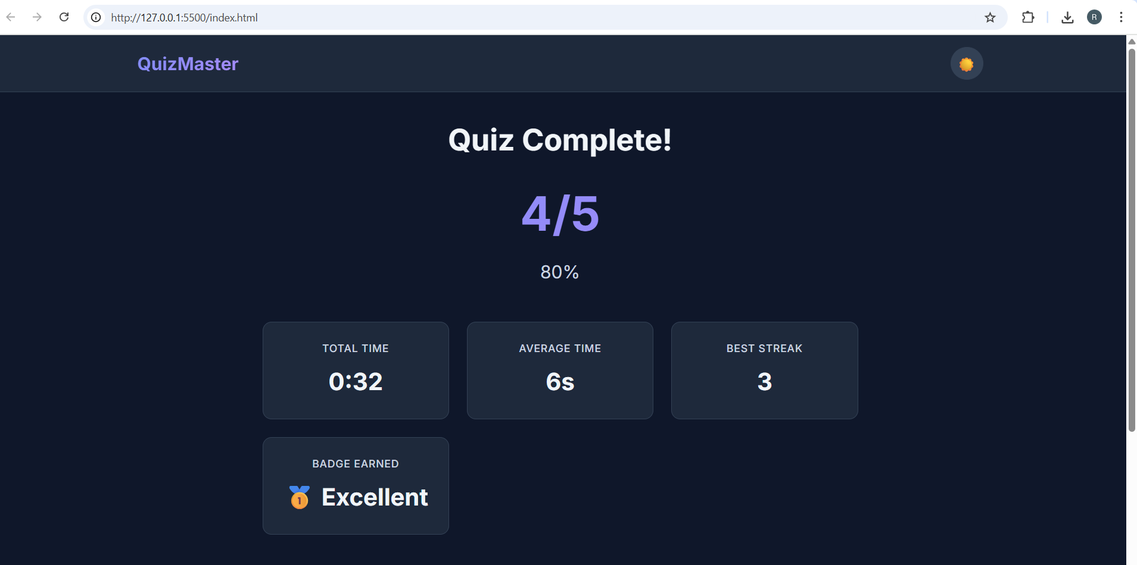
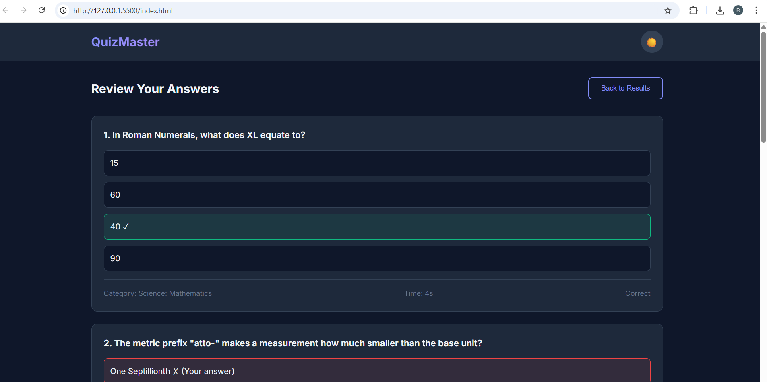
Output-

Slide 10
GITHUB AND DEPLOYMNET LINK
Attach your Github Link : https://github.com/ritesh-1209/QuizMaster
Deployment link: https://ritesh-1209.github.io/QuizMaster/

Slide 11
Conclusion
The Quiz App demonstrates how HTML, CSS, and JavaScript can be combined to build a fully functional web application..
Enhances learning experience through gamification.
Provides real-time feedback, analytics, and user engagement.
A simple yet powerful model for education, training, and entertainment.

Slide 12
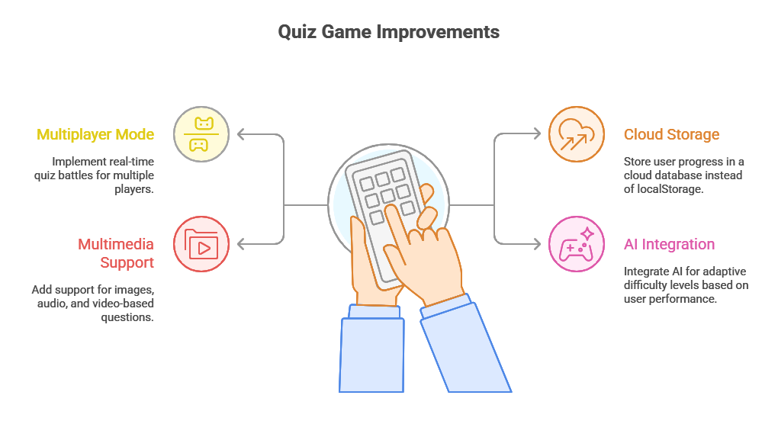
Future scope
Add multiplayer mode (real-time quiz battles).
Store user progress in cloud database instead of localStorage
Support for images, audio, and video-based questions.
Integration with AI for adaptive difficulty levels.

Slide 13
References
Took help form google, ChatGPT, and various other websites
https://www.w3schools.com/
https://www.google.com/
https://chatgpt.com/

Slide 14
THANK YOU

