Slide 1
APACHE MAVEN
Anshoo Verma

Slide 2
Introduction
What is Maven?
“Maven is a software management and comprehension tool based on the concept of Project Object Model (POM) which can manage project build, reporting, and documentation from a central piece of information”
What is POM?
“As a fundamental unit of work in Maven, POM is an XML file that contains information about project and configuration details used by Maven to build the project”
History: Jakarta Turbine Project

Slide 3
Objectives and Characteristics of MAVEN
Maven is more than just Build Tool
Maven was built considering certain objectives
Maven Provides:
Easy Build Process
Uniform Build System
Quality Project Information
Guidelines for Best Practices Development
Achieved Characteristics:
Visibility
Reusability
Maintainability
Comprehensibility “Accumulator of Knowledge”

Slide 4
Comparison with ANT
  One level above ANT
  Higher level of reusability between builds
  Faster turn around time to set up a powerful build
  Project website generation
  Less maintenance
  Greater momentum
  Repository management
  Automatic downloads
ANT | MAVEN
Target build.xml | Goal pom.xml
Notes:
Higher level of reusability between builds
Faster turn around time to set up a powerful build (once you're used to Maven)
Less maintenance
Shared build meme. I know how to build any maven project
Greater momentum: Ant is now legacy and not moving fast ahead. Maven is forging ahead fast and there's a potential of having lots of high-value tools around Maven (CI, Dashboard project, IDE integration, etc).

Slide 5
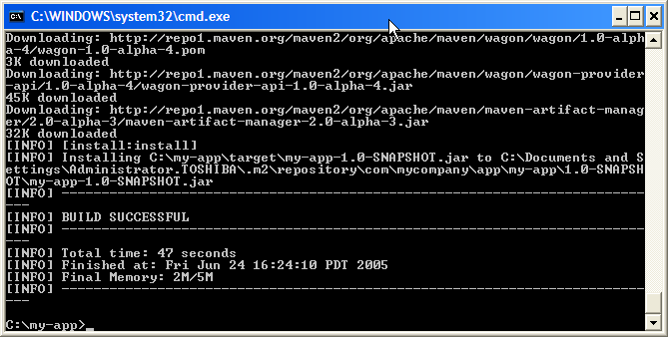
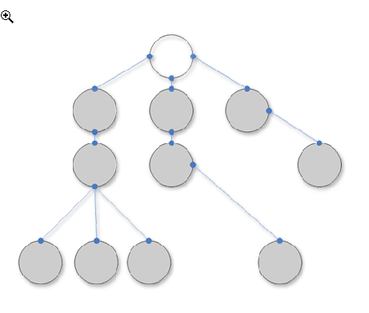
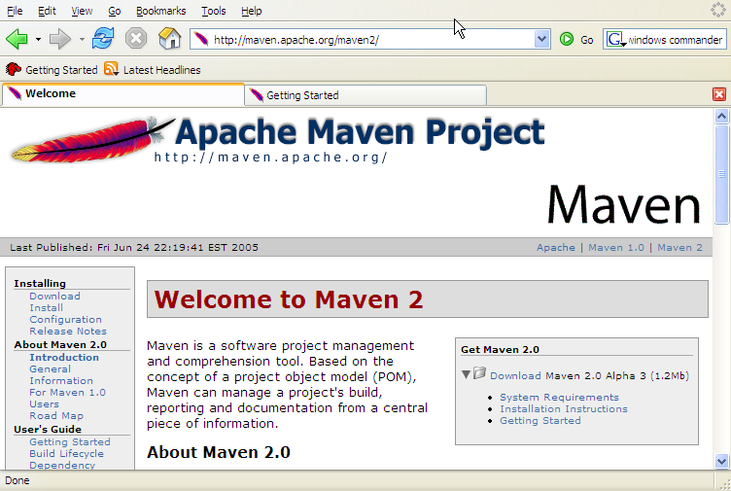
Main Features of MAVEN
Build-Tool
Dependency Management Tool
Documentation Tool

Slide 6
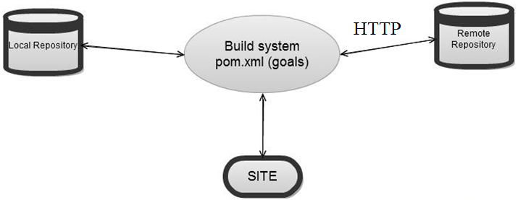
Overview of Simple Architecture
Notes:
A repository in Maven is used to hold build artifacts and dependencies of varying types
The local repository refers to a copy on your own installation that is a cache of the remote downloads, and also contains the temporary build artifacts that you have not yet released.
Remote repositories refer to any other type of repository, accessed by a variety of protocols such as file:// and http://. These repositories might be a truly remote repository set up by a third party to provide their artifacts for downloading

Slide 7
Project Creation in MAVEN
mvn archetype:generate
-DgroupId = com.mycompany.app
-DartifactId = my-app
-DarchetypeArtifactId = maven-archetype-quickstart
-DinteractiveMode = false
Notes:
The prefix archetype is the plugin that contains the goal . similar to a task in ant.

Slide 8
Contents of the Created Project
POM
source tree for your application's sources
source tree for your test sources

Slide 9
POM.XML
<project xmlns = "http://maven.apache.org/POM/4.0.0" xmlns:xsi = "http://www.w3.org/2001/XMLSchema-instance" xsi:schemaLocation = "http://maven.apache.org/POM/4.0.0 http://maven.apache.org/xsd/maven-4.0.0.xsd">
<modelVersion> 4.0.0 </modelVersion>
<groupId> com.mycompany.app </groupId>
<artifactId> my-app </artifactId>
<packaging> jar </packaging>
<version> 1.0-SNAPSHOT </version>
<name> Maven Quick Start Archetype </name>
<url> http://maven.apache.org </url>
<dependencies>
<dependency>
<groupId> junit </groupId>
<artifactId> junit </artifactId>
<version> 4.8.2 </version>
<scope> test </scope>
</dependency>
</dependencies>
</project>

Slide 10
BUILD.XML
<project default = "compile">
<property name = "classesdir = " " value = "..."/>
<property name = "libdir" value = "..."/>
<target name = "compile">
<mkdir dir = "${classesdir}"/>
<javac destdir = "${classesdir}">
<src>
<pathelement location = "src/main/java"/>
</src>
<classpath>
<fileset dir = "${libdir}">
<include name = "*.jar"/>
</fileset>
</classpath>
</javac>
</target>
</project>
Notes:
By following the standard Maven conventions you can get a lot done with very little effort! Just as a casual comparison, let's take a look at what you might have had to do in Ant to accomplish the same thing. Now, this is simply to compile a single tree of application sources and the Ant script shown is pretty much the same size as the POM shown above. But we'll see how much more we can do with just that simple POM! There is far more functionality available to you from Maven without requiring any additions to our POM as it currently stands. To get any more functionality out of our example Ant build file you must keep making error-prone additions. So what else can you get for free? There are a great number of Maven plug-ins that work out of the box with even a simple POM like we have above. We'll mention one here specifically as it is one of the highly prized features of Maven: without any work on your part this POM has enough information to generate a web site for your project! You will most likely want to customize your Maven site but if you're pressed for time all you need to do to provide basic information about your project is execute the following command:

Slide 11
Project Object Model (POM)
  Metadata: Location of Directories, Developers/Contributors, Dependencies, Repositories
  Dependencies (Transitive Dependencies), Inheritance, and Aggregation
  Key Elements
  Project
  Model Version
  Group ID
  Packaging
  Artifact ID
  Version
  Name
  URL
  Description
Notes:
project This is the top-level element in all Maven pom.xml files.
modelVersion This element indicates what version of the object model this POM is using. The version of the model itself changes very infrequently but it is mandatory in order to ensure stability of use if and when the Maven developers deem it necessary to change the model.
groupId This element indicates the unique identifier of the organization or group that created the project. The groupId is one of the key identifiers of a project and is typically based on the fully qualified domain name of your organization. For example org.apache.maven.plugins is the designated groupId for all Maven plug-ins.
packaging This element indicates the package type to be used by this artifact (e.g. JAR, WAR, EAR, etc.). This not only means if the artifact produced is JAR, WAR, or EAR but can also indicate a specific lifecycle to use as part of the build process. (The lifecycle is a topic we will deal with further on in the guide. For now, just keep in mind that the indicated packaging of a project can play a part in customizing the build lifecycle.) The default value for the packaging element is JAR so you do not have to specify this for most projects.
artifactId This element indicates the unique base name of the primary artifact being generated by this project. The primary artifact for a project is typically a JAR file. Secondary artifacts like source bundles also use the artifactId as part of their final name. A typical artifact produced by Maven would have the form <artifactId>-<version>.<extension> (for example, myapp-1.0.jar).
version This element indicates the version of the artifact generated by the project. Maven goes a long way to help you with version management and you will often see the SNAPSHOT designator in a version, which indicates that a project is in a state of development. We will discuss the use of snapshots and how they work further on in this guide.
name This element indicates the display name used for the project. This is often used in Maven's generated documentation.
url This element indicates where the project's site can be found. This is often used in Maven's generated documentation.
description This element provides a basic description of your project. This is often used in Maven's generated documentation

Slide 12
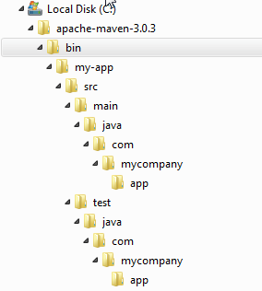
Standard Directory Layout
src/main/java | Application/Library sources
src/main/resources | Application/Library resources
src/main/filters | Resource filter files
src/main/assembly | Assembly descriptors
src/main/config | Configuration files
src/main/scripts | Application/Library scripts
src/main/webapp | Web application sources
src/test/java | Test sources
src/test/resources | Test resources
src/test/filters | Test resource filter files
src/site | Site
LICENSE.txt | Project's license
NOTICE.txt | Notices and attributions required by libraries that the project depends on
README.txt | Project's readme
Notes:
If you were to create a Maven project by hand this is the directory structure that we recommend using.Having a common directory layout would allow for users familiar with one Maven project to immediately feel at home in another Maven project. The advantages are analogous to adopting a site-wide look-and-feel.

Slide 13
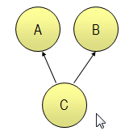
Dependency Management
« Any Version After 1.0 »
<dependencies>
<dependency>
<groupId>com.acme</groupId>
<artifactId>B</artifactId>
<version>[1.0,)</version>
<scope>compile</scope>
</dependency>
</dependencies>
Artifact
Repository
(Local)
Artifact
Repositories
(Remote)
Build C
Look for A & B
Look for A & B

Slide 14
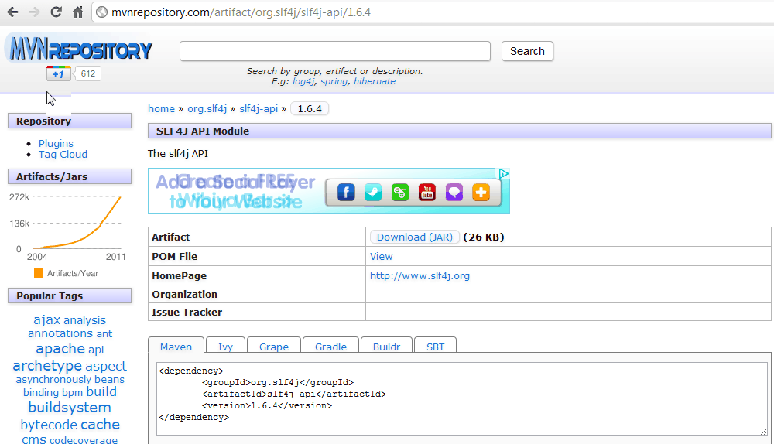
Dependency Management

Slide 15
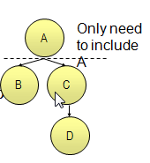
Transitive Dependencies
Allows automatically inclusion of libraries
Avoids the need to discover and specify the required libraries that your own

Slide 16
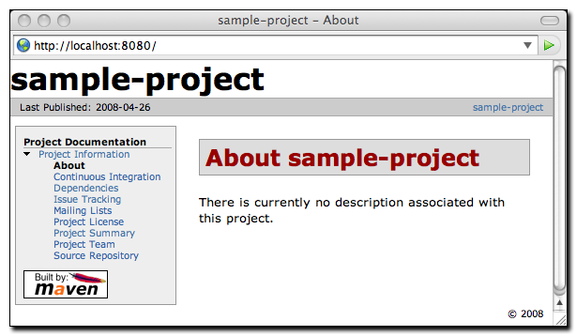
Documentation – Building Own Site
mvn site
pom.xml
  <project> ...
  <distributionManagement>
  <site>
  <id>website</id>
  <url>scp://www.mycompany.com/www/docs/project/</url>
  </site>
  </distributionManagement> ...
  </project>
  mvn site-deploy

Slide 17
Exercise
First download from https://maven.apache.org/download.cgi
And paste to c folder and set environment variable for accessing from anywhere command propmt.
Sometime c folder having issue so copy d drive or any other drive.
Set varible like this C:\Program Files\apache-maven-3.3.9\bin.

Slide 18
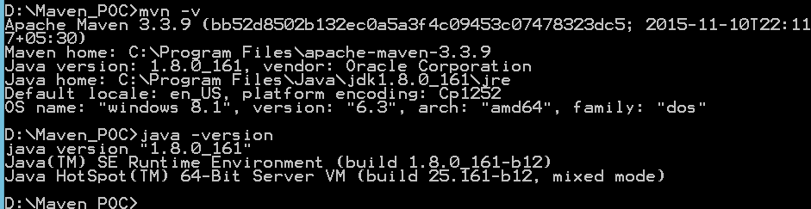
Notes:
Check java version and mvn version

Slide 19


