Slide 1
Feature extraction in poem
TEAM NO : 37
R.PANDIAN
pandian4mail@gmail.com
9486088421
M.MANIKANDAN
manikandancse12@gmail.com
9488587831
MENTOR: Dr. MAHALAKSHMI GS

Slide 2
PROBLEM STATEMENT
Poems contain different features which are hidden.
The goal of our project is to find the features in a given poem
The following features are extracted from a given poem : Similes, compound words, idioms, stylic forms and type of poem.

Slide 3
INTRODUCTION:
There is an explosive growth and scope for poems these days. Poems depict the emotions of people and the poets.
Efforts have been made to bring out the actual meaning of the poem.
For this, various poetic features have to be identified first.
Using these features, the actual meaning or the context of the poem can be found out.

Slide 4
BACKGROUND AND MOTIVATION
The readers of a poem generally find it difficult to find out the actual meaning or context of the poem.
Hence, a method of automation of finding the meaning of the poem was found to be necessary.
This led us to think about the extraction of features from poems automatically.

Slide 5
RELATED WORK
The existing methods are mostly based on distinguishing between a poem and prose and concentrate less on extracting the actual features from the poem.
The existing methods identify the features, but fail to give more information about the features. For eg, they tell whether a simile is used in a poem, but they don’t tell the things that are compared.

Slide 6
METHODOLOGY
The poem is obtained from the reader and is parsed to find the features.
The poem is parsed and different parts of speech are extracted and they are compared with the datasets used to find the features.
The matches found with the data sets are identified as features and displayed to the user.

Slide 7
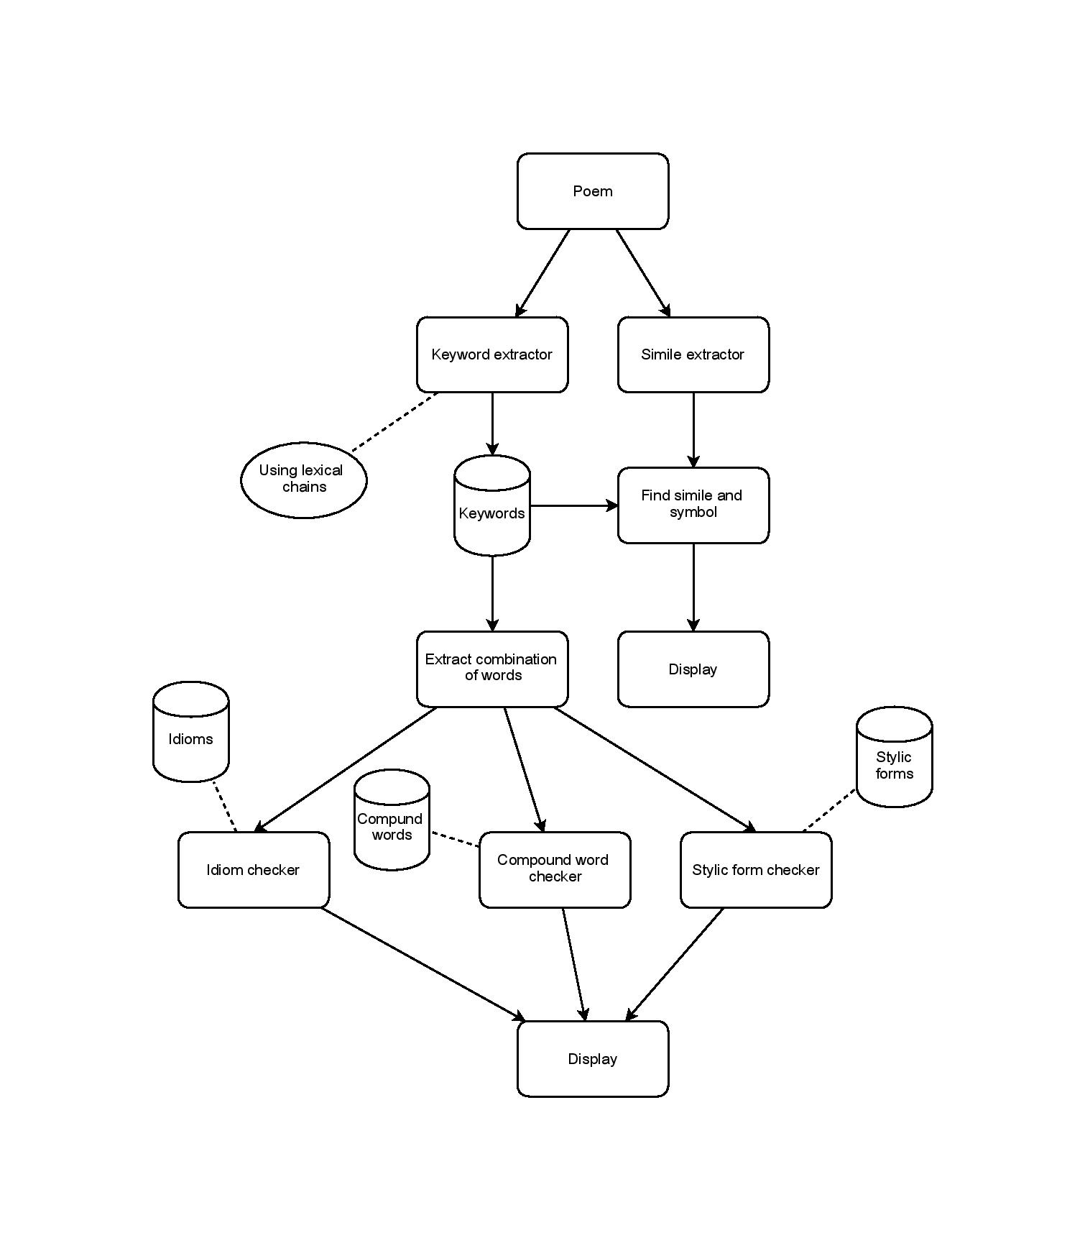
MODULE DIAGRAM

Slide 8
EVALUATION
The end user for this software which we develop are those who need to find out the contest of a poem.
The user uploads a poem and he gets the output the set of features that are present in the poem.
Also, the implementation of this software on all platforms
will be an important task.

Slide 9
REFERENCES
Hamid R. Tizhoosh, Farhang Sahba, Rozita Dara, Poetic Features for Poem Recognition: A Comparative Study, JOURNAL OF PATTERN RECOGNITION RESEARCH (2008)
Gonenc Ercan, Ilyas Cicekli Using lexical chains for keyword extraction, Information Processing & Management Volume 43, Issue 6,

