Slide 1
Efficient Summarization of Healthcare Responses
DHAIRYA(2022157)
HARSH VISHWAKARMA(2022205)
PANDILLAPELLY HARSHVARDHINI (2022345)
Group number: 20
NLP FINAL PROJECT

Slide 2
Motivation
Online platforms like Reddit and Quora host rich discussions on health topics, often from diverse personal and professional perspectives. However, the information is scattered, unstructured, and varies in quality. Traditional summarization models focus on general summaries and often fail to capture these valuable perspectives. Our motivation is to explore how advanced models like FLAN-T5 and PLASMA can generate structured, perspective-aware summaries, helping users access clearer, more reliable, and contextually relevant health information.

Slide 3
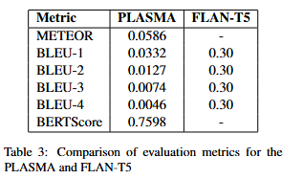
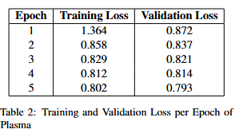
BASELINE
FLAN-T5 (w/ LoRA): Flan-T5 is a fine-tuned encoder-decoder transformer model that performs zero-shot or few-shot summarization and classification using natural language instructions. In this setup, it is used to directly generate summaries and labels from the input. It basically summarizes
Plasma: It introduces soft prefixes learned during training to guide the generation toward a target perspective. Additionally, PLASMA includes a perspective-controlled objective that calculates energy values based on perspective alignment, tone, and anchor-text matching.

Slide 4
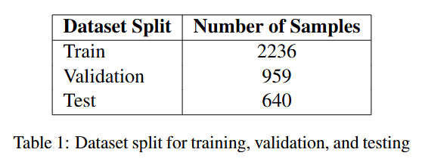
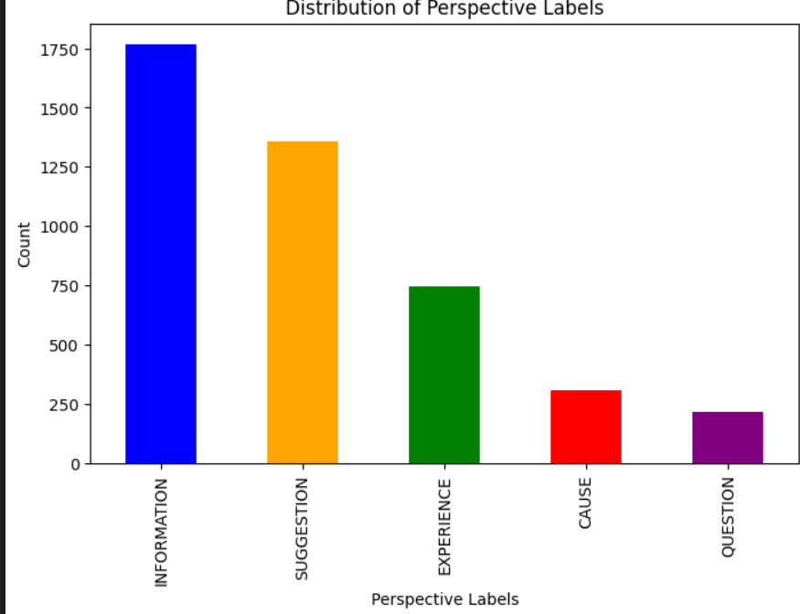
Dataset description
Files: Three JSON files—train.json, valid.json, test.json.
Each file contains a list of JSON examples with key fields: uri, question, context, answers, labelled_answer_spans, labelled_summaries, and raw_text. This structure facilitates perspective-based summarization by mapping answers to categorized summaries.

Slide 5
Methodology
Fine-tuned Flan-T5 with LoRA + Pegasus
Fine-tuned Flan-T5 using LoRA for memory-efficient instruction-based summarization and combined it with Pegasus outputs. A stacked ensemble compares both outputs to generate one unified summary per input that attempts to align with user perspective.
Fine-Tuned BART + Fine-tuned Flan-T5 with LoRA
Trained BART and Flan-T5 (LoRA) on perspective-tagged data and selected the better summary output from the two based on relevance and fluency. This ensemble leveraged BART's natural language quality and Flan-T5’s strong instruction-following to improve summary precision.
Snorkel + Logistic Regression (LR)
Used Snorkel labeling functions and embeddings from all-mpnet-base-v2 to train a logistic regression model for perspective classification. Each test sentence is labeled using Snorkel if confident, otherwise fallback to LR; summaries are generated per perspective using BART and refined with Pegasus.
Snorkel + SVM + Zero-Shot Learning
Used MiniLM embeddings with an SVM classifier, Snorkel rules, and Zero-Shot Learning (BART MNLI) as a fallback for robust perspective labeling. Summarization was done using both standard BART and BART with few-shot prompts based on similar training examples for improved context alignment.

Slide 6
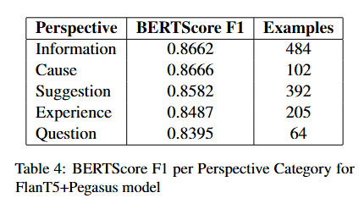
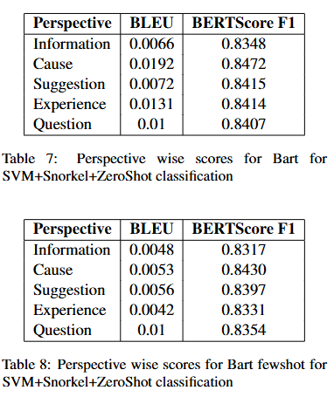
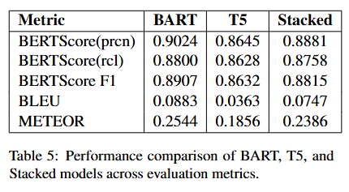
Results/Analysis/conclusion

Slide 7
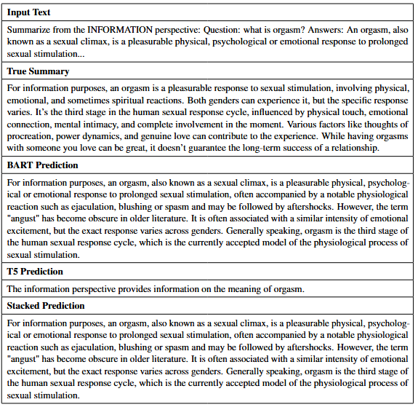
PREDICTION EXAMPLES

Slide 8
OBSERVATIONS
Model Performance Comparison
BART achieves highest semantic accuracy:
BERTScore F1: 0.8907, Precision: 0.9024, Recall: 0.8800.
T5 underperforms across all metrics:
BERTScore F1: 0.8632, BLEU: 0.0363, METEOR: 0.1856.
Stacked Model (ensemble) performs better than T5 and close to BART:
BERTScore F1: 0.8815 (balanced precision & recall).
BLEU and METEOR scores are low across all models due to abstractive summarization.
Perspective-wise Performance (FlanT5 + Pegasus)
Cause (F1 = 0.8666) and Information (F1 = 0.8662) perform best.
Suggestion (F1 = 0.8582) and Experience (F1 = 0.8487) slightly lower due to subjective language.
Question performs lowest (F1 = 0.8395) – due to fewer training samples and linguistic variation.

Slide 9
OBSERVATIONS
Weakly Supervised Perspective-Aware Summarization
BART + Pegasus + Snorkel + LR achieves:
BERTScore F1: 0.5572, BLEU: 0.0045 → limited due to weak perspective separation.
SVM + Snorkel + Zero-Shot + BART:
Best F1 for Cause (0.8472) and Suggestion (0.8415).
Lowest BLEU for Information (0.0066) → factual consistency issue.
Few-Shot BART:
Maintains strong BERTScores (e.g., Suggestion: 0.8397, Cause: 0.8430). BLEU remains low (max 0.01) → captures meaning, not exact wording.
General Insights
BERTScore favors semantic quality → BART excels.
Data imbalance affects performance (e.g., underperformance in "Question").
Ensemble models improve generalization through complementary strengths.

Slide 10
Individual team members’ contributions
Dhairya (2022157): Led the implementation of the stacking ensemble models, including the integration of Flan-T5 with LoRA, BART, and Pegasus. Fine-tuned models using Hugging Face Transformers and handled the training setup including formatting the input prompts and managing experiment configurations. Evaluated final summaries using BERTScore, BLEU, and METEOR, and compiled comparative results across perspectives.
Pandillapelly Harshvardhini (2022345): Designed and developed the weakly supervised classification pipeline using Snorkel with Logistic Regression and SVM. Implemented the zero-shot fallback mechanism using facebook/bart-large-mnli to handle abstentions from Snorkel and SVM. Processed the dataset and constructed the classified-test-output.json used in downstream summarization tasks.
Harsh Vishwakarma (2022205): Handled extractive and abstractive summarization workflows, including BART-based sentence summarization and Pegasus-based refinement. Conducted Perspective-wise analysis of summary quality and aligned model outputs with human-labeled references. Composed the observations and analysis, and contributed to writing the final report including insights from metrics and ablation studies.

Slide 11
Thank You

