Slide 1
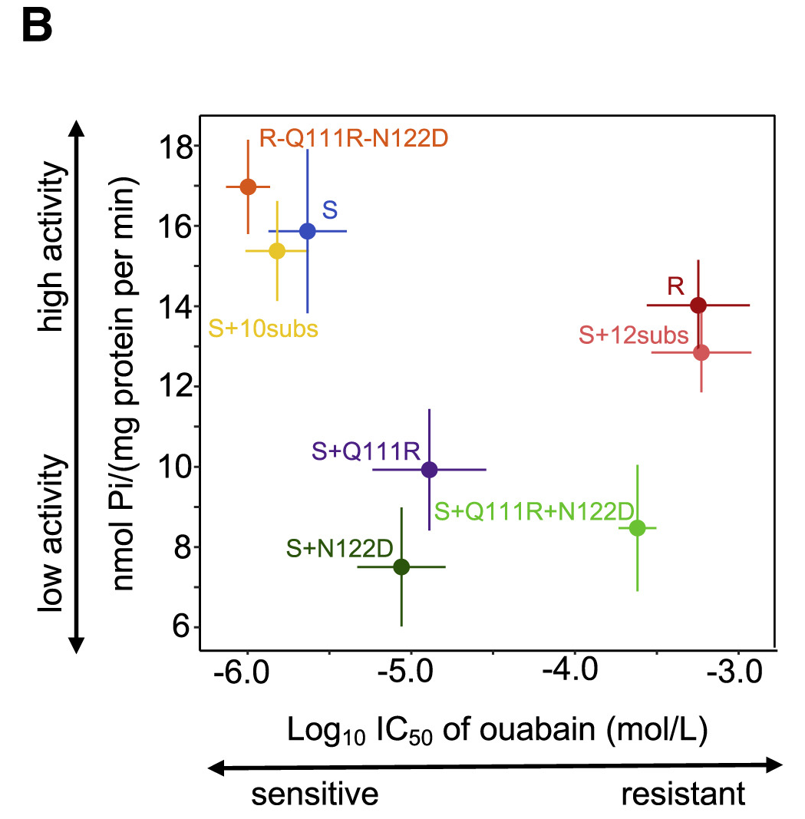
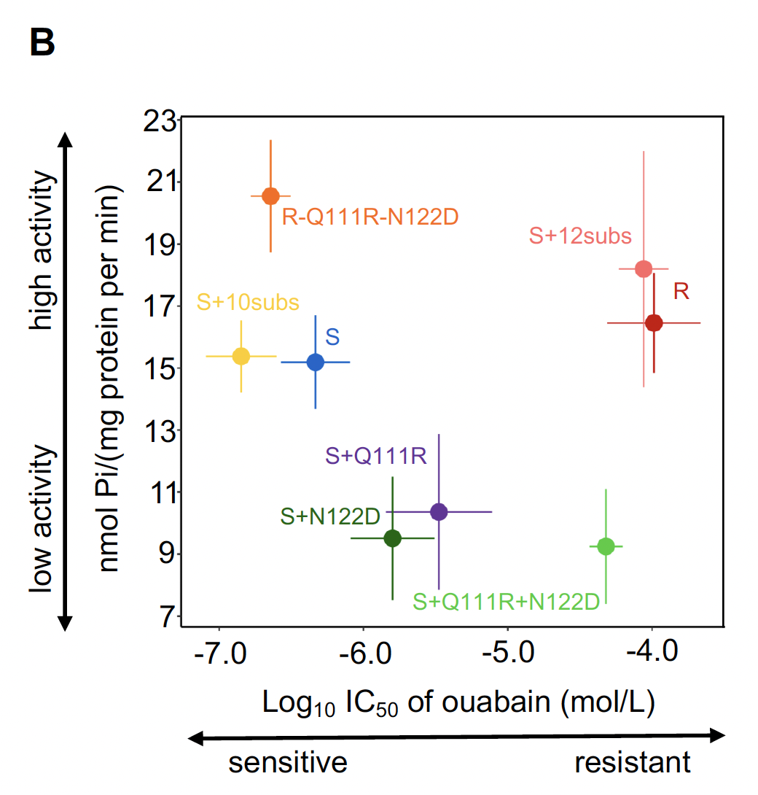
Original Results, Fig 5B
Corrected Results, Fig 5B

Slide 2
Original text, Fig 5B
Corrected text, Fig 5B

Slide 3
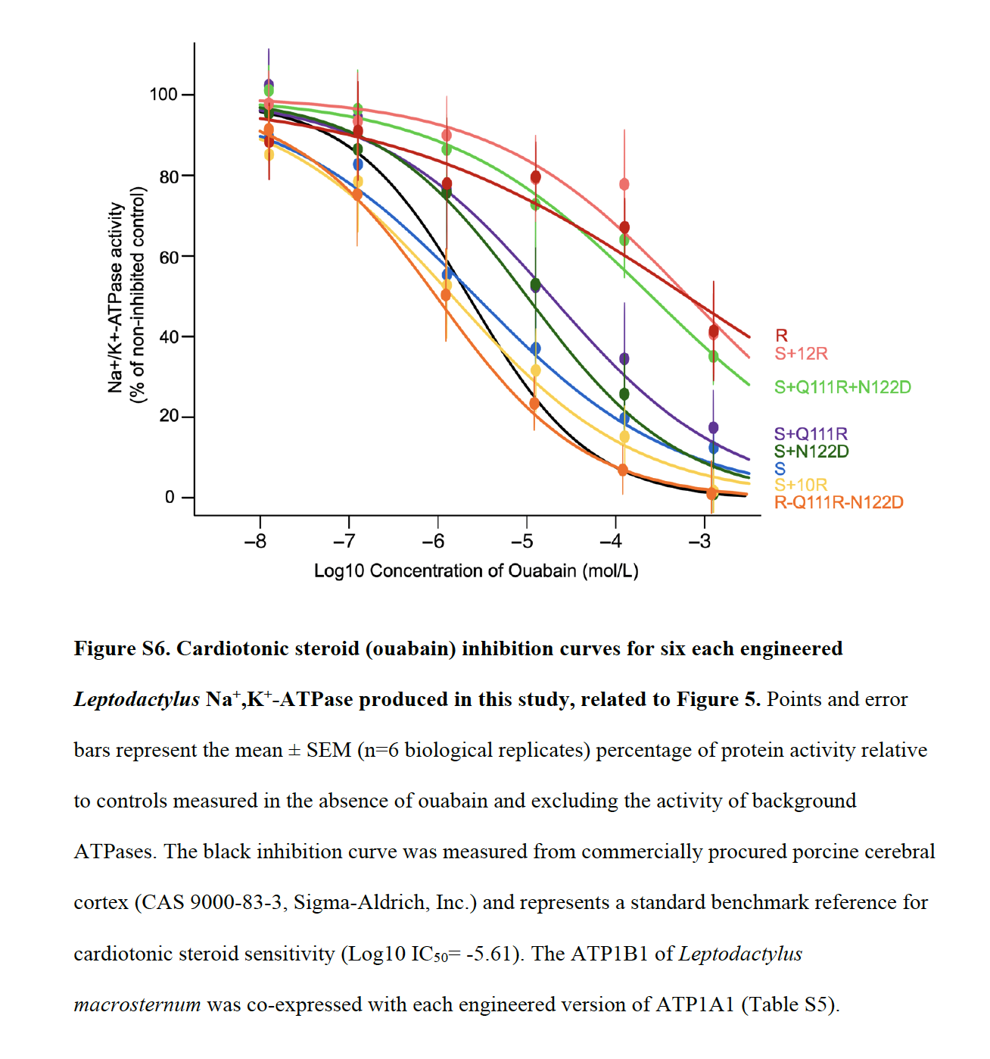
Original, Fig S6
Corrected, Fig S6

Slide 4
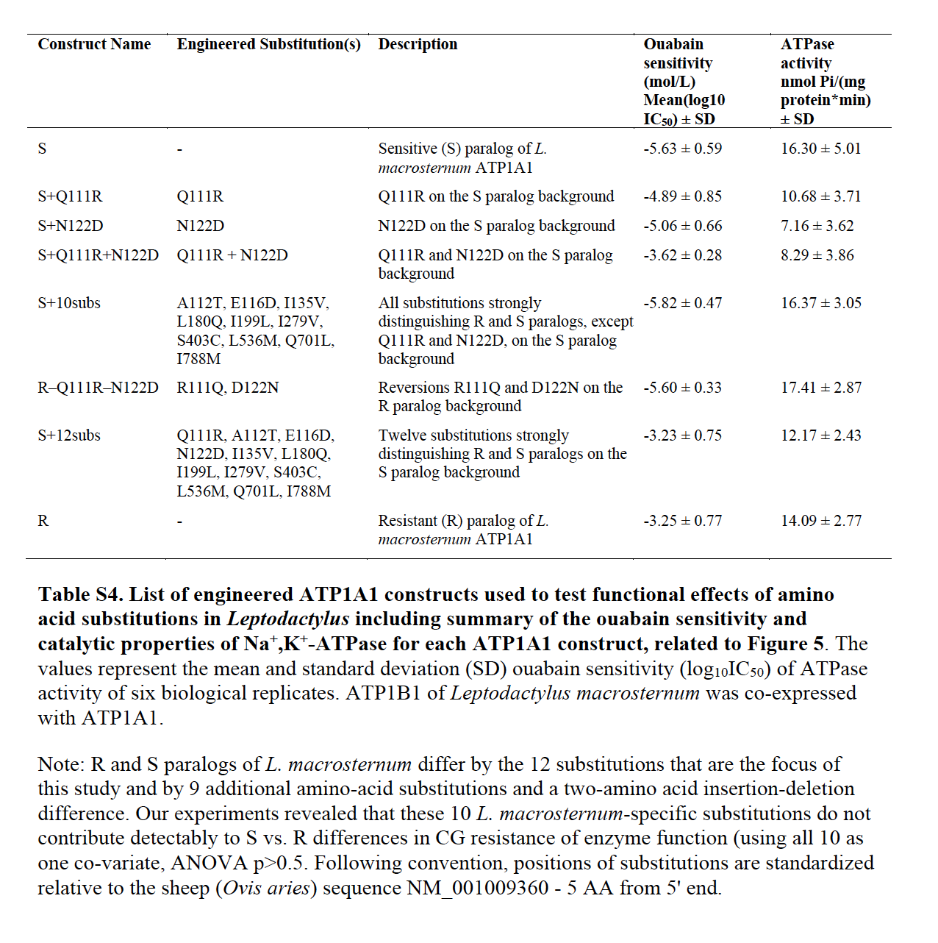
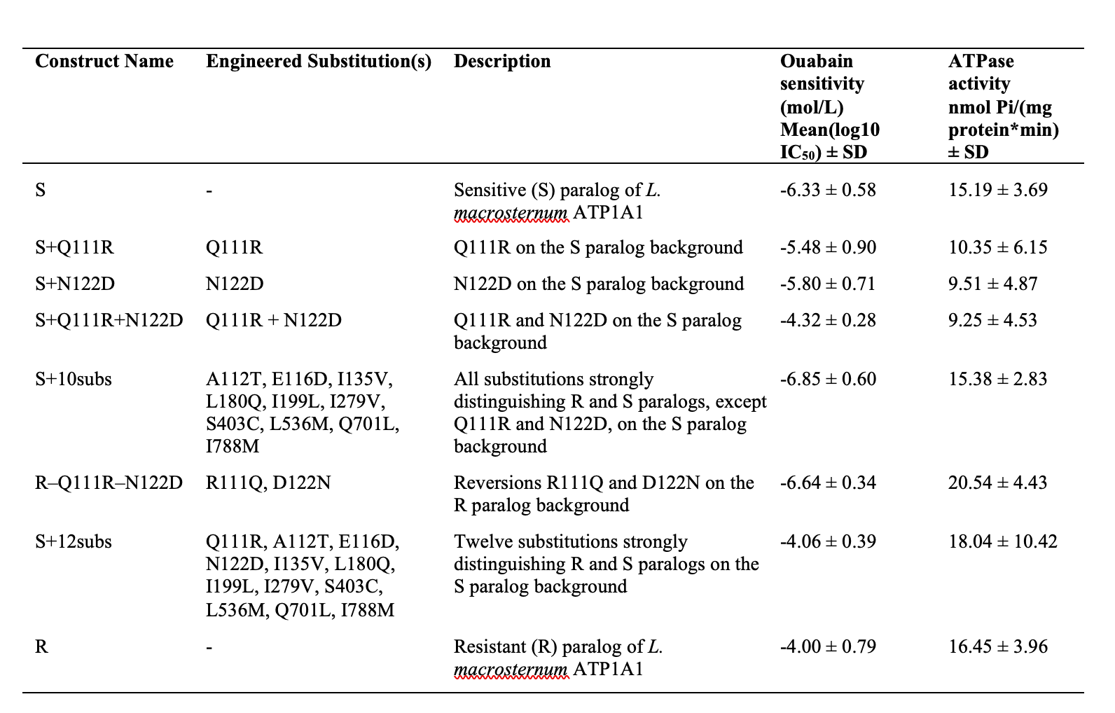
Original, Table S4
Corrected, Table S4

Slide 5
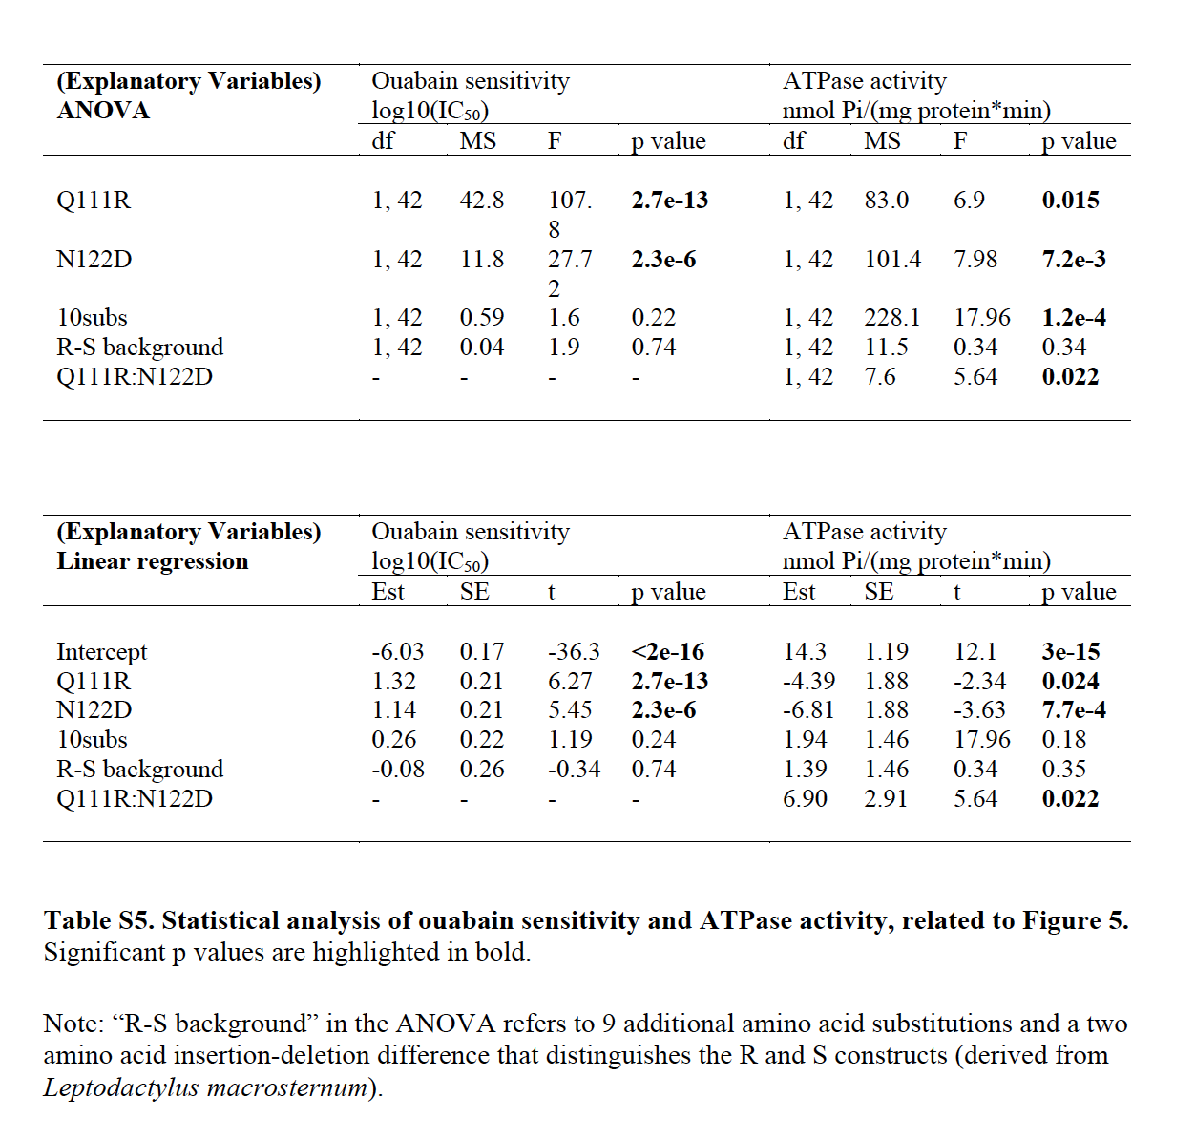
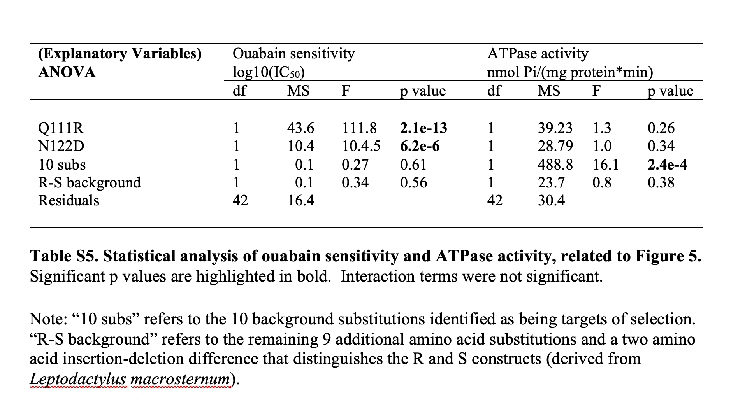
Original, Table S5
Corrected, Table S5

