Slide 1
Automated Market Makers
The Push-and-Solve Algorithm for Uniswap v3 Clones
Pandolfo Edoardo – Seminar Activity
Based on the paper: Vincent Danos, Leo Murao Watson, Hamza El Khalloufi, Santiago Valencia. On-chain optimal aggregation of Uniswap v3 clones. 2024. ⟨hal-04800479v2⟩

Slide 2
CEX vs DEX
 | Centralized Finance | Decentralized Finance
infrastructure | Centralized servers: transactions managed by private entities (Ex. Binance, Crypto.com) | Blockchain & Smart Contracts: Self-executing code on public ledgers (e.g., Ethereum)
Market Mechanism | Limit Order Books (LOB): Matches buy and sell orders from participants. Based on supply and demand | Automated Market Makers (AMM): automatically compute prices through an algorithm
Liquidity profile | Usually do not exchange new assets | Suitable for low liquidity assets
Costs | Trading Fees: Fees paid to the exchange | Gas Fees + Slippage + LP fees
Advantages | More efficient (High frequency Trading), Fiiat on/off-Ramp… | Non-Custodial, Permissionless, transparency…

Slide 3
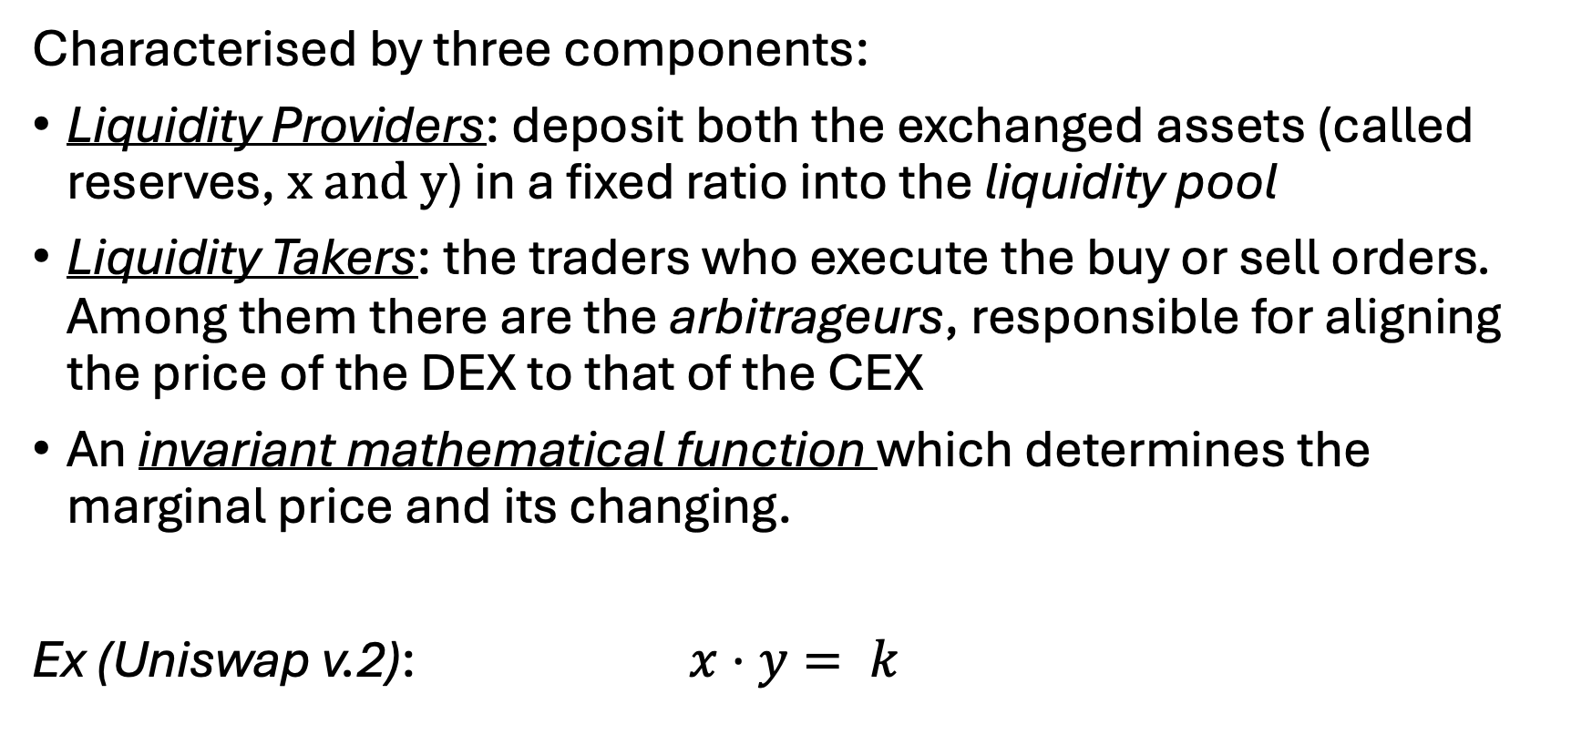
CFMMs
Characterised by three components:
Liquidity Providers: deposit both the exchanged assets (called reserves, $x and y$) in a fixed ratio into the liquidity pool
Liquidity Takers: the traders who execute the buy or sell orders. Among them there are the arbitrageurs, responsible for aligning the price of the DEX to that of the CEX
An invariant mathematical function which determines the marginal price and its changing.
Ex (Uniswap v.2): $x⋅y= k$

Slide 4
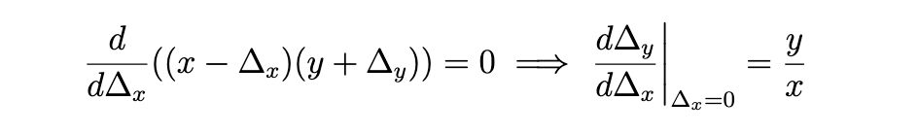
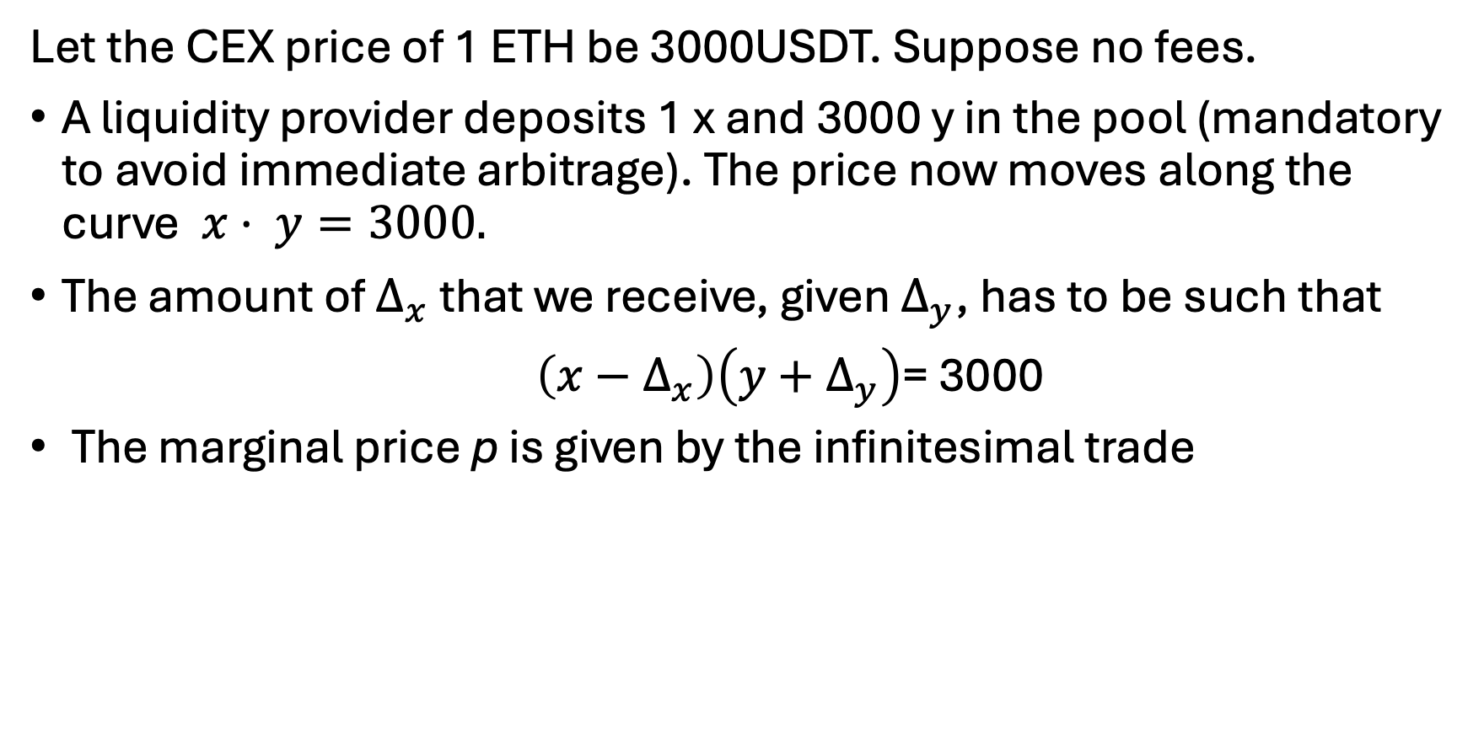
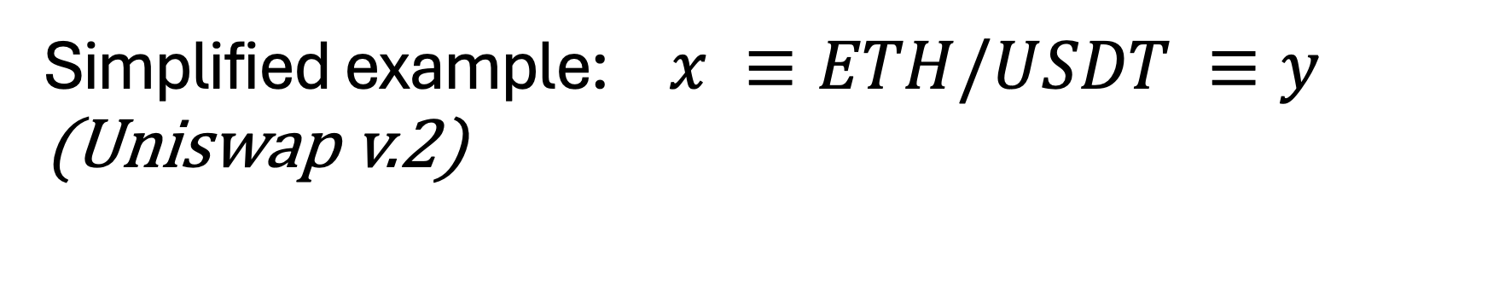
Simplified example: $x ≡ETH/USDT ≡y$ (Uniswap v.2)
Let the CEX price of 1 ETH be 3000USDT. Suppose no fees.
A liquidity provider deposits 1 x and 3000 y in the pool (mandatory to avoid immediate arbitrage). The price now moves along the curve$x⋅ y=3000.$
The amount of $Δ_{x}$ that we receive, given $Δ_{y}$, has to be such that
$\left(x−Δ_{x}\right)\left(y+Δ_{y}\right)$= 3000
The marginal price p is given by the infinitesimal trade

Slide 5
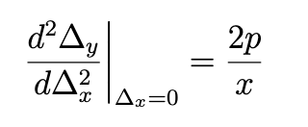
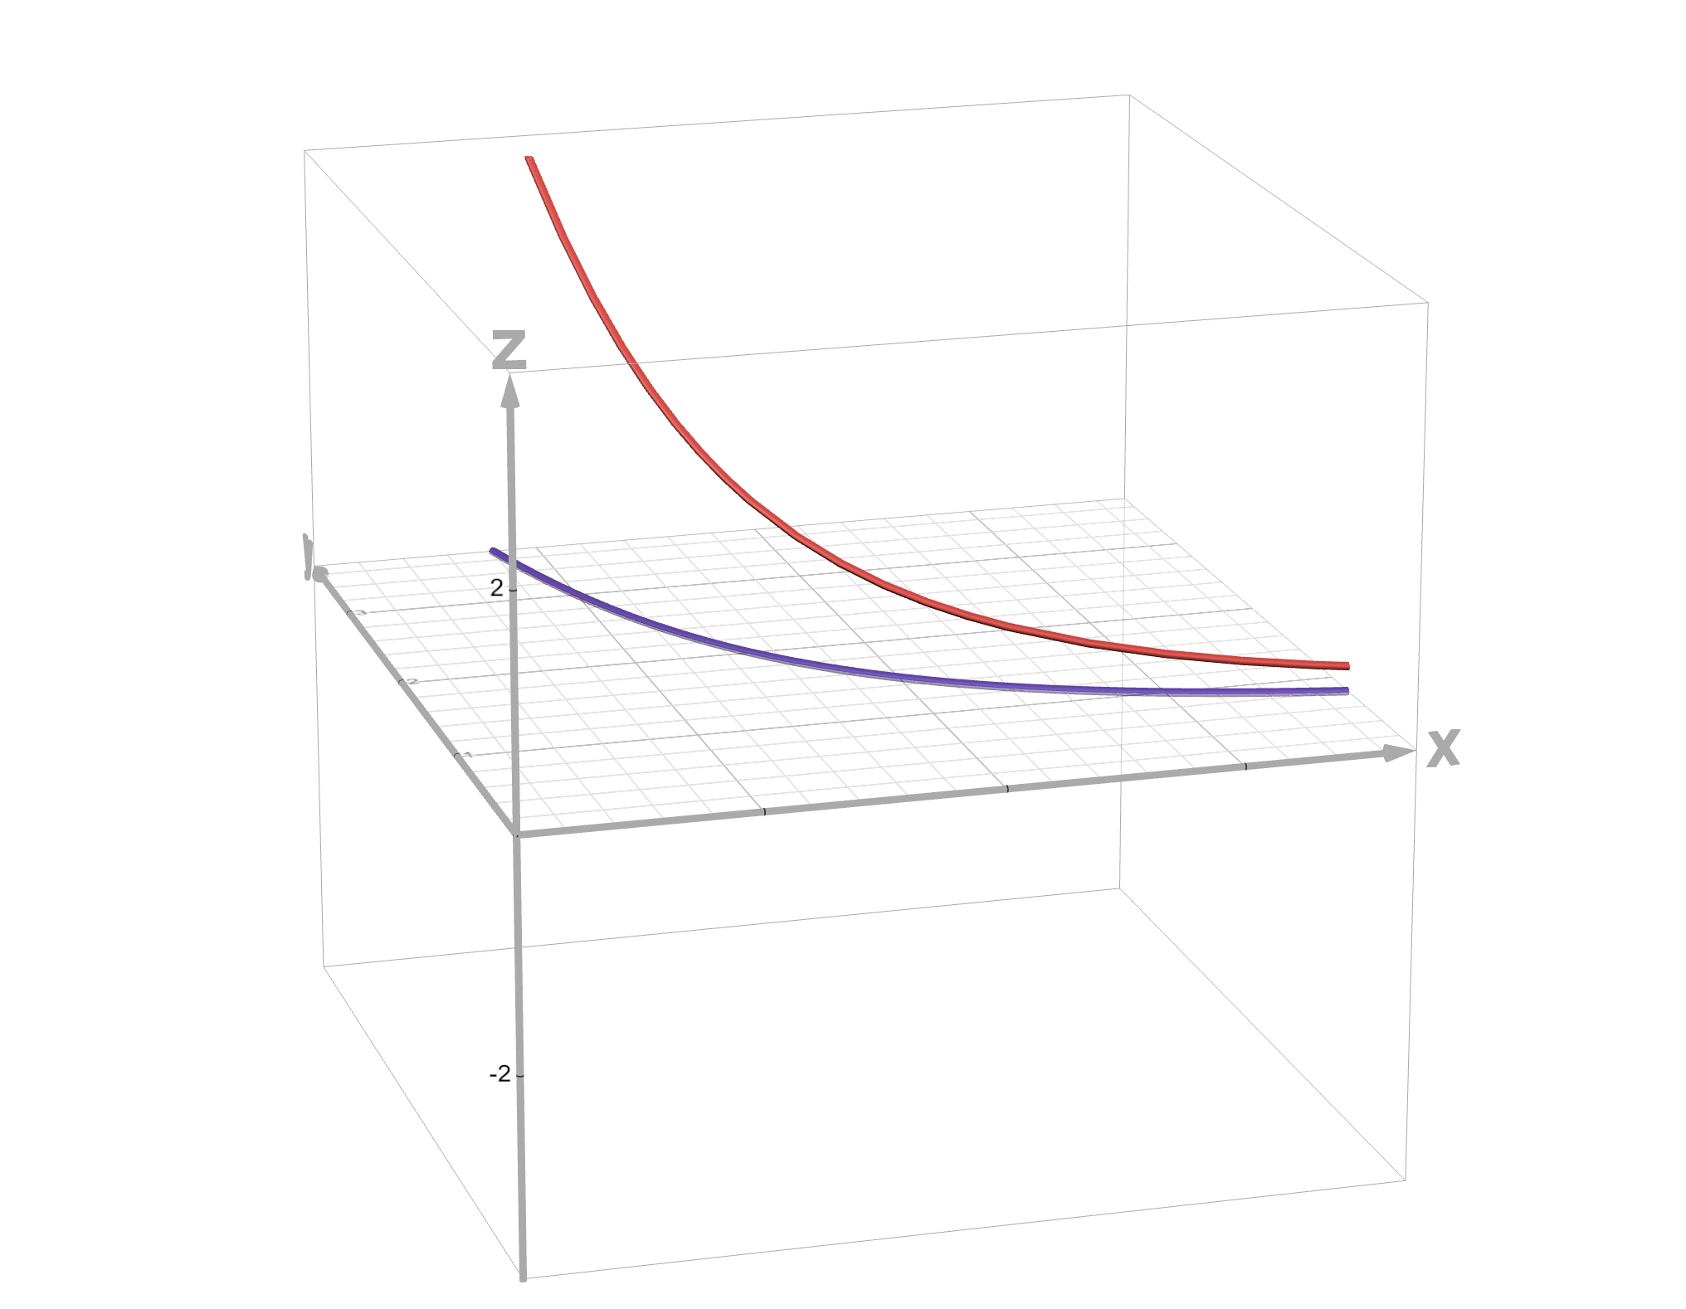
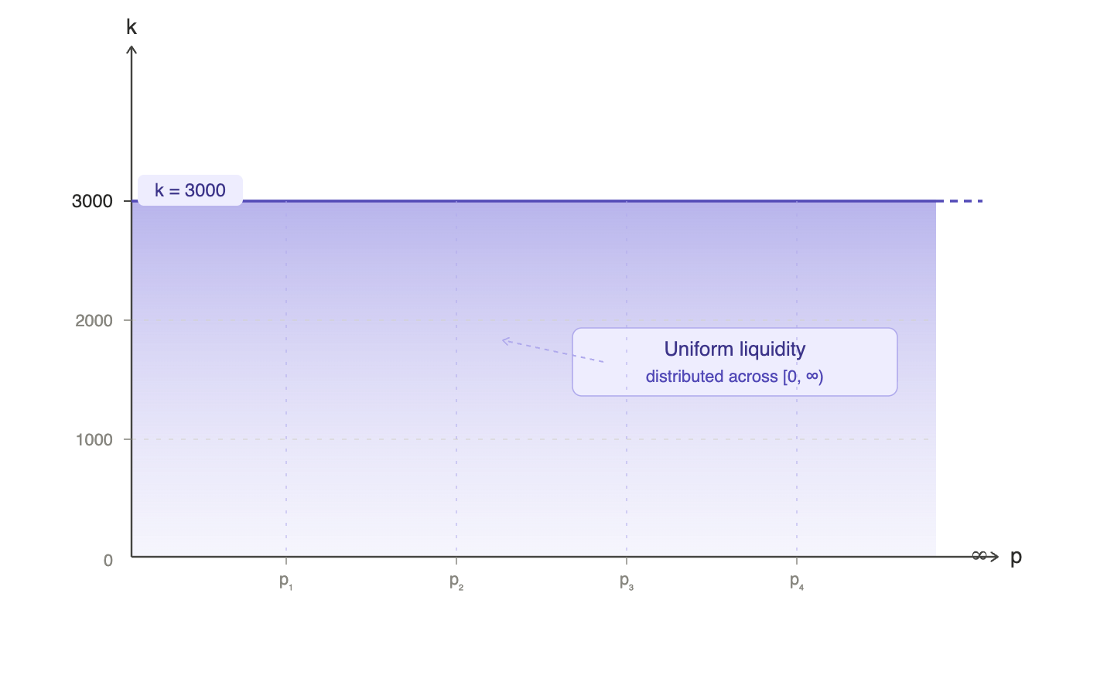

slippage: how much we actually receive:
$Δ_{x}=\frac{Δ_{y}⋅x}{ y+Δ_{y}}$
ggGraphical representation of Uniswap V.2:
Here the second derivative shows that the slippage decreases if we have more reserves
Distribution of liquidity in Uniswap v2
A d = price
= {yx = k, z = 0}
https://www.geogebra.org/calculator/u7tvacxv

Slide 6
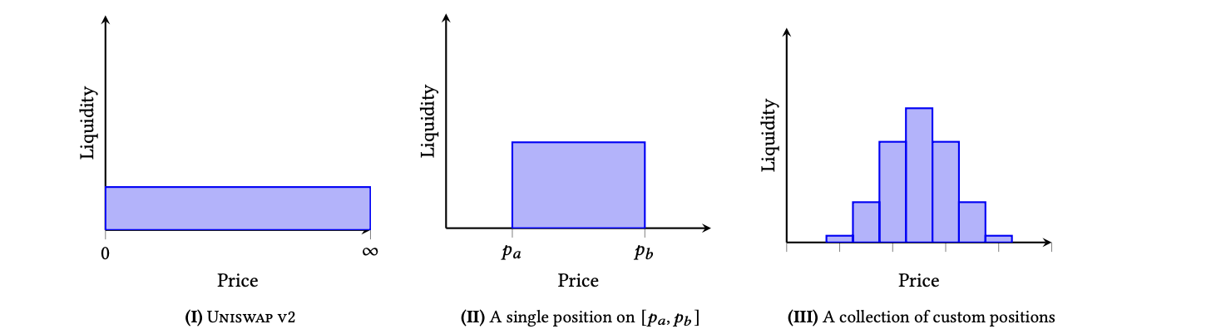

Uniswap v.3
Motivation: capital inefficiency, Imitation of centralized markets (in an on-chain environment).
Uniswap v1 and v2, only a fraction of the assets in the pool are available at a given price. This is inefficient, particularly when assets are expected to trade close to a particular price at all times.
Concentrated Liquidity: LP’s are allowed to concentrate their liquidity to smaller price ranges than $\left(0,∞\right)$. They can also create different combinations of positions.

Slide 7

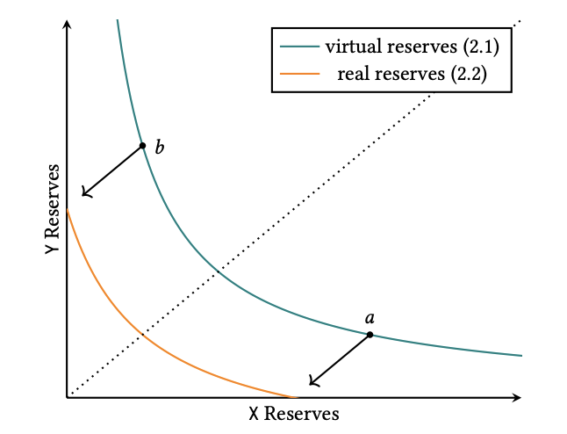


In the chosen range of a position $\left[p_{a},p_{b}\right]$ the reserves follow a new curve:
where ${ L}^{2}≡k$.
Differently from v2 It is possible to exhaust a reserve, which then becomes inactive (the position of the LP no longer receives trading commission)
The slippage is reduced, since the virtual reserve is more liquid in the range than it would have been in V2
To implement custom liquidity provision, the space of possible prices is demarcated by discrete ticks. Ticks represent prices at which the virtual liquidity of the contract can change

Slide 8
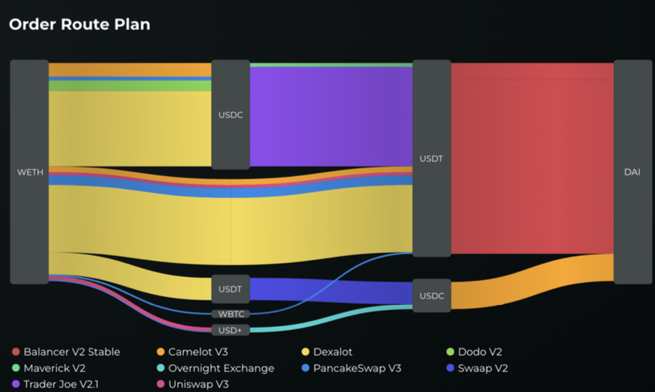
Optimal Splitting Problem
The low costs of reproducing DeFi protocols has led to a proliferation of clones and variants of Uniswap v2 and v3, all competing for the same liquidity.
aggregators which aim to consolidate the multiple oﬀerings that takers face, relieve them of time-consuming searches, and optimise the execution of their market orders.
Problem: computationally expensive aggregators work off-chain
temporal slippage: discrepancy between the plan and the actual on-chain execution
Figure 1: An execution plan computed by the Odos routing algorithm for an ETH-to-USDC swap of 10 ETH on Arbitrum (October 2024). One sees that the Odos aggregator computes a plan which includes several splits between Uniswap v3 clones.

Slide 9
Idea: aggregation should be executed and planned on-chain. There would be no latency, no induced slippage, so no loss of value to the intermediary (and complete transparency)
Work of the paper: propose a simple enough algorithm for on chain implementation. The algorithm concerns optima splitting among price parametrised AMMs (PPMs) on the same pair x/y
Aim: We are given a finite family of AMMs defined on the same pair X/Y, and a market order (say taker wants to buy X with an amount ∆y of Y), and the problem is to split ∆y among the AMMs in order to maximise the total amount of X obtained.

Slide 10
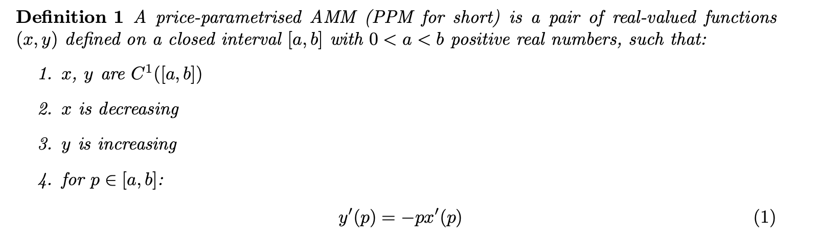
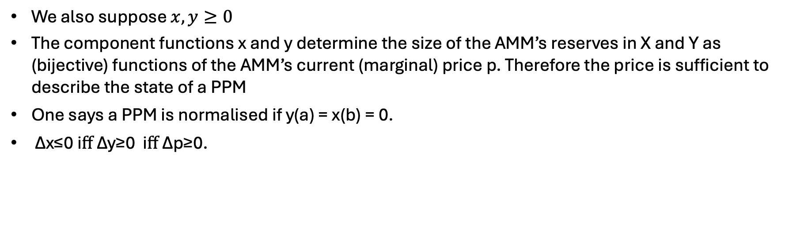
PPMs
We also suppose $x,y≥0$
The component functions x and y determine the size of the AMM’s reserves in X and Y as (bijective) functions of the AMM’s current (marginal) price p. Therefore the price is sufficient to describe the state of a PPM
One says a PPM is normalised if y(a) = x(b) = 0.
∆x≤0 iﬀ ∆y≥0 iﬀ ∆p≥0.

Slide 11
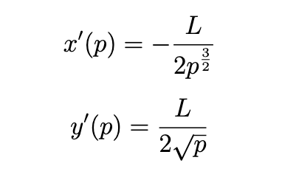
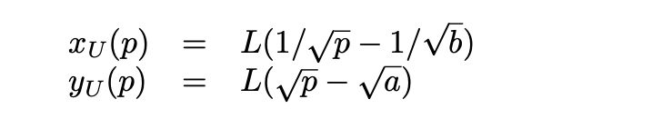
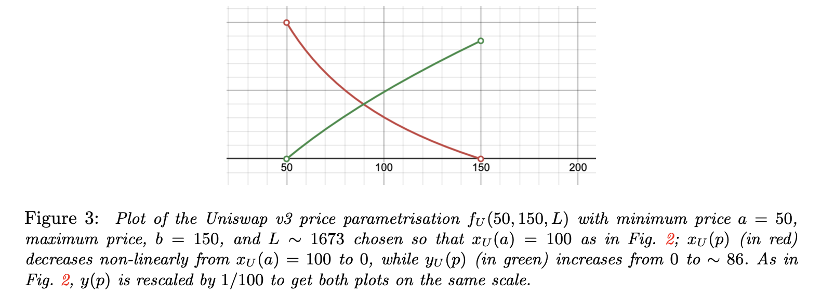
Example (Uniswap v3)
2:

Slide 12
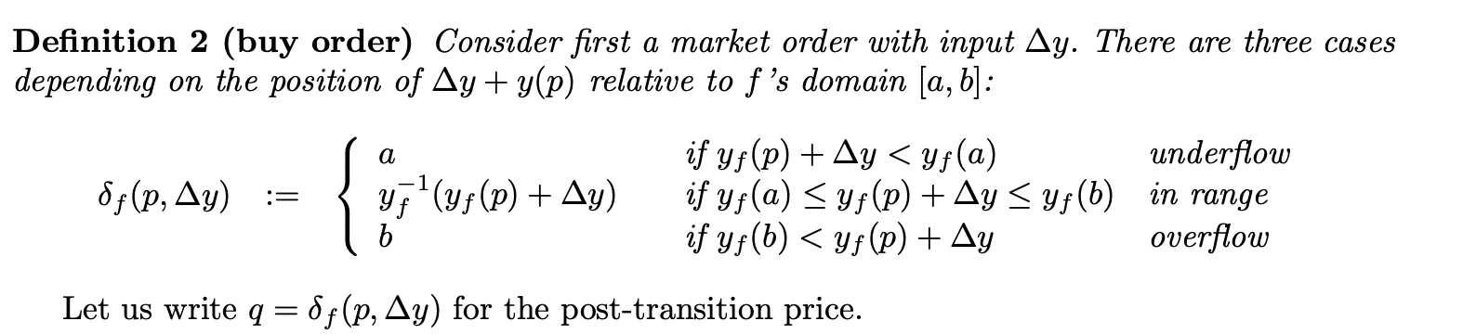
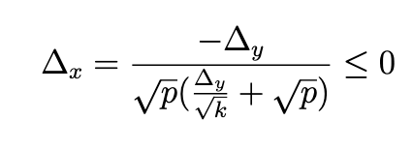
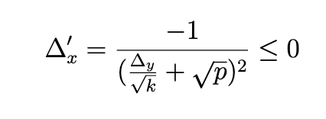
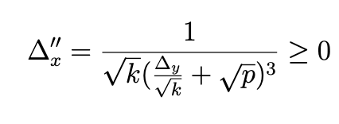
Volume-Volume maps are concave
Thus –$∆x$ is positive increasing and concave

Slide 13
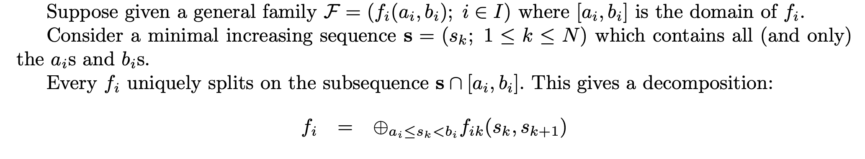
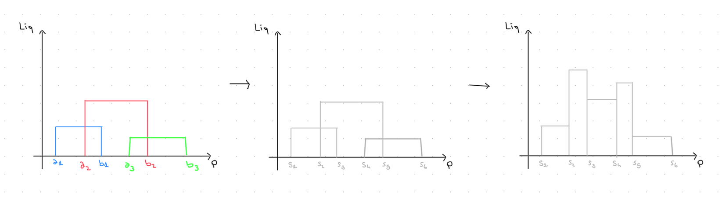
Splits and sums of PPMs
Figure 3: Uniswap v.3 split and sum

Slide 14
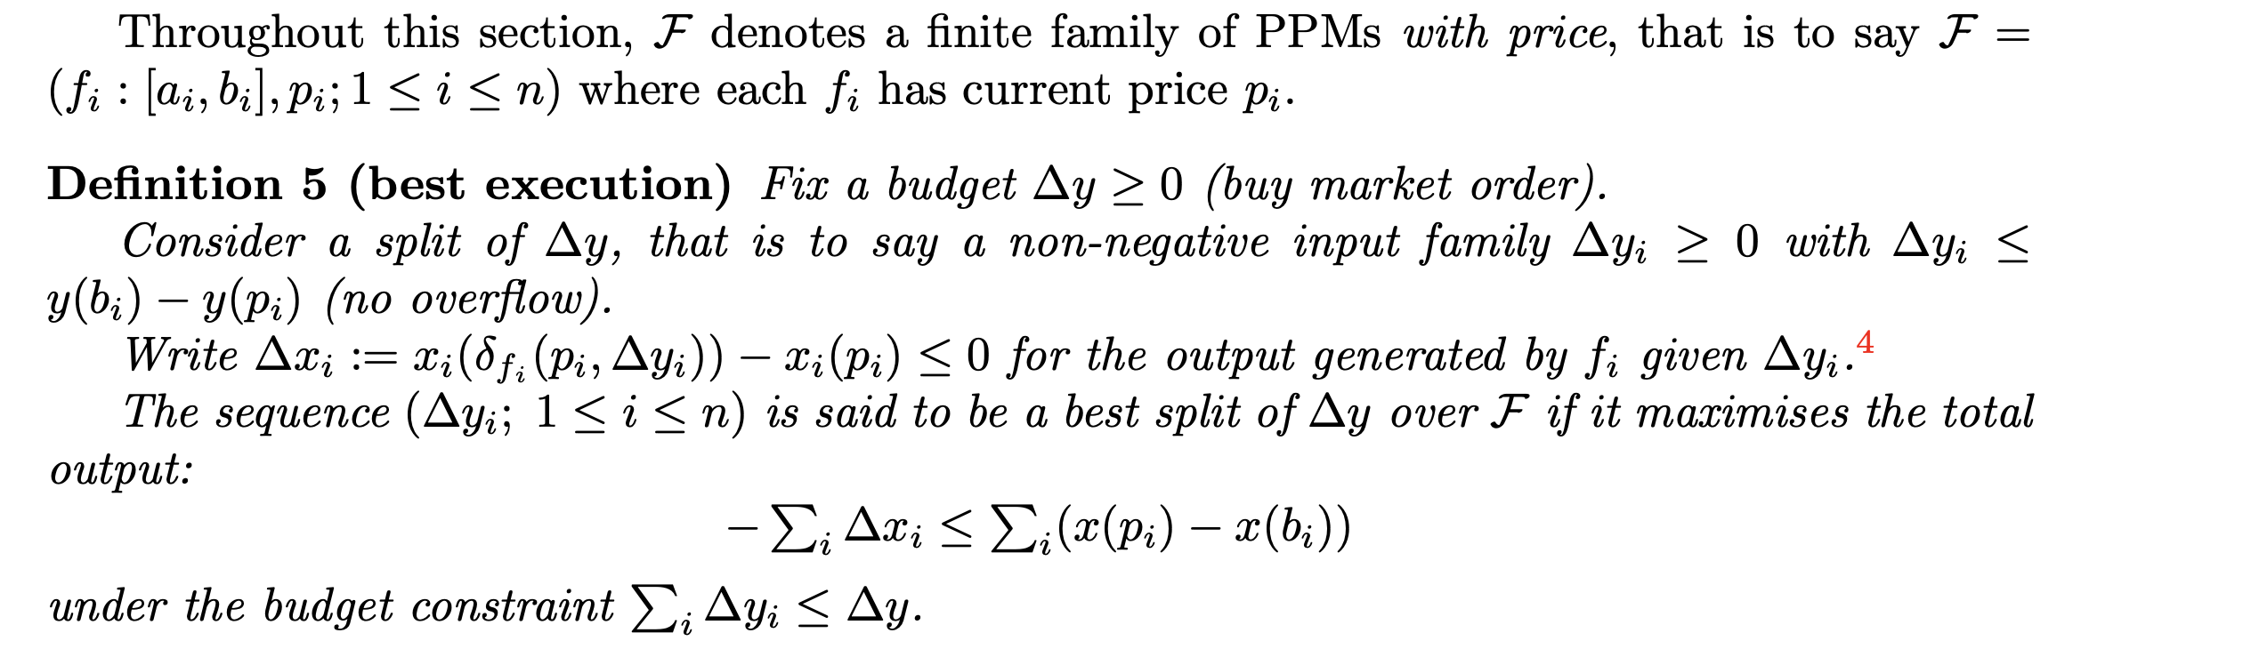
Best Execution of a Family of PPMs

Slide 15
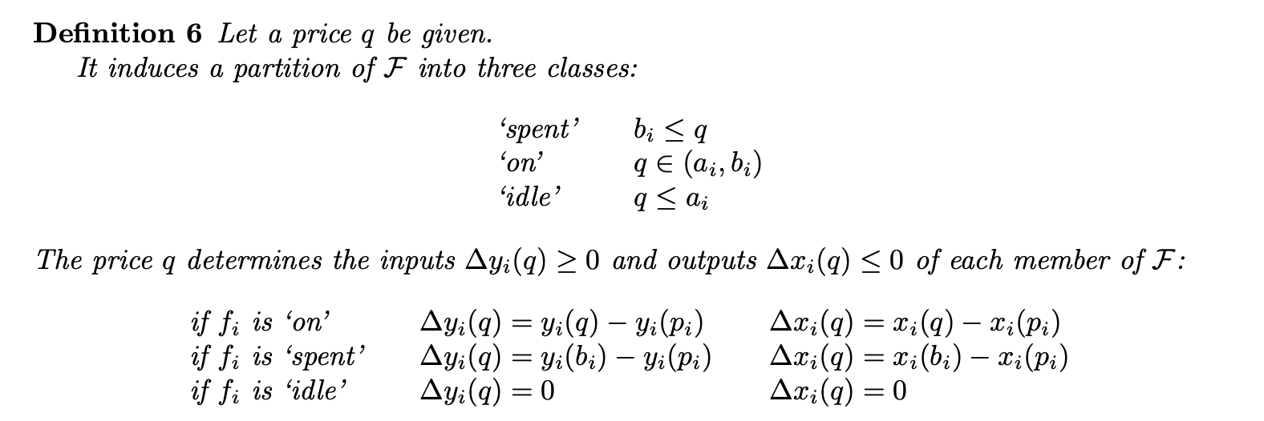
[EkT76]
(‘Convex Optimization, Boyd’ 4.2.2)
Reformulation of the problem

Slide 16
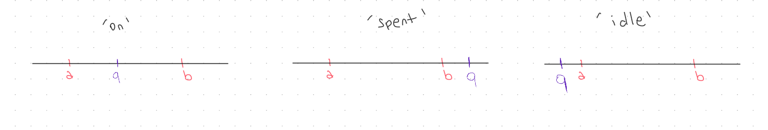
Proof: …

Slide 17
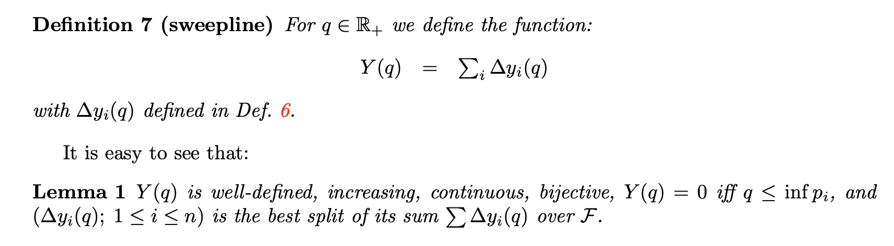

Slide 18
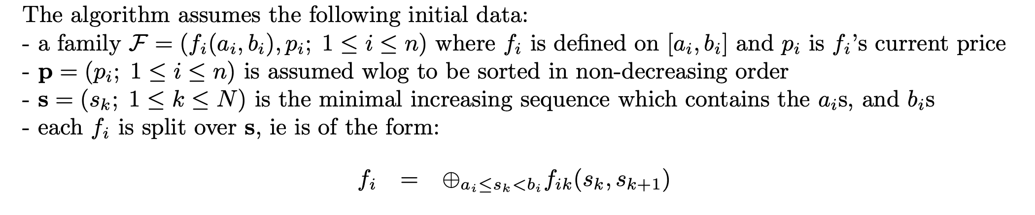
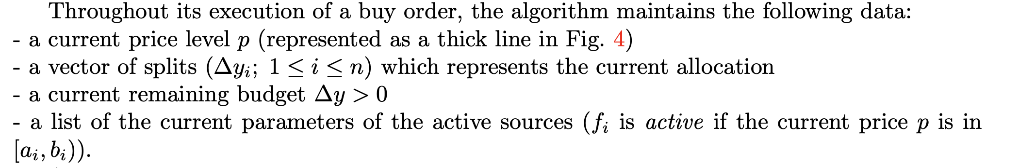
Push and Solve Algorithm

Slide 19
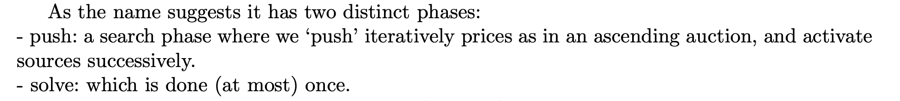


Slide 20
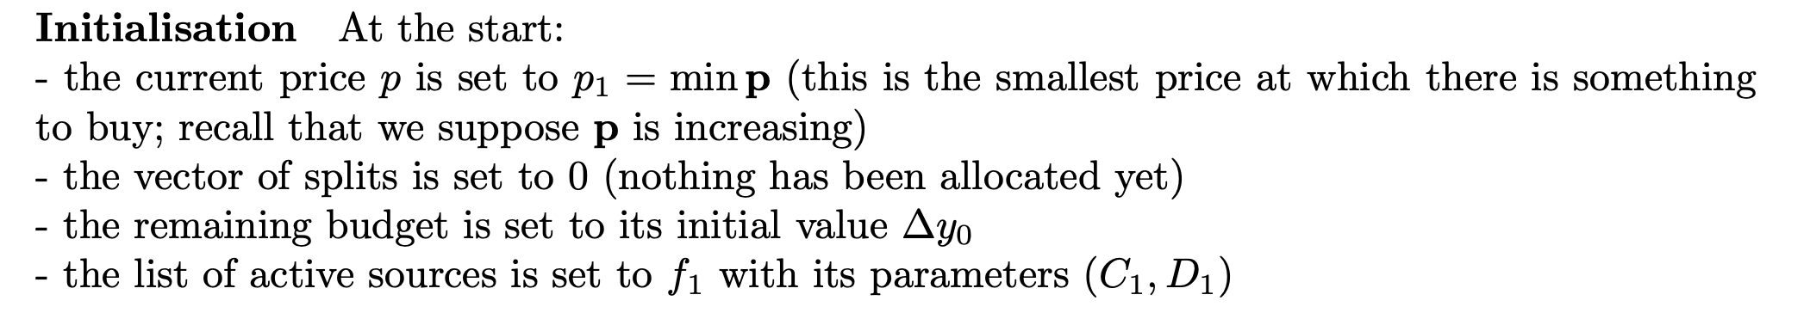
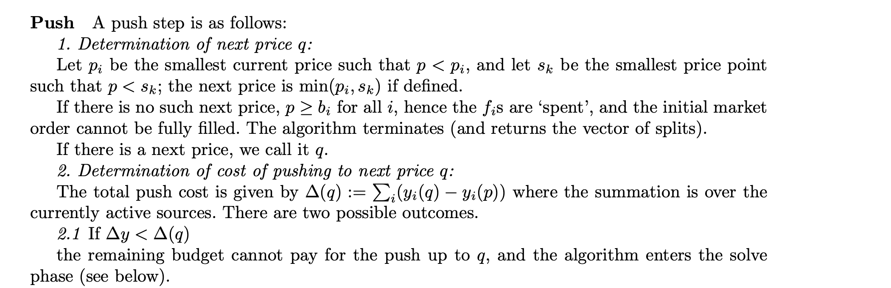

Slide 21
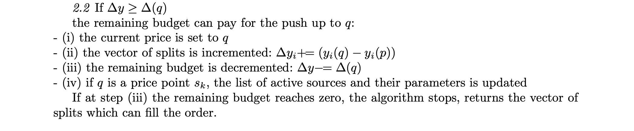
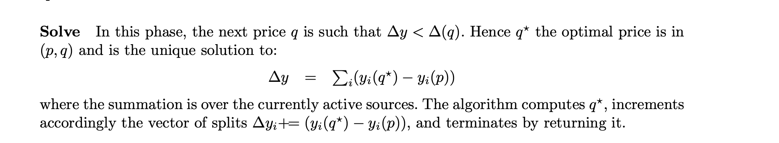
The algorithm is query optimal

Slide 22
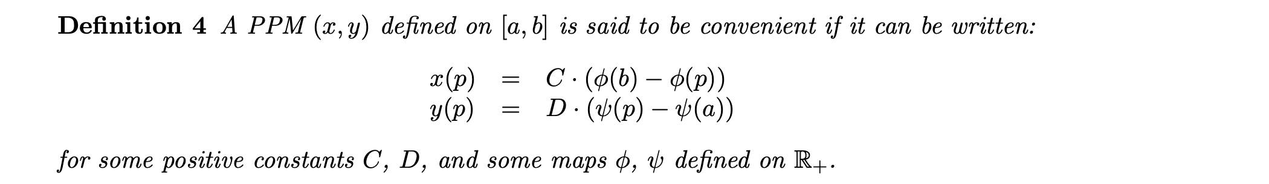
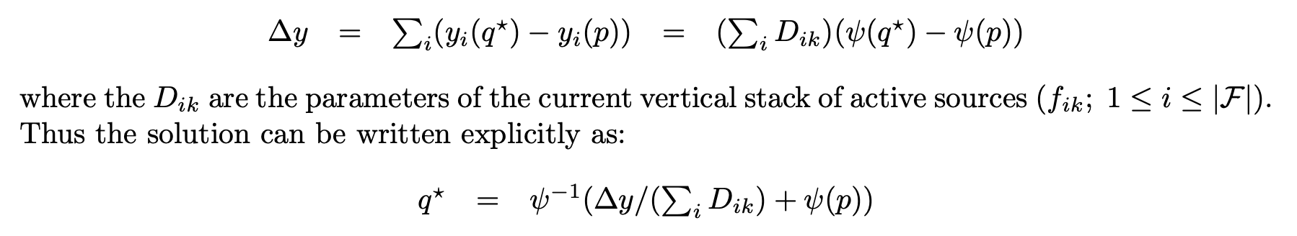
Application to convenient family of PPMs
Then if we suppose that all sources in F obey the same convenient format with functions φ, ψ, the equation in the solve step takes the following simpler form:

Slide 23
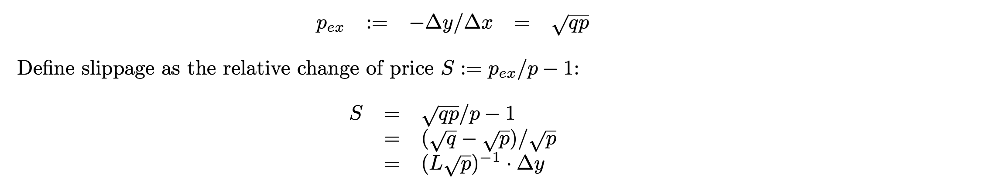
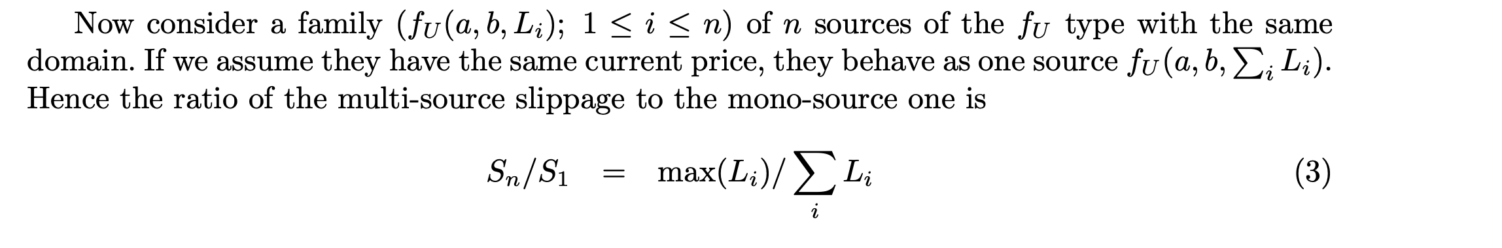
Slippage calculations

Slide 24
References
https://app.uniswap.org/whitepaper-v3.pdf (Uniswap v.3 core)
https://arxiv.org/pdf/1911.03380 (An Analysis of Uniswap Markets)
https://arxiv.org/pdf/2208.06046 (AMM and Loss vs Rebalancing)
For general optimal routing: https://arxiv.org/pdf/2204.05238 and https://arxiv.org/pdf/2302.04938
https://web.stanford.edu/~boyd/cvxbook/bv_cvxbook.pdf (‘Convex Optimization’)
[EkT76] Ekeland, I., and Teman, R., 1976. Convex Analysis and Variational Problems, North-Holland Publ., Amsterdam.
Michael Patriksson, ‘A survey on the continuous nonlinear resource allocation problem’. (off-chain algorithmic solutions to the problem)

