Slide 1
Game : SlimeDefense
Nguyen Van Luc

Slide 2
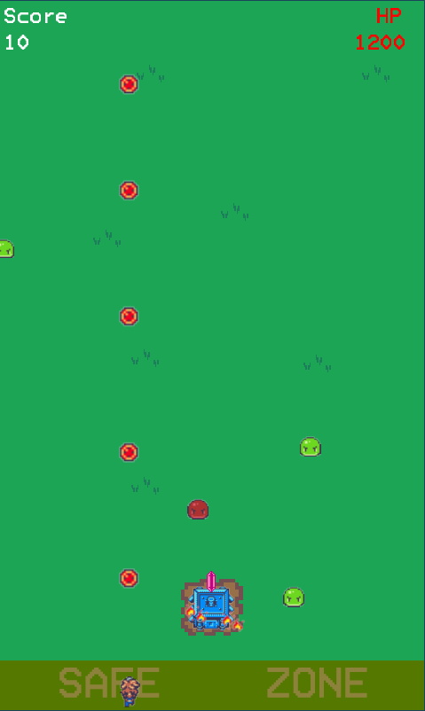
Types of game
Top-Down View
Tower Defense

Slide 3



Character-Player-Base
Character could move left and right
Auto fire
Base have 3000 HP
If Base’s Hp go down to 0 , game over.

Slide 4


Character-Monster
Random create
if shoted by the player, turns into a red slime
Create Green Slime Only
Create 200 damage to Base
Every 30 seconds, all green slimes turn into red slime
If shoted by player, it disappear.
Create 500 damage to Base
Faster than Green Slime.
Green Slime
Red Slime

Slide 5
Main Gameplay
Target: Protect the Base
Score: Time that the player can defend(have timer)

