Slide 1



School Data Base Management System
Designing a comprehensive school database management system is a critical undertaking that aims to streamline and digitize the administrative processes within an educational institution. This robust system will serve as the backbone for managing a wide range of data, including student records, course enrollment, teacher information, and attendance tracking. By leveraging the power of technology, this project seeks to enhance efficiency, improve data accessibility, and foster better decision-making for the benefit of the entire school community.

Slide 2
Aim and Abstract
The primary aim of this School Database Management System (SDMS) project is to create a comprehensive and efficient system that streamlines the management of a school's data. This system will enable administrators, faculty, and staff to effectively organize, store, and retrieve vital information related to the school's departments, students, courses, teachers, enrolments, grades, and attendance records. By centralizing and digitizing this data, the SDBMS will improve data accuracy, enhance data accessibility, and facilitate informed decision-making processes within the school.
The abstract of this project outlines the key objectives and expected outcomes of the SDMS. The system will provide a seamless user experience for all stakeholders, allowing them to easily access and update the necessary information. It will also incorporate robust security measures to ensure the confidentiality and integrity of the school's data. Additionally, the SDMS will feature advanced reporting and analytics capabilities, enabling school leaders to identify trends, monitor performance, and make data-driven decisions to improve the overall educational experience for students.

Slide 3
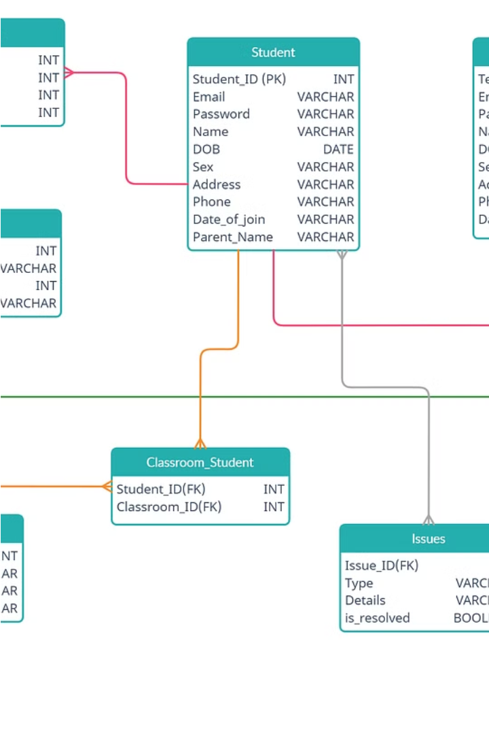
Project Background and Description
The School Database Management System (SDMS) is a comprehensive software solution designed to streamline and enhance the management of school-related data and processes. This project aims to create a centralized database that will serve as the backbone for storing and organizing crucial information about the school's departments, students, courses, teachers, enrolments, grades, and attendance records.
The SDMS will provide a user-friendly interface that allows administrators, faculty, and staff to efficiently access, update, and analyse data pertaining to the school's operations. By consolidating all relevant information into a single, integrated system, the SDMS will improve data accuracy, reduce redundancy, and facilitate better decision-making processes for the school's leadership.
The project's primary objective is to develop a robust and scalable database management system that can handle the growing demands of the school's data management needs. This includes the ability to store and retrieve student records, manage course enrollment and scheduling, track teacher assignments and credentials, and generate comprehensive reports for administrative and academic purposes.

Slide 4
Entities: Department, Student, Course, Teacher, Enrollment, Grade, Attendance
Student
Course
The Course entity represents the various classes offered by the school. Each course has a unique course code, a title, a description, credit hours, and the department it belongs to. Courses are taught by teachers and enrolled in by students. The database tracks the schedule, syllabus, and other details related to each course.
Teacher
The Teacher entity represents the faculty members who instruct the courses. Each teacher has a unique employee ID, personal information (name, contact details), academic qualifications, and the courses they are assigned to teach. Teachers are associated with a specific department and play a crucial role in the educational process by delivering lectures, grading assignments, and providing guidance to students.
Department
The Department entity represents the various academic departments within the school, such as Computer Science, English, Mathematics, and Biology. Each department has a unique identifier, a name, a description, and is led by a department chair. Departments offer a range of courses and employ teachers who specialize in the department's subject area.
The Student entity represents the individuals enrolled at the school. Each student has a unique student ID, personal information (name, date of birth, contact details), academic information (grade level, GPA, transcript), and enrollment details. Students register for courses, attend classes, and receive grades that are tracked through the database.
Enrolment
The Enrollment Module of the SDMS is designed to streamline the entire admission and registration process for new and returning students. This module facilitates the collection and management of applications, ensuring that all student data—from personal information to educational background—is securely captured and processed.
Grades
The Grade Module in the SDMS is critical for tracking academic performance and maintaining accurate records of student assessments. This module allows teachers to enter grades for assignments, tests, projects, and examinations, which are then automatically calculated to update final course grades according to predefined grading rubrics
Attendance
The Attendance Module is key to managing daily student and staff presence in the school. It automates the recording of attendance for each class, significantly reducing the time and effort traditionally involved in manual roll-calls. Teachers can quickly mark attendance through the system interface, and the data is immediately available to administrators and parents.

Slide 5
Attributes
Departments department_id (INT, Primary Key), name (VARCHAR(255)), head_of_department_id (INT) | Teachers teacher_id (INT, Primary Key), name (VARCHAR(255)), email (VARCHAR(255), UNIQUE), phone_number (VARCHAR(15)), department_id (INT, Foreign Key referencing Departments.department_id) | Students student_id (INT, Primary Key), name (VARCHAR(255)), email (VARCHAR(255), UNIQUE), phone_number (VARCHAR(15)), department_id (INT, Foreign Key referencing Departments.department_id)
Courses course_id (INT, Primary Key), name (VARCHAR(255)); teacher_id (INT, Foreign Key referencing Teachers.teacher_id), department_id (INT, Foreign Key referencing Departments.department_id) | Enrollments enrollment_id (INT, Primary Key), student_id (INT, Foreign Key referencing Students.student_id), course_id (INT, Foreign Key referencing Courses.course_id), enrollment_date (DATE) | Grades grade_id (INT, Primary Key), student_id (INT, Foreign Key referencing Students.student_id), course_id (INT, Foreign Key referencing Courses.course_id), grade (VARCHAR(2))
Attendance attendance_id (INT, Primary Key), student_id (INT, Foreign Key referencing Students.student_id), course_id (INT, Foreign Key referencing Courses.course_id), attendance_date (DATE), present (BOOLEAN)

Slide 6
Relations
Department-Teacher Relationship
Department-Head Relationship
Department-Student Relationship
Course-Teacher Relationship
Course-Department Relationship
Enrollment-Student Relationship
Enrollment-Course Relationship
Course-Grades Relationship
Student-Grades Relationship
Course-Attendance Relationship
Student-Attendance Relationship

Slide 7
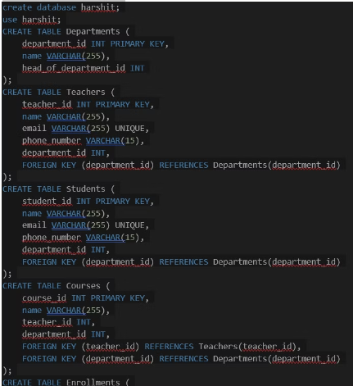
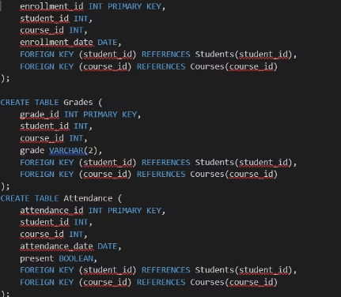
Conversion of ER Diagram into Tables
Once the Entity-Relationship (ER) diagram has been designed, the next step is to convert it into relational database tables. This involves mapping the entities, attributes, and relationships from the ER diagram into a set of tables with appropriate columns and data types.
The process of converting an ER diagram to tables is straightforward. Each entity in the ER diagram is represented as a table, and the attributes of the entity become the columns of the table. The primary key for each table is identified, and any foreign key relationships are established between tables to represent the relationships defined in the ER diagram.
For example, the "Student" entity in the ER diagram would become a table with columns for the student's ID, name, address, and other relevant attributes. The "Enrollment" entity, which represents the relationship between students and courses, would become a table with columns for the student ID, course ID, and any additional information related to the enrollment, such as the semester or grade.

Slide 8
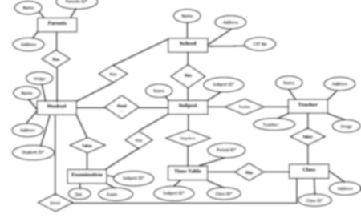
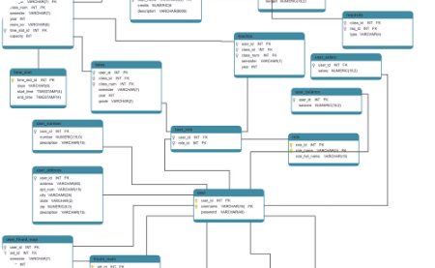
ER Model Diagram
Entity Relationship Model
Relational Database Schema
The Entity Relationship (ER) model is a high-level conceptual data model that provides a way to visualize the relationships between the different entities in the School Database Management System. This diagram illustrates the key entities, such as Department, Student, Course, Teacher, Enrollment, Grade, and Attendance, as well as the connections and cardinalities between them. By clearly defining these entities and their interactions, the ER model forms the foundation for the relational database design, helping to ensure data integrity, minimize redundancy, and support the efficient retrieval and management of information within the school system.
The ER model is then translated into a relational database schema, which represents the tables, columns, and relationships in a more formal, implementation-ready format. This schema diagram shows how the entities and their attributes are mapped to relational tables, with primary and foreign key constraints defining the connections between them. The schema diagram provides a detailed, technical view of the database structure, enabling developers and database administrators to understand the data organization and relationships, facilitating the creation of efficient queries, reports, and other database-driven applications for the school's information management needs.

Slide 9

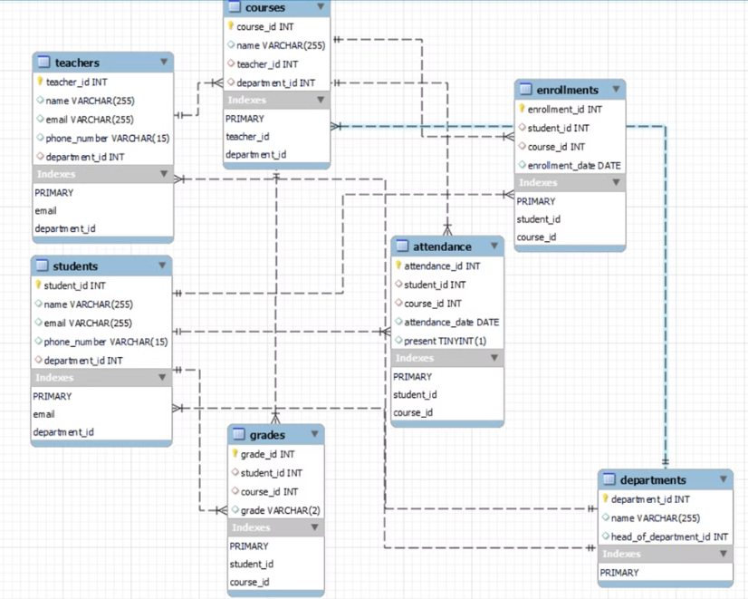
Schema Diagram
The schema diagram serves as a crucial tool in the development and maintenance of the School Database Management System. It provides a clear roadmap for developers, allowing them to design and implement the database architecture effectively, while also facilitating the integration of new features or modifications to the existing system.

Slide 10
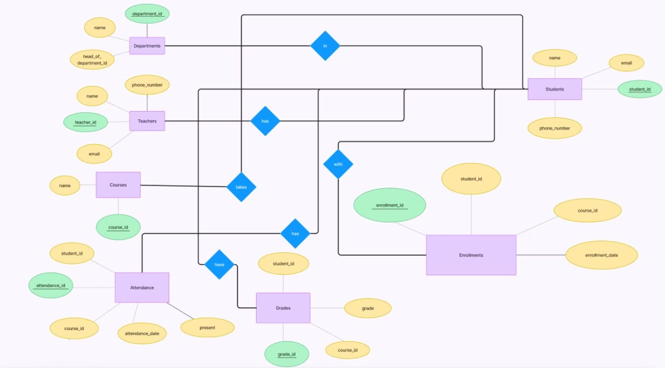
ER Model

Slide 11



Normalization of Tables
First Normal Form (1NF)
1
Eliminate repeating groups and ensure all attributes are atomic.
Second Normal Form (2NF)
2
Ensure full functional dependency - no partial dependencies.
Third Normal Form (3NF)
3
Eliminate transitive dependencies - no non-key attributes dependent on other non-key attributes.
Normalization is the process of organizing data in a database to reduce redundancy, improve data integrity, and optimize query performance. It involves breaking down a database into smaller tables and defining relationships between them. The three main steps of normalization are: 1. First Normal Form (1NF): Ensure that the table has no repeating groups and that all attributes are atomic (cannot be broken down further). This involves creating a primary key and removing any multi-valued attributes. 2. Second Normal Form (2NF): Ensure that all non-key attributes are fully dependent on the primary key. This means removing any partial dependencies, where a non-key attribute depends on only a part of the primary key. 3. Third Normal Form (3NF): Eliminate any transitive dependencies, where a non-key attribute depends on another non-key attribute. This involves separating such attributes into their own tables. By following these normalization steps, the database design will become more efficient, with reduced data redundancy and improved data integrity. This ultimately leads to faster query times, easier maintenance, and greater flexibility in the overall system.

Slide 12

SQL Queries and Views
To effectively manage the School Database Management System, a variety of SQL queries and views will be implemented.
These queries and views will enable efficient data retrieval, manipulation, and analysis to support the school's administrative and academic needs.
The SQL queries and views will be designed with efficiency, security, and data integrity in mind.
QUERIES
Select all records from a table:
SELECT * FROM Departments;
Select records based on conditions:
SELECT * FROM Students WHERE department_id = 1;
Update existing records:
UPDATE Teachers SET phone_number = '555666777' WHERE teacher_id = 2;
Delete records from a table:
DELETE FROM Departments WHERE department_id = 4;
Count:
SELECT COUNT(*) FROM Students;
Insert a single record into a table:
INSERT INTO Departments (department_id, name) VALUES (4, 'Literature');

Slide 13
Views
View 1: List of Departments with Head of Department's Name:
CREATE VIEW Department_Head_View AS
SELECT d.department_id, d.name AS department_name, d.head_of_department_id, t.name AS head_of_department_name
FROM Departments d
LEFT JOIN Teachers t ON d.head_of_department_id = t.teacher_id;
Department_Head_View:
department_id
department_name
head_of_department_id
head_of_department_name
1
Mathematics
2
Jane Smith
2
Science
3
Michael
3
History
NULL
NULL

Slide 14
THANK YOU
Done By:
G. Harshit – AP22110010076
P. Vishnu – AP22110010094
V. Revanth – AP22110010109

