Slide 1
IBM University Engagement Project Submission
“Exploring the Power of Agentic AI with IBM Granite and IBM Bob”

Slide 2

Project Tile – Travel Planner Agent
Domain of Project – Travelling
Student Name | Recent Passport Photo | Email ID | Mobile number [WhatsApp]
Arunkumar Panduga |  | arunkumar9010755083@gmail.com | 9010755083

Slide 3
Problem Statement -
Problem Statement: Travel Planner Agent
The Challenge
Planning a trip often requires searching across multiple platforms for transportation options, travel duration, costs, destinations, and suitable travel plans. Comparing flights, trains, buses, and road trips manually can be time-consuming and confusing.
Travelers may also struggle to determine which option provides the best balance between cost, travel time, convenience, and personal preferences.
The Objective
Build an AI-powered Travel Agent that provides personalized travel recommendations and helps users plan their journeys through an interactive conversational interface.
The solution should:
Multi-Modal Travel Comparison – Compare flights, trains, buses, and road trips based on travel requirements.
Personalized Recommendations – Recommend the most suitable travel option based on budget, time, and preferences.
Travel Information – Provide estimated cost, duration, and convenience for different transportation options.
Intelligent Trip Planning – Help users plan journeys by understanding natural-language travel requests.
AI-Powered Conversation – Allow users to interact with the travel agent through a simple chatbot interface.
Smart Recommendation – Identify options such as Budget Pick, Fastest Option, and Best Overall Choice.
User-Friendly Interface – Present travel comparisons and recommendations in an easy-to-understand format.

Slide 4
Proposed Solution -
Proposed Solution – AI-Powered Travel Planner Agent
The proposed solution is an AI-powered Travel Agent built using IBM Bob, IBM watsonx.ai, and IBM Granite models to provide intelligent and personalized travel planning assistance.
The system uses IBM Granite 4 H Small as the core AI model to understand user travel requirements, process natural-language queries, and generate relevant travel recommendations. Granite 4 H Small is designed for instruction following, conversational applications, tool interaction, and RAG use cases.
The solution provides the following capabilities:
Travel Query Understanding – Understands user requirements such as destination, starting location, budget, preferred transportation, and travel duration.
Transportation Comparison – Compares different travel modes including flights, trains, buses, and road trips.
Cost & Duration Analysis – Presents estimated travel costs and journey durations to help users make informed decisions.
Personalized Recommendations – Generates recommendations according to the user's requirements and highlights the most suitable option.
Conversational Travel Assistant – Users can ask questions naturally instead of filling out complicated travel forms.
Interactive Dashboard – Provides a visually appealing interface with destination cards, comparison tables, recommendation cards, and an interactive chat experience.
Cloud Deployment – The application is deployed as a Node.js web service and made publicly accessible through Render.
Overall, the solution provides an end-to-end AI travel planning assistant that simplifies transportation comparison and helps users make faster and more informed travel decisions.

Slide 5
Technology Used
IBM Bob – AI-assisted development of the Travel Agent application and frontend/backend code. IBM Bob is designed to assist across the software development lifecycle and work with real codebases.
IBM Granite 4 H Small – Core Generative AI model for understanding travel queries and generating intelligent travel recommendations.
IBM watsonx.ai / Watson Machine Learning – Provides access to the IBM Granite model and AI inference.
Node.js & Express.js – Backend server that handles user requests and communicates with the IBM AI model.
HTML, CSS & JavaScript – Used to build the interactive Travel Agent user interface.
REST API – Enables communication between the frontend, backend, and IBM Granite model.
GitHub – Used for source-code management and version control.
Render – Used to deploy the Node.js application and make the Travel Agent publicly accessible.

Slide 6
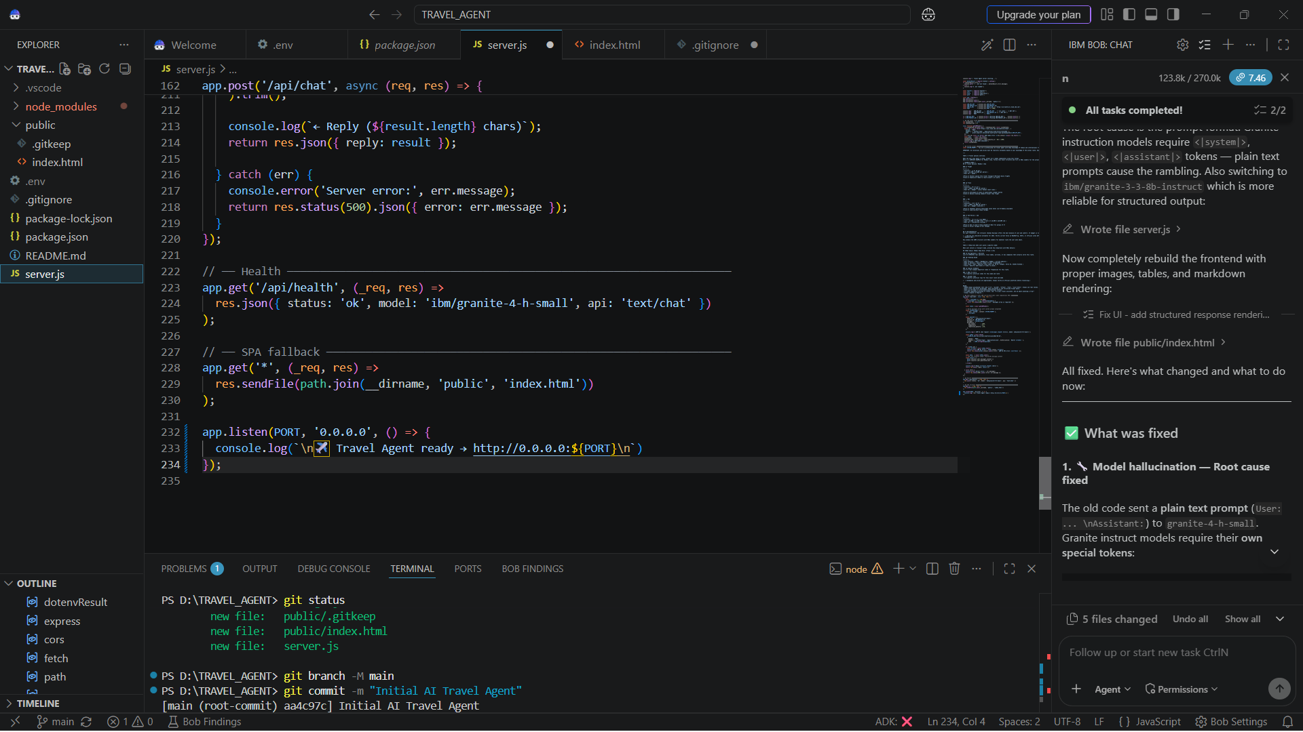
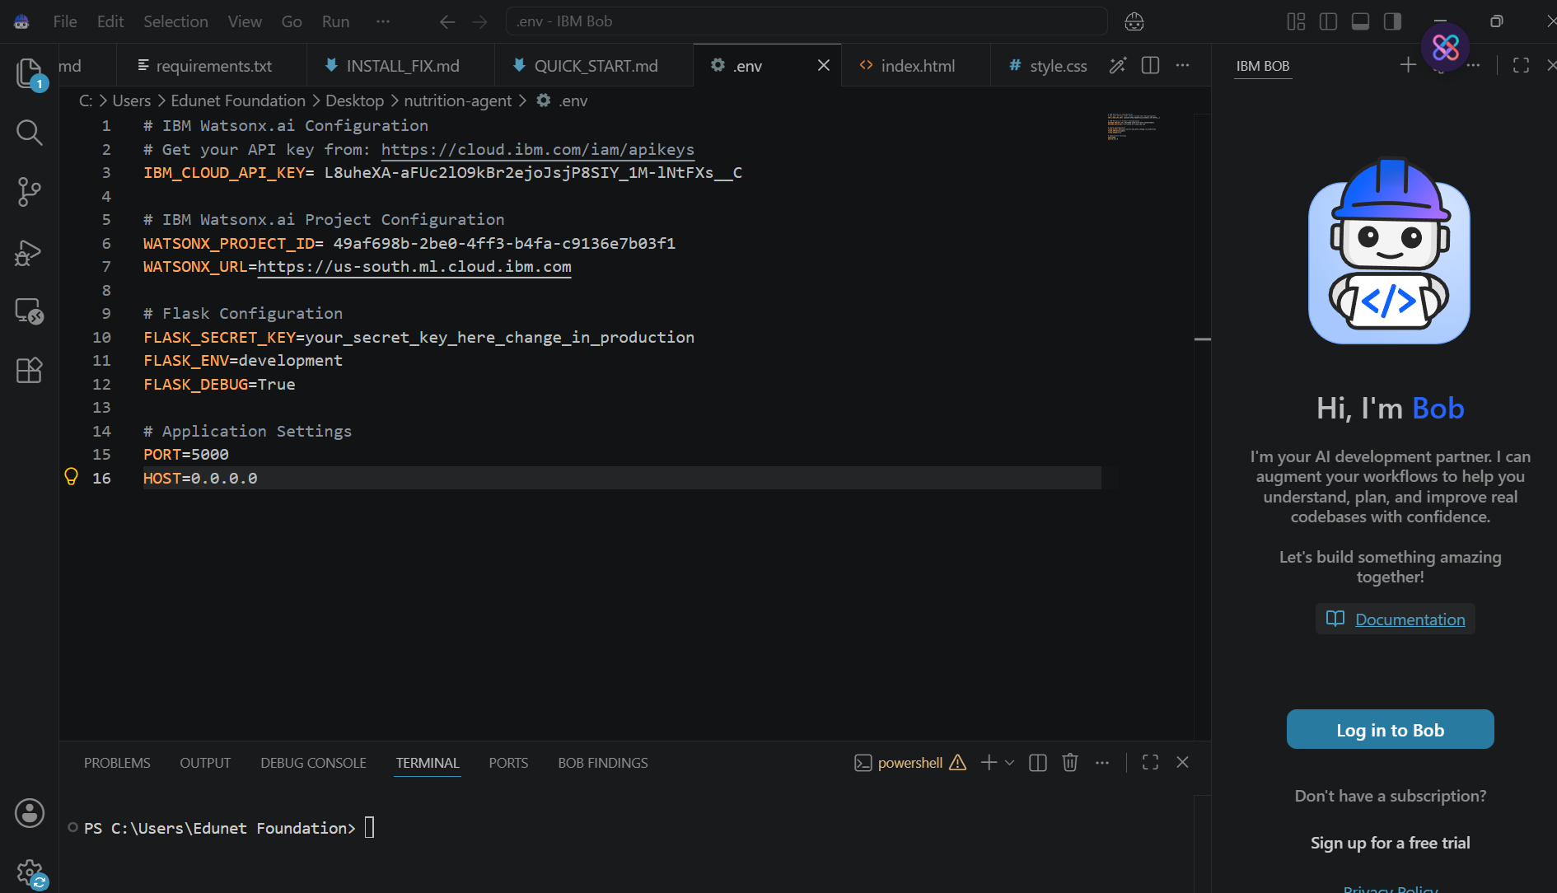
Required Files created using IBM bob -
App.py
Requirements.txt
Style.css
.env
Index.html

Slide 7
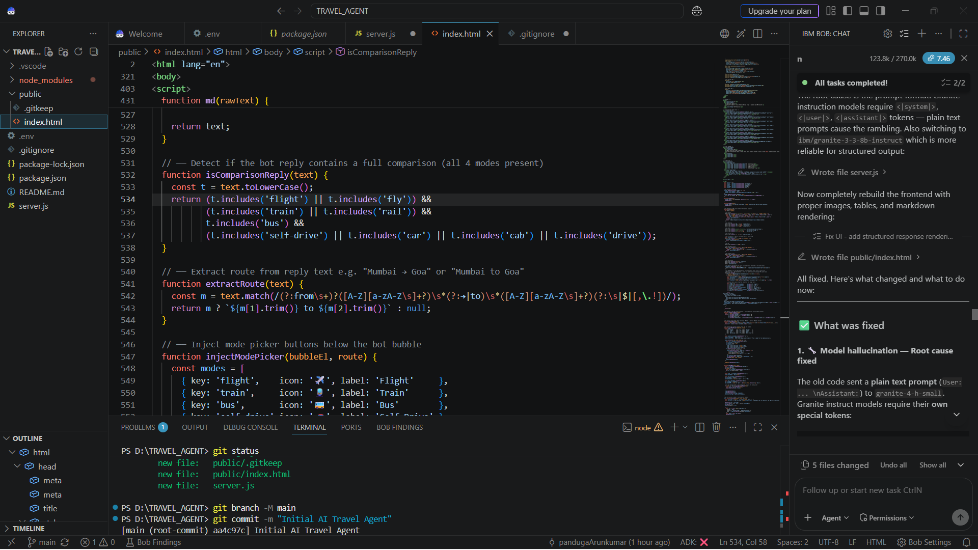
IBM Bob Screenshots:

Slide 8
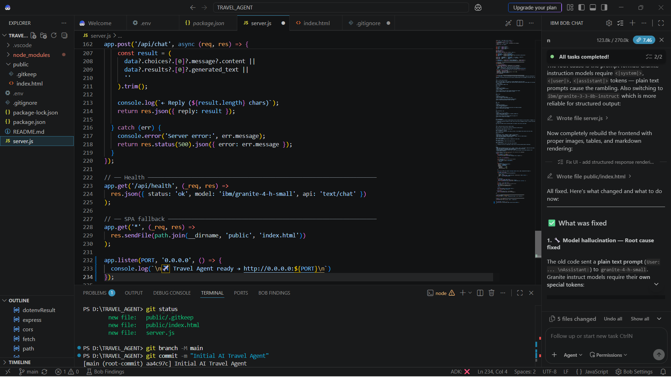

Slide 9
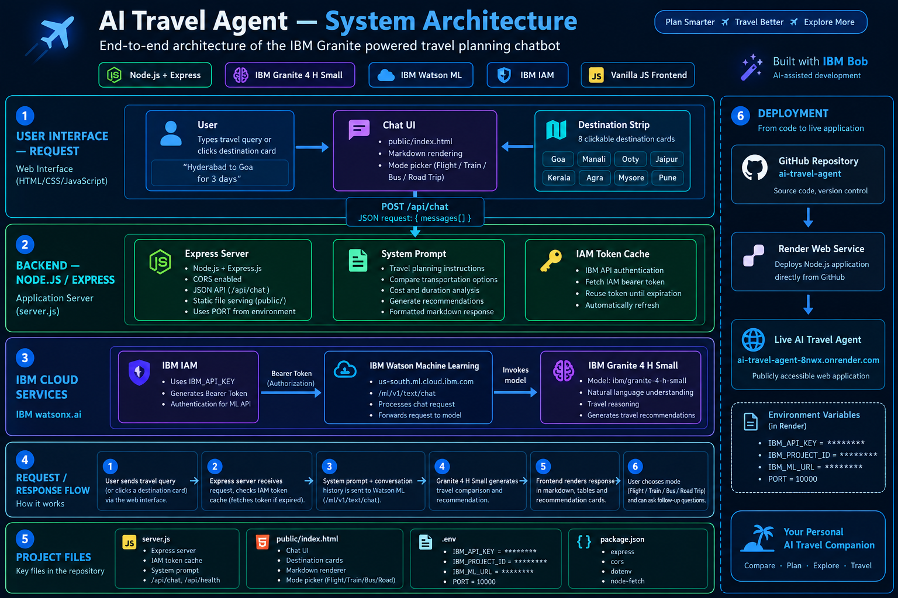
Architecture blueprint for IBM bob:

Slide 10

Role of Agentic AI in the solution
Role of Agentic AI in AI Travel Planner Agent
Agentic AI enables the Travel Agent to go beyond a simple chatbot by understanding travel goals, analyzing user requirements, comparing transportation options, and generating actionable recommendations. The system uses IBM Granite 4 H Small to understand natural-language travel queries and produce context-aware responses. Granite 4 H Small is designed for instruction following and agentic tasks such as tool use and structured reasoning.
The Travel Agent analyzes important factors such as destination, travel preference, budget, journey duration, and transportation mode to generate relevant travel suggestions.
The system performs several intelligent tasks:
Goal Understanding – Identifies what the traveler wants, such as destination, budget, duration, and preferred travel mode.
Travel Comparison – Compares flights, trains, buses, and road trips based on estimated cost and travel time.
Decision Support – Highlights the Best Overall Option, Budget Pick, and Fastest Option.
Context Awareness – Uses the conversation history and user's current request to generate more relevant responses.
Personalized Recommendations – Adapts recommendations according to the travel requirements provided by the user.
Natural-Language Interaction – Allows users to communicate with the system using normal conversational questions instead of complex forms.

Slide 11
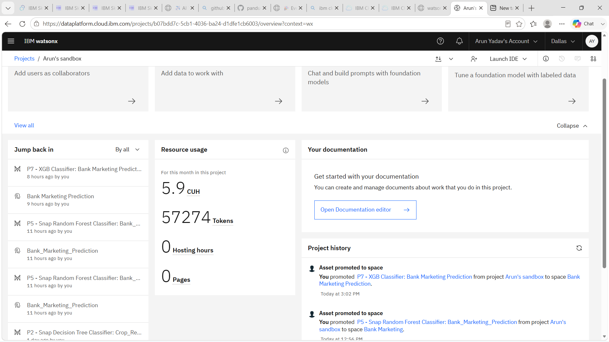

Token Usage
11,761 token are used
Before Prompt
After the Prompt
·
·
·

Slide 12
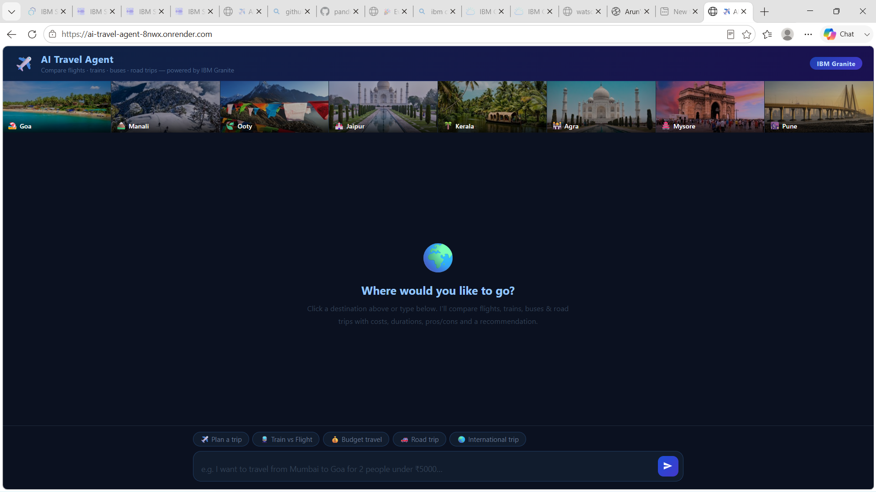
Project Output Screenshot
Please put IBM Bob output screenshots with 2-3 prompts.
You can take 2-3 more slides for each screenshot
·
·
·

Slide 13
Project Output Screenshot
Please put IBM Bob output screenshots with 2-3 prompts.
You can take 2-3 more slides for each screenshot
·
·
·

Slide 14
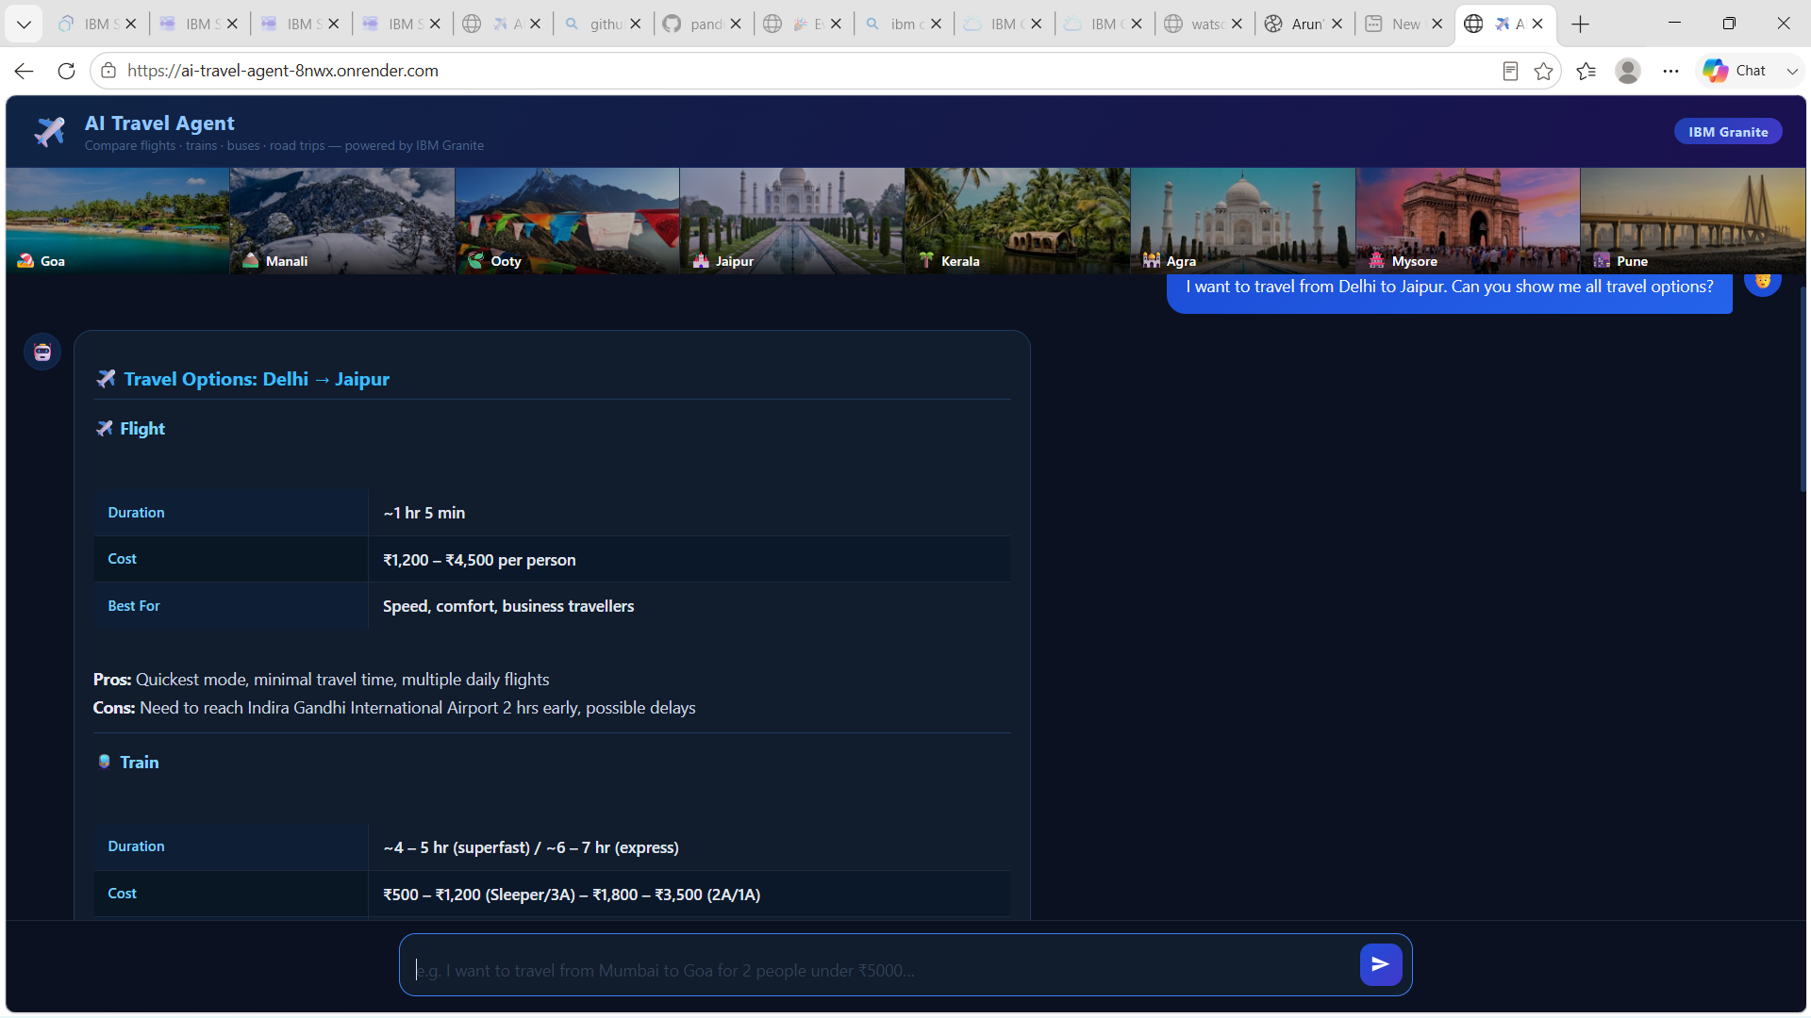
Project Output Screenshot
Please put IBM Bob output screenshots with 2-3 prompts.
You can take 2-3 more slides for each screenshot
·
·
·

Slide 15
Novelty and Uniqueness
The proposed AI Travel Agent stands out by combining conversational AI, intelligent travel comparison, and personalized recommendations into a single travel-planning system.
Conversational Travel Planning – Users can describe their travel requirements naturally instead of filling out complex forms. The AI understands destinations, travel preferences, duration, and budget-related requests.
Multi-Mode Travel Comparison – The system compares flights, trains, buses, and road trips within a single interface, making it easier to evaluate different transportation choices.
Intelligent Decision Support – Instead of simply listing options, the system highlights Best Overall Option, Budget Pick, and Fastest Option to help users make a quicker decision.
Personalized Recommendations – Travel suggestions are generated according to the user's requirements, such as preferred destination, budget, travel time, and transportation preference.
Natural-Language AI Interaction – Powered by IBM Granite 4 H Small, the application can understand conversational travel questions and generate structured travel recommendations. Granite 4 H Small supports instruction following and tool-calling capabilities suited to AI assistant and agentic applications.

Slide 16
Git Hub Link
GitHub & Live Application
GitHub Repository
🔗 https://github.com/pandugaArunkumar/ai-travel-agent
Live Application
🚀 https://ai-travel-agent-8nwx.onrender.com
Project Contents
server.js — Node.js + Express backend & IBM Granite integration
public/index.html — Travel Agent UI
package.json — Project dependencies
README.md — Project documentation
·
·
·

Slide 17
Future Scope
1. Real-Time Travel Data Integration
The Travel Agent can be integrated with real-time APIs for flight, train, bus, and hotel availability, prices, schedules, and booking information. This would allow the system to provide live travel options instead of estimated information.
2. Hotel & Accommodation Recommendations
The system can be extended to recommend hotels, hostels, and other accommodations based on destination, budget, location, ratings, and user preferences.
3. Complete AI Trip Planner
Future versions can generate a complete day-by-day itinerary including transportation, accommodation, sightseeing locations, restaurants, estimated expenses, and recommended activities.
4. Voice & Multilingual Travel Assistant
Voice interaction and multilingual support can be added so users can communicate with the Travel Agent in their preferred language through speech or text.
·
·
·

Slide 18
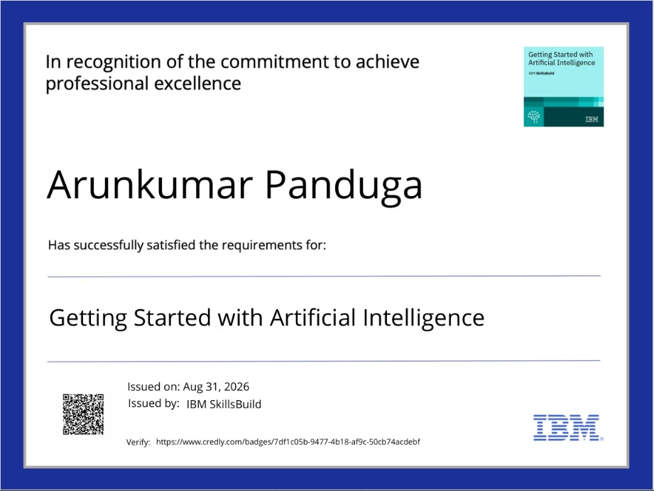
Certificates Earned:

Slide 19
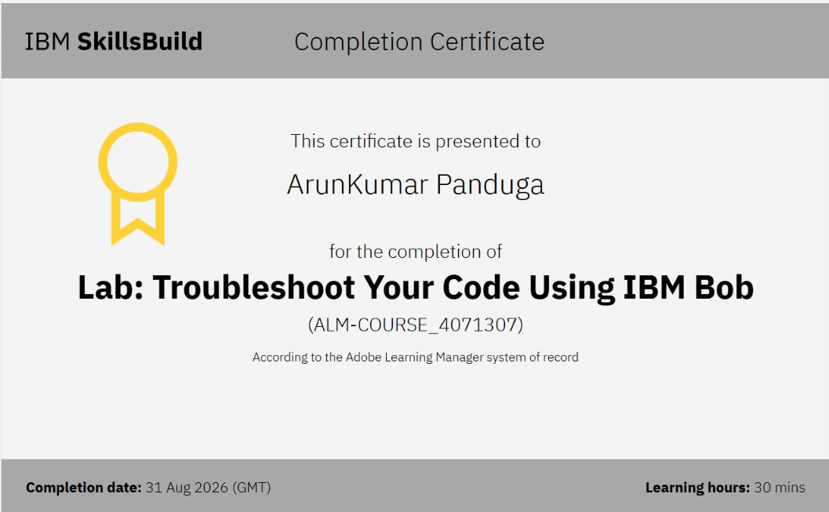
Certificates Earned:​
Add your IBM BOB Certificate

Slide 20
THANK YOU

