Slide 1



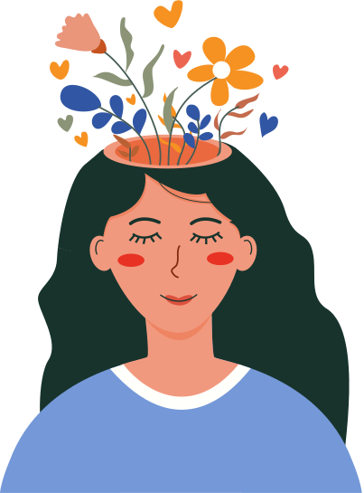








Mind
Ease
A digital platform to support stress management and emotional wellbeing

Slide 2









What is Mental Health?
Refers to emotional, psychological, and social well-being.
It affects how we think, feel, and behave.
Helps us handle stress and make decisions.

Slide 3
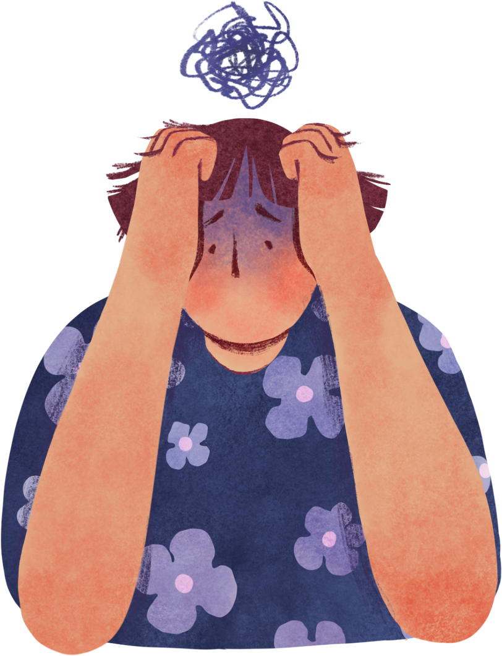

Problem Statement
Many students experience stress, anxiety, and emotional burnout due to academic pressure, social factors, and lack of guidance.
However, they often hesitate to seek help because of fear, stigma, or limited access to proper support.
Existing mental wellness resources are not interactive or engaging enough to hold students’ interest.
There is a need for an accessible, student-friendly platform that provides support, guidance, and stress-relief tools in an engaging way.

Slide 4


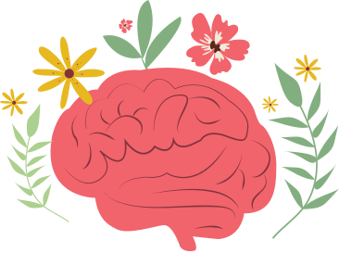
SOLUTION
  A friendly virtual assistant that provides quick emotional support, guidance, and stress-relief tips anytime.( AI CHATBOT)
  Fun and simple games like puzzles and memory boosters that help students relax, reduce stress, and refresh their minds.(STRESS RELIEF GAMES)
  Students can track their daily mood and follow quick breathing, stretching, and relaxation exercises to stay calm and improve emotional balance.(MOOD TRAKER)
  Therapy and tips to overcome stress and manage mental health.(TIPS &THERAPY)

Slide 5

OUR PROJECT
AI-Based Mental Wellness Website Named MINDEASE
Our mental wellness website is a student-friendly platform designed to support emotional wellbeing. It offers interactive tools such as an AI chatbot, stress-relief games, mood tracking features, and helpful wellness resources. The website aims to make mental health support more accessible, engaging, and stigma-free for students.

Slide 6

Team Members
- Pandaga Sushvika
- Khushi Yadav
- Grithika Goud.
- K.l. Sneha.
- Shazia.
- B.Vinutna.

Slide 7

Thank You!

