Slide 1
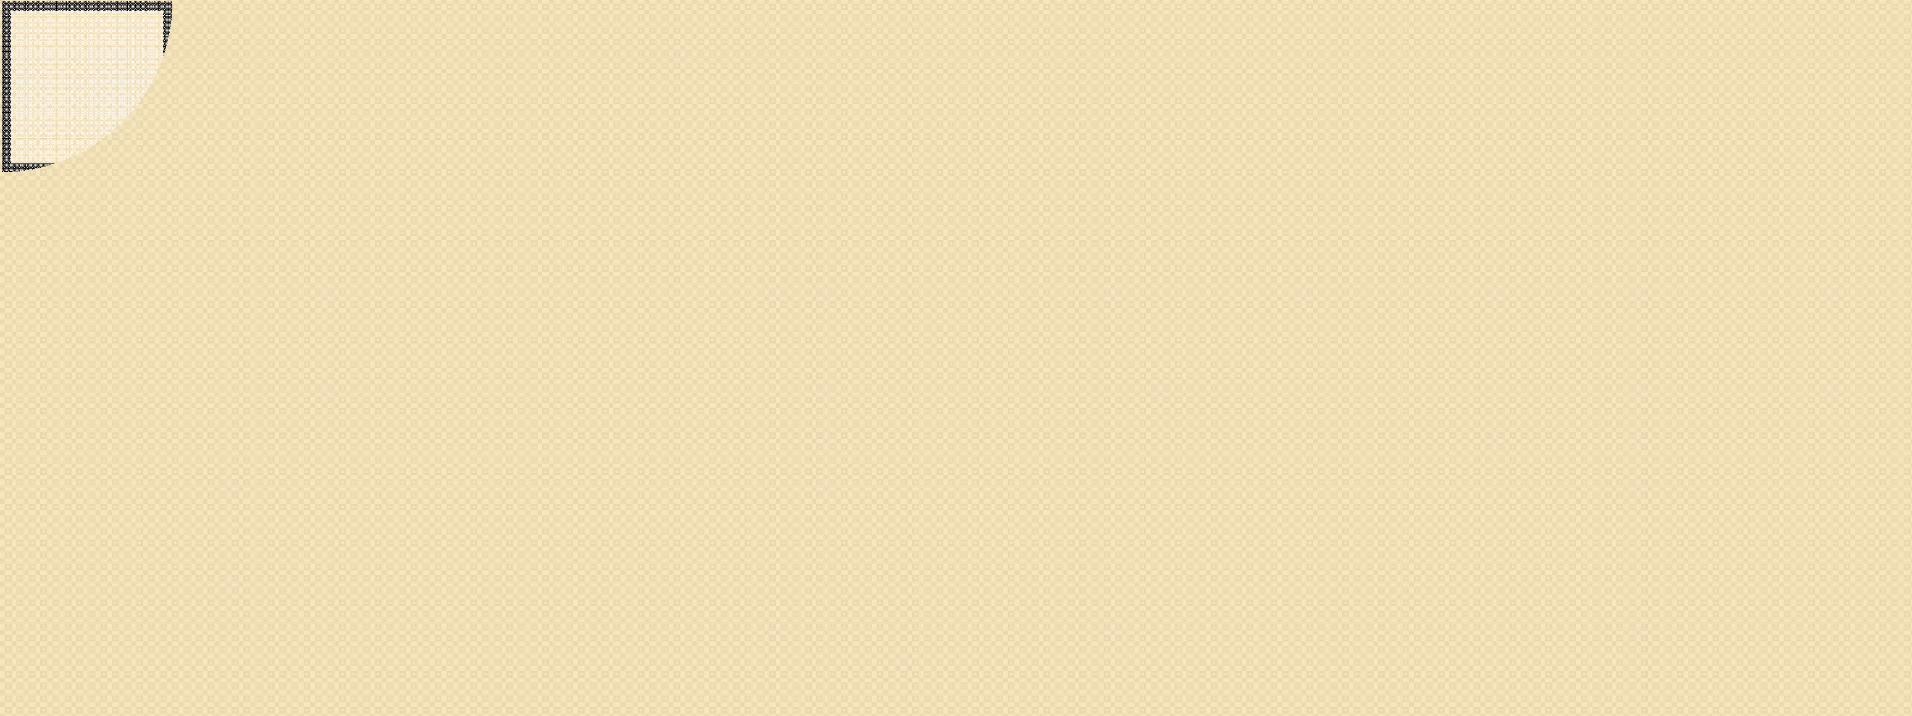



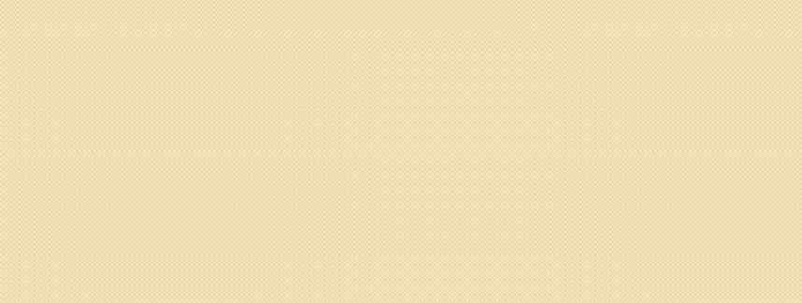
Course Name : MACHINE LEARNING Course Code : 20AD04
Course Instructor : M. Rajesh Reddy
Semester : V Regulation : R20 Unit: 4
1

Slide 2

UNIT-4: SYLLABUS
Classification- Introduction, Example of Supervised Learning, Classification Model, Classification Learning Steps.
Common Classification Algorithms –
k-Nearest Neighbour (kNN), Support vector Machines (SVM), Random Forest model.

Slide 3
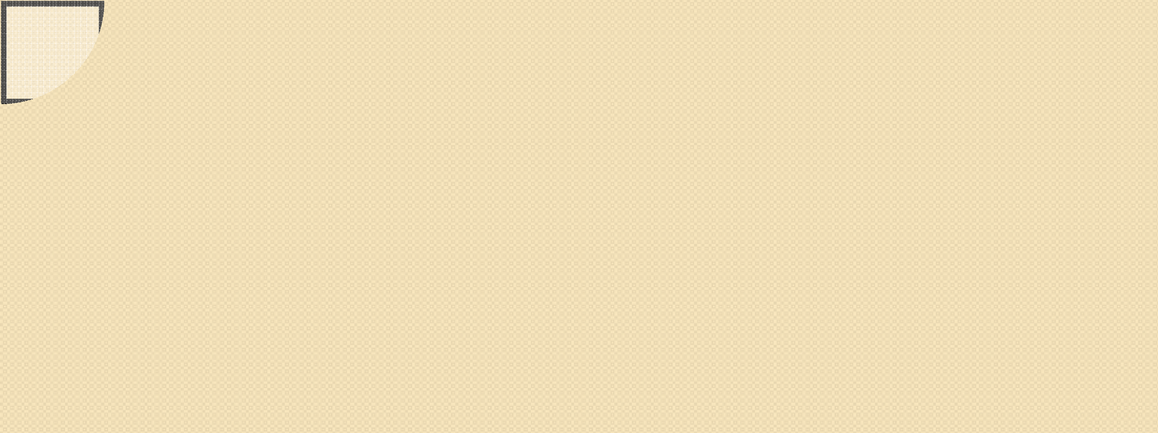
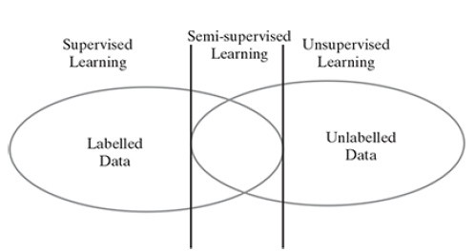
4.1 EXAMPLE OF SUPERVISED LEARNING
In supervised learning, the labelled training data provide the basis for learning which is the experience or prior knowledge or belief.
The process of learning from the training data by a machine can be related to a teacher supervising the learning process of a student who is new to the subject. So,it is called supervised learning. In this case, teacher is the training data.
Training data is the past information with known value of ‘class’ or ‘label’. So, we say that the ‘training data is labelled’ in the case of supervised learning.
There is no labelled training data for unsupervised learning.
Semi-supervised learning, uses a small amount of labelled data along with unlabelled data for training.

Slide 4
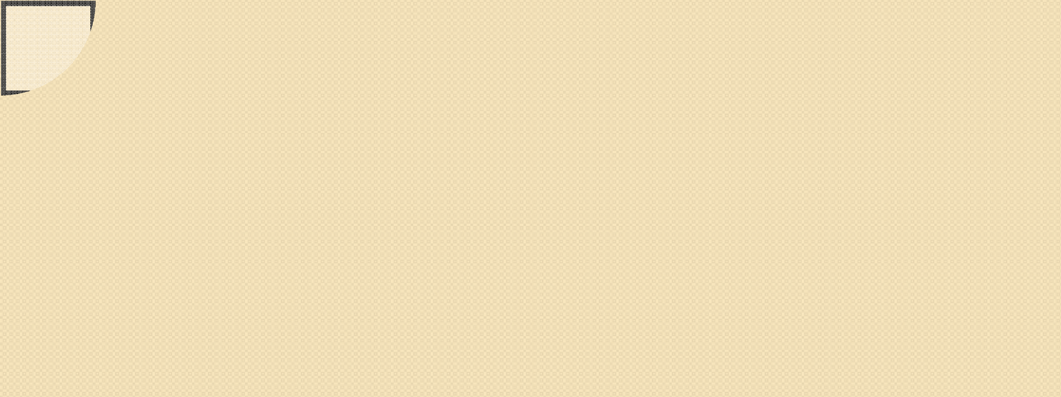
4.1 EXAMPLE OF SUPERVISED LEARNING
Example scenario of Supervised Learning:
In a hospital, many patients are treated in the general wards.
In comparison, the number of beds in the Intensive Care Unit (ICU) is much less.
What to do if the health condition of a number of patients in the general ward suddenly aggravates and they would have to be moved to ICU.
This problem can be addressed in a much better way if it is possible to predict which of the patients in the normal wards have a possibility of their health condition deteriorating and thus need to be moved to ICU.
This kind of prediction problem comes under the purview of supervised learning or, more specifically, under classification.
The hospital already has all past patient records.
The records of the patients whose health condition aggravated in the past and had to be moved to ICU can form the training data for this prediction problem.
Test results of newly admitted patients are used to classify them as high-risk or low-risk patients.

Slide 5

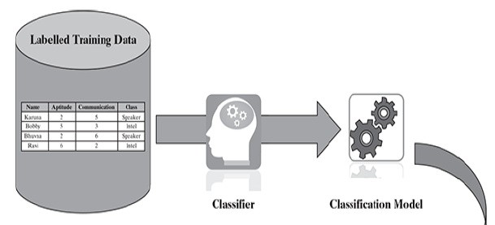
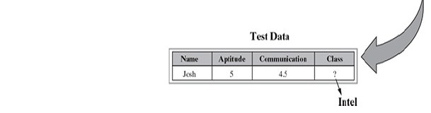
4.2 CLASSIFICATION MODEL
When we are trying to predict a categorical or nominal variable, the problem is known as a classification problem.
A classification problem is one where the output variable is a category such as ‘red’ or ‘blue’ or ‘malignant tumour’ or ‘benign tumour’, etc.
In classification, the whole problem centres around assigning a label or category or class to a test data on the basis of the label or category or class information that is imparted by the training data.
Example classification problems :
Image classification
Disease prediction
Win–loss prediction of games
Prediction of natural calamity such as earthquake, flood, etc.
Handwriting recognition

Slide 6

4.3 CLASSIFICATION LEARNING STEPS
First, there is a problem which is to be solved, and then, the required data (related to the problem, which is already stored in the system) is evaluated and pre-processed based on the algorithm.
Algorithm selection is a critical point in supervised learning.
The result after iterative training rounds is a classifier for the given problem.

Slide 7
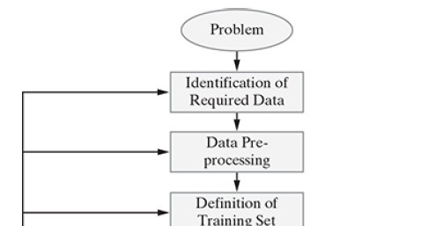
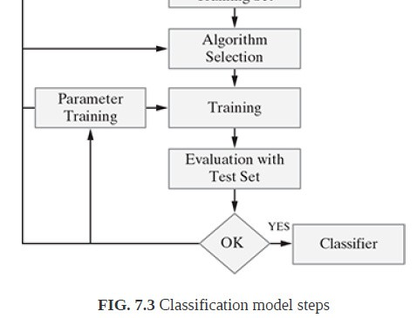
4.3 CLASSIFICATION LEARNING STEPS

Slide 8
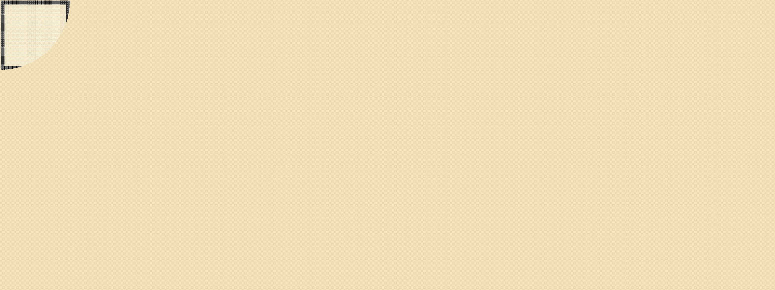
4.3 CLASSIFICATION LEARNING STEPS
Step-1: Problem Identification:
Identifying the problem is the first step in the supervised learning model.
The problem needs to be a well-formed problem,i.e. a problem with well-defined goals and benefit, which has a long-term impact.
Step-2: Identification of Required Data:
On the basis of the problem identified above, the required data set that precisely represents the identified problem needs to be identified/evaluated.
For example: If the problem is to predict whether a tumour is malignant or benign, then the corresponding patient data sets related to malignant tumour and benign tumours are to be identified.

Slide 9
4.3 CLASSIFICATION LEARNING STEPS
Step-3: Data Pre-processing:
This is related to the cleaning/transforming the data set.
This step ensures that all the unnecessary/irrelevant data elements are removed.
Data pre-processing refers to the transformations applied to the identified data before feeding the same into the algorithm.
Because the data is gathered from different sources, it is usually collected in a raw format and is not ready for immediate analysis.
This step ensures that the data is ready to be fed into the machine learning algorithm.

Slide 10
4.3 CLASSIFICATION LEARNING STEPS
Step-4: Definition of Training Data Set:
Before starting the analysis, the user should decide what kind of data set is to be used as a training set.
The training set needs to be actively representative of the real-world use of the given scenario.
Thus, a set of data input (X) and corresponding outputs (Y) is gathered either from human experts or experiments.
Example: In the case of signature analysis, the training data set might be a single handwritten alphabet, an entire handwritten word (i.e. a group of the alphabets) or an entire line of handwriting (i.e. sentences or a group of words).

Slide 11
4.3 CLASSIFICATION LEARNING STEPS
Step-5: Algorithm Selection:
This involves determining the structure of the learning function and the corresponding learning algorithm.
On the basis of various parameters, the best algorithm for a given problem is chosen.
Step-6: Training:
The learning algorithm identified in the previous step is run on the gathered training set for further fine tuning.
Some supervised learning algorithms require the user to determine specific control parameters (which are given as inputs to the algorithm).
These parameters (inputs given to algorithm) may also be adjusted by optimizing performance on a subset (called as validation set) of the training set.
Step-7: Evaluation with the Test Data Set:
Training data is run on the algorithm, and its performance is measured here.
If a suitable result is not obtained, further training of parameters may be required.

Slide 12
4.4 COMMON CLASSIFICATION ALGORITHMS
k-Nearest Neighbour (kNN)
Random forest
Support Vector Machine (SVM)
Decision tree
Naïve Bayes classifier

Slide 13
4.4.1 k-Nearest Neighbour (kNN) Algorithm
The kNN algorithm is a simple but extremely powerful classification algorithm.
The name of the algorithm originates from the underlying philosophy that people having similar background or mindset tend to stay close to each other.
In the same way, as a part of the kNN algorithm, the unknown and unlabelled data which comes for a prediction problem is judged on the basis of the training data set elements which are similar to the unknown element.
So, the class label of the unknown element is assigned on the basis of the class labels of the similar training data set elements.

Slide 14
4.4.1 k-Nearest Neighbour (kNN) Algorithm
      How kNN works?
        Consider a very simple Student data set as depicted in Figure.
        It consists of 15 students studying in a class. Each of the students has been assigned a score on a scale of 10 on two performance parameters – ‘Aptitude’ and ‘Communication’.
        A class value is assigned to each student based on the following criteria:
          Students having good communication skills as well as a good level of aptitude have been classified as ‘Leader’
          Students having good communication skills but not so good level of aptitude have been classified as ‘Speaker’
          Students having not so good communication skill but a good level of aptitude have been classified as ‘Intel’

Slide 15

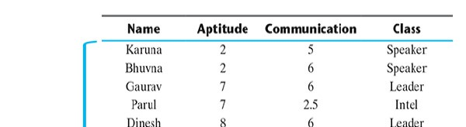
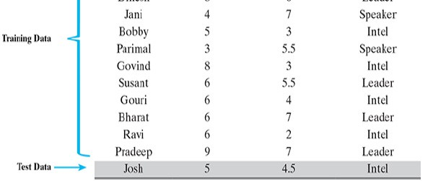
4.4.1 k-Nearest Neighbour (kNN) Algorithm
4.4.1.1 How kNN works?

Slide 16
4.4.1 k-Nearest Neighbour (kNN) Algorithm
      How kNN works?
        In the kNN algorithm, the class label of the test data elements is decided by the class label of the training data elements which are neighbouring.
        There are two challenges:
          What is the basis of this similarity or when can we say that two data elements are similar?
          How many similar elements should be considered for deciding the class label of each test data element?
        The most common approach adopted by kNN to measure similarity between two data elements is Euclidean distance

Slide 17

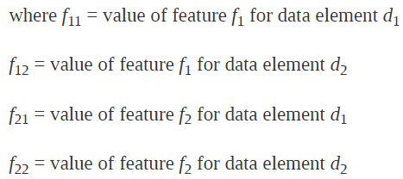
4.4.1 k-Nearest Neighbour (kNN) Algorithm
      How kNN works?
        Consider a very simple data set having two features (say f₁and f₂), Euclidean distance between two data elements d₁and d₂ can be measured by

Slide 18

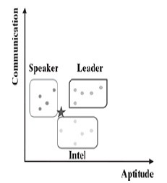
4.4.1 k-Nearest Neighbour (kNN) Algorithm
      How kNN works?
        The training data points of the Student data set considering only the features ‘Aptitude’ and ‘Communication’ can be represented as dots in a two- dimensional feature space.
        As shown in the figure, the training data points having the same class value are coming close to each other.
        The test data point for student Josh is represented as an asterisk in the same space. To find out the closest or nearest neighbours of the test data point, Euclidean distance of the different dots need to be calculated from the asterisk.
2-D representation of the student data set

Slide 19

4.4.1 k-Nearest Neighbour (kNN) Algorithm
      How kNN works?
        Let us try to find the answer to the second challenge, i.e.how many similar elements should be considered.
        In the kNN algorithm, the value of ‘k’ indicates the number of neighbours that need to be considered.
        For example, if the value of k is 3, only three nearest neighbours or three training data elements closest to the test data element are considered.
        Out of the three data elements, the class which is predominant is considered as the class label to be assigned to the test data.
        In case the value of k is 1, only the closest training data element is considered.
        The class label of that data element is directly assigned to the test data element.

Slide 20

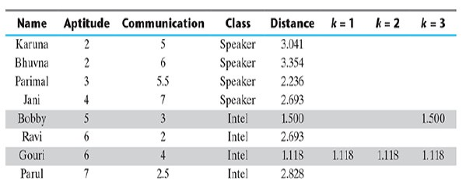
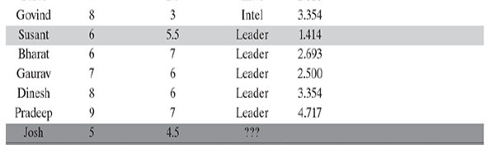
4.4.1 k-Nearest Neighbour (kNN) Algorithm
4.4.1.1 How kNN works?
when the value of k is taken as 1, only one training data point needs to be considered.
The training record for student Gouri is closest with a distance of 1.118.
Gouri has class value ‘Intel’. So, the test data point is also assigned a class label value ‘Intel’.
When the
value of k is 3, the closest neighbours of Josh in the training data
In this case, the class value of Josh is decided by majority voting.
Because the class value of ‘Intel’ is formed by the majority of the neighbours, the class value of Josh is assigned as ‘Intel’.
set are Gouri, Susant, and Bobby.
.

Slide 21

4.4.1 k-Nearest Neighbour (kNN) Algorithm
      How kNN works?
        It is often a tricky decision to decide the value of k. The reasons are as follows:
          If the value of k is very large (in the extreme case equal to the total number of records in the training data), the class label of the majority class of the training data set will be assigned to the test data regardless of the class labels of the neighbours nearest to the test data.
          If the value of k is very small (in the extreme case equal to 1), the class value of a noisy data or outlier in the training data set which is the nearest neighbour to the test data will be assigned to the test data.
        The best k value is somewhere between these two extremes.

Slide 22

4.4.1 k-Nearest Neighbour (kNN) Algorithm
      How kNN works?
        Few strategies that can be adopted to arrive at a value for k.
          One common practice is to set k equal to the square root of the number of training records.
          An alternative approach is to test several k values on a variety of test data sets and choose the one that delivers the best performance.
          Another interesting approach is to choose a larger value of k, but apply a weighted voting process in which the vote of close neighbours is considered more influential than the vote of distant neighbours.

Slide 23

4.4.1 k-Nearest Neighbour (kNN) Algorithm
4.4.1.2 kNN Algorithm
Input: Training data set, test data set (or data points), value of ‘k’ (i.e. number of nearest neighbours to be considered)
Steps:
Do for all test data points
Calculate the distance (usually Euclidean distance) of the test data point from the different training data points.
Find the closest ‘k’ training data points, i.e. training data points whose distances are least from the test data point.
If k = 1
Then assign class label of the training data point to the test data point
Else
Whichever class label is predominantly present in the training data points, assign that class label to the test data point
End do

Slide 24
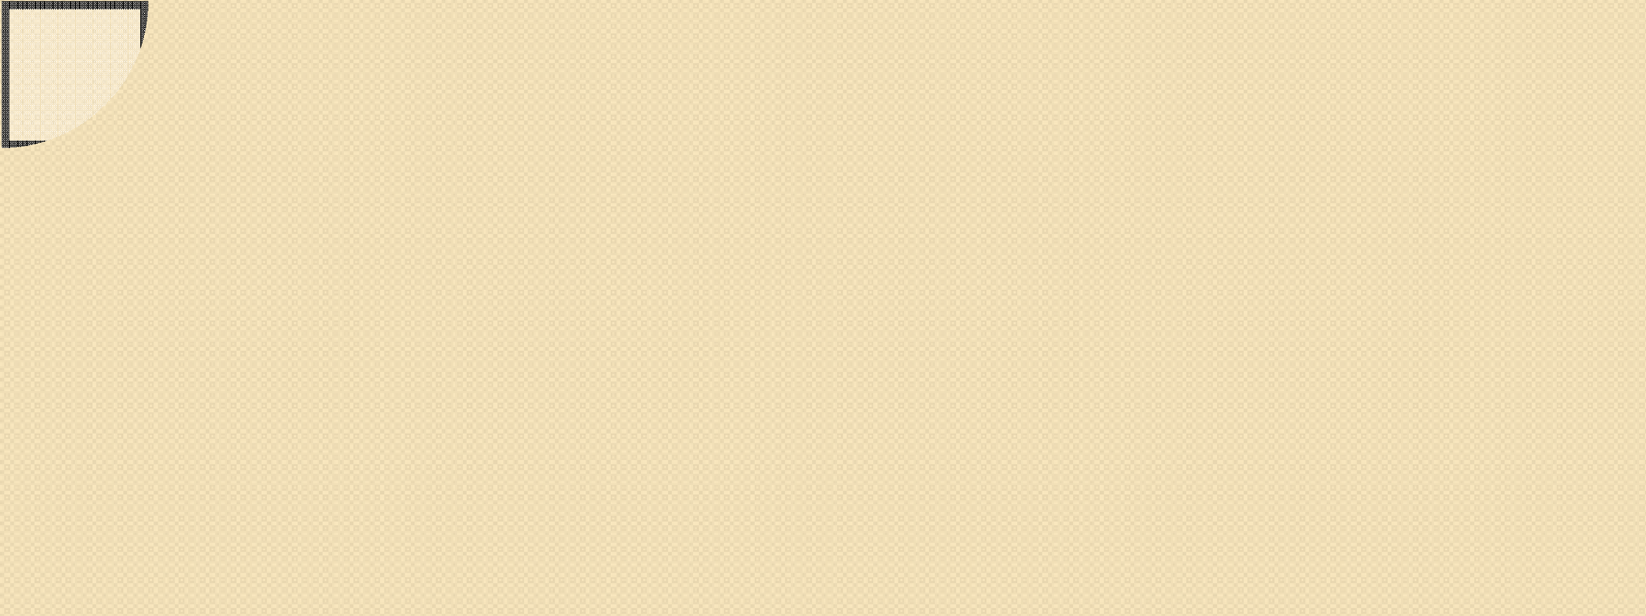
4.4.1 k-Nearest Neighbour (kNN) Algorithm
Strengths of the kNN algorithm:
Extremely simple algorithm – easy to understand
Very effective in certain situations, e.g. for recommender system design
Very fast or almost no time required for the training phase
Weaknesses of the kNN algorithm
Does not learn anything in the real sense. Classification is done completely on the basis of the training data. So, it has a heavy reliance on the training data. If the training data does not represent the problem domain comprehensively, the algorithm fails to make an effective classification.
Because there is no model trained in real sense and the classification is done completely on the basis of the training data, the classification process is very slow.
Also, a large amount of computational space is required to load the training data for classification.

Slide 25
4.4.1 k-Nearest Neighbour (kNN) Algorithm
Application of the kNN algorithm
One of the most popular areas in machine learning where the kNN algorithm is widely adopted is recommender systems.
As we know, recommender systems recommend users different items which are similar to a particular item that the user seems to like.
The liking pattern may be revealed from past purchases or browsing history and the similar items are identified using the kNN algorithm.
Another area where there is widespread adoption of kNN is searching documents/ contents similar to a given document/content. This is a core area under information retrieval and is known as concept search.

Slide 26
Ensemble Learning
Ensemble learning is a machine learning technique combining multiple individual models to create a stronger, more accurate predictive model.
Ensemble learning aims to mitigate errors, enhance performance, and increase the overall robustness of predictions, leading to improved results across various tasks in machine learning and data analysis.
A problem in machine learning is that individual models tend to perform poorly i.e, they tend to have low prediction accuracy. To mitigate this problem, we combine multiple models to get one with a better performance.
The individual models that we combine are known as weak learners. We call them weak learners because they either have a high bias or high variance. Because they either have high bias or variance, weak learners cannot learn efficiently and perform poorly.

Slide 27
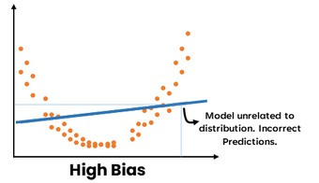
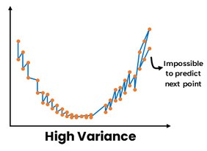
Ensemble Learning
High-bias and High-variance Models
A high-bias model results from not learning data well enough. It is not related to the distribution of the data. Hence future predictions will be unrelated to the data and thus incorrect.
A high variance model results from learning the data too well. It varies with each data point. Hence it is impossible to predict the next point accurately

Slide 28
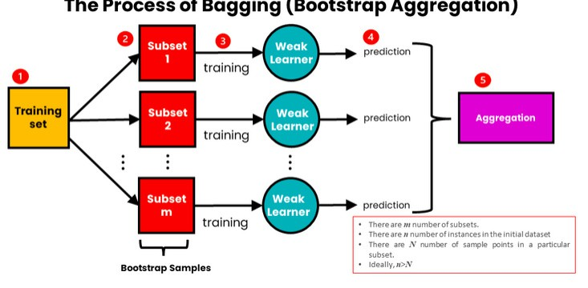
Ensemble Learning
Reducing Variance with Bagging
We use bagging for combining weak learners of high variance. Bagging aims to produce a model with lower variance than the individual weak models. These weak learners are homogenous, meaning they are of the same type.
Bagging is also known as Bootstrap aggregating. It consists of two steps: bootstrapping and aggregation.

Slide 29
4.4.2 Random Forest Model
Random forest is an ensemble classifier,
i.e. a combining classifier that uses and combines many decision tree classifiers.
Ensembling is usually done using the concept of bagging with different feature sets.
The reason for using large number of trees in random forest is to train the trees enough such that contribution from each feature comes in a number of models.
After the random forest is generated by combining the trees, majority vote is applied to combine the output of the different trees.

Slide 30
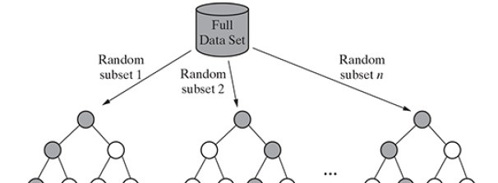
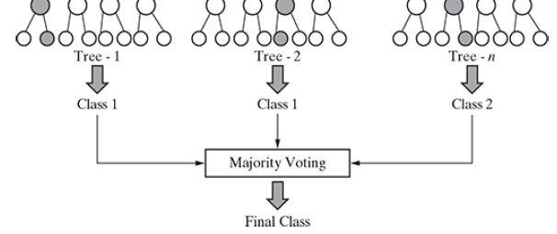
4.4.2 Random Forest Model
Random forest model

Slide 31
4.4.2 Random Forest Model
      Working of a Random Forest Model
        If there are N variables or features in the input data set, select a subset of ‘m’ (m < N) features at random out of the N features. Also, the observations or data instances should be picked randomly.
        Use the best split principle on these ‘m’ features to calculate the number of nodes ‘d’.
        Keep splitting the nodes to child nodes till the tree is grown to the maximum possible extent.
        Select a different subset of the training data ‘with replacement’ to train another decision tree following steps (1) to (3). Repeat this to build and train ‘n’ decision trees.
        Final class assignment is done on the basis of the majority votes from the ‘n’ trees.

Slide 32
4.4.2 Random Forest Model
4.4.2.2 Out-of-bag (OOB) error in random forest
In random forests, each tree is constructed using a different bootstrap sample from the original data.
The samples left out of the bootstrap and not used in the construction of the i-th tree can be used to measure the performance of the model.
At the end of the run, predictions for each such sample evaluated each time are tallied, and the final prediction for that sample is obtained by taking a vote.
The total error rate of predictions for such samples is termed as out-of-bag (OOB) error rate.
The error rate shown in the confusion matrix reflects the OOB error rate.

Slide 33

4.4.2 Random Forest Model
4.4.2.3 Strengths of Random Forest Model
It runs efficiently on large and expansive data sets.
It has a robust method for estimating missing data and maintains precision when a large proportion of the data is absent.
It has powerful techniques for balancing errors in a class population of unbalanced data sets.
It gives estimates (or assessments) about which features are the most important ones in the overall classification.
It generates an internal unbiased estimate (gauge) of the generalization error as the forest generation progresses.
Generated forests can be saved for future use on other data.
Lastly, the random forest algorithm can be used to solve both classification and regression problems.

Slide 34

4.4.2 Random Forest Model
4.4.2.4 Weakness of Random Forest Model
This model, because it combines a number of decision tree models, is not as easy to understand as a decision tree model.
It is computationally much more expensive than a simple model like decision tree.
4.4.2.5 Applications of Random Forest Model
Random forest is a very powerful classifier which combines the versatility of many decision tree models into a single model.
Because of the superior results, this ensemble model is gaining wide adoption and popularity amongst the machine learning practitioners to solve a wide range of classification problems.

Slide 35

4.4.3 Support Vector Machines
SVM is a model, which can do linear classification as well as regression.
SVM is based on the concept of a surface, called a hyperplane, which draws a boundary between data instances plotted in the multi-dimensional feature space.
The output prediction of an SVM is one of two conceivable classes which are already defined in the training data.
SVM algorithm builds an N-dimensional hyperplane model that assigns future instances into one of the two possible output classes.

Slide 36

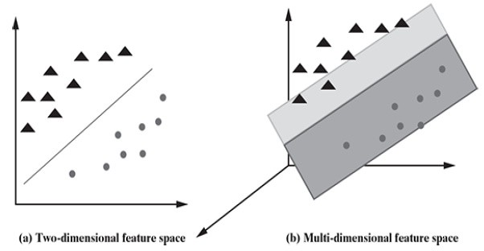
4.4.3 Support Vector Machines
      Classification using hyperplanes
        In SVM, a model is built to discriminate the data instances belonging to different classes.
        For simplicity, we assume that the data instances are linearly separable.
        In this case, when mapped in a two-dimensional space, the data instances belonging to different classes fall in different sides of a straight line drawn in the two-dimensional space as shown in figure (a).
        If the same concept is extended to a multidimensional feature space, the straight line dividing data instances belonging to different classes transforms to a hyperplane as shown in figure (b)
FIG: Linearly separable data instances
.

Slide 37

4.4.3 Support Vector Machines
      Classification using hyperplanes
        Training data sets which have a substantial grouping will function well with SVM.
        Generalization error in SVM is the measure of how accurately and precisely this SVM model can predict values for previously unseen data (new data).
        A hard margin in SVM means that an SVM model is inflexible in classification and tries to work exceptionally fit in the training set, thereby causing overfitting.
Important Terminology in SVM:
        Support Vectors: These are the data points (representing classes), the critical component in a data set, which are near the identified set of lines (hyperplane). If support vectors are removed, they will alter the position of the dividing hyperplane.
        Hyperplane and Margin: For an N-dimensional feature space, hyperplane is a flat subspace of dimension (N−1) that separates and classifies a set of data.

Slide 38


4.4.3 Support Vector Machines
      Classification using Hyperplanes
For example,
        In a two-dimensional feature space (data set having two features and a class variable), a hyperplane will be a one-dimensional subspace or a straight line.
        Mathematically, in a two-dimensional space, hyperplane can be defined by the equation:
c₀ + c₁ X₁ + c₂ X₂ = 0
        In a three-dimensional feature space (data set having three features and a class variable), hyperplane is a two-dimensional subspace or a simple plane.
        In an N-dimensional space, hyperplane can be defined by the equation:
c₀ + c₁ X₁ + c₂ X₂ +……+ c_{n} X_{n}= 0 (or)
        When a new testing data point/data set is added, the side of the hyperplane it lands on will decide the class that we assign to it. The distance between hyperplane and data points is known as margin.

Slide 39

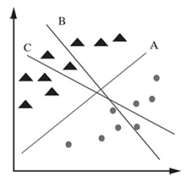
4.4.3 Support Vector Machines
4.4.3.2 Identifying the correct hyperplane in SVM
There may be multiple options for hyperplanes dividing the data instances belonging to the different classes.
We need to identify which one will result in the best classification.
Scenario 1:
In this scenario, we have three hyperplanes: A, B, and C.
Now, we need to identify the correct hyperplane which better segregates the two classes represented by the triangles and circles.
We can see, hyperplane ‘A’ has performed this task quite well.
Support vector machine: Scenario 1

Slide 40

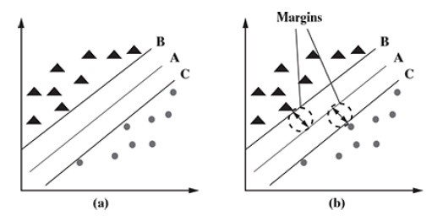
4.4.3 Support Vector Machines
4.4.3.2 Identifying the correct hyperplane in SVM
Scenario 2:
In this scenario, we have three hyperplanes: A, B, and C.
We have to identify the correct hyperplane which classifies the triangles and circles in the best possible way.
Here, maximizing the distances between the nearest data points of both the classes and hyperplane will help us decide the correct hyperplane. This distance is called as margin.
In the below figure, the margin for hyperplane A is high as compared to those for both B and C. Hence, hyperplane A is the correct hyperplane.
Support vector machine: Scenario 2

Slide 41
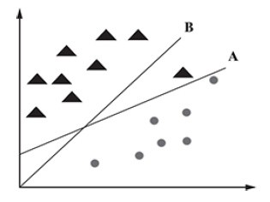
4.4.3 Support Vector Machines
4.4.3.2 Identifying the correct hyperplane in SVM
Scenario 3:
If we use the rules as discussed scenario-2 to identify the correct hyperplane in the below figure, we might have selected hyperplane B as it has a higher margin (distance from the class) than A.
SVM selects the hyperplane which classifies the classes accurately before maximizing the margin.
Here, hyperplane B has a classification error, and A has classified all data instances correctly. Therefore, A is the correct hyperplane.
Support vector machine: Scenario 3

Slide 42
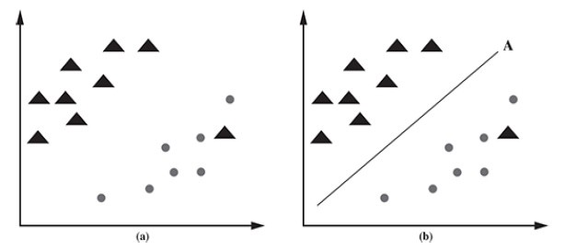
4.4.3 Support Vector Machines
4.4.3.2 Identifying the correct hyperplane in SVM
Scenario 4:
In this scenario, as shown in Figure, it is not possible to distinctly segregate the two classes by using a straight line, as one data instance belonging to one of the classes (triangle) lies in the territory of the other class (circle) as an outlier.
SVM has a feature to ignore outliers and find the hyperplane that has the maximum margin (hyperplane A).
Hence, we can say that SVM is robust to outliers.
Support vector machine: Scenario 4

Slide 43
4.4.3 Support Vector Machines
4.4.3.2 Identifying the correct hyperplane in SVM
By summarizing the observations from the different scenarios, we can say that:
The hyperplane should segregate the data instances belonging to the two classes in the best possible way.
It should maximize the distances between the nearest data points of both the classes, i.e. maximize the margin.
If there is a need to prioritize between higher margin and lesser misclassification, the hyperplane should try to reduce misclassifications.

Slide 44
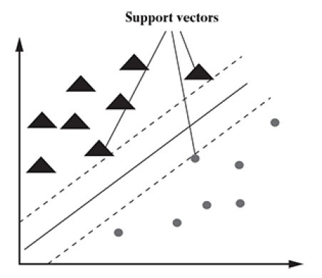
4.4.3 Support Vector Machines
4.4.3.3 Maximum margin hyperplane
Finding the Maximum Margin Hyperplane (MMH) is nothing but identifying the hyperplane which has the largest separation with the data instances of the two classes.
Support vectors, as can be observed in Figure, are data instances from the two classes which are closest to the MMH.
There should be at least one support vector from each class.
Modelling a problem using SVM is nothing but identifying the support vectors and MMH corresponding to the problem space.
Support vectors

Slide 45
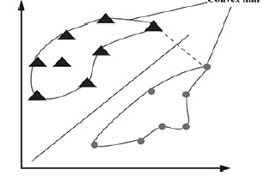



4.4.3 Support Vector Machines
      Maximum margin hyperplane
        Identifying the MMH for linearly separable data:
          Finding out the MMH is relatively straightforward for the data that is linearly separable.
          In this case, an outer boundary needs to be drawn for the data instances belonging to the different classes.
          These outer boundaries are known as convex hull.
          The MMH can be drawn as the perpendicular bisector of the shortest line (i.e. the connecting line having the shortest length) between the convex hulls.
N- dimensional feature space can be represented by the equation:
the objective is to find a set of values for the vector such that
In order to maximize the distance between
Drawing the MMH for linearly
separable data
hyperplanes, the value of should be minimized.
The task of SVM is to solve the optimization problem:

Slide 46
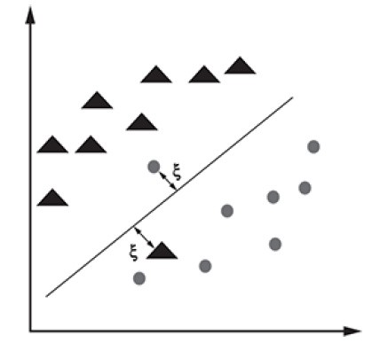

4.4.3 Support Vector Machines
      Maximum margin hyperplane
        Identifying the MMH for non- linearly separable data:
          For finding out the MMH for non-linearly separable data, we have to use a slack variable ξ, which provides some soft margin for data instances in one class that fall on the wrong side of the hyperplane.
          As shown in figure, a data instance belonging to the circle class falls on the side of the hyperplane designated for the data instances belonging to the triangle class and vice versa.
A cost value ‘C’ is imposed on all such data instances that fall on the wrong side of the hyperplane.
The task of SVM is now to minimize the total cost due to such data instances in order to solve the revised optimization problem:
Drawing the MMH for non-
linearly separable data

Slide 47
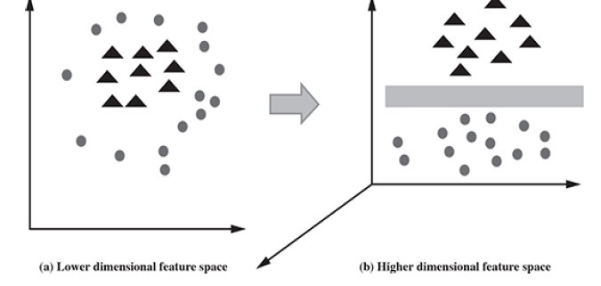
4.4.3 Support Vector Machines
4.4.3.4 Kernel trick
SVM has a technique called the kernel trick to deal with non-linearly separable data.
Kernels are functions which can transform lower dimensional input space to a higher dimensional space i.e they convert linearly non-separable data to a linearly separable data.

Slide 48

4.4.3 Support Vector Machines
4.4.3.4 Kernel trick
Some of the common kernel functions for transforming from a lower dimension ‘i’ to a higher dimension ‘j’ used by different SVM implementations are as follows:
Linear kernel: It is in the form
Polynomial kernel: It is in the form Sigmoid kernel: It is in the form Gaussian RBF kernel: It is in the form
  When data instances of the classes are closer to each other, kernel trick method can be used.
  The effectiveness of SVM depends both on the:
    selection of the kernel function
    adoption of values for the kernel parameters

Slide 49
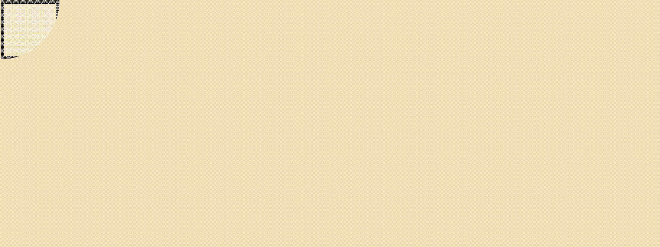
4.4.3 Support Vector Machines
4.4.3.5 Strengths of SVM:
SVM can be used for both classification and regression.
It is robust, i.e. not much impacted by data with noise or outliers.
The prediction results using this model are very promising.
4.4.3.6 Weaknesses of SVM
SVM is applicable only for binary classification, i.e. when there are only two classes in the problem domain.
The SVM model is very complex – almost like a black box when it deals with a high-dimensional data set. Hence, it is very difficult and close to impossible to understand the model in such cases.
It is slow for a large dataset, i.e. a data set with either a large number of features or a large number of instances.
It is quite memory-intensive.

Slide 50

4.4.3 Strengths Support Vector Machines
4.4.3.7 Applications of SVM:
SVM is most effective when it is used for binary classification, i.e. for solving a machine learning problem with two classes.
Image classification
Image segmentation
Hand-written character recognition
Text categorization
Financial distress prediction
Prediction of common diseases
Sentiment Analysis
Encryption
Geo-spatial applications
Speech Recognition

Slide 51

Unit-4 Question Bank
Discuss in detail the learning steps of classification.
Explain k-nearest neighbor classification algorithm with an example.
With a neat sketch, discuss the working of a random forest model.
Explain different scenarios in identifying correct hyperplane using support vector machines.
Illustrate about identifying maximum margin hyperplane in support vector machines.
Discuss the role of kernel trick in support vector machines.
List the strengths, weaknesses and applications of support vector machines.

