Slide 1
Internet and Web Tech Lab
Student Database
System
Group – 26
Vishala Reddy (14/IT/36)
G Vamsi Krishna (14/IT/40)
Ashish Agarwal (14/IT/60)

Slide 2
Technologies used
HTML
CSS
Javascript
PHP
We have also not used none of the pre build frameworks like Bootstrp or AJAX

Slide 3
Work Division
Vishala Reddy
  Transitions using Javascript,
  Placeholder pages for various pages,
  MySQL db setup using PhpMyAdmin
Vamsi
  Forms present in the HTML pages
  Authentication of the forms using Javascript
  Php Backend to Activate/Update/Display information.

Slide 4
Work Division
Vamsi
  Mysqli query updates.
Ashish
  Entire CSS of the project
    Includes Making the Nav Bar from scratch
    Background settings
    Table/input box settings
    Form display settings
  Regex definitions

Slide 5
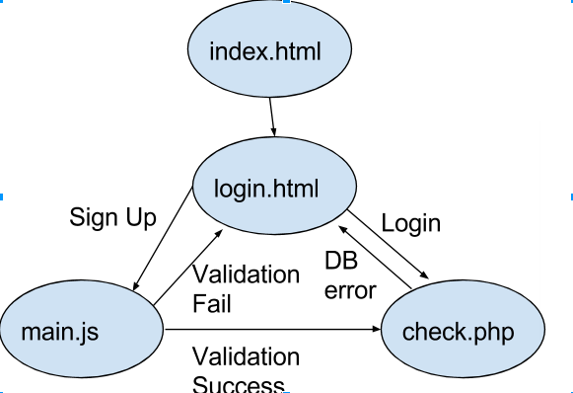
Flow of Control

Slide 6
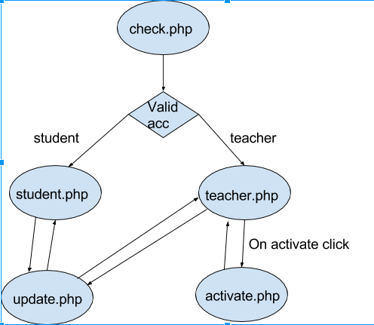
Flow of Control

Slide 7
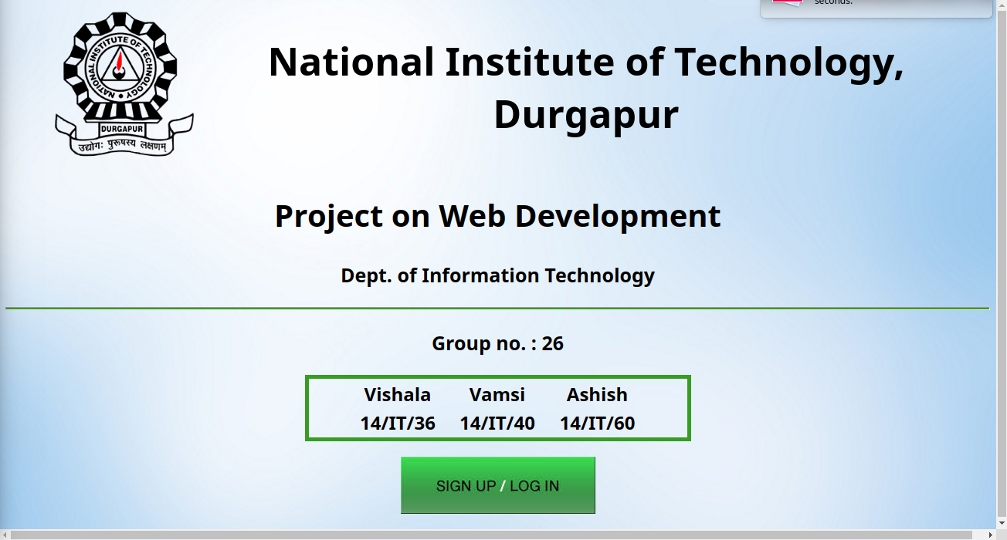
Landing Page

Slide 8
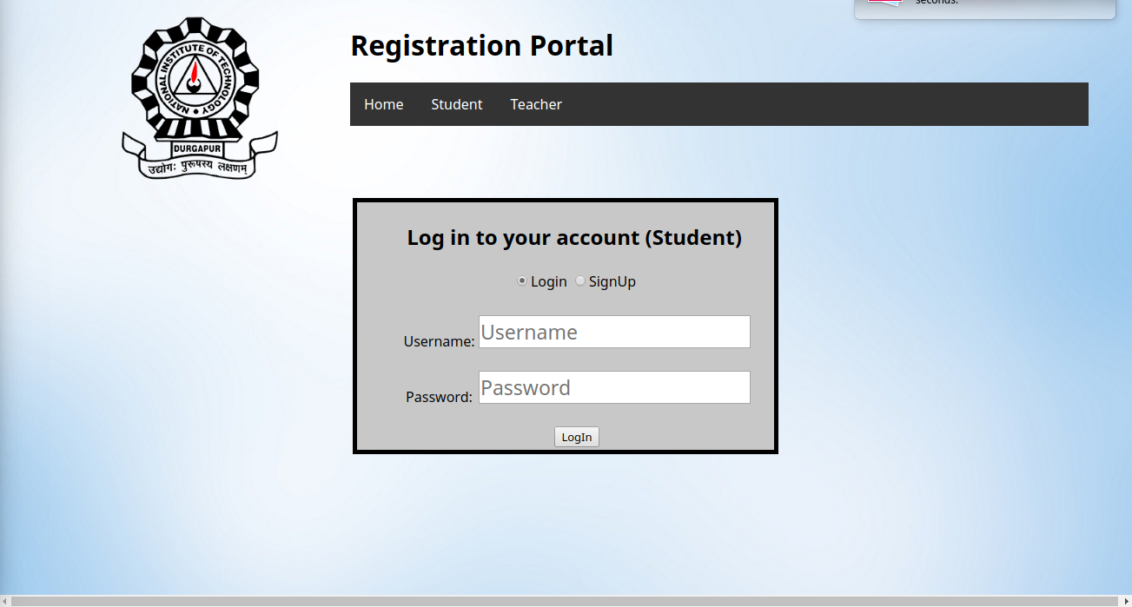
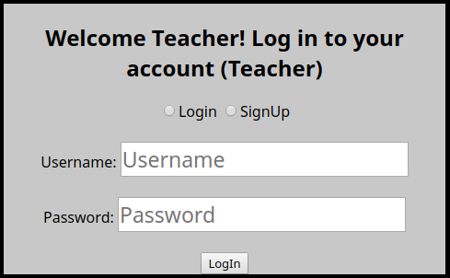
Login/Sign Up page

Slide 9
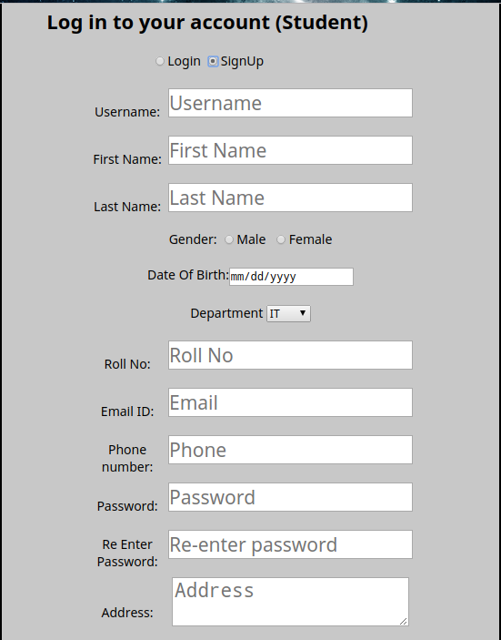
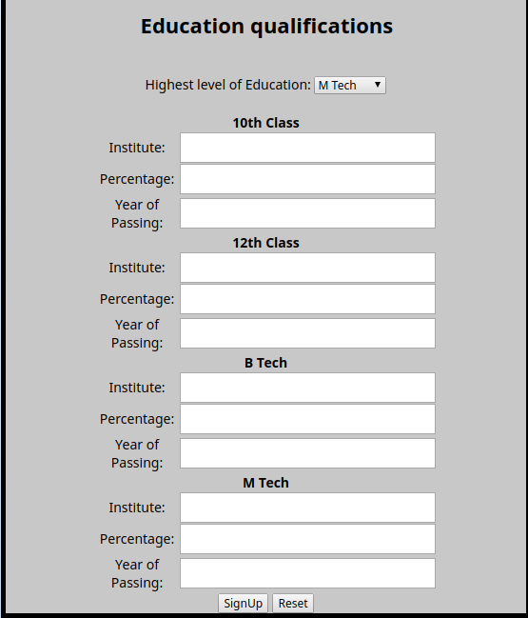
Sign Up Form

Slide 10
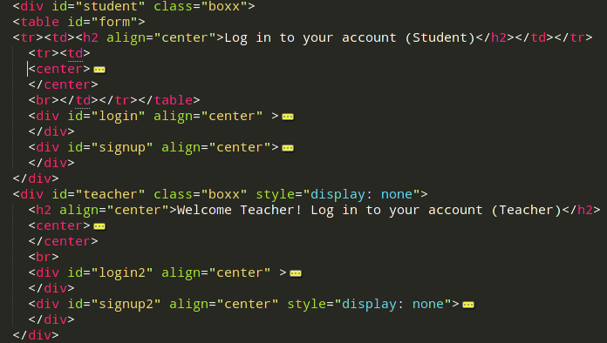
Login/Sign Up page code

Slide 11
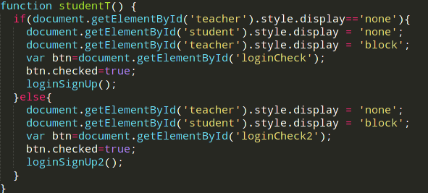
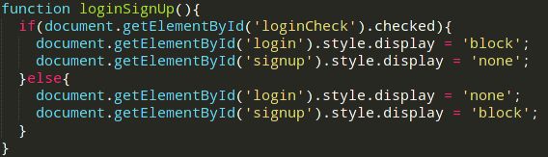
Code to Hide/Show Elements

Slide 12
Explanation
At a time only ONE of the following will be open:
  student→login
  student→signup
  teacher→login
  teacher→signup
Each of the above also have a hidden input term ‚key‘ which is set to sl, ss, tl, ts acc. to the current form opened. This is sent to check.php to differentiate the functionality being used.

Slide 13
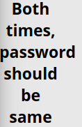

Check.php
This is used to handle all the signup and login into the database.
It decides the function to peform using the ‚key‘ variable in the POST request.
It displays database errors of the following form:

Slide 14
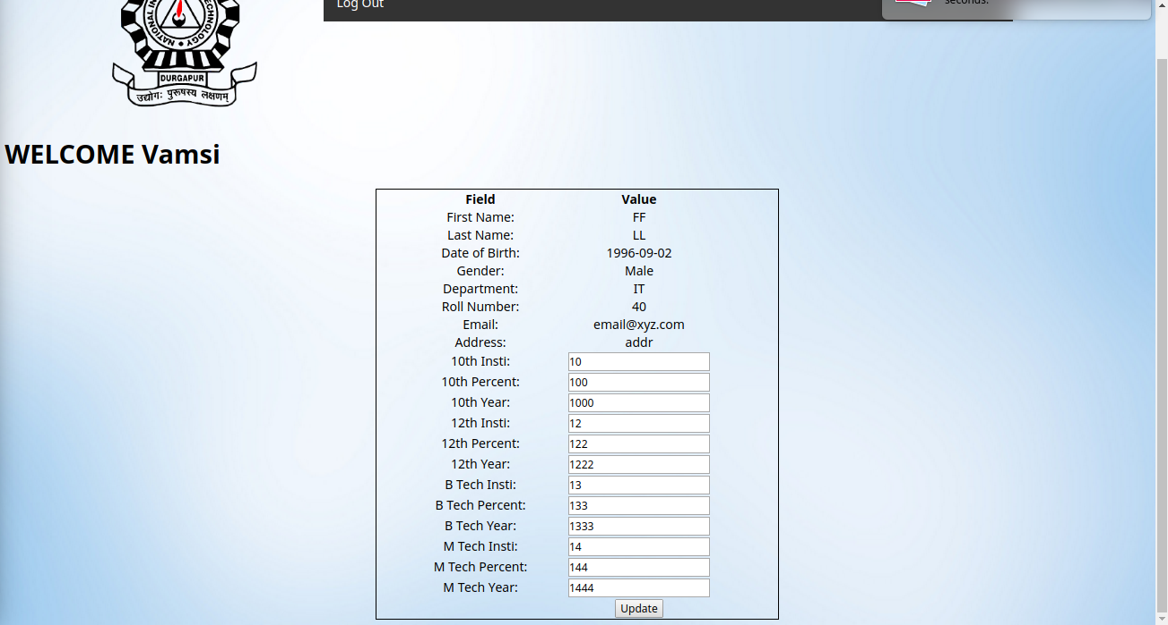
Student.php

Slide 15
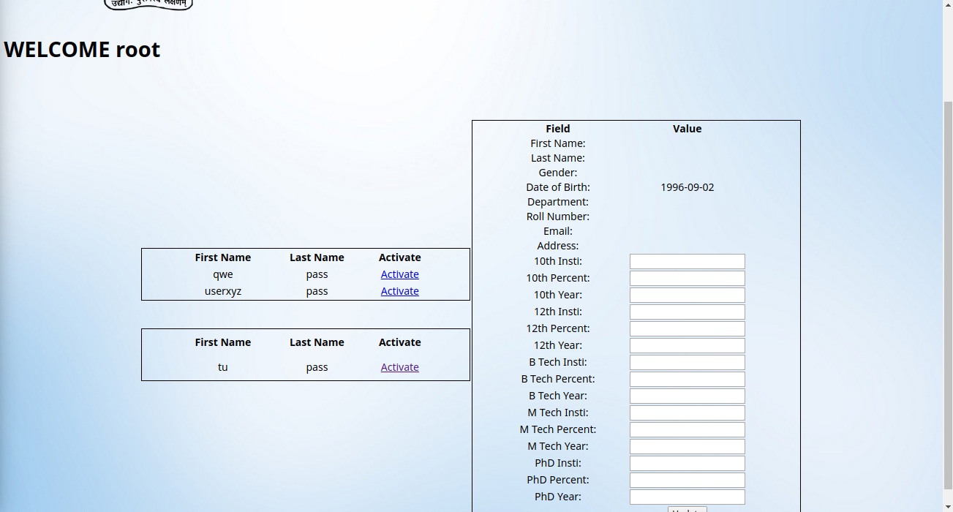
Techer.php

Slide 16


Validations used
We did all at once validation.
We divide the text according to type first and then for each we validate the text using regex.
We also display personalised error messages after validation, example:

Slide 17
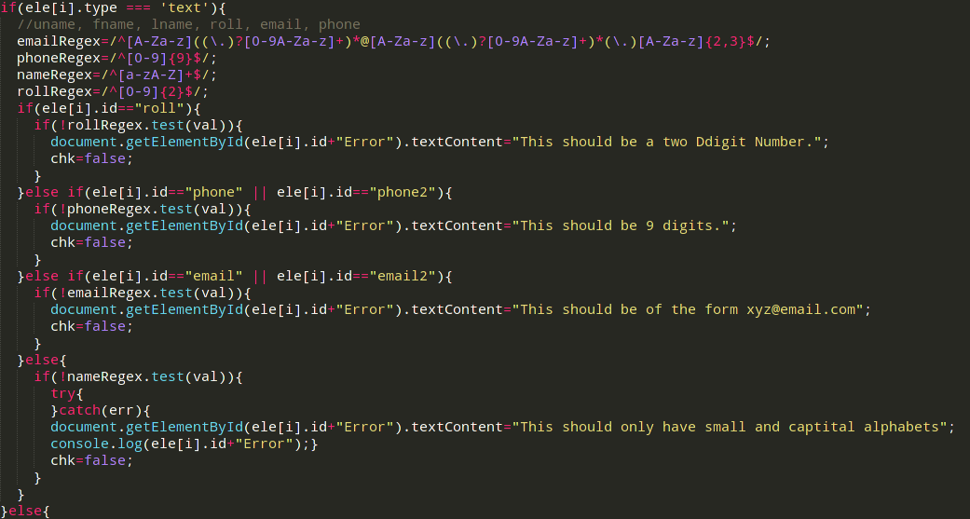
Error display after validation

Slide 18
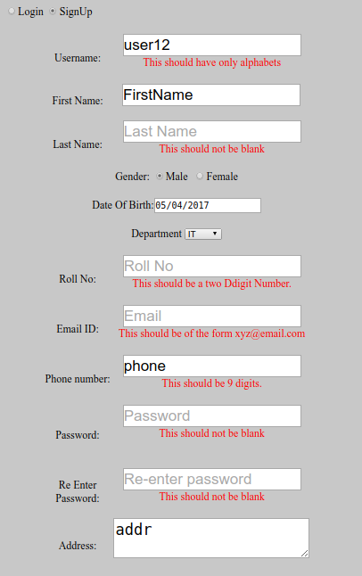
Validation error display

Slide 19
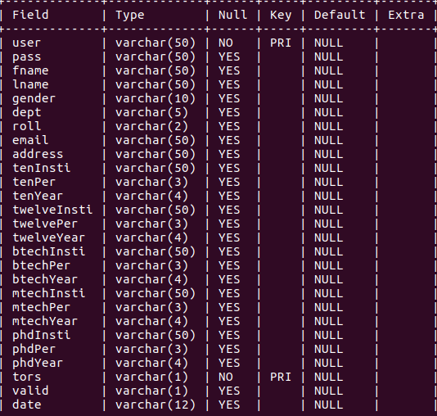
Database schema

Slide 20

Activation/Update

