Slide 1
Team 14
Hetav Pandya
Chirag Sethi
Seaghan Abreo
Diljot Grewal
Nishit Jain
Custom-Aid
-Because all wounds are not the same...

Slide 2
PROBLEM STATEMENT
Measuring the size of the wound is currently done manually which is highly inaccurate. This makes it difficult and time-consuming to monitor the healing process.
The current bandage lacks the potential to control the moisture content of the wound (moisture increases due to sweating), which can lead to bacterial infections. This slows down the healing process[1]. Moreover, excessive sweating requires the bandages to be changed frequently.

Slide 3
SCOPE
To develop a program to get the dimensions of a customisable bandage that leads to a quicker and a more efficient healing process by absorbing the extra moisture content, hence preventing any potential infections. The design should eliminate the need to measure the wound and change the bandage frequently[2].

Slide 4
Our Design
A program that detects the wound on the human body and calculates the area of the wound.
A bandage that is customised to :
Accurately cover the wound based on the area calculated by the program
Be Water Absorbent[3]
Be Non-Sticky
Be Non-Toxic[5]

Slide 5
The Program
The model:
Detects the wound using computer imaging algorithms and contour processing techniques.
Calculates the area covered by the wound.
Provides the optimum dimensions of a rectangular bandage that perfectly covers the patient’s wound.

Slide 6
Algorithm Used
The program selectively identifies the wound using a special range of HSV values.
The image is then converted into a contour image (Black & White) to compute its area.
The position of the extreme coordinates of the contour determines the corners of the rectangle.
The rectangular section is then displayed and its area is computed.

Slide 7
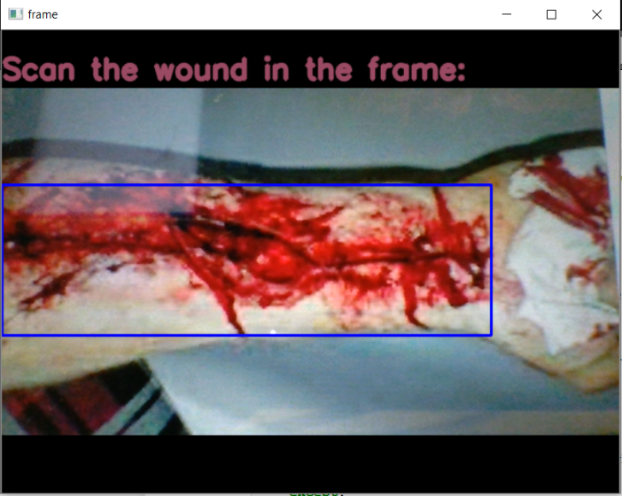
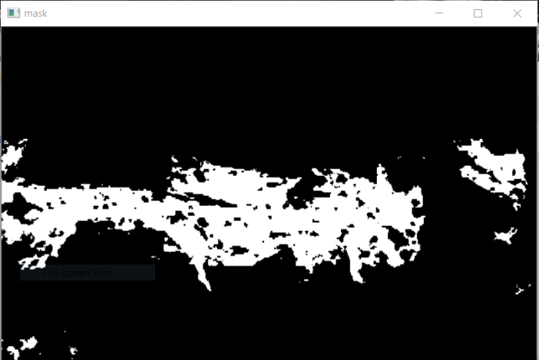
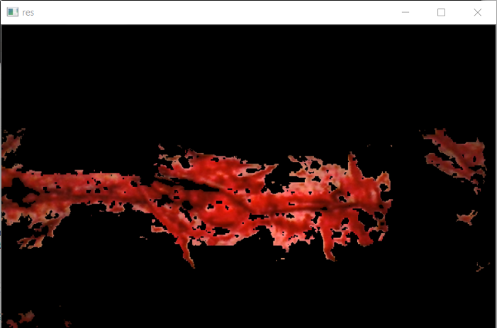
Snapshots of the program
The image captured by the camera.
Instructions are displayed on the screen for better user experience.
The contour image produced by the computer using the HSV values.
The final image produced by the computer after filtering noises and background disturbances.

Slide 8
Why SAPs?
Superabsorbent polymers (SAP) in our design will allow a large amount of excess water from the sweat to be absorbed, thus reducing the risk of infection[3]. Furthermore, any bacteria present will be trapped in the SAP as water is absorbed.
The design will use partially neutralised, lightly cross-linked polyacrylic acid as this polymer has been proven to give the best performance versus cost ratio.[4]
Each bandage will consist of a regulated amount of SAP, ensuring that only the excess amount of moisture is removed.
Notes:
hygroscopic material..
Works through osmosis as water concentration outside the structure is higher than water concentration inside the structure hence the wtaer molecules moved down the concentration gradient into the polymer. The material swells as a result.

Slide 9
Working of Custom-Aid
Custom-Aid contains :
A thin cotton layer with Super-Absorbent Polymer (concentration 0.011463 g/cm² for men, 0.01361 g/cm² for women) embedded in it.[5]
A thin sterile cotton pad with antiseptic properties.
SAP absorbs excessive moisture around the wound and allows it to heal faster. This also reduces the frequency of replacing bandages.

Slide 10
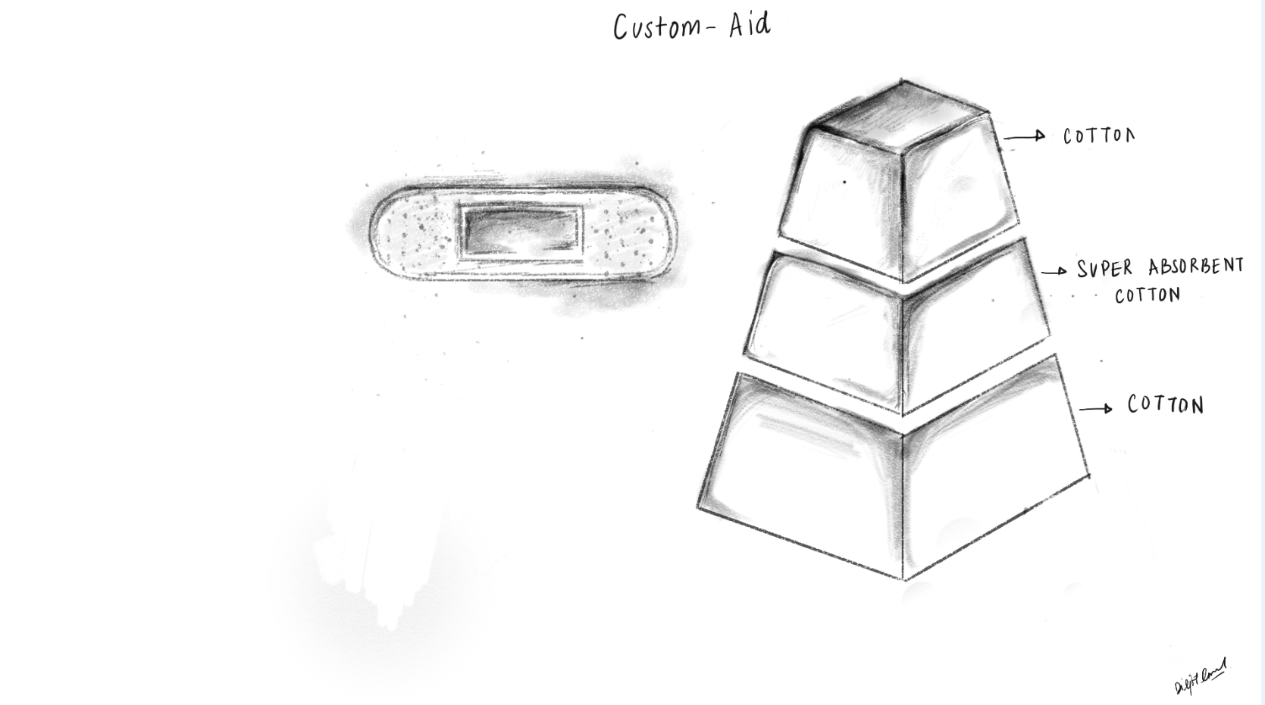
Illustration of Custom-Aid

Slide 11
Thank You!!!

