Slide 1
History of the internet
Wizards
Notes:
Also the sociology surrounding its development

Slide 2
who created the internet?
when did it start?
why?
how did it evolve?
why do we care?
how does it work?
what does it take to get access to it?
Wizards

Slide 3
who started it, and why?
the U. S. Department of Defense
  Defense Advanced Research Projects Agency (DARPA)
  began ~1962 in reaction to the Soviet Union's launch of Sputnik in 1957
  DARPA was told to find ways to utilize the nation’s investment in computers
  funding for projects that might provide dramatic advances for military
  timeframe of research could be 5 years or longer
  formed with an emphasis towards basic computing research
    was not oriented only to military products
  eventually, DARPA settled on computer networking as a main goal
Wizards

Slide 4
it didn’t happen all at once
1969
  ARPANET commissioned by DoD for research into networking
1971
  15 nodes (23 hosts) networked for the first time
  used NCP (network control protocol) to allow computers to communicate
    UCLA, SRI, UCSB, Univ of Utah, BBN, MIT, RAND, SDC, Harvard, Lincoln Lab, Stanford, UIU(C), CWRU, CMU, NASA/Ames
1972
  the first e-mail program was created by Ray Tomlinson of BBN
1973
  first international connections to the ARPANET
    University College of London (England) via NORSAR (Norway)
  development began on the protocol later to be called TCP/IP
    (collaboration between Stanford and DARPA)
1974
  first use of term internet in a paper on Transmission Control Protocol
1976
  Elizabeth II, Queen of the United Kingdom, sends her first email
Wizards

Slide 5
how did the network evolve?
ARPA’s created the first network
ARPA did not act as an enforcer on standards, but instead, invited public participation in improving the network
  the founding philosophy:
    to be resilient, the network was not supposed to rely on a centralized control
    this was revolutionary
the network relied on a growing number of standard specification documents
  only standards-compliant computers could communicate
ARPA retained “control” but exercised it judiciously (little)
Wizards

Slide 6
who wrote the network standards?
university researchers participated in standards work
private industry research contributed personnel
  AT&T, IBM, and many others funded their employees to work on network improvements
some people did it “for free” as a sideline to their work
standards were created by “the public” and “developers everywhere”
  via the RFC process (public proposals)
  if many in industry and research institutions implemented the proposals, they eventually became “standard”
Wizards

Slide 7
what is an RFC?
RFC stands for Request For Comment
RFCs are numbered standards documents
  managed by the Internet Engineering Task Force (IETF)
RFC 1, Host Software was published in 1969
  thousands now exist
  many are regarded as de facto standards by commercial and free software writers
  many others are essentially ignored.
RFCs remain known as RFCs even if they become standards
Wizards

Slide 8
who writes an RFC?
not standards organizations (such as ANSI, ISO or ECMA)
published by technical experts acting on their own initiative
  during a subsequent period of review, anyone on the Internet may submit comments
  this process has avoided the intractible problems of many formal standards bodies
RFC 2026 is about the RFC process: The Internet Standards Process, Revision 3
a complete RFC index is available from the IETF website
  the text of a particular RFC can be found by entering its number
Wizards
Notes:
The social process surrounding RFC authorship and review is unusual.
ANSI = American Nat’l Stds Institute
ISO = Int’l Stds Org
ECMA = Europ. Computer Mfg’s Assoc
This process has been remarkably successful in allowing computers to interwork together
IETF = Internet Engineering Task Force

Slide 9
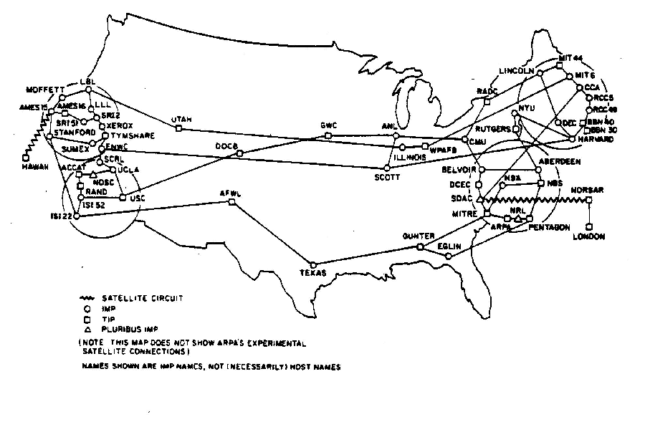
internet in 1977
Wizards

Slide 10
networking timeline - eighties
1978
  TCP protocol (Stanford research since 1976) split into TCP and IP protocols
1980
  ARPANET grinds to a complete halt on 27 October
    because of an accidentally-propagated status-message virus
  name server developed at University of Wisconsin
    so users would not have to know the exact path to other systems
  on January 1st, every machine connected to ARPANET had to use TCP/IP
    TCP/IP became the core internet protocol, replacing NCP entirely
1983
  first IBM personal computers sold
1984
  Domain Name System (DNS) introduced on ARPANET
1986
  Mail Exchanger (MX) records developed
    to allow non-IP network hosts to have email domain addresses
  Internet Engineering Task Force (IETF) created
    to coordinate contractors for DARPA
    Coordinated work on ARPANET, US Defense Data Network (DDN), and the Internet core gateway system
1987
  email link established between Germany and China
1989
  number of hosts breaks 100,000
Wizards
Notes:
Around the late seventies and early 1980’s, universities established “computer science” departments.
They all had email by the early 1980’s and were on the network.
However, email and newsgroups were largely read via command-line. Graphical user interfaces were still in their infancy (only MacIntosh computers were beginning to use them).

Slide 11
networking timeline – advent of WWW
1990
  ARPANET ceases to exist
  Tim Berners-Lee and CERN (The acronym CERN originally stood, in French, for Conseil Européen pour la Recherche Nucléaire --European Council for Nuclear Research), in Geneva implement HTTP for members of the international high-energy physics community
  independent internet service provicers begin to spring up everywhere
1991
  PGP (Pretty Good Privacy) released by Philip Zimmerman
1992
  number of internet hosts breaks 1,000,000
  no web yet; email and newsnet only (mostly at command line)
  world-wide web (WWW) HTTP protocol released by CERN
    Tim Berners-Lee, developer
Wizards

Slide 12
the web lumbers to its feet
1993
  the InterNIC created by U.S. National Science Foundation (NSF) to maintain the internet:
    directory and database (AT&T)
    domain registration (Network Solutions Inc.)
    information (General Atomics/CERFnet)
  Marc Andreessen and the Univ. of Illinois develop a GUI HTTP client
    Mosaic (see http://www.ibiblio.org/pioneers/andreesen.html)
      first web browser; initially it was free
  U.S. White House comes on-line (http://www.whitehouse.gov/):
    President Bill Clinton: president@whitehouse.gov
    Vice-President Al Gore: vice-president@whitehouse.gov
1996
  most internet traffic carried by independent Internet Service Providers (ISP’s) such as MCI, AT&T, Sprint, and many smaller companies
  number of internet hosts exceeds 15,000,000
  planning begins for IPv6 (next generation)
Wizards

Slide 13
IP v4 (now) vs. IP v6 (future)
the number of unassigned internet addresses is running out
a new classless scheme is gradually replacing the system based on classes A, B, and C
tied to adoption of IPv6
Wizards

Slide 14
the InterNIC
Internet Network Information Center
  a registered service mark of the U.S. Department of Commerce and now a defunct entity
the InterNIC began as a collaboration between AT&T and Network Solutions, Inc. (NSI) supported by the National Science Foundation; it offered four services:
  InterNIC Directory and Database Services -- online white pages directory and directory of publicly accessible databases
  Registration Services -- domain name and IP address assignment
  Support Services -- outreach, education, and information services for the Internet community
  Net Scout Services -- online publications that summarize recent happenings of interest to Internet users
the InterNIC is currently an informational Web site to provide the public with information about domain name registration
ICANN (see next slide) now oversees domain name registration
Wizards

Slide 15
ICANN
Internet Corporation for Assigned Names and Numbers
  a nonprofit organization that does:
    IP address space allocation
    protocol parameter assignment
    domain name system management
    root server system management functions previously performed under U.S. Government contract
    ICANN was created in the fall of 1998 in response to a policy statement issued by the US Department of Commerce. This statement called for the formation of a private sector not-for-profit Internet stakeholder to administer policy for the Internet name and address system
ICANN is responsible for managing and coordinating the DNS to ensure universal resolvability
Wizards

Slide 16
Domain Name Service (DNS)
stands for Domain Name System (or Service)
  a distributed database system
    translates domain names into IP addresses, and vice versa
      www.example.com might translate to 198.105.232.4
  DNS is a hierarchy of databases
    if one DNS server doesn't know how to translate a particular domain name, it asks another (higher-level) one, recursively until the IP address association has been returned
  nslookup is the command-line network application for DNS
Wizards

Slide 17
ICANN coordinates the root DNS servers
at the heart of the DNS are 13 special computers, called root servers
the root servers are distributed around the world
all 13 contain the same vital information
  this is to spread the workload and back each other up
Wizards

Slide 18
resiliency of the network
the network is not under centralized control
  frustrating but also good
part of the collapse of USSR in the late 1980’s came from the government’s inability to suppress information from being disseminated over the world-wide computer networks
in recent years, there have been serious, coordinated cyber-attacks on the DNS root servers; as many as 11 of the 13 were once disabled…
  but the internet kept working, with only some slowdown
during Katrina, the internet kept working in the stricken zones for anyone who had power and access via a phone line, cable network or satellite
  in some instances, this was the only reliable source of information about what was happening in the stricken areas
    a few data centers remained open, with backup power, barracading themselves inside and publishing status reports
Wizards

Slide 19
domain names
every domain name has a suffix that indicates which top level domain it belongs to
there are only a limited number of such domains, such as:
  .gov - government
  .edu - education
  .org – nonprofit organizations
  .mil - military
  .com - commercial business
  .net - network service providers
  .ca - Canada
  .th - Thailand
Wizards

Slide 20
DARPA spending today
in 2001
  ~$500 million total ($223 to universities)
in 2005
  ~$500 million total ($114 to universities)
  many more grants going exclusively to defense industry
  many grants won’t allow non-U.S. citizens
  more grants require non-publication of results
Wizards
Notes:
There has been a sad and dangerous fallout from 9/11.
Also, collapse of telecom industries in the U.S. closed several “pure research” labs.
Technology companies such as Microsoft and SUN do now still conduct limited “pure research” but it is much curtailed.
The people who wrote the important RFC’s still in use today are dying off.

Slide 21

the end of this slideset
Wizards

