Slide 1
KPMG - TASK 3
Your Data Insights and Presentation

Slide 2
ENTIRE DASHBOARD
PROFIT v/s CUSTOMER ID SHEET
GENDER v/s AVG. PROFIT SHEET
CONTENTS
BRAND WISE PROFIT SHEET
TRANSACTION MONTH v/s AVG. PROFIT SHEET

Slide 3
DASHBOARD

Slide 4
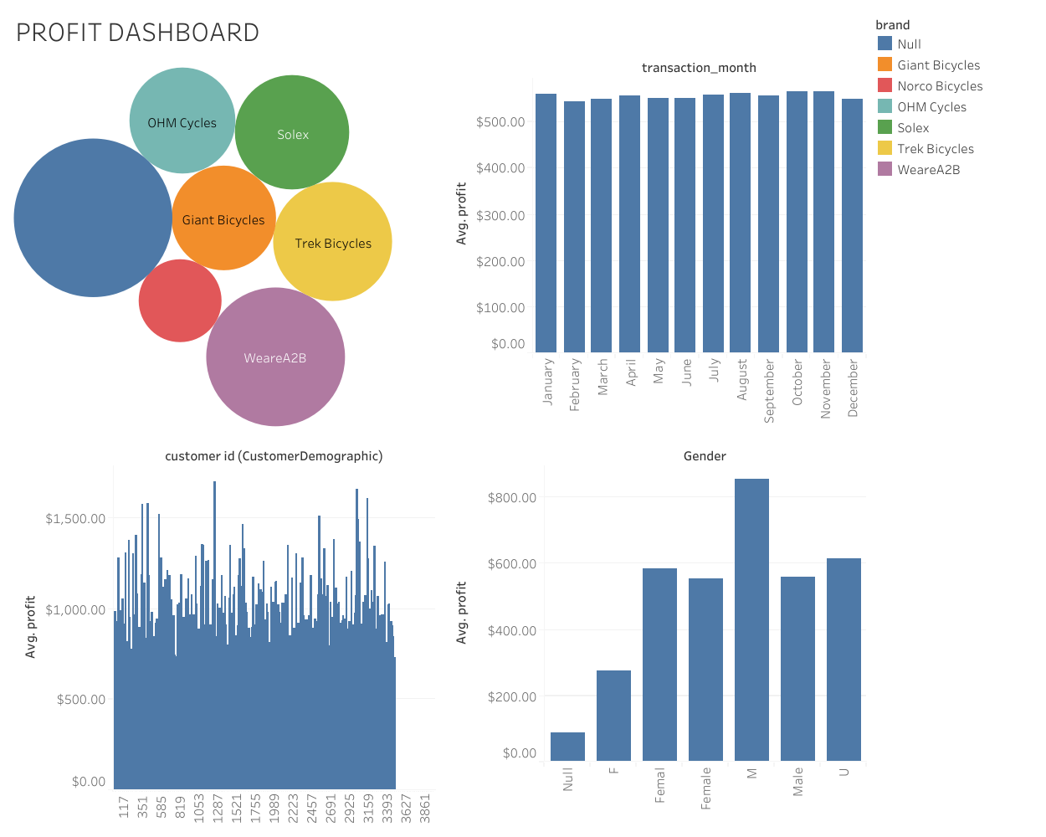
DASHBOARD
PROFIT DASHBOARD INDICATES THAT BASED ON PROFITS THERE ARE MANY INSIGHTS AILABLE TO EXTRACT.

Slide 5
PROFIT v/s CUSTOMER ID SHEET

Slide 6
PROFIT v/s CUSTOMER ID SHEET
PROFIT WITH THE INDIVIDUAL CUSTOMER ID’s SHOWS US THAT WHICH CUSTOMER HAD PURCHSED THE PRODUCTS WITH AVERAGE PROFIT.

Slide 7
GENDER v/s AVG. PROFIT

Slide 8
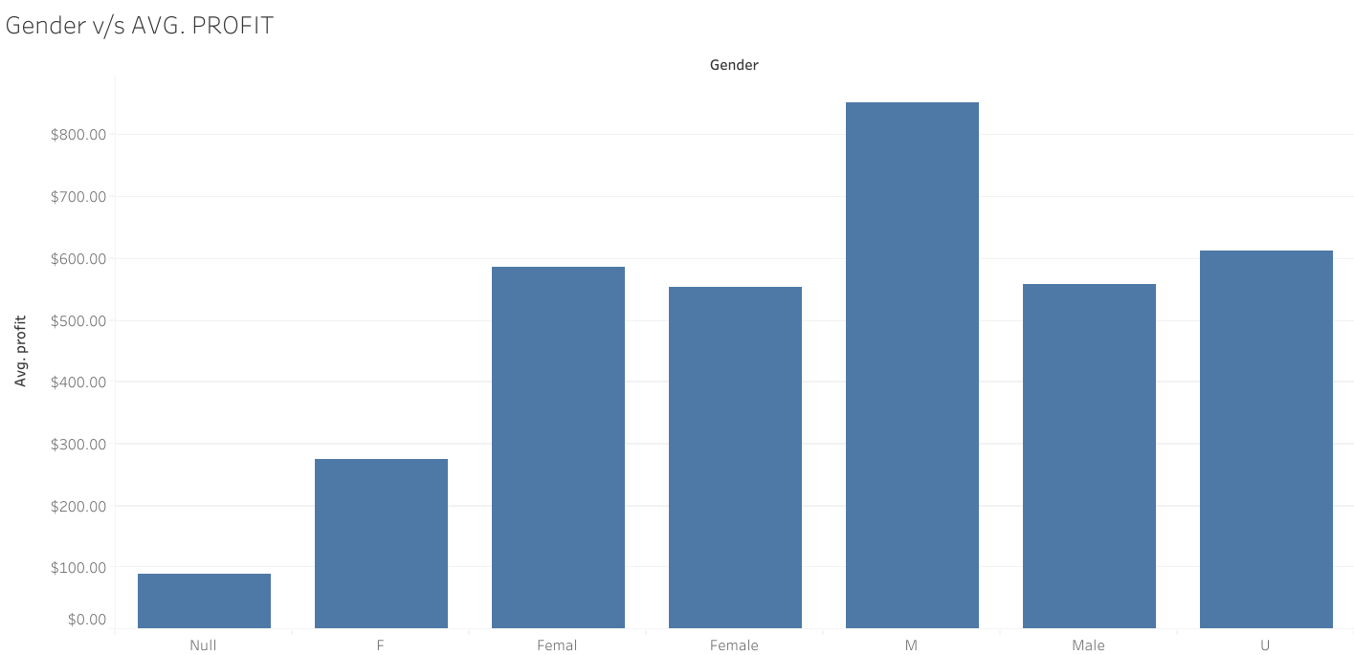
GENDER v/s AVG. PROFIT SHEET

Slide 9
BRAND WISE PROFIT

Slide 10
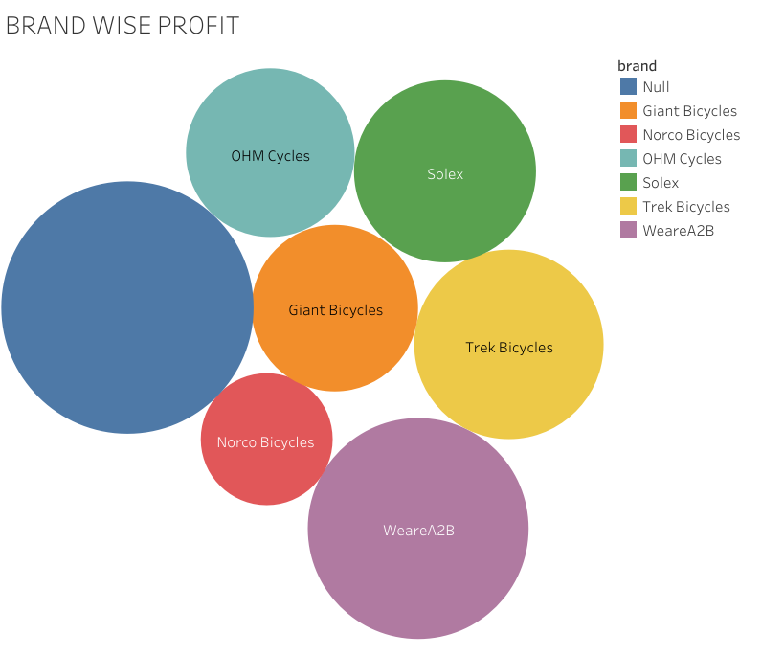
BRAND WISE PROFIT
AS WE CAN SEE, BRAND WISE PROFIT SHOWS THAT THERE’S NULL VALUES ARE PRESENT IN THE BRAND WISE VALUE FOR PROFIT.

Slide 11
TRANSACTION MONTH v/s AVG. PROFIT

Slide 12
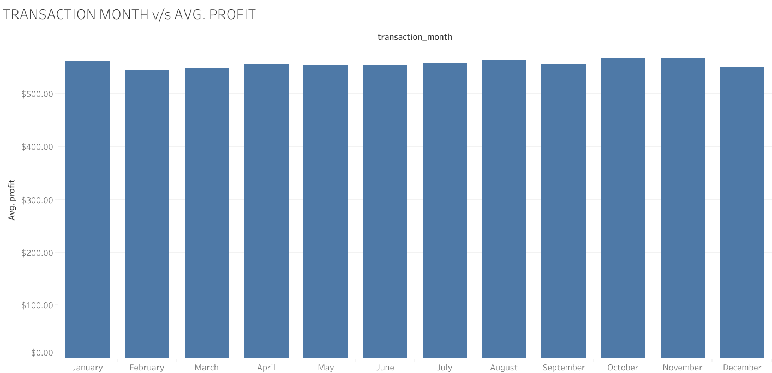
TRANSACTION MONTH v/s AVG. PROFIT SHEET

Slide 13

SUBMISSION
VEDANT A. PANDYA
PHONE: +91 942 862 1338
EMAIL: PANDYAVED1999@GMAIL.COM

Slide 14
THANKS

