Slide 1
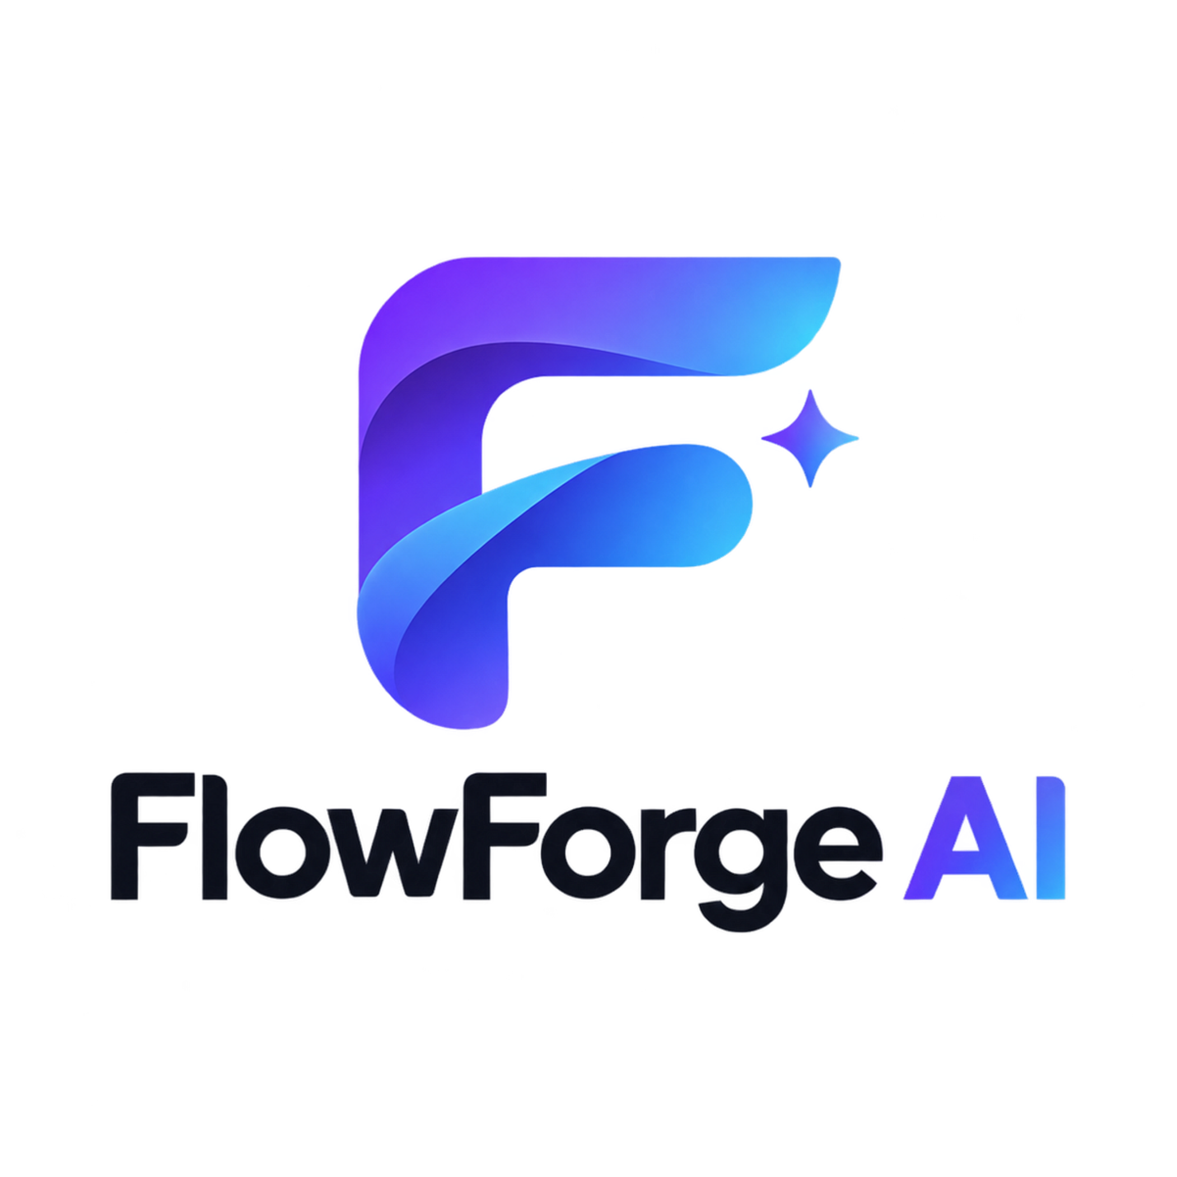
FlowForge AI — An Adaptive AI‑Powered Software Engineering Platform
P. Donica Mrinmayi • University ID: 2420030655
ASE Project – 1 • Academic Year 2026–2027

Slide 2
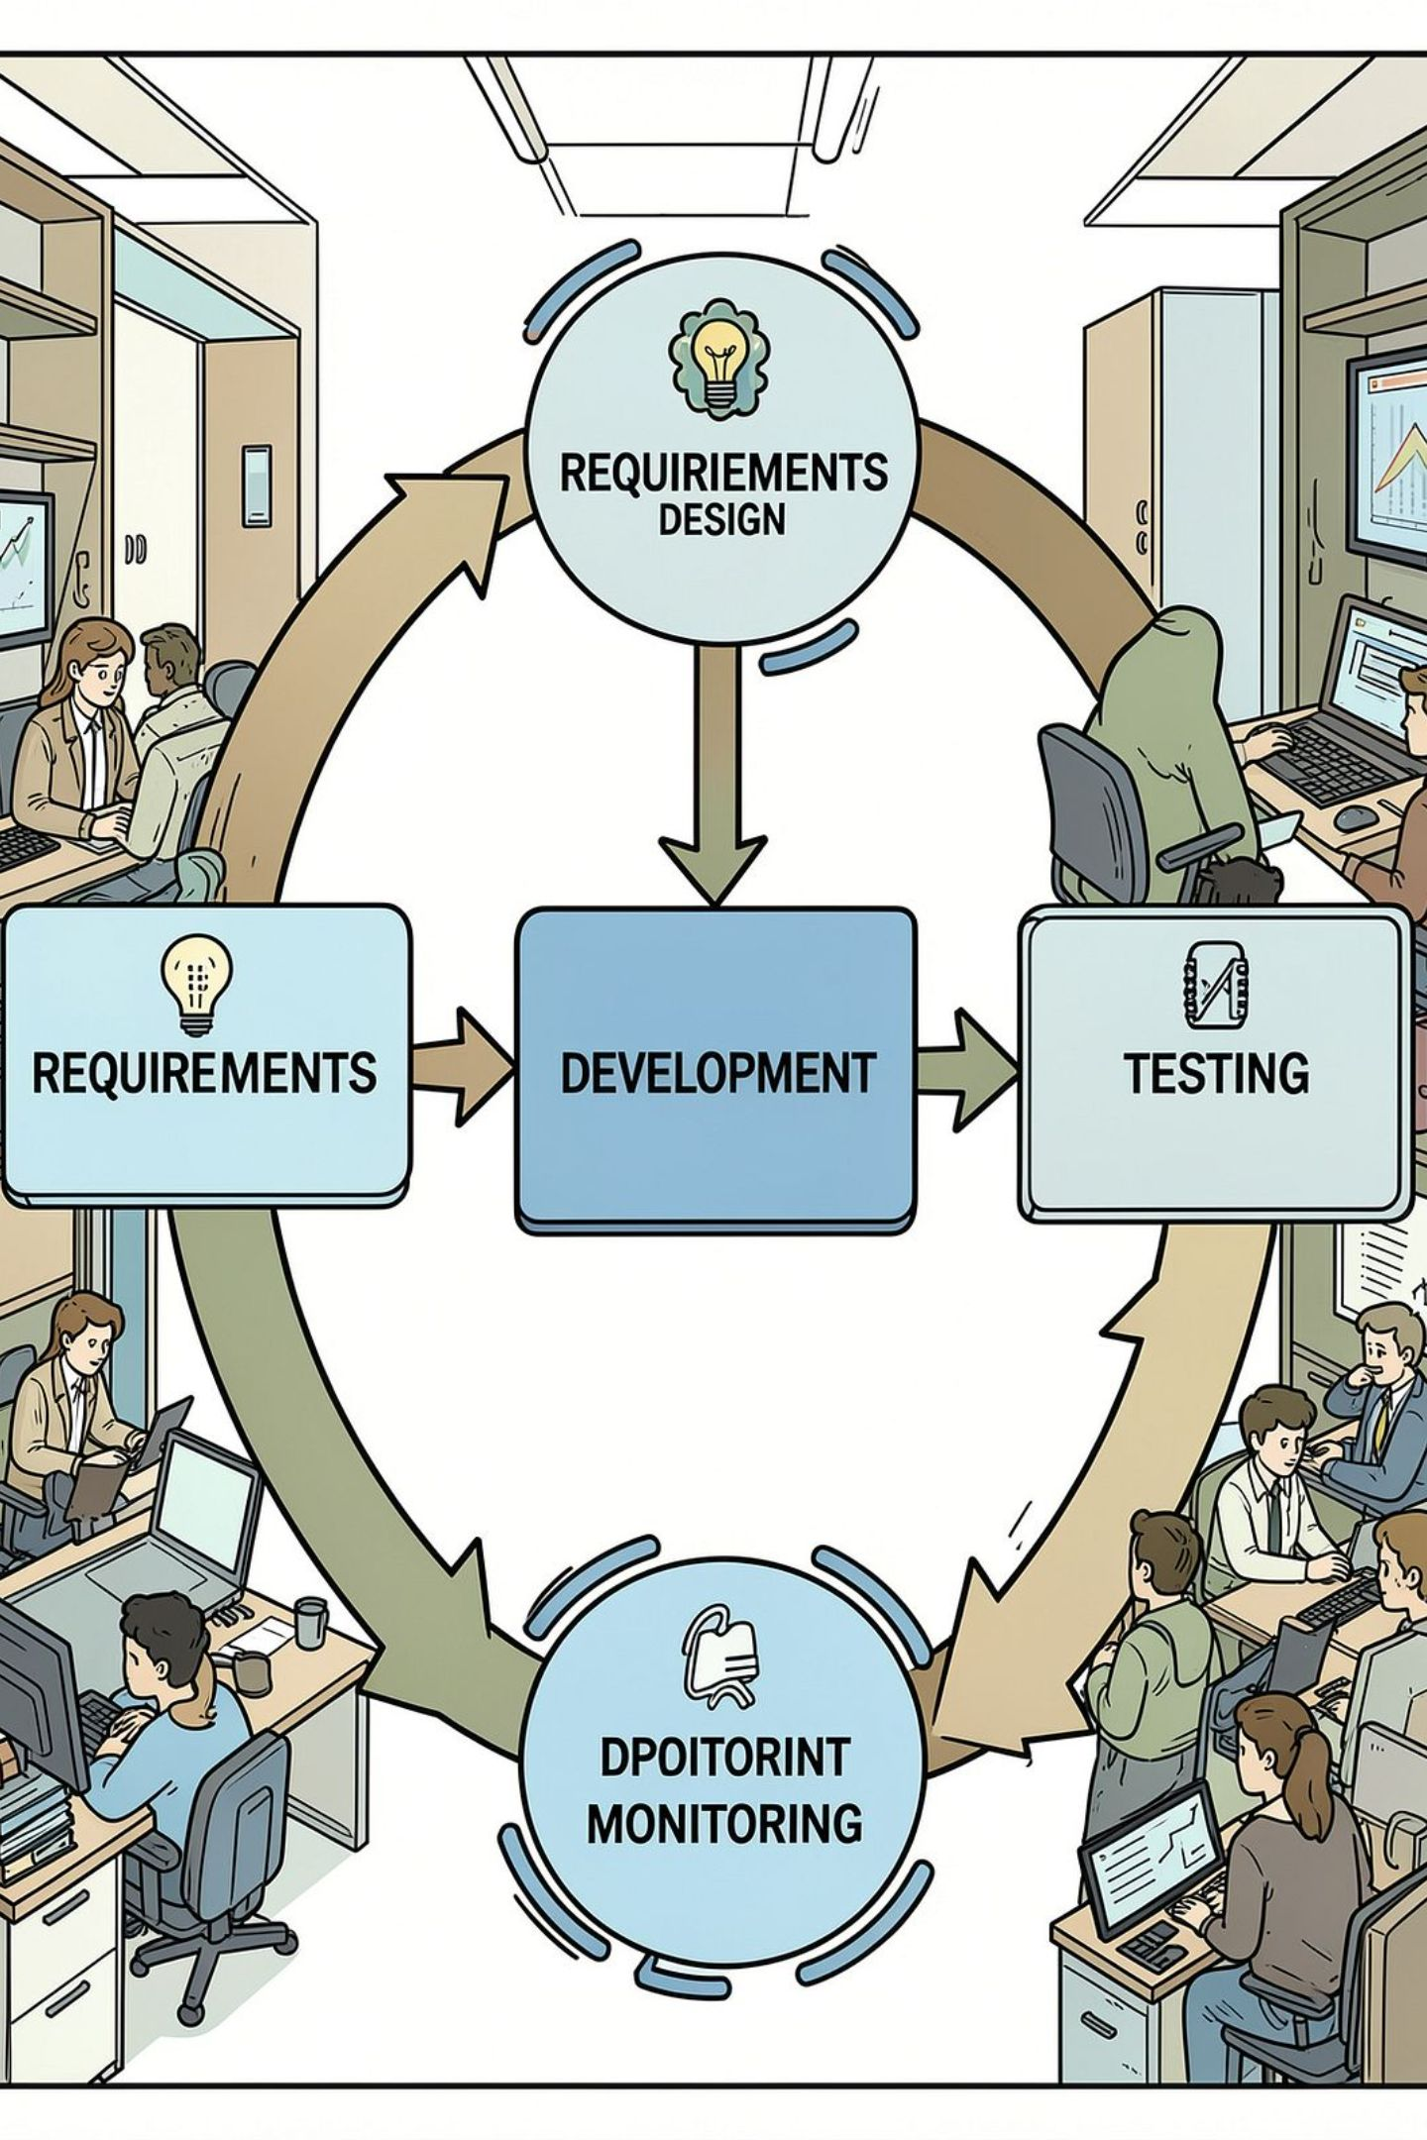
Introduction
FlowForge AI is a proposed AI‑powered platform designed to support the full Software Development Life Cycle (SDLC). It combines AI assistance with Agile practices to help teams manage requirements, planning, development, testing, deployment, and monitoring. The platform is designed to adapt project artifacts when requirements change.

Slide 3
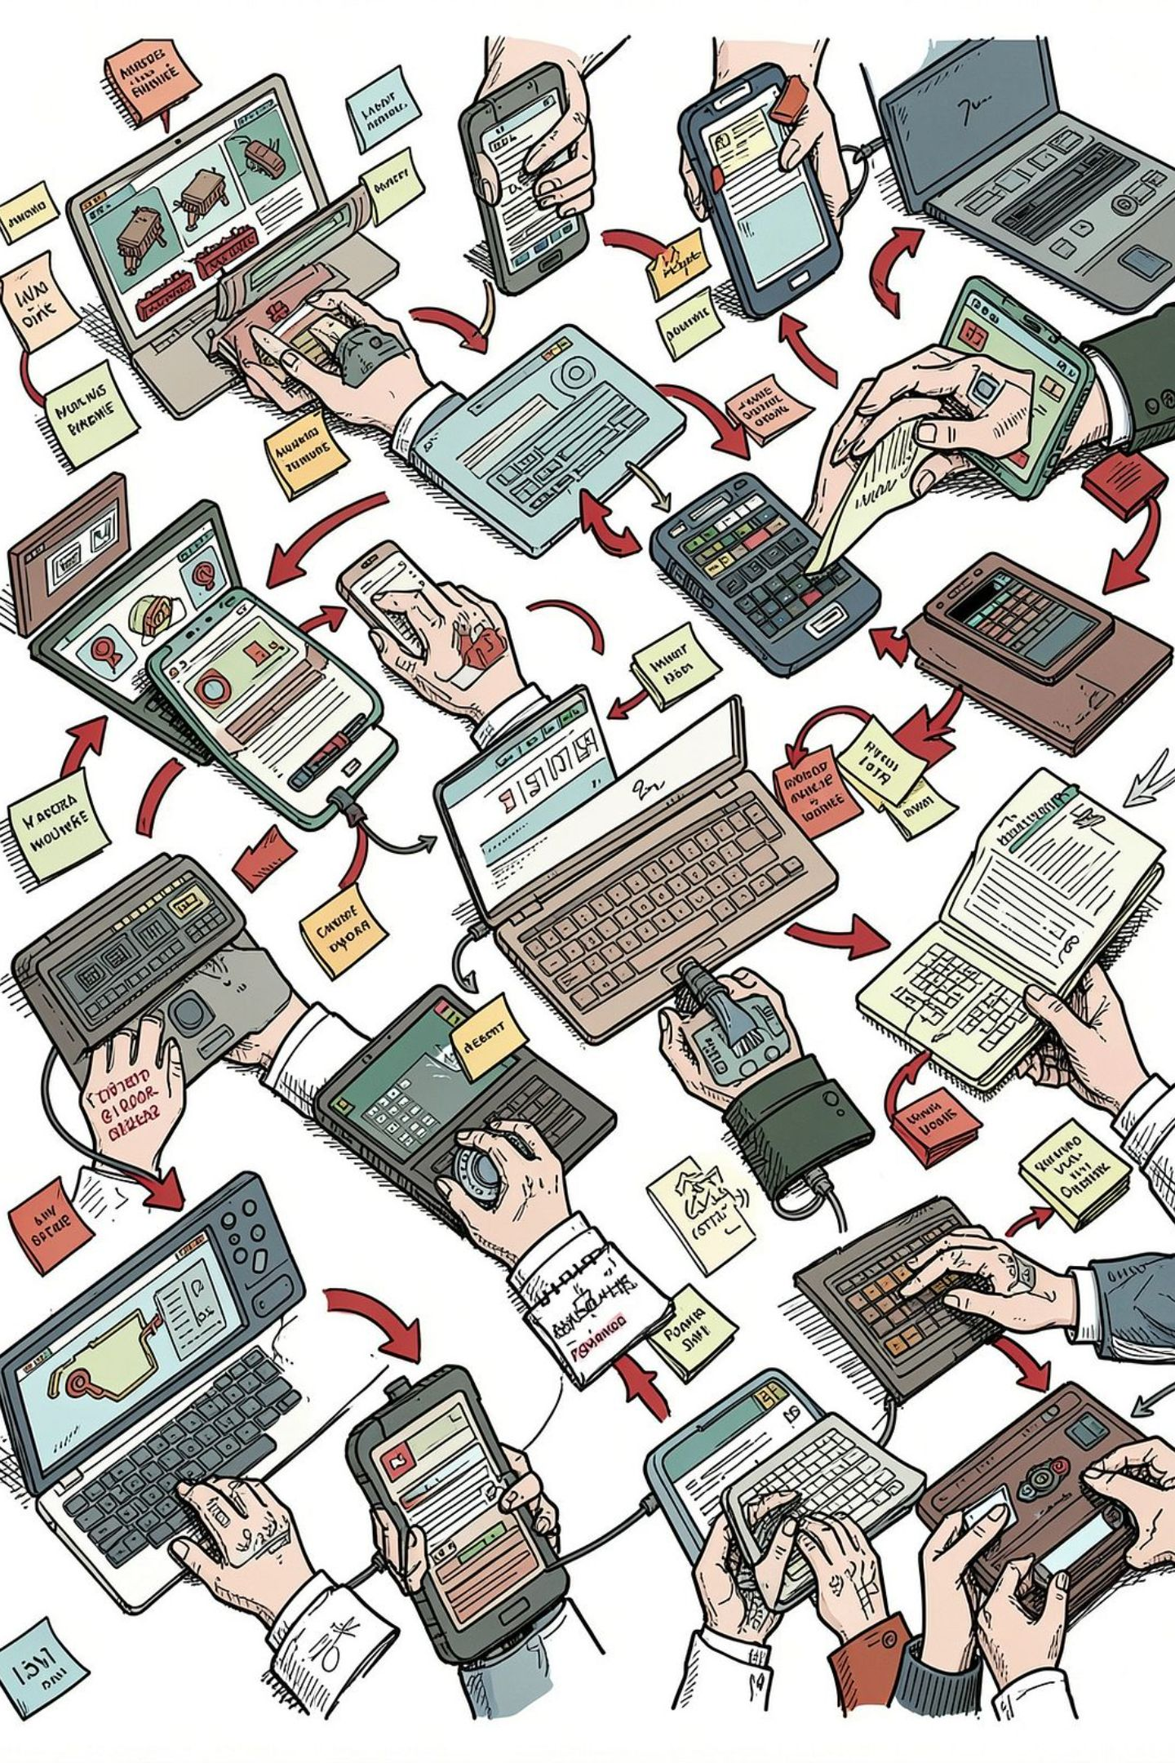
Problem Statement
Teams use multiple disconnected tools across the SDLC, creating friction.
Requirements frequently change during development.
Change propagation (user stories, tasks, tests, docs) is manual and error prone.
Repetitive tasks—documentation and test‑case creation—consume engineer time.
Maintaining consistency across stages is difficult and slows delivery.

Slide 4
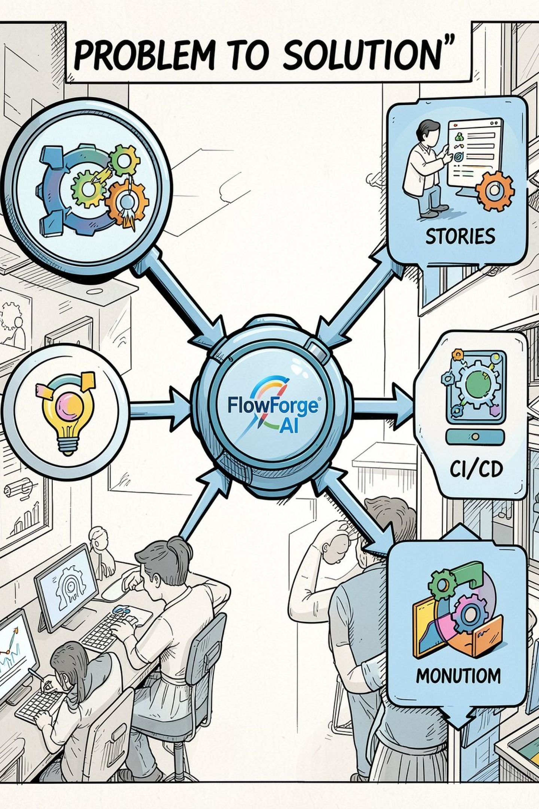
Proposed Solution
FlowForge AI (proposed) provides a unified SDLC workspace that leverages AI assistance to convert requirements into actionable artifacts and to keep them synchronized as requirements evolve.
Unified Platform
AI Assistance
Single workspace for backlog, sprints, testing, and deployment.
Planned AI workflows for requirement analysis and artifact generation.
Engineering Tooling
Integration with CI/CD, security scanning, monitoring, and cloud deploy.

Slide 5
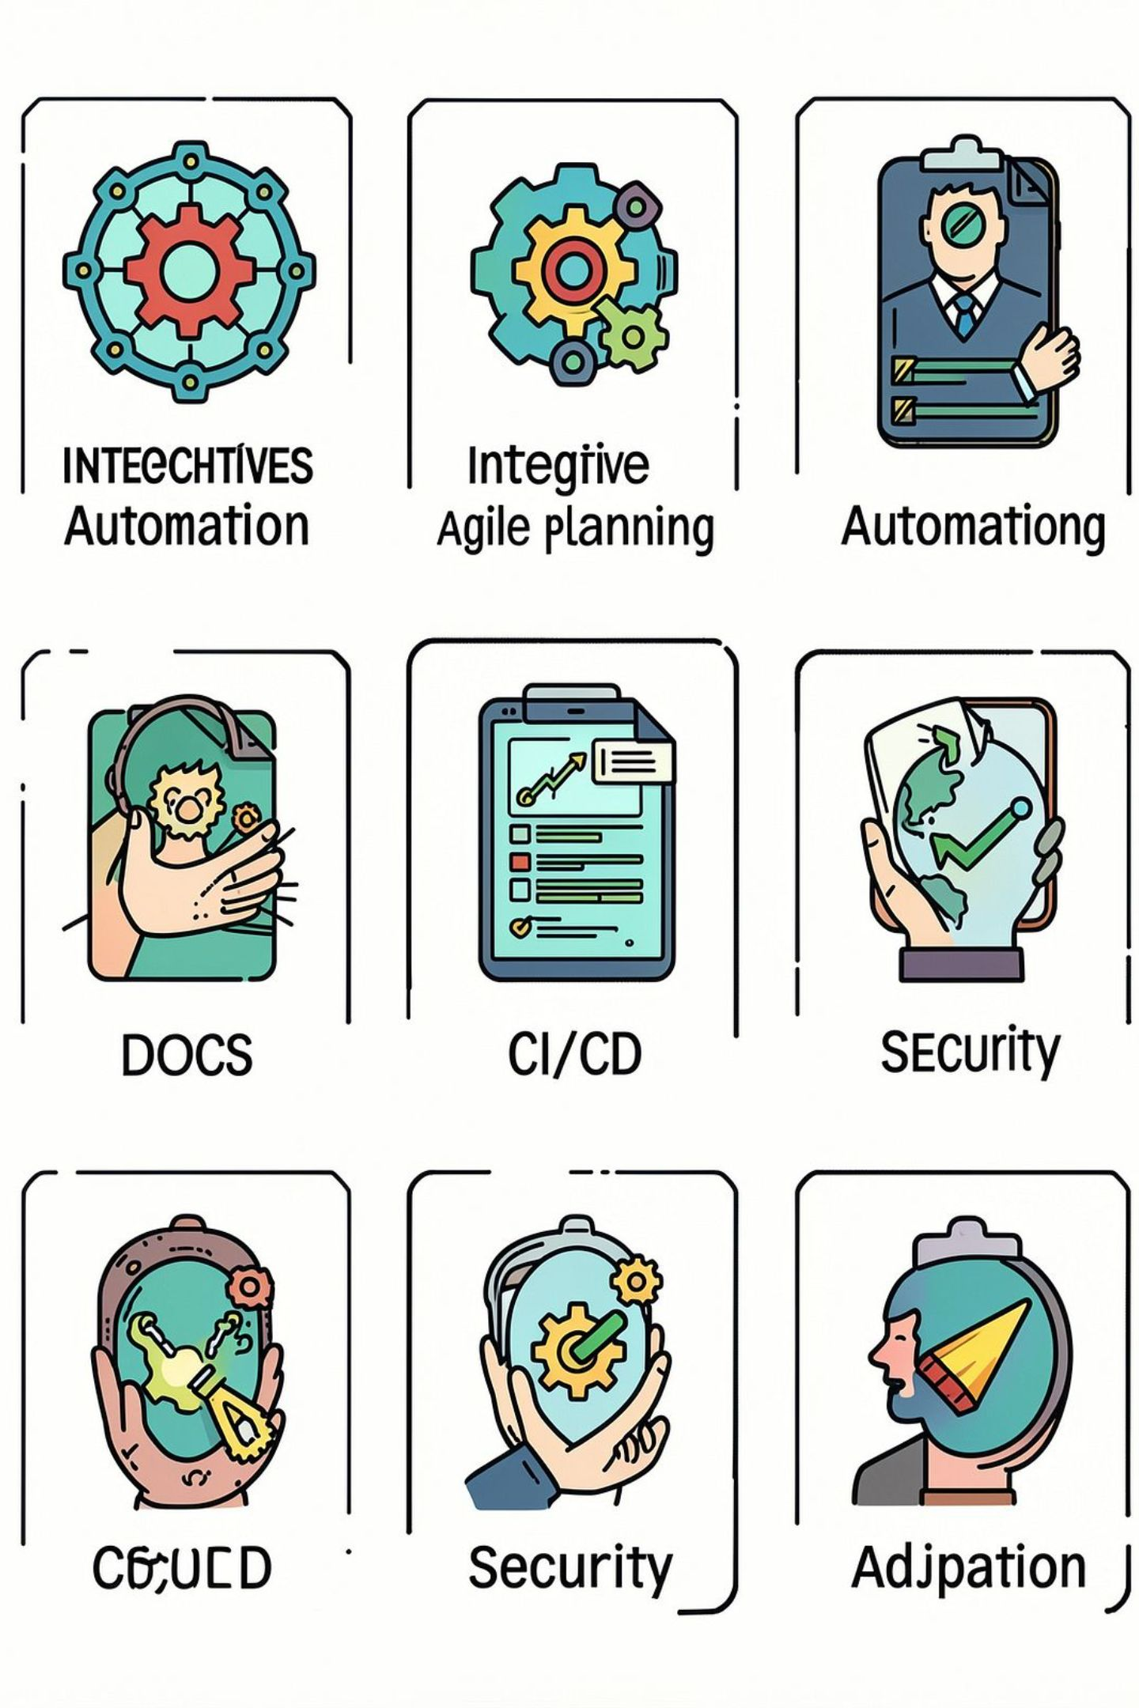
Project Objectives
Develop an integrated platform for SDLC management (proposed).
Automate repetitive SDLC activities using AI (planned).
Support Agile project planning and sprint management.
Assist in generating user stories, test cases, and documentation.
Support continuous integration and deployment pipelines.
Integrate security scanning and application monitoring.
Enable adaptation of artifacts when requirements evolve.

Slide 6
Key Features
Project Management
AI Assistance
Engineering Automation
Project & team management
Product backlog
Sprint planning
Kanban board
Requirement analysis
User story & acceptance criteria generation
Test‑case generation
Documentation generation
Requirement impact analysis
CI/CD
Security scanning
Application monitoring
Cloud deployment

Slide 7
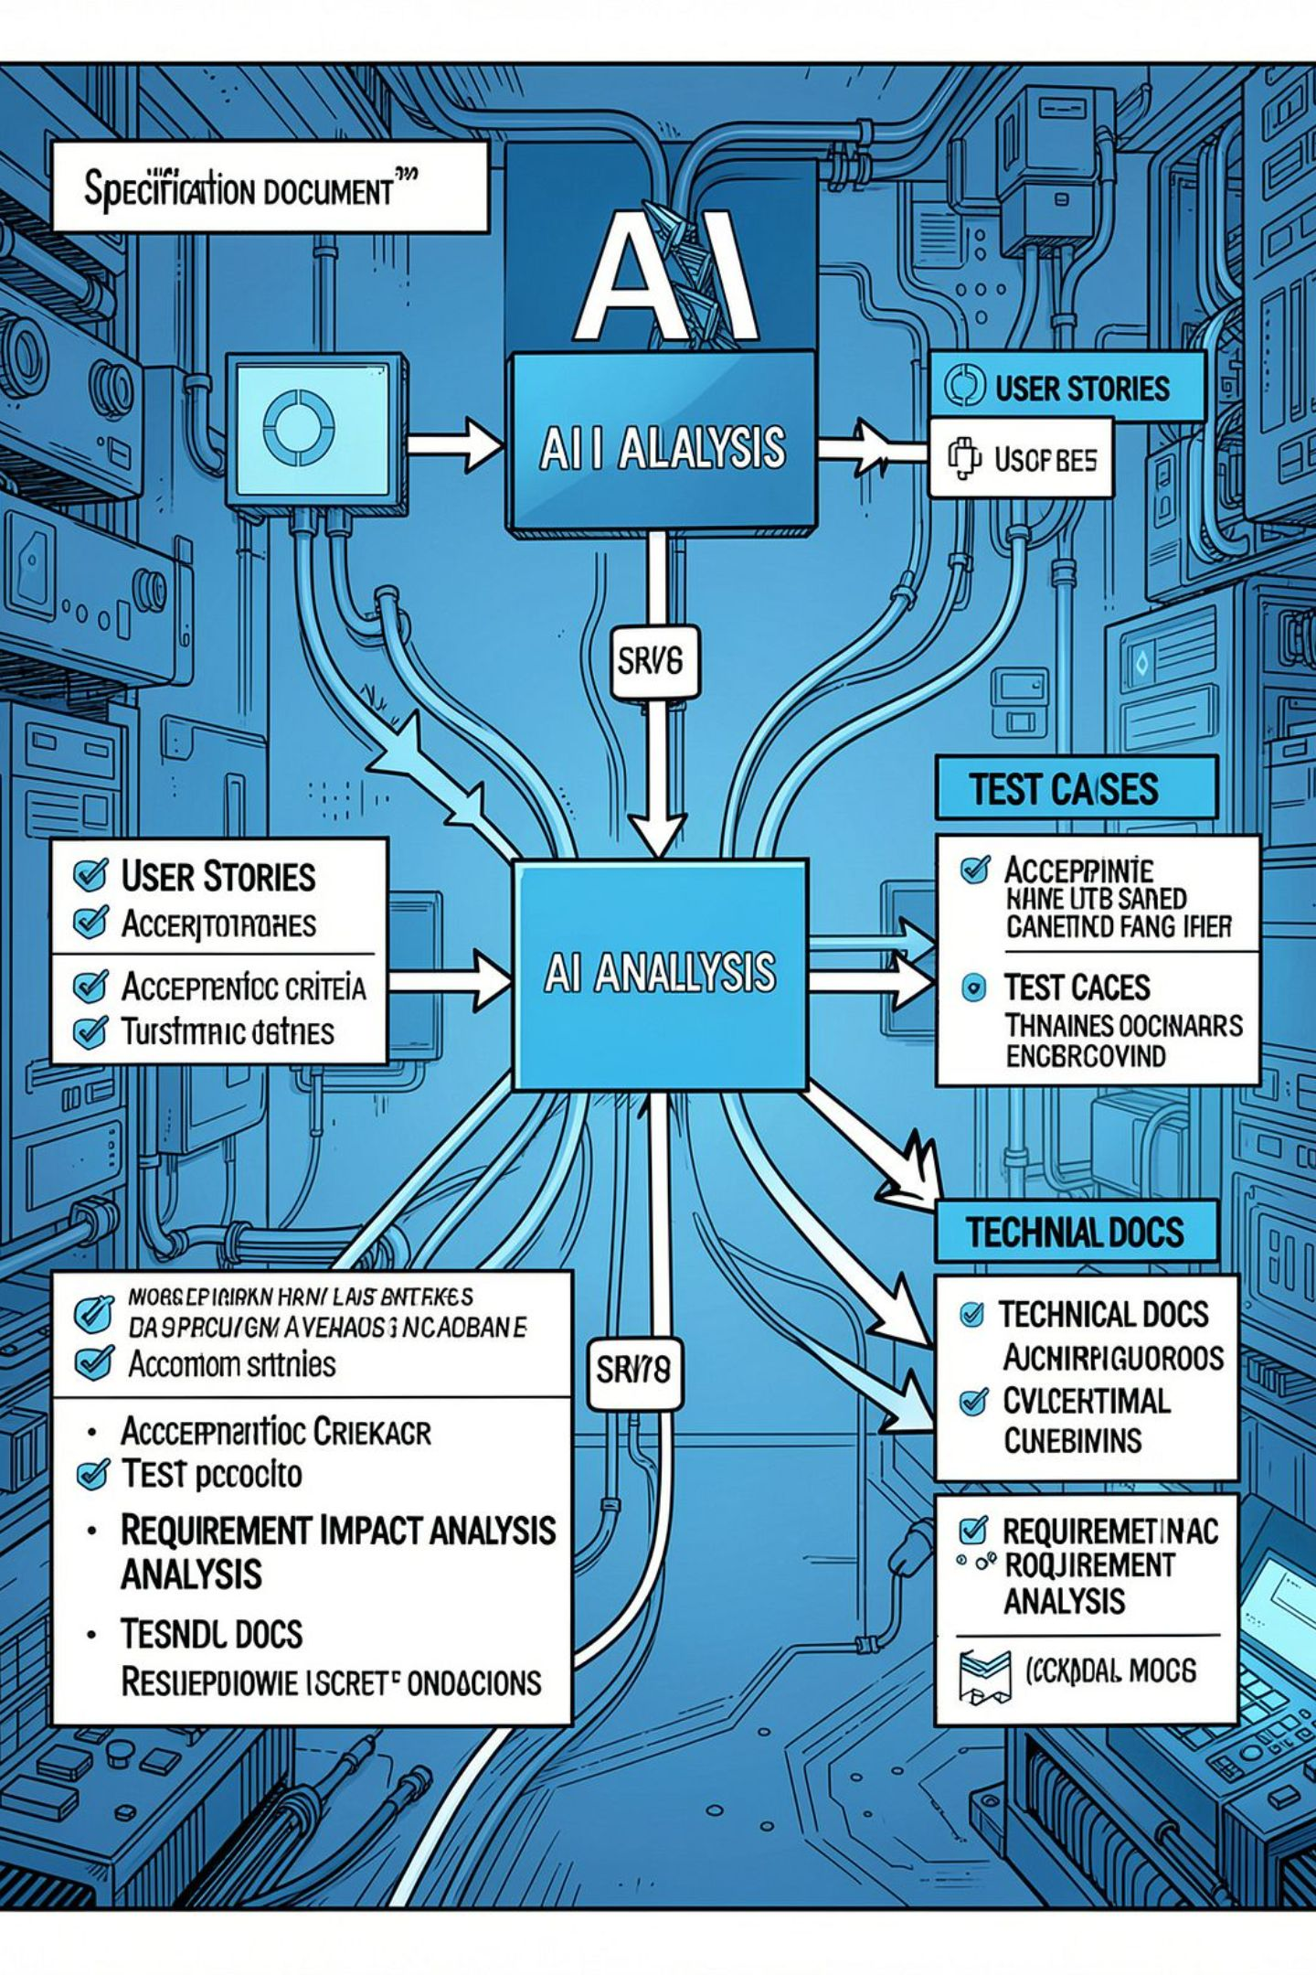
AI‑Powered Workflow (Pipeline)
Project Requirements ↓ AI Analysis ↓ Generated Artifacts: User Stories • Acceptance Criteria • Test Cases • Technical Documentation • Requirement Impact Analysis
The AI components are proposed to reduce repetitive authoring and assist developers by suggesting structured artifacts and identifying likely impact areas when requirements change.

Slide 8
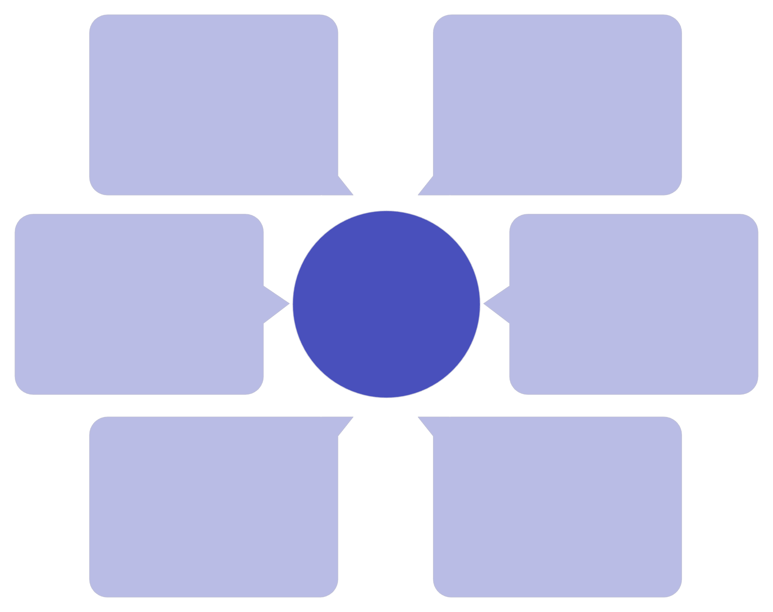
Proposed System Architecture
CI/CD & Containers
Users & Project Teams
GitHub Actions + Docker
Actors initiating requests
AI Services (LLM APIs)
Proposed System Architecture
React + TypeScript
External model integrations
Frontend UI layer
PostgreSQL & Redis
FastAPI Backend
API and business logic
Persistent and cache storage

Slide 9
Technology Stack
Frontend
React • TypeScript • Node • Tailwind CSS
Backend
Python • FastAPI
Database
PostgreSQL
AI
LLM APIs • RAG
DevOps
Docker • GitHub Actions • Kubernetes
Security & Monitoring
SonarQube • Trivy • OWASP ZAP • Prometheus • Grafana • AWS • Terraform

Slide 10
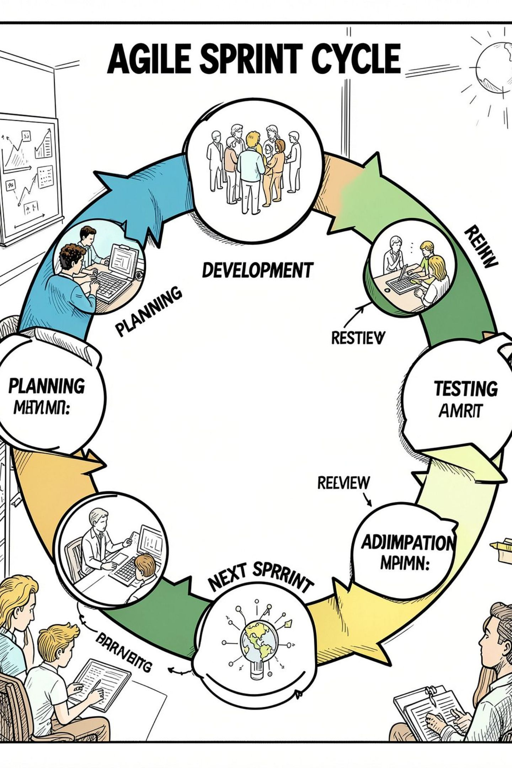
Development Methodology
Agile & Iterative Development (proposed delivery approach). Cycle: Planning → Development → Testing → Review → Adaptation → Next Sprint.
01
02
Practices
Quality
Agile/Scrum, user stories, product backlog, sprint planning.
Continuous testing, CI, and automated checks in each sprint.
03
Feedback
Review and adaptation each sprint; iterate on AI prompts and integrations.

