Slide 1
Web API
Daniel Mohl and Zach Bray (originally by Ryan Riley)
@dmohl and @zbray
blog.danielmohl.com
zbray.com

Slide 2
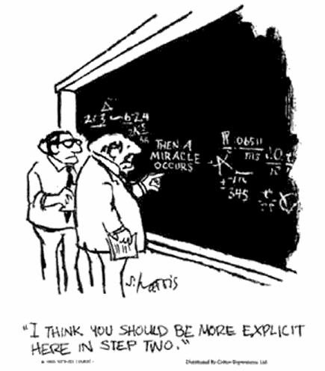

Slide 3
Simplest HTTP Application
HttpRequestMessage -> HttpResponseMessage

Slide 4
Component Parts
Request/Response
Methods, URIs, Status Codes
Headers (info on client, server, request type, etc)
General, Request, Response, Content
Resources –
“anything that has identity”–RFC2396
Notes:
HTTP defines several components that allow distributed, loosely-coupled agents to communicate. The first lines of requests and responses are standardized to ensure that loosely-coupled components can understand one another, yet they allow for extension either by standards bodies or for internal, proprietary use.

Slide 5
Resources
HTTP Resource
HTTP “Service”
GET /item/1
+ POST /item/1
+ PUT /item/1
+ DELETE /item/1
+ OPTIONS /item/1
GET (or POST) /
+ /items
+ /item/{itemId}
+ /setresult?foo=bar
Notes:
This may be new to some, but this resource is not the same as the collection of items at /items.

Slide 6
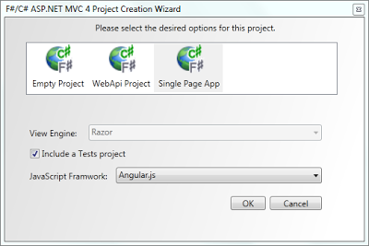
Web API with an OO Approach
Notes:
HTTP defines several components that allow distributed, loosely-coupled agents to communicate. The first lines of requests and responses are standardized to ensure that loosely-coupled components can understand one another, yet they allow for extension either by standards bodies or for internal, proprietary use.

Slide 7
Where does F# shine?
Serve functional Web APIs
Consume HTTP with pattern matching
Notes:
HTTP defines several components that allow distributed, loosely-coupled agents to communicate. The first lines of requests and responses are standardized to ensure that loosely-coupled components can understand one another, yet they allow for extension either by standards bodies or for internal, proprietary use.

Slide 8
Frank
F# DSL using System.Net.Http
Headers composition
Follows the natural composition of HTTP
Frank Resources == HTTP Resources
Define your own conventions!
Notes:
For those with a stronger bent towards building web sites, Mauricio Scheffer’s Figment may be a closer match to your taste.

Slide 9
Simplest HTTP Application
HttpRequestMessage -> HttpResponseMessage
HttpRequestMessage -> Async<HttpResponseMessage>
Notes:
Compare the Frank application signature with the simplest app signature we used above. The only addition is that we are stating that an application is non-blocking. This is the same idea as is used in node.js. It’s also sort-of required since Frank sits on System.Net.Http via MessageHandlers. The signature for the MessageHandler.SendAsync is the same but for Task rather than Async. This signature extends all the way through all layers of composition.

Slide 10
Define a Method Handler
// handler
let echo request = async {
let! body = request.Content.AsyncReadAsString()
return request.CreateResponse(HttpStatusCode.OK, body)
}
// method handler
get echo

Slide 11
Define a Resource
let helloworld request = async { … }
let echo request = async { … }
let resource = route “/” (get helloworld <|> post echo)
Notes:
A resource is the only current location that does not conform solely to the Frank application signature. A resource holds both a Uri Template (its name) as well as a HttpRequestMessage -> Async<HttpResponseMessage> option. Why the option? The resource will respond with a 405 Method Not Allowed if it does not respond to the method thrown its way. Thus the option allows the programmer to define the methods for the resource without having to manually hook up the 405 response.

Slide 12
Define an Application
let todoListResource = route “/” (get todoList <|> …)
let todoItemResource = route “/item/{1}” (put …)
let app = merge [ todoListResource; todoItemResource ]
Notes:
Similar to resource, merge is a function of HttpRequestMessage -> Async<HttpResponseMessage> option. When a resource uri is not found, a 404 Not Found response is returned. The result, however, is a Frank application.

Slide 13

Lab Time
Lab walk through
Your Turn

