Slide 1











The topic of our lesson is:
Music Tastes

Slide 2



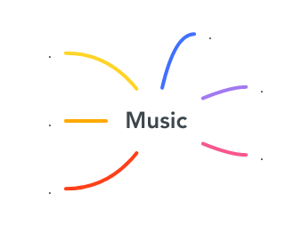



Mind map.

Slide 3


Checking up the homework

Slide 4

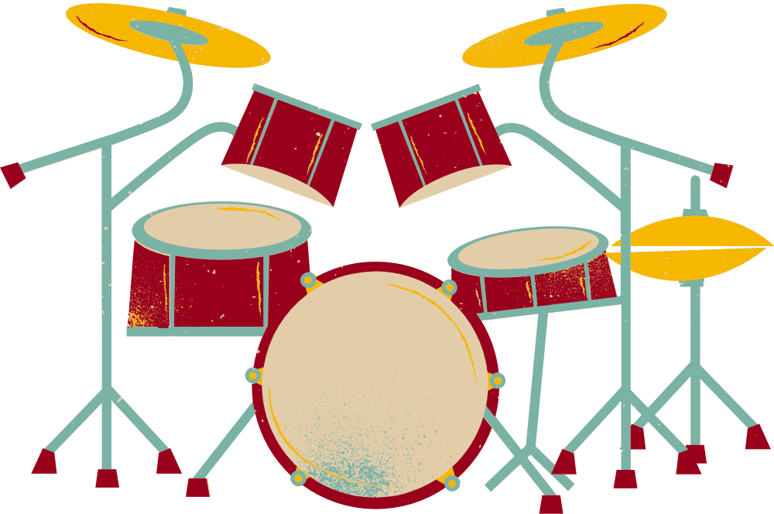




“Unscrumble the words”:
1) DMUR
2) ONAIP
3) UARTIG
4) ORHN
5) OLLEC
6) NOIDROCAC
7) INLOIV
8) TENIRALC

Slide 5

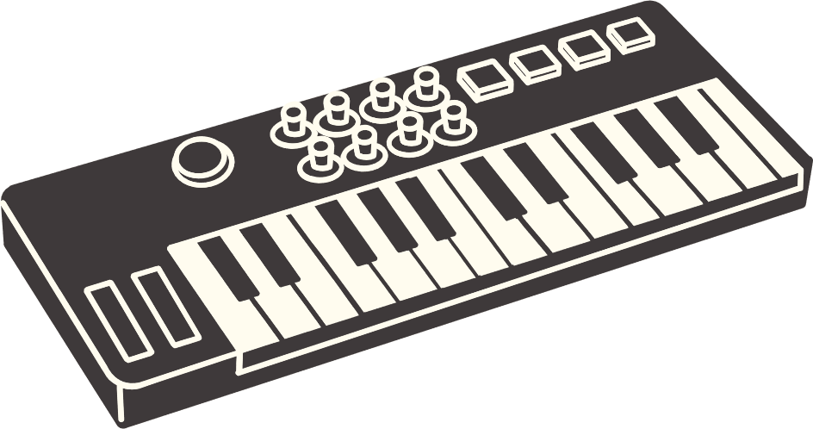

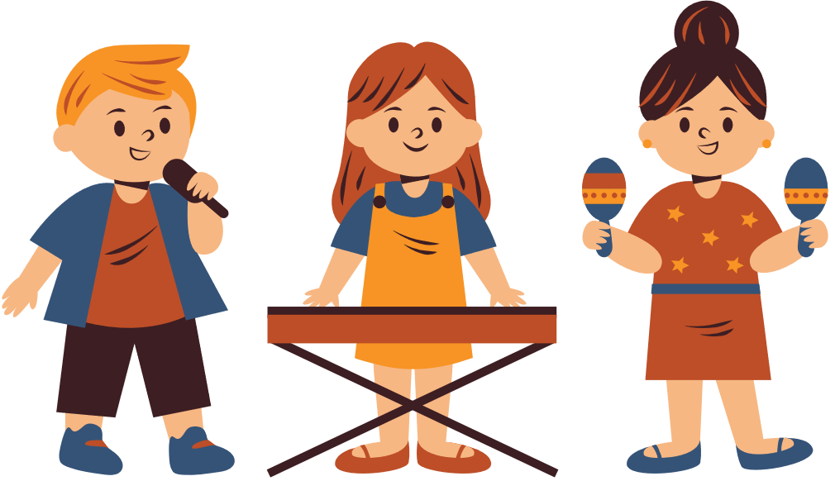

Answers:
1) DRUM
2) PIANO
3) GUITAR
4) HORN
5) CELLO
6) ACCORDION
7) VIOLIN
8) CLARINET

Slide 6


Complete the sentences with the words from the box:
[Pop music, classical music, reggae, folk music, jazz, punk, country, rap.]
1.--------is played by a big orchestra in a concert hall.
2.--------comes originally from black American musicians.
3.--------is played by young people with brightly coloured hair.
4.--------usually offers simple tunes which are popular for a short time.
5.-------- music is usually played on the guitar, banjo and violin.
6.------- is a musical style where the singer speaks or shouts the words.
7.------- comes from a specific region and is usually popular for a long period .
8.------- is often played freely, not following written music.

Slide 7

What music do you like and why?
Use these adjectives:
Beautiful, touching, serious, cheerful, relaxing, sad, simple, traditional,healing, emotional, exciting, catchy, soothing, pleasant, romantic, energetic.
And tell about your favourite music:
As for me, I like pop music because it is cheerful, simple and touching.
Where we usually listen to music?
In pairs, ask and answer the question.

Slide 8
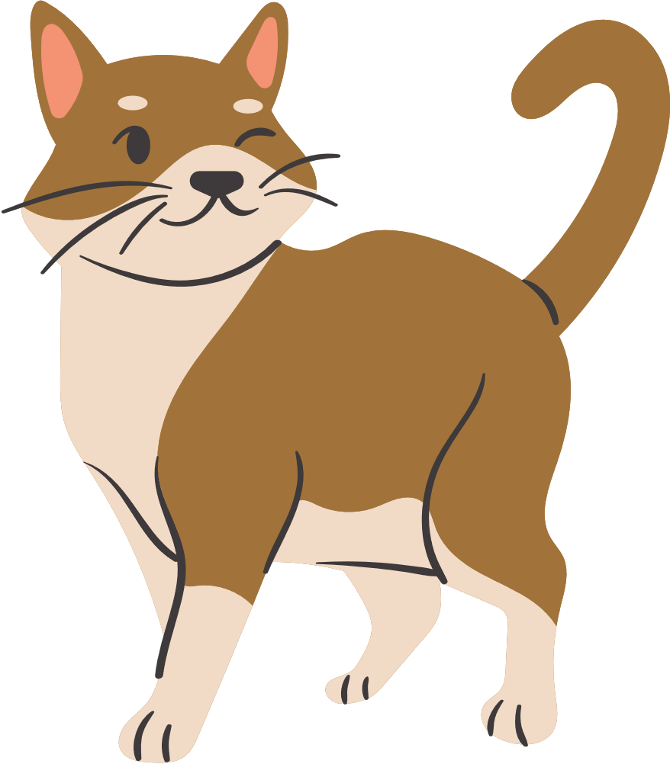
  1 word – the topic
  2 words – adjectives to describe it
  3 words – verbs connected with it
  4 words – your attitude to it
  1 word - your feelings (noun)

Slide 9

1) Music
2) Powerful , charming
3)Listen, sing, relax
4) I like listening it
5) Life

Slide 10

Homework:
https://wordwall.net/uk/resource/1847683/music/music-ep-2
Thank you for attention.
Good-bye!

