Slide 1
Enriching PANGAEA Datasets with ROR Identifiers
PAN.DataBase vs ROR DataBase
9376 entries containing following fields:
id_institution
Abbreviation
name
City
contact
country
fax
phone
state
Street
uri
uri_semantic
id_institution_type
id_user_created
96793 entries containing following fields:
Id (ROR_id)
name
types
links
aliases
acronyms
wikipedia_url
labels
Country {country_code,country_name}
external_ids {GRID,ISNI,OrgRef,Wikidata}
ROR api was used to gather the ROR id’s.
Search of organizations was done with 2 methods:
Querying & filtering
Affiliation matching
Notes:
id
name
types
links
aliases
acronyms
wikipedia_url
labels
country
external_ids

Slide 2
Structure:
Querying
Affiliation matching
Affiliation matching vs Querying

Slide 3
QUERYING

Slide 4
ROR API
Querying –input/output
PAN.DB input fields
name
country (filter)
ROR API output
List of JSON objects
The ROR id of the 1st object was put in the qROR_id column of “insitutions.csv”
ROR
API
Query
Example of Query URL:
https://api.ror.org/organizations?query=Department+of+Geosciences%2C+Bremen+University&filter=country.country_name%3AGermany'
Notes:
id
name
types
links
aliases
acronyms
wikipedia_url
labels
country
external_ids

Slide 5
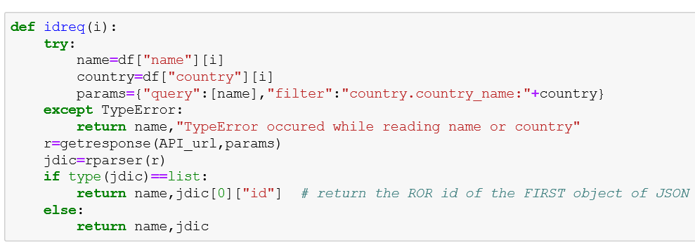
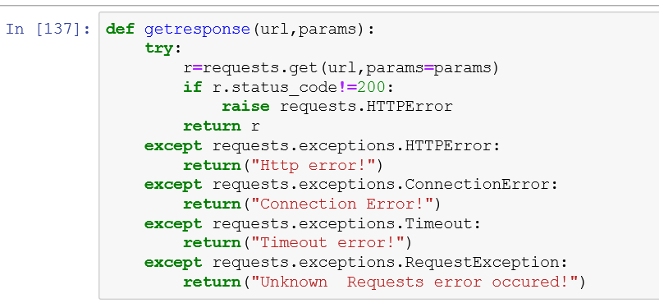
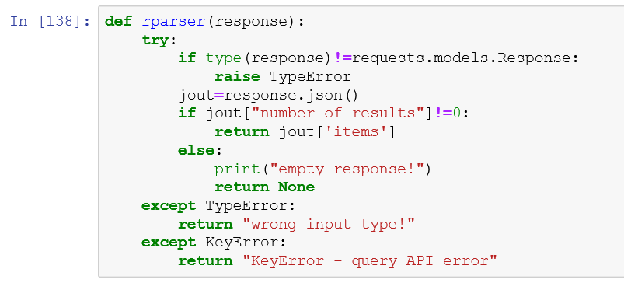
ROR API
Querying – query functions
First a few functions were written for to use the read the “name” and “country” fields from
PANGAEA Database and than use this information as input for the Query.
Notes:
id
name
types
links
aliases
acronyms
wikipedia_url
labels
country
external_ids

Slide 6
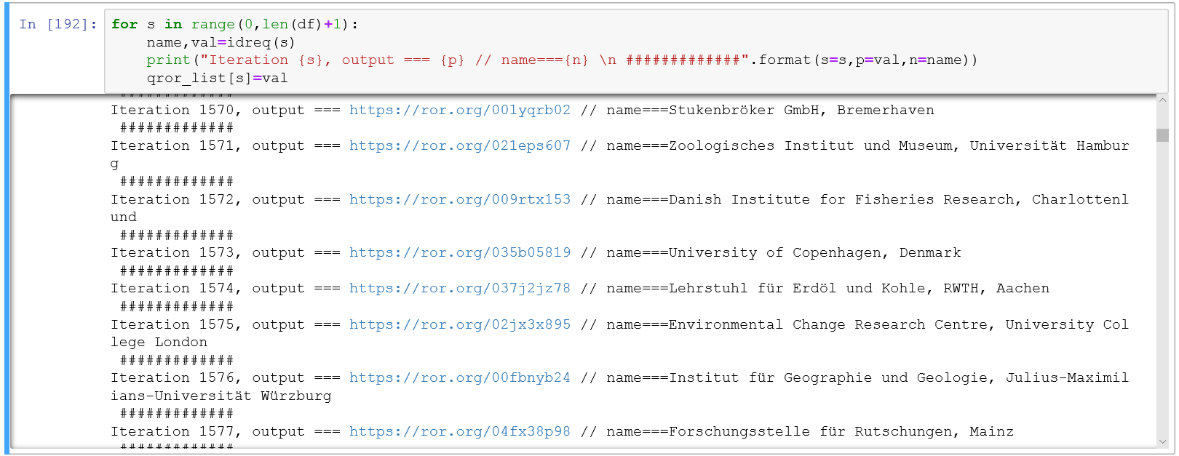
ROR API
Querying – query cycle
Than these functions were used in the cycle for the all 9376 entries of PANGAEA Database:
Notes:
id
name
types
links
aliases
acronyms
wikipedia_url
labels
country
external_ids

Slide 7
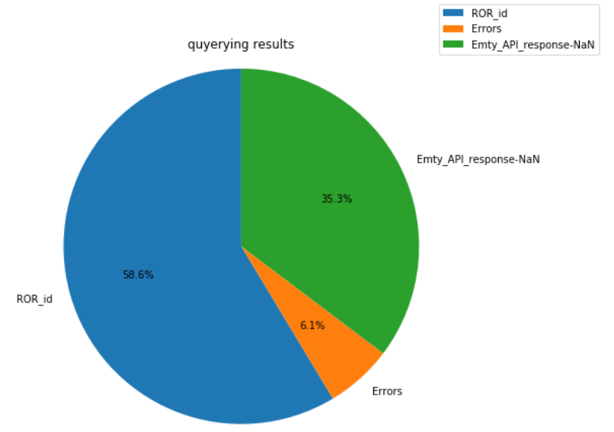
ROR API
Querying – results
For 58.6% of Pan.DB entries a some ROR_id was found (not always the correct one)
For 35.3% of Pan.DB entries nothing was found by the ROR API – empty response.
In 6.1% of Pan.DB entries have some error: KeyError, TypeError
Error types:
KeyError – API returns an error because
some of the input fields were incorrect. For example “country”= 'New Jersey, USA‘
TypeError – some of the input fields (country or name) are empty
Notes:
id
name
types
links
aliases
acronyms
wikipedia_url
labels
country
external_ids

Slide 8
Affiliation matching

Slide 9
ROR API
Affiliation matching –input/output
ROR API output
List of JSON objects, sorted by the matching confidence. The ROR id of the 1st object was put in the aROR_id column of “insitutions.csv”
+ Information about the matching process:
Score
Chosen
Matching type
And so on
This information was also added to the
“insitutions.csv”
PAN.DB input fields
abbreviation
name
city
contact
country
state
street
uri
uri_semantic
ROR
API
Affiliation matching
Example of Query URL:
https://api.ror.org/organizations?affiliation=DGGE%2CDepartment+of+Geology+and+Geophysics%2C+University+of+Edinburgh%2CEdinburgh%2C+EH9+3JW%2CScotland%2CWest+Mains+Road
Notes:
id
name
types
links
aliases
acronyms
wikipedia_url
labels
country
external_ids

Slide 10
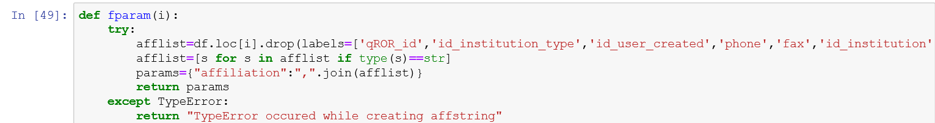
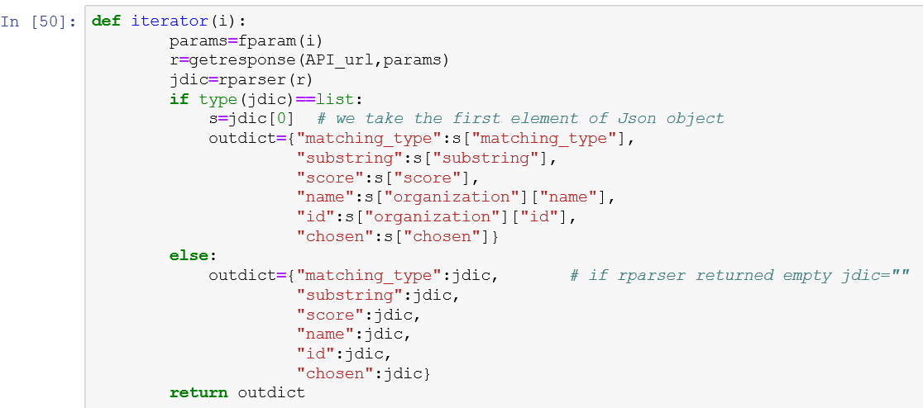
ROR API
Affiliation matching –functions
Additional function was created to the read the necessary fields from
PANGAEA Database and than write an affiliation string.
Also new “iterator” function was written to iterate over elements of PAN.DB and return on every step a dictionary with information about ROR_id and matching process.
Notes:
id
name
types
links
aliases
acronyms
wikipedia_url
labels
country
external_ids

Slide 11
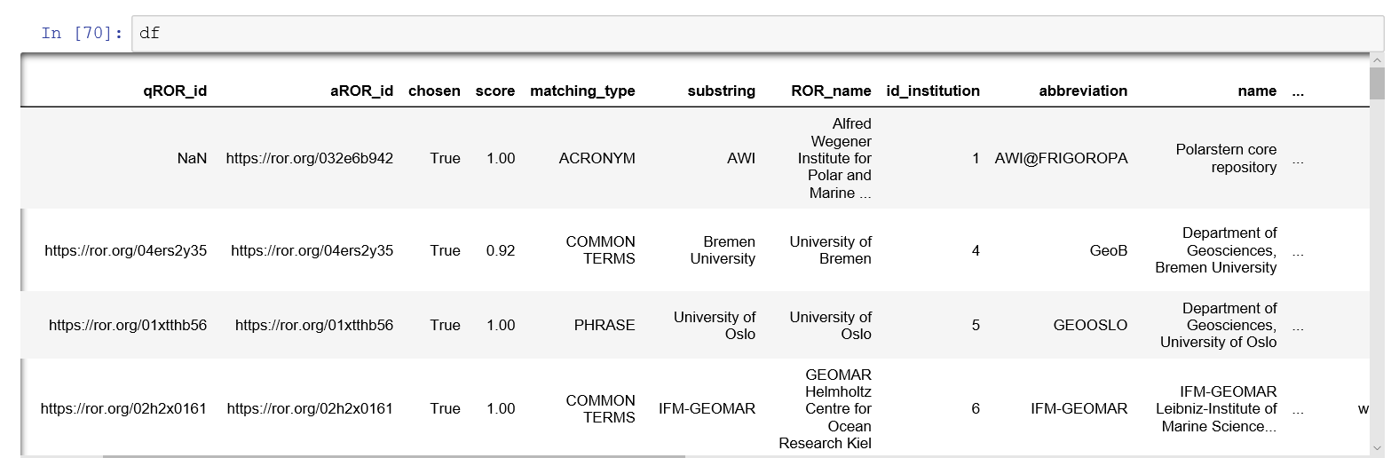
ROR API
Affiliation matching
New columns with aROR_id and information about affiliation matching process were added:
Notes:
id
name
types
links
aliases
acronyms
wikipedia_url
labels
country
external_ids

Slide 12
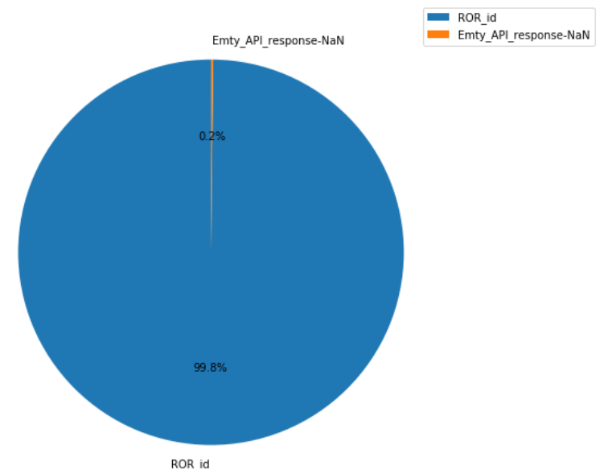
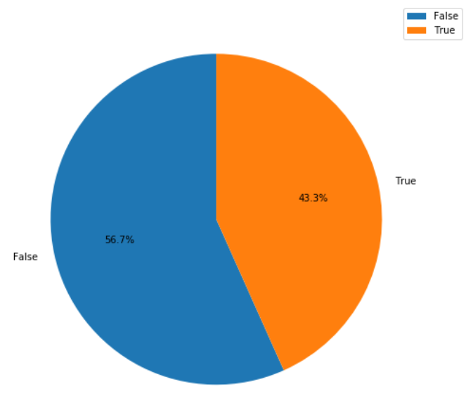
ROR API
Affiliation matching – results
For 99.8% of Pan.DB entries some ROR_id was found (not always the correct one)
For 0.2% of Pan.DB entries nothing was found by the ROR API – empty response
56,7% of ROR_id’s were labeled FALSE by API (some of these id’s are actually valid when checked manually)
43,3% of ROR_id’s were labeled TRUE by API
API responses in affiliation matching
ROR_id’s labeled TRUE and FALSE by API
Notes:
id
name
types
links
aliases
acronyms
wikipedia_url
labels
country
external_ids

Slide 13
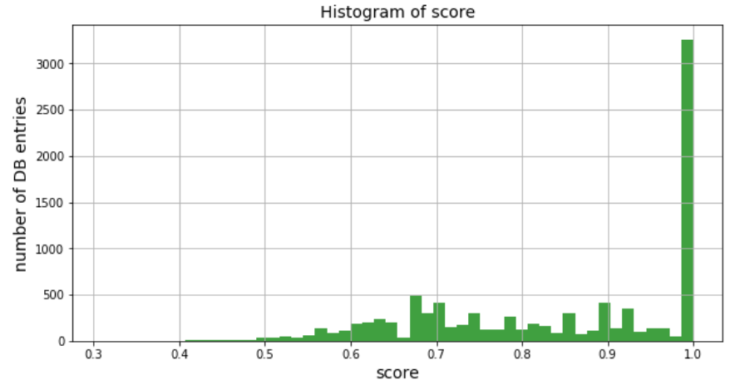
ROR API
Affiliation matching – score
Although the majority of the ROR_id’s are labeled FALSE by API, some of these id’s are actually valid when checked manually.
Another matching field of API– „score“ shows a more optimistic picture, with a high mean value of 0,84.
Probably API’s matching criteria are too strict.
Below is a comment of the ROR_API community member about the matching criteria:
“The main requirement is a matching confidence score of at least 0.9. We also make sure that affiliation substrings successfully matched to organizations do not overlap within one affiliation string.”
Notes:
id
name
types
links
aliases
acronyms
wikipedia_url
labels
country
external_ids

Slide 14
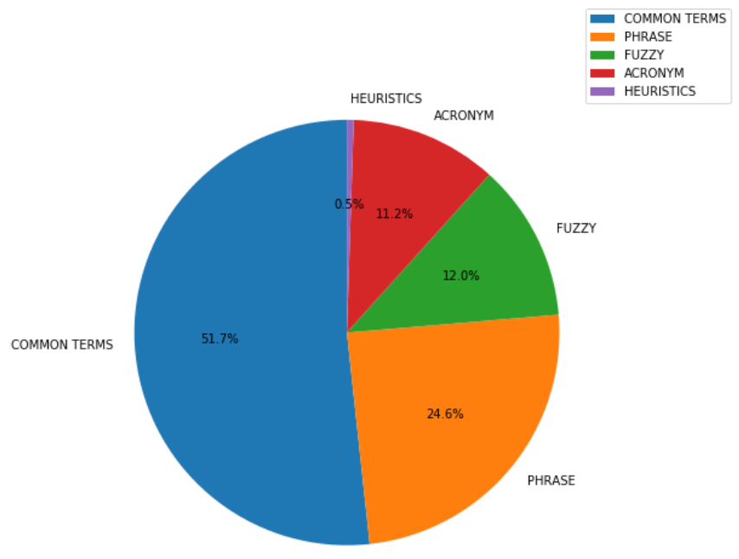
ROR API
Affiliation matching – matching type
The most common matching criteria in affiliation matching is – COMMON TERMS (51,7% of found ROR_id’s)
and PHRASE (24,6% of found ROR_id’s)
Matching criteria
Notes:
id
name
types
links
aliases
acronyms
wikipedia_url
labels
country
external_ids

Slide 15
Querying vs affiliation matching

Slide 16
ROR API
Comparison of affiliation matching and query
Affiliation matching returns significantly more ROR_id’s than query.
API responses - affiliation matching
API responses - query
Notes:
id
name
types
links
aliases
acronyms
wikipedia_url
labels
country
external_ids

